Slide 1
RAFIKI
Introduction
RAFIKI Project
EU-Africa Research Infrastructure Alliance to
Foster Infectious Disease research, Knowledge sharing and Innovation

Slide 2
RAFIKI Background
Call: HORIZON-INFRA-2024-DEV-01-02 (Strengthen the bilateral cooperation on research infrastructures with Africa)
37 proposals submitted, only 2 selected for funding (5%)
Scope: (1) Fostering EU-Africa cooperation in Research Infrastructures,
(2) sharing of good practices and experiences to facilitate the development of a strategic approach for structuring Research Institution capacities at pan-African level
Duration: 01/01/2025-31/12/2027
EU contribution: 1,499,981.30 €, Swiss contribution: 270,053.10€

Slide 3
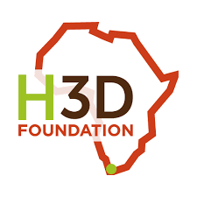








RAFIKI Consortium
Consortium Partners | Country
EU-OPENSCREEN ERIC (EU-OS), Coordinator | Germany
H3D Foundation | South Africa
University of Dundee | United Kingdom
University of Ghana | Ghana
Kenya Medical Research Institute | Kenya
Stellenbosch University | South Africa
University of Cape Town (UCT/H3D) | South Africa
University of Zambia | Zambia
Medicines for Malaria Venture* | Switzerland

Slide 4
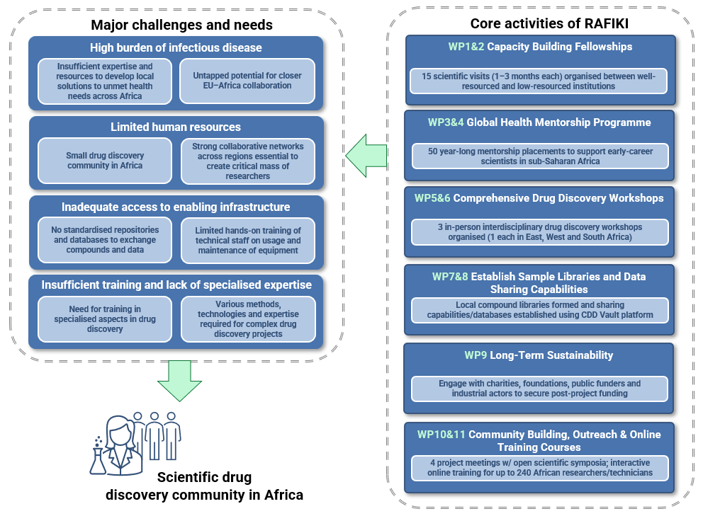
RAFIKI aims to address current challenges and needs in sub-Saharan African drug discovery

Slide 5
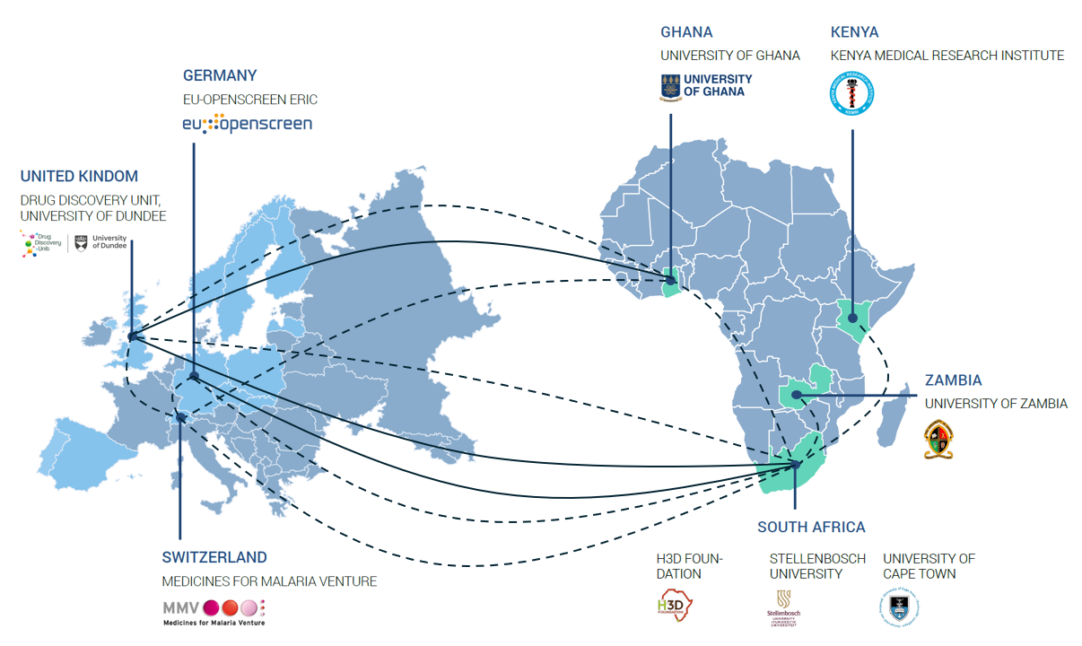
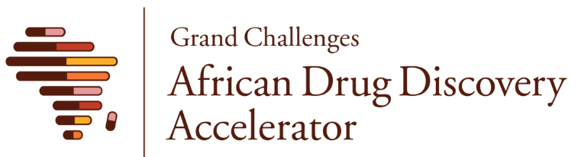
RAFIKI Consortium
Call text: “Proposals should build on existing cooperation activities between African and European countries and take into account the outcomes of previous and ongoing initiatives.”

Slide 6
RAFIKI: Expected Results
What do you expect to generate by the end of the project?
Training hubs in West, East and South Africa established as focal points for training, community building and drug discovery research.
15 scientists enrolled in capacity building fellowships.
50 early and mid-career scientists matched with senior experts from academia, innovative biopharmaceutical industry and PDPs in mentorship programme, including female researchers, to increase personal and professional development.
90 attendees at 3 comprehensive drug discovery workshops upskilled in drug discovery and related sciences.
Up to 240 researchers enrolled in 4 online training courses, offered annually in year 1, 2, 3.
Data and sample sharing procedures across institutions and countries established. First compound and bioactivity data exchanged between institutions.
Alumni network established to maintain the connections which are pivotal in helping to establish research careers.
Working group with representatives from charities, foundations & public funders established.
Industry Liaison Group established with experts from academia, innovative biopharmaceutical industry and PDPs.

Slide 7
RAFIKI: Expected Outcomes
What change do you expect to see after successful dissemination and exploitation of project results to the target group(s)?
Vibrant community of experts across Africa and Europe committed to better engagement and collaboration with local scientific communities.
Enhanced, long-term EU-Africa RI collaboration.
Increased accessibility to RIs providing relevant technologies and expertise enabling discovery projects.
Practical ways to share know-how and expertise, data, and shared resources (assays, compounds).
Critical mass and alumni network of drug discovery scientists across Africa.
Leveraged mutually beneficial partnerships with PDPs to extend established networks of experts and capabilities.
Success stories of fellowship and mentorship programmes, online training and workshops to inspire other scientists.
Amplification of partnerships and access through distributed RI (EU-OS), regional networks and training hubs in South, East and West Africa, product development partnership (PDP) (MMV) and Grand Challenges network (H3D-F).

Slide 8
RAFIKI and GC ADDA
The RAFIKI proposal was put together by GC ADDA members to build on and complement the ongoing GC ADDA projects and capacity building initiatives
RAFIKI drug discovery workshops, mentorship and online training will be open to the all GC ADDA members
Strengthening regional drug discovery hubs will support GC ADDA
Relevant resources developed under RAFIKI will be made available to GC ADDA members
RAFIKI activities towards sustainability and fundraising will work to support the entire GC ADDA network (not only the RAFIKI partners)
RAFIKI will have its own logo, which is being designed to complement the GC ADDA logo
RAFIKI will have its own website, which will link to the GC ADDA website

Slide 9
Timeline Overview (Jan – Dec 2025)
Q1
Q2
Q3
Q4
Jan
Feb
Mar
Apr
May
Jun
Jul
Aug
Sep
Oct
Nov
Dec
In-person Kick-off Meeting
WP 1: Capacity Building Fellowships
Prep research exchanges/training hub SOP's
5 x Capacity building exchanges over 12 months
WP 3: Global Health Mentorship Program
Identify mentors
25 mentorship pairings over 12 months
WP 5: Drug Discovery Workshops
Develop workshop content and frameworks
Workshop hosted at SU
Establish sample and data management plan
WP 7: Establish Sample Libraries and Data Management
CDD Vault workshop and set-up
Establish compound libraries
WP 9: Long-Term Sustainability
Establish advisory board, position papers, engagement with industry
WP 10: Community Building, Outreach, Training and Project Meeetings
Define communication plan and outreach
Implement communication procedures
Online Course 1
Online Course 2
Online Course 3
Online Course 4

