Slide 1
An overview of first-in-human trials including analytical considerations in the design, analysis and interpretation of clinical studies
Olawale Salami MD, DTM&H ( RCP), MBA
14th February 2025

Slide 2

Terms of Use – CC BY 4.0 License
These materials are shared to support teaching, research, and presentation activities across the GC ADDA community. All content is provided under the Creative Commons Attribution 4.0 (CC BY 4.0) license, which allows you to use, share, adapt, and build upon the material freely, including for commercial purposes. Please ensure that any use includes proper attribution to the original creators, indicates any modifications you make, and maintains the same open license. No additional restrictions may be applied.
Credit the author(s) as follows:
CC BY 4.0 [author, institution]

Slide 3

Overview
Introduction to first in human trials
Preclinical safety testing
Starting dose selection
Study design considerations in FIH trials
Biomarker assessment
Safety monitoring
Analytical considerations in FIH trials
Conclusion.

Slide 4
1. Introduction to First in Human Trials

Slide 5

First-in-Human Trials: Where Science Meets Caution
FIH trials (Phase 1) are the first human testing of a new drug, bridging preclinical data to real-world application.
Focus on assessing safety, tolerability, pharmacokinetics (PK), and pharmacodynamics (PD), ensuring no unexpected outcomes.
Conducted in small groups of healthy volunteers or patients, using dose escalation methods for safety.
Rigorous monitoring with sentinel dosing and early stopping criteria to minimise risks.
If successful, the drug advances to Phase 2; if not, it returns to the drawing board, balancing hope and caution.

Slide 6
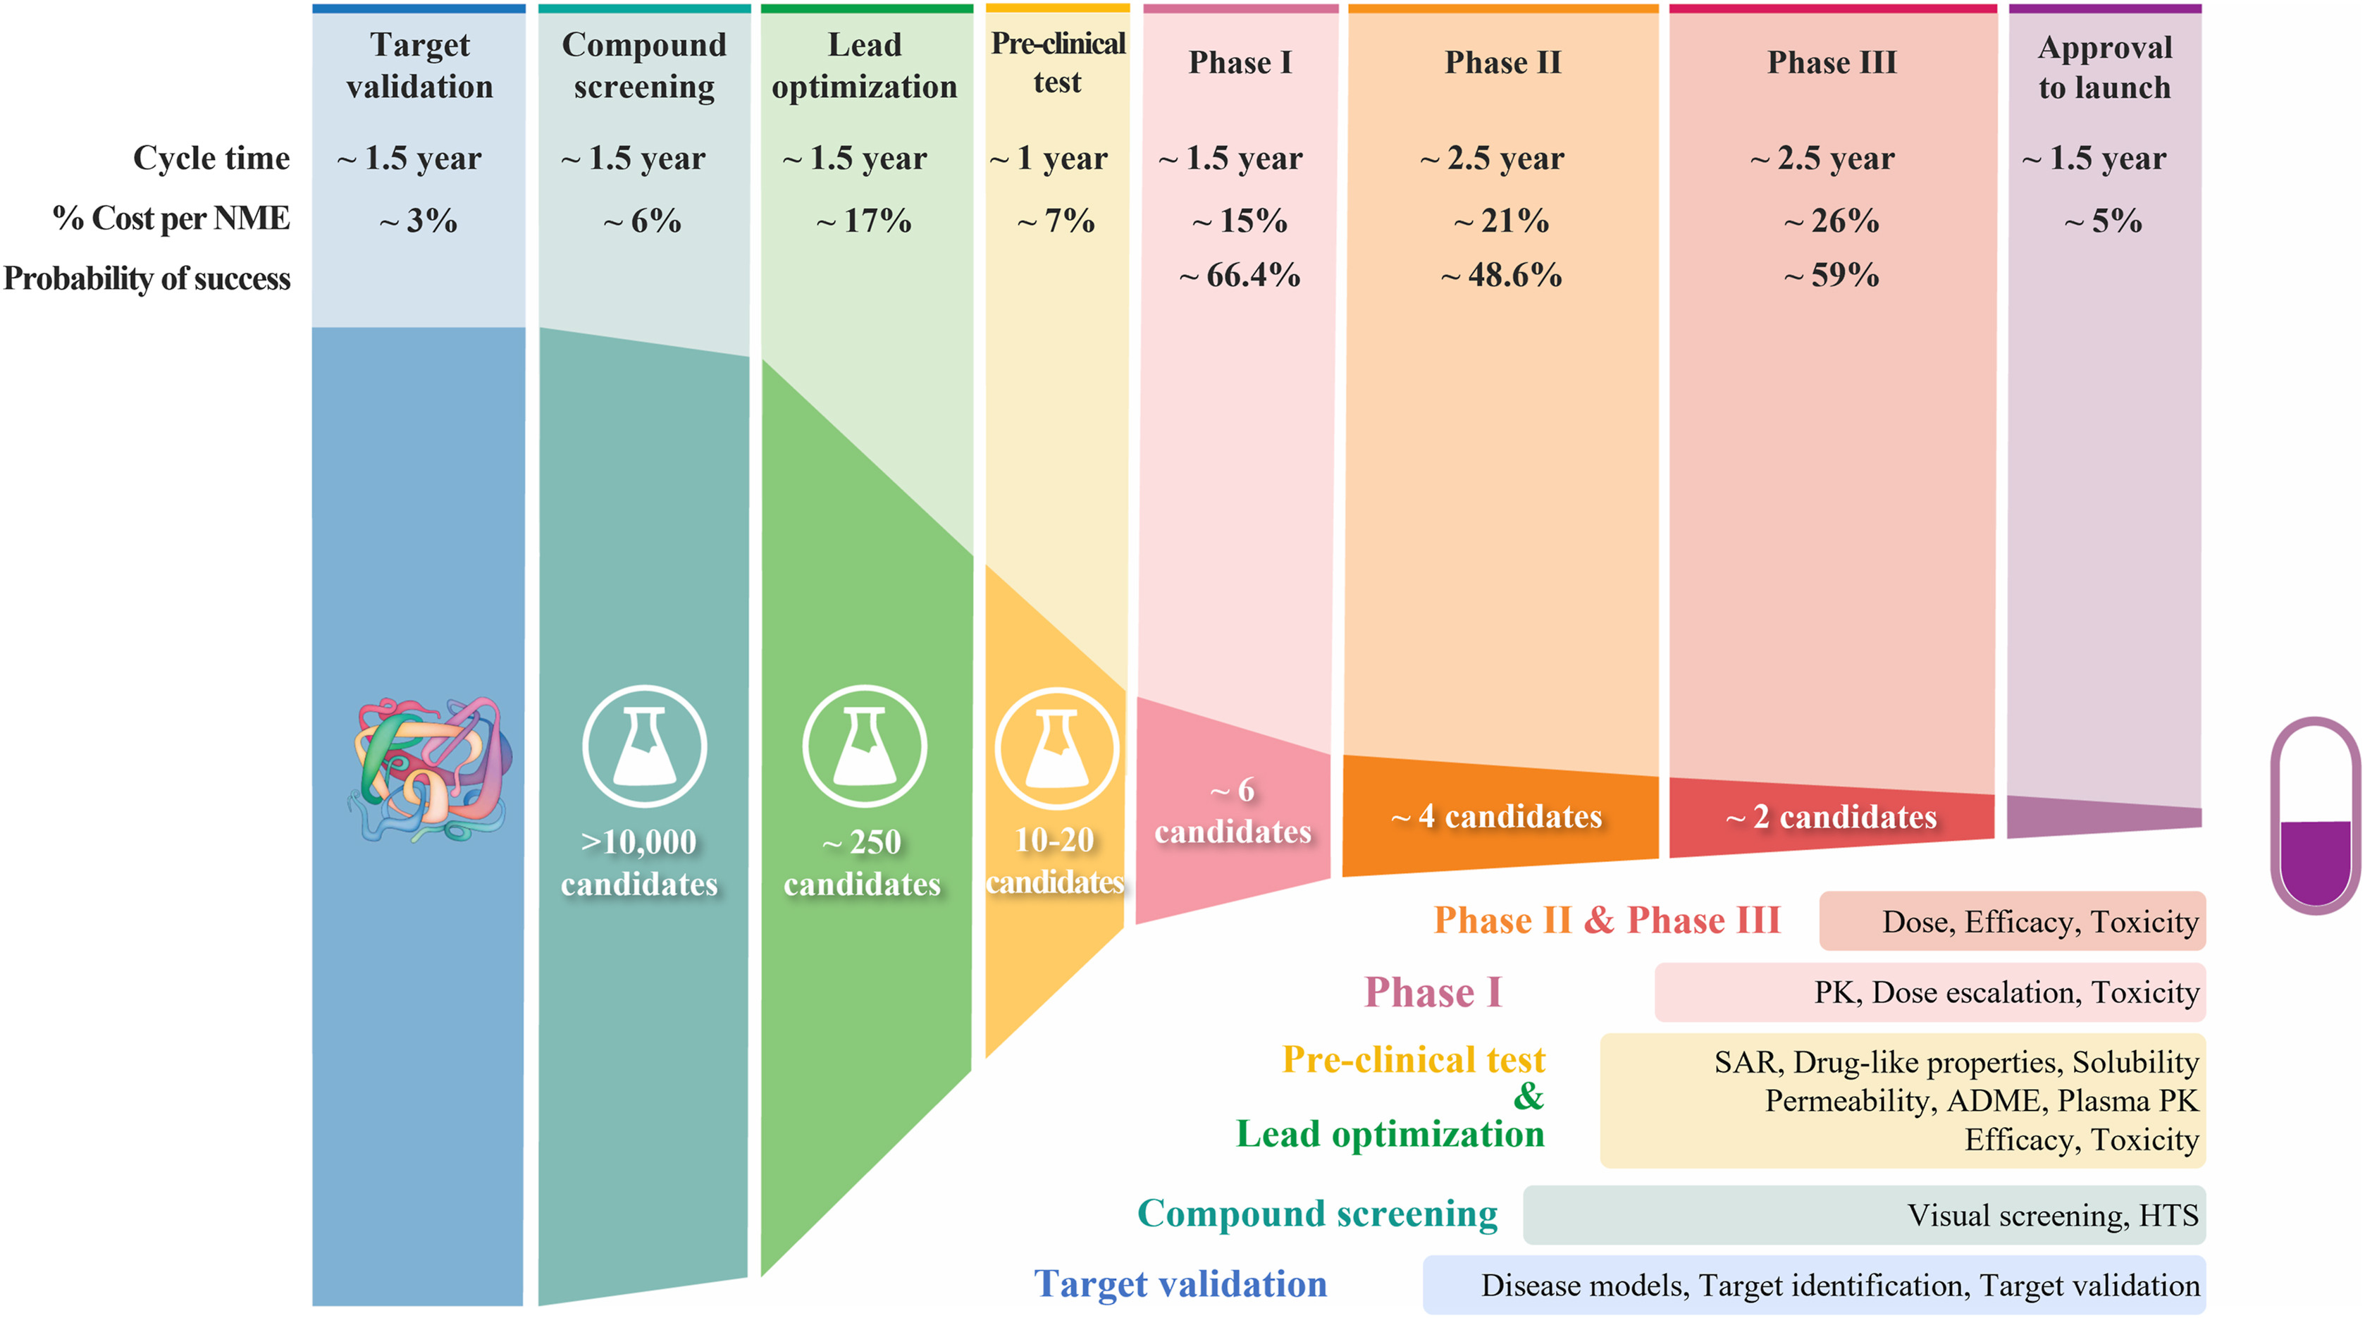
On the rough road to success……………
Duxin Sun.et al . Why 90% of clinical drug development fails and how to improve it?,Acta Pharmaceutica Sinica B, Volume 12, Issue 7

Slide 7
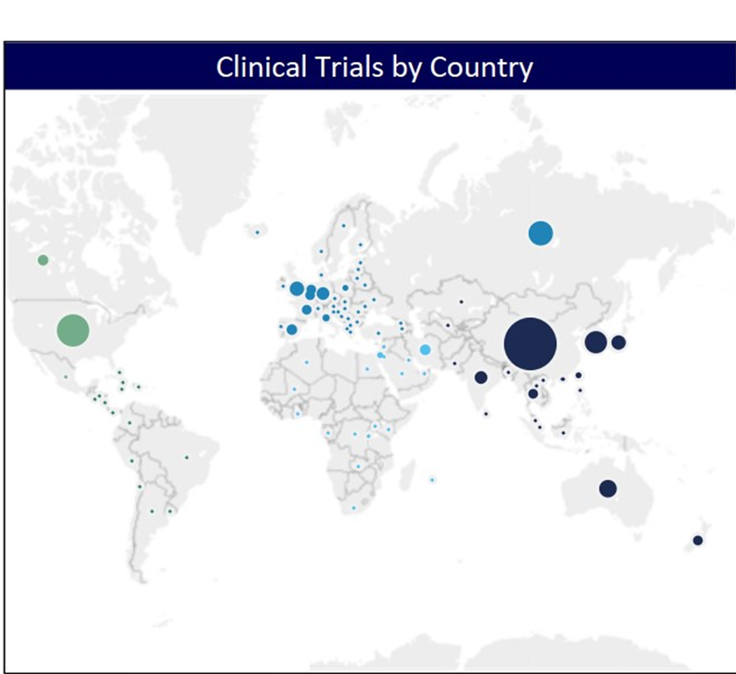
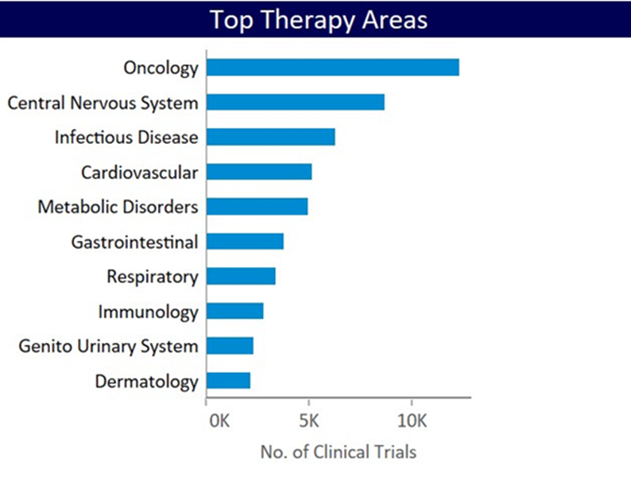
First in human trials: Location and therapeutic areas, but where is Africa?
Sources: globaldata.com, clinicaltrials.org

Slide 8
2. Preclinical safety testing for FIH trials

Slide 9
Preclinical safety testing for FIH trials
Key Guidelines and Regulatory Background:
ICH Guidance:
ICH M3(R2): Core safety evaluation expectations for FIH trials.
ICH S6(R1): Biologics-specific requirements.
ICH S9: Guidelines for anticancer pharmaceuticals.
Goals of Preclinical Safety Testing:
Identify organ toxicity and relation to drug exposure.
Assess on-target and off-target effects.
Determine relevance to human safety.
Identify and qualify biomarkers for clinical monitoring.
Considerations in Safety Testing Strategy:
Therapeutic Type: Different approaches for small molecules vs. biologics.
Therapeutic Indication: Tailored assessments for specific disease areas (e.g., CNS, oncology).
FIH Trial Design: Align preclinical studies to match trial scope, treatment duration, and patient/volunteer safety needs.

Slide 10
Preclinical Safety Study Design
Study Requirements by Therapeutic Type:
Small Molecules: Genotoxicity (ICH S2[R1]) and QT assessment for cardiac safety.
Biologics: Non-rodent species, focus on pharmacologic relevance.
Core Safety Protocols:
Toxicology: MTD, NOAEL, and dose-ranging in animals.
Safety Pharmacology: Cardio (QT prolongation), CNS, respiratory systems.
Photosafety: Initial phototoxic potential assessment (ICH S10).
Alternative Routes:
Exploratory trials (microdosing up to 14-day): Early PK, PD, biomarker data.

Slide 11
ICH recommended preclinical studies enabling FIH trials(1)
Study type | Small molecules | Large molecules | GLP compliance Requirement
Pharmacodynamics |  |  | No
In vitro (MOA) | X | X
In vivo (MOA and therapeutic effect) | X | X
Safety pharmacology (ICH S7A62 and S7B63) |  |  | Yes
In vitro (concentration-effect relationship) | X | X
In vivo (dose-response for CNS, CV, respiratory effects) | X | X
Pharmacokinetics (ICH M3(R2)6)
In vitro metabolism (across species microsomal metabolism) | X | NA | No
In vitro plasma protein binding | X | NA | No
Toxicokinetics from repeat dose GLP toxicity studies (ICH S3A64) | X | X | Yes
Shen, J., Swift, B., Mamelok, R., Pine, S., Sinclair, J. and Attar, M. (2019), Design and Conduct Considerations for First-in-Human Trials. Clin Transl Sci, 12: 6-19. https://doi.org/10.1111/cts.12582

Slide 12
ICH recommended preclinical studies enabling FIH trials(2)
Study type | Small molecules | Large molecules | GLP compliance Requirement
Genotoxicity battery (ICH S2(R1)7) |  |  | Yes
In vitro Ames test | X | *
In vitro and/or in vivo mammalian cell chromosomal damage evaluation | X | *
Single-dose / dose range finding |  |  | No and Yesc
Rodent single-dose (could be MTD study) | X | NA
Nonrodent single-dose (could be MTD study) | X | X
Repeat dose toxicity (ICH M3(R2)6) |  |  | Yes
Rodent multidose | X | Optional
Nonrodent multidose | X | X
Other studies |  |  | No
Immunotoxicity (ICH S865) | X | X
Photosafety (ICH S1010) | X | X
Shen, J., Swift, B., Mamelok, R., Pine, S., Sinclair, J. and Attar, M. (2019), Design and Conduct Considerations for First-in-Human Trials. Clin Transl Sci, 12: 6-19. https://doi.org/10.1111/cts.12582

Slide 13
3. Starting dose selection in FIH trials

Slide 14

Starting Dose Selection for FIH Trials
Objective: Define an initial dose range based on preclinical results (pharmacology, toxicology, PK data) and any relevant human data on similar mechanisms of action (MOA).
Key Considerations:
Starting dose must balance toxicity risks with the need for pharmacologic activity.
Dose range should include escalation steps to inform later efficacy-focused studies.
Avoid too low starting doses or overly cautious escalation to prevent unnecessary cohorts that can increase study size and duration.
Regulatory Guidance:
EMA: Covers preclinical to clinical transition, risks, and mitigation in FIH trials.
FDA: Suggests using NOAEL as a benchmark for a safe starting dose based on toxicology data.

Slide 15

FIH Dose Selection
No Standard Approach: Each drug candidate has unique considerations, making a single dose selection method impractical.
Common Methods:
Empirical Approach (FDA):
Uses NOAEL with allometric scaling for a maximum safe dose.
Pros: Low toxicity risk. Cons: May miss active pharmacologic dose, doesn’t address dose escalation.
Mechanistic Approach (EMA):
Utilizes detailed preclinical pharmacology data, ex vivo/in vitro studies, and modeling.
Focuses on Minimal Anticipated Biological Effect Level for more targeted, potent therapies, often at doses lower than NOAEL.
Regulatory frameworks provide a structured yet adaptable model for safe, effective FIH starting doses.

Slide 16
FIH Dose Selection (small molecules)
2 primary approaches to interspecies scaling of small molecules
Physiological-Based Pharmacokinetic (PBPK) Modeling:
Mechanistic, but data-intensive.
Allometric Scaling:
Empirical, less data-intensive, but less accurate for compounds with high cross-species variability
Allometric Scaling Modifications:
Rule of Exponents
Liver Blood Flow Correction
In Vitro Metabolic Clearance Correction
ICH S9 Guidance for Anticancer Agents:
Starting dose based on toxicity in animals.
Consider highest non-severely toxic dose (HNSTD) rather than NOAEL.

Slide 17
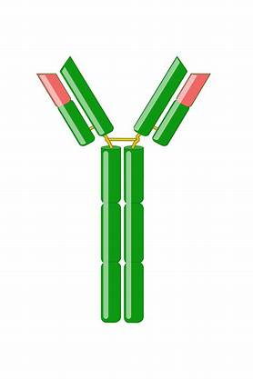
FIH Dose Selection (large molecules)
Biodistribution and Pharmacokinetics considerations
Polarity, Charge, Molecular Size
Primarily eliminated via renal excretion and proteolytic degradation to amino acids.
Allometric scaling methods are effective due to conserved processes across mammalian species.
Pharmacokinetics of Monoclonal Antibodies (mAbs):
Predictive models rely on PK data from nonhuman primates.
Linear PKs: Simple allometric scaling predicts human PK within a twofold range.
Nonlinear PKs: Overestimation occurs at sub-target-saturating concentrations; consider target-mediated parameters for accuracy.
Local Delivery Considerations:
Similar scaling principles apply but may require PBPK approaches due to challenges in validating target site PK in humans.

Slide 18
4. Study design considerations in FIH trials

Slide 19
Sample Size and Inclusion of Placebo Subjects in FIH Trials
Typical FIH Design: Blinded, placebo-controlled with 8-10 subjects per cohort (3:1 or 4:1 active:placebo) in multiple dose escalation cohorts.
Focus: Safety Signal Detection, not Hypothesis Testing.
Detectable Event Rate: Determined by total subjects, cohort size, event rate, and background rate.
Cohort Size (N): Increasing N from 1 to 6 improves event detection, minimal gain above N=10.
Placebo Inclusion: The rationale for inclusion of placebo-dosed subjects is the perceived bias in adverse event (AE) reporting.

Slide 20
Study Population in FIH Trials
Healthy Subjects vs. Patients: Evaluate risk-benefit for each study.
Higher Risk Agents: Patients might be considered (e.g., life-threatening diseases).
Healthy Subjects: Mitigate confounding factors (comorbidities, medications).
Sex Inclusion:
Traditionally: Male volunteers and non-childbearing females.
Modern Approach: Include females to understand sex differences in PK/safety/response.

Slide 21
Dose and Dose Escalation Scheme in FIH Trials
Mitigate Risk: Sequential dosing with observation periods between subjects (sentinel dosing).
Balance Safety and Defining Correct Dose Range: Avoid abandoning potentially useful drugs.
Maximum Exposure Level: Predefined for FIH trials in healthy volunteers.
EMA Guidance: Stop dose escalation at pre-defined maximum exposure (Cmax or AUC).
Oncology Trials:
Single subject at low dose for initial safety and PK assessment.
Body size-based dosing might not be necessary.
Dose Finding Designs:
Rule-based (e.g., 3+3 design) or model-based (adaptive Bayesian models).
Goal: Identify "Recommended Phase II Dose".

Slide 22
First-in-Human Study Design: SAD/MAD & Adaptive Approaches
Traditional Design:
Separate Single Ascending Dose (SAD) and Multiple Ascending Dose (MAD) studies, with MAD lagging behind SAD.
Adaptive SAD/MAD Combo Design:
Conducts SAD and MAD in parallel with adaptive cohorts to test new doses.
Benefit: Reduces timeline by up to 12 months.
Challenge: Requires strict safety start/stop criteria.
Key Assessments in FIH Studies:
Food and Formulation Effects: Often tested at therapeutically relevant doses in SAD arm with crossover designs for meaningful results.
Drug-Drug Interaction (DDI): Considered if candidate shows strong DDI potential (e.g., cytochrome P450 inhibition) to inform clinical relevance.
Immunogenicity:
Essential for high-risk protein therapeutics; animal studies aren't predictive, making FIH critical for gauging immune responses.

Slide 23
5. Safety monitoring in FIH trials

Slide 24
Safety Monitoring in FIH Studies – Key Challenges & Approaches
Safety Signal Detection:
Small sample size limits certainty in detecting safety signals.
Determining causality is complex, especially in patient populations with high noise-to-signal ratios.
Data Collection:
Standard assessments include physical exams, vital signs, lab tests (hematology, chemistry, urinalysis), and ECGs.
Additional tests (e.g., ophthalmologic, psychometric) may be required based on preclinical toxicology.
Special Focus on Cardiac Safety: Continuous ECG monitoring when preclinical data indicates risks to cardiac conduction, potentially avoiding later dedicated QT studies.
Monitoring Specific Reactions:
Localised reactions are essential for topical drugs.
For defined AEs of interest (e.g., hepatic issues), detailed history (e.g., alcohol intake, medications) and tests for confounding causes improve attribution accuracy.

Slide 25

Determining MTD & AE Management in FIH Studies
Maximum Tolerated Dose (MTD):
Determined by Dose-Limiting Toxicities (DLTs) at preset severity levels.
Trials designed with stepwise dose escalation within cohorts or individuals.
Important to perform in the intended patient population to reflect disease-specific susceptibilities.
Safety Monitoring Plans:
AE monitoring varies with predicted toxicity risk:
Low-risk: Sponsor-led monitoring.
Moderate/high-risk: Collaboration with independent experts or a data monitoring committee.
Independent monitoring is considered for placebo-controlled or high-toxicity risk trials.
Plan Requirements: Specifies data collection, review timelines, and criteria for dose adjustments or trial stopping based on toxicity signals.
Notes:
Think baby steps, not ‘let’s double it and see’.”

Slide 26
6. Biomarker assessment in FIH trials

Slide 27
Biomarker Assessment in FIH Studies – Purpose & Planning
Role of Biomarkers:
First chance to obtain biological readouts in humans, aiding drug development through target engagement and efficacy insights.
Supports precision medicine and diagnostic use (e.g., BRCA1/2 for cancer risk).
FIH Study as a Testing Ground:
Confirms preclinical hypotheses, paving the way for proof of concept (POC) and clinical diagnostics.
Critical for oncology and other fields where biomarkers guide treatment and risk assessments.
Planning Biomarker Inclusion:
Success relies on thorough preparation: literature review, bioanalytical method validation, clinical sampling strategy, and regulatory assessment.
Fit-for-Purpose Compliance: Defines the rigor of data handling based on biomarker role (e.g., POC vs. phase III support).

Slide 28
Biomarker Feasibility, Methods & Compliance
Method Development:
Simple markers (e.g., serum proteins) vs. complex samples (e.g., tissue biopsies) need validated methods for accuracy.
Bioanalytical techniques vary by matrix: common assays (e.g., LC-MS) or custom methods may be needed.
Regulatory & Analytical Considerations:
Qualification vs. Validation: Fully validated methods for phase III support; qualified assays suffice for early decisions.
Data Analysis Standards: Exploratory analyses may use simple methods, while advanced stages require regulatory-compliant standards.
Strategic Data Analysis:
Prospective data plan (e.g., using normalization factors for variable matrices like urine) aligns rigor with clinical development goals.

Slide 29
Risk Mitigation Strategies in FIH Clinical Trials
Preclinical considerations
Understanding drug absorption, metabolism, and excretion to predict human exposure.
Identify potential organ-specific toxicities and define the No-Observed-Adverse-Effect Level (NOAEL) in relevant animal models.
Immunogenicity and Off-Target Effects Evaluating the potential for immune reactions, receptor cross-reactivity, and unexpected biological effects.
Species Selection for Translation
2. Safe Dose Selection and Escalation Strategies
Starting Dose Determination
Dose Escalation and Stopping Criteria:
Adaptive design with predefined dose increments.
Sentinels (small cohorts) dosed sequentially before expanding to larger groups.
Early stopping criteria for toxicity or unexpected adverse events

Slide 30
Risk Mitigation Strategies in FIH Clinical Trials
Clinical Site Preparedness
Trials conducted in controlled hospital settings with rapid access to intensive care.
Trained personnel to manage severe adverse reactions, including cytokine storms
Participant Selection
Healthy volunteers or patients carefully screened for predisposing conditions.
Exclusion of individuals with high-risk genetic or immunologic profiles.
Real-Time Safety Monitoring
Intensive monitoring in the first 24–48 hours post-dose.
Biomarker-driven safety assessments for early detection of toxicity.
Implementation of Data and Safety Monitoring Boards (DSMBs) for ongoing risk evaluation.
Ethical and Regulatory Safeguards
Adherence to ICH E6 (GCP), ICH M3 (Nonclinical Safety Studies), and ICH S6 (Biologics)guidelines.
Informed Consent
Transparent risk communication to participants, detailing known and unknown risks.
Option for withdrawal at any stage without penalty.

Slide 31
7. Analytical Considerations in FIH trials

Slide 32
Statistical Considerations in Phase 1 Studies
Dose Escalation Strategy
Model-based designs (e.g., Bayesian adaptive designs) for optimal dose selection.
Stochastic Models: Account for variability in drug response across populations.
Sample Size Calculation
Small sample sizes (10-100 participants), but precision is critical for safety profiles.
Power Analysis
Ensuring sensitivity for detecting potential adverse effects at low doses.
Analysis of PK/PD Data
Non-compartmental analysis for estimating drug half-life, clearance, and volume of distribution.
Statistical models
For dose-response relationships, with focus on linear vs. nonlinear kinetics.

Slide 33
Interpretation Challenges and Pitfalls in Phase 1 Studies
Safety data interpretation
Adverse Events (AEs): Identifying causal links between drug and observed AEs.
Thresholds for Toxicity: Distinguishing between side effects and pharmacologically relevant toxicity.
Pharmacokinetic Variability
Understanding inter-individual variability in drug absorption, distribution, metabolism, and excretion (ADME).
Impact of genetic polymorphisms on drug metabolism (CYP450, UGT, etc.).
Generalisation to Larger Populations
Translating findings from healthy volunteers to patient populations.
Considerations for underlying diseases or drug interactions in later-phase trials.
Ethical Considerations:
Balancing scientific goals with participant safety.
Regulatory oversight and informed consent processes.

Slide 34
Conclusion: Keep these in mind for your first in human trials
Drug dosage form
Safety monitoring
Patient characteristics
Regulatory requirements
Study design
Biomarker selection and analysis
Preclinical safety studies and safety margin selection
Notes:
Something to also consider early is your route of adminstration

Slide 35
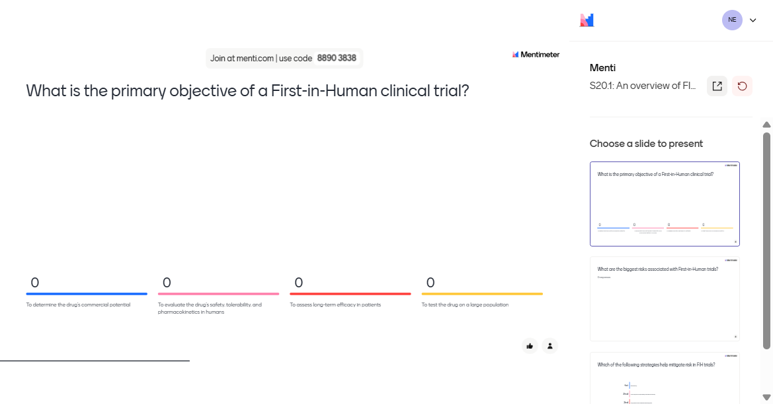
Mentimeter

Slide 36
Thank you for listening
Stay in touch via linkedIn
Olawale Salami | LinkedIn

