Slide 1
Drug Discovery and Development Course
Hit-to-Lead Med Chem Optimization Case Studies
Greg Basarab

Slide 2

Terms of Use – CC BY 4.0 License
These materials are shared to support teaching, research, and presentation activities across the GC ADDA community. All content is provided under the Creative Commons Attribution 4.0 (CC BY 4.0) license, which allows you to use, share, adapt, and build upon the material freely, including for commercial purposes. Please ensure that any use includes proper attribution to the original creators, indicates any modifications you make, and maintains the same open license. No additional restrictions may be applied.
Credit the author(s) as follows:
CC BY 4.0 [author, institution]

Slide 3
Learning Objectives
Fragment-based lead generation
Phenotypic Screening
Considerations around hits and ligand efficiency (LE); lead optimization of ligand lipophilicity efficiency (LLE)
Drug repurposing/repositioning

Slide 4
Program
Fragment-based Hit ID and H2L
Phenotypic Screening Hit ID and H2L
Drug repurposing

Slide 5
Fragment Screening
Fragment Screening and Hits
Medium throughput (100-2000 cmpds)
Weak potency
More MW ‘headroom’ for elaboration
Generally high ligand efficiency
Guidance from protein structure/molecular modeling
Screening strategies
Enzyme inhibition
NMR methods (waterLOGSY, STD-NMR, ILOE, ¹H-¹⁵N HSQC)
Isothermal titration calorimetry (ICT)/Microscale Thermophoresis (MST)
X-ray crystallography
The challenge inevitably becomes maintaining drug-like properties while designing potency improvements
Congreve, M et al. H. Drug Disc. Today, 8(19), 2003, 876

Slide 6
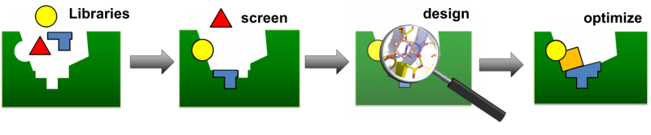
Fragment Screening
Rule of three: begin small ⇒ compound growth will (generally) be inevitable
Lead-like molecules for FGLD –
emphasis on ligand efficiency:
≤ 3 H-bond donors
≤ 3 H-bond acceptors
MW ≤ 300 Da
LogP ≤ 3
# rot bonds ≤ 3
PSA ≤ 60 Å²
Considerations of ligand growing and linking strategies
Jhoti et al. Nat. Rev. Drug Disc. 12(8), 2013, 644; Johnson et al. J. Med. Chem., 2016.

Slide 7
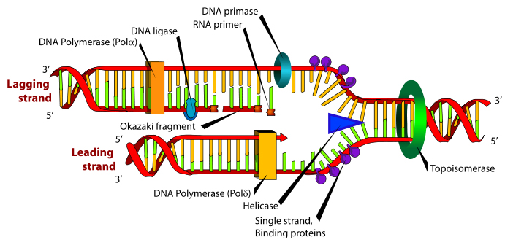
Case History: Bacterial Topoisomerases
Topoisomerases:
TopoIV
(ParEC)
Topoisomerases:
DNA Gyrase
(GyrAB)
  DNA gyrase & Topo IV are among many enzymes essential for DNA replication & cell viability
  DNA gyrase (GyrA₂B₂) supercoils DNA ahead of replication fork to relax torsional strain
  Topo IV (ParC₂E₂) relaxes and decatenates DNA beyond replication fork
  Due to high homology – inhibitors of DNA gyrase and Topo IV crossover to one another

Slide 8
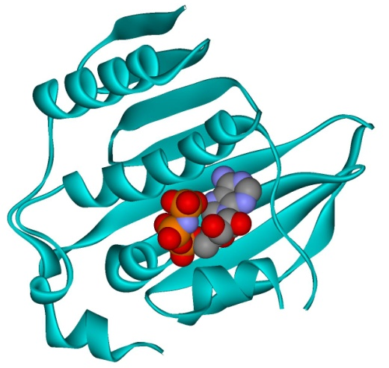
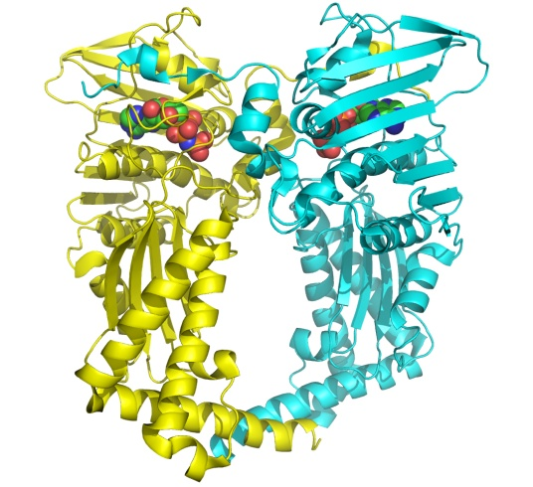
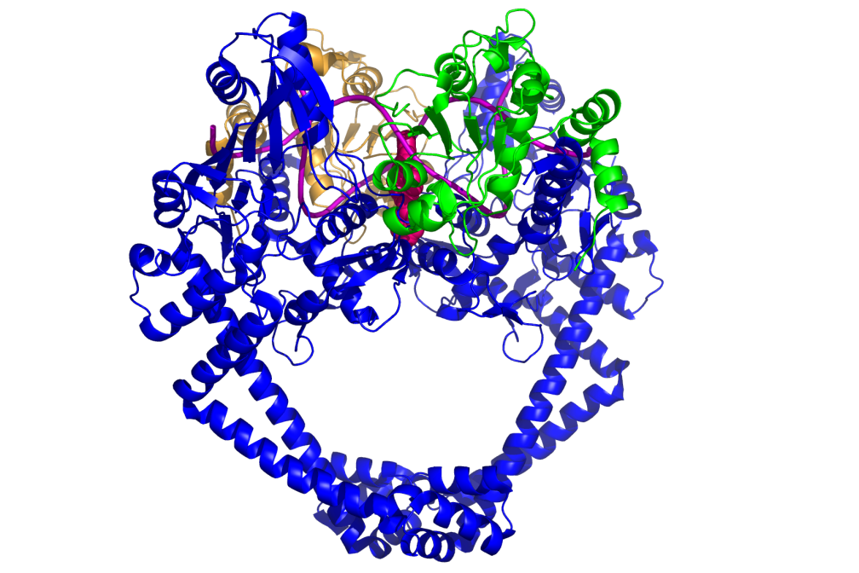
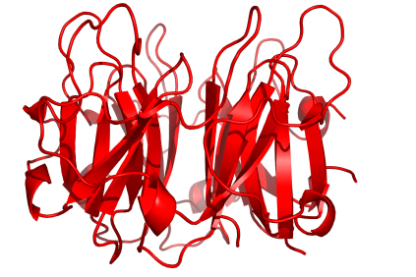
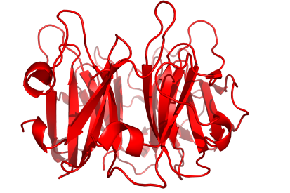
DNA Gyrase Crystallography
43 kDa
N-term
GyrB
(90 kDa)
24 kDa GyrB N-term domain
Suitable for NMR & E:I crystal structures
GyrA
(97 kDa)
Wigley, et al., Nature, 1991; Bax et al., Nature, 2010; Corbett et al., PNAS, 2004

Slide 9
Fragment-based Hit Identification
Screened 960 small molecules for binding to E. coli GyrB-24 using NMR
Fragments of known inhibitors provided the most potent hits with K_{d} values from 10 to 950 μM
Clorobiocin
Site 2
linker
Site 1
Eakin, A. et al AAC 56(3), 1240, 2012

Slide 10
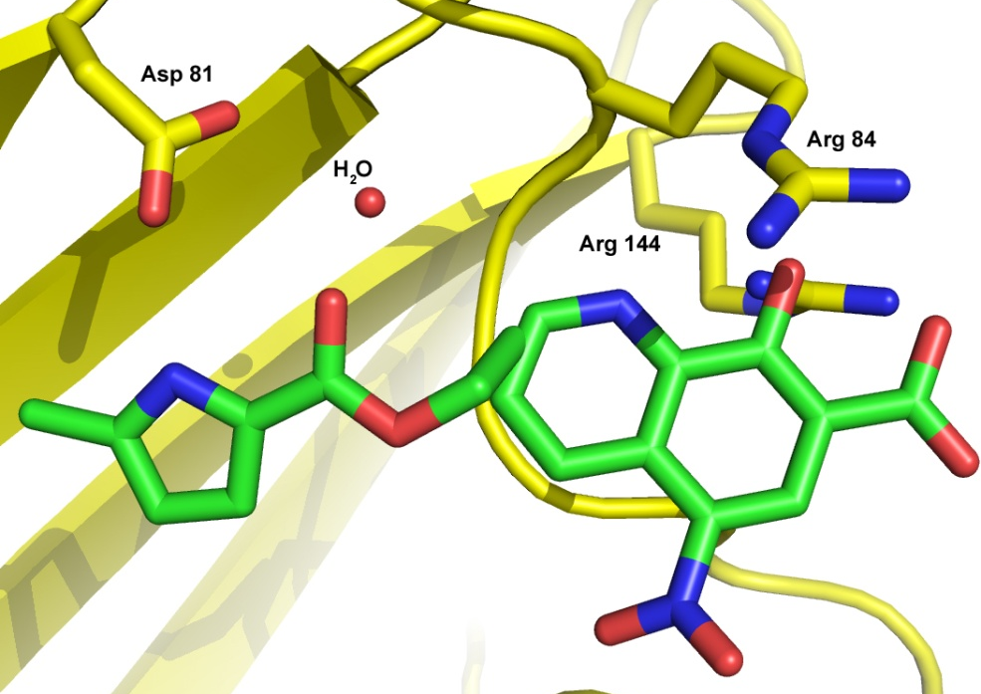
Two Fragments of Interest
  Models: Pyrrole at Site 1 – key H-bond and water bridge to Asp81
  Quinoline acid @ Site 2 – key salt bridge with Arg 144, π-stack w/ Arg84
Site 1
Pyrrole Hit
LE = 0.27
Site 2
Quinoline Hit
Linker
K_{d} = 1070 μM
K_{d} = 5000 μM
LE = 0.22
Rule of 3 compliant?
≤ 3 H-bond donors (1)
≤ 3 H-bond acceptors (2)
MW ≤ 300 Da (137)
cLogP ≤ 3 (1.15)
# rot bonds ≤ 3 (1)
PSA ≤ 60 Å² (42)
Rule of 3 compliant?
≤ 3 H-bond donors (1)
≤ 3 H-bond acceptors (5)
MW ≤ 300 Da (234)
cLogP ≤ 3 (0.19)
# rot bonds ≤ 3 (2)
PSA ≤ 60 Å² (116)
Site 2 – outside of ATP binding site
Site 1 – adenine of ATP
Eakin, A. et al AAC 56(3), 1240, 2012

Slide 11
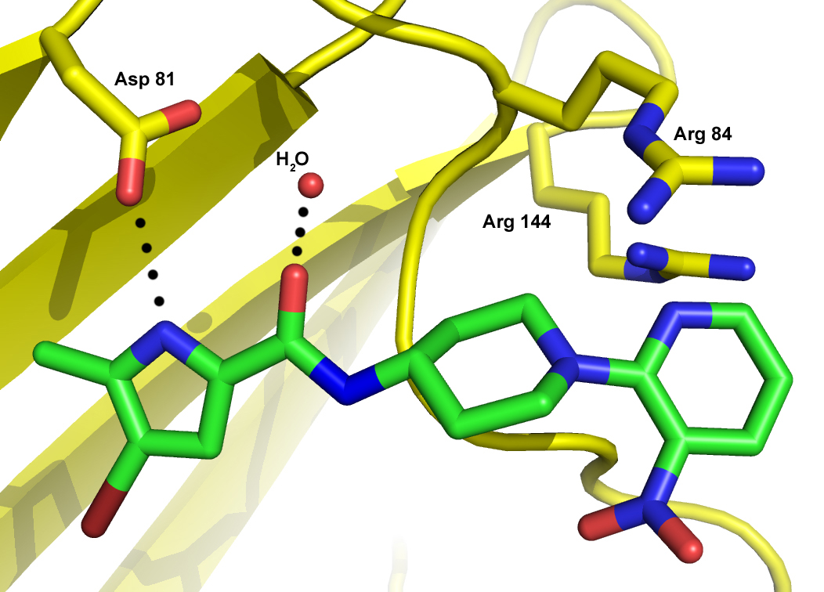
Best hit from library of pyrrole amides
GyrB:Pyrrolamide Crystal Structure
ATPase IC₅₀ (μM)
E. coli gyrase: 0.61 LE = 0.24
K_{i} = 0.28 0.26
S. aureus gyrase: 1.4 0.23
MIC (μg/ml)
S. pneumoniae: >64
S. aureus >64
Microsomal Clearance (mg/min/ml)
Human: >100
Pyrrole binds as predicted from NMR
Linker and heterocycle extend into the Site 2 region
Eakin, A. et al AAC 56(3), 1240, 2012

Slide 12
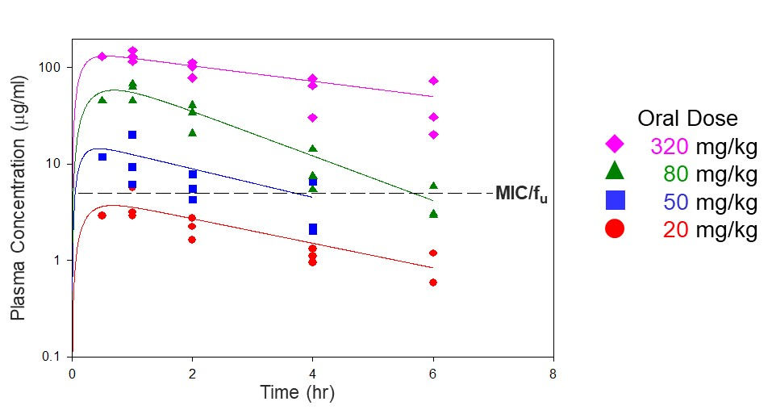
Hit to Lead
Gyrase K_{I} (nM):
S. aureus = 18 E. coli = 4.4
LE = 0.30 LE = 0.33
MICs (μg/ml):
S. pneumoniae = 0.25
M. catarrhalis = 0.5
H. influenzae = 2
Physical Properties
MW = 403
logD = 0.02
Solubility > 260 μM
Efficacy demonstrated on PO dosing
Mouse thigh model of S. pneumonia infection
Gyrase K_{I} (nM):
S. aureus = 19 E. coli = 9.6
LE = 0.30 LE = 0.32
MICs (μg/ml):
S. pneumoniae = 1
M. catarrhalis = 2
H. influenzae = 4
Physical Properties
MW = 431
logD = 3.4 μM
Solubility < 3 μM
Eakin, A. et al AAC 56(3), 1240, 2012

Slide 13
Development Candidate
Gyr A Sau K_{i} (μM) | <10 | <10 | <10
ParE Eco K_{i} (μM) | 240 | 73 | 54
WT Sau MIC (μg/ml) | 0.32 | 0.036 | 0.031
MRSA MIC (μg/ml) | 0.5 | 0.057 | 0.018
Spn MIC (μg/ml) | 0.016 | 0.016 | 0.007
Solubility (μM) | ND | 660 | 350
Rat Cl_{u} (ml/min/kg) | >1300 | 411 | 38
Bioavailability (%) | 6.7 | 81 | ND
(1)
(2)
(3)
Basarab, G. et al J. Med. Chem. 57(14), 6060, 2014

Slide 14
Phase 1 IV PK Trial – AZD5099
no deaths, serious or severe adverse events, or events that called for discontinuation
10 (23.8%) active-treated volunteers reported at least one adverse event (diarrhea, headache, or dizziness)
7 (50%) placebo-treated volunteers reported at least one adverse event
No safety concerns in clinical laboratory tests, vital signs, electrocardiograms, or physical examinations; no hypothermia or hyperthermia.
Product Vision: IV & oral step-down therapy for acute bacterial skin and skin structure infections and bacterial pneumonia caused by sensitive and drug-resistant Gram-posi-tive and fastidious Gram-negative respiratory tract pathogens
Development stopped due to:
High exposure variability in Phase 1 SAD study
Swollen mitochondria signal in rat & dog liver tissue (28d GLP study)
PK/PD magnitude decrease from continued mouse efficacy experiments
Realignment of infectious disease commercial position

Slide 15
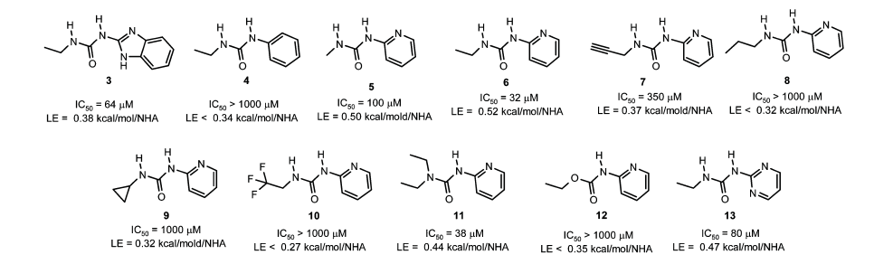
Second Fragment-Based Screen
Basarab, G. et al J. Med. Chem. 56(21), 8712, 2013

Slide 16
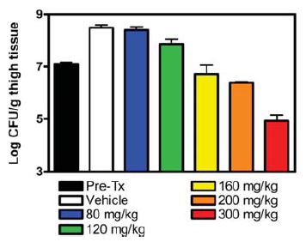
Fragment hit to lead
( | A | B
GyrB E. coli IC₅₀ (μM) | <0.01 | 0.002
ParE E. coli IC₅₀ (μM) | 0.23 | 0.003
WT S. aureus MIC (μg/ml) | 0.04 | <0.06
MRQR S. aureus MIC (μg/ml) | 0.06 | <0.06
MIC S. pneumoniae (μg/ml) | 0.05 | <0.06
MIC E. coli (μg/ml) | >64 | 0.57
MIC A. baumannii (μg/ml) | ND | 0.5
MIC P. aeruginosa (μg/ml) | ND | 1.1
Solubility (μM) | 19 | 66
PPB human (%) | 95.6 | 85.1
Rat Cl_{u} (ml/min/kg) | 820 | ND
Efficacy demonstrated in mouse thigh model of S. aureus infection
Basarab, G. et al J. Med. Chem. 56(21), 8712, 2013; Ho, S. W. et al. Eur. J. Med. Chem, 157, 610, 2018.

Slide 17
Phenotypic screening
Uses physiological systems, e.g. cells, tissues or whole organisms
Surveys compounds that act simultaneously on more than one target
Assumes no knowledge of the molecular mode-of-action relying on empiricism
Requires reverse genomics and proteomics to determine the target
Phenotypic assays endpoints:
identify new drug candidates and their corresponding molecular mechanisms of action
2) understand the underlying biology that will lead to identification of translation biomarkers
3) identify undesired effects related to toxicity of drug candidates

Slide 18
SPT Early History: Pharmacia-Upjohn
Drug Likeness
≤ 5 H-bond donors (2)
≤ 10 H-bond acceptors (6-9)
MW ≤ 500 Da (374)
cLogP ≤ 3 (-0.59)
# rot bonds ≤ 10 (1)
PSA ≤ 133 Å² (133)
Issues
Nitro group
High serum MIC shift
PNU-286607 ID’d via phenotypic screening against S. aureus & E. coli
Favorable PK properties – Cl_{p} = 12 ml/min/kg; Cl_{u} = 39 ml/min/kg, F = 95%
Efficacy in mouse thigh model of S. aureus infection
Activity resides in (-)-enantiomer
Miller, A. A., et al. AAC, 2806-12, 2008.

Slide 19
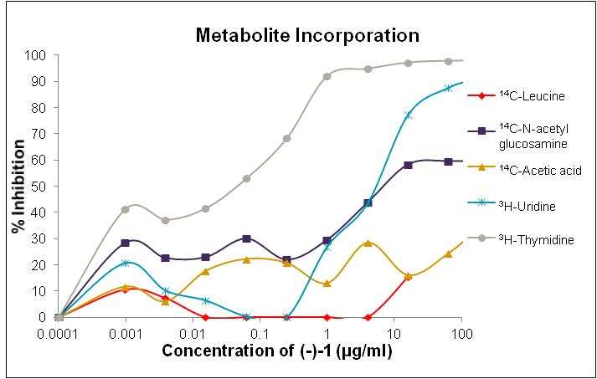
SPT Early History: Pharmacia-Upjohn
Labelled metabolite incorporation implicated DNA biosynthesis
  Lab resistant strains ⇒ mutations in DNA gyrase
Lab resistant strains ⇒ single point mutations in gyrB (Asp437) – near DNA cleavage site
No cross-resistance to other DNA gyrase inhibiting antibacterials including ciprofloxacin & novobiocin
Basarab, G. et al AAC. (2), e02192-21, 2022

Slide 20
Hit to Multiple Leads
Basarab, G.. et al. Org. Lett 16(24), 6456-59, 2014; Basarab, G. et al. ICAAC, 2012.

Slide 21
A Brief History of Time
Oral MRSA agent
Sau, Spn, Spy MICs (μM) | 1.5, 6.2, 3.5
Sol (μM) | 200
ppb (%free) | 11
Rat/Dog Cl (ml/min/kg) | 31/5.3
MLA genotoxicty (μM) | 50
Erythrocyte IC₅₀ (μM) | NT
In vivo efficacy | yes
IV/PO Gram-(+) agent
Sau, Spn, Spy MICs (μM) | 0.32, 0.45, 0.33
Sol (μM) | 80
ppb (%free) | 13
Rat/Dog Cl (ml/min/kg) | 9.1/5.9
MLA genotoxicty (μM) | 6.2
Erythrocyte IC₅₀ (μM) | 6
In vivo efficacy | yes
Zoliflodacin (PO N.g., G+)
Sau, Spn, Spy MICs (μM) | 0.57, 0.43, 0.36
Sol (μM) | 390
ppb (%free) | 17
Rat/Dog Cl (ml/min/kg) | 22/3.7
MLA genotoxicty | N
Erythrocyte IC₅₀ (μM) | >100
In vivo efficacy | yes
Basarab, G. et al. J. Med. Chem. 57, 9078-95, 2014; Basarab, G. et al. J. Med. Chem. 58, 6264-82, 2015

Slide 22
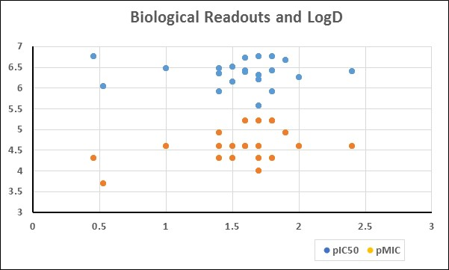
LipE – Target and Whole Cell Activity
Lip Eff = 6
Lip Eff = 5
Lip Eff = 4
1.5
Lip Eff = 3
2.5
Note the use of LogD and not cLogP
Lip Eff = 2
logD
LLE: pIC₅₀ – logD
MIC-LLE: pMIC – logD
}
Skew analog series to higher polarity
Basarab, G. et al J. Med. Chem. 58(15), 6264, 2015

Slide 23
Lipinski ‘rule of five’
MW = 487 | Fraction sp³ = 0.52
2 H-bond donors | LE = 0.19
8-12 H-bond acceptors | BEI = 0.014
cLogP = 0.76 | SEI = 0.047
clogD = 1.6 | LiPE = 6.0
Rot. Bonds = 1 | PFI = 3.6
TPSA = 143 | LELP = 4
Solubility = 390 μM | Dose # = 0.011 (by PK/PD) = 0.074
F = 46% mouse 34% rat 71-100% dog 58% monkey ??? human
≤ 5 H-bond donors
≤ 10 H-bond acceptors
MW ≤ 500 Da
LogP ≤ 5
Others
Rot. Bonds <10
TPSA <140

Slide 24
Oral Treatment for N. gonorrhoeae
Vision
Oral single dose treatment of uncomplicated gonorrhea
Attributes
Spiropyrimidinetrione (SPT): first-in-class non-quinolone topoisomerase chemotype and mode-of-action
Highly potent against Neisseria gonorrhoeae
Addresses evolving unmet medical need
FDA endorsed Ph2/3 study design
zoliflodacin
AZD0914\ETX0914
Current Status
  Phase 1: PK, safety, tolerability in healthy volunteers, completed March 2014
  Phase 1: ADME w/ healthy volunteers, completed February 2015
  Phase 2: Uncomplicated gonorrhea in patients, completed December 2015
  Phase 3: Uncomplicated gonorrhea met endpoint (November 2023)
  NDA application in progress

Slide 25
Drug Repurposing/Repositioning/Modification
Investigation of existing or shelved/failed drugs for new therapeutic purposes or modification of an existing entity to better fit the new therapeutic purpose
Compound | Primary disease | Repositioning
Acetylsalicylate | Mild analgesic | Antithrombotic
Amantadine | Influenza | Parkinson’s disease
Bleomycin | Various cancers | Pleural effusion
Cycloserine | Tuberculosis | Urinary tract infections
Cyclosporin | Transplant rejection | Rheumatoid arthritis; Psoriasis
Eflornithine | Facial hirsutism | Sleeping sickness
Finasteride | Benign prostate enlargement | Male pattern baldness; Hersutism in women
Histrelin | Prostate cancer | Precocious puberty
Infliximab | Ulcerative colitis; Crohn’s disease | Rheumatoid arthritis; Psoriasis
Interferon alfa | Hepatitis B and C | Various cancers
Retuximab | Various cancers | Rheumatoid arthritis
Bleomycin | Various cancers | Pleural effusion
Compound | Initial indication | Repurposing
Sildenafil | Angina | Erectile dysfunction
Gemcitabine | Antiviral | Cancer
Doxycylcline | Periodontic | Rosacea, antimicrobial
Minoxidil | Hypertension | Hair loss
Drugs get shelved drugs due to:
Insufficient efficacy
Commercial failure
Re-evaluation of market potential
Costs and difficulty of clinical trials
Notes:
Hersutism: excessive facial or body hair growth
Has been carried out for decades and decades ‘off-label’

Slide 26
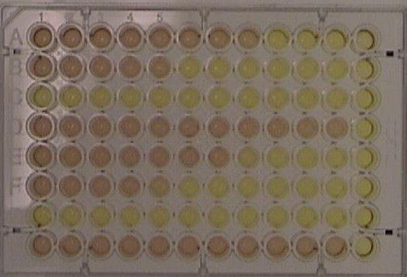
SPTs for Mycobacterium tuberculosis
Entasis (AstraZeneca spinoff) provided 24 SPTs for evaluation against M. tuberculosis (Mtb)
10 cmpds showed MICs < 10 μM across 5 media conditions
5 cmpds mitigated issues associated with genotoxcity and cytotoxicity
Optimization campaign initiated
Mtb culture
Basarab, G. et al AAC. (2), e02192-21, 2022

Slide 27
Selective M. tuberculosis SPT
H3D-005867
H3D-006621
Efficacious in mouse Mtb model
H3D-003387
Zoliflodacin
 | Mtb ADC/GLU/TW IC₅₀ (μM) | S. aureus IC₅₀ (μM) | Mtb MIC (μM) | S. aureus MIC (μM) | E. coli MIC (μM) | HepG2 IC₅₀ (μM)
H3D-005867 | 2.6 | ND | 0.49 | >125 | >125 | >300
H3D-006621 | 2 | ND | 1.7 | 0.45 | 31 | >300
H3D-003387 | 18 | 1.7 | 2.0 | 0.24 | 2.0 | 26
Zoliflodacin | 32 | 4.3 | 7 | 0.14 | 1.4 | >50
Govender, P. et al J. Med. Chem. 65(9), 6264, 2022

Slide 28
If we knew what we were doing, it would not be called research, would it?
Albert Einstein
Theoretical physicist, mathematician, lecturer, patent examiner, intellectual

