Slide 1
A Comprehensive Workshop on Preclinical Drug Discovery (CDD)
Welcome
Susan Winks

Slide 2
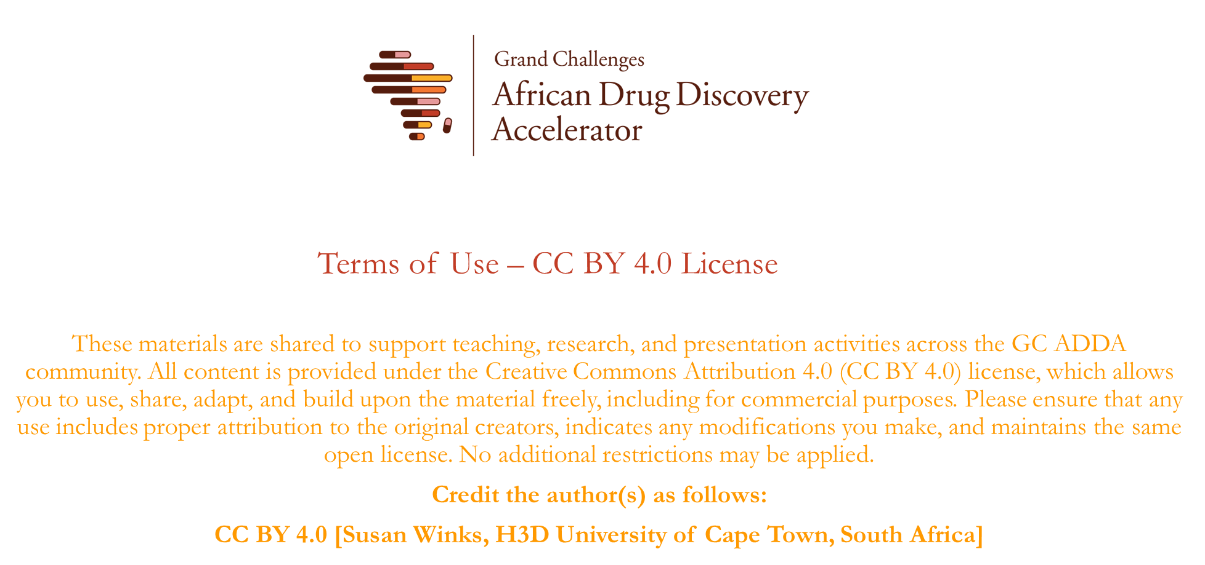

Slide 3

Workshop Objectives
To teach the basic concepts of preclinical drug discovery research.
To facilitate practical, team-based sessions to reinforce key drug discovery concepts
To build collaborative international, interdisciplinary networks between the workshop participants.

Slide 4
Programme

Slide 5
Break-away and Tour Groups
John Woodland*
Greg Basarab
Ronewa Tshinavhe
Adrienne Edkins
Ali Mohamed Ali
Andrea Zaliani
Bahne Stechmann
Caroline Maina
Clare Kimani
Fortunate Mokoena
Grace Mugumbate
Henrico Langeveld
Grace Obi
Precious Ndebele
Jessica Akester*
Venkata Sypu
Nyeleti Vukea
Carsten Hopf
Edwin Murungi
Festus Kojo Acquah
Tsungai Faith Manyadza
Lyn-Marie Birkholtz
Lauve Yamthe
Leonard Mudhebha
Leonnie Hanitratina
Lydia Kisula
Mziyanda Mbaba
Liezl Gibhard
Chris Jurisch
Nicola Elliott-Wong*
Cleavon Cloete
Richwell Mhlanga
Frank Surup
Sithulisiwe Ngwenya
Olayinka Akinpelu
Justice Akwensi
Kagisho Montjane
Maeruf Fetu Nassir
Peter Cheuka
Rajshekhar Karpoormath
Redolf Segodi
Nicolaas Salomane
Oluwatosin Audu
Mathew Njoroge
Susan Winks*
Shamsuddeen Yusuf Ma'aruf
Rudy Cozett
Simnikiwe Nogqala
Roslyn Thelingwani
Sheraz Gul
Arnold Donkor Forkuo
Sospeter Njeru
Mohammed Shaban
Sizwe Tshabalala
Richard Amewu
Rolivhuwa Makotole
Ncina Mogolla
Lauren Coulson

Slide 6
Tues, 16 April 2024
Med School
PD Hahn
Orange
Biology
ADME
Green
ADME
Biology
Blue
Chemistry
CADD/AI
Yellow
CADD/AI
Chemistry

Slide 7
Wed, 17 April 2024
Med School
PD Hahn
Blue
Biology
ADME
Yellow
ADME
Biology
Orange
Chemistry
CADD/AI
Green
CADD/AI
Chemistry

Slide 8
Ground Rules
Everyone participates​
One person speaks at a time​
Return promptly from breaks​
No laptops/cell phones to be used during the sessions​
Parking lot for off-topic discussion items
Code of Conduct has been shared, please adhere to these principles

Slide 9
House keeping
Bathroom Locations
Lunch location (Vegetarians to queue up first)
Dinner meals

Slide 10
Getting to know who is in the room!
Find someone you haven’t met before, introduce yourself and find out about them.
Prepare yourself, as you will then need to introduce your new friend to the room
their name
where they are from
what they do
what they are hoping to get out of the meeting.

Slide 11
Questions?

Slide 12
Lab Tours Tues, 16 April
VW CDD Workshop Lab Demos (Group 1) Tues, 16 April 2024 |  |  |  |  |  |  | VW CDD Workshop Lab Demos (Group 3) Tues, 16 April 2024
Time | Item | Facilitators | Meeting Location | Duration |  |  | Time | Item | Facilitator | Venue | Duration
14:15 - 14:30 | Travel to IDM |  | Barnard Fuller Entrance | 15 min |  |  | 14:15 - 14:30 | Travel to PD Hahn |  |  | 15 min
14:30 - 15:15 | Biology Lab Demo | Nicolaas, Charles, Raygaana, Zaahida | IDM BSLII Lab | 45 min |  |  | 14:30 - 15:15 | Chemistry Lab Demo | Tania, Grace, Christabel, Oluwatosin, Mziyanda, Sauvik | Lab 7D, Level 7 | 45 min
15:15 - 15:30 | Travel to GSH |  |  | 15 min |  |  | 15:15 - 15:30 | Walk to Jack de Wet |  |  | 15 min
15:30 - 16:15 | ADME Lab Tour | Zama, Thulile, Warren, Nesia, Keabetswe | GSH Old Main Building Entrance | 45 min |  |  | 15:30 - 16:15 | CADD and AI Demo | Stephen, Jason | Jack De Wet Meeting Room, Level 6 | 45 min
16:15 - 16:30 | Travel to Hotel |  |  | 15 min |  |  | 16:15 - 16:30 | Travel to Hotel |  |  | 15 min
VW CDD Workshop Lab Demos (Group 2) Tues, 16 April 2024 |  |  |  |  |  |  | VW CDD Workshop Lab Demos (Group 4) Tues, 16 April 2024
Time | Item | Facilitator | Venue | Duration |  |  | Time | Item | Facilitator | Venue | Duration
14:15 - 14:30 | Travel to GSH |  |  | 15 min |  |  | 14:15 - 14:30 | Travel to PD Hahn |  | Barnard Fuller Entrance | 15 min
14:30 - 15:15 | ADME Lab Tour | Zama, Thulile, Warren, Nesia, Keabetswe | IDM BSLII Lab | 45 min |  |  | 14:30 - 15:15 | CADD and AI Demo | Stephen, Jason | Jack De Wet Meeting Room, Level 6 | 45 min
15:15 - 15:30 | Travel to IDM |  |  | 15 min |  |  | 15:15 - 15:30 | Walk to Level 7 H3D lab 7D |  |  | 15 min
15:30 - 16:15 | Biology Lab Demo | Nicolaas, Charles, Raygaana, Zaahida | GSH Old Main Building Entrance | 45 min |  |  | 15:30 - 16:15 | Chemistry Lab Demo | Tania, Grace, Christabel, Oluwatosun, Mziyanda, Sauvik | Lab 7D, Level 7 | 45 min
16:15 - 16:30 | Travel to Hotel |  |  | 15 min |  |  | 16:15 - 16:30 | Travel to Hotel |  |  | 15 min

Slide 13
Lab Tours Wed, 17 April
VW CDD Workshop Lab Demos (Group 1) Tues, 16 April 2024 |  |  |  |  |  |  | VW CDD Workshop Lab Demos (Group 3) Tues, 16 April 2024
Time | Item | Facilitators | Meeting Location | Duration |  |  | Time | Item | Facilitator | Venue | Duration
14:15 - 14:30 | Travel to PD Hahn |  |  | 15 min |  |  | 14:15 - 14:30 | Travel to IDM |  | Barnard Fuller Entrance | 15 min
14:30 - 15:15 | Chemistry Lab Demo | Tania, Grace, Christabel, Oluwatosun, Mziyanda, Sauvik | Lab 7D, Level 7 | 45 min |  |  | 14:30 - 15:15 | Biology Lab Demo | Nicolaas, Charles, Raygaana, Zaahida | IDM BSLII Lab | 45 min
15:15 - 15:30 | Walk to Jack de Wet |  |  | 15 min |  |  | 15:15 - 15:30 | Travel to GSH |  |  | 15 min
15:30 - 16:15 | CADD and AI Demo | Stephen, Jason | Jack De Wet Meeting Room, Level 6 | 45 min |  |  | 15:30 - 16:15 | ADME Lab Tour | Zama, Thulile, Warren, Nesia, Keabetswe | GSH Old Main Building Entrance | 45 min
16:15 - 16:30 | Travel to Hotel |  |  | 15 min |  |  | 16:15 - 16:30 | Travel to Hotel |  |  | 15 min
VW CDD Workshop Lab Demos (Group 2) Tues, 16 April 2024 |  |  |  |  |  |  | VW CDD Workshop Lab Demos (Group 4) Tues, 16 April 2024
Time | Item | Facilitator | Venue | Duration |  |  | Time | Item | Facilitator | Venue | Duration
14:15 - 14:30 | Travel to PD Hahn |  | Barnard Fuller Entrance | 15 min |  |  | 14:15 - 14:30 | Travel to GSH |  |  | 15 min
14:30 - 15:15 | CADD and AI Demo | Stephen, Jason | Jack De Wet Meeting Room, Level 6 | 45 min |  |  | 14:30 - 15:15 | ADME Lab Tour | Zama, Thulile, Warren, Nesia, Keabetswe | IDM BSLII Lab | 45 min
15:15 - 15:30 | Walk to Level 7 H3D lab 7D |  |  | 15 min |  |  | 15:15 - 15:30 | Travel to IDM |  |  | 15 min
15:30 - 16:15 | Chemistry Lab Demo | Tania, Grace, Christabel, Oluwatosun, Mziyanda, Sauvik | Lab 7D, Level 7 | 45 min |  |  | 15:30 - 16:15 | Biology Lab Demo | Nicolaas, Charles, Raygaana, Zaahida | GSH Old Main Building Entrance | 45 min
16:15 - 16:30 | Travel to Hotel |  |  | 15 min |  |  | 16:15 - 16:30 | Travel to Hotel |  |  | 15 min

