Slide 1
Drug Discovery and Development Course
Basic principles of pharmacodynamics
Mwila Mulubwa

Slide 2

Terms of Use – CC BY 4.0 License
These materials are shared to support teaching, research, and presentation activities across the GC ADDA community. All content is provided under the Creative Commons Attribution 4.0 (CC BY 4.0) license, which allows you to use, share, adapt, and build upon the material freely, including for commercial purposes. Please ensure that any use includes proper attribution to the original creators, indicates any modifications you make, and maintains the same open license. No additional restrictions may be applied.
Credit the author(s) as follows:
CC BY 4.0 [Mwila Mulubwa, H3D University of Cape Town, South Africa]

Slide 3
Learning objectives
Define pharmacodynamics (PD)
Explain receptor theory and drug action
Interpret dose–response relationships
Describe models of drug-receptor interaction
Understand signal transduction pathways and amplification mechanisms
Explain variability in drug response
Apply PD principles to drug development and clinical therapeutics.

Slide 4
Pharmacodynamics (PD)
Pharmacodynamics (PD) examines the biochemical and physiologic effects of drugs on the body,
Including mechanisms of action (intensity, and duration of effect)
Or simply what a “drug does to the body”, encompassing the relationship between drug concentration and effect.

Slide 5
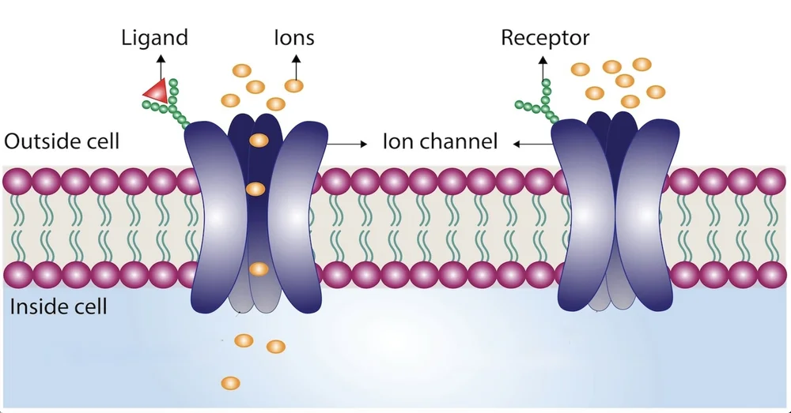
Receptor theory and drug action
Receptors are macromolecules (often proteins) that drugs bind to in order to produce a biological response.
Major receptor families:
G protein-coupled receptors (GPCRs)
Ligand-gated ion channels
Enzyme-linked receptors
Nuclear receptors
Image credit: https://www.richardsonthebrain.com/receptors

Slide 6
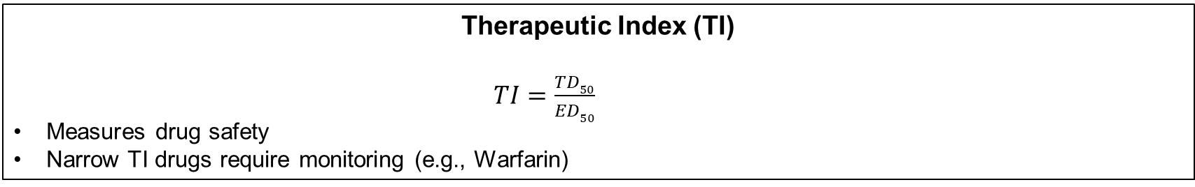

Dose-Response relationships
Graded Dose–Response Curve
$$E=Emax∗\frac{C}{EC50+C}$$
Describes continuous response in an individual
Key parameters:
E_{max} → maximal effect
EC₅₀ → potency
Log transformation yields sigmoidal curves
Quantal Dose–Response
Binary outcome (e.g., alive/dead, seizure/no seizure)
Used to estimate:
ED₅₀ (effective dose)
TD₅₀ (toxic dose)
LD₅₀ (lethal dose)
Therapeutic Index (TI)
$TI=\frac{TD50}{ED50}$ ​ ​
Measures drug safety
Narrow TI drugs require monitoring (e.g., Warfarin)

Slide 7
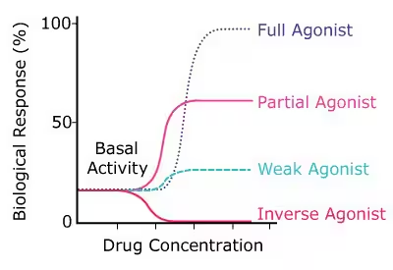
Types of agonism
Full agonist: produces maximal response (e.g., Morphine)
Partial agonist: submaximal effect even at full occupancy (e.g., Buprenorphine)
Inverse agonist: reduces constitutive receptor activity
Image credit: Merck https://www.sigmaaldrich.com/ZA/en/technical-documents/technical-article/protein-biology/interrogation-protein-pathways/receptor-agonists-antagonists

Slide 8
Types of antagonism
Competitive Antagonism
Reversible binding
Shifts dose-response curve right (↑EC50, same Emax)
Example: Naloxone
Non-Competitive Antagonism
Reduces Emax
Cannot be overcome by increasing agonist
Allosteric Modulation
Binds different site than agonist
Can enhance or inhibit response

Slide 9
Signal transduction and amplification
Drug binding triggers intracellular cascades:
Second messengers:
cAMP
IP₃/DAG
Ca²⁺
Amplification:
One receptor → multiple downstream effects
Explains high sensitivity and spare receptors
Ligands can preferentially activate specific pathways
Known as biased agonism
Important in modern drug design (e.g., safer opioids)

Slide 10
Pharmacodynamic variability
Tolerance
Decreased response with repeated exposure
Mechanisms:
Receptor downregulation
Enzyme induction
Desensitization (Tachyphylaxis)
Rapid decrease in response
Often due to receptor phosphorylation/internalization
Pharmacogenomics
Genetic variability affects PD
Example: β₂-receptor polymorphisms affecting bronchodilator response
10

Slide 11
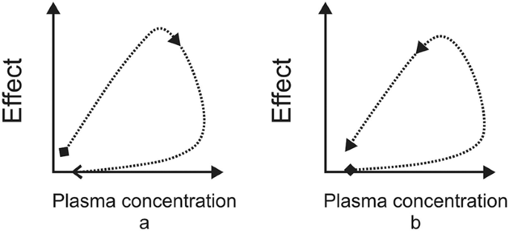
Time-dependent pharmacodynamics
Hysteresis loops:
Delay between concentration and effect
Causes:
Distribution delay
Indirect mechanisms
Image: Almoslem et al. (2022). Kinetics of Drug Action: A PKPD Approach. In: Talevi, A. (eds) The ADME Encyclopedia.

Slide 12
Clinical and drug development implications
Dose selection based on exposure–response
Identification of biomarkers
Optimization of therapeutic window
Evaluation of benefit–risk profile

Slide 13
Thanks!

Slide 14
Your key idea / concept / question

