Slide 1
A Comprehensive Workshop on Preclinical Drug Discovery (CDD)
Introduction to ADME assays
Mathew Njoroge

Slide 2
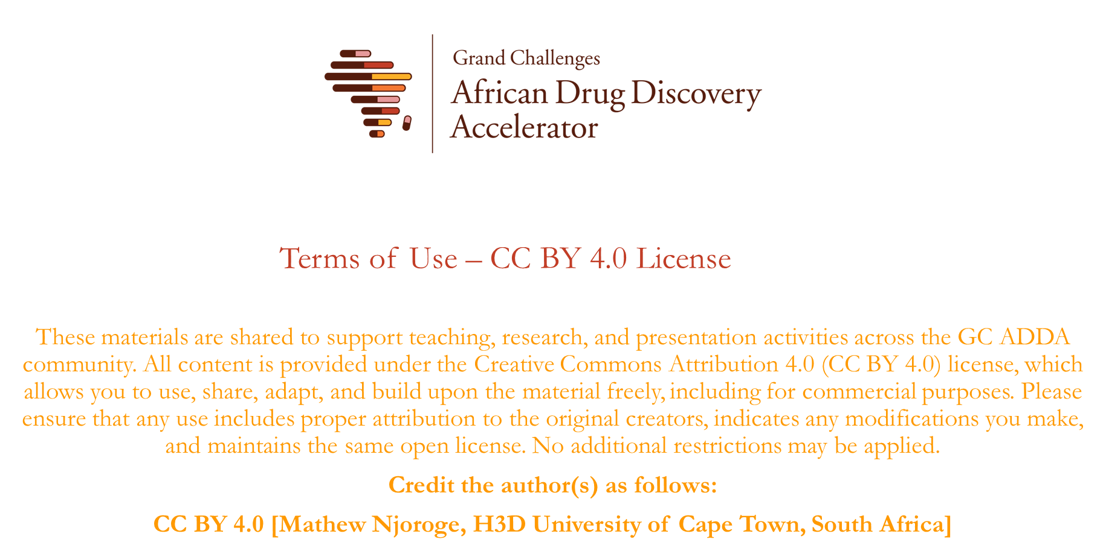

Slide 3

Learning Objectives
Understand the importance of solubility, permeability and metabolic stability in drug discovery
Understand the interpretation of solubility, permeability and metabolic stability data
Understand how in vitro ADME parameters relate to in vivo Pharmacokinetics

Slide 4
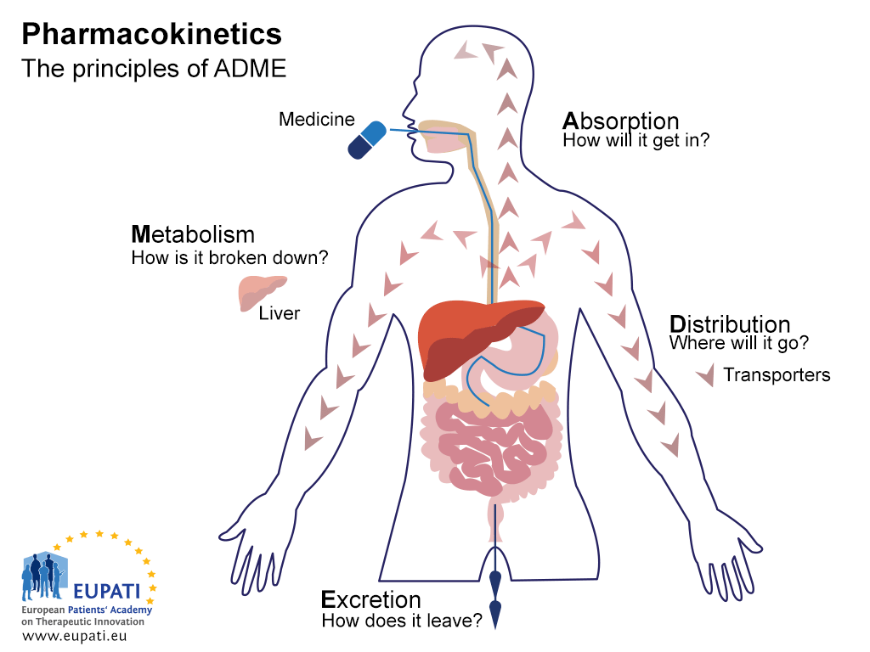
Why doesn’t good in vitro potency translate to good in vivo potency?
In vitro
target
target
In vivo potency depends on whether the drug can be Absorbed, Distributed, Metabolized and Excreted in a way that maximizes concentration at the site of action

Slide 5
ADME
Absorption – How will it get in?
Permeability
Solubility
Physicochemical characteristics
Distribution – Where will it go?
Permeability
Physicochemical characteristics
Metabolism – How is it broken down?
Metabolic stability experiments using microsomes and hepatocytes
Excretion – How does it leave?
Metabolic stability experiments using microsomes and hepatocytes
Physicochemical characteristics
Solubility, Permeability, Metabolic stability

Slide 6
Solubility
In vitro assays
Needs to be soluble enough to give reliable in vitro activity data
In vivo assays
Needs to be soluble enough for absorption when administered to patients or animal models otherwise data will be poorly reproducible
Is my compound soluble enough for biological assays?
Is my compound soluble enough for in vivo PK?
Measure solubility by adding DMSO stock to buffer
(Kinetic solubility)
Measure solubility by adding buffer to solid compound
(Thermodynamic solubility)

Slide 7
Permeability
Permeability is a measure of the velocity of drug passage across membranes
Compounds need to go through biological membranes to be absorbed from the gastrointestinal tract or to move from circulation to the site of action.
Passive permeability is the main way that most drugs cross membranes
Active transport
Passive permeability
Paracellular transport
Influx
Efflux
Cellular barrier

Slide 8
Permeability measurement
Permeability can be measured across artificial membranes e.g Parallel Artificial Membrane Assay (PAMPA) or across cellular monolayers e.g Caco-2 or MDCK
Cellular permeability measurements have the advantage of capturing both the active and passive processes that impact a compound as it goes through a cell membrane.
PAMPA
Cellular permeability e.g CaCo-2
Data
Velocity across A-B (P_{app}) usually in 10⁻⁶ cm/s e.g MMV390048 41 x 10⁻⁶ cm/s or LogP_{app} e.g -3.39
Efflux ratio can also be calculated as Papp B-A/A-B
Donor well containing test compound in buffer
Apical chamber containing test compound in buffer
Cell monolayer e.g Caco-2
Artificial membrane
Permeable membrane
Acceptor well with buffer solution
Basolateral chamber with buffer solution

Slide 9
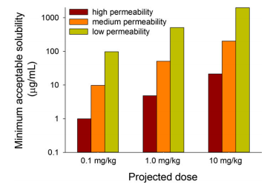
Solubility, Permeability and Dose
MAD = Solubility x Ka x SIWV x SITT
Small intestine
transit time
Solubility in µg/ml
Intestinal absorption rate constant (permeability)
Small intestine
water volume
Lipinski 2000 J Pharm Tox Methods 44, 235 – 249
Williams et al 2013 Pharmacol Rev 315 - 499

Slide 10
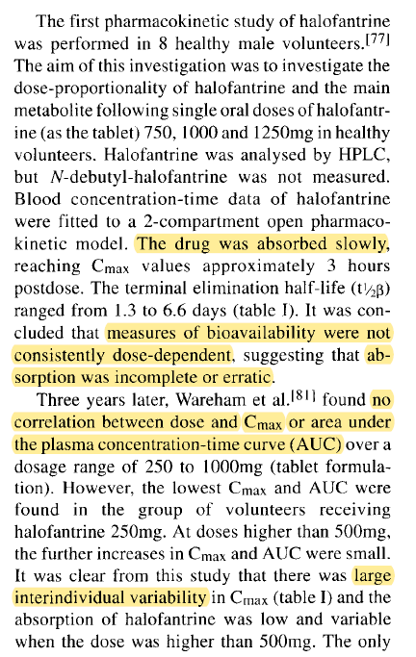
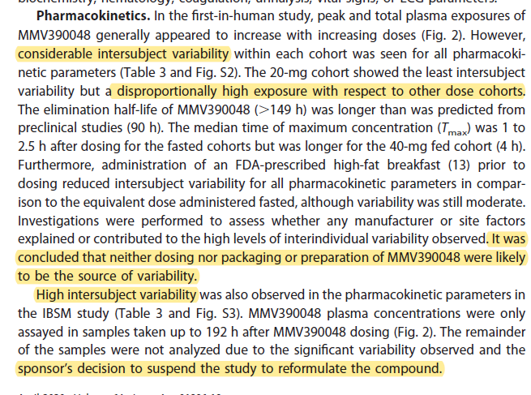
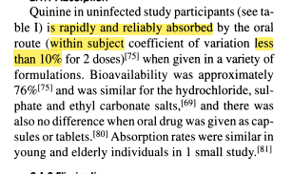
Solubility, Permeability and Dose
 | MMV390048 | Halofantrine | Quinine
Solubility (µM) | 17 | 140 | 6050
Caco-2 (A-B 10-6 cm/s) | 41 | >300 | 39
MAD | 15 | 466 | 4280

Slide 11
Metabolism
Enzymatic compound biotransformation, often to more polar, and less active metabolites
Classically viewed as;
Phase I metabolism: Redox reactions to create functional groups (e.g hydroxylation) or expose functional groups already present (Demethylation)
Phase II metabolism: Conjugative reactions in which endogenous compounds are attached to functional groups created in Phase I or already present in the molecule

Slide 12
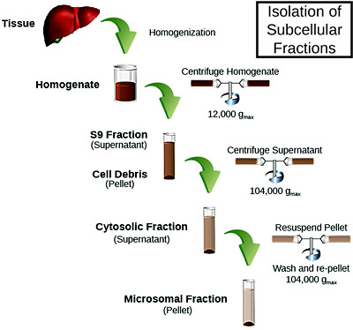
Metabolism measurement
The liver is the primary organ involved in drug metabolism therefore in vitro metabolic stability assays rely on cells and subcellular fractions extracted from the liver:
Hepatocytes
Cells prepared by removing connective tissue from the liver
More expensive and lower throughput than microsomes
Have the full set of enzymes expressed in the liver with both redox enzymes (Phase I metabolism) and conjugative enzymes (Phase II metabolism)
Microsomes
Subcellular fractions prepared by homogenisation and ultracentrifugation of liver tissue
Offer a cheap high throughput method for screening metabolic stability of compounds
Have most of the key enzymes involved in oxidative/reductive metabolism of drugs especially CYP450 enzymes
Sekisui Xenotech©

Slide 13
Metabolism data
In vitro metabolism data can be scaled to in vivo metabolism by factoring in various scaling factors
Primary data derived from LC-MS analyte responses
Stable – high % remaining e.g >85% in H3D assay
Calculated from % remaining using first order equations
Stable – Long t_{½} e.g >150 min in H3D assay
Apparent intrinsic clearance, calculated t_{½} and incubation parameters
Stable – Low CL_{int,app} e.g <11.6 µl/min/mg or <2.7 µl/min/e6 cells in H3D assay
Predicted in vivo intrinsic clearance calculated by scaling microsomes/hepatocytes to liver weight per kg body weight
Can also factor in binding and liver blood flow for predicted in vivo clearance
% remaining
Half-life (min)
In vitro CL_{int,app} Microsomes - (µl/min/mg)
Hepatocytes - µl/min/e6 cells
Predicted in vivo CL_{int,app} (ml/min/kg)

Slide 14
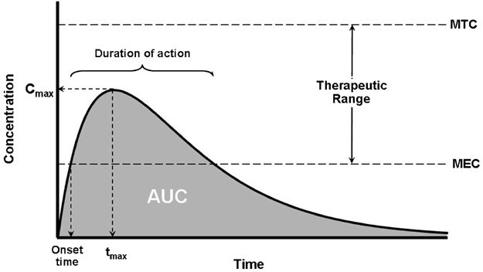

From ADME to PK
The unbound Area Under the Curve (AUC_{u}) is one of the key measures of how much compound is in circulation
For an oral drug;
$${AUC}_{u}= F_{abs} . F_{gut} . \frac{Dose}{{CL}_{int, u}}$$
Fraction absorbed
Physchem – MW, TPSA, pKA etc
Solubility
Lipophilicity
Permeability
Fraction escaping gut metabolism
Metabolic stability
Unbound intrinsic clearance
Metabolic stability

Slide 15
Key Takeaways
In vivo efficacy needs good potency and good ADME
Solubility, Permeability and Metabolic stability are key ADME properties and impact in vivo pharmacokinetics

Slide 16
Further resources
Di and Kerns 2003 Profiling drug like properties in discovery research. Curr Opin Chem Biol 7 (3) 2003
Das et al., 2022 Structural modification aimed for improving solubility of lead compounds in early phase drug discovery. Biorg & Med Chem 56, 115614
Di et al., 2020 The critical role of passive permeability in designing successful drugs. Chemmedchem 15 (20) 1862 - 1874
Smith et al 2019 Clearance in drug design . J Med Chem 62(5), 2245-2255. This publication covers the importance of clearance and the effect it has on the disposition of a drug as well as the link between in vitro and in vivo measurements and scaling.
Maurer et al 2020 Dose predictions for drug design. J Med Chem 63(12), 6423 – 6435. This publication discusses how the link between pharmacokinetic and pharmacodynamic parameters is used to determine the predicted human dose

Slide 17
Questions?

