Slide 1
A Comprehensive Workshop on Preclinical Drug Discovery (CDD)
Selecting a target for drug discovery
Lauren Coulson

Slide 2
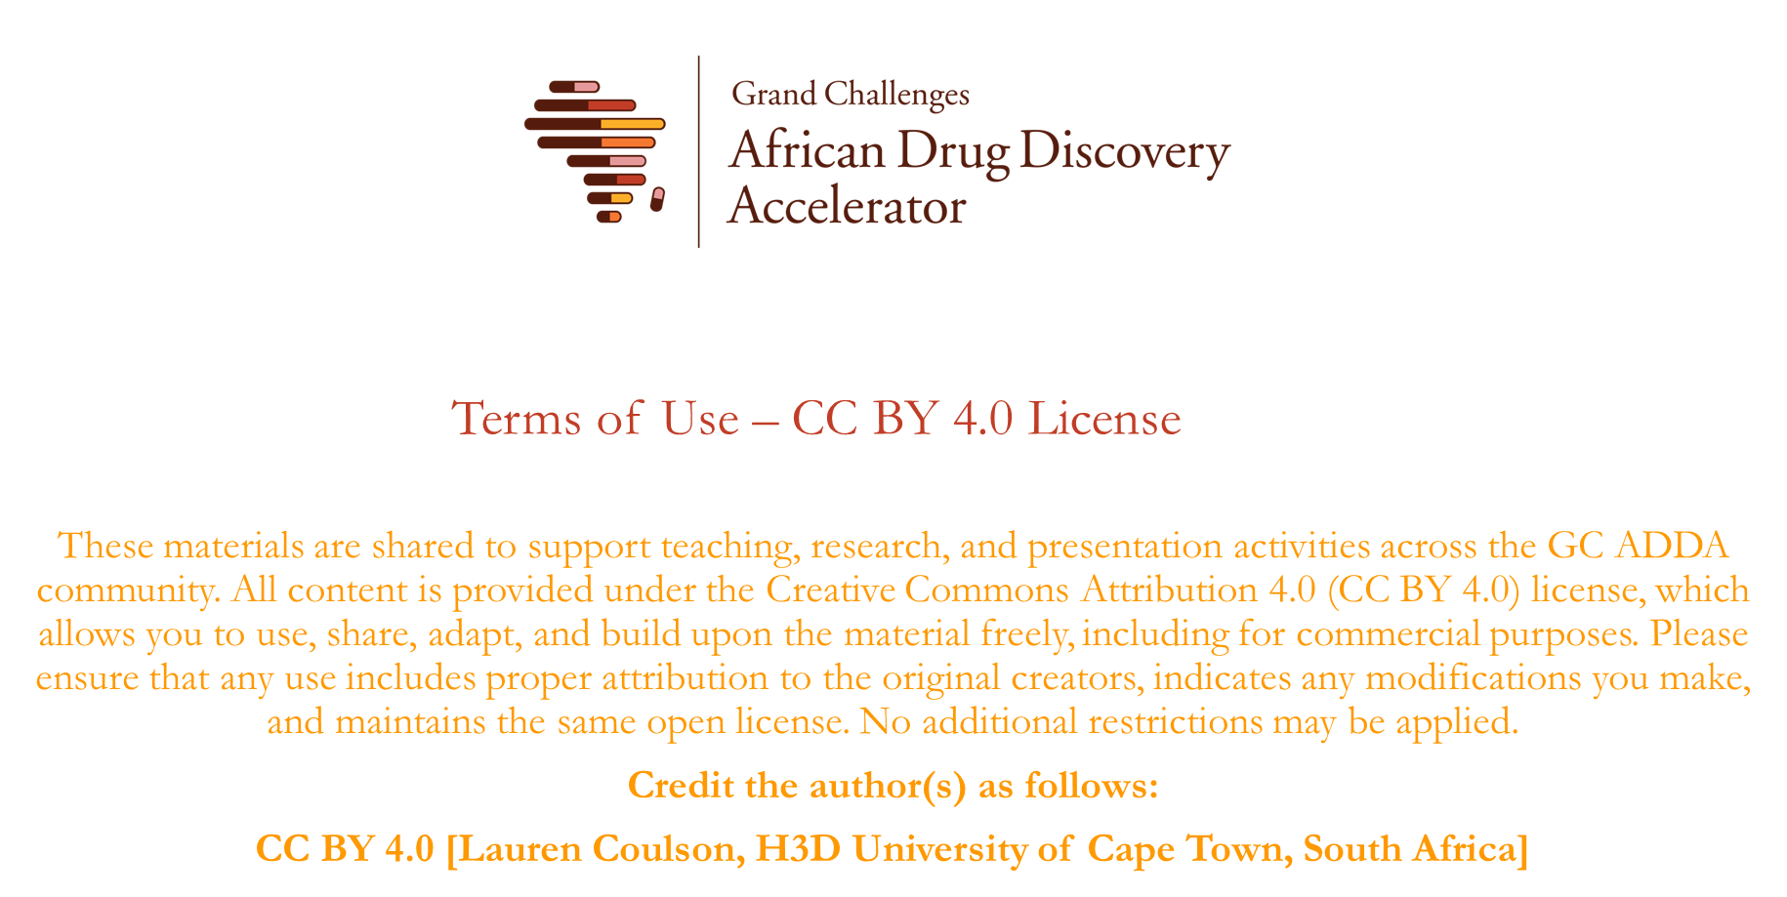

Slide 3

Learning objectives
Selecting a target for drug discovery with focus on infectious diseases
Understanding of principles and approaches used for
Phenotypic and target-based drug discovery
Target identification and validation
Target prioritization for drug discovery

Slide 4
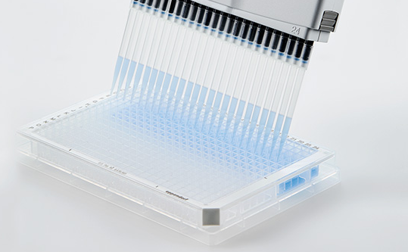
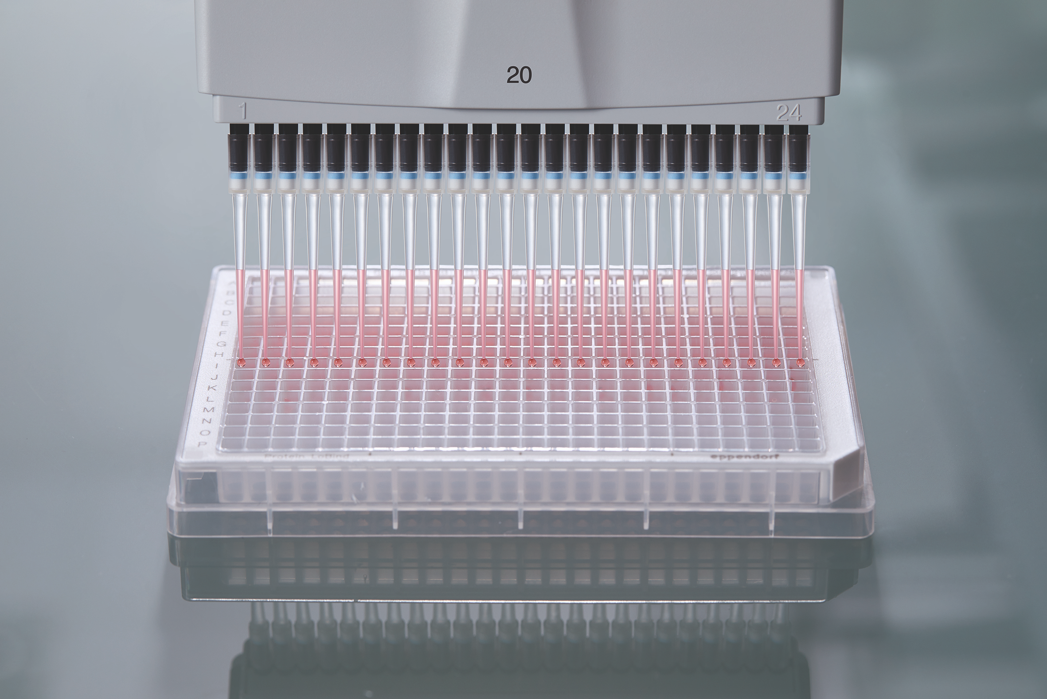
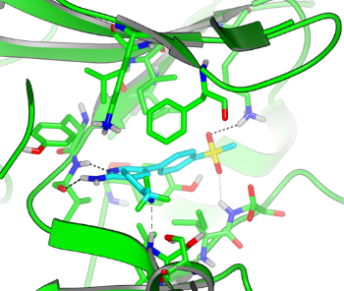
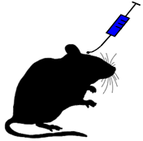
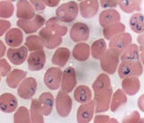
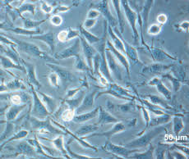
Target-based vs phenotypic drug discovery
Counter-screen
human orthologue/s
Target-based
Target ID & Validation
Target-based screen
Structure determination/
In silico predictions
Compound Libraries
Hit Identification
Hit-to-lead and Lead optimisation
Disease
In vivo model
Phenotypic
Phenotypic whole-cell screen
Secondary profiling
(different forms/stages of disease)
cell-based model system
counter-screen
(cytotoxicity)

Slide 5
Target-based vs phenotypic drug discovery
Phenotypic
(cell-based)
Target-based
(protein biochemical assays)
Immediate evidence that compound can kill pathogen
Can identify hits acting though polypharmacology (multiple targets/pathways) and non-protein targets
Target known with predicted phenotype (e.g. rate of kill, lifecycle stage activity)
Possible to predict human off-targets
Structure-based compound optimization possible for potency and selectivity
PROS
CONS
Cell-based models can have limitations (cost, throughput, relevance)
Rational optimization based on target not possible
Factors affecting SAR complex (cell penetration, protein binding, multiple targets etc)
Requires well validated target (high risk if incorrect target is selected)
Biochemical assay development & structural biology challenging for some targets
compounds that inhibit target may not have phenotypic activity (cell penetration, slow rate of kill)
Potentially higher risk for resistance
Does not identify pro-drugs or compounds acting through polypharmacology

Slide 6
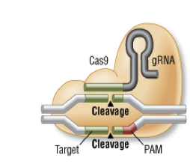
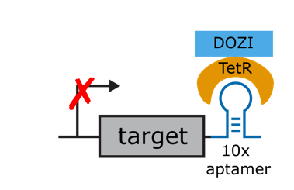
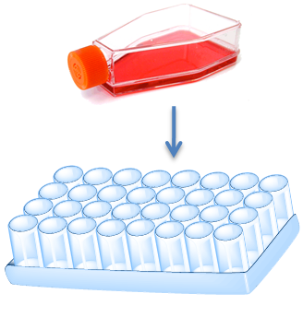
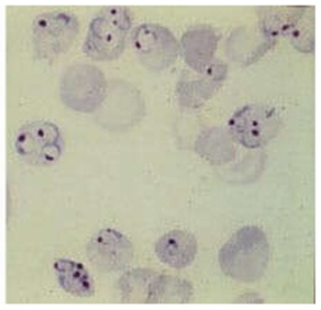
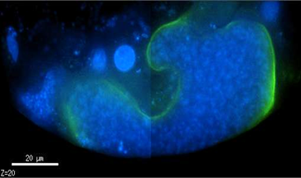
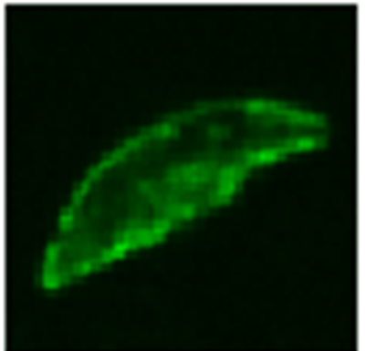
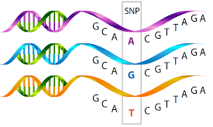
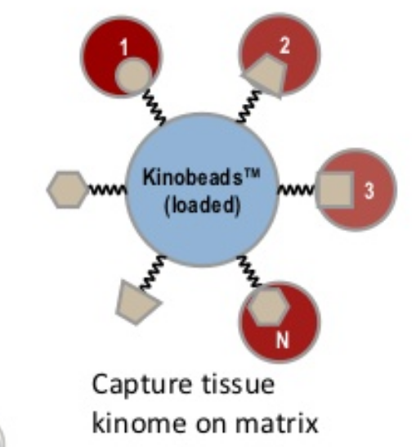
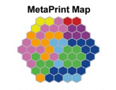
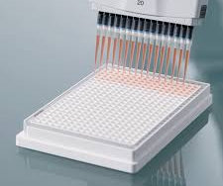
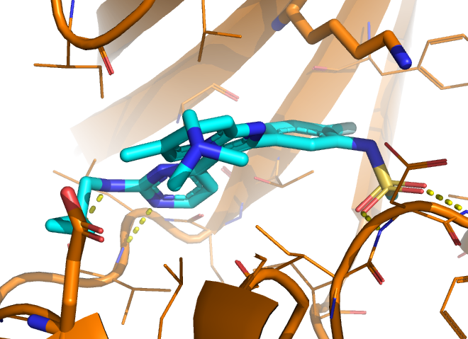
Tools for drug discovery
In vitro and in vivo models of infection
In vitro resistance selections
& whole-genome sequencing
Genetically engineered pathogens
Examples for malaria
BLOOD STAGE ASSAY
LIVER STAGE ASSAY
GAMETOCYTE ASSAY
CRISPR-Cas9
NSG mouse model of
P. falciparum infection
Resistant mutant lines
Hypormophs (cKD)/Hypermophs (overexpressors)
Reporter lines
‘Omics approaches for MOA studies
Recombinant protein expression, biochemical assays, structural biology
Chemoproteomics, Metabolomics, Proteomics

Slide 7
Target Validation
Genetic validation - knocking out/disrupting the gene kills the parasite
Phenotypic validation - chemical compound inhibiting target shows activity in cell-based model of disease
In vivo proof-of-concept – effective in animal model of infection
Clinical validation in human

Slide 8
Considerations when selecting a target
Essentiality
Disease form/Life cycle stage
Vulnerability
Kinase Target
Rate of Action
Conservation/ Pan-Species Activity
Resistance
Propensity
Druggability
Assay & Structures
Selectivity

Slide 9
Considerations when selecting a target
Genetic essentiality does NOT always equate to good drug targets
Knockouts remove 100% of protein. If requirement is for high levels of inhibition to achieve phenotypic activity it may be difficult to achieve this pharmacologically.
Some proteins have more than 1 function – which function(s) is essential?
Rate of kill
Essentiality may differ under different conditions (in vitro vs in vivo) and at different life cycle stages.
Essentiality may differ between species
On-target whole-cell activity? Polypharmacology?
Resistance propensity
Selectivity compared to human homologues

Slide 10
Establishing a target-based assay
Can your target of interest be expressed recombinantly?
What are you going to measure?
catalytic activity?
binding?
disrupt protein-protein interactions?
Is there a known probe or substrate to do this? What is the readout?
What is the cost and throughput of the assay?

Slide 11
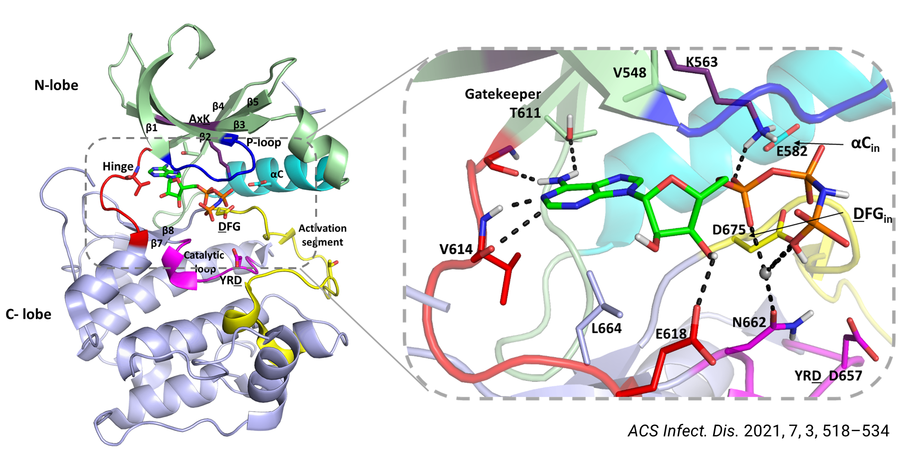
High-resolution structures for drug design
Is there a high-resolution structure available (X-ray crystal or CryoEM structure >2.3 Å)? Ligand bound or apo?
Structure of close orthologue to build reliable homology model? AlphaFold model?
Likelihood of solving structure (size, membrane-bound or soluble, disordered etc)
Are structures for key potential human off-targets available allowing for optimisation of selectivity? Is there a strategy for obtaining selectivity based on differences in binding pocket?

Slide 12

Druggability, tool compounds & screening libraries
Is there evidence of a binding pocket?
Are tool compounds available for your target or a related target from other species?
Do reported inhibitors have drug-like properties?
How to choose a compound library to screen against your target
Protein family - focused
Natural products
DNA-encoded libraries
Source virtual screening hits
Tailored to the target
Bigger is not necessarily better
Drug-like compounds
Consider a fragment-based screening approach
Can you include a counter-screen?

Slide 13
Examples from malaria
PI4Kβ
CLK3
Plasmodium cyclin-dependent-like kinase 3
Plasmodium Phosphatidylinositol 4-kinase beta
Target ID on phenotypic hits with potent multistage antiplasmodium activity
Knockout studies showed genetic essentiality
Target selected for high-throughput screen
Biochemical assay established
~30 000 compounds made up of several kinase-focused libraries
KDU691
Tool compound identified
for further target validation
Life cycle stage profiling
Resistance selections
Chemogenetics confirmation of on-target activity
In vivo POC demonstrated in rodent model of infection
MMV390048
In vitro resistance selections – mutations in PfPI4K gene
Chemoproteomics (pull down experiments & Kinobead studies)
Biochemical assay confirmed direct inhibition of Plasmodium PI4K activity
TCMDC-135051
MMV390048 showed efficacy in Phase IIa clinical trials clinical validation of PI4Kβ
Challenges: Selectivity/toxicity & resistance risk
Challenges: Potency, selectivity & resistance risk

Slide 14
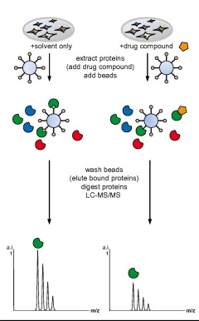
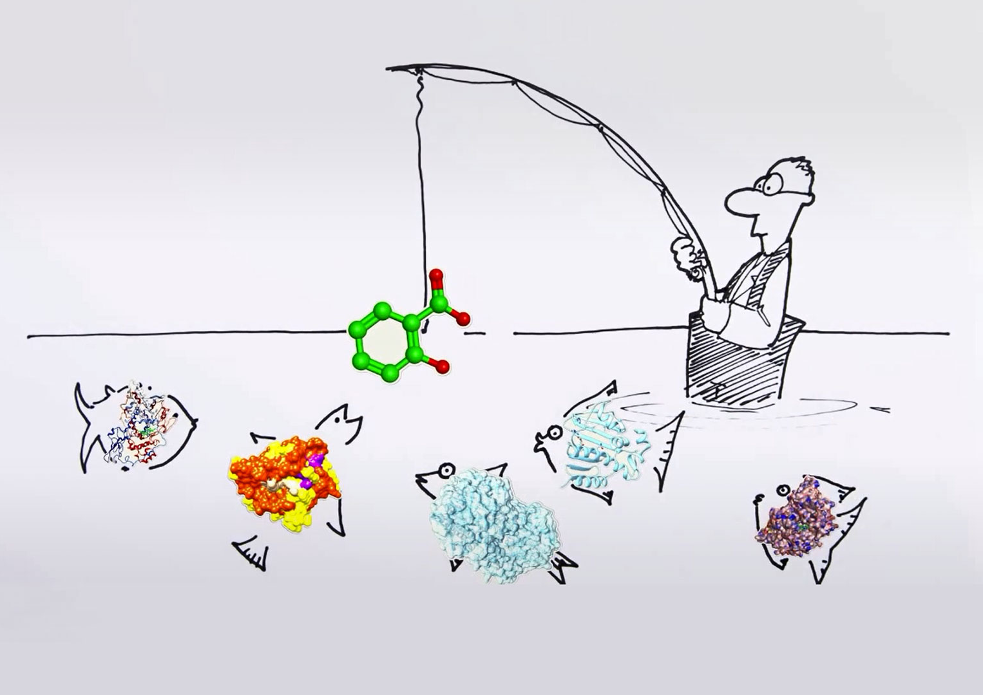
Chemoproteomics approaches used for target ID
https://www.roche.com/research_and_development/drawn_to_science/target_identification.htm
Bantscheff et al. Bioorganic & medicinal chemistry 20.6 (2012): 1973-1978.

Slide 15
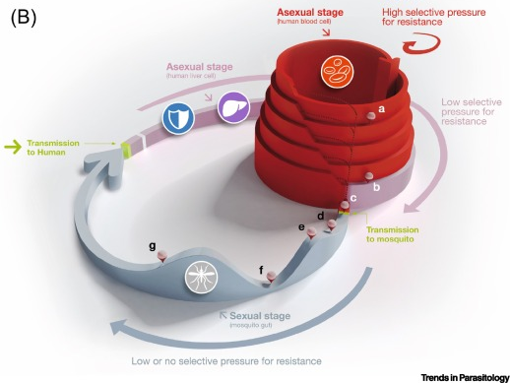
Resistance risk for antimalarials
Differences in the parasite population size throughout the stages of the life cycle.
https://doi.org/10.1016/j.pt.2021.04.006

Slide 16
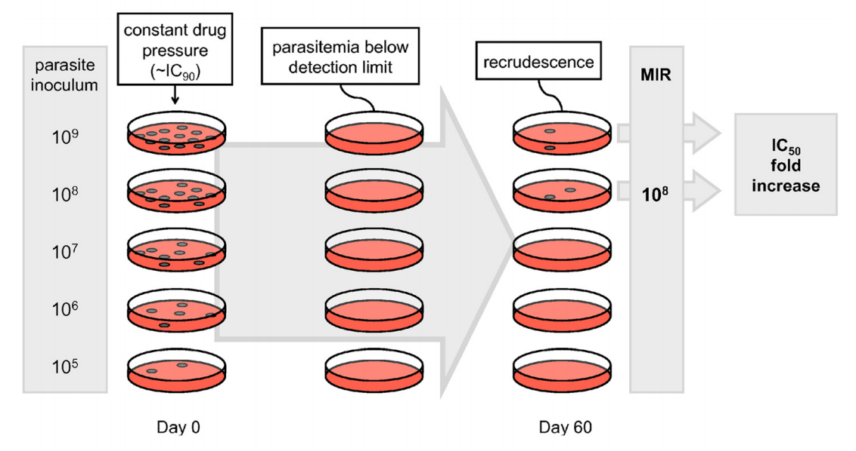
Resistance risk for antimalarials
https://doi.org/10.1186/1475-2875-11-292

Slide 17
Polypharmacology
A single drug acting on more than one molecular target to produce the desired therapeutic effect.
‘death by a thousand cuts’ or ‘the magic shotgun approach’
Complex multifactorial diseases such as cancer, neurological disorders, and infection may require modulation of multiple pathways to ensure drug efficacy
Potential advantages
additive or synergistic effects resulting from the modulation of multiple pathways resulting in a lower effective dose
delayed drug resistance
reduced pill burden and costs associated with complex combination therapies
Identification of target-pairs for designed polypharmacology

Slide 18
Summary
Carefully assess target before investing resources in a target-based drug discovery program
Essentiality may be disease model, life cycle stage or species specific
Phenotypic validation requires target engagement in a cellular context to be clearly linked to the observed phenotypic whole cell activity.
Large range of genetic and ‘omics tools available for target ID and validation, interdisciplinary teams are key for a successful target-based drug discovery program

Slide 19
References
Gilbert, I. H., Drug discovery for neglected diseases: Molecular target-based and phenotypic approaches. J. Med. Chem. 2013, 56, 7719-7726. https://doi.org/10.1021/jm400362b
Yang, T. et al. MalDA, Accelerating Malaria Drug Discovery. Trends in Parasitology 2021, 37, 493-507. https://doi.org/10.1016/j.pt.2021.01.009
Arendse, L. B.; Wyllie, S.; Chibale, K.; Gilbert, I. H. Plasmodium Kinases as Potential Drug Targets for Malaria: Challenges and Opportunities. ACS Infectious Diseases 2021, 7, 518-534. https://doi.org/10.1021/acsinfecdis.0c00724
McNamara, C. W.; Lee, M. C.; Lim, C. S.; Lim, S. H.; Roland, J.; Nagle, A.; Simon, O.; Yeung, B. K.; Chatterjee, A. K.; McCormack, S. L. Targeting Plasmodium PI(4)K to eliminate malaria. Nature 2013, 504 (7479), 248-253. https://doi.org/10.1038/nature12782
Paquet, T. et al. Antimalarial efficacy of MMV390048, an inhibitor of Plasmodium phosphatidylinositol 4-kinase. Sci. Transl. Med. 2017, 9 (387), eaad9735. https://www.science.org/doi/10.1126/scitranslmed.aad9735
Alam, M. M. et al. Validation of the protein kinase PfCLK3 as a multistage cross-species malarial drug target. Science 2019, 365 (6456), eaau1682. https://www.science.org/doi/10.1126/science.aau1682
Bantscheff, M.; Drewes, G. Chemoproteomic approaches to drug target identification and drug profiling. Bioorg Med Chem. 2012, 20(6), 1973-8. https://doi.org/10.1016/j.bmc.2011.11.003
Ding, X. C.; Ubben, D.; Wells, T. N. C. A framework for assessing the risk of resistance for anti-malarials in development. Malaria Journal 2012, 11, 292. https://doi.org/10.1186/1475-2875-11-292
Duffey, M.; Blasco, B.; Burrows, J. N.; Wells, T. N.; Fidock, D. A.; Leroy, D. Assessing risks of Plasmodium falciparum resistance to select next-generation antimalarials. Trends in Parasitology 2021. https://doi.org/10.1016/j.pt.2021.04.006

Slide 20
Questions?

