Slide 1
A Comprehensive Workshop on Preclinical Drug Discovery (CDD)
Mass spectrometry applications in drug discovery
Cellular drug responses, compound mode of action and drug disposition
Prof. Dr. Carsten Hopf, Mannheim, Germany

Slide 2
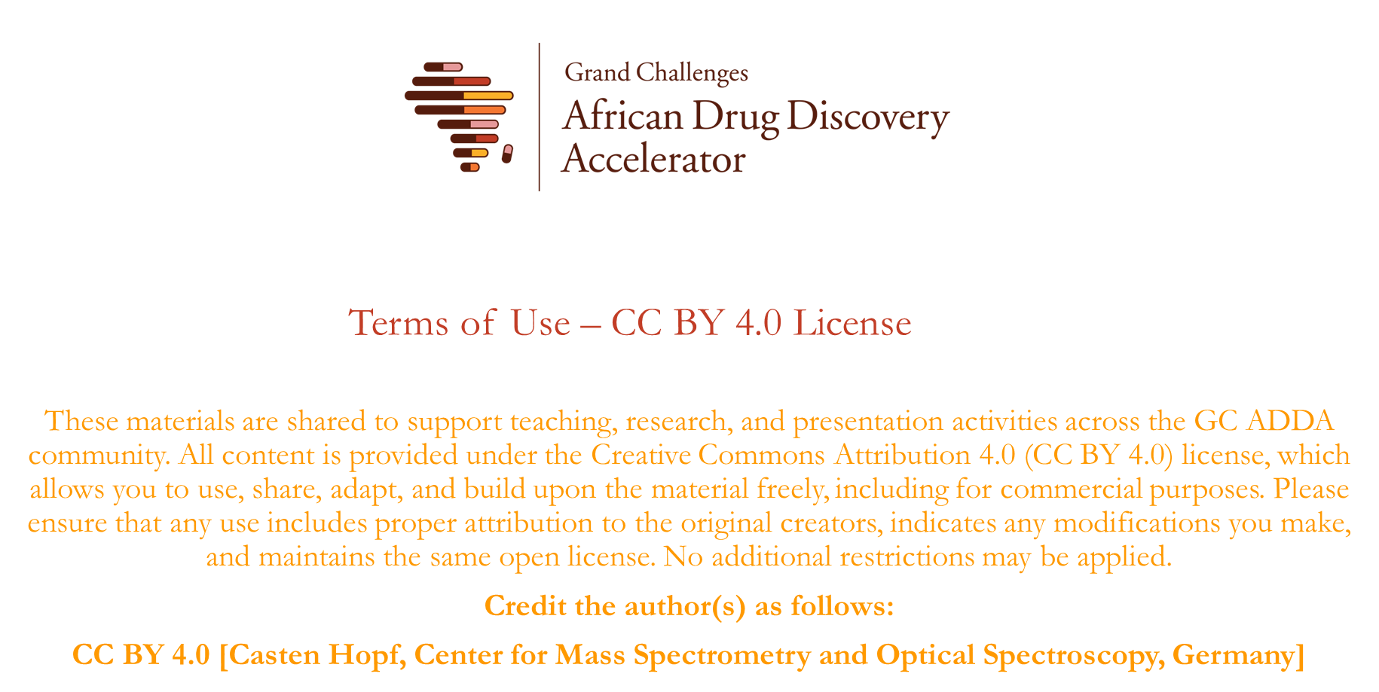

Slide 3

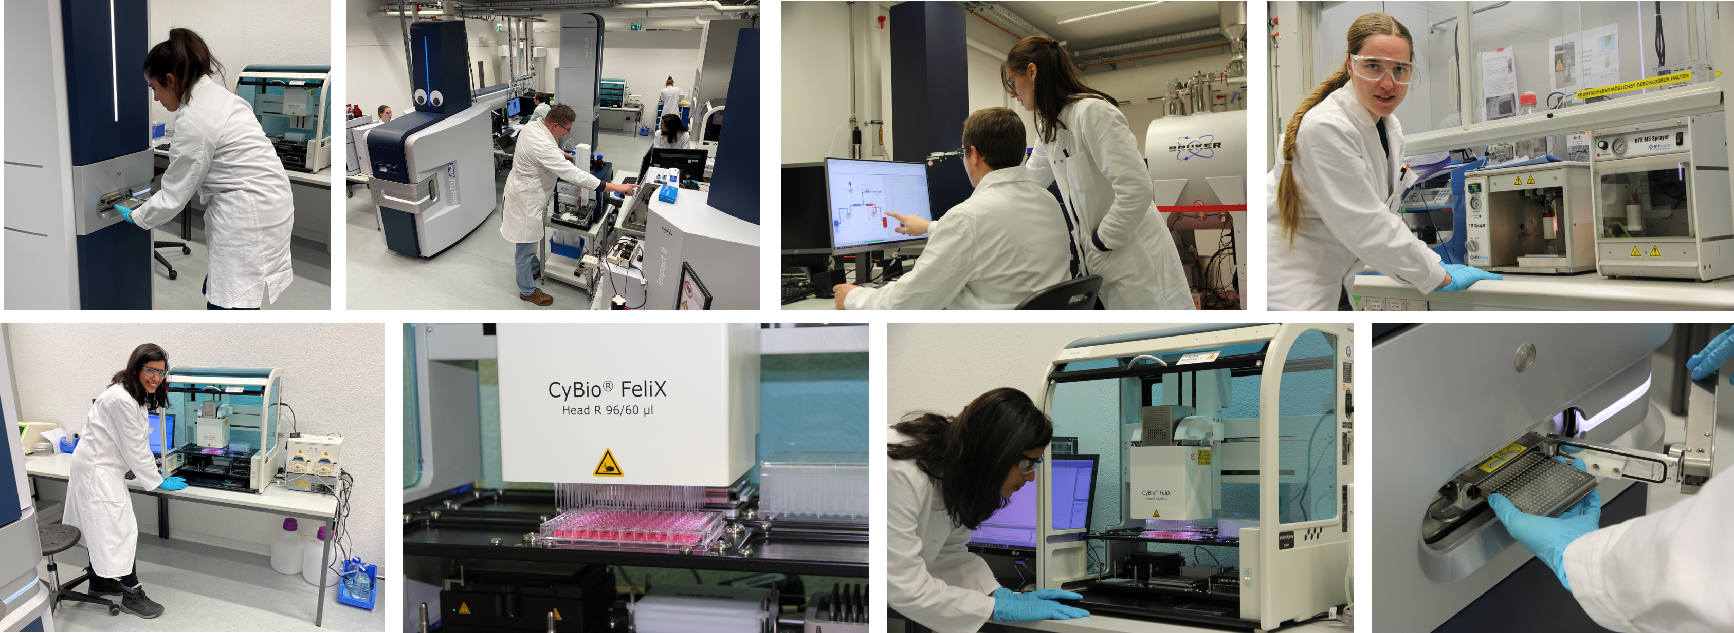
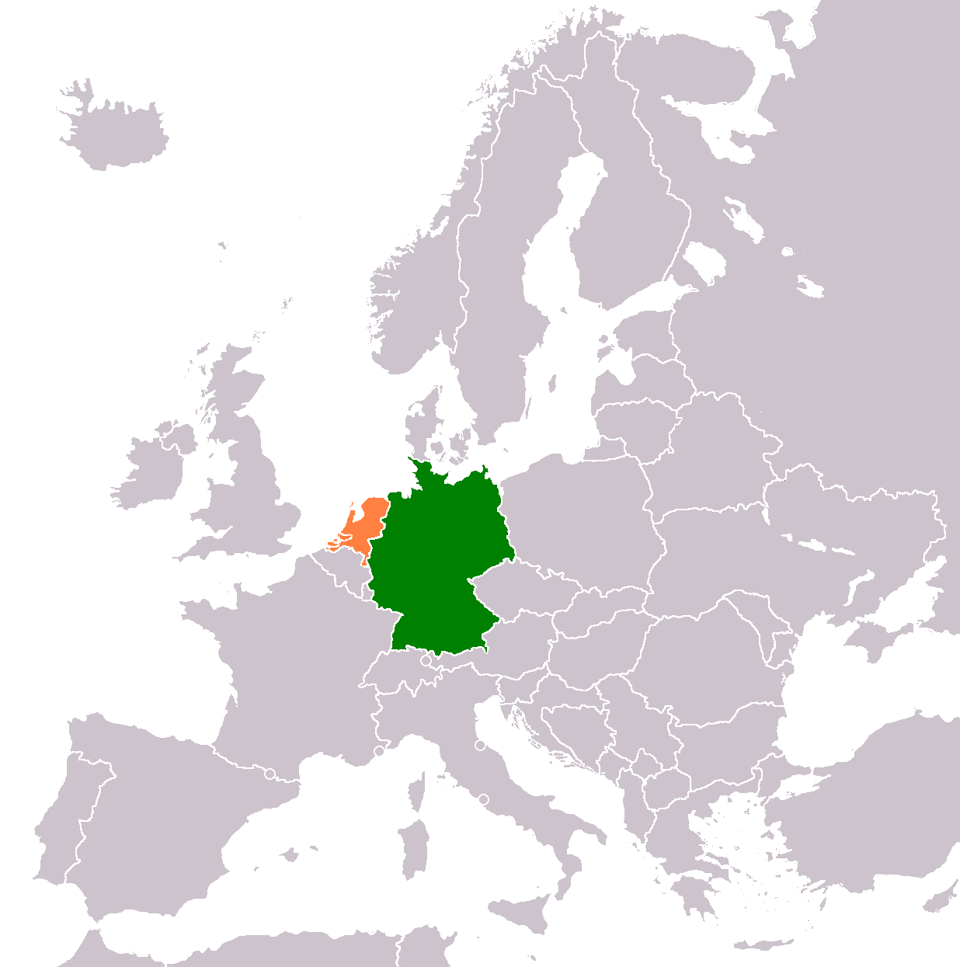
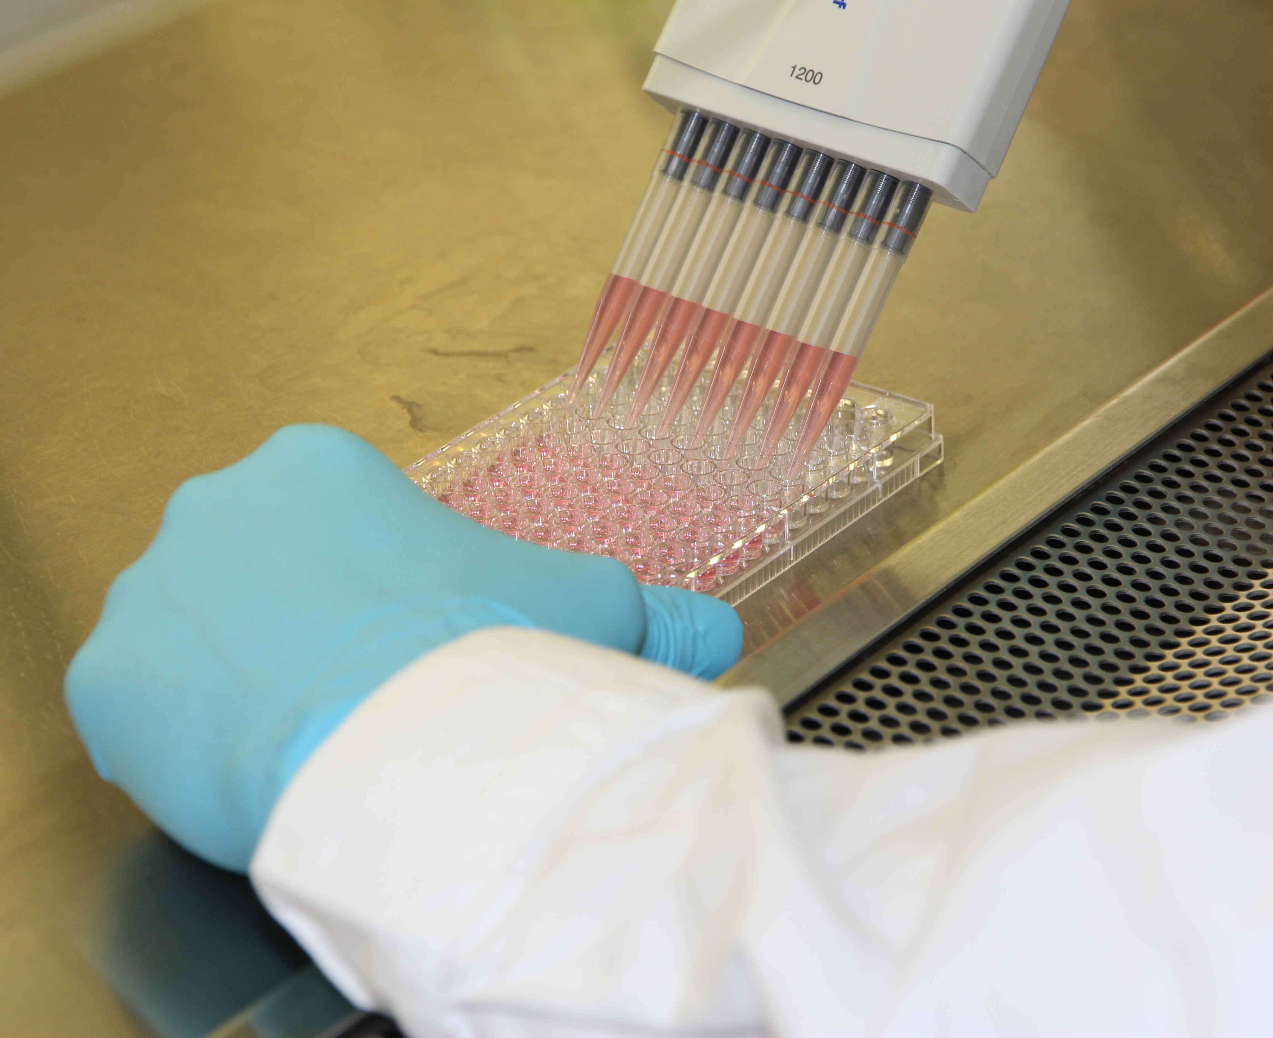
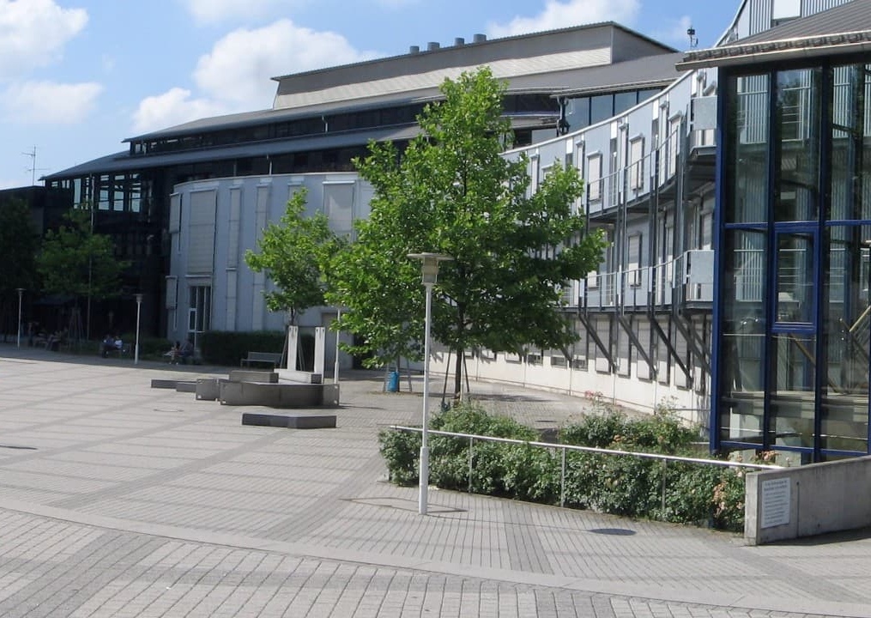
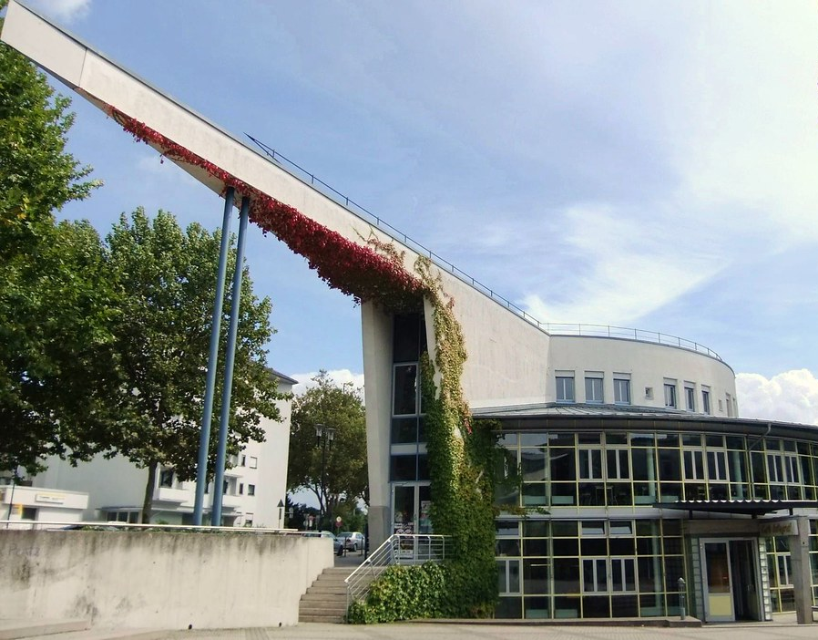
CeMOS Research Center Mannheim, Germany
Mannheim

Slide 4
Learning Objectives
Mass spectrometry technologies are emerging in preclinical drug discovery
What is MALDI mass spectrometry (MALDI MS)?
Use of MALDI MS in cell-based drug screening or profiling
Use of MALDI MS in drug disposition analysis
Use of MALDI MS in drug mode of action analysis

Slide 5
Learning Objectives
Mass spectrometry technologies are emerging in preclinical drug discovery
What is MALDI mass spectrometry (MALDI MS)?
Use of MALDI MS in cell-based drug screening or profiling
Use of MALDI MS in drug disposition analysis
Use of MALDI MS in drug mode of action analysis

Slide 6
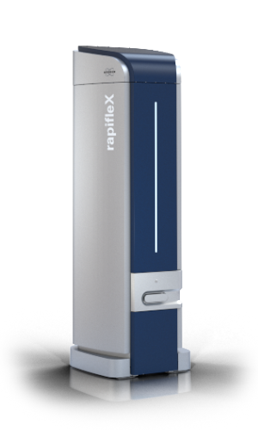
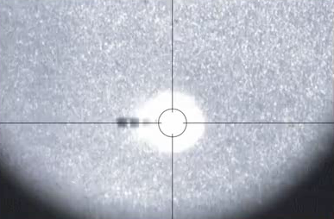
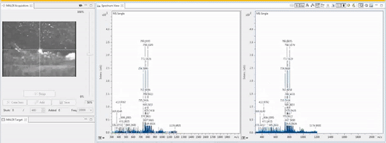
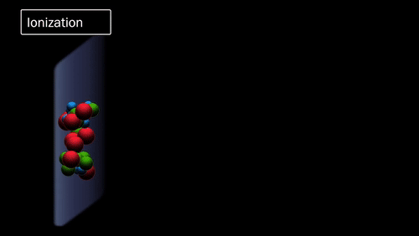
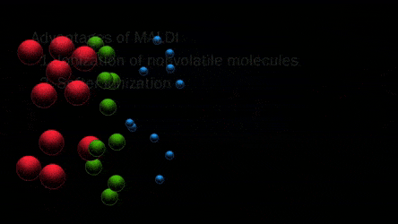
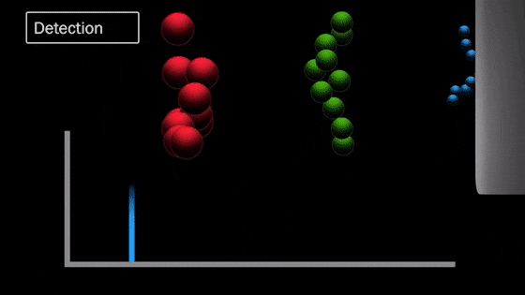
MALDI MS determines the biochemical composition of cells and tissues
Separation of lipids, metabolites
based on mass (& charge)
Desorption/Ionization
Detection

Slide 7
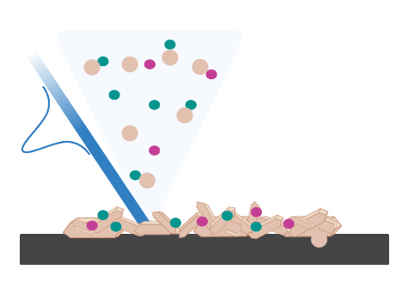
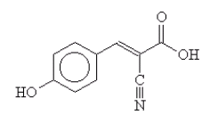
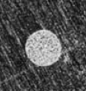
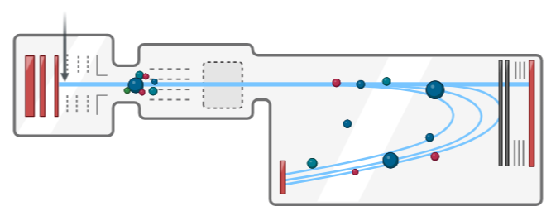
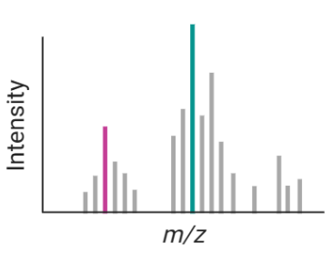


Biochemicals are embedded in matrix, ionized by laser and sorted by time-of-flight (TOF) in the MS
Information technology: Pattern recognition
Sample
Desorption and Ionization
Mass analysis =
time of flight (TOF) measurement
Co-crystallization with chemical matrix
Biochemicals sorted by mass (&charge)
Pulsed laser
MALDI plume
+
+
+
+
+
+
Charge transfer
Mass spectrum
α-cyano-4-OH-
cinnamic acid (HCCA)
+
m/z ~ t²
AOI 1
AOI 2
Neutral matrix molecules
MOI 1
MOI 2
+
Matrix ions
MALDI TOF

Slide 8
Technology advantages of MS
No expensive reagents like antibodies required (“label-free”)
Works for lipids, carbohydrates/N-glycans, peptides, drugs, drug metabolites
Measures hundreds of biochemicals simultaneously (“high molecular content” method)
No autofluorescence or fluorescence quenching

Slide 9
Learning Objectives
Mass spectrometry technologies are emerging in preclinical drug discovery
What is MALDI mass spectrometry (MALDI MS)?
Use of MALDI MS in cell-based drug screening or profiling
Use of MALDI MS in drug disposition analysis
Use of MALDI MS in drug mode of action analysis

Slide 10
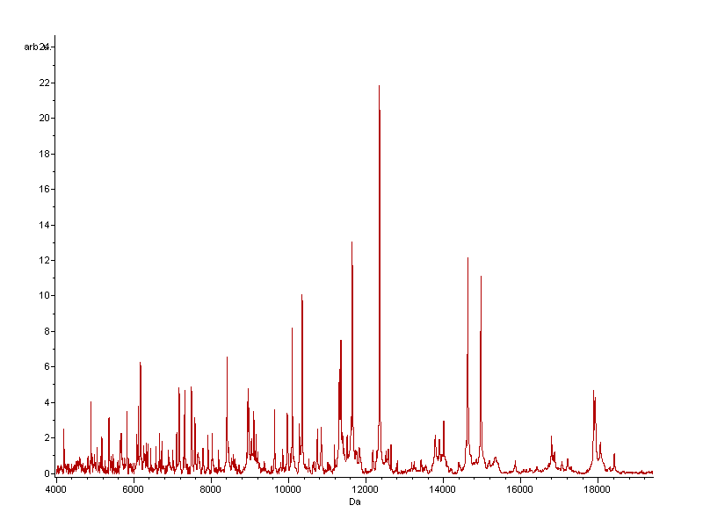
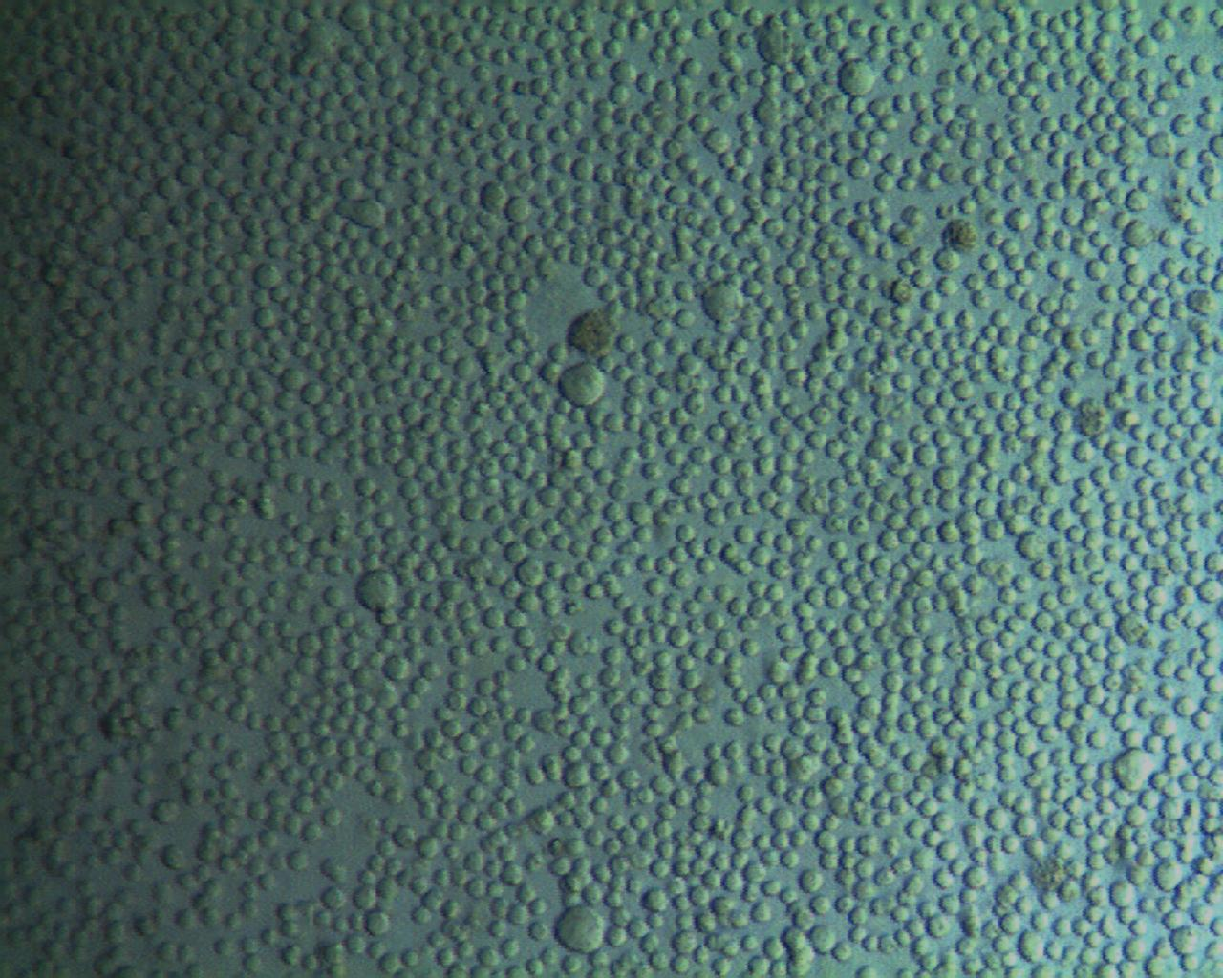
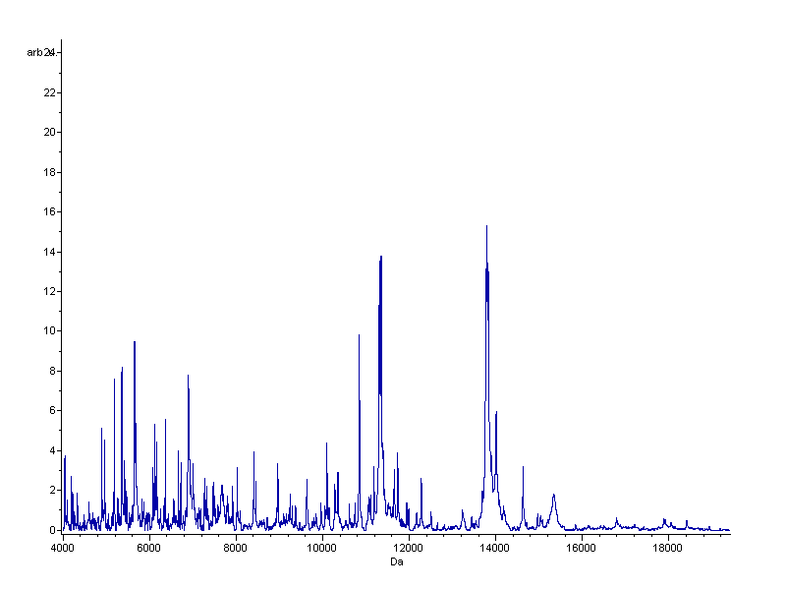
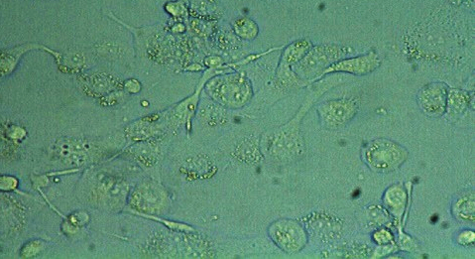
After cell treatment with “drugs”, cell morphology AND MS patterns change
Undifferentiated cells
Day 0
Intensities (arbitrary units)
200 nM PMA
Differentiated cells
Day 8
Intensities (arbitrary units)
Munteanu et al., Anal. Bioanal. Chem., 2012
Munteanu and Hopf, Bioanalysis, 2013
Munteanu et al., Anal. Chem., 2014
m/z 4000 – 20000 Da

Slide 11
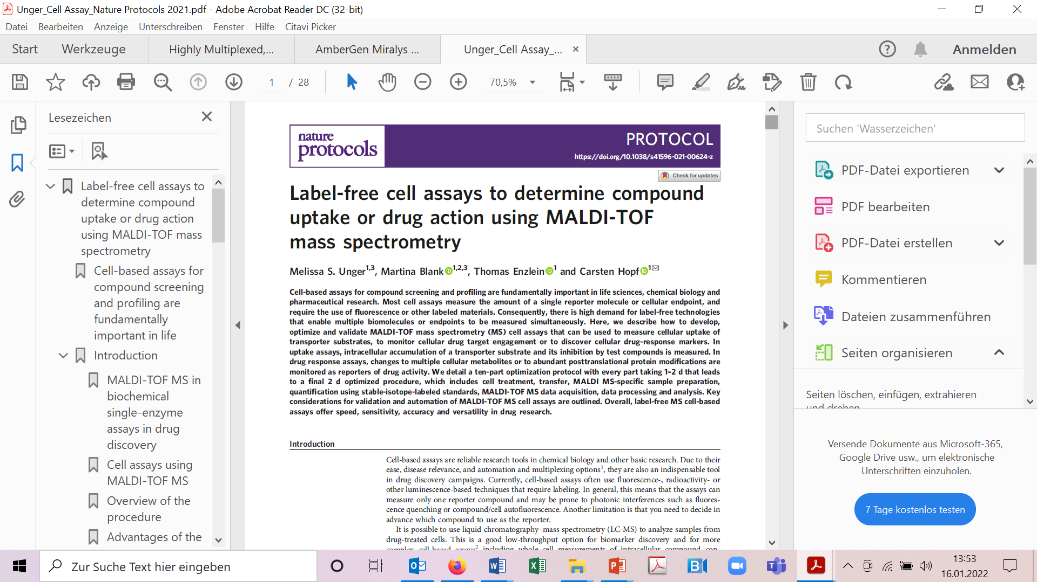
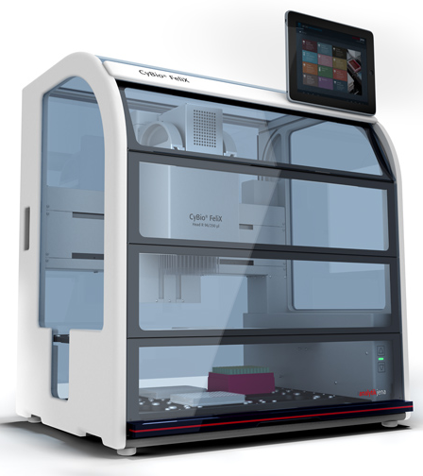

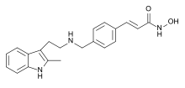
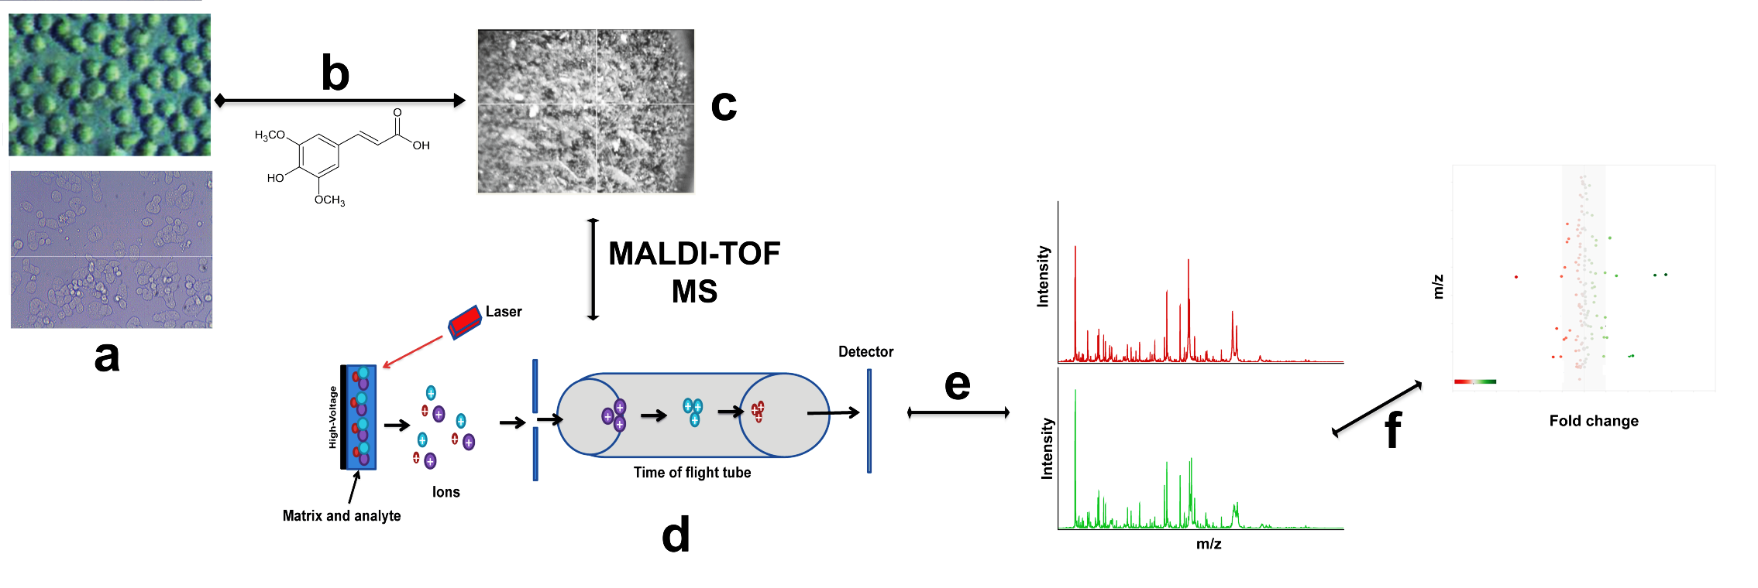

Semi-automated MALDI MS cell assays in early drug discovery
Analytik Jena
CyBio FeliX
Unger et al., Nature Prot, 2021
384-well format
Cell Culture + Drug
MALDI-Matrix
MALDI-TOF MS
Bruker rapifleX
384-well plate
measured in <5 min
“MS Lipid/Metabolite Fingerprint”
Intensity
m/z

Slide 12
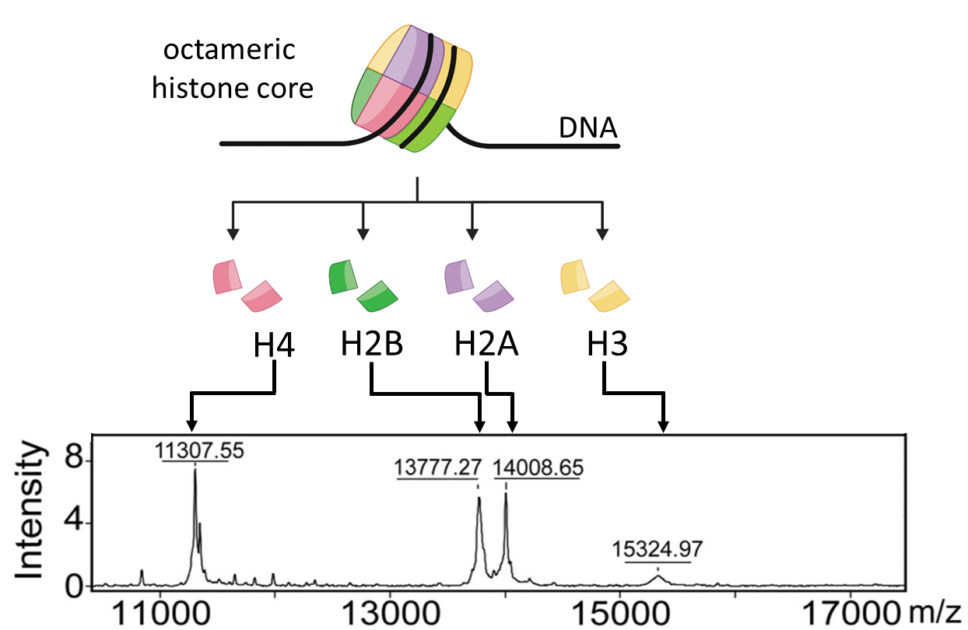


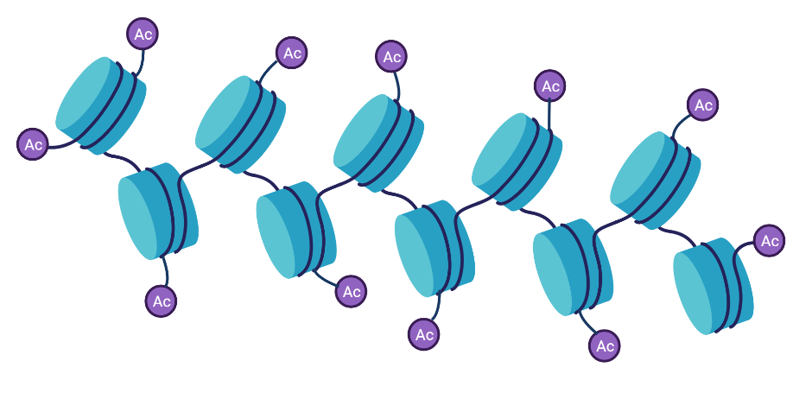
Example 1: Profiling of histone deacetylase (HDAC) inhibitors in K562 leukemia cells
closed chromatin
HDAC
HATs
open chromatin
Munteanu et al., Anal Chem. 86.10, 4662-4647 (2014)

Slide 13
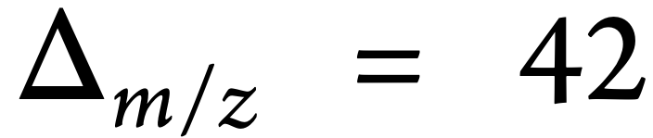


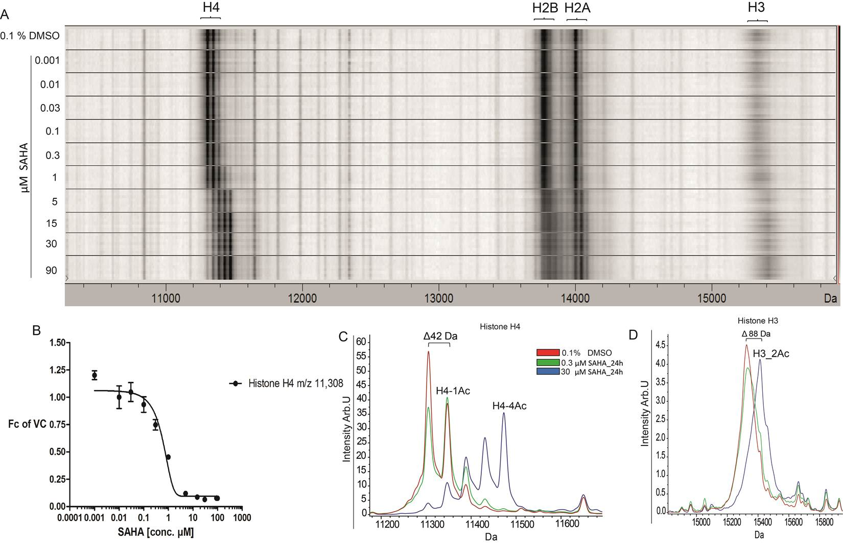
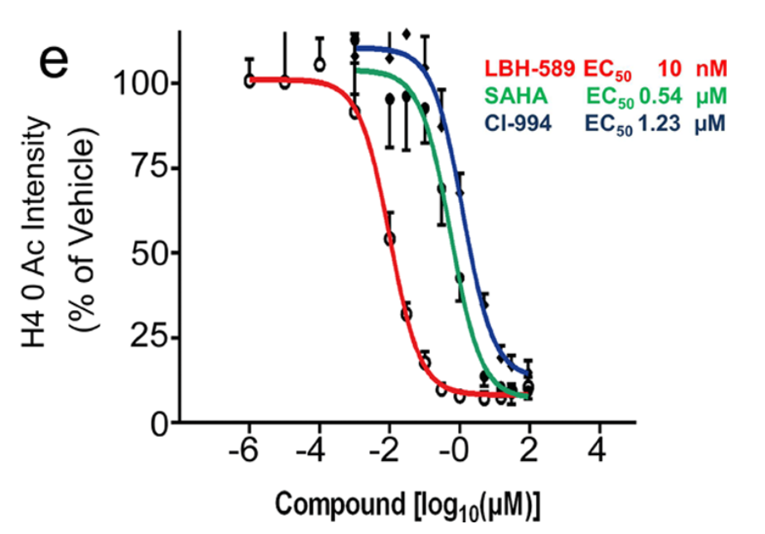
Example 1: HDAC inhibition causes acetylation of histones and a mass shift of 42 Da
hydrogen
acetyl
HDACi
H4
H2A/B
H3
SAHA/vorinostat
Concentration (µM)
Munteanu et al., Anal Chem. 86.10, 4662-4647 (2014)

Slide 14
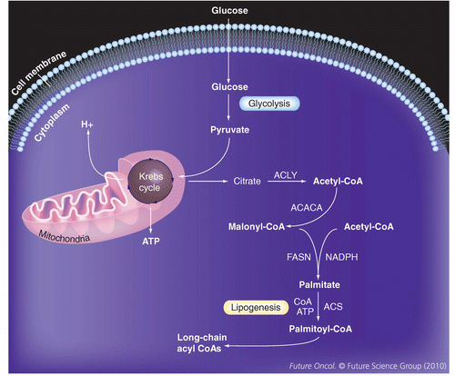
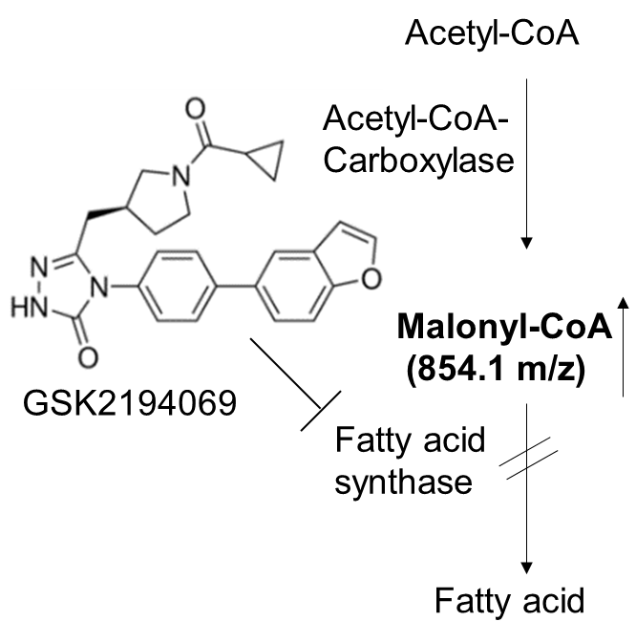
Example 2: Profiling of fatty acid synthase (FASN) inhibitors in A549 lung cancer cells
FASN is linked to many diseases
Various types of cancer
Non-alcoholic
steatohepatitis (NASH)
Non-alcoholic
fatty liver disease (NAFLD)
Diabetes
FASN is a target
in drug discovery

Slide 15
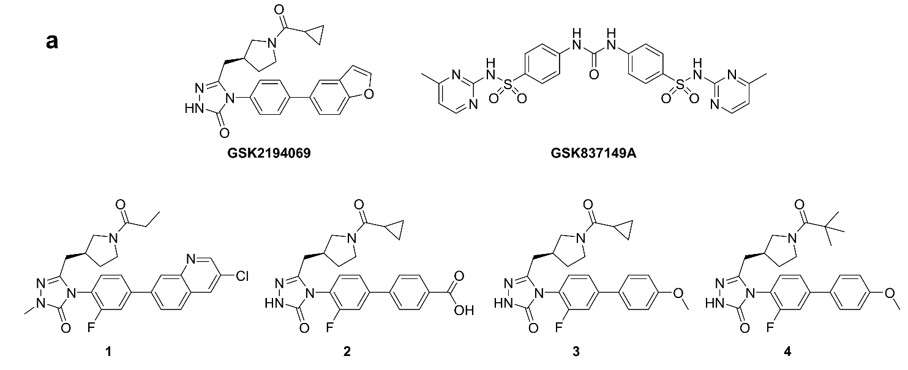
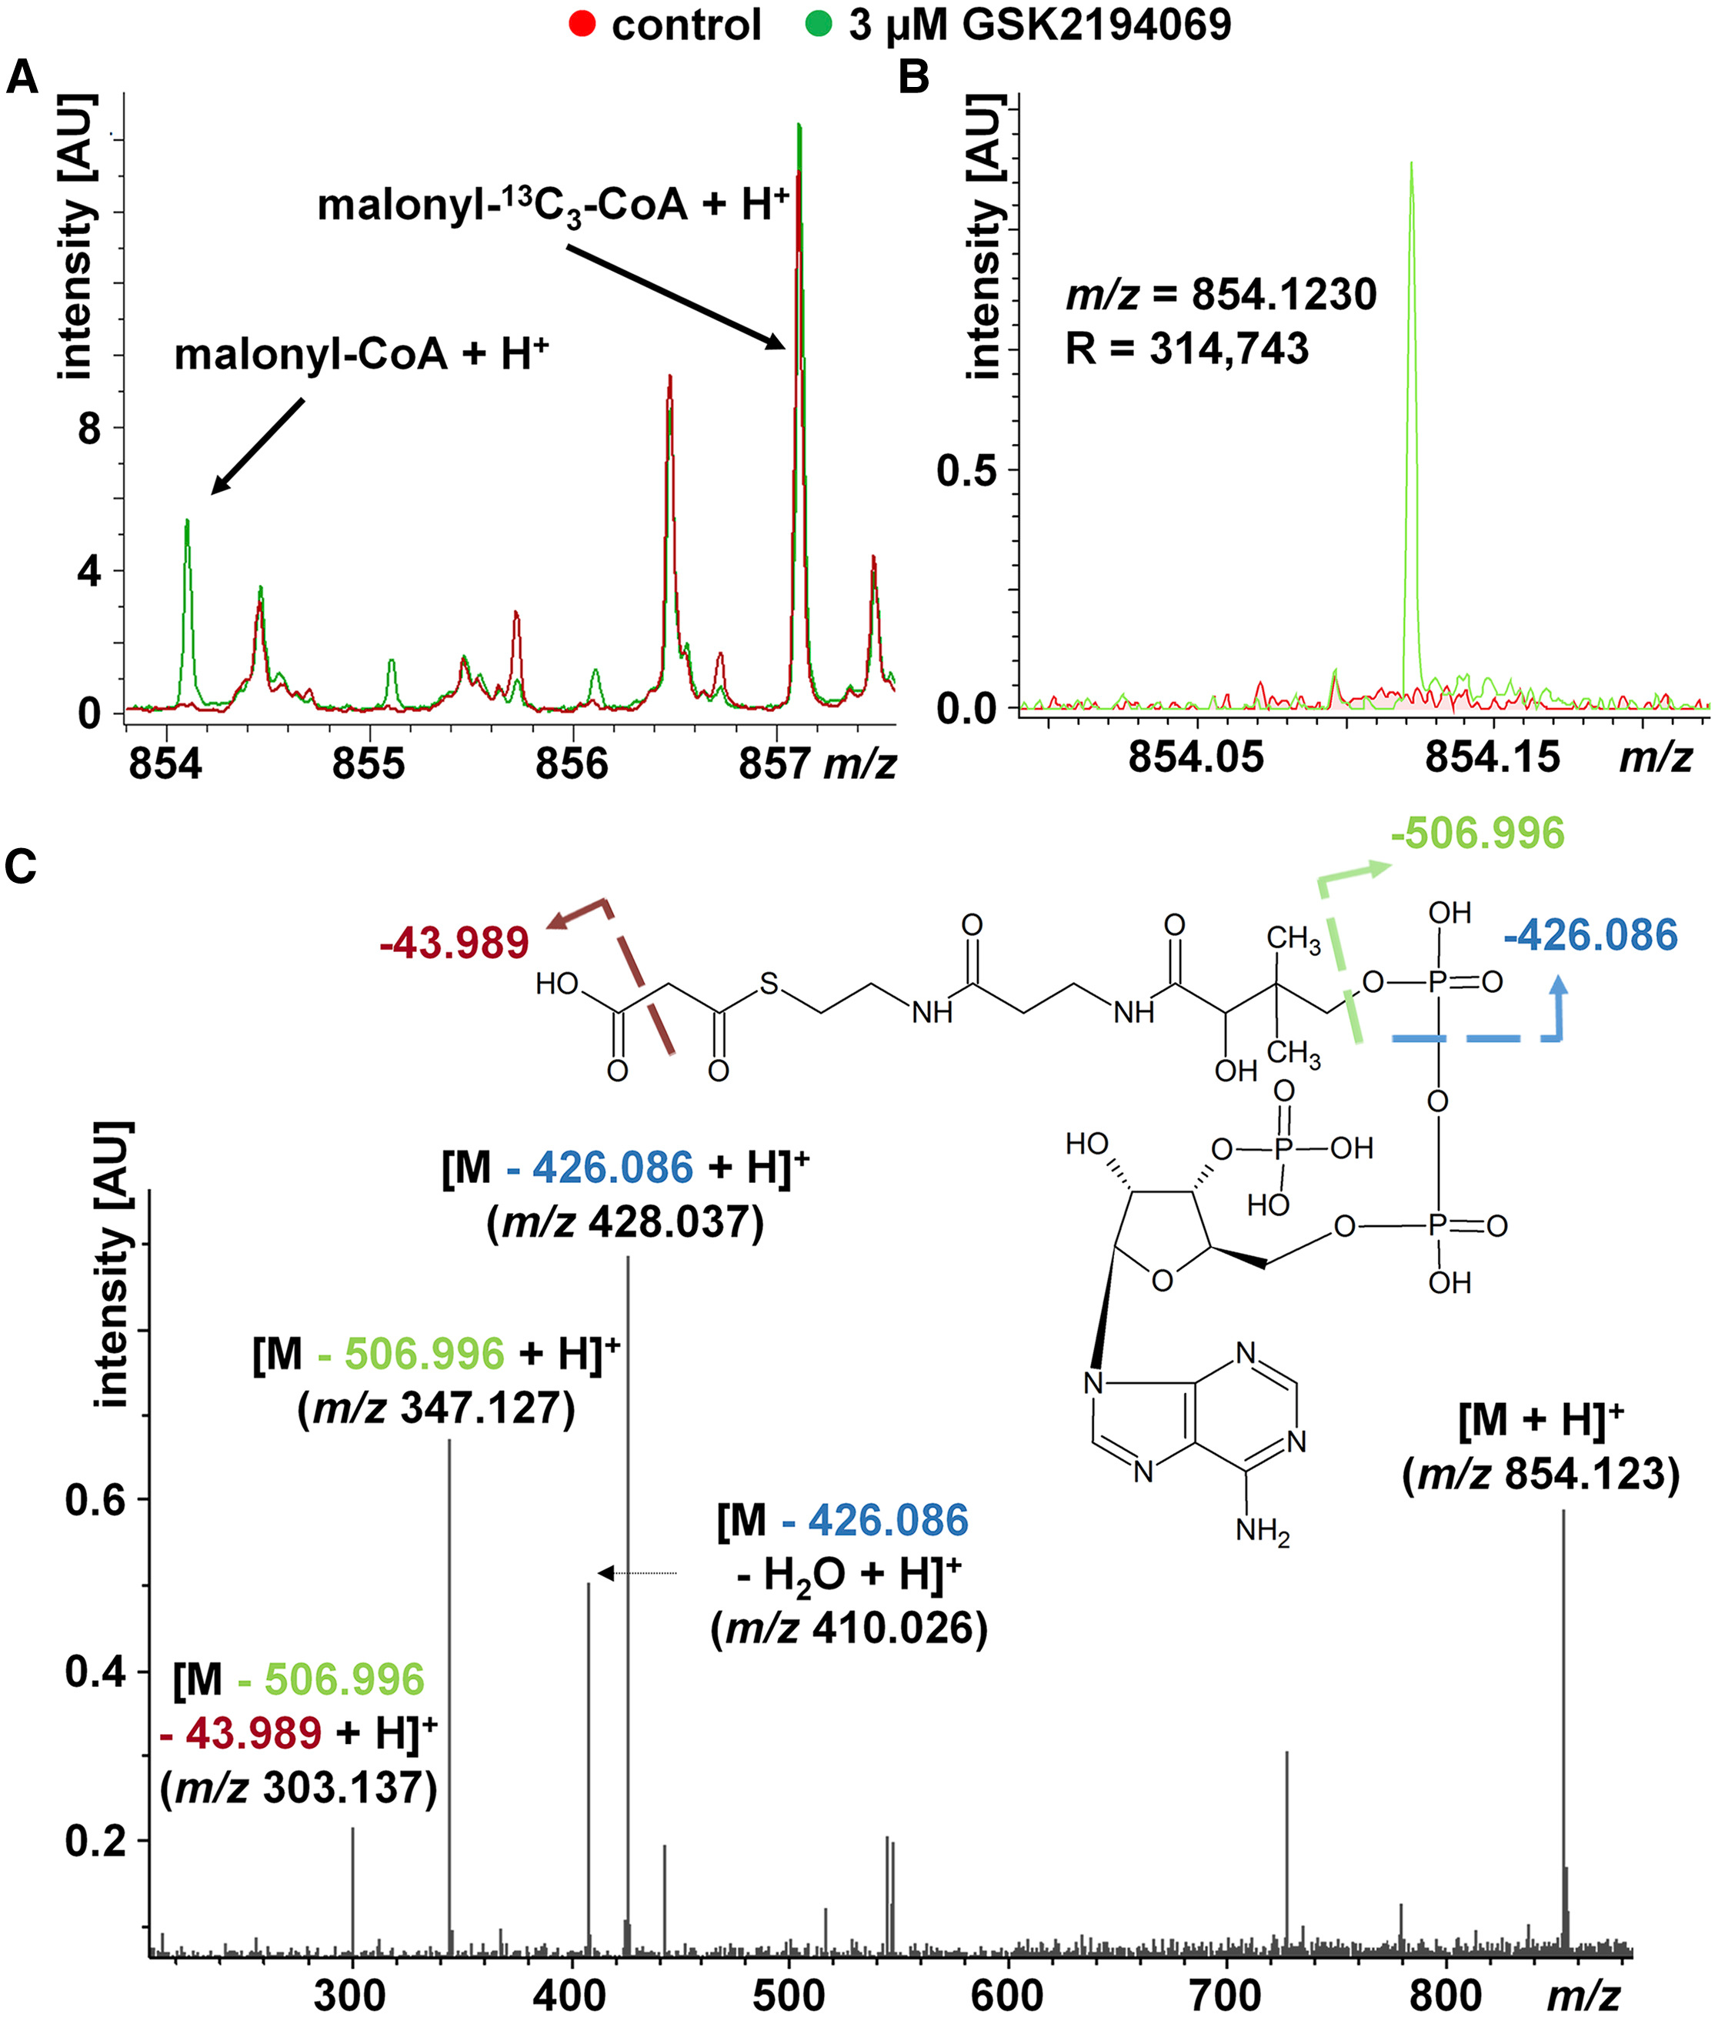
Example 2: Malonyl-CoA accumulation in cells as known marker of FASN inhibition
Weigt et al., Cell Chem Biol. 26(9), 1322-1331 (2019)

Slide 16
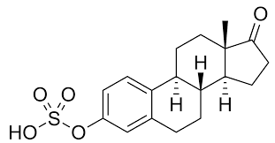
Example 3: Screening for inhibitors of the transporter OATP2B1
Exchanger
Coupled transporter
Passive transporter
Mitochondrial transporter
Vesicular transporter
Estron-3-sulfate
Substrate of OATP2B1
SLC series
Hediger et al. The ABCs of membrane transporters in health and disease (SLC series) Molecular Aspects of Medicine, 34, 2013, 95-107
Other transport proteins
Water channel
ABC transporter
Ion channel
Pump

Slide 17
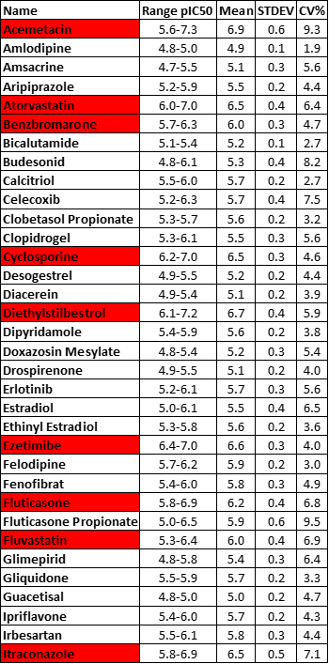
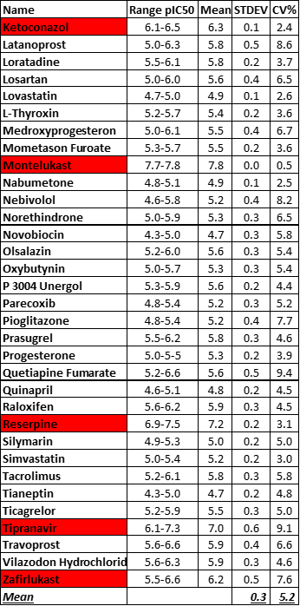
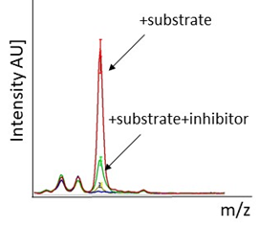
Example 3: Measurement of substrate transport in cells by MALDI MS
67 inhibitors (inhibition ≥50%) identified red: pIC₅₀ ≥6
Unger et al. Anal. Chem. (2020)

Slide 18
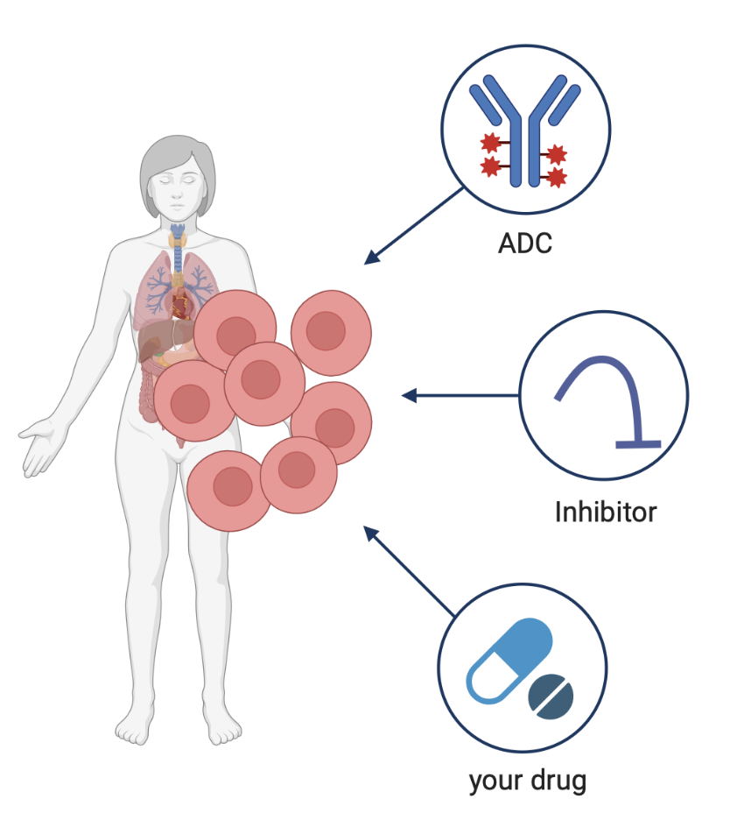
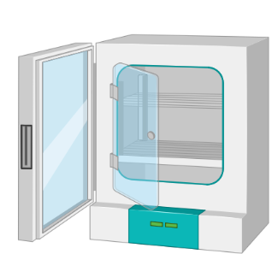
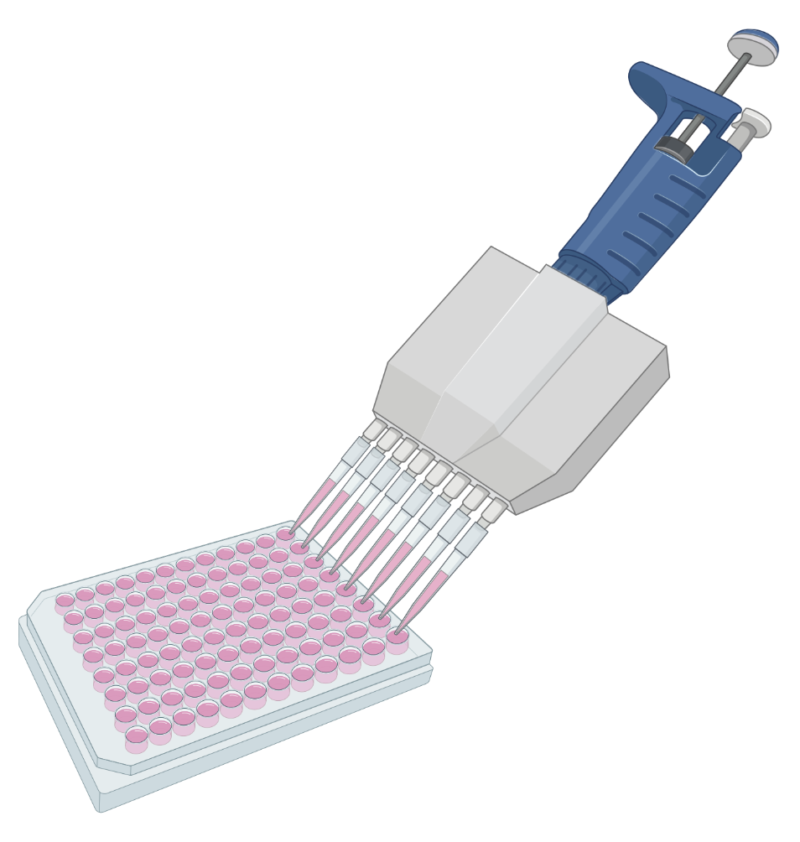
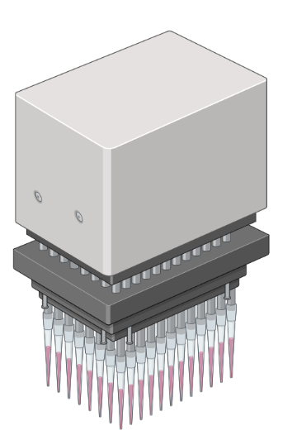
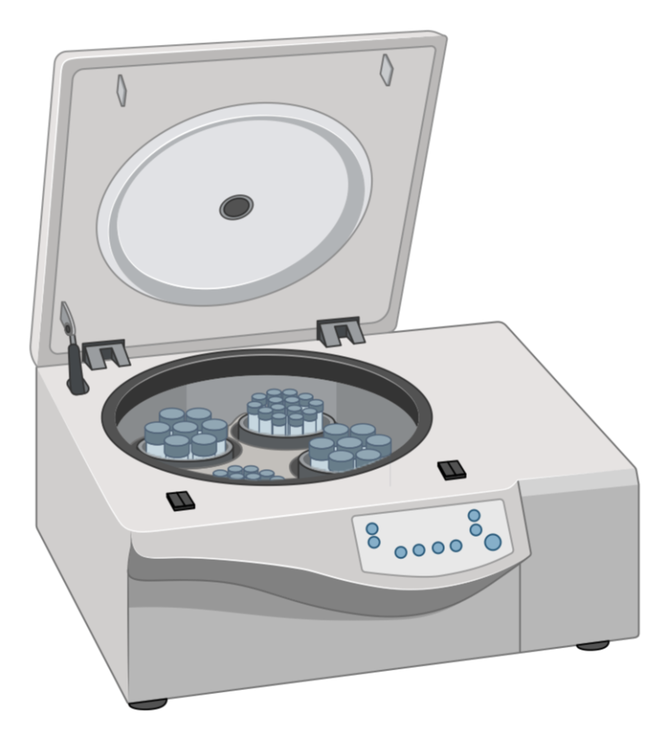
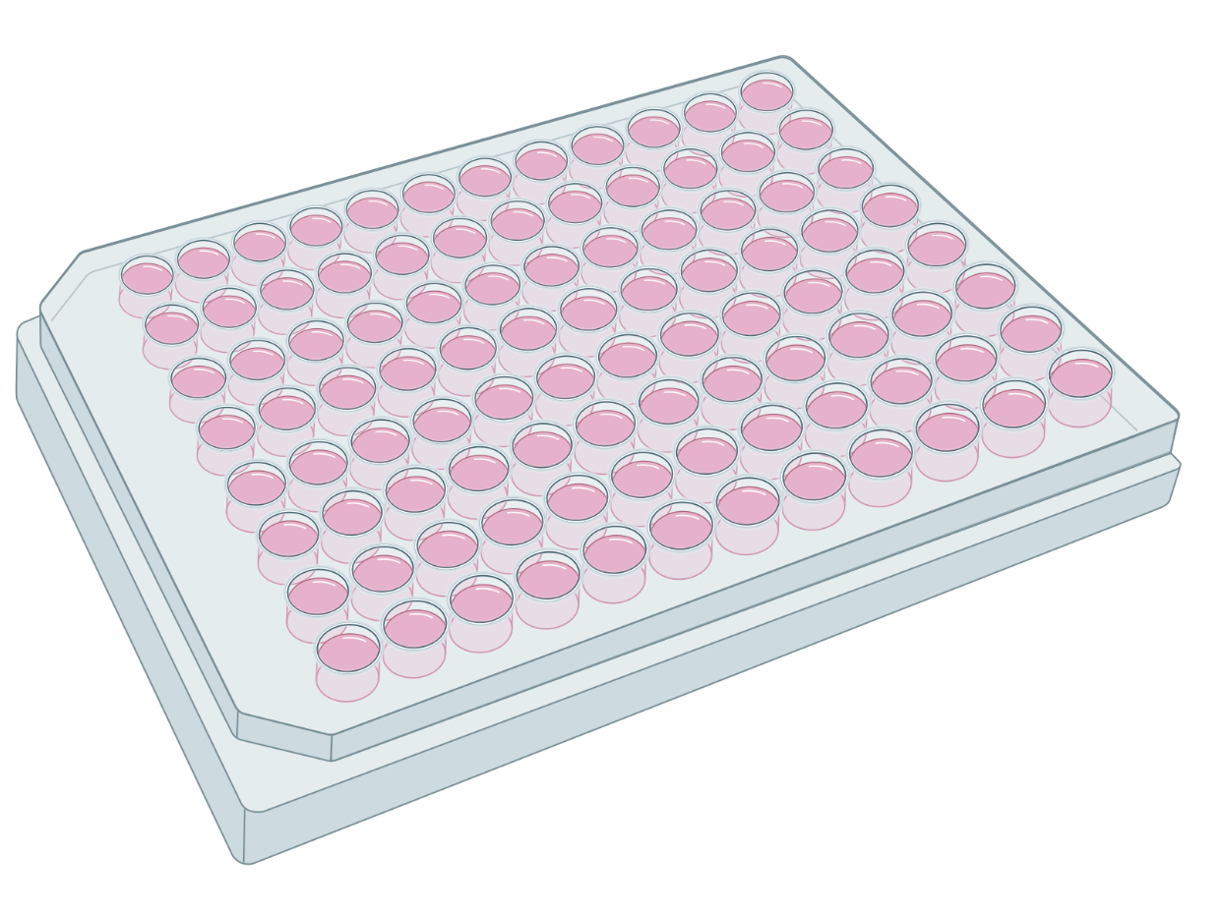
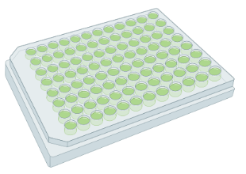
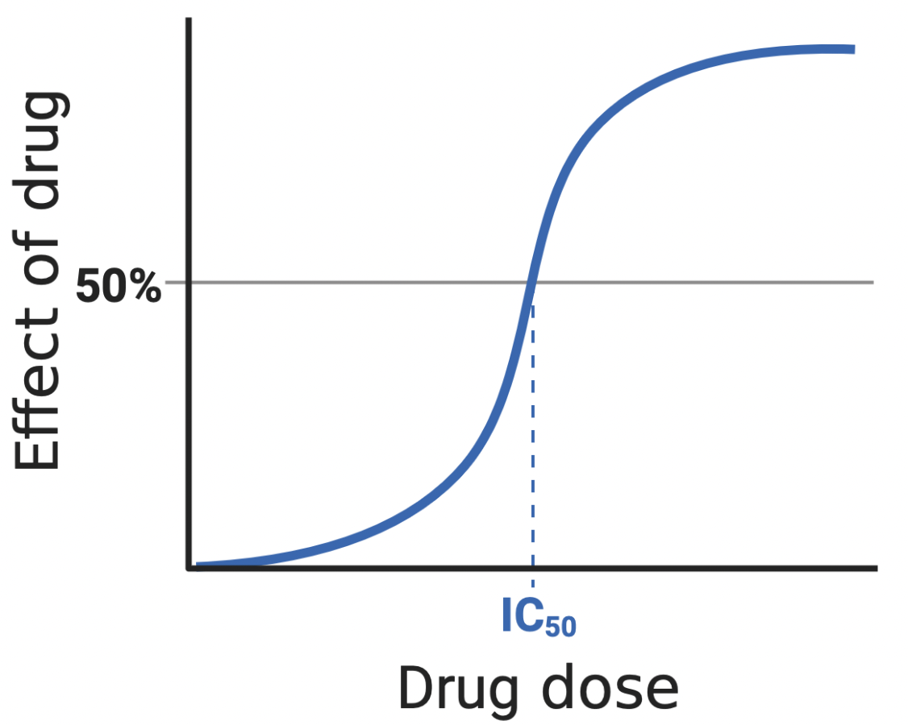
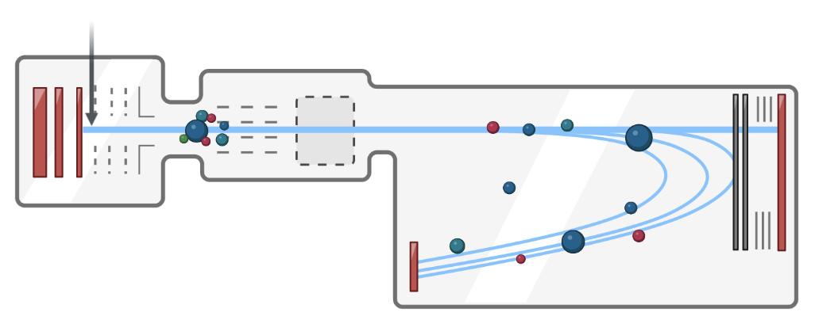
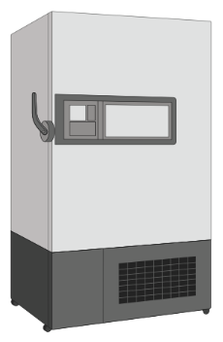
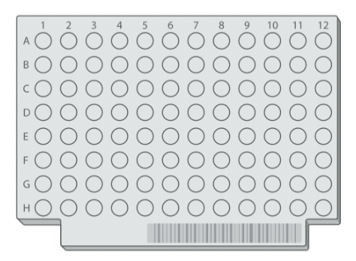
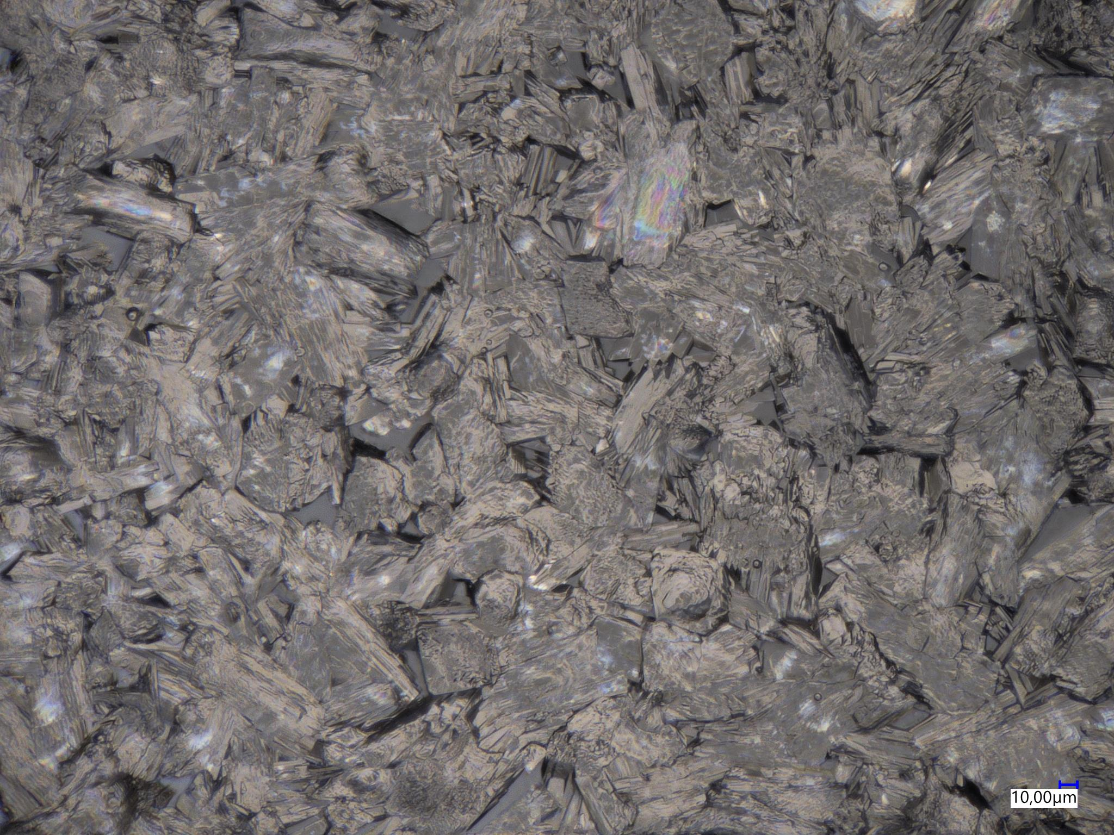

Summary: Process for MALDI MS cell assays in early DD
assay definition
cell culture
drug treatment
transfer/
centrifuge
i
ii
iii
iv
data anaylsis
MALDI MS
resuspension/
matrix application
freeze/storage
viii
vii
vi
v

Slide 19
Learning Objectives
Mass spectrometry technologies are emerging in preclinical drug discovery
What is MALDI mass spectrometry (MALDI MS)?
Use of MALDI MS in cell-based drug screening or profiling
Use of MALDI MS in drug disposition analysis
Use of MALDI MS in drug mode of action analysis

Slide 20










MALDI mass spectrometry imaging
1. Fresh-frozen or FFPE tissue
2. Mounting of
Tissue sections
3. MALDI matrix application
4. Pixel-wise
MALDI MS analysis
Sectioning
Laser
••••••••
••••••••
••••••••
5. Data processing
6. Image reconstruction
Intensity
MS imaging data cube
X
Y
m/z
Y
m/z
m/z
X

Slide 21

















MS Imaging of organs, 3D-cell cultures, plated cells or mosquitos
Kidney or brain
3D model systems
Single cells
Mosquitos
1mm
500µm
100µm
700µm
25
100
m/z₁
m/z₅
m/z₂
m/z₃
m/z₆
m/z₄
m/z₇
0
100
m/z₁
0
100
0
100
m/z₂
m/z₂
m/z₁
m/z₃
m/z₃
m/z₁
m/z₂
m/z₄
S. Iakab et al., bioarxiv (2022): 2022-12
L. Gruber et al., bioarxiv (2023): 2023-12
300µm
2mm
600µm
0
100
0
100
0
100
m/z₁
m/z₂
m/z₃
m/z₄
m/z₁
m/z₁
m/z₂
m/z₂

Slide 22

Example A: Drug disposition in rat brain
Vehicle
10 mg/kg drug
Rat 1
Rat 2
Rat 3

Slide 23







Example B: Lipid markers of kidney anatomy
ISOM + CDLH
IM + PUL
Distal tubule
Glomeruli
SM4 38:1;03 [M-H]⁻
SM3 44:1;02 [M-H]⁻
SM4 42:1;04 [M-H]⁻
GM3 34:1;02 [M-H]⁻
Overlay
mean spectrum
SM4 38:1;03 [M-H]⁻
SM4 42:1;04 [M-H]⁻
SM3 44:1;02 [M-H]⁻
GM3 34:1;02 [M-H]⁻
L. Gruber et al., bioarxiv (2023): 2023-12

Slide 24
Learning Objectives
Mass spectrometry technologies are emerging in preclinical drug discovery
What is MALDI mass spectrometry (MALDI MS)?
Use of MALDI MS in cell-based drug screening or profiling
Use of MALDI MS in drug disposition analysis
Use of MALDI MS in drug mode of action analysis

Slide 25



EU-OPENSCREEN Case Study: Dual Arginase 1/2 inhibitor OATD-02 (molecure – a Polish SME)
Vehicle
OATB-02
Anti-PD-L1
Epacadostat (EPA)
EPA + anti-PD-L1
EPA + anti-PD-L1
+OATB-02

Slide 26
































Citrulline
Control
Cmax
Ct
Control
Cmax
Ct
liver
kidney
Argininosuccinate
Control
Cmax
Ct
Drug metabolite (OATD2479)
Control
Cmax
Ct
liver
OATD-02
kidney
1 mm
Control
Cmax
Ct
Arginine
Control
Cmax
Ct
liver
liver
kidney
3 mm

Slide 27








Arginine accumulates in tumor upon Arginase inhibition by OATD-02
Drug metabolite (OATD2479)
Arginine
Control
Cmax
Ct
Control
Cmax
Ct

Slide 28
Example 2 again: Profiling of fatty acid synthase (FASN) inhibitors in A549 lung cancer cells
FASN is linked to many diseases
Various types of cancer
Non-alcoholic
steatohepatitis (NASH)
Non-alcoholic
fatty liver disease (NAFLD)
Diabetes
FASN is a target
in drug discovery

Slide 29


Besides malonyl-CoA another molecule accumulates in cancer cells after FASN inhibition → identification by MS as CDP-choline
Weigt et al., Cell Chem Biol. 26(9), 1322-1331 (2019)

Slide 30


Some compound lead to CDP-choline accumulation but NOT to malonyl-CoA accumulation
Weigt et al., Cell Chem Biol. 26(9), 1322-1331 (2019)

Slide 31
Summary and key takeaways
MS technologies are label-free, do not require reagents, and do not suffer from photonic interferences (e.g. autofluorescence)
The cover a wide range of molecules, because every biomolecule has a mass
They are fast and robust enough for early drug discovery
Up to hundreds of different biomolecules can be assessed simultaneously

Slide 32
References/resources
Unger MS, Blank M, Enzlein T, Hopf C. Label-free cell assays to determine compound uptake or drug action using MALDI-TOF mass spectrometry. Nature Protoc. 2021 Dec;16(12):5533-5558. doi: 10.1038/s41596-021-00624-z.
Schulz S, Becker M, Groseclose MR, Schadt S, Hopf C. Advanced MALDI mass spectrometry imaging in pharmaceutical research and drug development. Curr Opin Biotechnol. 2019 Feb;55:51-59. doi: 10.1016/j.copbio.2018.08.003.
Weigt D, Parrish CA, Krueger JA, Oleykowski CA, Rendina AR, Hopf C. Mechanistic MALDI-TOF Cell-Based Assay for the Discovery of Potent and Specific Fatty Acid Synthase Inhibitors. Cell Chem Biol. 2019 Sep 19;26(9):1322-1331.e4. doi: 10.1016/j.chembiol.2019.06.004.
Abu Sammour D, Cairns JL, Boskamp T, Marsching C, Kessler T, Ramallo Guevara C, Panitz V, Sadik A, Cordes J, Schmidt S, Mohammed SA, Rittel MF, Friedrich M, Platten M, Wolf I, von Deimling A, Opitz CA, Wick W, Hopf C. Spatial probabilistic mapping of metabolite ensembles in mass spectrometry imaging. Nature Commun. 2023 Apr 1;14(1):1823. doi: 10.1038/s41467-023-37394-z
Munteanu B, Meyer B, von Reitzenstein C, Burgermeister E, Bog S, Pahl A, Ebert MP, Hopf C. Label-free in situ monitoring of histone deacetylase drug target engagement by matrix-assisted laser desorption ionization-mass spectrometry biotyping and imaging. Anal Chem. 2014 May 20;86(10):4642-7. doi: 10.1021/ac500038j.

Slide 33
Questions?
Thank you:
Dr. Stefan Schmidt
Dr. Sandra Schulz
Dr. Björn Fröhlich
Dr. Bogdan Munteanu
Dr. David Weigt
Dr. Melissa Unger
Dr. Yasemin Ucal
Livia Borggrefe
Lars Gruber

