Slide 1
A Comprehensive Workshop on Preclinical Drug Discovery (CDD)
In silico Methods in Drug Discovery
Grace Mugumbate

Slide 2
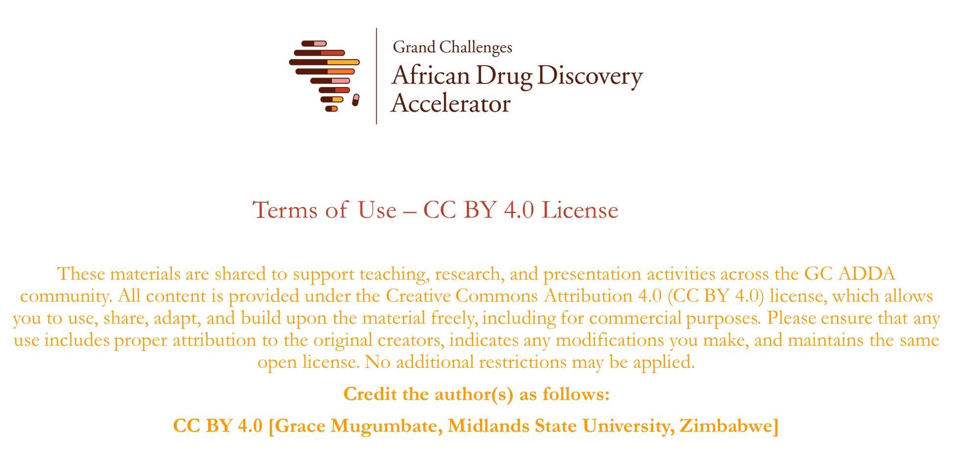

Slide 3
Objectives
Explain the concepts of a Drug Discovery and Development Pipeline.
Access bioactivity databases, such as ChEMBL, to search for compounds.
Perform virtual screening using structure-based and ligand-based methods

Slide 4
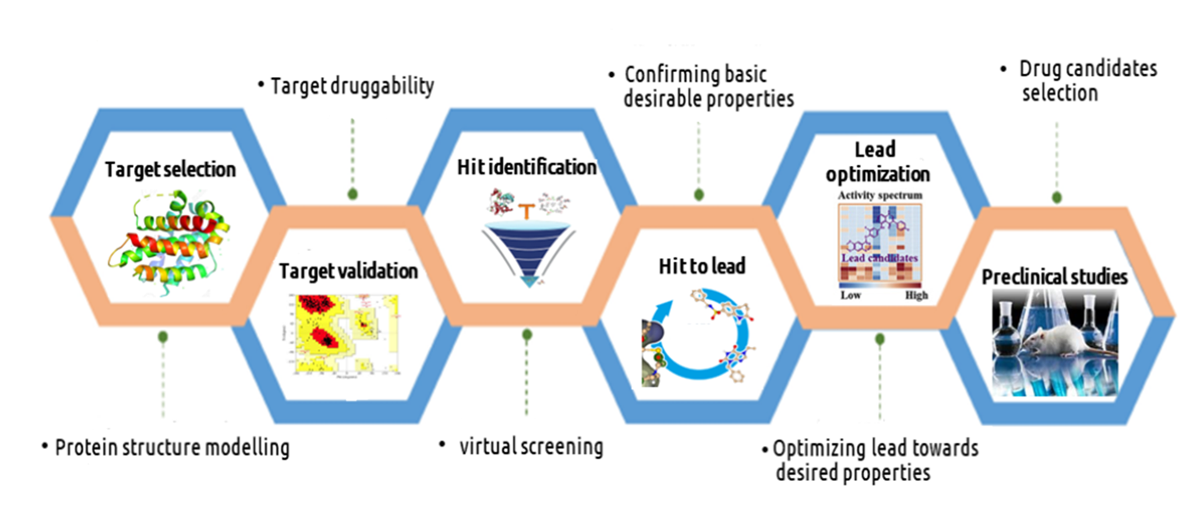
Introduction
In silico drug discovery is the identification of drug target molecule by employing computational tools and methods.
It serves as the initial stage in the drug discovery pipeline, where computational methods aid in the identification of potential drug targets.

Slide 5
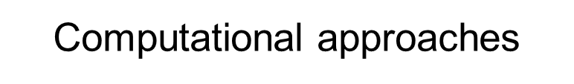
Drug Discovery and Development Pipeline
Target identification
Hit Identification
Lead Optimisation
Pre-Clinical
Clinical
Target Identification (What to work on?)
Target to Disease links - Open Targets
Hit identification/Lead Optimisation (Which compound?)
Bioactivity Data – e.g. ChEMBL, SureChEMBL, UniChem, Pubchem, Drugbank, BindingDB
Pre-clinical data (Is it safe, does it get there?)
in-vivo exposure and toxicity data - ChEMBL
Clinical Candidates & Approved Drugs (What works?)
Efficacy target, disease annotation - ChEMBL

Slide 6
Virtual Screening
Virtual screening (VS) refers to the range of in silico (computational) techniques used to search large compound databases to select a smaller number for biological testing.
VS can be used to:
select compounds for screening from in-house databases
Choose compounds to purchase from external suppliers
Decide which compounds to synthesize.
VS depends on the available information about the particular disease targets.

Slide 7
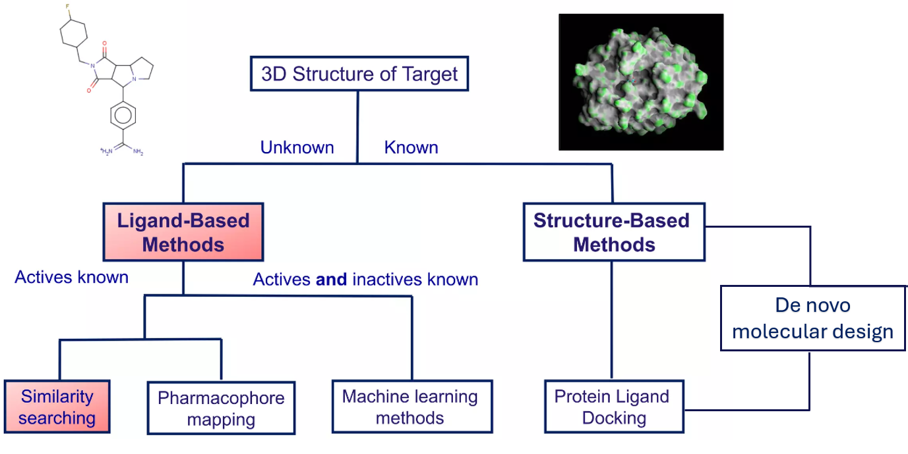
In silico methods in drug discovery

Slide 8
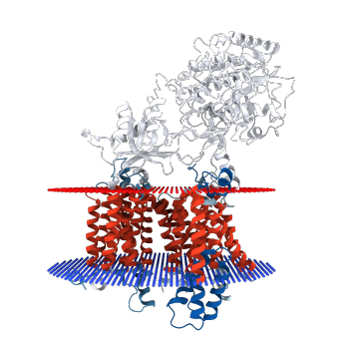
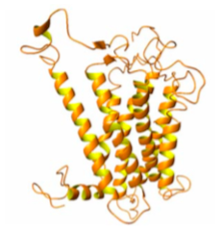
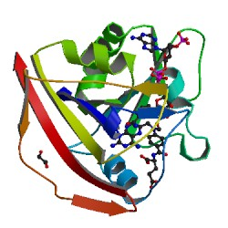
Sources of Protein 3D structures
Researchers deposit 3D structures of proteins obtained from the X-ray crystallography, NMR and Electron Microscopy experiments into the Protein databank (PDB) or from homology modeling.
The PDB contains > 217,966 macromolecules
Simple proteins
Proteins complexes
Homology model
Enables thorough inspection of the binding site topology, including other clefts, cavities, allosteric pockets and electrostatic properties of the site.

Slide 9
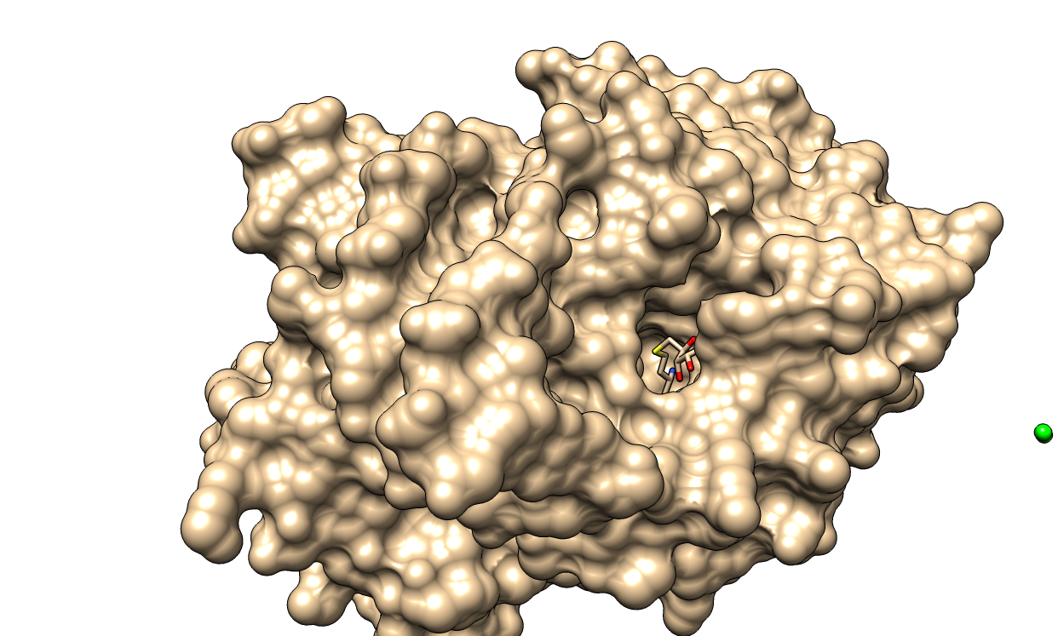
Structure-based Drug Discovery (SBDD)
SBDD: the systematic use of structural data obtained from 3D structures of macromolecular targets e.g. receptors, enzymes, kinases, nucleic acids, etc to identify their ligands (small molecule that bind to the target) using docking calculations.
SBDD also allows for the design of ligands with the desired properties for effective modulation of the protein or nucleic acid.
Thus, generates selective modulators with high binding affinity that will interfere with specific cellular processes and ultimately leading to the desired pharmacological and therapeutic effects

Slide 10
SBDD techniques: Molecular Docking
Molecular docking: since 1980 molecular docking became the most essential structure-based technique in drug discovery to determine;
Ligand binding modes
Intermolecular interactions that stabilise the ligand-receptor complex
Quantitatively predict binding energetics and provide a ranking of docked compounds based on the binding affinity.

Slide 11
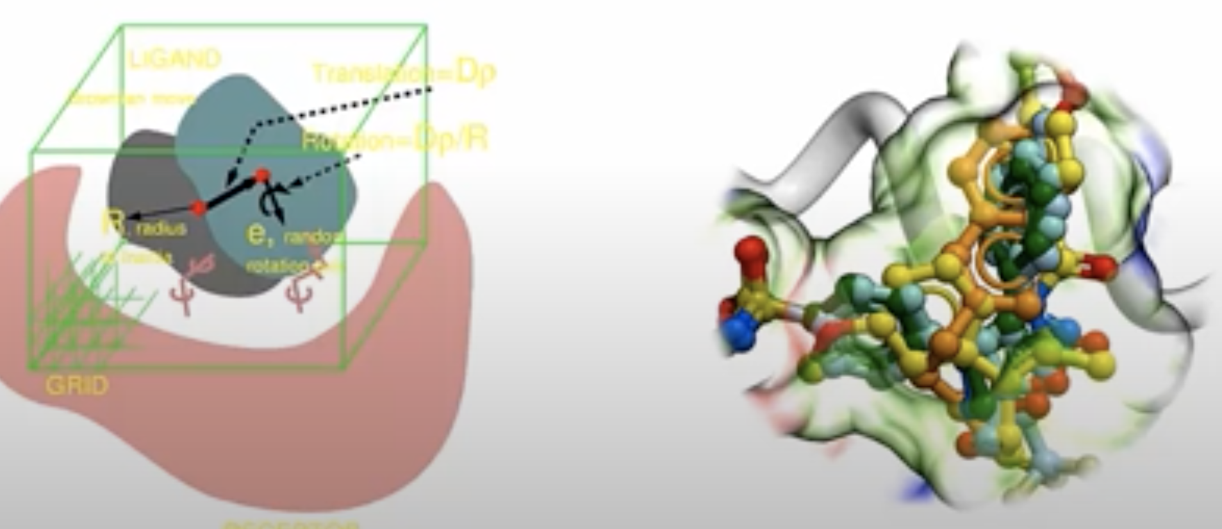
Molecular Docking stages
Docking: Modeling of binding of macromolecules between themselves or with small – molecule ligands (chemical compounds) to form a ligand-target complex
Molecular docking is performed using computational algorithms e.g. Autodock Vina, Autodock 4.2, Glide, ICM dock, MOE etc.
Molsoft slides
The technique involves two steps:
Exploration of conformational pace representing various potential binding modes – conformational search.
Accurate prediction of the interaction energy associated with each of the predicted binding conformations - Scoring of conformations. The ligand is evaluated using a specific scoring function.
Defined binding pocket
Ligands inside the binding pocket

Slide 12
Molecular Docking: scoring function
ΔG_{b} = ΔG_{solv} + ΔG_{conf} + ΔG_{int} + ΔG_{rot} + ΔG_{t/r} + ΔG_{vib}
Where,
ΔG_{solv} is the contribution of the solvent due to solvent effects,
ΔG_{conf} is from the conformational changes in the protein and the ligand,
ΔG_{int} is the free energy due to specific protein-ligand interactions,
ΔG_{rot} is the free energy loss associated with freezing internal rotations of the ligand and the protein,
ΔG_{t/r} is the loss in translational and rotational free energy caused by
association of two bodies to give the bound com.
Ferreira LG, (2015), Molecules, 20, 13384-13421,

Slide 13
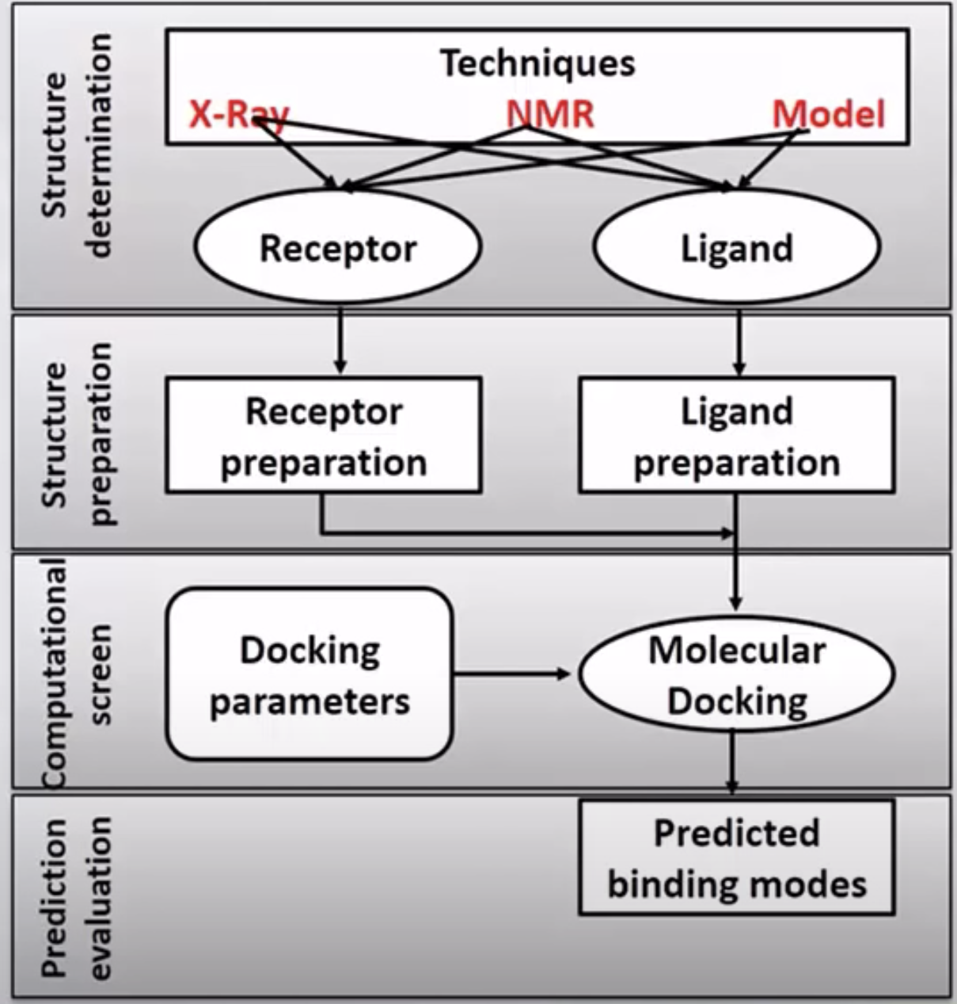
Docking Protocol
Step 1: Select 3D structure of targets and ligands to use from PDB and/or small molecule databases
Step 2: i) Prepare structure by resolving structural issues – missing residues, missing side chain atoms e.g. hydrogen, clashes, rare residue states e.g. protonated Asp or Glu (HIV protease), water molecules from crystallization etc.
ii) Identify a druggable binding pocket and define it using a grid box
Step 3: i) Set docking parameters,
ii) evaluate the docking protocol and
iii) Production stage – dock unknown ligands
Step 4: Analysis of docking results: binding energies, binding conformations, binding affinities and binding interactions

Slide 14
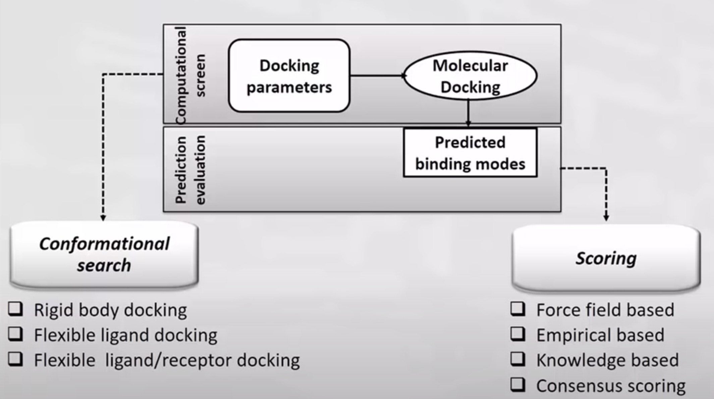
Docking Process

Slide 15
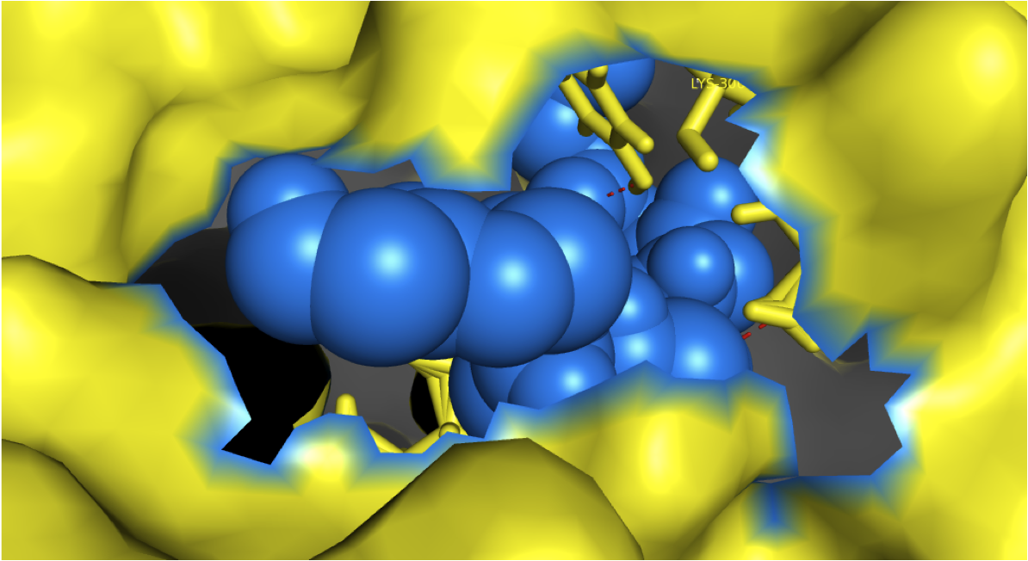
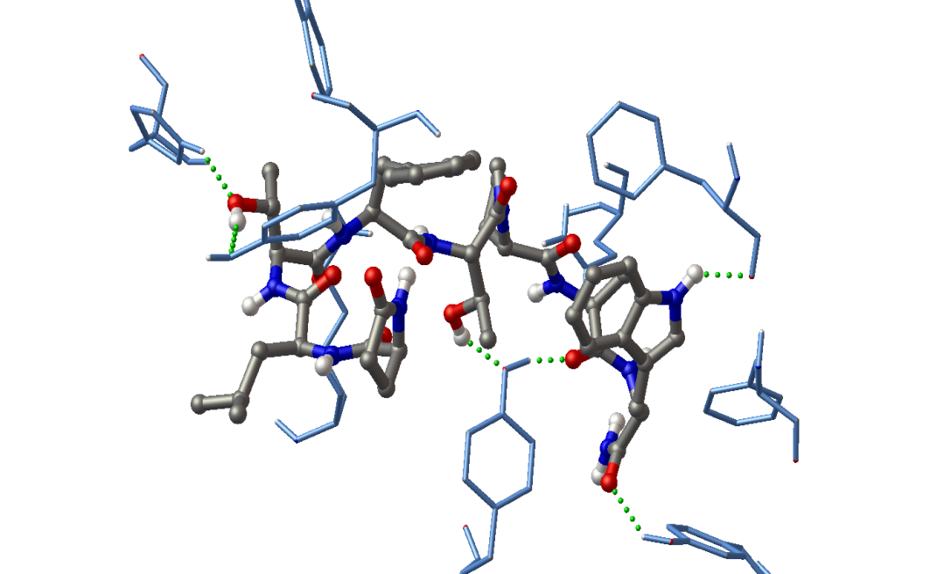
Structure-based Drug Discovery cont…
The obtained target-ligand complexes are used to determine binding affinity and study intermolecular interactions: with which residue/atom, through what interaction
N-terminus
TRP22
ECL2
HIS16
GLN209
PHE126
TYR110
PHE130
LYS307
TYR285
TYR221
Binding affinities (ΔG_{b} , Ki)
Anoga -AKH: - 47.30kJ/mol, 5.22 nM
α-Helix region
Mugumbate, G. et al Peptides, 32 (3), 553-559, 2011, 2) Mugumbate, G. C, PhD thesis, UCT, 2010

Slide 16
Target-Ligand interactions
Target-ligand complexes are stabilized by intermolecular forces
Electrostatic forces
1) Hydrogen bonds (green dots)
2) Ionic bonds/salt bridges between charged atoms
3) Polar contacts e.g. with OH group
Hydrophobic bonds – non polar bonds
Van der Waals forces e.g. carbon chains, halogens
Pi – pi interactions involving aromatic rings.
Target residues
Ligand

Slide 17
Ligand-based drug discovery
LBDD relies on the knowledge of other molecules that are known to bind to the biological target of interest.
These other molecules may be used to derive a pharmacophore model.
Ligand-based approaches are valuable for optimizing known ligands or lead compounds by analysing the structure-activity relationship (SAR) of existing ligands.

Slide 18



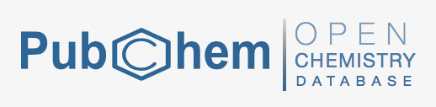







Resources and tools
Small molecules
Examples

Slide 19
Molecular Similarity Search
Look for compounds that are most similar to the query compound (known drug or of known bioactivity)
Each compound in the database is ranked based on a calculated score
In other application areas, the technique is known as pattern matching or signature analysis

Slide 20
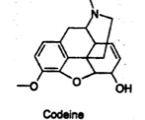
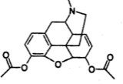
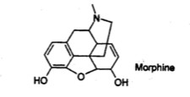
Similar Property Principle
Structurally similar molecules usually have similar properties, e.g., biological activity
Similar compounds will tend to have similar activities in assays
Similar proteins will tend to interact with similar compounds
Known also as “neighborhood behavior”
Examples: morphine, codeine, heroin
Codeine
Heroin
Morphine

Slide 21
Advantages of Similarity Search
One known active compound becomes the search key
User sets the limits on output
Possible to re-cycle the top answers to find other possibilities
Subjective determination of the degree of similarity
Needs to be used with care…
Similarity measures can be very context dependent
What works on one project may not work in another

Slide 22
Applications of Similarity Search
Evaluation of the uniqueness of proposed or newly synthesized compounds
Finding starting materials or intermediates in synthesis design
Handling of chemical reactions and mixtures
Finding the right chemicals for one’s needs, even if not sure what is needed

Slide 23
Similarity and Dissimilarity
Consider two objects A and B:
a is the number of features (characteristics) present in A and absent in B
b is the number of features absent in A and present in B
c is the number of features common to both objects and
d is the number of features absent from both objects.
Thus, c and d measure the present and the absent matches, respectively, i.e., similarity; while a and b measure the corresponding mismatches, i.e., dissimilarity.
(Chemoinformatics; A Textbook (2003), p. 304)

Slide 24
Tanimoto Coefficient
Tanimoto Coefficient of similarity for Molecules A and B:
S_{AB} = c _
a + b – c
a = bits set to 1 in A, b = bits set to 1 in B, c = number of 1 bits common to both
Range is 0 to 1. Value of 1 does not mean the molecules are identical.
Other similarity coefficients:
Dice coefficient, Cosine similarity, Euclidean distance, Hamming distance, Soergel distance.

Slide 25
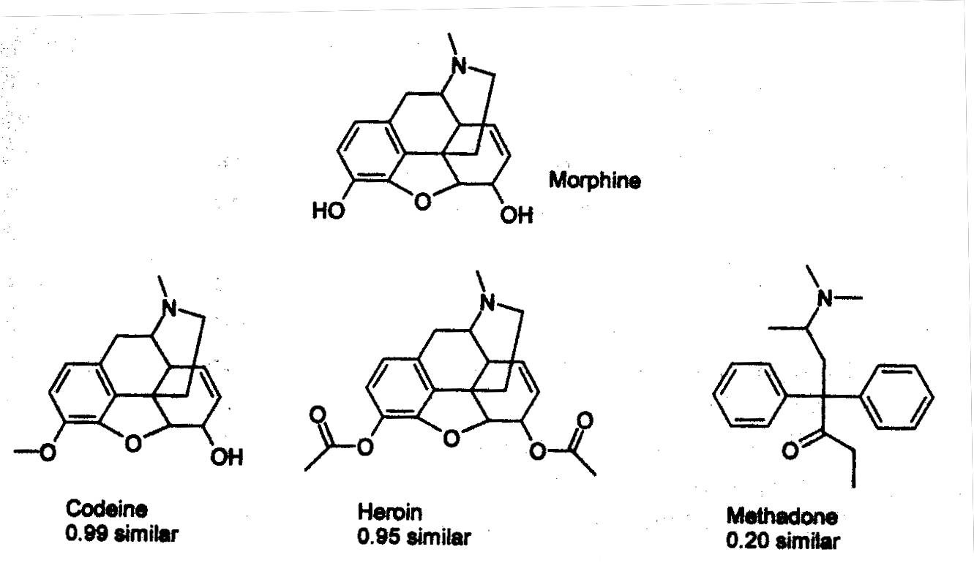
Tanimoto Coefficient to Find Compounds Similar to Morphine

Slide 26
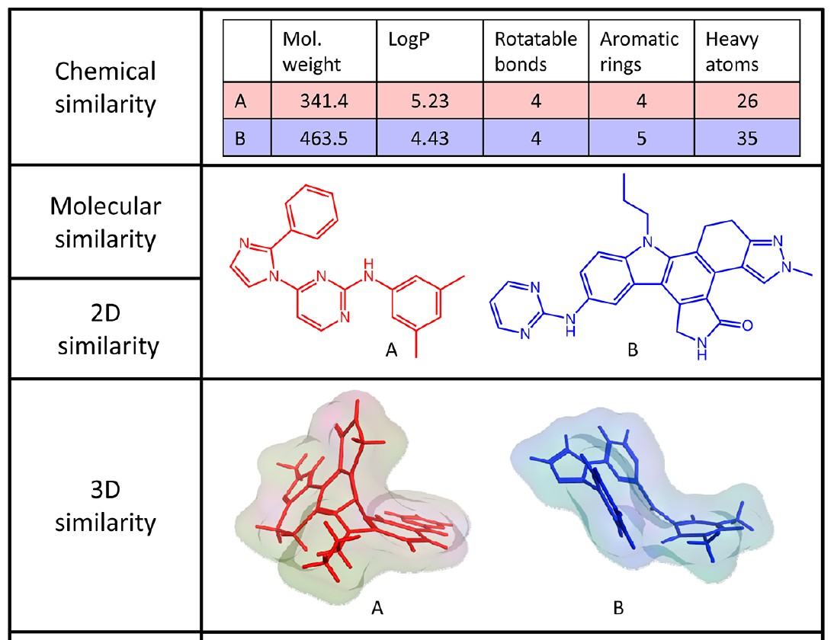
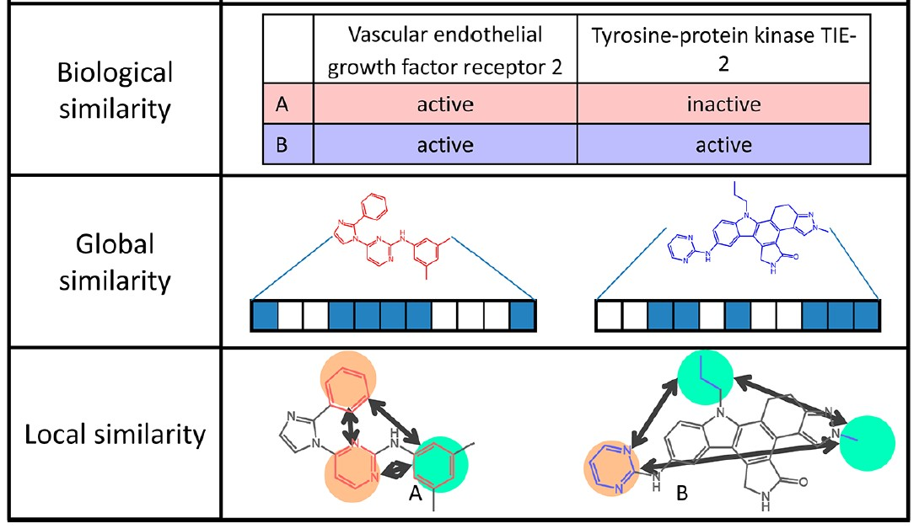
Similarity principle for small molecules
Many complementary techniques exist
Maggiora, G. et al., ‘Molecular Similarity in Medicinal Chemistry’, J. Med. Chem., 2014, 57 (8), p. 3186.

Slide 27
2D Similarity Measures
Commonly based on “fingerprints,” binary vectors with 1 indicating the presence of the fragment and 0 the absence
Could relate structural keys, hashed fingerprints, or continuous data (e.g., topological indexes that take into account size, degree of branching, and overall shape)

Slide 28
Activity: Exploiting the similarity principle: compounds
Search for compounds similar to phenotypic actives in a bioactivity database such as ChEMBL.
The targets against which these similar compounds are active might be involved in MoA of phenotypic actives
Many variations and elaborations are possible
e.g. group compounds and/or targets to increase robustness
Similarity Ensemble Approach (SEA)
Again, these approaches can only generate hypotheses
need to follow up with experiments

Slide 29
Pharmacophore
Definition: A pharmacophore is the ensemble of steric and electronic features that is necessary to ensure the optimal interactions with a specific biological target structure and to induce or inhibit its biological response
Glossary of terms used in Medicinal Chemistry (IUPAC Recommendations 1998) Pure & Appl. Chem. 1998, 70(5), 1129-1143 http://dx.doi.org/10.1351/pac199670051129).

Slide 30
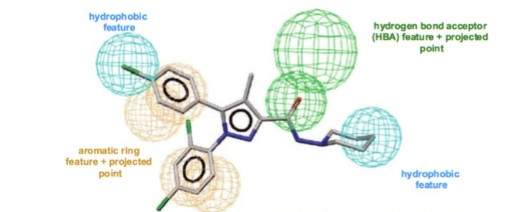
Example: Rimonabant
Cannabinoid Receptor 1 (CB1) antagonist pharmacophore
Other common feature types (not used here)
hydrogen bond donor
positive/negative features (charged/ionized
Customized features
Inclusion/exclusion volume spheres (shapes)

Slide 31
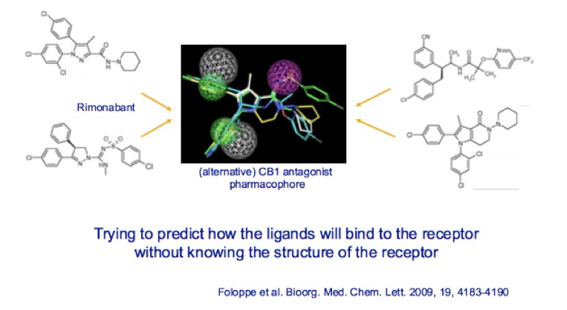
Generating pharmacophore models: Ligand - based

Slide 32

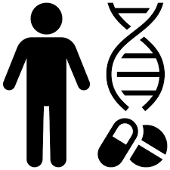

Current trends in in silico drug discovery.
Application of personalized drugs
In silico methods may play a key role in tailoring drug therapies to individual genetic profiles.
Integration of AI
Advancement in artificial intelligence and machine learning algorithms that enhance the predictive power and efficiency of in silico methods.
Multi-target discovery
In silico approaches will be able to facilitate the design of multi-target drugs addressing complex disease with multiple molecular targets.

Slide 33
Recap
Introduction to In silico Drug Discovery
Virtual Screening
Structure-based methods
Protein-ligand docking
Ligand-based methods
Similarity search
Pharmacophore mapping
Current trends in in silico drug discovery

Slide 34


Slide 35
Questions?

