Slide 1
A Comprehensive Workshop on Preclinical Drug Discovery (CDD)
Screening compound library assessment
L Birkholtz

Slide 2
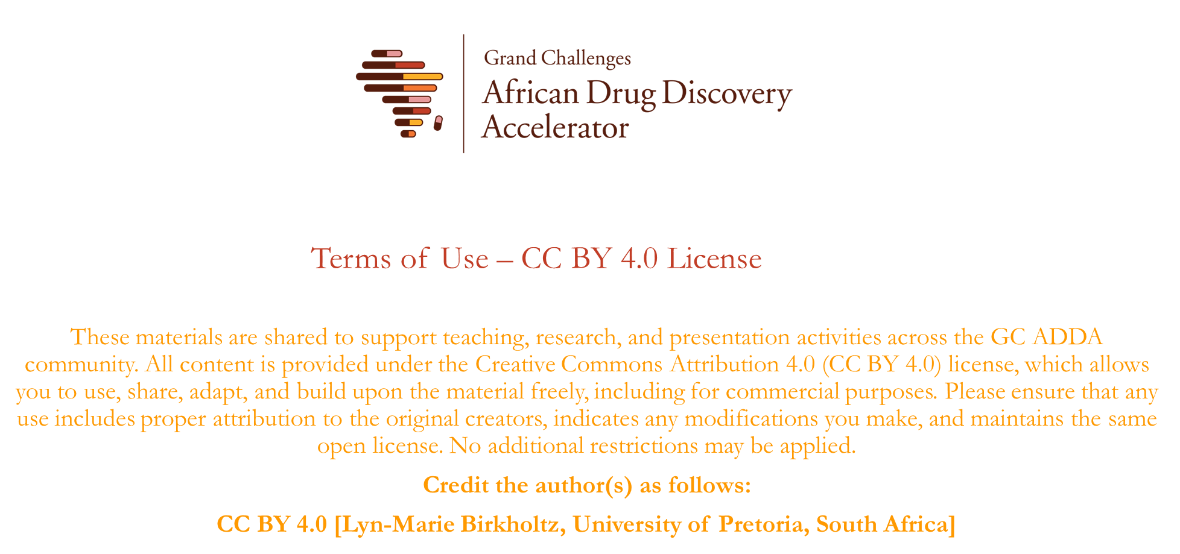

Slide 3
Learning objectives
After the screening compound library assessment lecture, you should be able to understand:
  how to design a screening campaign
  how to identify appropriate compound libraries
  how to apply an appropriate biological assay
  how to assess data quality from a library screen
  how to define, confirm and validate a hit from a screen

Slide 4
Enabling technology
/ Target validation
Screening
Hit to Lead
Lead Optimisation
Pre-clinical candidate
‘Screening’
  ……‘the process of evaluating several entities in parallel for a desired outcome’
  Assaying several small molecules simultaneously for an inhibitory effect

Slide 5

Enabling technology
/ Target validation
Screening
Hit to Lead
Lead Optimisation
Pre-clinical candidate
‘Screening’
  ……‘the process of evaluating several entities in parallel for a desired outcome’
  Assaying several small molecules simultaneously for an inhibitory effect
  Confirmed hit
  Has the desired activity (most promising lead candidate – but not a drug!)
  Everything within a screening campaign is designed with this outcome in mind as a measure of success

Slide 6
Enabling technology
/ Target validation
Screening
Hit to Lead
Lead Optimisation
Pre-clinical candidate
‘Screening’
  ……‘the process of evaluating several entities in parallel for a desired outcome’
  Assaying several small molecules simultaneously for an inhibitory effect
Fragment
5%
DEL
1%
Directed
8%
SBDD
14%
Knowledge based
43%
Random
29%
doi.org/10.1021/acs.jmedchem.8b00675

Slide 7

Enabling technology
/ Target validation
Screening
Hit to Lead
Lead Optimisation
Pre-clinical candidate
‘Screening’
  ……‘the process of evaluating several entities in parallel for a desired outcome’
  Assaying several small molecules simultaneously for an inhibitory effect

Slide 8
Critical considerations of a screening campaign
Assay development and validation for a screen
Primary screen
Hit confirmation
XC50 determination
Cost
  Procuring of library (and library size)
  Starting biological material cost
  Assay cost per unit
Time
  Screening is starting point to all drug discovery programmes – timeframes are critical
  Throughput (medium to HTS?)
Accuracy
  Reproducibility
  Variability
  False + / -
Counter screen

Slide 9
Small molecule library considerations
Quality
  Rigorous medicinal chemistry input
  Stability & purity
    Influences assay readout validity
Composition & size
  Diversity vs drug-like properties
  Number-crunching vs conservative
Origin
  Where do you get a library to screen?
    Opensource vs commercial (e.g. GSK, GlobalHealth, Dundee, SelleckChem, BioFocus, Enamine, Wuxi, Caymans, Merck KGaA, BI Open)
    Legacy libraries/compounds
  Useful online databases:
    ChemSpider, Chembl, Zinc, eMolecules, TargetMol, Molport, Enamine, WUXI, Drugbank, BindingDB,
Optimal library considerations
Devoid of problematic functionalities
Physicochemical space predicted
Aqueous solubility acceptable
ADME properties predicted
Complexity analysed
Diversity analysed

Slide 10
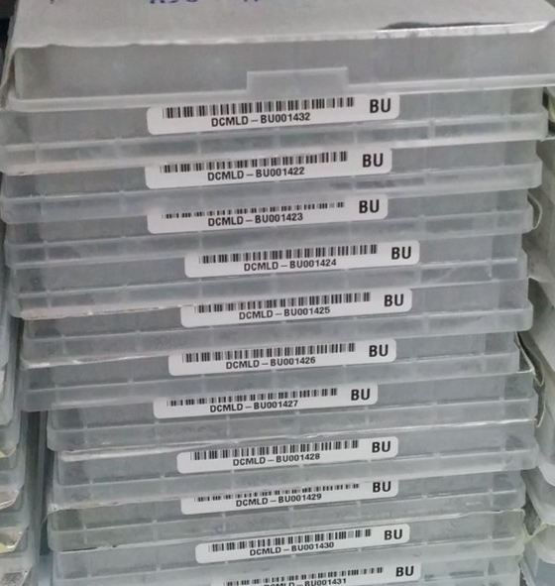
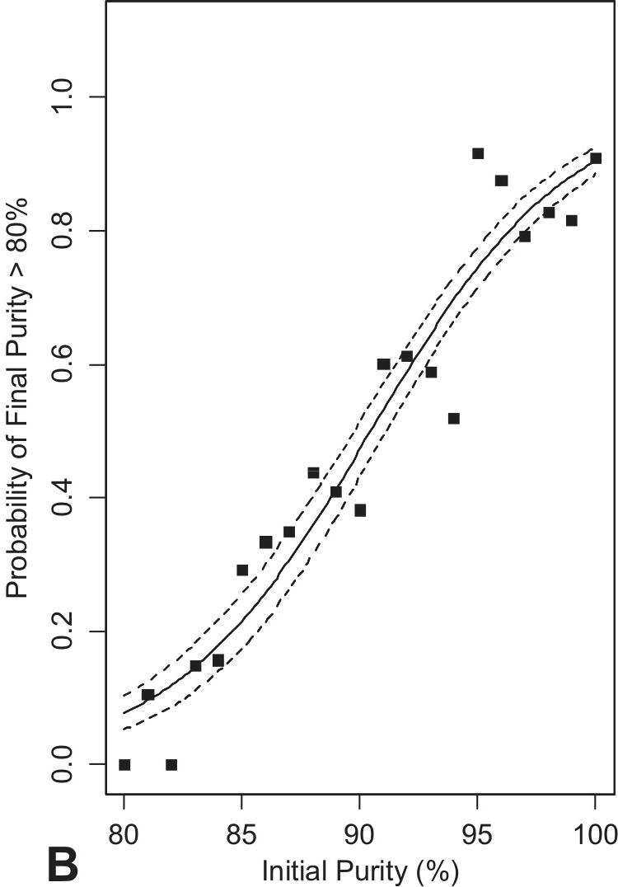
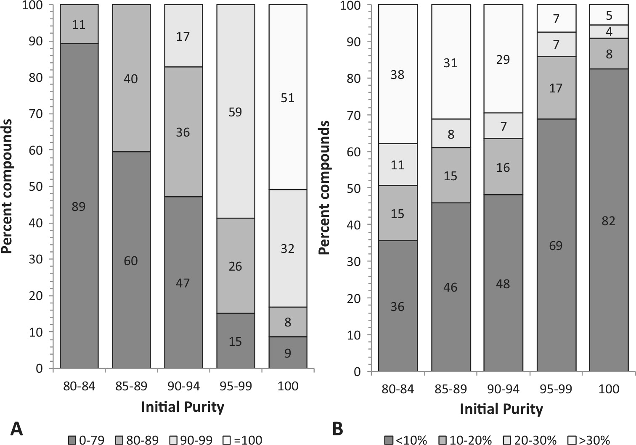
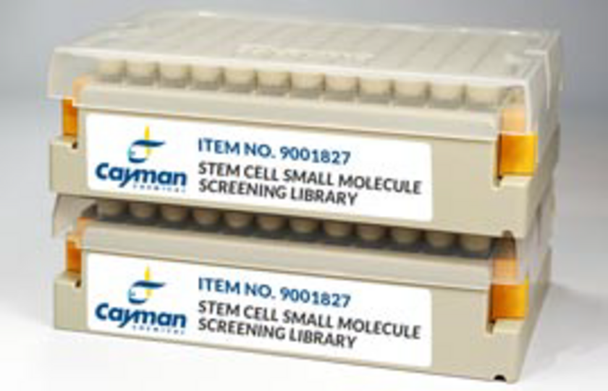
Small molecule library - QUALITY
Stability & purity
    Influences assay readout validity
    >80% purity required at minimum, >95% preferred
    Stable in solid stock or liquid (DMSO) under various conditions
      Careful of freeze-thaw cycles in batches (sealed plates vs individual tubes), light sensitivity and humidity
    Random verification of selected compounds required before screen
      Identity & purity after storage – LC-MS & NMR
~2000 compounds from 125 000 legacy set
Stored in DMSO at -20ºC for several years
Purity analysed by LC-MS
https://doi.org/10.1177/1087057113492201

Slide 11
Small molecule library - COMPOSITION
Diversity
  Provides breath (beyond ’low hanging fruits’) – library usually larger
  May be needed for challenging targets
  Could pose significant challenges in med chem program
Lead-like properties
  Devoid of structural alerts (e.g. PAINS (pan-assay interference compounds) alerts, reactive/toxicity flags (e.g. aromatic nitro groups; acid chlorides etc).
    ‘Lipinski like’ (e.g. lead like at MW < 400 Da; clogP < 4.0; clogD ~3.0; HBA < 10; HBD ≤ 5; tPSA < 100)
    MPO scoring
      Multi-parameter optimisation scoring (e.g. with DataWarrior or Stardrop)
Focussed libraries
  Typically smaller
  Can provide rapid hits for H2L programs
Size - how many compounds should one screen? (or…..how many can you handle?)
  Capacity & capabilities of the assay, liquid handling/robotics
  Dimensionality reduction vs retaining clusters?
    Clusters of compounds provide a space around which activity can be confirmed rather than just singletons (by chance)
    Tanimoto similarity scoring (>0.85)
    Representatives from a cluster may be identified

Slide 12
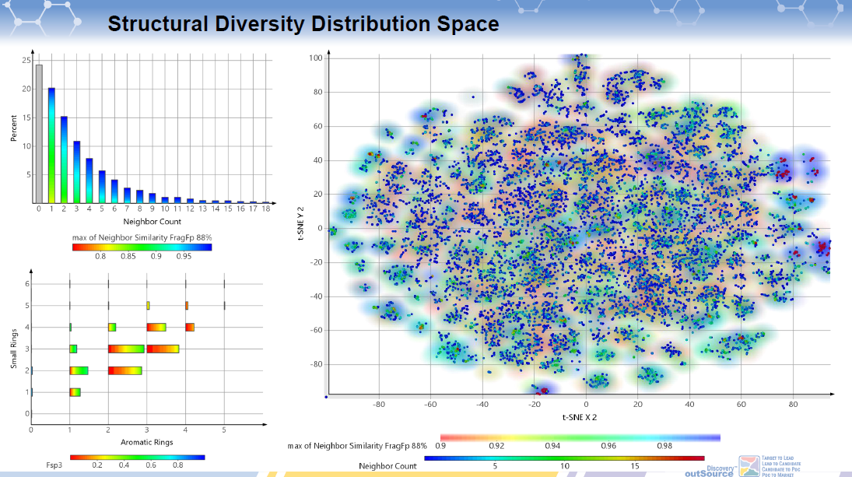

Slide 13
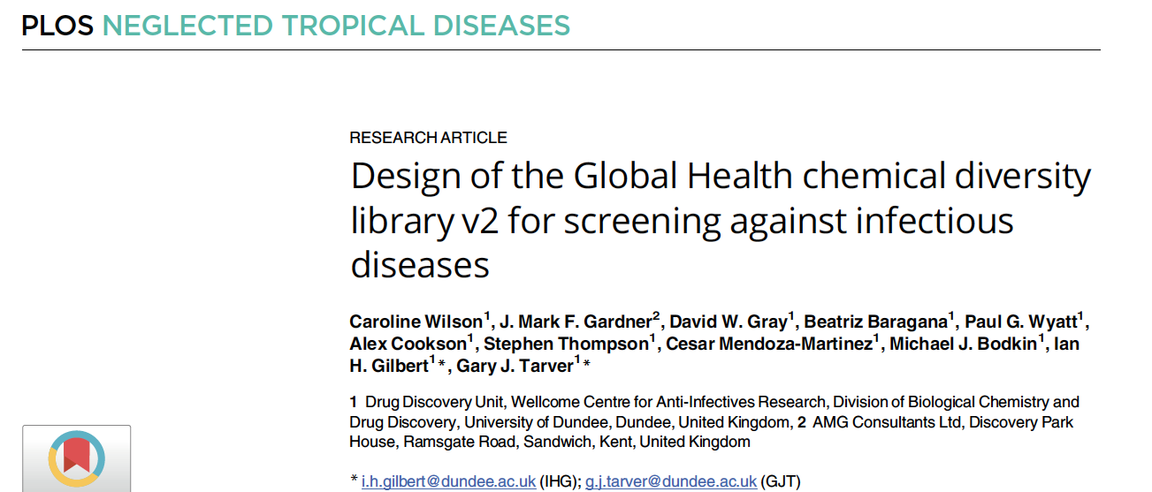
Selected from the Enamine REAL library (readily accessible virtual library of 4.5 billion compounds)
Readily synthesized using commercial starting blocks in 1-2 steps
Novel structural diversity (MMV & TBDA Stardrop filter for antimalarial/antiTB fragments applied)
Filtered for structural alerts
Applied ‘wide physicochemical properties’
  MW 320-450; logP 0-4; HBD 0-3; HBA 0-8; rotatable bonds<8, structural filters (naphtalen ester, bromine, sulfonimadamide, pthaliminde)
Diversity & clustering algorithms applied (DataWarrior)
30 000 compound diversity set generated
10.1371/journal.pntd.0011799

Slide 14
Assay requirements in a screen
Biological and pharmacological relevance
  Has to provide meaningful data on disease biology
'Screening friendly’
  Assay setup and readout
  Scale
  Timeframe
Robustness
  Sensitivity
  Interference
Performance
  Reproducibility
  Variability

Slide 15
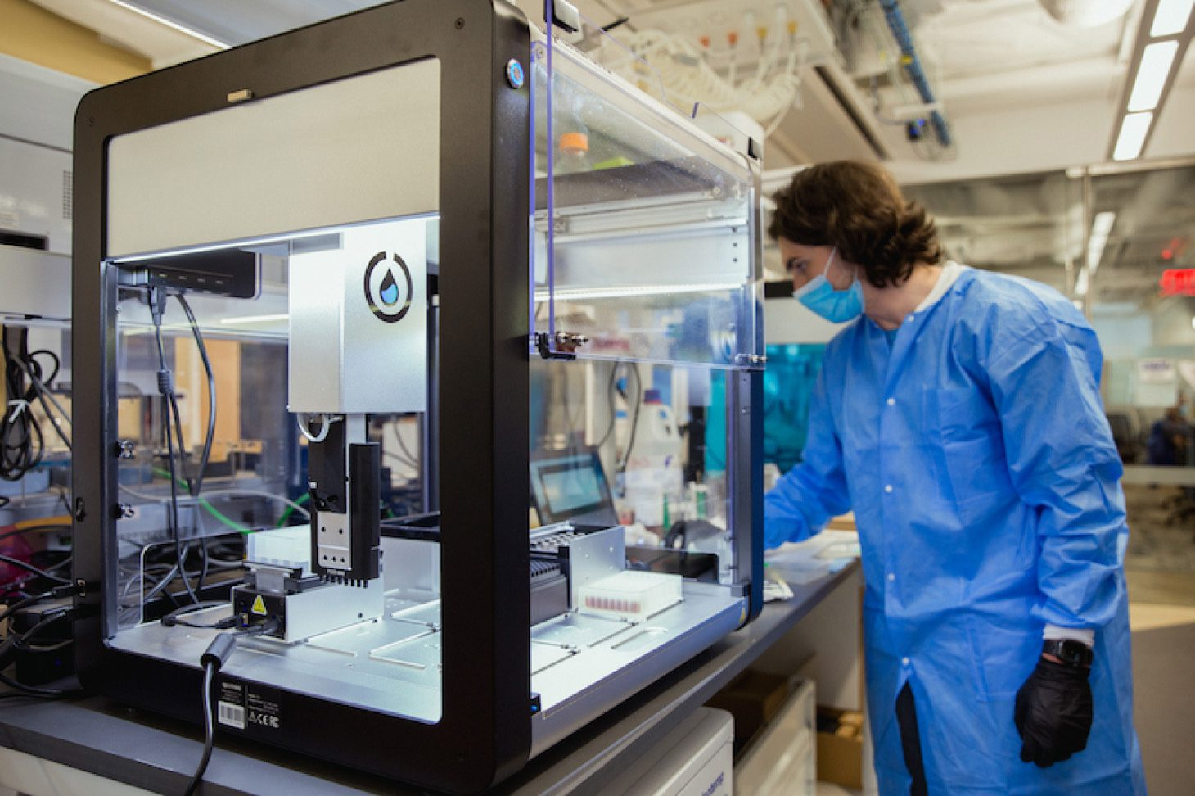

Assay requirements – ‘Screening friendly’
3 different types:
  Isolated molecular target assay
    biochemical assay of enzyme activity e.g. kinases, proteases etc
  Cell- or organism-based assay
    Reporter gene or phenotypic viability assays (e.g luc reporters, MTT, CellTiterGlo, AlamarBlue)
  Cell-free multicomponent assay
    Activity on cell extracts, membranes, reconstituted signalling cascades
Various different readouts
  Colorimetric, fluorescence, luminescence, isotope etc
Application of assay to scale of screen
  Size matters – screening implies going from 1 assay to many!!!
    Influenced by capacity, economics, timeframe
  Amenability to increased throughput = decreased timeframes & variability
    Miniaturisation (eppie – to plate, 96-well (100-200 uL); 384-well (25-50 uL), 1536-well (4-10 uL)
      Allows more assays in parallel to decrease variability
      Lowers reagent consumption (decreased cost)
      Is the assay sensitive enough?
      Precision decreases as density increases
  Least amount of steps, activities required
  Cost effective

Slide 16
Assay requirements - Robustness
Minimising variability is critical
Intra-plate:
  Limit interference in the assay readout
    Limit false positives (e.g. compounds with autofluorescence that provides a signal in a fluorescent assay, same with colorimetric)
  Limit technical variability
Inter-plate:
  Consistency in assay reagents and conditions = reproducibility
    Across assay plates, across days, across different biological sample preps
    Assay reagents:
      Ensure stability in assay, in aliquots, after storage (freeze thawing)
      Use the same assay reagents for a single screening campaign
    Biological sample
      Control for sample preparation consistency as far as possible
      Can the sample be scaled up to provide more starting material – and
      Check for mycoplasma contamination
      If cell-based assay, control for life cycle variance in unicellular organisms

Slide 17
Assay requirements - Robustness
Critical elements of a good assay – controls & minimizing variability
  Each assay platform is sensitive to interference
    Introduces variability with negative outcome on data validity of screening campaign
    Influences scoring of an ‘active’ compound in the screen
Assay must be robust & reproducible
  Trustworthy indication of a hit
  ‘Hit’ criteria must be clearly defined, predictive & outcome specific
  Assay should tolerate DMSO (typically 1% for biochemical screens, 0.1% for cellular screens if assaying at 10 μM compound concentration)
  Orthogonal validation assays may be required
  Clear differences in readout of + and - controls are critical
    BOTH should not interfere with the assay readout (e.g. autofluorescence in a fluorescent readout)
    Positive – same result as desired of an active
    Negative – ‘vehicle control’

Slide 18
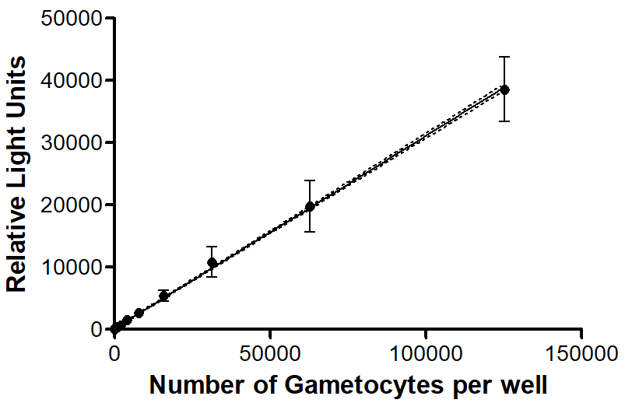
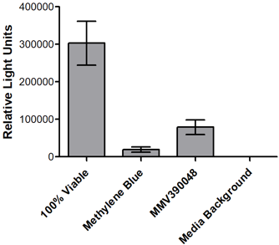
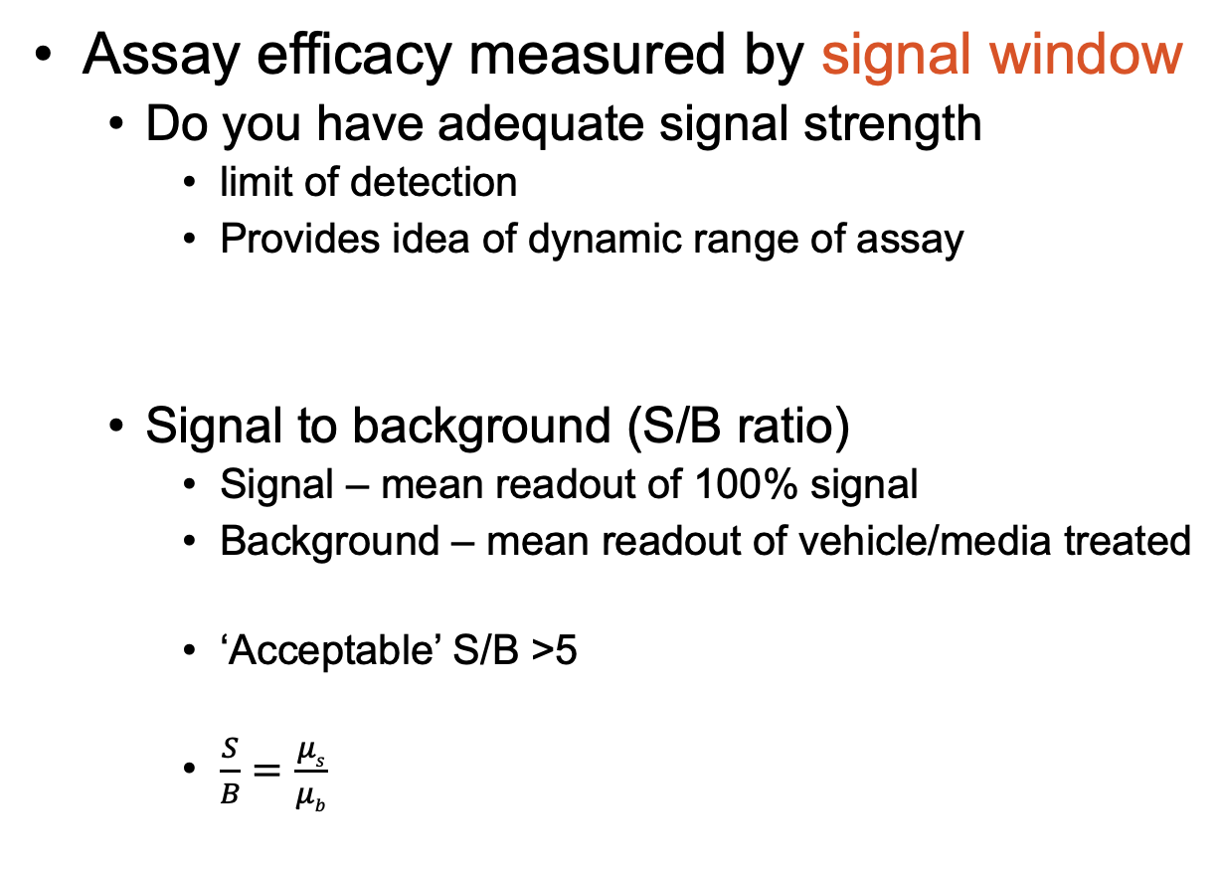
Key assay performance indicators
Assay efficacy measured by signal window
  Do you have adequate signal strength
    limit of detection
    Provides idea of dynamic range of assay
  Signal to background (S/B ratio)
    Signal – mean readout of 100% signal
    Background – mean readout of vehicle/media treated
    ‘Acceptable’ S/B >5
    $\frac{S}{B}=\frac{μs}{μb}$
Z factor: 0.83
S/N: 28441 ± 9511
S/B: 2126 ± 645
n = 81
Mean signal/mean background

Slide 19
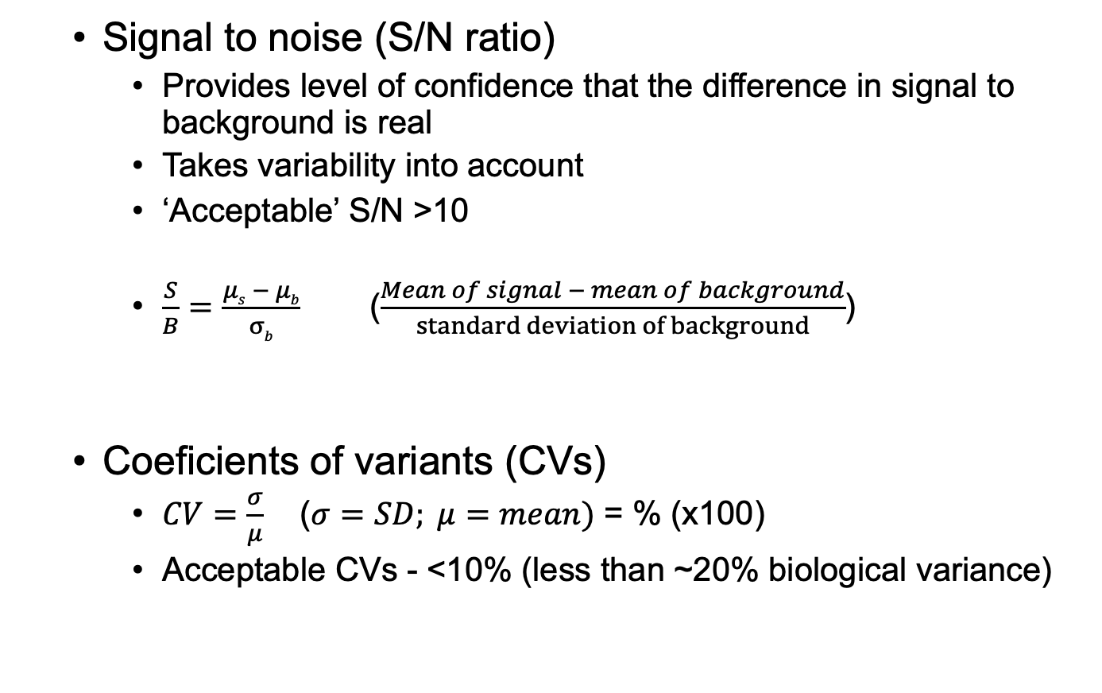
Key assay performance indicators
  Signal to noise (S/N ratio)
    Provides level of confidence that the difference in signal to background is real
    Takes variability into account
    ‘Acceptable’ S/N >10
    $\frac{S}{B}=\frac{μs − μb}{σb}$ ($\frac{Mean of signal − mean of background}{standard deviation of background}$)
  Coeficients of variants (CVs)
    $CV=\frac{σ}{μ}$ ($σ=SD; μ=mean)$ = % (x100)
    Acceptable CVs - <10% (less than ~20% biological variance)
Z factor: 0.83
S/N: 28441 ± 9511
S/B: 2126 ± 645
n = 81

Slide 20
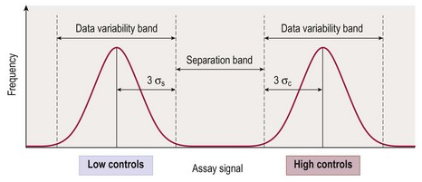
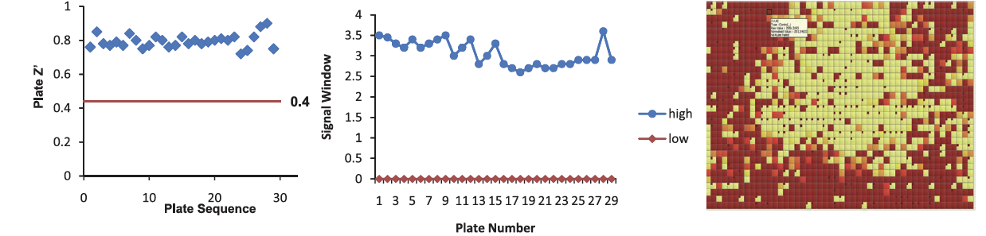
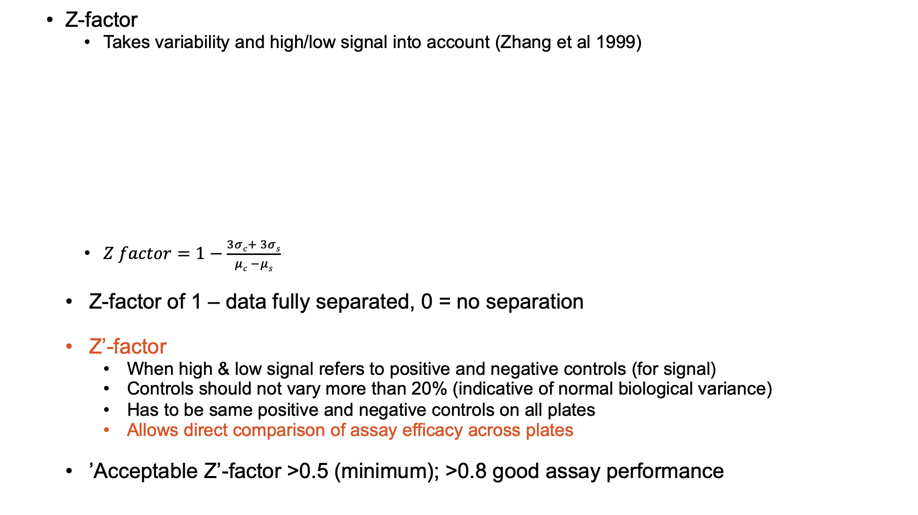

Key assay performance indicators
  Z-factor
    Takes variability and high/low signal into account (Zhang et al 1999)
    $Z factor=1−\frac{3σc+ 3σs}{μc −μs}$
  Z-factor of 1 – data fully separated, 0 = no separation
  Z’-factor
    When high & low signal refers to positive and negative controls (for signal)
    Controls should not vary more than 20% (indicative of normal biological variance)
    Has to be same positive and negative controls on all plates
    Allows direct comparison of assay efficacy across plates
  ’Acceptable Z’-factor >0.5 (minimum); >0.8 good assay performance
$$3σ=accounts for 99.7\% of all data$$
68-95-99 rule of SDs

Slide 21
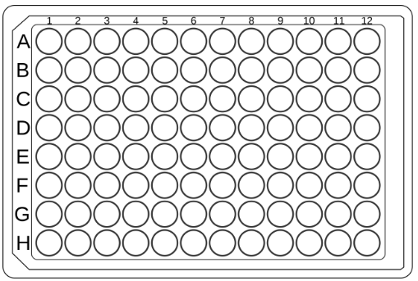
Determine screening outcome = effect
Uniformity in plate setup critical
  Comparative controls always included
  Controls are in at least triplicates (signal control, positive may be more
  Controls should not vary more than CV of 20%, indicative of normal biological variance and all data within 3SD
Compounds (80)
Compounds (80)
Vehicle
Signal
Vehicle
Signal
control cpd
Negative
Negative
Single concentration vs dualpoint
Balance between accuracy and variability
  Parallel evaluation decreases intra-plate variability (all compounds at e.g. 10 μM)
  Duplicates provide information on technical variability (e
E.g. fluorescence readout

Slide 22
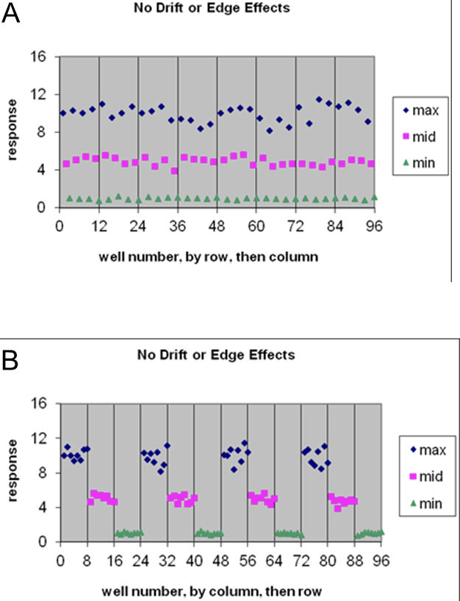
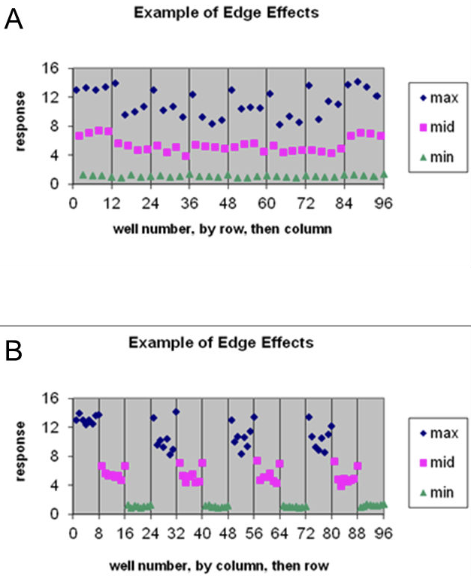
Determine inhibitory effect
Spatial evaluation of readout
  Signal should be randomly distributed – if you see ‘patterns’ there may be a problem
  Edge effect
    Generates biased outlier data (false negatives)
    NB in cell-based assays (e.g. gas exchange, pH effects of media, etc).
    Replace with media/water OR randomize controls
Compounds (48)
Compounds (80)
Signal
Vehicle
control cpd
Negative

Slide 23
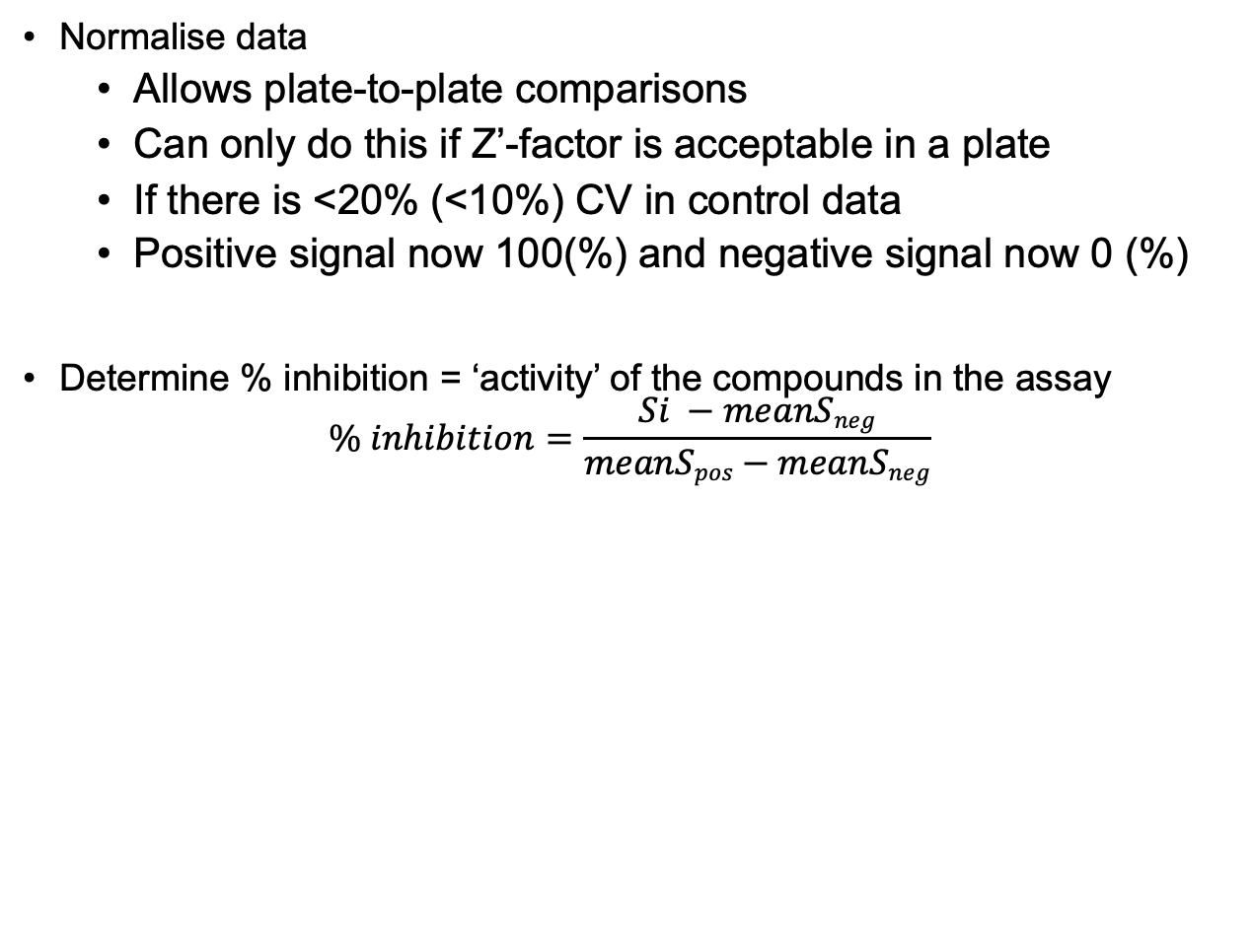
Determine screening outcome = effect
Normalise data
  Allows plate-to-plate comparisons
  Can only do this if Z’-factor is acceptable in a plate
  If there is <20% (<10%) CV in control data
  Positive signal now 100(%) and negative signal now 0 (%)
Determine % inhibition = ‘activity’ of the compounds in the assay
$$\% inhibition=\frac{Si −meanSneg}{meanSpos−meanSneg}$$

Slide 24
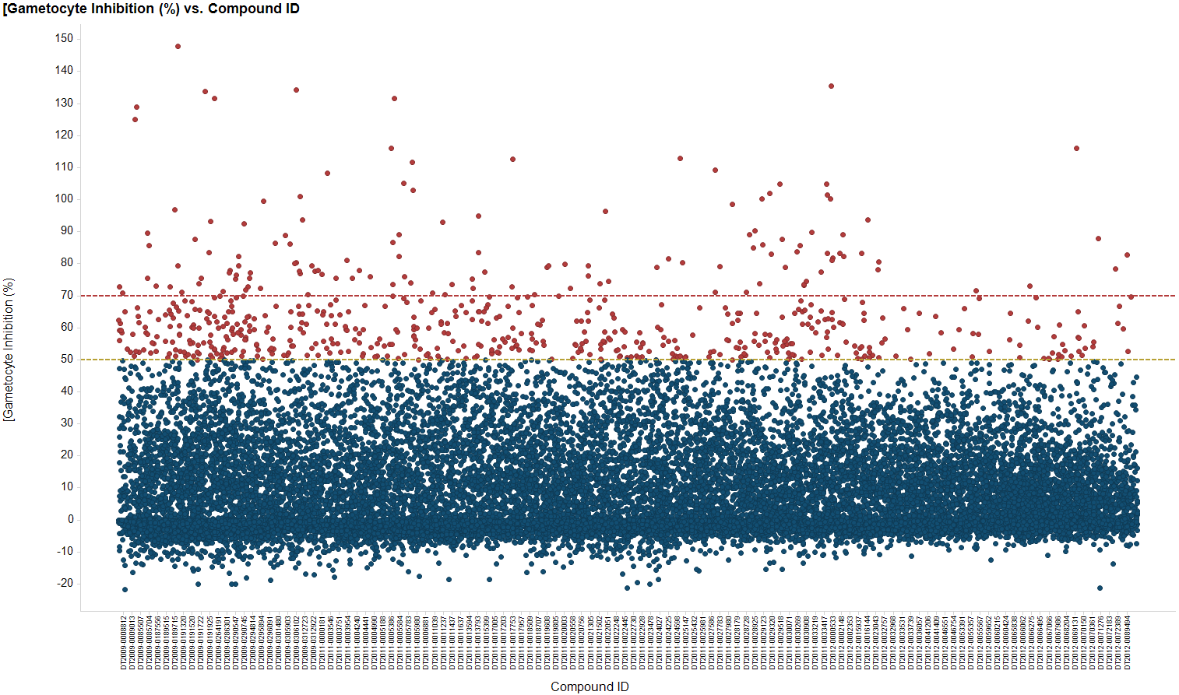
Determine screening outcome = effect
BioFocus Diversity Set (~25 000 cpds), screened against malaria parasites
  5 μM single point screen
  Potential hits at >70% inhibition
  Z’-factor 0.71, SD – 11%
Courtesy SAMTC, D Mancama

Slide 25
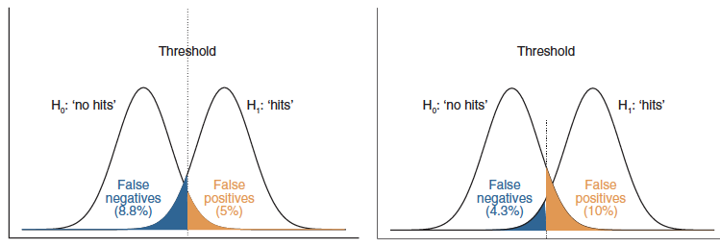
Hit identification
Define the threshold for a hit
  Currently not statistically defined and rather an inferred ‘rule of thumb’ decision
  E.g. no of compounds with >70% inhibition OR % of compounds with top performance (e.g. top 1% of compounds)
  Should consider impact this has on false positives and false negatives
  Hit rates vary at around 1%
doi: 10.10383/nbt1186

Slide 26
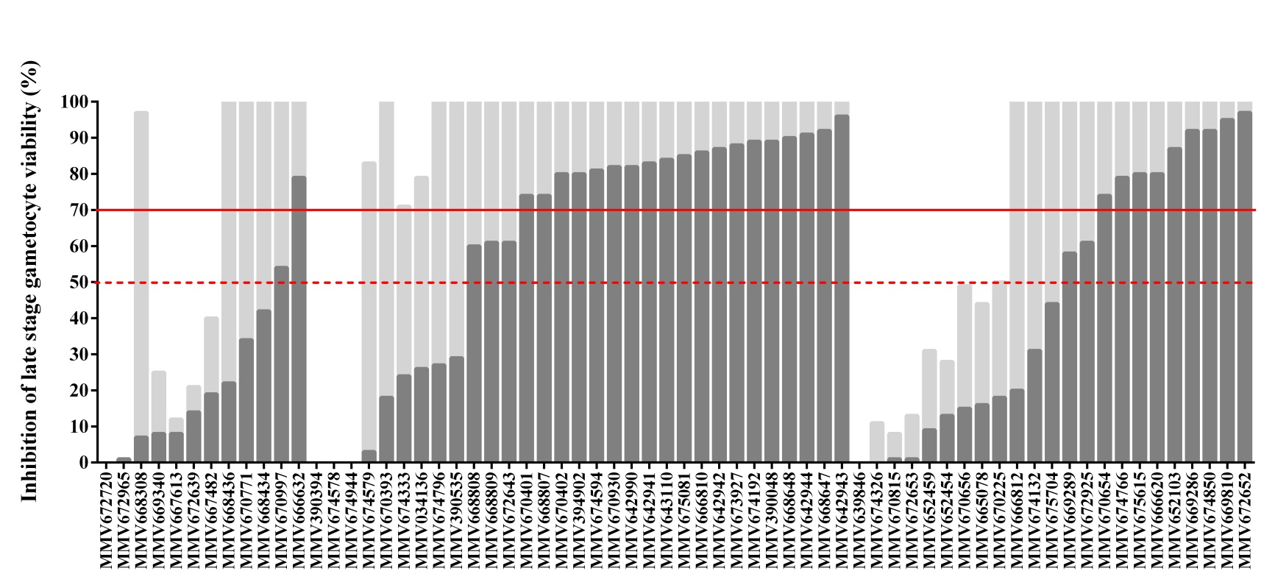
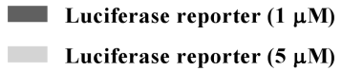
Hit confirmation
Hits re-analysed by repeats
  Expect linear correlation with a repeat experiment (and small standard error – now associated with n repeats, typically n=3)
  Dual point evaluation provides confidence in hit activity
    E.g. 1 & 5 μM concentration-dependent effect
  False positives detected
Parasite viaity (% inhibition)
doi: 10.1093/jac/dky008.

Slide 27
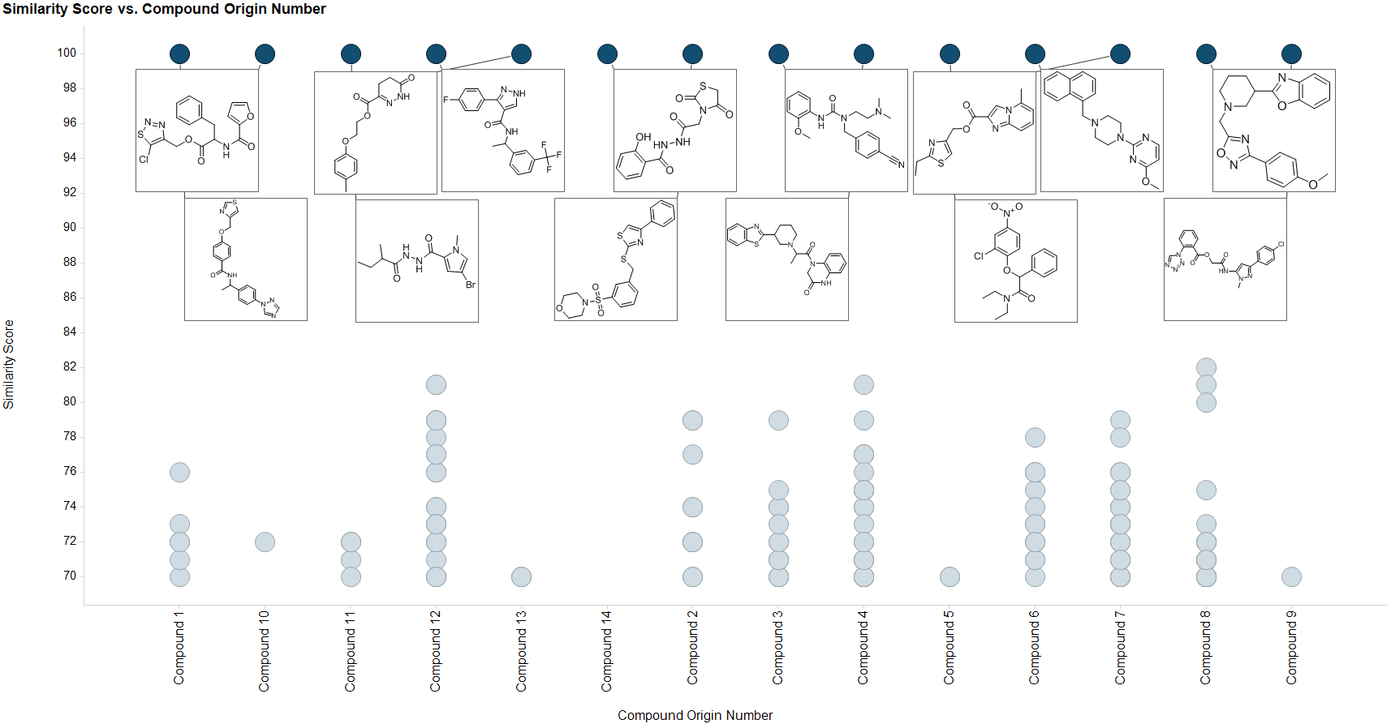
Hit confirmation
Hits by structural similarity
  Provides confidence in assay data beyond singletons
Fingerprinting of ≥70% inhibition hits, Tanimoto similarity ≥0.7

Slide 28
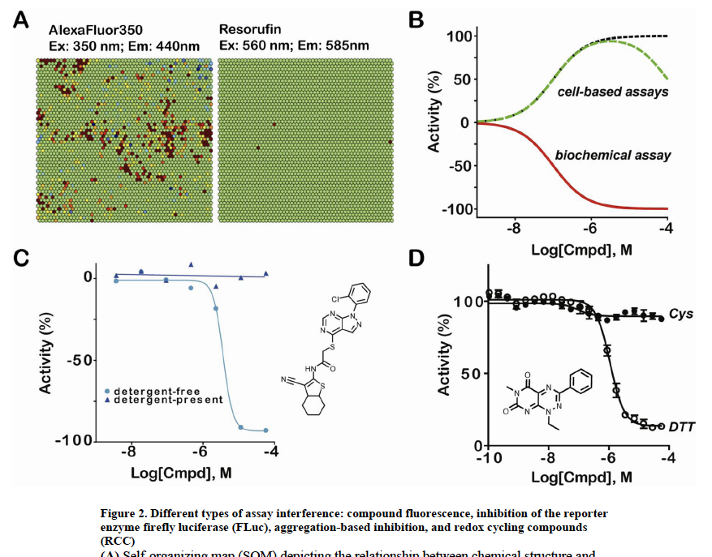
Hit confirmation
Hits re-analysed by counter screen
  False positives due to assay interference:
    compound fluorescence,
    aggregation,
    luciferase inhibition,
    redox reactivity,
    toxicity.
doi: 10.1016/j.cbpa.2010.03.020

Slide 29
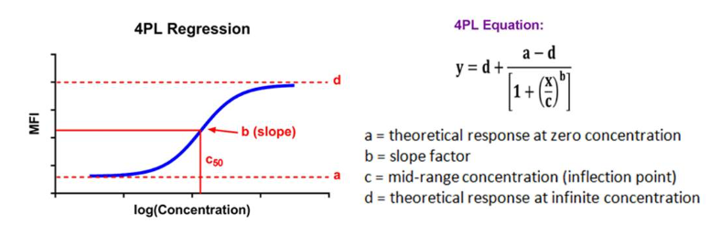
Hit confirmation - XC₅₀
Hits re-analysed in resupply and full dose-response
Correlation between hit activity & XC50 >0.7 (Novartis study)
XC₅₀ determined by full dose-response
  Technical duplicates/triplicates, biological repeats (e.g. n=3)
  Spanning at least 2 orders of magnitude of concentrations (e.g. 2-3 fold dilution series)
  Applies four-parameter logistic Hill equation
    Describes sigmoidal regression model for a dose-response curve
  EC₅₀, IC₅₀, CC₅₀ etc value = potency
    Provides a value for direct comparison between compounds

Slide 30
Data analysis & management
Shareable
Transparent
Manageable
Software like CDD Vault, DotMatrics, ScienceCloud for data sharing and storage
Analysis tools such as DataWarrior, Stardrop, CDD Vault

Slide 31
Screening checksheet (or cheatsheet!)
Assay development and validation for a screen
Primary screen
Hit confirmation
XC50 determination
Small molecule chemical library
  Quality & diversity key
    Are the compounds still pure, stable, intact?
Biological assay
  Robustness key
    Is the Z-factor acceptable across plates?
    Did the controls work, with minimal variance?
    Was there assay interference?
  Could the hit be confirmed
Counter screen

Slide 32
Questions?

Slide 33
Resources
https://www.criver.com/resources/webinar-ds-when-biology-and-chemistry-collide-formula-hts-success
Fundamental considerations in drug design. doi: 10.1016/B978-0-323-90608-1.00005-8. PMCID: PMC9212230
The Effect of Initial Purity on the Stability of Solutions in Storage. https://doi.org/10.1177/1087057113492201
The use of structural alerts to avoid the toxicity of pharmaceuticals. doi: 10.1016/j.toxrep.2018.08.017
NB: Selecting, Acquiring, and Using Small Molecule Libraries for High-Throughput Screening. doi: 10.1002/9780470559277.ch110252
Cheminformatics tools for analyzing and designing optimized small molecule collections and libraries. doi: 10.1016/j.chembiol.2019.02.018
Lessons Learnt from Assembling Screening Libraries for Drug Discovery for Neglected Diseases. doi: 10.1002/cmdc.200700139
Design of the Global Health chemical diversity library v2 for screening against infectious diseases. https://doi.org/10.1371/journal.pntd.0011799
Reporting data from high-throughput screening of small-molecule libraries. DOIhttps://doi.org/10.1038/nchembio0807-438
NB: HTS assay validation: https://www.ncbi.nlm.nih.gov/books/NBK83783/pdf/Bookshelf_NBK83783.pdf
A Simple Statistical Parameter for Use in Evaluation and Validation of High Throughput Screening Assays. DOI: 10.1177/108705719900400206
NB: Statistical practice in high-throughput screening data analysis. DOIhttps://doi.org/10.1038/nbt1186
The edge effect: A global problem. The trouble with culturing cells in 96-well plates. https://doi.org/10.1016/j.bbrep.2021.100987
Apparent Activity in High-Throughput Screening: Origins of Compound-Dependent Assay Interference. doi: 10.1016/j.cbpa.2010.03.020
https://www.youtube.com/watch?v=UXQRndXlMPY
https://www.youtube.com/watch?v=xRD01yMG27s

