Slide 1
A Comprehensive Workshop on Preclinical Drug Discovery (CDD)
Screening cascades, assay development
and quality control
John Woodland

Slide 2
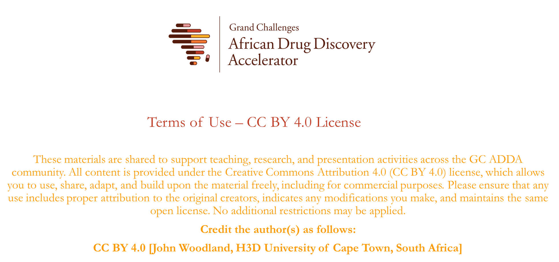

Slide 3


Learning objectives
Describe the purpose and value of screening cascades in guiding drug discovery projects
Explain the importance of robust assays in drug discovery programmes
Outline the steps involved in assay development and discuss strategies for optimising assay performance
Discuss the interplay between screening cascades and assay development in the context of drug discovery, and understand how these aspects contribute to the overall efficiency and success of drug discovery projects

Slide 4

How does a diverse drug discovery team coordinate its efforts?
Which experiments?
When to do them?
How to decide which compounds to progress?

Slide 5
What is a screening cascade?
A flow-chart describing the order of experiments that will be undertaken by the project team, with cut-off values that will allow compounds to progress to the next phase of the project
To define priorities and to coordinate efforts amongst the team
Iterative (the ‘design-make-test’ cycle) in order to optimise the parameters required for a clinical candidate

Slide 6







A simplified screening cascade
Design and synthesis
Aqueous solubility
Potency against target
Cytotoxicity
Microsomal metabolic stability
Pharmacokinetic (PK) studies
Efficacy studies

Slide 7
A simplified screening cascade
Higher-throughput
in vitro assays
Design and synthesis
Aqueous solubility
Potency against target
Cytotoxicity
> 10 µM at pH 6.5
Selectivity index > 100
< 500 nM
Microsomal metabolic stability
Pharmacokinetic (PK) studies
Lower-throughput
in vivo assays
(more expensive and time-consuming)
Efficacy studies

Slide 8
Notes
Not every compound needs to be tested in every experiment
A compound that satisfies these criteria is not yet a drug
  Identify a number of promising (or frontrunner) compounds with good properties to absorb the attrition during the pre-clinical assessments
The screening cascade is dynamic and may change as the course and priorities of the project change

Slide 9
A more detailed screening cascade
Design and synthesis
In vitro activity
Solubility pH 6.5
What do we want to know?
Is the compound active?
Is the compound soluble?
Is the compound stable in the body?
Is the compound safe?
Is the compound absorbed?
Is the compound active
in vivo?
How does the compound act?
Further PK and efficacy studies…
Per request
IC₅₀ < 500 nM
pH 6.5 > 10 µM
Per request
Speed of action,
cross-resistance
CYP inhibition
HepG2, Vero
Cardotoxicity risk: hERG
Permeability:
Caco=2 or PAMPA
Mutant generation
IC₅₀ < 20 µM
SI > 100x
IC₅₀ > 10 µM
Microsomal metabolic stability
Life cycle stage activities
Reactive Metabolite
PGP substrate
CHO cytotoxicity
SI > 100x
CL_{int} <11.6 μL/min/mg
5-pt mics stability
PPB, stability
Mouse PK
Exposure sufficient for efficacy
In vivo efficacy (single/multi-dose/ED₉₀) + PK
ED₉₀ < 10 mg/kg
Per request
Biolody
DMPK
MOA
Further in vitro DMPK (hepatocyte stability)
In vitro genotox.
Toxicology
Off-target activities
Rat/dog/monkey PK
Exploratory rat tox.

Slide 10
Tips for designing a screening cascade
Define the mandatory experiments that will form the ‘critical path’ (experiments that have to be conducted, with favourable results, in order for compounds to be progressed to the next stage of the project) and which experiments are optional or ‘nice-to-have’
Keep in mind the target product profile (TPP) that has been developed for that project
Screening cascades vary according to disease area and will be different for infectious diseases compared to non-communicable diseases

Slide 11
Example: FHA-H2L cascade for Mtb
Per request
Design and synthesis
MBC, KK
NRP-activity
MIC₉₀ < 2 µM
SI > 20
Sol. > 25 µM
MIC vs SDR mutant panel
Mtb MIC
Solubility pH 7.4
Biochemical assay
MIC₉₀ < 10 µM
Sol > 10 µM
IC₅₀ < 5 µM
FHA
(6 to 8 months)
RNAP MOA assays
HepG2 cytotox.
Microsomal stability
LogD
mutant generation
SI > 20x
MIC₉₀ < 2 µM
CL < 11.6 µL/min/mg
Mouse PK + PPB
IVCL < 40 mL/min/kg; oral F >20%
Dose escalation and tolerability
sufficient exposure for efficacy, well tolerated
H2L
Synergy studies with TB drugs
Efficacy in acute mouse model

Slide 12
Example: FHA-H2L cascade for Pf
Design and synthesis
In vitro gametocytes
In vitro NF54 IC₅₀
Solubility pH 6.5
Ideal IC₅₀ < 100 nM
Progressed IC₅₀ < 500 nM
> 10 µM
Met ID
Caco-2
Heps
pK_{a}
(as appropriate for likely issue)
Not critical for progression
Other assays on request:
In vitro K1 IC₅₀
CHO cytotox.
MLM
Ideal = NF54 IC₅₀
Progressed < 3x NF54 IC₅₀
Ideal SI > 1000 x
Minimum SI > 10 x
Apparent CL_{int}
< 11.6 mL.min⁻¹.kg⁻¹
In vitro sporozoites
Speed of action,
resistance
Predicted high lipid perm.
cLogD_{7.4} [0-3]
PSA: ideal < 75Å²
max. 100 Å²
Mutant generation
CYP inhibition
hERG
Mouse PK
PPB
MicsB
logD
IC₅₀ > 20 µM
SI > 1000x
IVIV correlation? No
Yes -> C_{av,u} > 3 x NF54 IC₅₀? No
Yes
Back to design and synthesis to improve potency
Parasitology
DMPK
PfSCID mouse
PKPD
MOA
PoC: ED₉₀ < 50 mg/kg
Toxicology

Slide 13



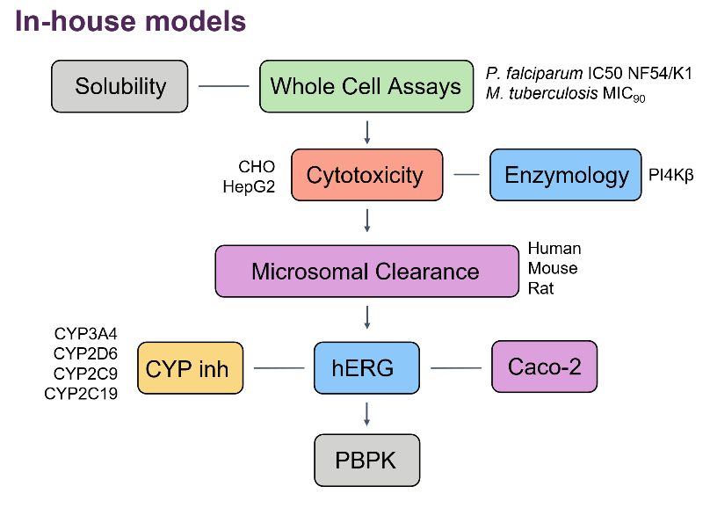
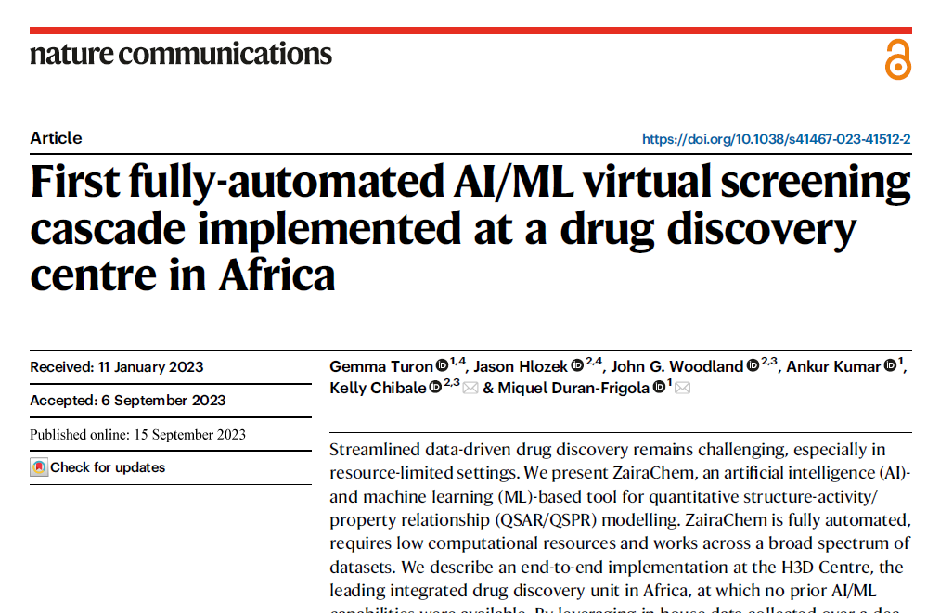
Virtual screening cascades
Virtual screening for new chemical matter
Prioritising analogues for synthesis
Build additional models from literature data
Link predictive models to generative algorithms
Development and implementation of a virtual screening cascade and predictive models trained on (in-house) data
Lightweight versions of the models available at https://h3d-screening-cascade-app-fikzu.ondigitalocean.app/

Slide 14
Over to you
Do you use a screening cascade in your project(s)?
Who devised it? Did you have any input?
Does it help to guide the project?
Do you ever update it as the project changes or progresses?
Are there any modifications that you would suggest?

Slide 15
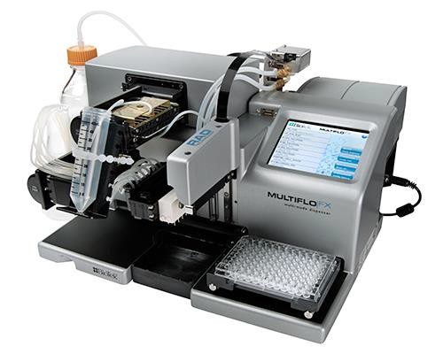
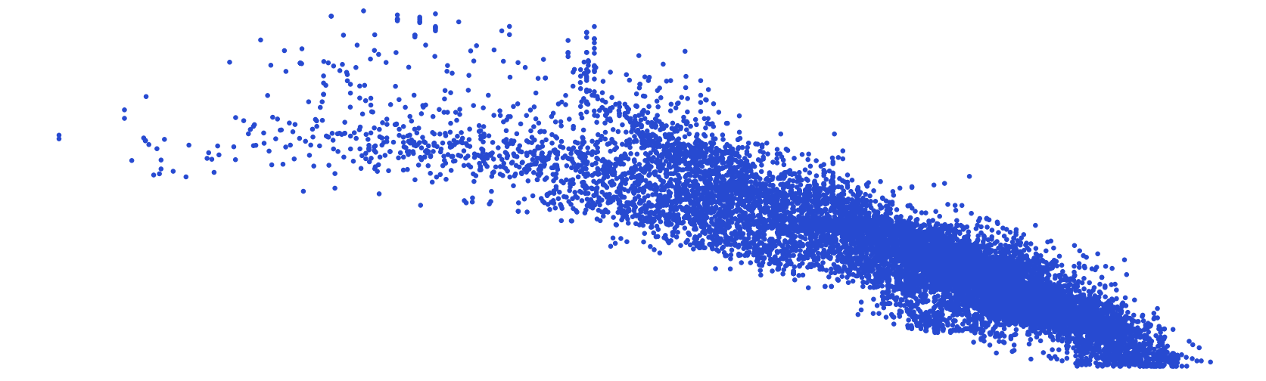
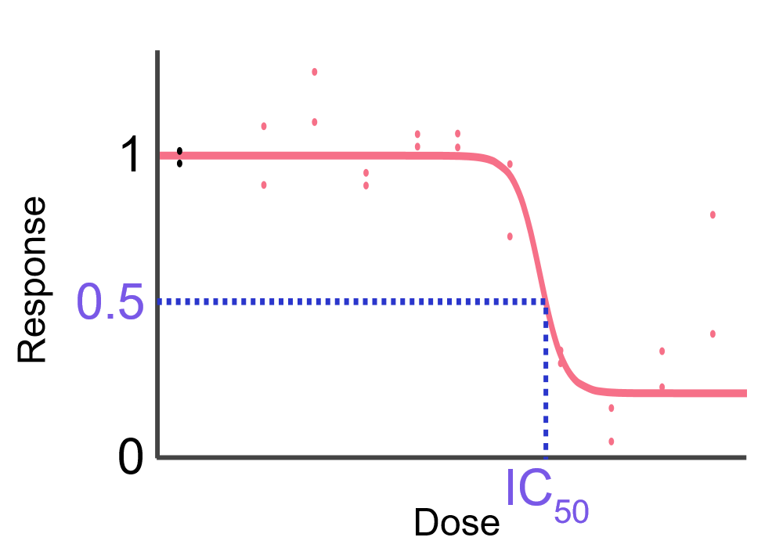
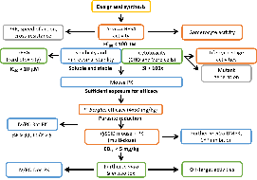
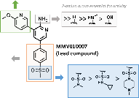

Drug discovery and development
Once you’ve identified many hits, use computational tools to analyse the data, followed by a SWOT analysis, to decide on the best chemical series
Hit confirmation
(i.e. measure IC₅₀ values)
Hit validation AKA formal hit assessment
(i.e. resynthesise hits to check activity)
Screening of many thousands of compounds to find hits, i.e. those compounds active against a pathogen (phenotypic screening) or a protein/pathway (target-based screening)
1-2 years
Screening and
hit identification
Hit-to-lead and
lead optimisation
Pre-clinical
development
Clinical
development
2-5 years
1-2 years
5-10 years
Extensively test the safety of the optimised candidate (e.g. toxicology, off-targets, etc.)
Phase 1 (safety and appropriate dose in healthy volunteers)
Phase 2 (safety and efficacy in patients)
Phase 3 (RCT with many patients)
Guided by SAR studies and the screening cascade, engineer or optimise the compounds to remove undesirable features until they fulfil the criteria for a late lead (e.g. potency, solubility, stability, etc.)

Slide 16
Assays
Structured experimental procedures designed to investigate biological and chemical samples under well-defined conditions
An analytical measurement defined by a set of reagents that produces a detectable signal for quantifying a biological process
Assays allow researchers to investigate the presence, identity, amount, interaction, dynamics and impact of chemical and biological molecules, entities or processes in a sample

Slide 17
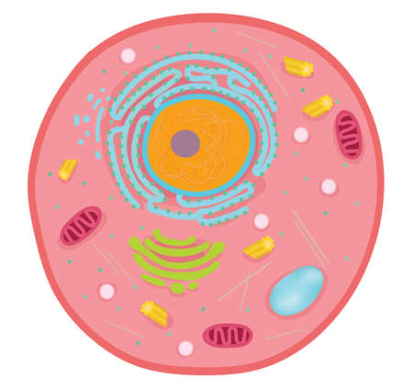
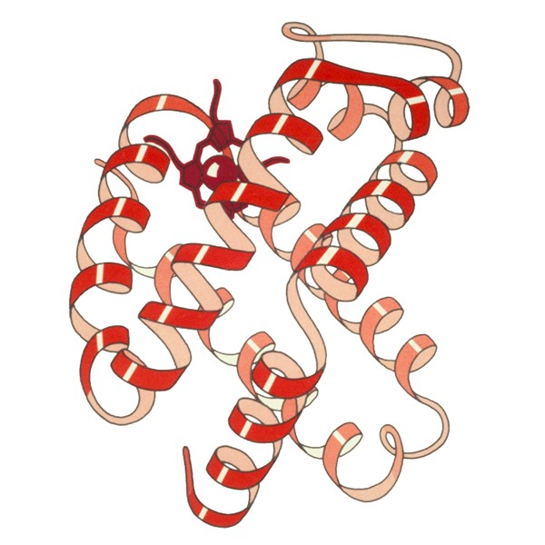
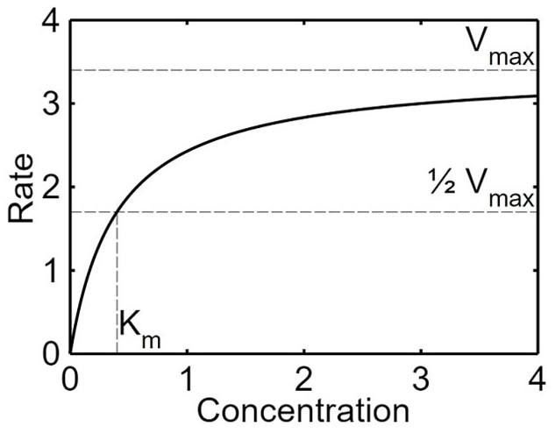

Common types of assays
Cell-based: Usually more physiologically-relevant assays that incorporate the intricacies of cellular function, structure and phenotypes
Biochemical: Usually based on purified targets that help to reveal the underlying mechanisms in biological interactions
Biophysical: Insights into the affinity and binding kinetics between biomolecules and small molecules
In silico: Computational approaches that can be useful for screening large numbers of molecules

Slide 18
Types of assays – cell-based
Cell-based assays may help to evaluate the efficacy of drug molecules in a more effective way than biochemical assays. Cell cultures and provide deeper insight into the effects of small molecules on humans, often with temporal (time) and spatial (location) resolution
  Reporter gene assay: To detect primary signal pathway modulators
  Mammalian two-hybrid assay: To study mammalian protein interactions in the cellular environment
  Fluorescence-based immunohistochemical assays: To study morphological features and molecular target activities
  Immunofluorescence assays: For high-throughput target protein analysis
  Protein fragment complementation assays: To study protein-protein interactions

Slide 19
Types of assays – biochemical
Biochemical assays are used to measure the binding affinity or inhibitory activity of the tested molecule with the target enzyme or its receptor
Fluorescence resonance energy transfer (FRET)-based assay: Used to screen inhibitors and monitor proteolytic activity
High-performance liquid chromatography (HPLC): Used to assess proteolytic action (mainly for chromogenic compounds) and can be used to screen inhibitors
Enzyme-linked immunosorbent assay (ELISA): To analyse the inhibitory activity of the test compound
Surface plasmon resonance (SPR) techniques: Used to study the interactions of the test compound with the target protein

Slide 20
Types of assays – in silico
In silico methods are effective techniques to screen a large library of compounds and evaluate their affinity and efficacy even before they enter development, based on their structure
Important applications in assessing the pharmacodynamic (PD) and pharmacokinetic (PK) properties of molecules. The two types of virtual screening methods commonly used are ligand-based methods (utilising topological fingerprints and pharmacophore similarity) and target-based methods
Docking and consensus scoring are some target-based approaches used to estimate the binding affinity of the selected compounds
Quantitative structure-activity relationships (QSAR) predict the quantitative relationship between a chemical structure and its biological activity

Slide 21
Sources of variation in assays
Cell-based assays:
Culturing media
Culturing conditions
Serum
Stage of the cell cycle
Passage number
Biochemical assays:
Temperature
pH
Concentration of ions
Solubility of reagents
Stability of reagents
Aggregation of reagents

Slide 22
To consider when developing an assay
Pharmacological/physiological relevance: Does the assay sufficiently reflect the disease state to identify compounds with the desired potency and mode of action?
Assay reproducibility: Is the assay sufficiently reproducible across plates, screen days and, indeed, the entire duration of the project (which may span several years)?
Assay quality: The most robust assays have simple protocols, well-defined controls, stable reagents and optimal instrumentation with Z' factors > 0.5
Assay costs and format: The format (e.g. 96-well or 384-well) depends on the context (academia, industry or high-throughput screening) with microtitre plates, reagents and volumes selected to minimise costs
Potential interference: Should be configured to be relatively insensitive to solvent concentrations, e.g. cell-based assays typically tolerate up to 1% DMSO, while biochemical assays can handle up to 10%. Assays should also be evaluated for their false negative and false positive hit rate

Slide 23
Assay readouts
Label-based assays:
  Rely on chemical or biological labels, such as fluorescent dyes and proteins, to detect target activity, binding, localisation, etc.
  Revered for their sensitivity and specificity but can be complex and potentially intrusive to natural interactions
Label-free assays:
  These do not rely on labels, instead leveraging the intrinsic properties of the analytes
  They preserve the natural state of molecules and are simpler but may lack sensitivity and require specialised equipment
For instance, fluorescence-based assays might be favoured due to their sensitivity, making them ideal for detecting the nuanced interactions of small molecules with their target proteins; meanwhile, label-free assays, such as MALDI-TOF mass spectrometry, can directly reveal these interactions without any potential interference from surrogate labels

Slide 24
Steps for developing an assay
Design
Validation
Optimisation
Scale-up
If/once a target has been firmly established, an effective procedure to detect or measure it must be devised. Whether a label-based or label-free assay is selected depends on various factors:
  The required sensitivity
  The nature of the sample
  The equipment available

Slide 25
Steps for developing an assay
Design
Validation
Optimisation
Scale-up
Validation is paramount to the reliability of the assay
Rigorous testing under controlled assay conditions is needed to scrutinise three pivotal criteria:
  Accuracy: How close the assay’s results align with the true value
  Repeatability: The consistency of results under identical conditions
  Reproducibility: The assay’s capacity to produce consistent outcomes under varied circumstances

Slide 26
Steps for developing an assay
Design
Validation
Optimisation
Scale-up
Necessary to refine the assay, ensuring its optimal efficiency and sensitivity. May need to tinker with various parameters, e.g. adjusting reagent concentrations, fine-tuning incubation times and assay linearity, or modifying temperature settings
Goal is to (1) enhance the assay’s sensitivity to detect even trace amounts of the biochemical, cellular or biophysical activity and (2) bolster its robustness to reduce error

Slide 27
Steps for developing an assay
Design
Validation
Optimisation
Scale-up
Focuses on preparing the assay for broader applications, e.g. processing more samples or integrating the assay into high-throughput systems
Maintaining the assay’s consistency and reliability remains paramount

Slide 28
Key statistical concepts
Statistical measurements of accuracy and precision reveal an assay’s basic reliability:
  Accuracy: When an assay measures what it is supposed to measure, i.e. to measure the true amount or concentration of a substance in a sample
  Precision: When repeated determinations (analyses) on the same sample give similar results. When a test method is precise, the amount of random variation is small
Sensitivity (true positive rate) is the probability of a positive test result, conditioned on the result truly being positive. The more sensitive a test, the fewer “false-negative” results it produces
Specificity (true negative rate) is the probability of a negative test result, conditioned on the result truly being negative. The more specific a test is, the fewer “false-positive” results it produces

Slide 29
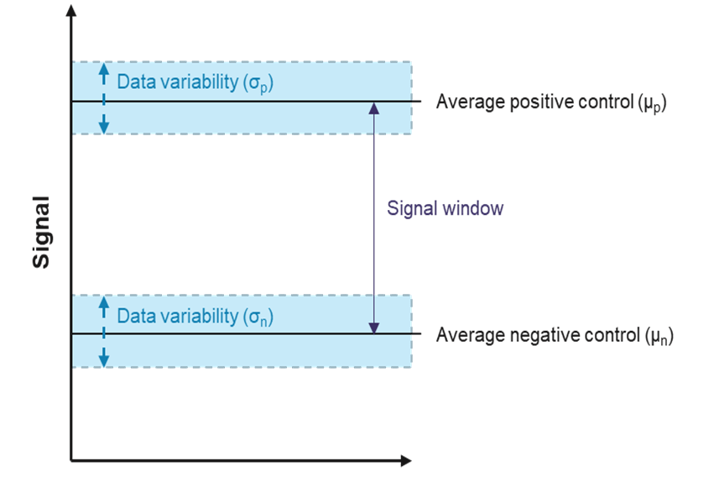
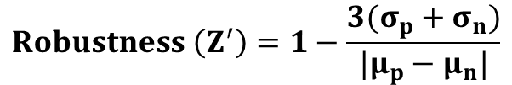
Measuring assay robustness
Z’ (‘robustness’) is a measure of the variance within an experiment comparing the positive and negative controls based on the average between positive (µ_{p}) and negative (µ_{n}) controls as well as their standard deviations (σ_{p} and σ_{c})
Assays with Z’-values between 1 and 0.5 are considered to be robust as there is a large separation band between the positive and negative control
https://www.ppscreeningcentre.com/what-are-optimal-assay-conditions/
$$Robustness \left(Z^{′}\right)=1−\frac{3(σ_{p}+σ_{n})}{|μ_{p}−μ_{n}|}$$

Slide 30
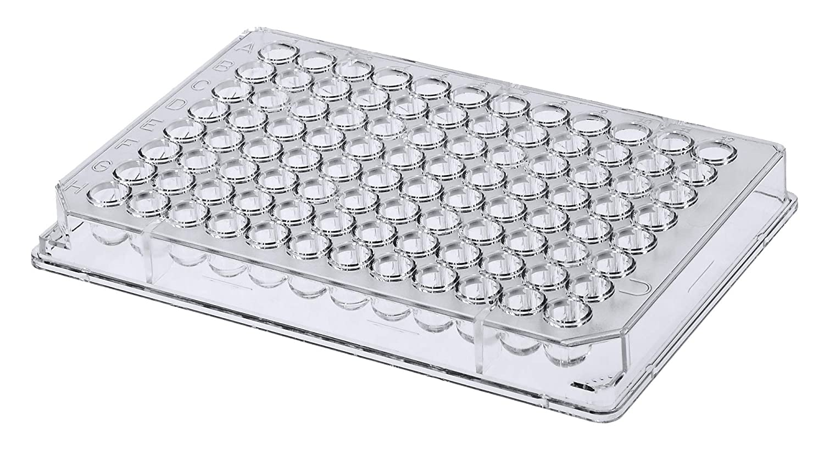
Example
Beta-haematin inhibition to probe implication in the malaria parasite haemozoin formation pathway
Biomimetic detergent-based
cell-free chemical assay
Inhibitor
Incubate 5 h at 37°C
(pH 4.8)
Cell-based haem fractionation assay

Slide 31
Emerging trends
3D cell-based models, e.g. organoids (for enhanced physiological relevance)
High-content screening
Microfluidics
Machine learning
Do not forget about data integrity, properly training the assayers, proper documentation and validation, SOPs…

Slide 32
Summary
Screening cascades are a critical tool in the H2L and LO stages of a drug discovery project to guide SAR studies to most efficiently optimise the compounds to fulfil the criteria for progression. Note that screening cascades are dynamic, iterative and depend on the project/disease area
Robust assays are indispensable for generating results that will guide the project. Relevance, reproducibility, quality and cost should all be considered during the design, validation, optimisation and scale-up of chemical and biological assays

Slide 33
References and resources
J. P. Hughes, et al. ‘Principles of early drug discovery’, British Journal of Pharmacology, 2011, 162, 1239.
J. Zhang, et al. ‘A Simple Statistical Parameter for Use in Evaluation and Validation of High-Throughput Screening Assays’, Journal of Biomolecular Screening, 1999, 4, 67.
H. Bar and A. Zweifach. ‘Z’ Does Not Need To Be > 0.5’, SLAS Discovery, 2020, 25, 1000.
Dr John Woodland
Research Officer, H3D Centre
Room 7.15, PD Hahn Building, UCT
john.woodland@uct.ac.za

Slide 34
Questions?

