Slide 1
A Comprehensive Workshop on Preclinical Drug Discovery (CDD)
Hit discovery options: targeted and phenotypic screening methods
Adrienne Edkins

Slide 2
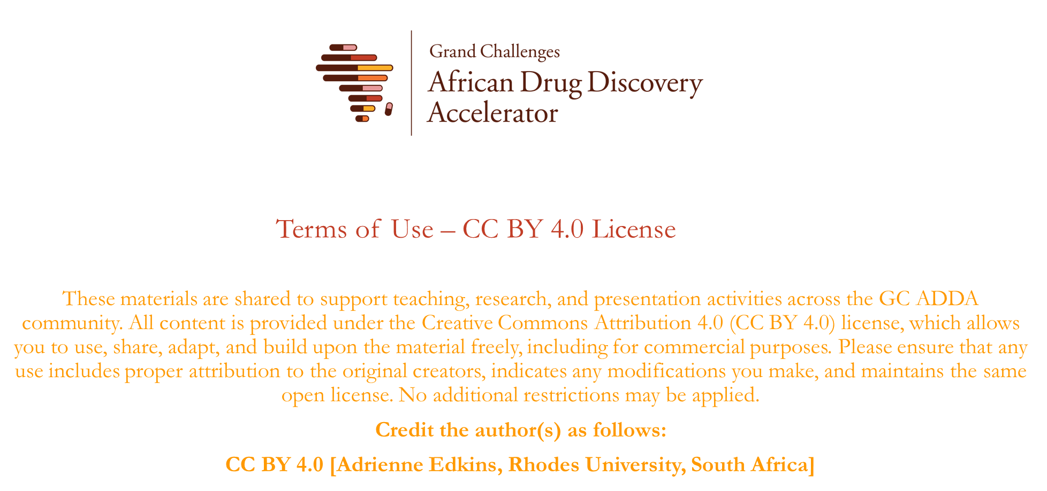

Slide 3

Objectives
Discuss the process of hit discovery
Compare targeted and phenotypic approaches to hit discovery
Understand concepts and approaches related to hit discovery using examples from our research

Slide 4


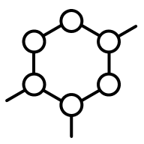
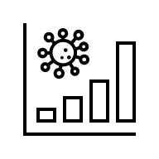
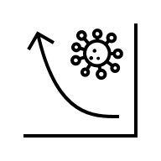


Overview of hit discovery in the pipeline
Research
Lead discovery
Preclinical
Clinical
Approval
10 – 20 years
$1 billion
Hit discovery
Target
Phenotype
Compound screen
Bioassay
Secondary assay
Hit compound

Slide 5

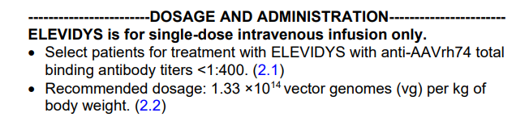
Broad approaches to hit discovery
Target-based screen
(Target to hit)
Hit: compound with desired activity that is validated by secondary testing
Lead: compound with biological and pharmacological activity
Target: biological entity (e.g. protein, RNA, gene) linked to a specific condition
Phenotypic screen: biological screen that is disease focused but not target specific
Library screen
Biological activity
Target
Phenotypic screen
(Hit to target)

Slide 6
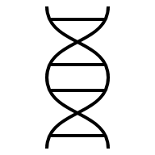


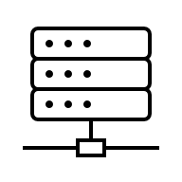

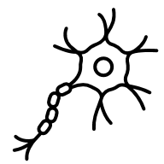

Broad approaches to hit discovery
Target identification
Target validation
Screening
Secondary assay
Hit
Phenotypic assay

Slide 7
Phenotypic screen (hit to target)
Biological activity screen (cell or tissue-based model)
More reflective of the disease state (e.g. patient derived samples/iPSC) (phenotypic ‘rule of 3’)
Unbiased (with respect to mechanism of action/MOA/target)
Feeds into target identification (HTS and hypothesis driven)
Target identification or validation may be challenging
Increased poorly qualified leads may overload the pipeline
Biological activity
Library screen
Target

Slide 8
Target-based screens (Target to hit)
Target specific screen (in vitro bioassay of disease modifying entity)
Rational design and drug improvements
Faster (e.g. 20 years from disclosure to application versus 25 for phenotypic screens doi: 10.1038/nrd4336)
Cheaper (on average)
Technology dependent (advances permit more target-based screens)
Issues with translation to biological activity (may lack activity due to factors other than target specificity e.g. lack of cellular permeability)
Target Library screen Biological activity

Slide 9
Target-based screens (Target to hit)
Properties of a promising drug target
Disease driver (central function in the disease phenotype)
Altered or different in disease (disease versus physiological or host versus pathogen)
Restricted or disease-specific expression
Druggable (accessibility to modulation)
Vulnerable (magnitude of modulation required for biological effect
Assayable (to permit screening)
Target Library screen Biological activity

Slide 10
Target identification and validation
TARGET
RNAi/ CRISPR/ overexpression
Disease association/ variants
Bioinformatics
Tool compounds
Cell based and disease models
Expression and signalling analysis
Important for both target-based and phenotypic screens
Range of approaches depending on the context
Aim to evaluate the biological entity in the context of the characteristics of a good target
Off-target effects
Efficacy/safety

Slide 11
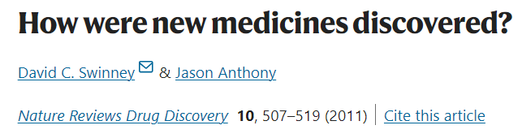
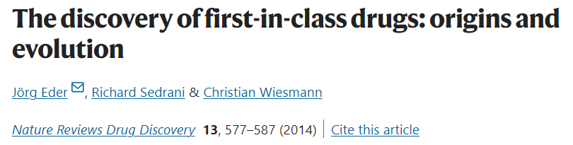
Target-based versus phenotypic screens?
1999 – 2008
75 first in class (novel MOA/chemotype)
28 (56%) phenotype
17 (34%) target-based
164 follower drugs (new variants of existing drugs)
83 (51%) target-based
30 (18%) via phenotypic assays
1999 – 2013 113 first in class
(novel MOA/chemotype)
35 (31%) phenotype
78 (69%) target-based (45 small molecules and 33 biologics)
8 true phenotypic screen
11

Slide 12



Screening strategies
High-throughput screens (wide range of different chemical entities)
Focused (pharmacophore or target-specific)
Fragment-based (smaller fragments with low affinity binding are elaborated or combined into drug like molecules)
Virtual screen (using targets, unbiased or targeted to specific sites)
Structure-guided design (based on existing target-inhibitor complex)

Slide 13


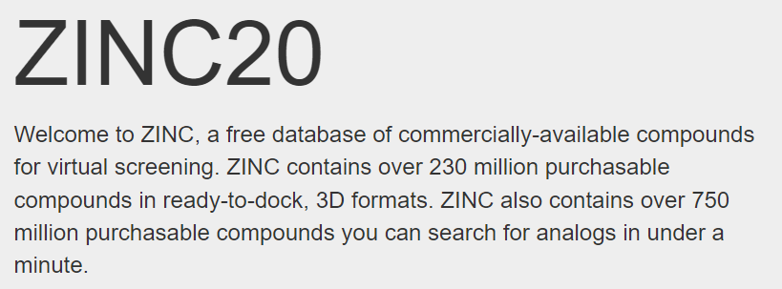

Compound libraries
Chemical library: series of chemicals in a format that permits screening
Pharmaceutical industry (e.g. GSK TCOLF)
Curated collections (e.g. MMV/DNDi pandemic response box; NIH)
Commercial collections (e.g. LOPAC, Molport)
Academic collaborations
In silico libraries (e.g. ZINC)
Diverse: few compounds from a wide range of different chemotypes
Focused: restricted number of chemotypes but more representatives

Slide 14
Secondary assays
Validate biological activity from initial screen
Alternative or extended format
Emphasis on functional output rather than scale of screening
Selectivity or specificity
Interference (pan-assay interference compounds/PAINS)
Basic structural activity relationship (SAR) if possible

Slide 15
Summary
Hit identification is a core activity of early drug discovery
Hits are early compounds that show bioactivity that withstands secondary testing (compared to leads which also have pharmacological activity)
Phenotypic (hit to target) and targeted (target to hit) approaches can be applied successfully to hit identification
Both approaches have pros and cons and selection of approach depends on the context and aim of the drug discovery programme
Target identification and validation is important component of both approaches (but may occur at different phases)
Hits need to be biologically active in secondary (re)testing

Slide 16
Additional Reading
Hughes JP, Rees S, Kalindjian SB, Philpott KL. Principles of early drug discovery. Br J Pharmacol. 2011 Mar;162(6):1239-49. doi: 10.1111/j.1476-5381.2010.01127.x.
Harris CJ, Hill RD, Sheppard DW, Slater MJ, Stouten PF. The design and application of target-focused compound libraries. Comb Chem High Throughput Screen. 2011 Jul;14(6):521-31. doi: 10.2174/138620711795767802.
Swinney DC, Anthony J. How were new medicines discovered? Nat Rev Drug Discov. 2011 Jun 24;10(7):507-19. doi: 10.1038/nrd3480.
Eder J, Sedrani R, Wiesmann C. The discovery of first-in-class drugs: origins and evolution. Nat Rev Drug Discov. 2014 Aug;13(8):577-87. doi: 10.1038/nrd4336. Epub 2014 Jul 18.
Wagner BK. The resurgence of phenotypic screening in drug discovery and development. Expert Opin Drug Discov. 2016;11(2):121-5. doi: 10.1517/17460441.2016.1122589.
Jones LH, Bunnage ME. Applications of chemogenomic library screening in drug discovery. Nat Rev Drug Discov. 2017 Apr;16(4):285-296. doi: 10.1038/nrd.2016.244.
Croston GE. The utility of target-based discovery.Expert Opin Drug Discov. 2017 May;12(5):427-429. doi: 10.1080/17460441.2017.1308351.
Berg EL. The future of phenotypic drug discovery. Cell Chem Biol. 2021 Mar 18;28(3):424-430. doi: 10.1016/j.chembiol.2021.01.010.

Slide 17
Questions?

