Slide 1
A Comprehensive Workshop on Preclinical Drug Discovery (CDD)
Project management and organisation of multidisciplinary projects
Dr Bahne Stechmann & Jessica Akester

Slide 2
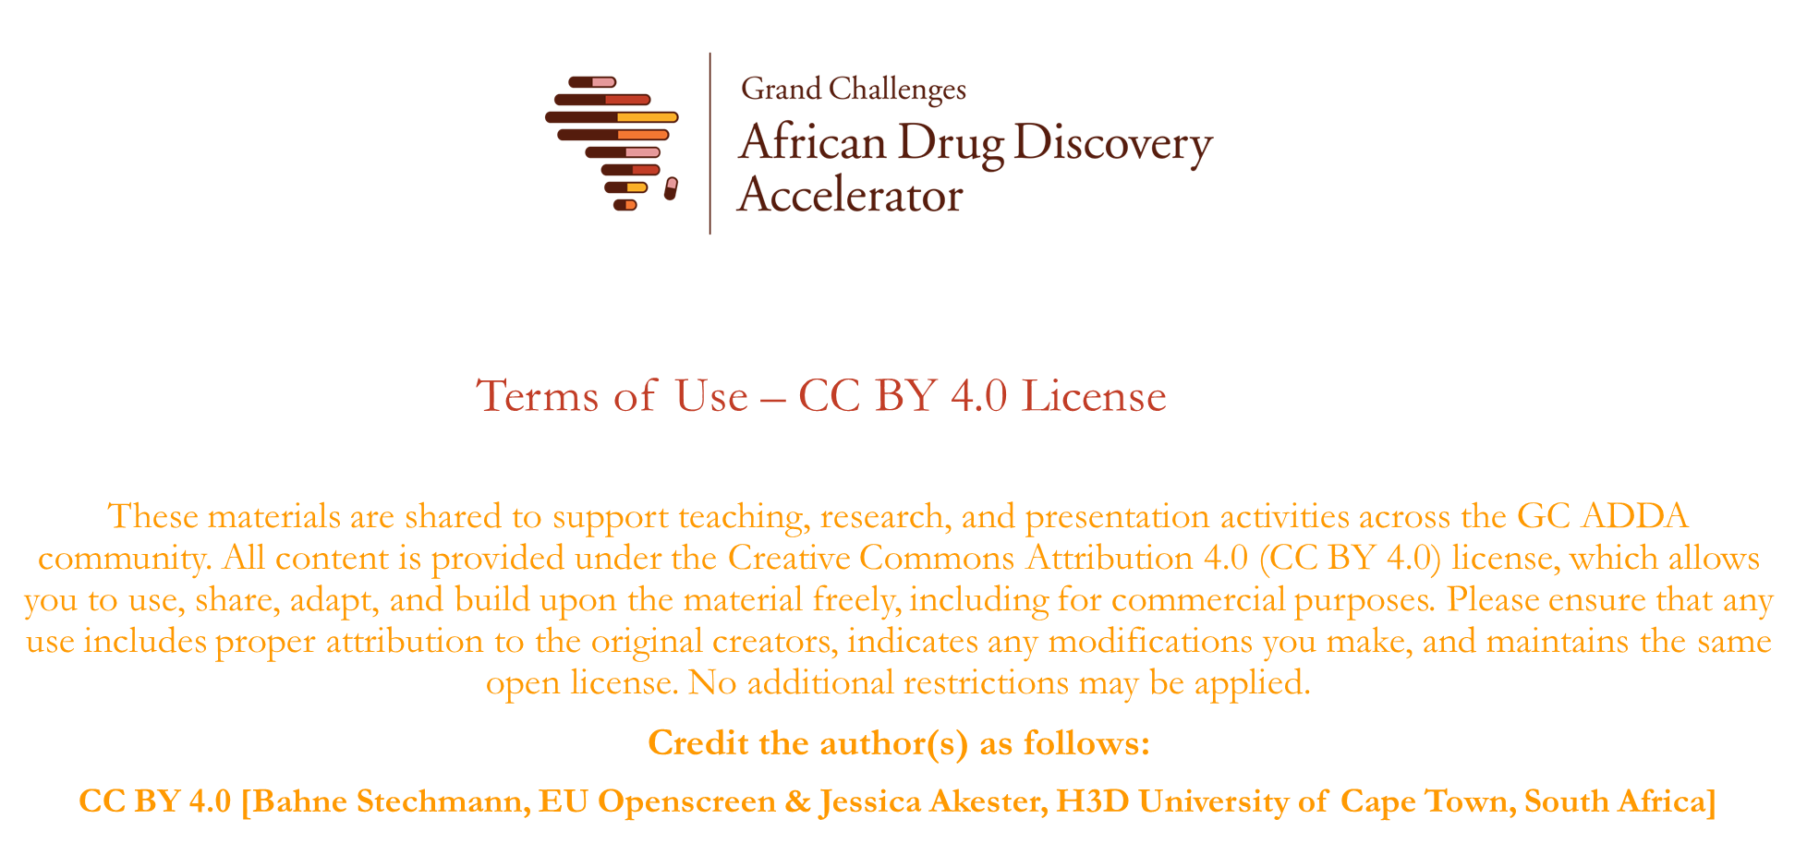

Slide 3

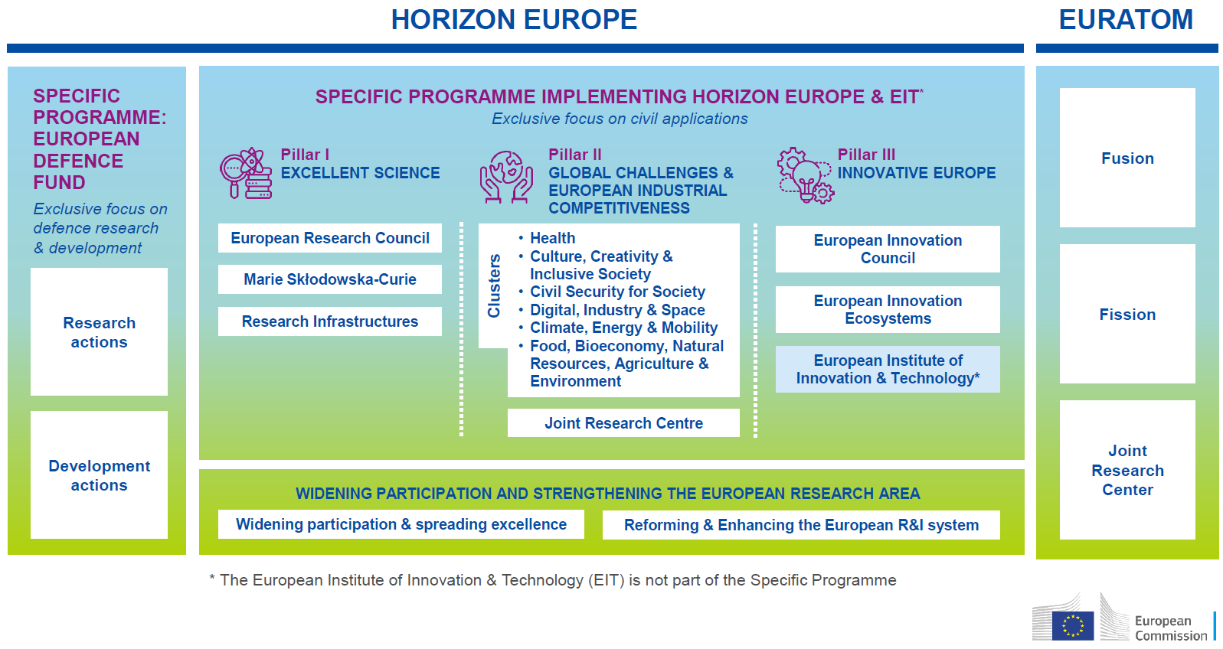
Project Management of larger multinational EU consortia
The EU has bilateral agreements with 20 individual countries around the world, including South Africa, Morocco, Egypt, Algeria, aiming to increase cooperation in research and innovation.

Slide 4





Proposal preparation: Organise your time and define your tools
List all steps until the deadline:
Project sheet & topic identification
Monitoring
  Work meeting
  Set-up SharePoint or Google Drive
Partners
  Identification & contact details
  Prepare project outline (2-3 pages) for prospective partners
  Letters of Engagement / NDAs (if needed)
  PIC's
  Regular consortium meetings
Workplan
  Definition of WPs, deliverables, milestones
  Partner's contributions
  GANTT & PERT charts
Sections of the Application (Part A and B)
Proof reading and editing time
Budget (as early and transparent as possible)
Submission / checks / internal validation

Slide 5

Building a consortium
Expand the consortium once the project’s scope and geographical coverage are defined
Consider a balanced geographical representation and complementarity between types of institutions and expertise
Involve SMEs/industry to maximise impact and exploitation
Be thoughtful about the size of your consortium and the selection of consortium partners

Slide 6

Coordination of the project proposal preparation
As the proposal coordinator, be ready to work a lot...
But also to delegate tasks, e.g., to specialists, WP leaders - collaborative work starts at the proposal stage
Do not scare your partners - prepare templates, ask for input to specific sections with clear instructions by realistic deadlines
Gather and consolidate input on collective capacity: projects, networks geographical outreach, exploitation potential, etc.
There should be one editor - typically the coordinator who has the overall picture of the project

Slide 7

Successful proposals
Make sense
  Concept responding to real needs, everything logically linked
Are consistent
  Proposal flows well
Address everything
  From work programme priorities to cross-cutting issues
Consider the evaluator’s perspective
  Be critical, consider perspectives of different types of evaluators
Look and sound good!
  Style, formatting, language and graphics

Slide 8

Unsuccessful proposals
Lack focus
Do not reflect the end-users’ needs
Do not provide added value
Are not sufficiently ambitious
Have a design flaw
Are not clear
Are messy

Slide 9
Questions?

