Slide 1
A Comprehensive Workshop on Preclinical Drug Discovery (CDD)
Drug Discovery in an African Context: Challenges and opportunities
Susan Winks

Slide 2
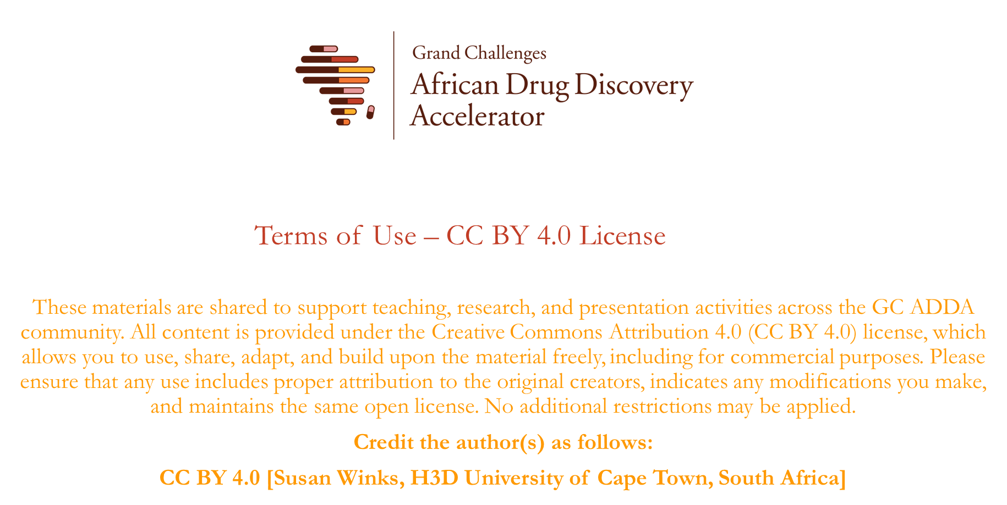

Slide 3
Learning Objectives
Practical understanding of the complexities and challenges of Drug Discovery and Development in Africa
Starting with what you have and building a track record
The power of networks/partnerships
Sustainability considerations

Slide 4
Why should we be doing drug discovery research in Africa?
Average cost of discovering a new drug and taking it to market is ~US$1.3 billion (South African total government R&D budget for 2023 was ~US$0.5 billion)
Rapid rise of new infectious diseases and non-communicable diseases (NCDs) in Africa
Impact on health and socio-economic development
The greatest threat in Africa is from the combined effect of the wide range of diseases in humans, crops, and animals, which interact with each other and with the environment
Strong interplay between genetics, the socioeconomic and physical environment in which patients live and effective treatment of disease
Applying “Northern” (developed world) solutions to Southern (developing world) problems will not always work
Therefore, Africans need to build drug discovery and development capacity in close proximity to African patient populations to understand and meet the pressing health needs of the continent and its people

Slide 5
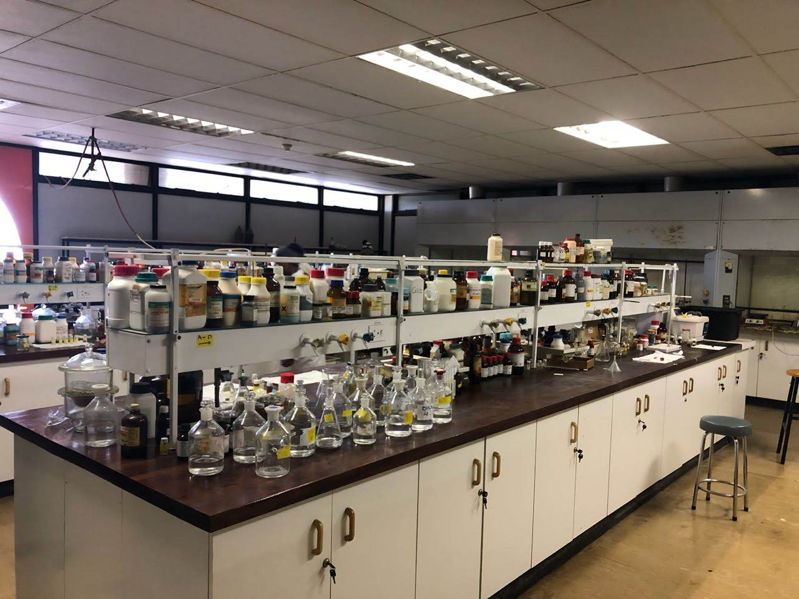
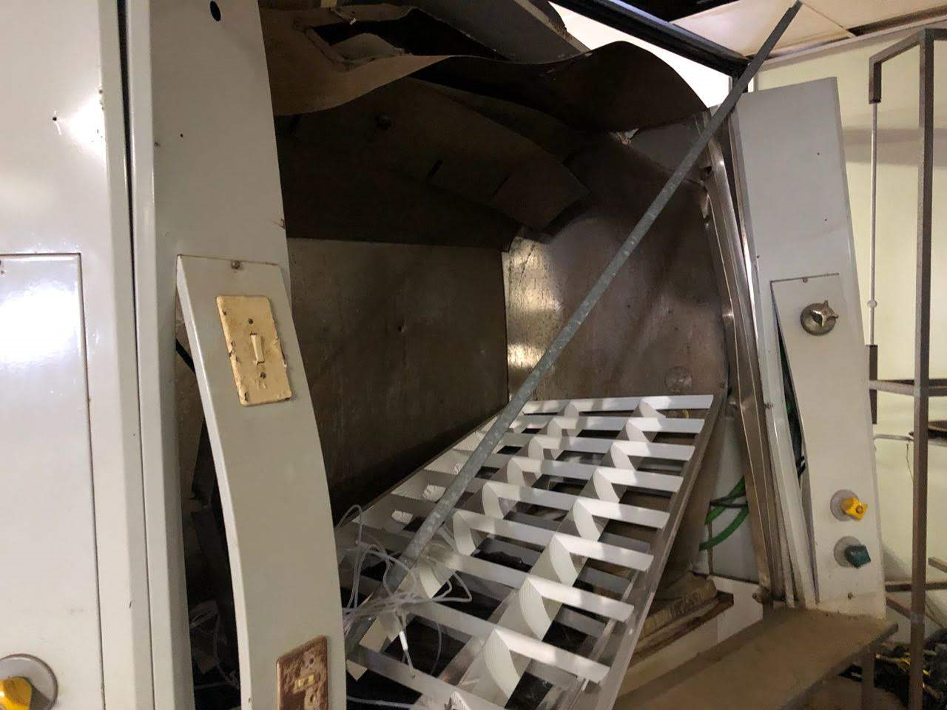
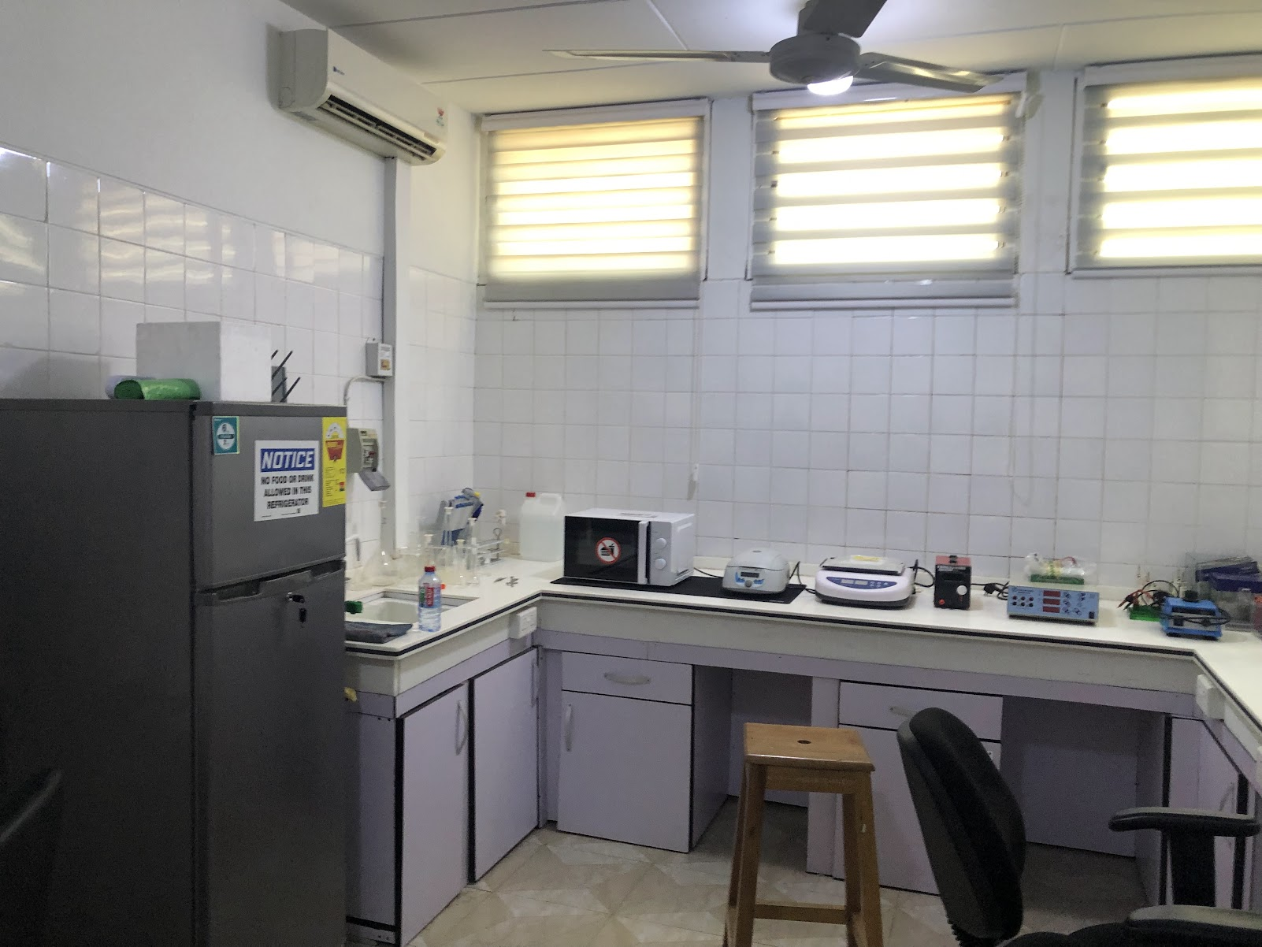
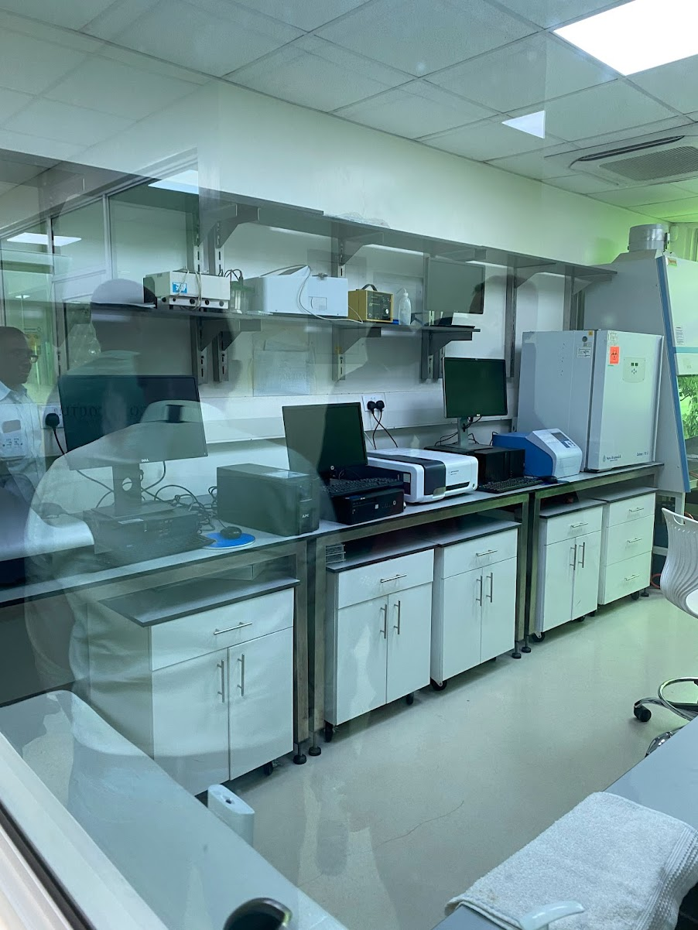
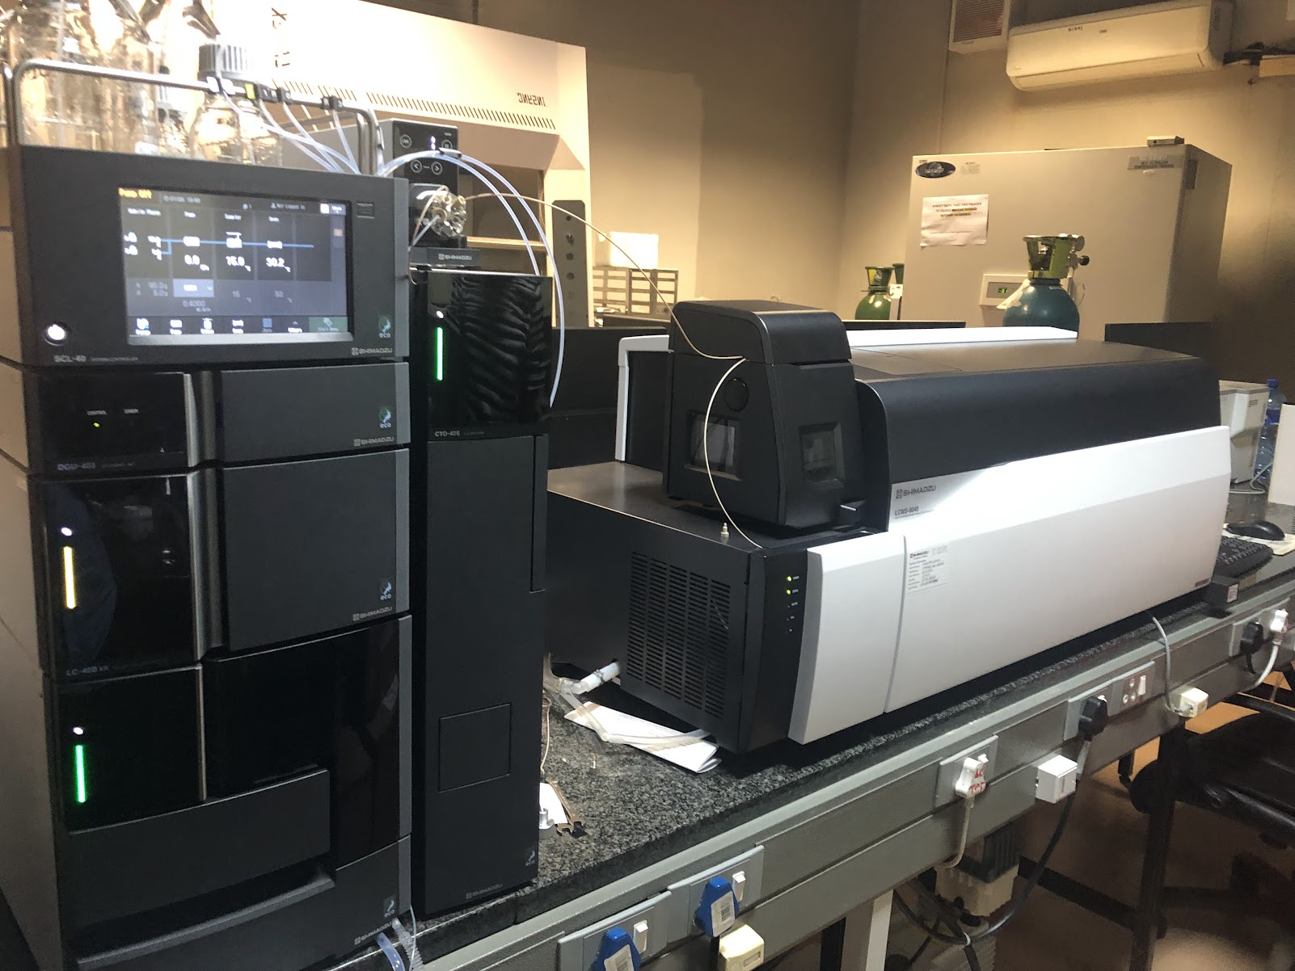
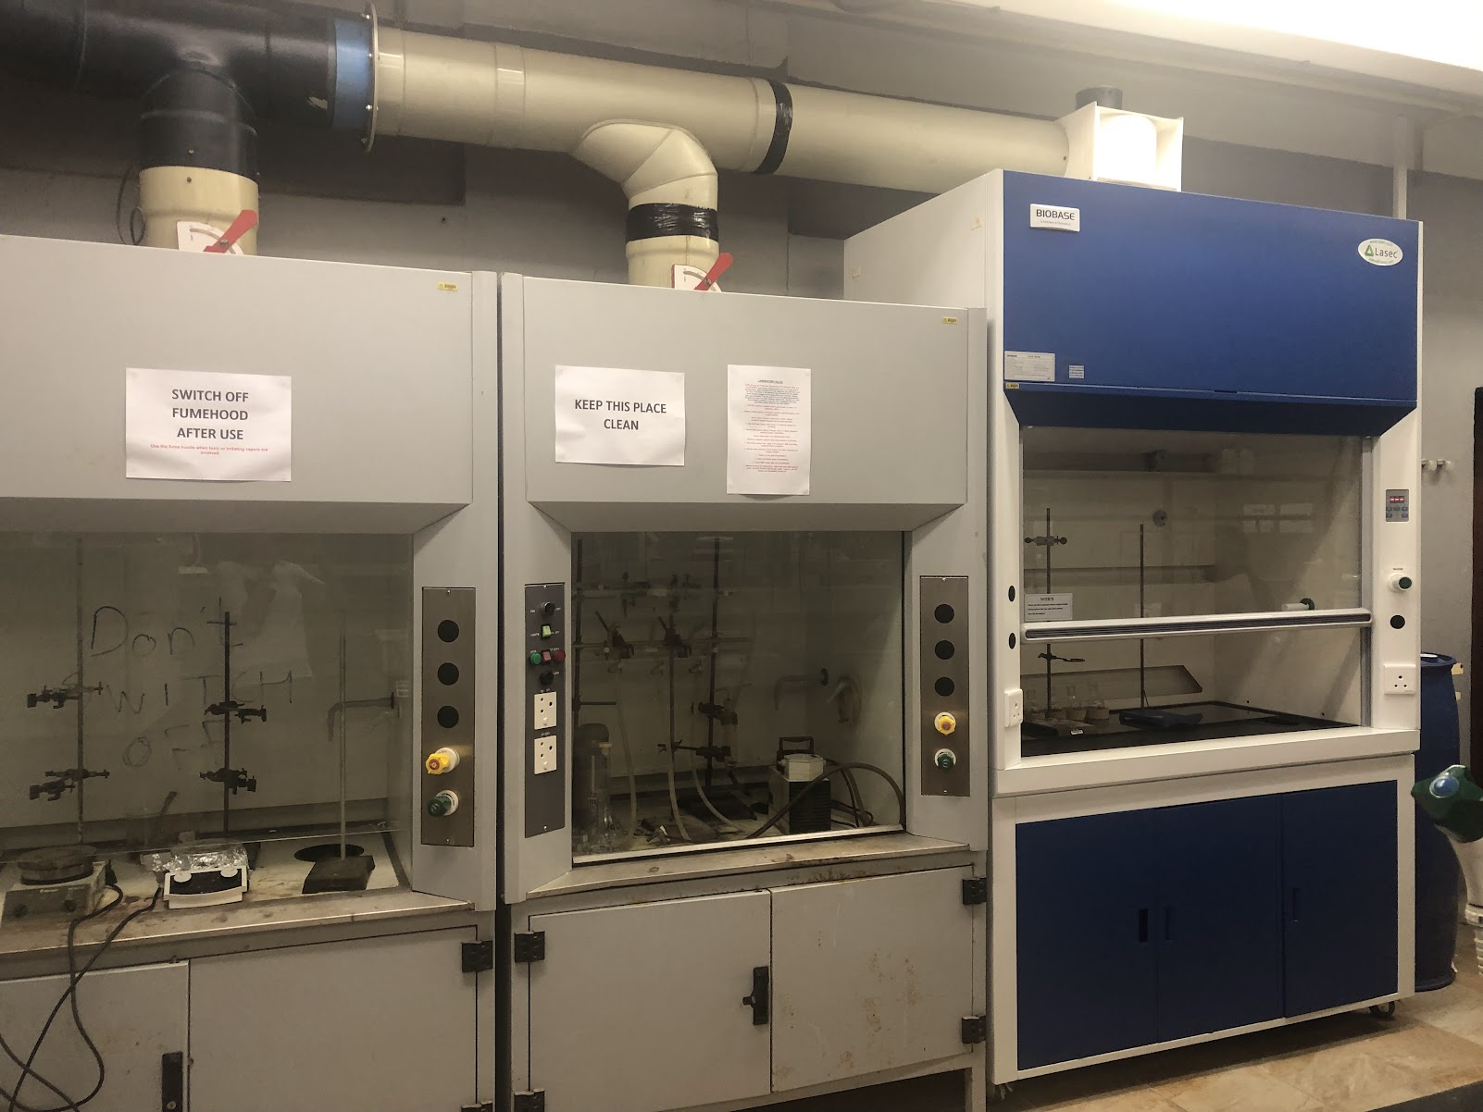
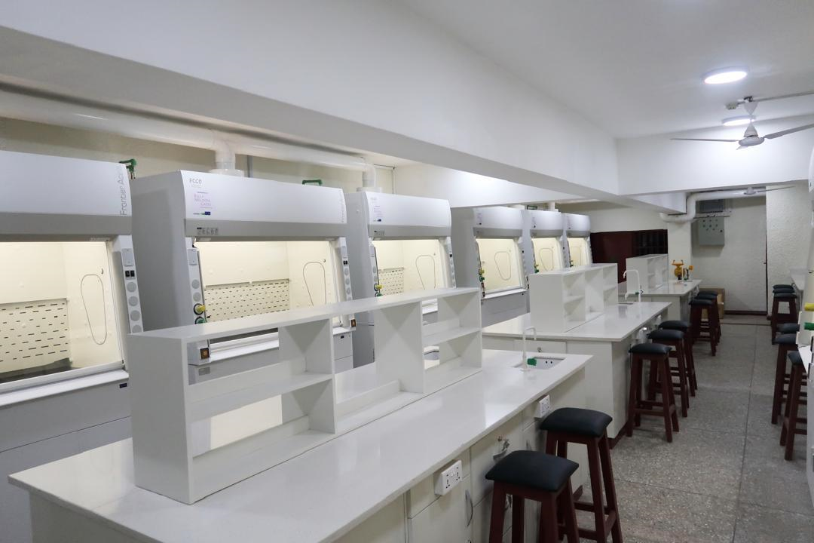
What does it mean to do research in Africa?

Slide 6
SWOT Analysis
STRENGTHS Strong academic training Natural product resources Understanding the local environment Flexibility & resilience Motivated to succeed | WEAKNESSES Limited resources Lack of research funding Supply chain issues for research consumables
OPPORTUNITIES Access to African patients and African disease burden (African population is the fastest growing, ~40% of the global population by 2100) African led solutions (therapies are not currently optimized for African patients) African research networks AI/ML tools and new technologies Pandemic Preparedness awareness and funding opportunities | THREATS Lack of regulatory harmonization Limited pre-clinical and clinical development funds Lack of infrastructure and equipment funding to support expansion “Brain Drain” -skills loss through emigration

Slide 7
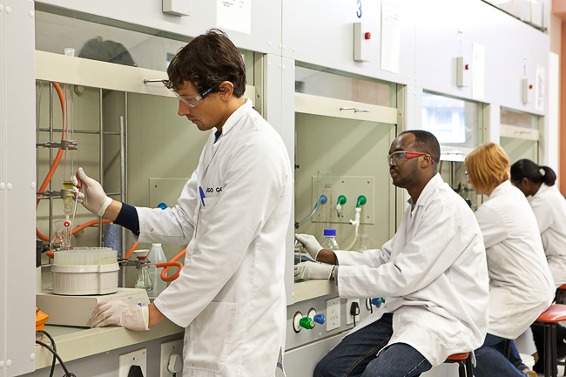
H3D Model: Start with Projects
Projects are always the drivers
Build a track record and demonstrate success in order to attract additional investment
Work with partners to access what you don’t have
Build local capacity required for the project, with a strategy to sustain it

Slide 8
AI/ML tools and new technologies
Look for tools/technology that will give you a competitive edge, fast track innovation and translation to better health outcomes in Africa
ZairaChem
  an artificial intelligence (AI)-and machine learning (ML)-based tool for quantitative structure-activity/property relationship (QSAR/QSPR) modelling.
  Virtual screening cascade for malaria and tuberculosis drug discovery comprising 15 models for key decision-making assays ranging from whole-cell phenotypic screening and cytotoxicity to aqueous solubility, permeability, microsomal metabolic stability, cytochrome inhibition, and cardiotoxicity.
  Designed for fast and easy implementation in low resource settings
Ref: Turon G, Hlozek J, Woodland JG, Kumar A, Chibale K, Duran-Frigola M. First fully-automated AI/ML virtual screening cascade implemented at a drug discovery centre in Africa. Nat Commun. 2023 Sep 15;14(1):5736. doi: 10.1038/s41467-023-41512-2. PMID: 37714843; PMCID: PMC10504240

Slide 9
Partnerships
Government partnership: aligning with national research priorities is critical to establishing strong government support, which can unlock additional foreign direct investment.
Working with product development partners allows you to access established networks of experts and the capabilities required in a particular disease area to take a product from discovery through to development.
Industry partnerships for global health research can be synergistic and beneficial to industry and academia. It takes time to build trust and requires a willingness on both sides to experiment to find the right model.
Partnerships with philanthropies with shared goals supports the development of infrastructure, long-term funding and access to relevant global networks.
Academic partnerships allow for leveraged resources, joint training initiatives and stronger research proposals.

Slide 10
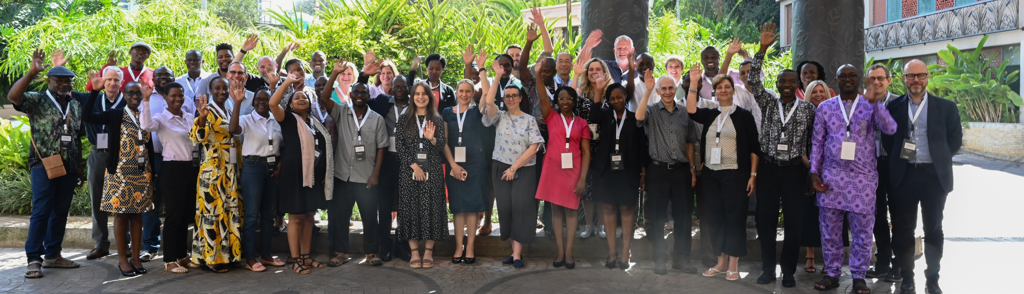
Consortia
Pre-competitive industry–academia collaborations like Tuberculosis Drug Accelerator (TBDA) and the Malaria Drug Accelerator (MalDA) serve as powerful mechanisms for accelerating research.
Grand Challenges African Drug Discovery Accelerator (GC ADDA) is a newly formed network. GC ADDA aims to create a sustainable ecosystem, to leverage the drug discovery research expertise, capabilities, infrastructure, and resources across the continent to support drug discovery for unmet medical needs, focussed on African health challenges and African innovation

Slide 11

Funding
Use seed funding to generate pilot data to allow you to attract bigger grants
Diversified funding sources provides more stability for research groups
Aim for long term strategic partnerships
Aim to “leverage funding” with multiple partners –shared risk/shared reward
Owning Intellectual Property Rights is a responsibility
Focus should be on building a strong track record

Slide 12
Fundraising
Fundraising for drug discovery research is a continual process
Proactive approaches to philanthropies, industry partners and government partners can yield longer term partnerships
Respond to funding calls that are well aligned with your priorities
Proposals must fit the call and should be achievable within the time frame
Writing successful proposals takes time and care. Plan well ahead of time.
Proposals should be hypothesis-driven and have supporting pilot data
Clearly state your project’s potential for impact

Slide 13
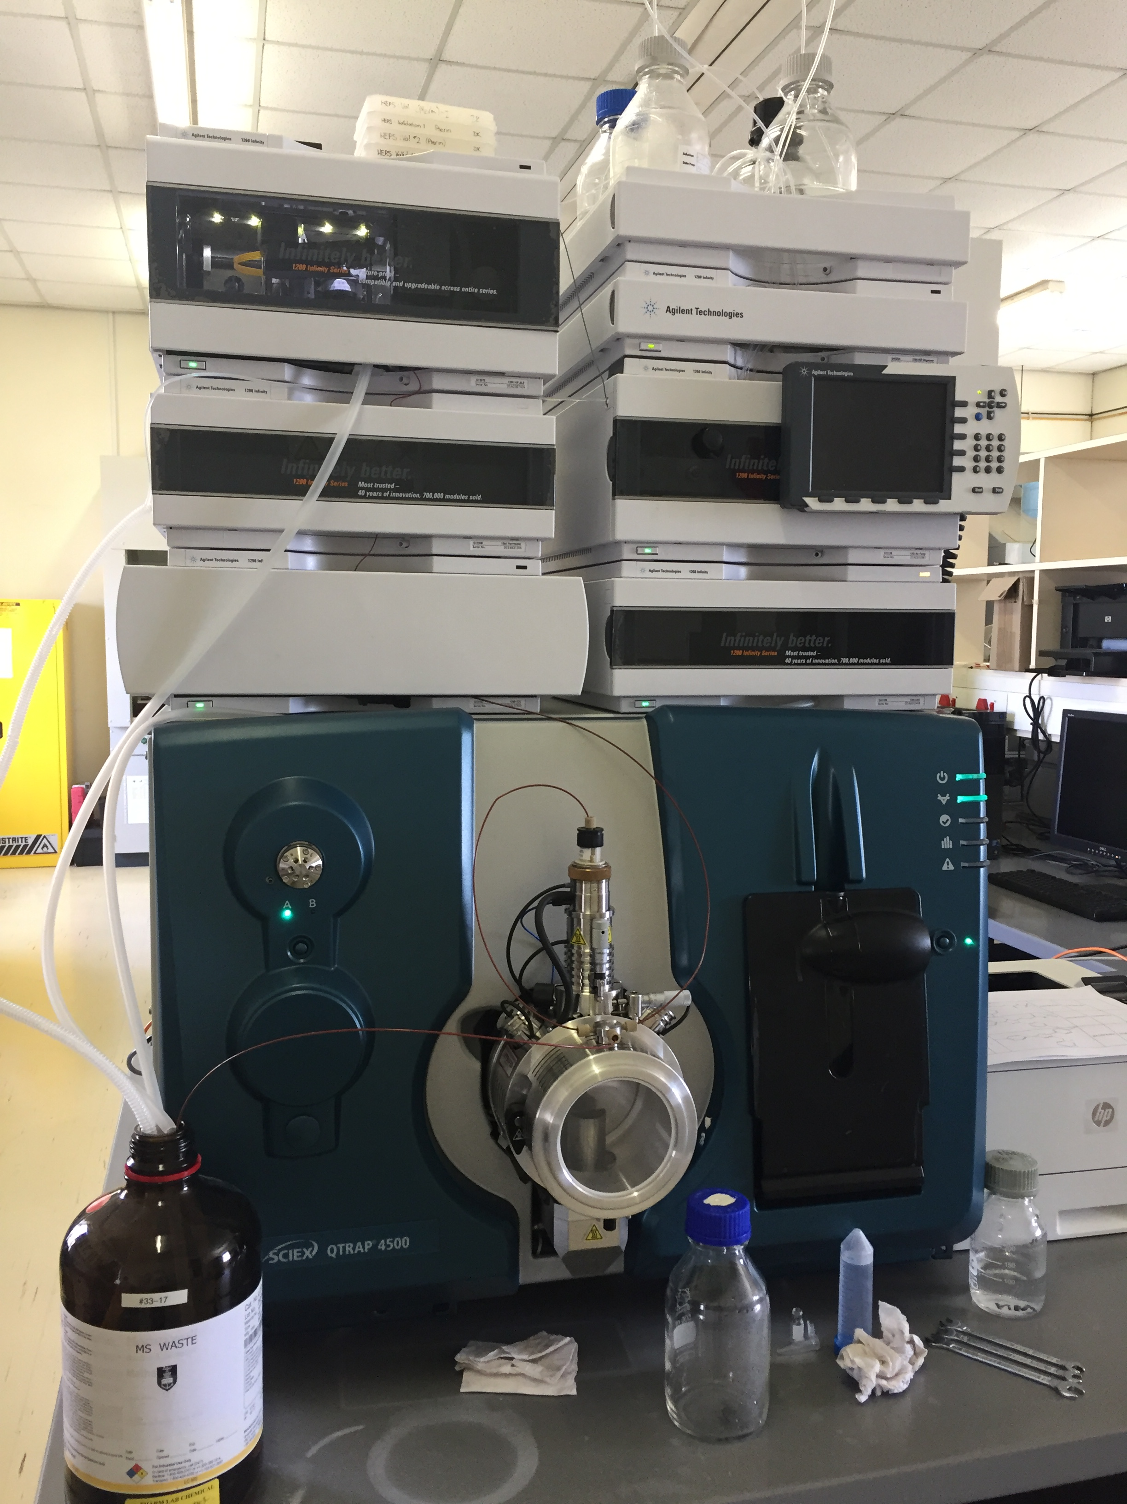
Equipment
What equipment is critical to success?
Is there enough work to justify owning and running it?
Is it more cost effective to access the equipment through other institutions?
Do you have the technical skills to operate it?
Do you have a plan for maintenance and service support? Can you get spare parts locally?
Are there other research groups who could share the responsibility/costs?
What is your plan for long term management and replacement?

Slide 14
Succeeding within a University environment
Institutional support is critical for overcoming operational challenges
Universities have different missions to research centres, which can require unique organisational structures and incentive structures
  Universities: have broad academic education mission; investigator driven academic research, timelines and processes align with academic calendar
  Drug Discovery Research Centres: drug discovery mission; innovation-driven translational research; highly team-based, interdisciplinary and collaborative; timelines need to be able to respond to evolving needs in real time to meet funder requirements and deliver on grant objectives
Work with your institutional research office and executive office to get support and buy-in for structuring your centre for success, including performance management structures
Proactively address institutional hurdles that impede research operations

Slide 15
Operational considerations
Systems and processes that support drug discovery research:
  Finance systems (Procurement, Budget management, Financial Reporting)
  Data Management systems (data storing, data analysis, data sharing)
  Sample Management (inventory management, dispensing, tracking, storing)
  Legal (collaboration agreements, non-disclosure agreements, material transfer agreements, funding agreements etc.)
  IP management (patent filing, technology transfer and licensing)
You need to get these right if you want to succeed!

Slide 16
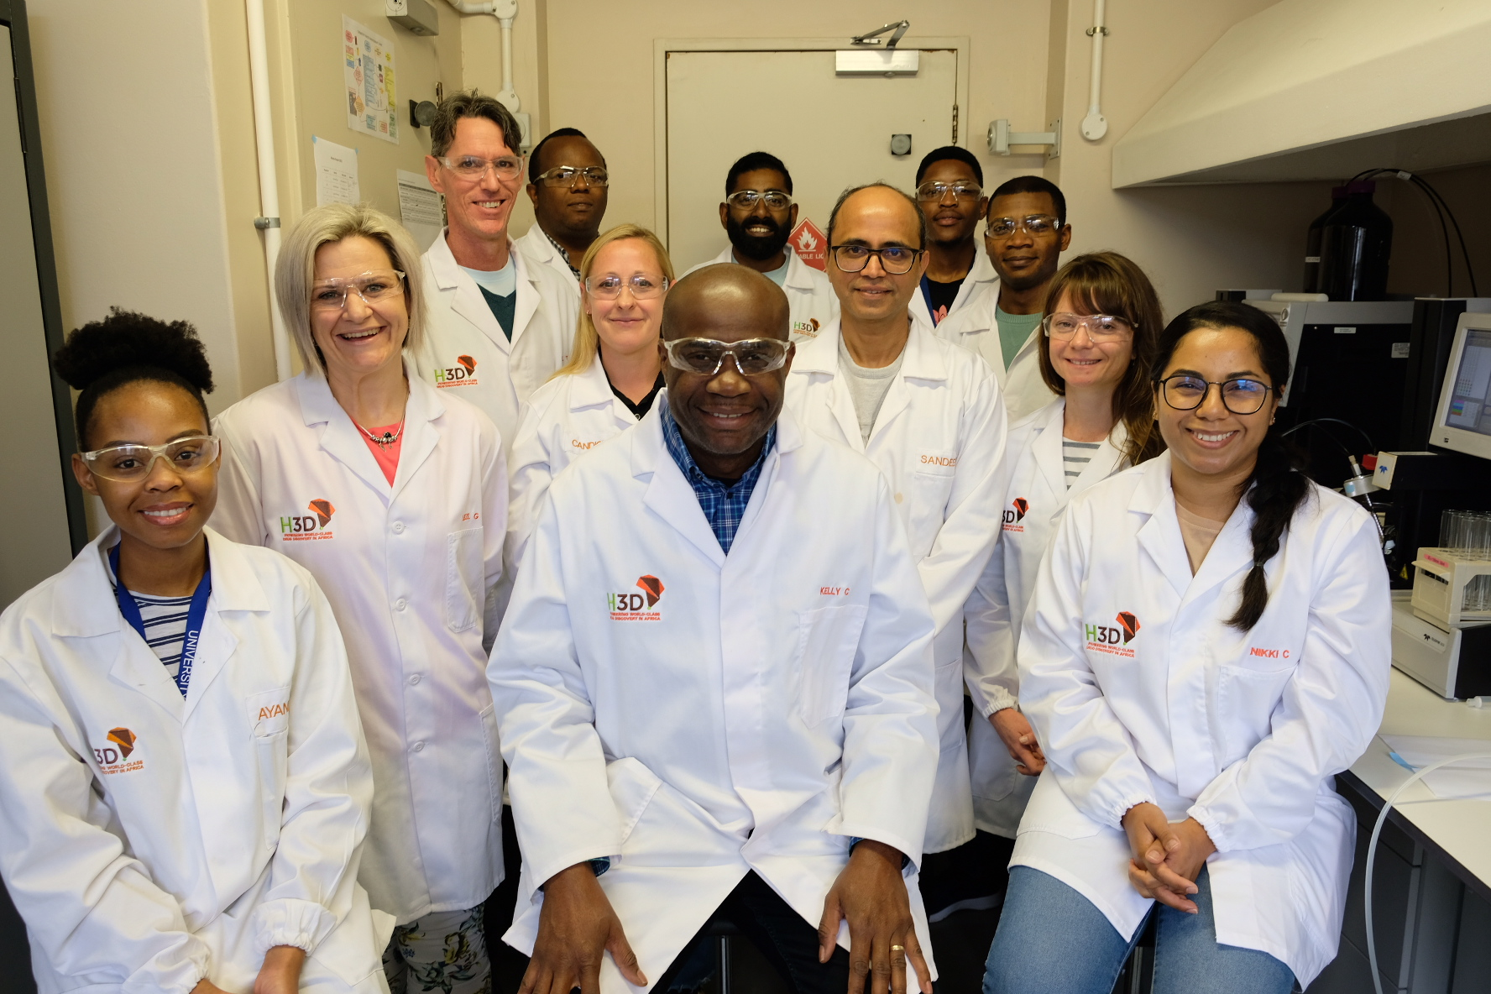
Organisation and interdisciplinary team structure
Matrix organisational structure to promote interdisciplinary team-work
Flexibility working with multiple international partners
  Strong communication plan
  Clear roles and responsibilities
Strong project management
Joint scientific governance from experts from different disciplines

Slide 17
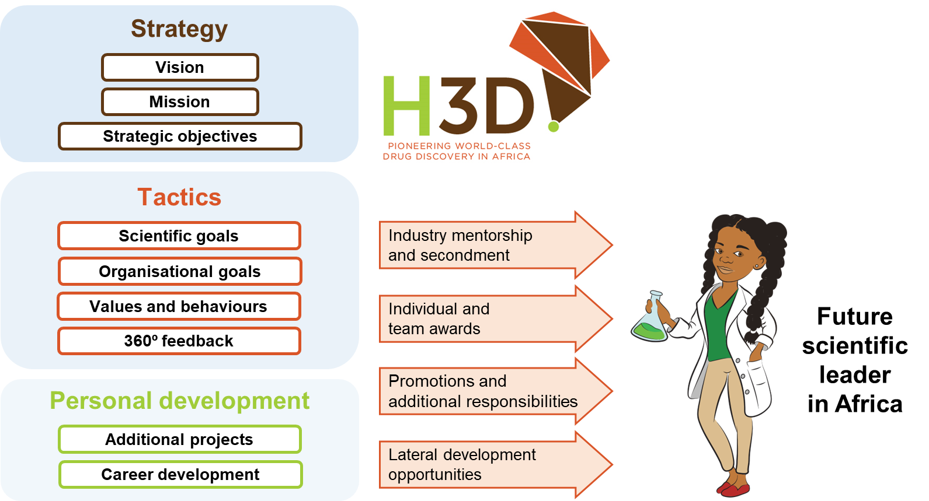
Developing and retaining skills
Create jobs and career paths, so that young scientists can see a way forward and will stay in Africa
Provide appropriate mentorship, scientific & leadership training

Slide 18
Key Takeaway
Drug Discovery research in Africa is critical to meet the pressing health needs of the continent
Focus on projects, funding will follow once you have established a track record
Partnerships are essential
To be sustainable you need to work with your institution to strengthen operational systems & create career paths to retain skilled scientists

Slide 19
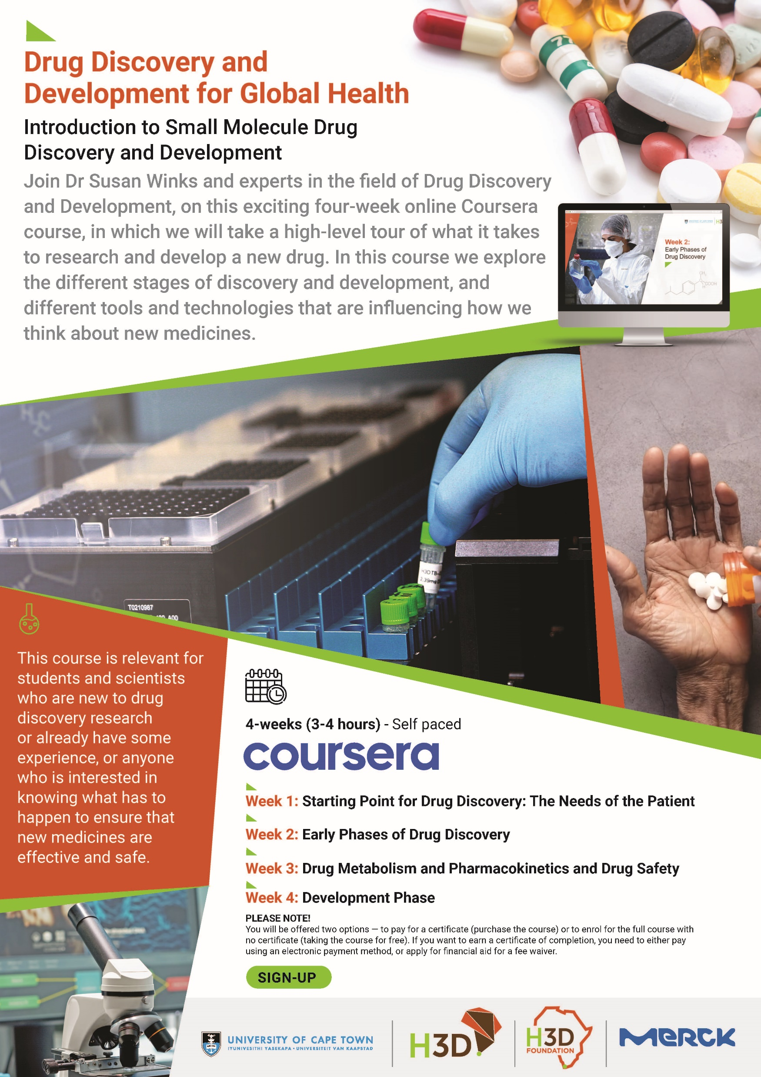
References
Winks S, Woodland JG, Pillai G', Chibale K. Fostering drug discovery and development in Africa. Nat Med. 2022 Aug;28(8):1523-1526. doi: 10.1038/s41591-022-01885-1. PMID: 35840729.
Turon G, Hlozek J, Woodland JG, Kumar A, Chibale K, Duran-Frigola M. First fully-automated AI/ML virtual screening cascade implemented at a drug discovery centre in Africa. Nat Commun. 2023 Sep 15;14(1):5736. doi: 10.1038/s41467-023-41512-2. PMID: 37714843; PMCID: PMC10504240.
Veale CGL, Edkins AL, Winks S, Njoroge M, Chibale K. Including African data in drug discovery and development. Nat Rev Drug Discov. 2023 Jul;22(7):521-522. doi: 10.1038/d41573-023-00088-8. PMID: 37264173.
“Introduction to Small Molecule Drug Discovery and Development” online course, Coursera, 2023.

Slide 20
Questions?

