Slide 1
A Comprehensive Workshop on Preclinical Drug Discovery (CDD)
Case Histories: Drug Optimization,
Repurposing, Repositioning for Covid-19
Greg Basarab

Slide 2
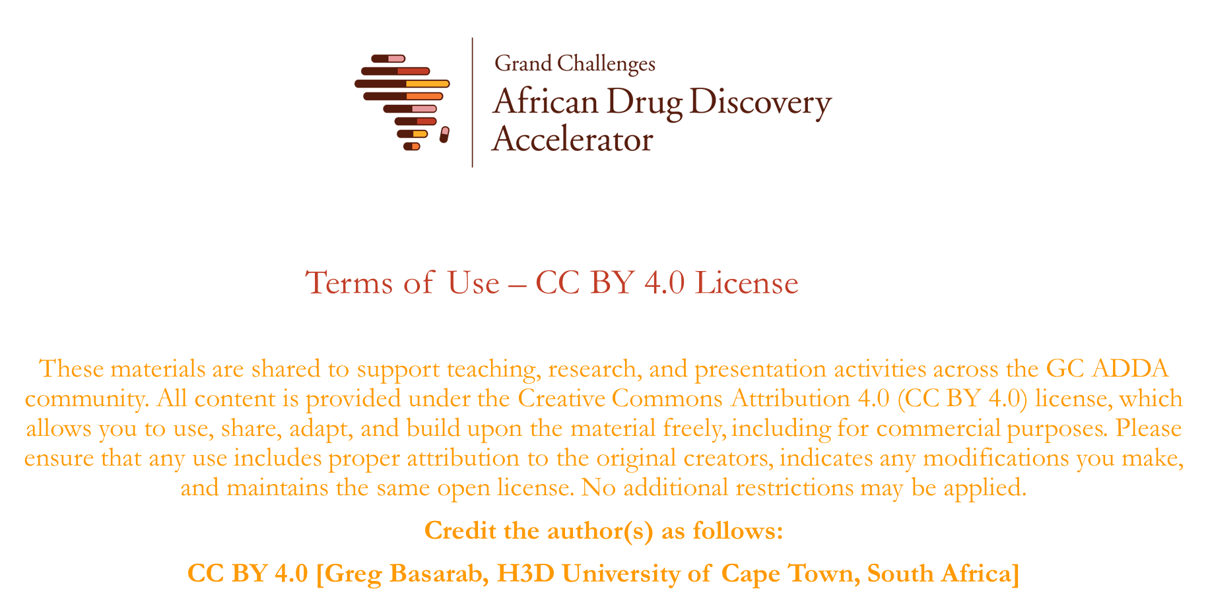

Slide 3
Learning objectives
Considerations around:
Development of existing drugs for new purposes
Drug dosing
Drug Pharmacokinetics (PK)/Pharmacodynamics (PD)
Drug toxicology
Drug development timelines
Covid-19 hysteria

Slide 4
Typical drug development timeline
Zoliflodacin - single dose cure for gonorrhea
Scaffold ID’d
Drug ID’d
2000
May2010
IND Submission
Regulatory
Approval
Jan 2025?
Jun 2012
2000
2004
2008
2012
2016
2020
2024
2000 | 2004 | 2008 | 2012 | 2016 | 2020 | 2024
Pfizer Discovery
AZ Discovery
Pre-clinical
Phase 1
Phase 2
Phase 3
NDA
FDA
1st CD
2nd CD
Phase 1
QTc
4 CD’s over 6-8 years
3rd CD
Phase 1
ADME
Phase 1 Bioequivalence

Slide 5
Definitions
Drug Repositioning: Investigation of existing drugs for new therapeutic purposes
Drug Repurposing: Investigation of failed or shelved drugs for new therapeutic purposes
Drug Modification: Analog optimization of an existing drug for new/expanded therapeutic purposes

Slide 6
Drug repositioning/repurposing/modification
Advantages of repositioning & repurposing & modification
Fast development timelines
Quick target validation & activity characterization (all)
Close-in analogues known or available (modification)
Favorable PK & biopharmaceutics properties (repositioning & repurposing)
Favorable toxicology (repositioning & repurposing)
No need for pre-clinical & clinical (Ph1) investigations (repositioning/repurposing)
Established pharmaceutical supply & distribution chain, formulation technology (repositioning)
Knowledge of drug-drug interactions (repositioning/repurposing maybe modification)

Slide 7
However…
However…(for repurposing & repositioning)
Pharmacodynamic parameters need to be re-investigated:
- target population will be different
- target tissue may be different
- PD driver may differ ⇒ alternate dosing regimen
- Regulatory review process required incl. Phase 2/3 clinical trials
and Intellectual Property (IP) rights need to be assessed

Slide 8
Drug Repositioning Investigation of existing drugs for new therapeutic purposes
Compound | Primary disease | Repositioning
Acetylsalicylate | Mild analgesic | Antithrombotic
Amantadine | Influenza | Parkinson’s disease
Bleomycin | Various cancers | Pleural effusion
Cycloserine | Tuberculosis | Urinary tract infections
Cyclosporin | Transplant rejection | Rheumatoid arthritis; Psoriasis
Eflornithine | Facial hirsutism | Sleeping sickness
Finasteride | Benign prostate enlargement | Male pattern baldness; Hersutism in women
Histrelin | Prostate cancer | Precocious puberty
Infliximab | Ulcerative colitis; Crohn’s disease | Rheumatoid arthritis; Psoriasis
Interferon alfa | Hepatitis B and C | Various cancers
Retuximab | Various cancers | Rheumatoid arthritis
Bleomycin | Various cancers | Pleural effusion

Slide 9
Drug Repurposing Investigation of failed or shelved drugs for new therapeutic purposes
Drugs get shelved drugs due to:
Insufficient efficacy
Commercial failure
Re-evaluation of market potential
Costs and difficulty of clinical trials
Compound | Initial indication | Repositioned
Sildenafil | Angina | Erectile dysfunction
Gemcitabine | Antiviral | Cancer
Doxycylcline | Periodontic | Rosacea, antimicrobial
Minoxidil | Hypertension | Hair loss

Slide 10
Drug Modification Analog optimization of an existing drug for new/expanded therapeutic purposes
Cephalosporins | Example | Pathogen spectrum
First generation | cefalotin | Gram-positive cocci
Second generation | cefachlor | Gram-positive cocci Some Gram-negative bacilli
Third Generation | ceftriaxone | Gram-positive cocci, Enterobacteriaceae Fastidious Gram-negatives
Fourth Generation | cefepim | Gram-positive cocci, Enterobacteriaceae (incl. Amp-C β-lactamase producing) Fastidious Gram-negatives P. aeruginosa
Fifth Generation | ceftaroline fosamil | Gram-positive staph (incl. MRSA) Gram-positive cocci (incl. PRSP) Enterobacteriaceae Fastidious Gram-negatives

Slide 11
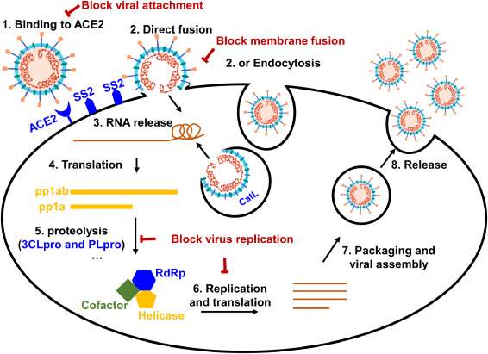
SARS-CoV-2 Life Cycle
Three anti-virals have achieved regulatory approval for the treatment of COVID-19
(aka Mpro)

Slide 12
A Brief History of Quinoline Antimalarials
Drug
Modification
Repositioned for
SARS-CoV-2

Slide 13
Human PK of Hydroxchloroquine (HCQ)
Hydroxychloroquine
EC₅₀ = 20-35 nM (~9.2 ng/ml) vs P. falciparum
800 mg dose HQ: fCmax/EC₅₀ ≈ 10.4 fAUC/EC₅₀ ≈ 180
 | 200 mg | 800 mg*
C_{max} (ng/ml) | 44 | 176
fC_{max} (ng/ml) | 24 | 96
AUC_{0-∞} (ng h/ml) | 753 | 3012
fAUC_{0-∞} (ng h/ml) | 414 | 1656
*extrapolated
HCQ EC₅₀

Slide 14
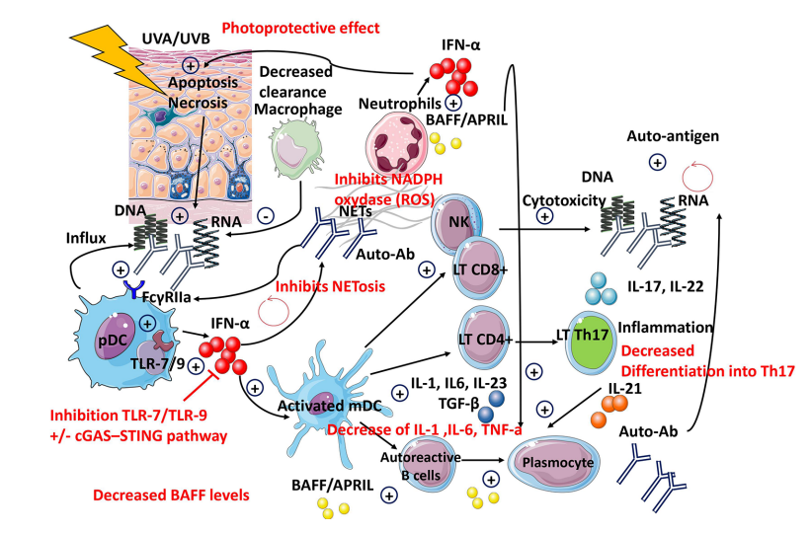
HCQ Repositioning for Lupus
Upwards of 5 mg/kg/day ⇒ 200-400 mg daily doses

Slide 15
HCQ Repositioning for SARS-CoV-2
Hydroxychloroquine
EC₅₀ = 900-1500 nM (~400 ng/ml) vs SARS-CoV-2
800 mg dose HQ: fCmax/EC₅₀ ≈ 0.24 fAUC/EC₅₀ ≈ 4.1
HCQ EC₅₀
HCQ hERG IC₂₀

Slide 16
Analysis of Clinical Data
In June 2020, the FDA ended the emergency use of hydroxychloroquine and chloroquine for treatment of COVID-19.
Over time, clinical trials showed hydroxychloroquine:
Led to serious heart problems in some people
Did not effectively treat COVID-19
Did not prevent infection with the virus that causes COVID-19

Slide 17
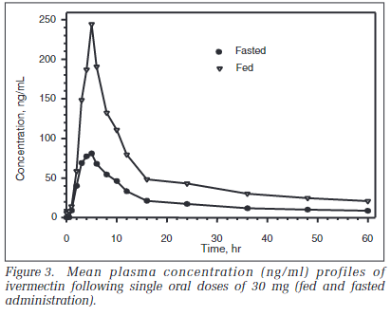
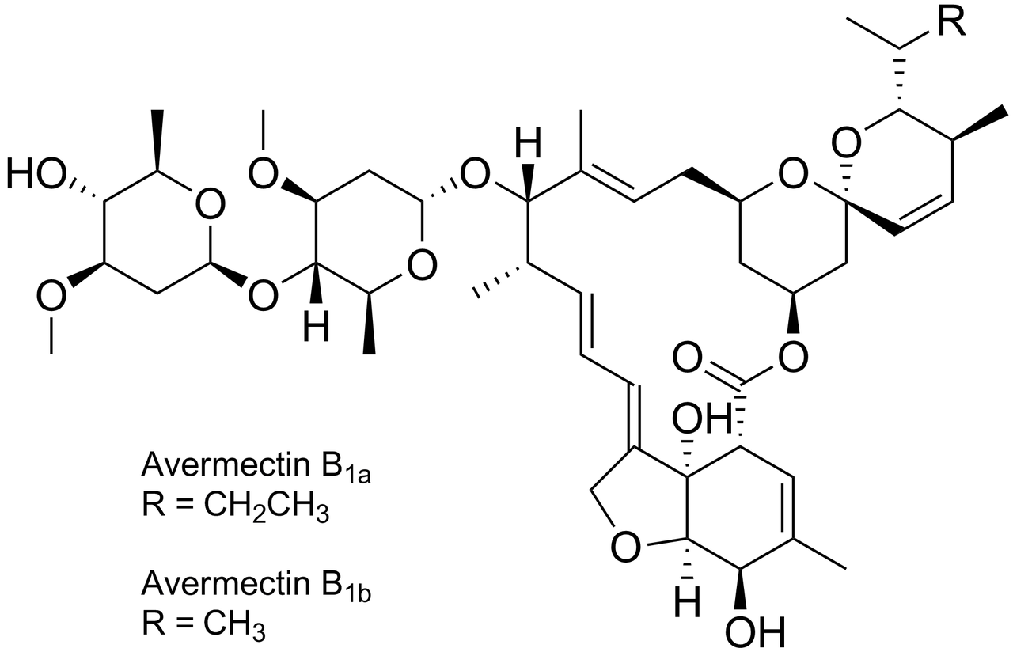
Repositioning of Ivermectin for SARS-CoV-2
Approved treatments (once or twice yearly):
10.5 mg (onchocerciasis), 14 mg (strongyloidiasis), 10.5-14 mg (lymphatic filariasis)
~50% reduction @ 100 ng/ml against O. volvulus field isolates
EC₅₀ ≈ 2100 ng/ml against SARS-Cov-2
EC₅₀/fC_{max} > 100 (30 mg dose)
ng/ml | 30 mg fed | 30 mg fasted | 60 mg fasted | 90 mg fasted | 120 mg fasted
C_{max} | 261 | 85 | 165 | 158 | 248
fC_{max} | 16 | 5.4 | 10.4 | 9.95 | 15.6
100 ng/ml vs O. volvulus

Slide 18
FDA Guidance
Ivermectin is approved for human use to treat infections caused by some parasitic worms and head lice and skin conditions like rosacea.
Currently available data do not show ivermectin is effective against COVID-19.
Taking large doses of ivermectin is dangerous.
Animal ivermectin products are very different from those approved for humans. Use of animal ivermectin for the prevention or treatment of COVID-19 in humans is dangerous.
ACTIV-6 Clinical Trial: Ivermectin 600 μg/kg (42 mg for 70 kg person) Once Daily in 566 Outpatients With Mild to Moderate COVID-19
 | Med. Time to Recovery (days) | Adverse Effects | Serious Adverse Effects | Hospitalizations or Deaths (d28)
Ivermectin | 11 | 9.2% | 0.9% | 5
Placebo | 11 | 7.1% | 0.5% | 2

Slide 19
Remedesivir – Drug Repurposing
Remdesivir
Inhibitor of viral RNA dependent RNA polymerase (RdRp)
RNA elongation terminated on incorporation into chain
IV treatment for Hepatitis C – superseded by close-in analog sofosbuvir
Active vs MERS-CoV & SARS-CoV - mouse & monkey efficacy
Developed as a treatment Ebola (Phase 2/3 trials) – perhaps ongoing

Slide 20
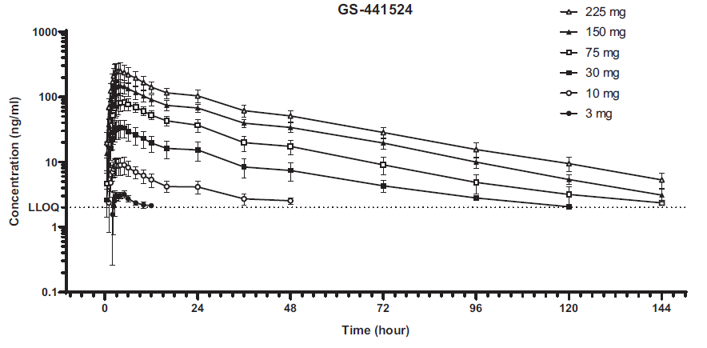
Drug Repurposing - Remdesivir
EC₅₀ (SARS-CoV-2) = 9.9 nM (human airway epithelial cells)
Review of 8 Randomized Clinical Trials (10480 hospitalized patients):
Inconclusive for seriously ill patients (high flow oxygen, mechanical ventilation)
2% fewer deaths (28d) when patients on no or low-flow oxygen – statistically significant
No increase in adverse or serious adverse events over placebo/no remdesivir
Approved in more than 50 countries worldwide to reduce the risk of hospitalization or death for patients with mild to moderate COVID-19
20

Slide 21
Drug Repurposing - Molnupiravir
Discontinued drug in development for treatment of influenza – concerns about mutagenicity
In development for the treatment Venezuelan equine encephalitis virus (VEEV)
Inhibitor of viral RNA dependent RNA polymerase (RdRp)
Ester prodrug get cleaved – nucleoside metabolite gets phosphorylated
Differentiated mode-of-inhibition (vs. remdesivir): missense incorporation into RNA & viral death
Nucleosides often w/ high barriers to resistance
Planned IND in June 2020, but accelerated due to demonstrated SARS-CoV-2 activity
Oral treatment for SARS-Cov-2 approved in the UK for patients with severe risk factors
FDA Emergency Use Authorization (EUA) for populations where other treatments are not feasible

Slide 22
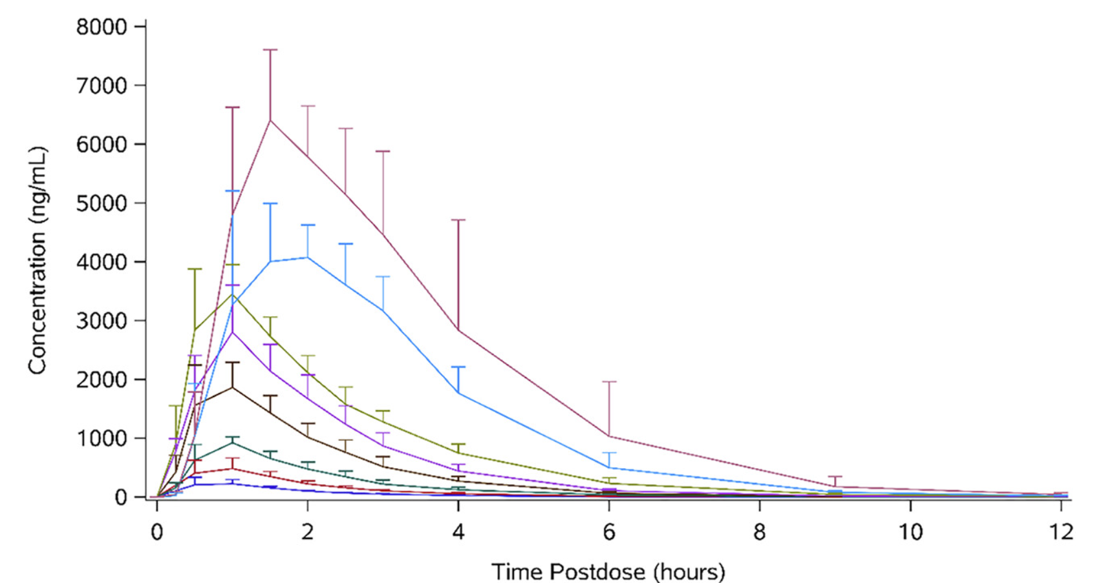
Human PK of Molnupiravir
IC₅₀ = 150 nM Calu-3 cells
300 nM Vero cells
Clinical dose: 800 mg every 12 h
IC₅₀ = 78 ng/mL

Slide 23
Issues of Molnupiravir Mutagenicity
Ames positive – Bacterial indicator of mutagenicity
Negative in MLA micronucleus assay
in vivo rat micronucleus
Rat Pig-a-gene mutagenicity
Big Blue® mutagenicity
Whistleblower testified in May 2020 (US House of Representatives) denouncing U.S. government's touting of hydroxychloroquine as a ‘game changer’ and acceleration of molnupiravir.
Phase 1 (Ridgeback Therapeutics) in April 2020.
Phase 2/3 (Merck) began in October 2020 - 709 drug, 699 placebo patients
6.8% of patients on molnupiravir were hospitalized or died (29 days)
9.7% of patients on placebo were hospitalized or died (29 days)
Nov 2021: FDA approval for mild-to-moderate COVID‑19 in adults at high risk for progression to severe COVID‑19.
Nov 2022: British National Institute for Health and Care Excellence recommended against molnupiravir routine use to treat COVID‑19 ⇒ no significant difference to hospitalization or death rates & not cost effective.
chromosome
aberrations

Slide 24
Drug Repositioning - Ritonavir
Ritonavir (Abbvie)
1990 – 1st disclosure as HIV-protease inhibitor
1996 – 2nd HIV protease drug into clinical use – initially as a single agent
2014 – combined w/ ombitasvir & paritaprevir for HCV
2021 – combined w/ nirmatrelvir for SARS CoV-2
}
CYP3A4
inhibitor
Developed as protease inhibitor for the treatment of HIV
Superseded by other HIV protease-inhibiting drugs
However ... it is used in combination with other HIV protease inhibitors
Notable inhibitor of CYP3A4: drug-drug interactions (DDI)
Repurposed (Repositioned): PK adjuvant for treatment of Hepatitis C (HCV) – no intrinsic activity
Favorable PK & biopharmaceutics properties
Repurposed PK adjuvant for treatment of SARS-Cov-2
No activity against SARS-CoV-2

Slide 25
Drug Modification Leading to Nirmatrelvir
PF-00835231: M^{pro} inhibitor effective for SARS-CoV-1 (SARS 2002-2004 epidemic)
Absorptive permeability/low oral absorption addressed in analogue program
Switch of reversible covalent warhead from ketone to nitrile
PF-07321332: potent M^{pro} affinity & antiviral activity – brief optimization campaign
Good bioavailability but only moderate clearance (CYP3A4 metabolism)
PK rescued by co-administration with ritonavir (now generic)
Efficacy shown in mouse model of viral infection
Favorable safety profile

Slide 26
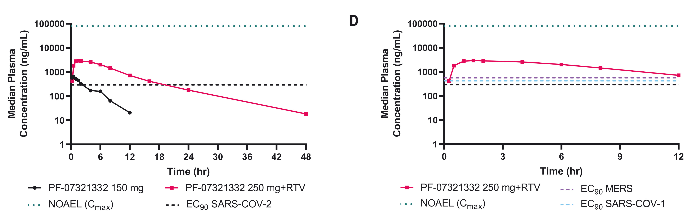
Paxlovid: Nirmatrelvir-Ritonavir Combination
Human PK
Positive results of direct SARS-CoV-2 testing ☺ Emergency use authorization (FDA, Dec 2021) for mild-to-moderate coronavirus disease (COVID-19) in adults & pediatrics (12 years & older; 40 kg or higher)
EC₉₀ = 0.090 µg/ml
Total EC₉₀ = 0.29 µg/ml
Total EC₉₀/C_{max} ≈ 0.1
Dosing: 300 mg nirmatrelvir; 100 mg ritonavir – Twice a Day

Slide 27
Paxlovid (Nirmatrelvir and Ritonavir) Timeline
First oral antiviral to reduce the risk of hospitalization or death due to mild-to-moderate COVID-19;
Apr 2022 – Early SARS CoV-2 Ph 2/3
May 2020 – Randomized SARS CoV-2
Ph 2/3 – still ongoing
Drug repurposing: ritonavir (CYP3A4 inhibitor)
2014 – HCV
(in combination)
Jan 2020 WGS
SARS Cov-2
1996 - HIV
Mar 2022 – Non-hospitalized patients & severe pediatrics Ph 2/3
May 2023– FDA full approval
Dec 2021 – Covid-19
Emergency use authorization
2003 – PF00835231
CD for SARS CoV-1
2020 – Drug repositioning: Nirmatrelvir
M^{pro} inhibitor
20 months: ‘Compound in the freezer’ to regulatory submission

Slide 28
Summary
Know your pharmacology
Mode-of-action
in vitro to in vivo translation of efficacious effects
In vitro to in vivo translation of pharmacokinetics
Evaluate doses and regimens
Address toxicology issues
Consider opportunities relevant to mode-of-administration
Apply modern methods of Drug Discovery & Development
Understand the reasons the drug may have succeeded or may have failed

Slide 29
References
Slide 8: SARS-CoV-2 Life Cycle - Su et al., Fundam. Res. 1(2), 151 (2021)
Slide 10: Human PK of HCQ - Fan et al., Rheumatol Ther 2, 183 (2015)
Slide 11: HCQ for Lupus - Dima et al., Ther. Adv. Musculoskel. Dis. 14, 1-25 (2022)
Slide 12: HCQ for Covid - Bansal et al., Ann. Med. 53(1), 1117 (2019)
Slide 14: Ivermectin PK - Guzzo et al., J. Clin. Pharmacol. 42, 1122 (2002)
Slide 15: Ivermectin clinical data - www.clinicaltrials.gov
Slide 17: Human PK of remdesiver - Humeniuk et al., Clin. Transl. Sci. 13, 896 (2020)
Slide 17: Remdesivir clinical trial data - Amstutz et al., Lancet 11, May, 453 (2023)
Slide 19: Human PK of Molnupiravir - Painter et al., Antimicrob. Agents Chemother., 65(5) 02428-20 (2021)
Slides 22 & 23: Nirmatrelvir - Owen et al., Science 374, 1586–1593 (2021)

Slide 30
Questions?

