Slide 1
Principles of Compound Optimization
Drug-likeness: Multiparameter optimization in Small-molecule Drug Discovery
Dr. Richard Amewu

Slide 2
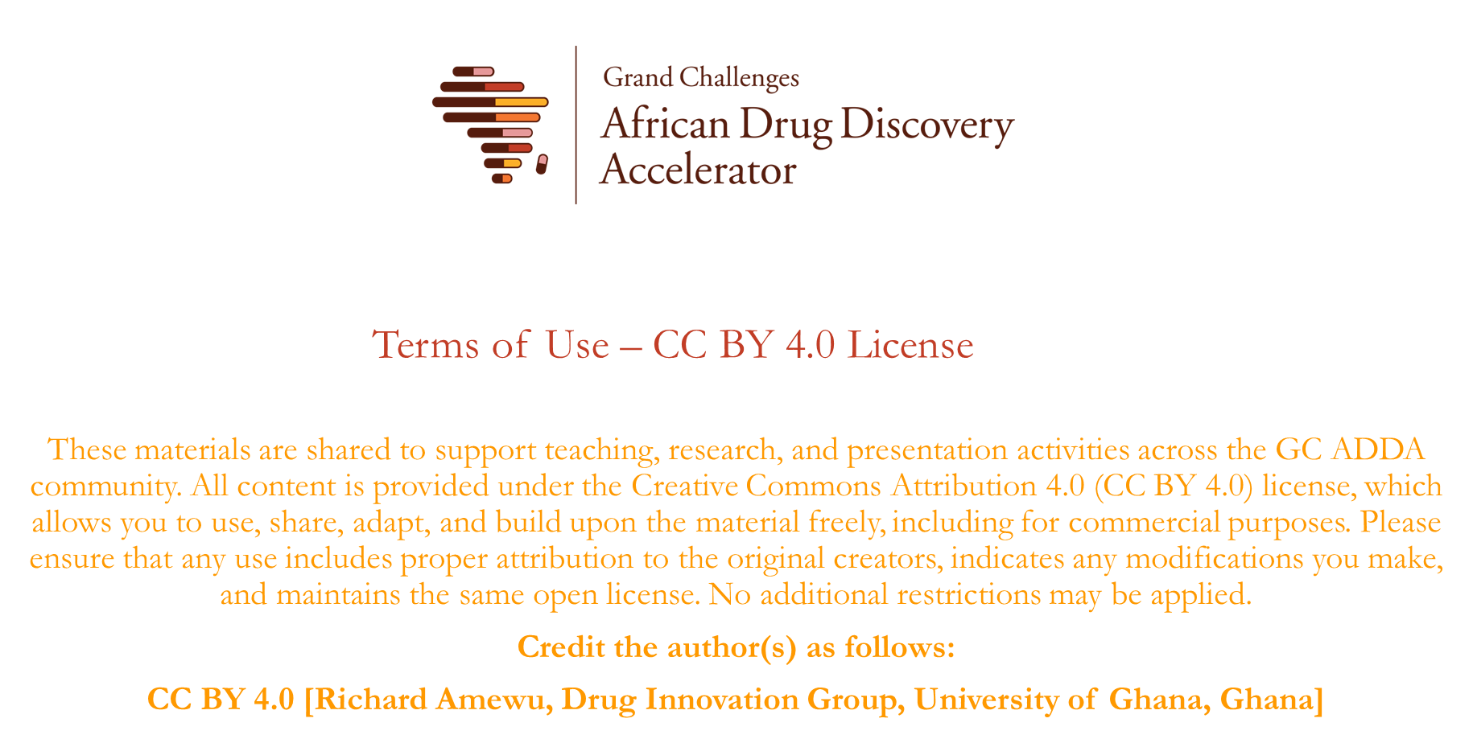

Slide 3

Presentation Overview
Drug-likeness:
How to define drug-likeness?
Which parameter are critical to pay attention to?
Drug-likeness and therapeutic area: how does drug-likeness differ by TA?
Current trends in optimizing drug-like properties in medchem
Summary

Slide 4
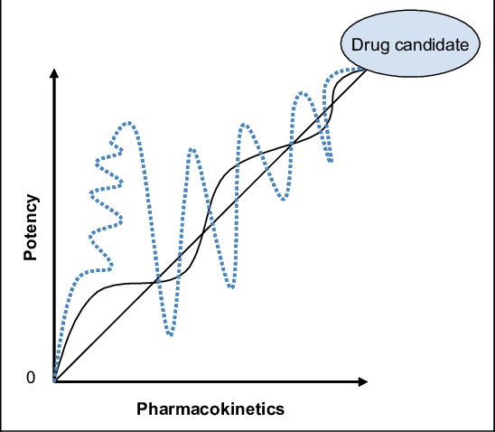
Learning Outcomes
What makes a drug research project successful?
Balancing multiple parameters to arrive at the ideal drug candidate
Decision making using metrics generated assays
Using the RoF guidelines
Designing the ideal candidate based on trends
Calling it quit on a project

Slide 5



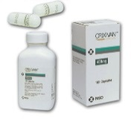
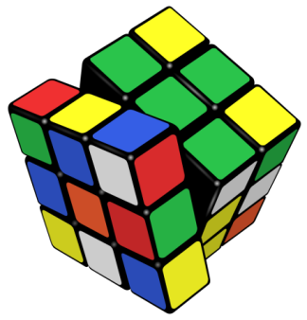
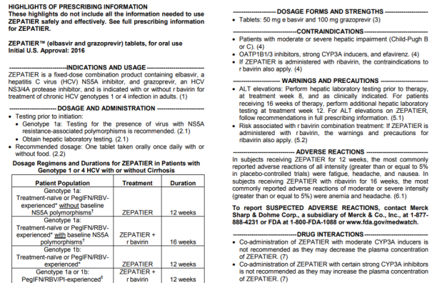
Inventing a New Drug
Preclinical
Candidate
PK / PD /
Safety
WMA
New Drug
Target
Identification
Target
Validation
Lead
Identification
Lead
Optimization
Preclinical
Development
Clinical
Development
Regulatory Approval
Lifecycle Management
Drug Discovery
Development
Commercialization
A multiparametric problem
Competitive Label
Lipophilicity
Clearance
10-15 years¹
Absorption
Potency
Distribution
$1.3 billion¹
1000’s of scientists,
clinicians, and patients
Promiscuity
(Safety)
¹Tufts Center for the Study of Drug Development ²Pharmaceutical Research and Manufacturers of America
Notes:
Solving multiple issues simultaneously
ADME group with expertise to support end-to-end portfolio. Efforts are laser focused on bringing forth products which address critical unmet need across the globe.
PreLO-LO:
integrate in silico, in vitro/in vivo tools to drive relationships between phys chem attributes and druggability
Understand key attributes to impact human doses/pharmacology (develop tPKPD)
Proactive design of drugs to avoid DDI, polymorphic PK
SCS-Ph3:
mechanistic enzyme and transporter understanding of leading clinical cmpds
Mechanistic understanding of DDIs and implication for dose populations
File approval-beyond:
Informing regulatory and labeling aspects to drive patient access

Slide 6
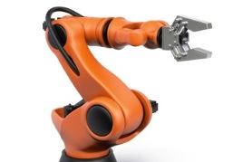

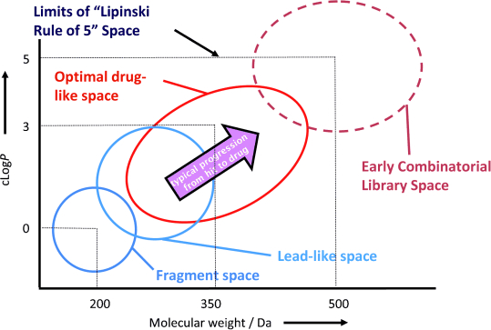


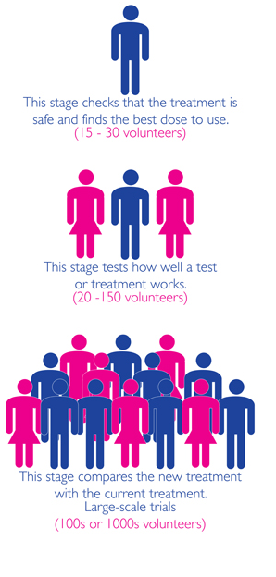

From Discovery to Approved Drug (Small molecule example) Culmination of Many Years of Work
Year
Compounds
Discovery
1
millions
Screening
2
1000’s
Hit to Lead
Patent Filed
Patent Approved
Patent Expiry
3
100’s
Lead Optimization
Safety
Development
4
10
IND
6
5
Phase 1
8
2-3
Phase 2
10
1
Phase 3
12
1
Approved Drug
Market exclusivity ~10 yrs
Generics

Slide 7



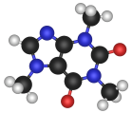
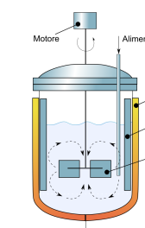
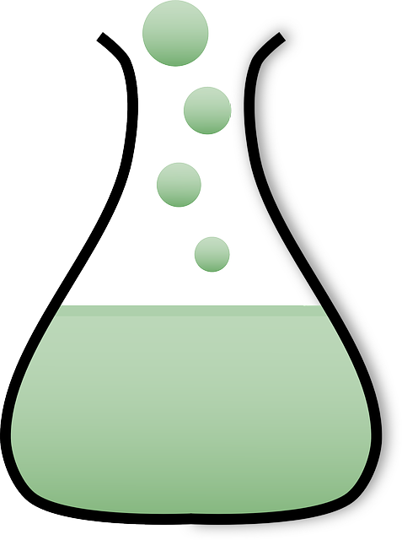

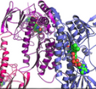






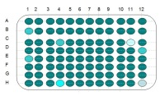
Drug Discovery: Takes A Multi-disciplinary Project Team
Molecular Modeler
Formulation
Scientist
Drug Metabolism
Medicinal
Chemist
Biologist
HTS
Scientist
Safety
Assessment
In vivo
Pharmacologist
In vitro
Pharmacologist

Slide 8
Discovery Research has Access to Multiple Experiments
In silico
In vitro
Solubility in formulation vehicles
Metabolic stability
In vivo
Preclinical PK studies
Preclinical ADME studies
Modeling of binding site
Physchem properties
Human Dose prediction
Modeling of tPKPD
QSAR Models (i.e. PK parameter, metabolism, potency etc
…and many more
Potency (in vitro)
HTS for binding and potency
Toxicology studies (i..e AMS, micronucleus, hepatotoxicity etc)
Metabolite identification
ADME studies
Efficacy models in preclinical species
Toxicology studies preclinical species
Biological mechanism of action studies
Biological proof of mechanism studies
…and many more

Slide 9
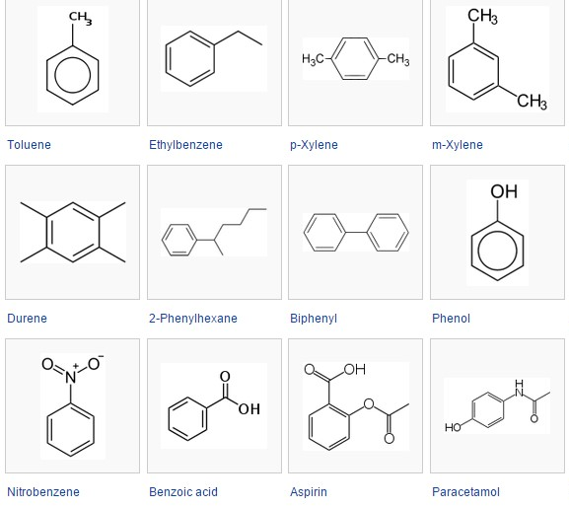
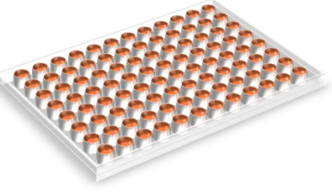


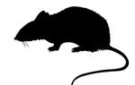



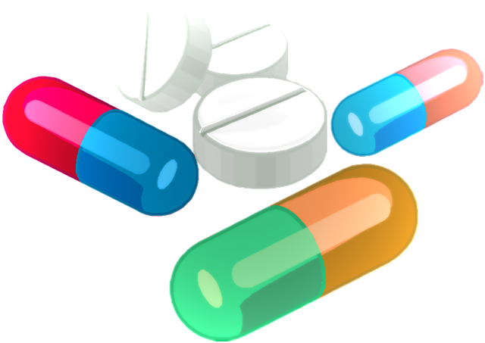
Drug Discovery Cycle → Design – Make – Test
Synthesis of New Chemical Entities (NCE)
In vitro Testing:
i.e. Potency assays; Drug-like properties
In vivo testing:
Efficacy model (PKPD model)
Preclinical PK / Tox studies
Human Dose Prediction
(translation of preclinical PKPD to human)
Project Evaluation
Refine Hypothesis and Structure-Activity Relationships (SAR)
Design of NCE
Generating virtual library using predictive models (QSAR)

Slide 10

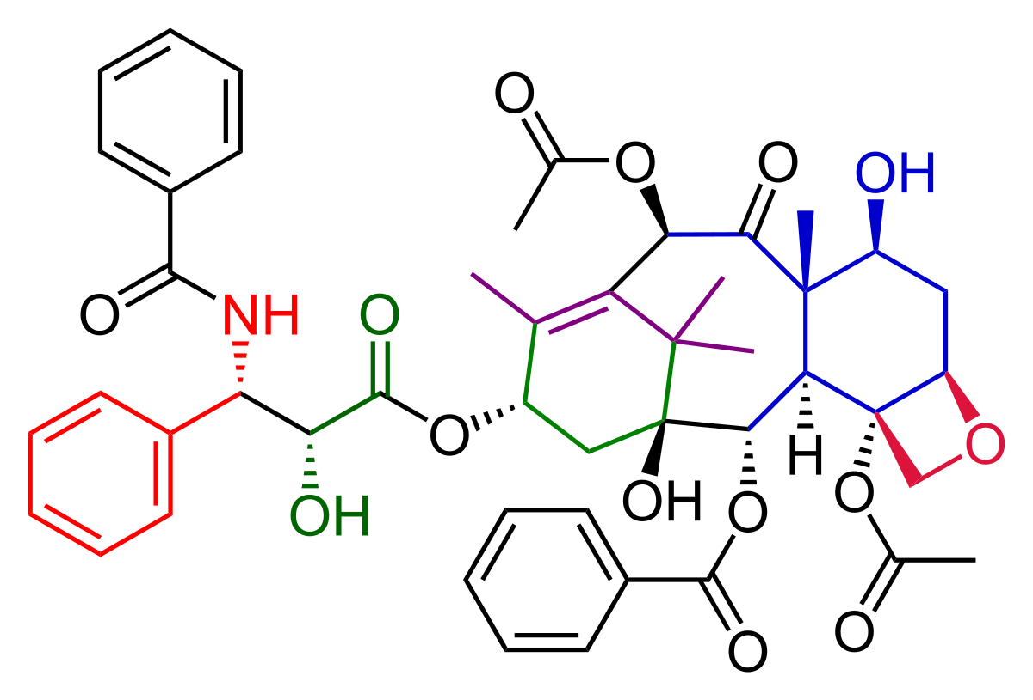
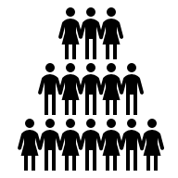

Drug Discovery after many iterative cycles….
Target
Identification
Target
Validation
Lead
Identification
Lead
Optimization
Preclinical
Development
Clinical
Development
Regulatory Approval
Lifecycle Management
Drug Discovery
Development
Commercialization
….might deliver a compound for first-in-human studies

Slide 11
What does it take to turn a small molecule lead in a successful drug?
Pharmaco-dynamic
Pharmaco-kinetics
Nonclinical Safety
Developability
Acceptable toxicity in nonclinical species & human in vitro assays, species selectivity etc
Compound stability, formulation, solubility, cost of goods, etc….
“Compound works at the target”
- potent, active, selective, efficacious -
Reaches target in tissue at desired unbound concentration & with desired dosing frequency

Slide 12
What does it take to turn a small molecule lead in a successful drug?
Pharmaco-dynamic
Pharmaco-kinetics
Nonclinical Safety
Developability
Defines
Therapeutic Window
Defines
Drug-likeness
Defines
Human Dose

Slide 13
Presentation Overview
Drug-likeness:
How to define drug-likeness?
Which parameter are critical to pay attention to?
Drug-likeness and therapeutic area: how does drug-likeness differ by TA?
Current trends in optimizing drug-like properties in medchem
Summary

Slide 14

Structure — Properties — Drug Profile
Structure
Molecular Properties
Physchem & biochemical Properties
PK & Tox Properties
Drug Property Profile
size
MW
shape
sp³ ratio
flexibility
# rotatable bonds
# aromatic rings
polarity
Lipophilicity
Ionization
# H-acceptors & donors
Polar surface area
logP
logD
pKa
Chemical stability
solubility
Permeability
Metabolic stability
Protein binding
PK
CL, Vd, t1/2, F
In vitro tox
LD50
off target effects
In vitro & in vivo
DDI risk
victim & perpetrator profile: drug metabolizing enzyme and transporters
Design – make – test cycle to obtain desired target property

Slide 15
Presentation Overview
Drug-likeness:
How to define drug-likeness?
Which parameter are critical to pay attention to?
Drug-likeness and therapeutic area: how does drug-likeness differ by therapeutic area?
Current trends in optimizing drug-like properties in medchem
Summary

Slide 16
Drug-likeness and therapeutic area: how does drug-likeness differ by therapeutic area?
Physical Chemical Properties | Anti-cancer kinase inhibitors (n=25) | HIV protease inhibitors & anti-HCV drugs (n=19) | Others
Molecular weight | 479 | 653 | 422
clogP | 4.4 | 4.9 | 3.1
# Chiral atoms | 0.24 | 4.5 | 1.7
Fsp3 | 0.24 | 0.49 | 0.40
% Failing rule of 5 (≥ 2 rules not met) | 16% | 74% | 12%
Physical Chemical Properties | CNS Drugs | Non-CNS Drugs
Molecular weight | 319 (151–655) | 330 (163–671)
clogP | 3.43* (0.16–6.59) | 2.78* (−2.81–6.09)
ClogD | 2.08 (−1.34–6.57) | 1.07 (−2.81–5.53)
PSA | 40.5 (4.63–108) | 56.1 (3.25–151)
H-Donor | 0.85* (0–3) | 1.56* (0–6)
H-acceptors | 3.56 (1–10) | 4.51 (1–11)
Flexibility (rotatable bonds) | 1.27* (0–5) | 2.18* (0–4)
Aromatic rings | 1.92 (0–4) | 1.93 (0–4)
Oral Drugs Published 1990-2014 (n=216)
NeuroRx. 2005 Oct; 2(4): 541–553.
Toxicity of CNS drugs: Bioorg Med Chem Lett. 2008;18(17):4872-5.
Chem Neurosci. 2010 Jun 16; 1(6): 420–434
J Med Chem. 2015 Mar 26;58(6):2584-608.
Advanced Drug Delivery Reviews Volume 101, 1 June 2016, Pages 22-33
Drug properties between addictive and non-additicive ADHD Drugs: ACS Chem. Neurosci. 2017, 8, 6, 1416–1428

Slide 17
Drug-likeness and therapeutic area: how does drug-likeness differ by therapeutic area?
CNS drugs need to cross the blood brain barrier (BBB) which requires
Lipophilic
Small size molecules
Low surface polarity and low H-donor/acceptor risk etc
Infectious Disease drugs don’t necessarily need to get into the brain; hence….peripheral target tolerates wider chemical space
Larger molecules
reasonable hydrophilicity and polar surface
….but have to keep common principles in mind for permeability, bioavailability, and half-life

Slide 18
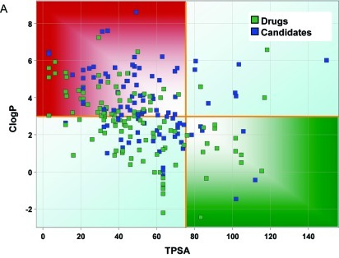
Why does the properties for CNS drugs and other drugs differ?
high safety risk
Brain penetration
Blood-brain-barrier
TPSA
Off-target toxicity
flexibility
Biochemical stability
logP
Low safety risk
Highlighted green property space reduces CNS-related safety risks while enables acceptable PK and PD

Slide 19
Attributes of Successful oral CNS Drugs
Potent activity: low to subnanomolar
Highly selective
Molecular weight < 450
Minimal hydrophobicity (clogp < 5)
Number of H-bond donor < 3
Number of H-bond acceptor < 7
Number of rotatable bonds < 8
H-bonds < 8
pKa, neutral or basic with pK_{a} 7.5–10.5 (avoid acids)
Polar surface area < 60–70 Å²
Aqueous solubility > 60 μg/ml.
Not an efficient P-glycoprotein substrate (in vivo).
>30-Fold margin between hERG IC₅₀ and effective unbound plasma concentration.
P450 enzyme CYP inhibition < 50% at 30 µM.
No significant CYP2D6 metabolism
Not a potent CYP3A4 inducer.
Effective permeability >1 × 10⁻⁶cm/sec (here for Caco2 cells; value range shifts depending on cell-line: Caco2, LLC-PK1, or MDCK2; all have endogenous active transport capability and should be checked with transport inhibitors)
tox
distribution
PKPD
Drug interaction
Many CNS compounds contain basic amines – it is known that safety and PK liabilities are associated with lipophilic basic amines, such as hERG inhibition, phospholipidosis, and being substrate of polymorphic CYP2D6
NeuroRx. 2005 Oct; 2(4): 541–553.

Slide 20
Attributes of Successful oral Infectious Disease Drugs
Major differences to CNS drug properties
Potent activity: low nanomolar
Highly selective against major mutants
Molecular weight < 600 (data are influenced by natural products with a high MW; doesn’t appear to be target driven)
Minimal hydrophobicity (clogp < 3)
Number of H-bond donor < 3
Number of H-bond acceptor < 10
H-bonds < 8
pKa: 2–8
Polar surface area 60 to 130 Å²
Aqueous solubility > 60 μg/ml.
Effective permeability >1 × 10⁻⁶cm/sec (Caco2 cells)
P450 enzyme CYP inhibition < 50% at 100 µM.
Not a potent CYP3A4 inducer.
Not a potent inhibitor of transporters
>30-Fold margin between hERG IC₅₀ and effective unbound plasma concentration.
General consideration:
Drugs against infectious diseases cover a large physchem space.
Many of the antibacterial drugs are derived from natural products with a physchem space that deviates from drug-like properties.
tox
Distribution/oral bioavailability
PKPD
Drug interaction
J. Med. Chem. 2008, 51, 10, 2871–2878 (antibacterial)
RSC Med. Chem.,2021,12, 43 (anti-TB)
J. Nat. Prod. 2015, 78, 6, 1370–1382 (anti-infectious disease drugs of natural origin)
Biomaterials 2013, 34(26) 6202-28 (anti-HIV drugs)

Slide 21
Drug-likeness: beyond the Ro5
 | Mean property values
 | Exception space (≥ 2 90%ilesª violated) |  | Mainstream space (≤ 1 90%ileª violated) (n = 1938)
 | Natural products (n = 26) | Natural product based (n = 85)
Mol wt | 786 | 649 | 313
cLogP | 1.8 | 2.3 | 2.4
O + N | 16.0 | 13.1 | 4.6
OH + NH | 7.4 | 4.2 | 1.4
LogD pH 7.4 | − 1.3 | 0.5 | 1.2
Ar ring | 1.2 | 1.3 | 1.5
Fsp3 | 0.66 | 0.61 | 0.42
Chiral atoms | 12.5 | 8.2 | 1.2
RotB | 9.1 | 8.6 | 4.0
TPSA | 245 | 186 | 64
Typically, BCS class III: low permeability, high solubility; requires often high oral doses or active transporter mediated uptake for efficacy
Advanced Drug Delivery Reviews Volume 101, 1 June 2016, Pages 22-33

Slide 22
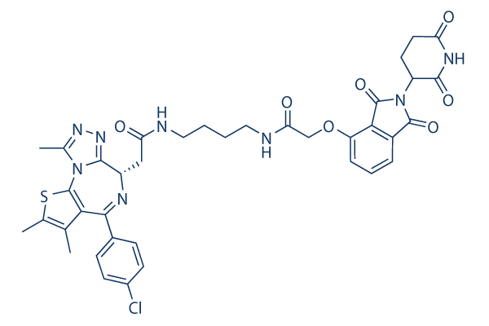
Drug-likeness: beyond the Ro5
Examples: Natural product derived property space, Protac or Degrader molecules, multi-specific drugs
Paclitaxel: chemotherapeutic drug
ProTac:
proteolysis targeting chimera
Rifampin: antibiotic used to treat bacterial infections, including TB
linker
Target of interest binding part
Cyclosporine A: immunosuppressant
Protein degrader binding part
Advanced Drug Delivery Reviews Volume 101, 1 June 2016, Pages 22-33

Slide 23
Presentation Overview
Drug-likeness:
How to define drug-likeness?
Which parameter are critical to pay attention to?
Drug-likeness and therapeutic area: how does drug-likeness differ by TA?
Current trends in optimizing drug-like properties in medchem
Summary

Slide 24
Drug design: current trends in optimizing drug-like properties
Goal in Medicinal Chemistry:
Medicinal Chemists aim is to define the parameters that increase the probability of identifying drug-like molecules in a most efficient way (few design-make-test cycles).
Understanding the fundamental relationships between physicochemical properties and in vitro and in vivo endpoints which requires to prospectively design compounds with an overall favorable profile
Multiparameter optimization (MPO) approaches help in drug design. Examples are:
Lipinski’s Rule of 5 (Ro5)
LE: ligand efficiency
LLE: ligand-lipophilicity efficiency
VLE: volume of distribution-ligand efficiency
The idea behind those multi-parameter optimization approaches:
potency, size, unbound volume and lipophilicity have been proposed as tools to evaluate binding efficiencies to the desired biological target
ACS Chem. Neurosci. (2010), 1, 420–434
J. Med. Chem. 2020, 63, 21, 12156–12170

Slide 25

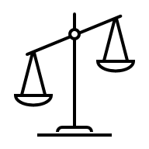

Drug design: MPO approaches
Central observation:
Individual Drug Parameters Have No Optimal Target Value → how to operate in this ambiguous space?
MPO requires:
interpretable data,
flexibility for each project (parameter range might differ depending on therapeutic area, dosing route etc),
weighing of parameters as this is a critical component of MPO and weighing values might need to be adjusted per target/project
Computer-aided design has further the promise to customize the properties used for MPO significantly.
Instead of using 2 or 5 properties, a project team can decide to use e.g. 10 properties to optimize simultaneously.
Calculating the score for marketed drugs in this research space can help to set a target score.
PARETO optimization: there may not be a single best combination of parameters, but rather a family of solutions that each represents a different, optimal combination.
Current Pharmaceutical Design, 2012, 18, 1292-1310

Slide 26
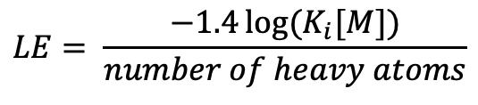

Drug design: LE and LLE as MPO
LE: ligand efficiency
LLE: ligand-lipophilicity efficiency
Ligand efficiency (LE) is a concept used to estimate the efficiency of binding with respect to size, as measured by the number of heavy atoms. LE was derived from the observation that smaller compounds tend to have better physicochemical and ADME properties than large compounds. Therefore, given two equally potent compounds it is preferable to choose the smaller.
Ligand-lipophilicity efficiency (LLE) focuses on maximizing lipophilicity efficiency (lit.: Mol. BioSyst. 2, 429–446): maximize potency while maintaining as low of a lipophilicity as possible, due to the association between high lipophilicity and several issues:
High membrane permeation
poor metabolic stability,
poor solubility,
lack of selectivity and
higher risk of non-specific toxicity
$$LE= \frac{−1.4\log{{(K}_{i}[M])}}{number of heavy atoms}$$
$LLE=$ $−\log{{(K}_{i}[M])} −clogD$

Slide 27
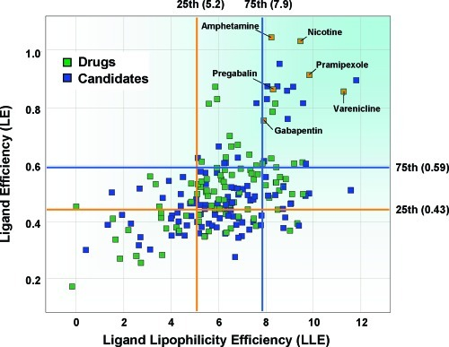
Drug design: LE and LLE target values in discovery
LE and LLE targets:
LE value of ≥ 0.43 or LLE value of ≥ 5.2 or better both will increase the success of your chemical matter to be drug-like

Slide 28
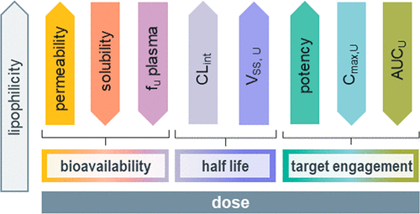
Drug design: VLE as MPO
Central observation:
Lipophilicity has a dominant effect on many parameters that determine unbound drug exposure as well as drug potency. Despite this observation, large body of drug data indicates lipophilicity has no consistent directional impact on dose.
→primary goal is to balance physchem properties that will improve human dose
VLE: volume of distribution-ligand efficiency
J. Med. Chem. 2020, 63, 21, 12156–12170

Slide 29
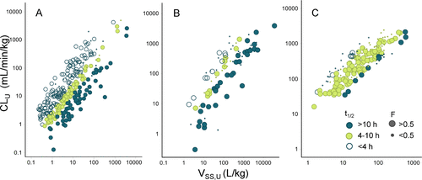
Drug design: including unbound volume as MPO focuses on the dose
Unbound CL and Vss are associated with half-life of molecules
Marketed drugs
Clinical candidates 2006 to 2018
Arbitrarily picked research project
Design goal

Slide 30
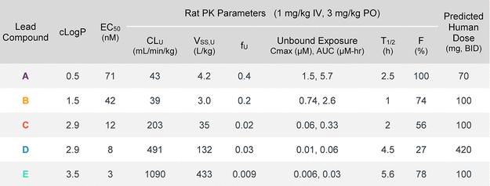
Drug design: including unbound volume as MPO extends the chemical space that can be explored and focuses on the dose
Dose Optimization Can Be Achieved across Diverse Physicochemical Space
Similar predicted dose
Widely differing properties

Slide 31
Summary
Therapeutic index is defined by the toxicity profile relative to the efficacy; both observations will be informed by the drug properties
Drug properties are derived from molecular, physchem, biochemical, PK and tox properties and need to be optimized simultaneously
Molecular and Physchem properties for drugs differ across therapeutic areas
MPO approaches are being used to efficiently modify the molecular and physchem properties of an explored chemical space to minimize the number of design-make-test cycle before selecting a compound for human testing.
MPO approaches could include focusing on LE, LLE, VLE, Ro5 etc. or more sophisticated computer-aided assessment and design.
Ro5 molecules derived from natural products or Protacs are also explored, but face many challenges during the development to overcome lack of drug-likeness

Slide 32
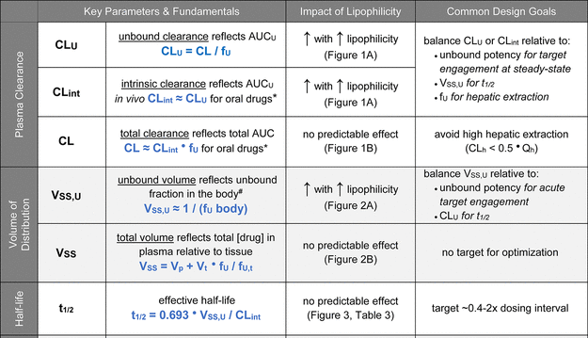
Drug design: impact of lipophilicity on drug-likeness properties such as PK
Effects of Lipophilicity on Drug Design Parameters

Slide 33
Questions?

