Slide 1
A Comprehensive Workshop on Preclinical Drug Discovery (CDD)
In vivo PK and PK/PD relationships
Liezl Gibhard

Slide 2
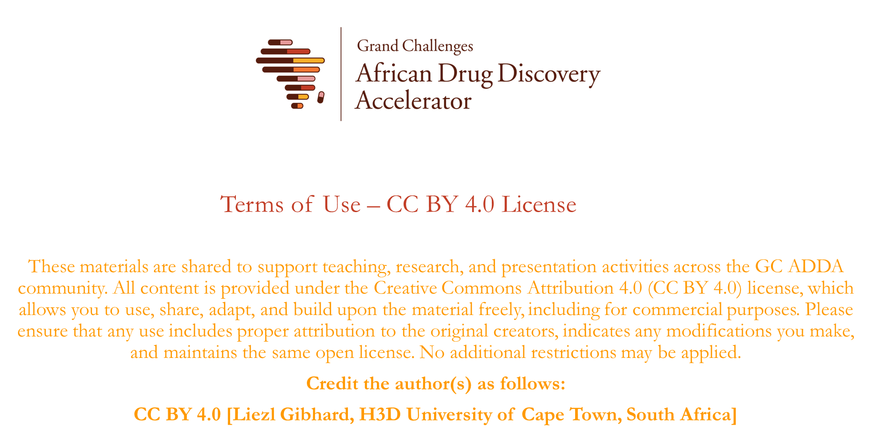

Slide 3

Learning objectives
Understanding of the importance of in vivo pharmacokinetics and pharmacodynamics
2. Understanding key pharmacokinetic parameters
3. Brief overview of PK/PD relationships from a malaria perspective

Slide 4
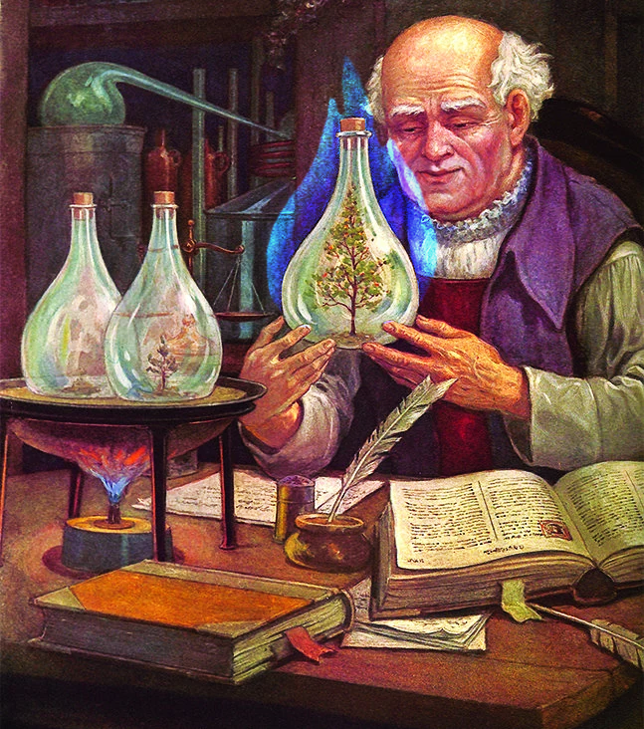
Why do we study PK?
“All things are poison, and nothing is without poison; only the dose permits something not to be poisonous.”
Paracelsus (1493-1541)

Slide 5
Defining PK and PD
We administer a drug (dose) because we seek a certain effect (response), but a complex chain of events links the administration dose to the observed response
DOSE
RESPONSE
Plasma concentration
Target effect
Target concentration
Pharmacokinetics (PK)
Pharmacodynamics (PD)

Slide 6
Defining PK and PD?
“Pharmacokinetics may be simply defined as what the body does to the drug,
as opposed to pharmacodynamics which may be defined as what the drug does to the body”
Leslie Z. Benet
Pharmacokinetics describes what happens to the drug after it enters the body, while pharmacodynamic describes its effect.

Slide 7
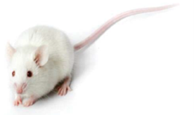
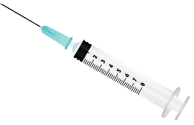

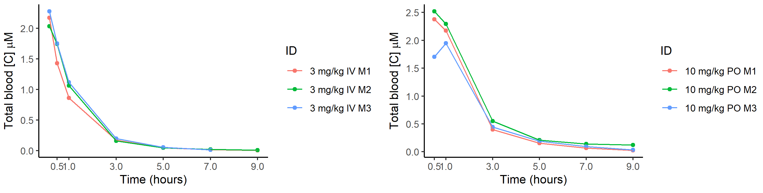
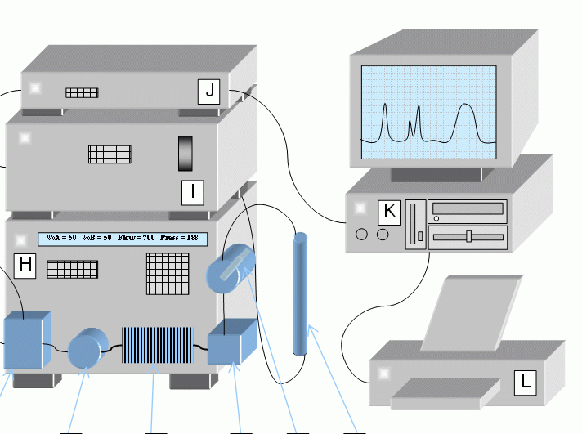
Let’s start with PK
IV dose
3 mg/kg
IV formulation:
150 µL DMA
500 µL PEG
350 µL D5W
LC-MS analysis and data processing: determination of drug concentration
Oral formulation:
1 mL 0.5% CMC with 0.2% tween 80
Blood collected at pre-defined time points
Oral dose
10 mg/kg
7

Slide 8
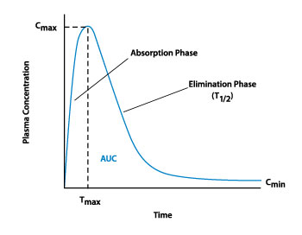
Key pharmacokinetic parameters
PK is based on the description of drug concentrations.
The processes that characterize PK are summarized in the (L)ADME scheme.
The features of the PK curve - result of the processes underpinned by the primary PK parameters
Primary PK parameters
Bioavailability
Volume of distribution
Clearance
These reflect actual physiological processes and concepts
Image from http://saladax.com
8

Slide 9
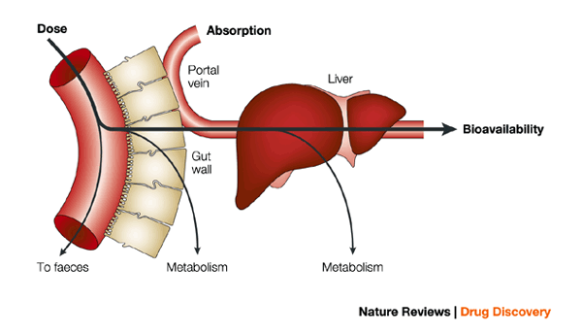
Bioavailability
Bioavailability (F) represent the fraction of intact drug that is systemically available, i.e. reaching the systemic circulation.
For intravenous administration F = 1, for any other route of administration 0 ≤ F ≤ 1
Not all the drug given with an oral dose reaches the site of measurement because of:
incomplete dissolution
Incomplete absorption
pre-systemic metabolism

Slide 10
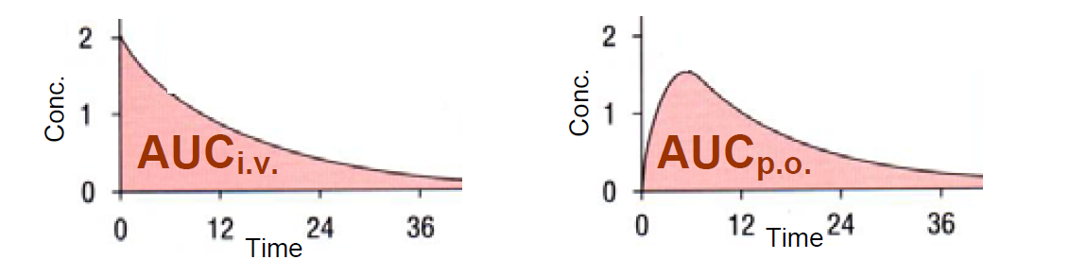
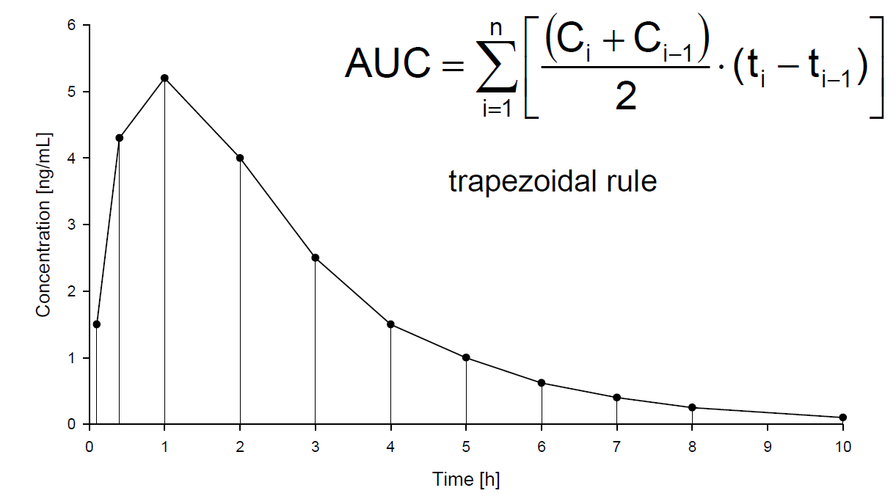
Bioavailability
To estimate the absolute bioavailability of a certain formulation or route of administration x, it is necessary to compare its exposure (measured as Area Under the concentration-time Curve - AUC), with the exposure of IV administration.
NCA Analysis

Slide 11

Volume of distribution
The apparent volume of distribution (V_{d}) quantifies the distribution of the drug in the body.
It is apparent because it assumes that the drug is evenly distributed throughout the body with the same concentration measured (e.g. blood/plasma).
V_{d} influences drug exposure e.g C_{max} and AUC
$$Vd=\frac{\text{F}\text{ ∗ }\text{Dose}}{\text{AU}{\text{C}}_{\text{0−}\text{t}}∗ke}$$

Slide 12
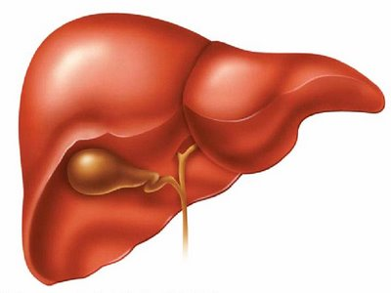
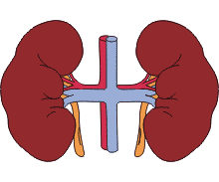
Clearance (CL)
Clearance can be interpreted as the volume of fluid “cleared” of the drug per time unit
CL = Dose
AUC
Metabolism
main mechanism of drug elimination
liver and intestine as major sites
metabolites more polar than the parent drug and renally excreted
Excretion
kidneys – renal
liver – hepatic
lungs - pulmonary (volatiles)
mL/min/kg
Mouse: 90 mL/min/kg
Rat: 85 mL/min/kg
Human: 21 mL/min/kg

Slide 13
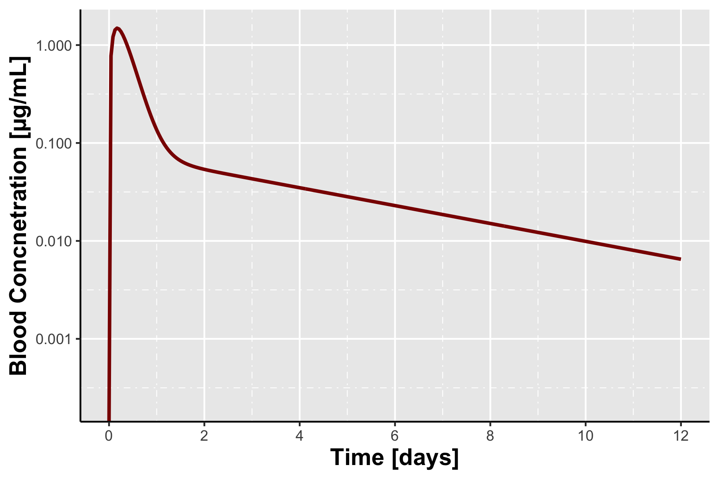
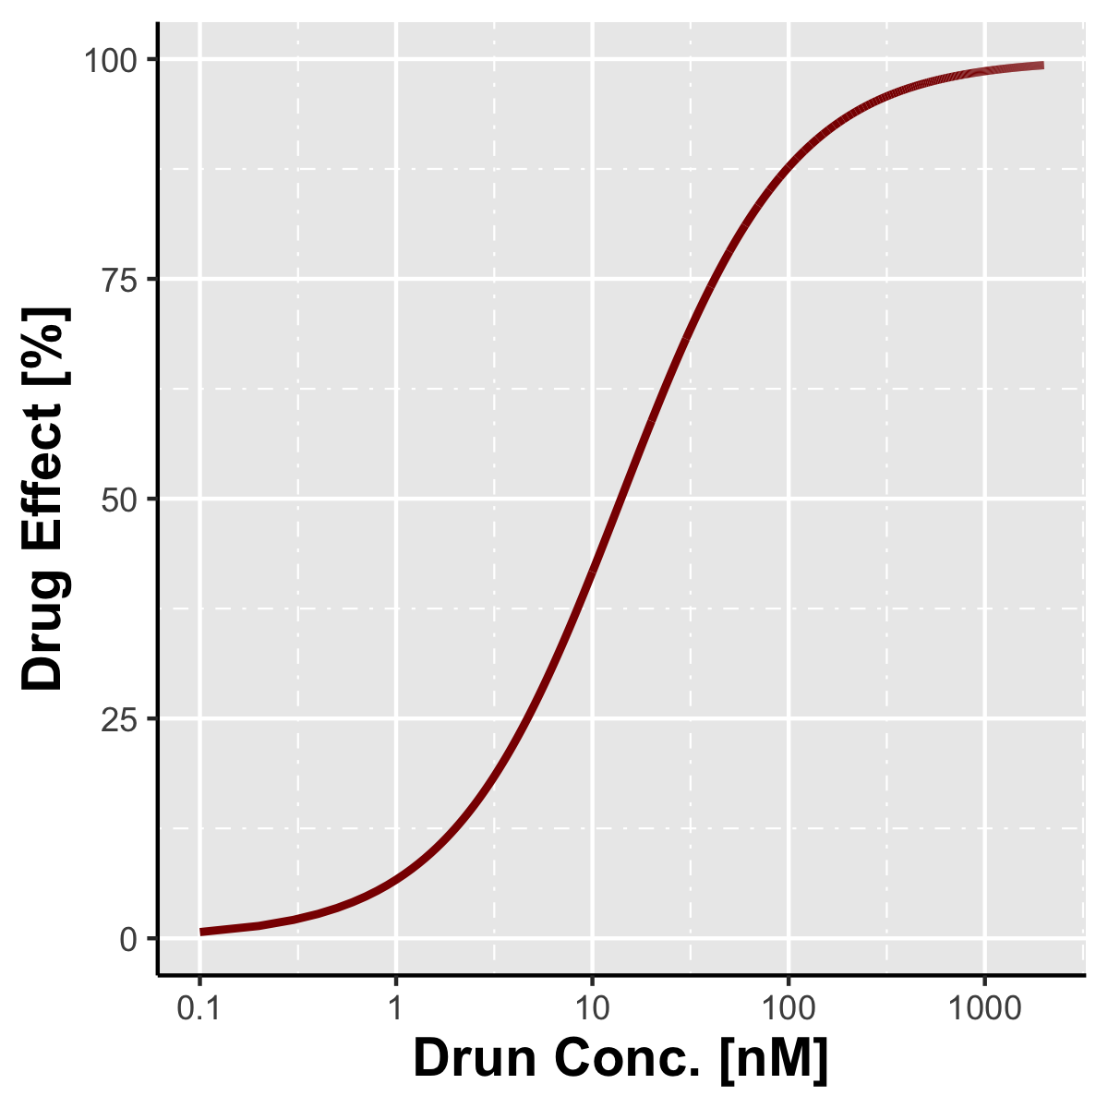

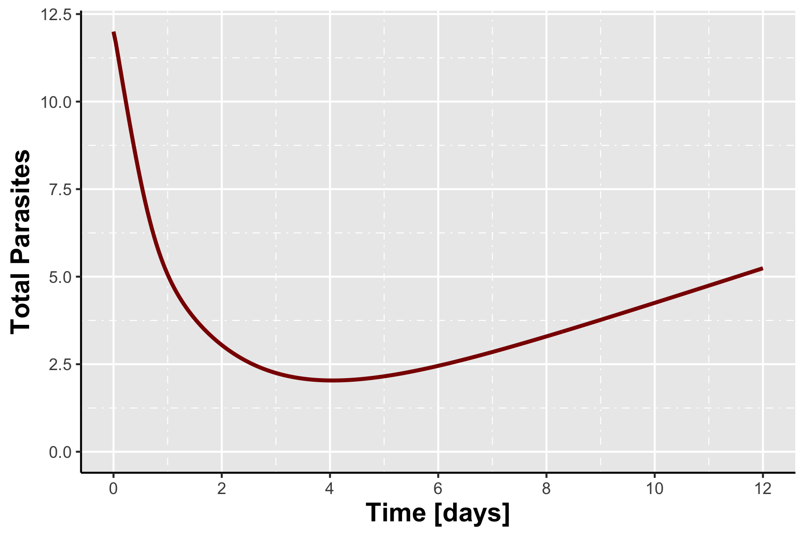
Understanding PK/PD relationship

Slide 14
What is the NSG mouse model for malaria?
Features
NOD background contributes innate immune deficiencies
- Defective macrophages
scid mutation
- prevents development of mature T and B cells
II2rg gene knockout
- blocks signalling from 6 distinct interleukins
- blocks NK cell development
Results in an immunocompromised mouse that enables us to:
Engraftment with human erythrocytes – 60%
Infect with Plasmodium falciparum

Slide 15
Understanding the experimental design
Week 1
Week 2
Week 3
Week 4
Week 5
Week 6
Infection from cryovial
Start growth in vivo
Check growth rate
Experimental week
Quadruple dose regimen
Single dose regimen
Dose Fractionation
Experimental read-out
ED₉₀
AUC_{ED90}
Recrudescence
Engraftment before infection
Engraftment after infection

Slide 16
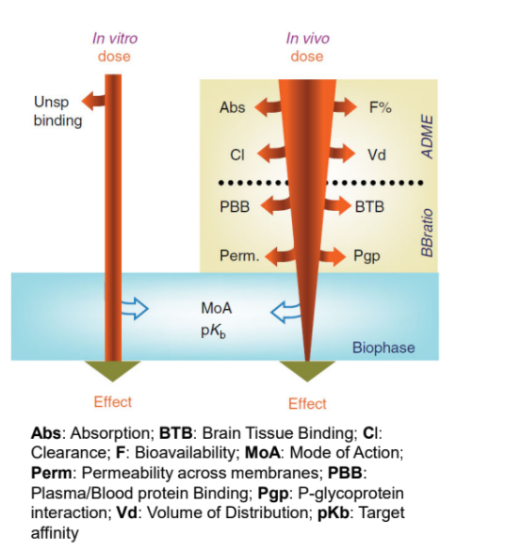
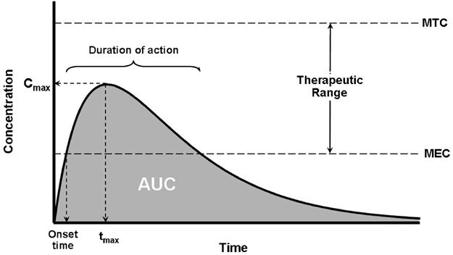
In vitro activity ≠ In vivo efficacy
Maximum Tolerated Concentration
Minimum Effective Concentration
e.g IC₅₀ or MIC₉₀

Slide 17
Let’s have a closer look
Method of estimation | Goodness of fit | Parameter | Mean | Unit of the parameter
Log fit | 0.99 | ED₉₀ | 31.98 | mg/kg⁻¹
Log fit | 0.98 | AUC_{ED90} | 16.28 | µM.h

Slide 18
Further resources
Smith, D. A., Beaumont, K., Maurer, T. S., & Di, L. (2018). Relevance of Half-Life in Drug Design. Journal of Medicinal Chemistry, 61(10), 4273–4282. https://doi.org/10.1021/acs.jmedchem.7b00969
Smith, D. A., Beaumont, K., Maurer, T. S., & Di, L. (2019). Clearance in Drug Design. Journal of Medicinal Chemistry, 62(5), 2245–2255. https://doi.org/10.1021/acs.jmedchem.8b01263
Smith, D. A., Beaumont, K., Maurer, T. S., & Di, L. (2015). Volume of Distribution in Drug Design. Journal of Medicinal Chemistry, 58(15), 5691–5698. https://doi.org/10.1021/acs.jmedchem.5b00201
Smith, D. A., Di, L., & Kerns, E. H. (2010). The effect of plasma protein binding on in vivo efficacy: Misconceptions in drug discovery. In Nature Reviews Drug Discovery (Vol. 9, Issue 12, pp. 929–939). https://doi.org/10.1038/nrd3287
le Bihan, A., de Kanter, R., Angulo-Barturen, I., Binkert, C., Boss, C., Brun, R., Brunner, R., Buchmann, S., Burrows, J., Dechering, K. J., Delves, M., Ewerling, S., Ferrer, S., Fischli, C., Gamo–Benito, F. J., Gnädig, N. F., Heidmann, B., Jiménez-Díaz, M. B., Leroy, D., … Wittlin, S. (2016). Characterization of Novel Antimalarial Compound ACT-451840: Preclinical Assessment of Activity and Dose–Efficacy Modeling. PLoS Medicine, 13(10). https://doi.org/10.1371/journal.pmed.1002138
Angulo-Barturen, I., Jiménez-Díaz, M. B., Mulet, T., Rullas, J., Herreros, E., Ferrer, S., Jiménez, E., Mendoza, A., Regadera, J., Rosenthal, P. J., Bathurst, I., Pompliano, D. L., de las Heras, F. G., & Gargallo-Viola, D. (2008). A murine model of falciparum-malaria by in vivo selection of competent strains in non-myelodepleted mice engrafted with human erythrocytes. PLoS ONE, 3(5). https://doi.org/10.1371/journal.pone.0002252

Slide 19
Questions?

