Slide 1



Purple Poppy
International
War Animal Day
24th February
Ancre Somme Association
Registered Charity NIC108368

Slide 2


Introduction
International War Animal Day is marked across the world on the 24th February
The Purple Poppy - The symbol of Remembrance for the animals that served.
The Northern Ireland Purple Poppy Memorial - Creation of a memorial to all animals that served.

Slide 3

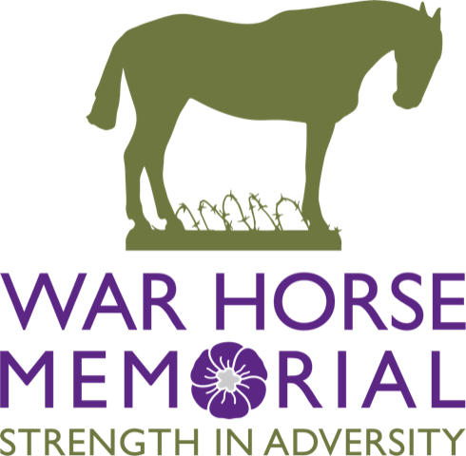
War Animal Day
International War Animal Day takes place on the 24th February.
It was established by the War Horse Memorial in 2024.

Slide 4
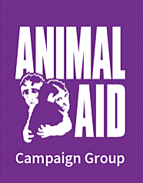
The Purple Poppy
The Purple Poppy was created by the Animal Aid Charity in 2006.
The first Purple Poppy day was held on the 23rd August 2016.

Slide 5

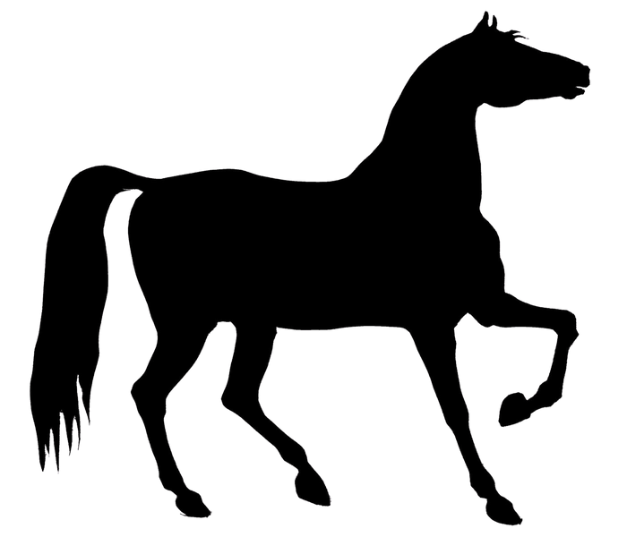
Role of Animals
It is estimated that over 8 million horses, donkey’s and mules died during the WW1.
Throughout history animals have accompanied men into combat as modes of transport and communication, protectors and companions.
Dogs, cats, and more unusual animals including monkeys, bears and lions, were kept as pets and mascots to raise morale and provide comfort amidst the hardships of war.

Slide 6
Unsung Heroes
The role of animals should never be under estimated.

Slide 7
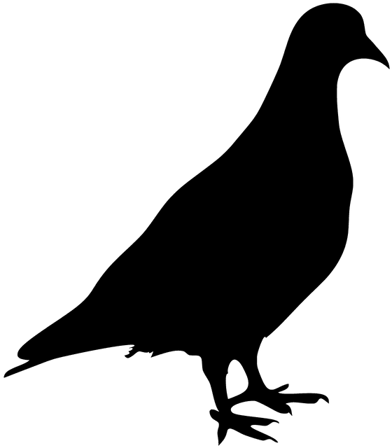
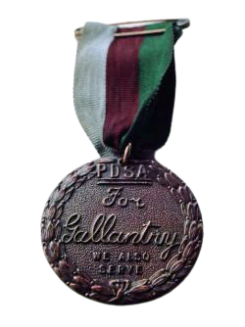
Paddy (Pigeon number NPS.43.9451) was a carrier pigeon, from Northern Ireland, awarded the Dickin Medal after being the fastest pigeon to arrive back in England with news of the success of the D-Day invasion, out of hundreds dispatched.
He flew 230 miles (370 km) across the English Channel in four hours and fifty minutes, the fastest recorded crossing, and was awarded the medal on 1 September 1944, just under three months after the crossing.
Paddy was trained by Andrew Hughes of Carnlough and is the only animal in Northern Ireland to be awarded this medal.
PADDY

Slide 8
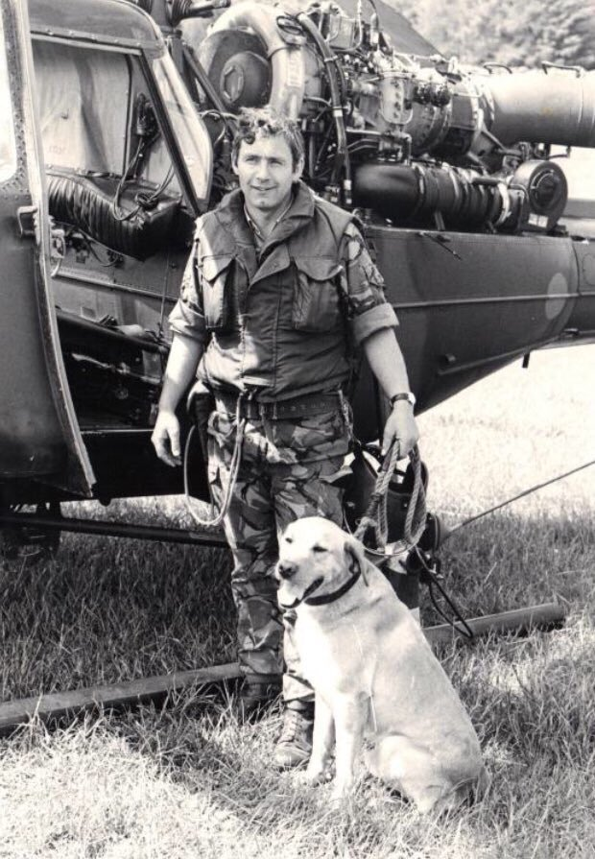
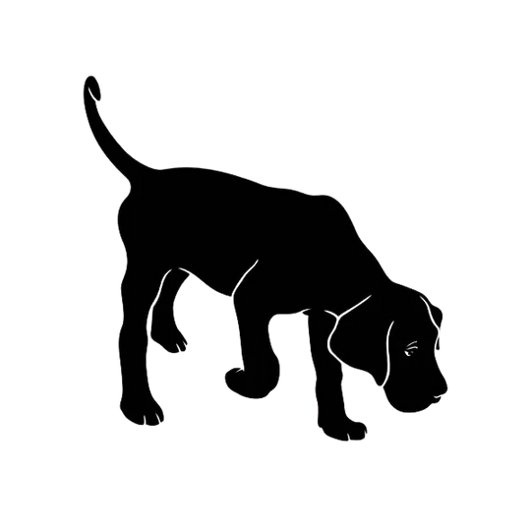
Corporal Brian Brown QGM, 3UDR, and his dog Oliver were killed on the 28th May 1986.
He was killed by an bomb as he and his search dog Oliver made a second search of a petrol station, Newry Road, Kilkeel, after a bomb warning.
A dog handler for ten years, Corporal Brown had declined promotion because he wanted to continue working with dogs.
He was awarded a Posthumous Queen's Gallantry Medal which the Queen presented to his widow in Jul 1987.
Golden Labrador Oliver was one of two dogs killed in Northern Ireland.
OLIVER

Slide 9
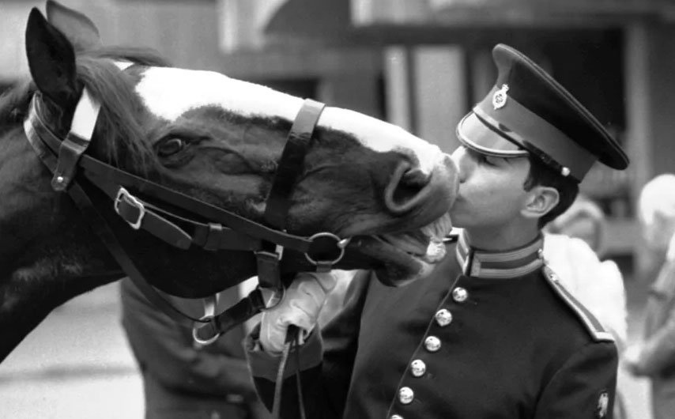
Sefton was being ridden to the Changing of the Guard on Horse Guards Parade on July 20th 1982 when a car bomb was detonated in Hyde Park that claimed the lives of four men and seven horses.
Sefton was one of eight horses left injured by the blast. He was given a 50/50 per cent chance of survival. Sefton returned to his duties with his regiment, and he often passed the exact spot where he had received such horrific injuries.
SEFTON

Slide 10
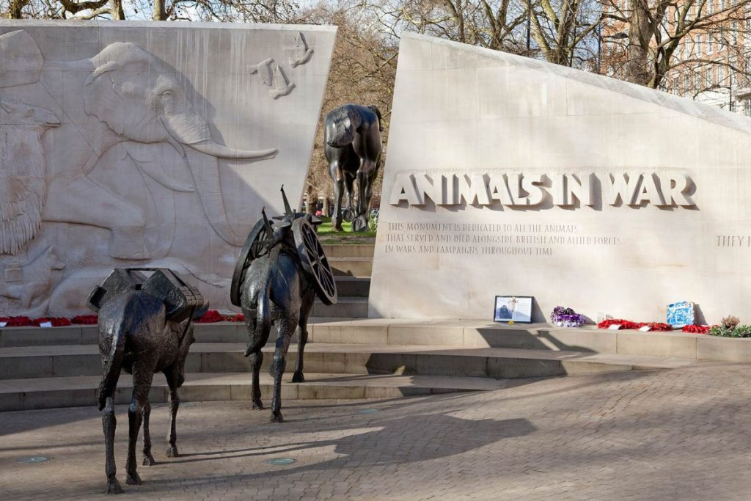
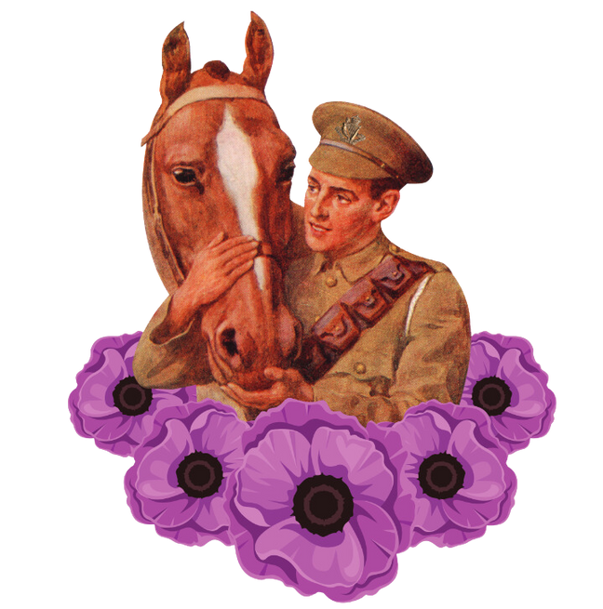
Animal
Memorials
Animals in War Memorial
London

Slide 11
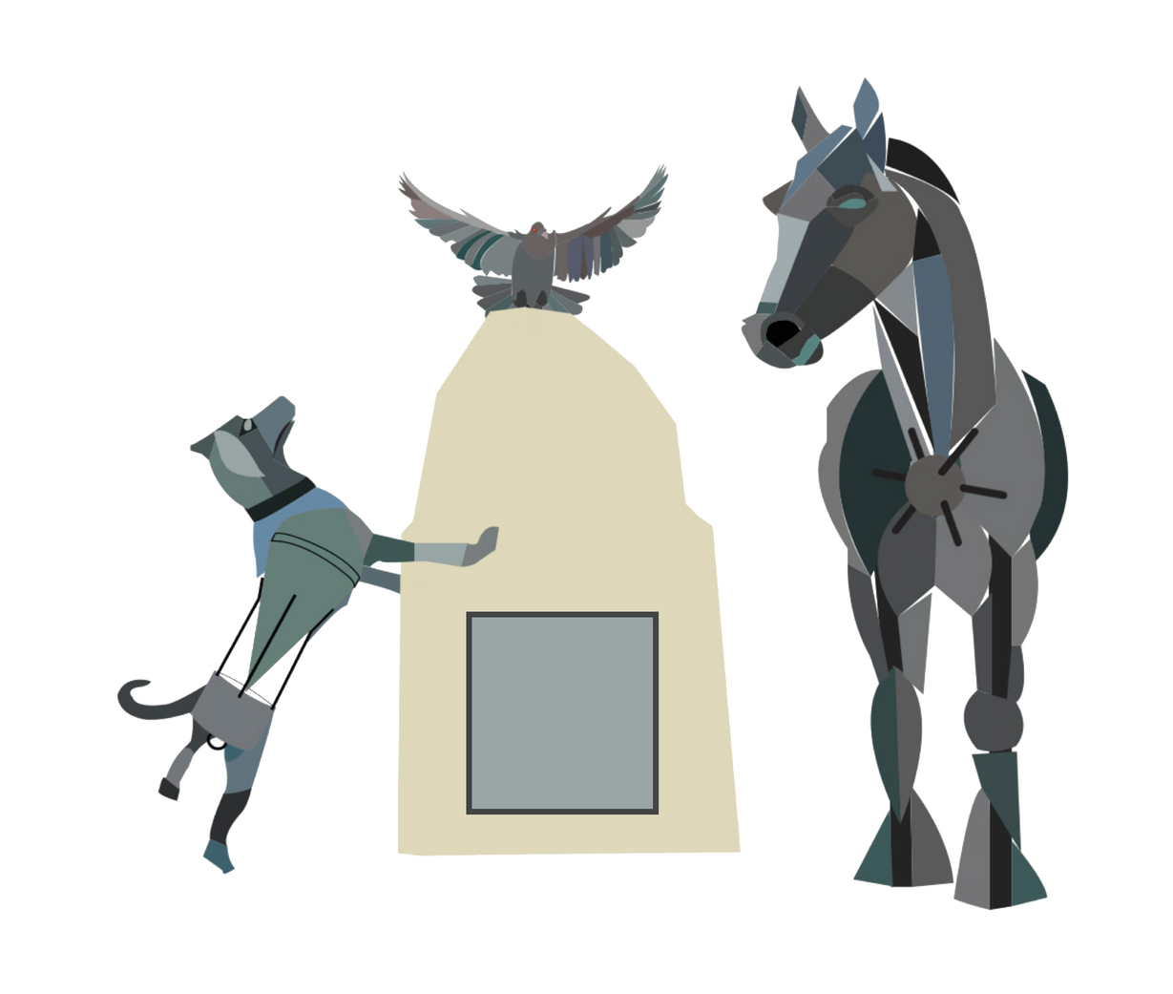
Northern Ireland
Purple Poppy
Memorial
Northern Ireland Purple Poppy Memorial
Brownlow House

Slide 12
About
The memorial will be brought to life by Moneypenny's Blacksmiths, in Portadown. It will consist of a life size horse, dog, and a pigeon mounted on a stone plinth. The memorial will be situated in the Courtyard of Brownlow House.
As part of the project we are currently looking for people, from all walks of life, who would be interested in carrying out a six week course in blacksmithing and engraving.
As well as the memorial we also plan to produce an educational resource. This resource will give a better of the role played by animals in various battles, wars, and conflicts from WW1 to the present day.

Slide 13
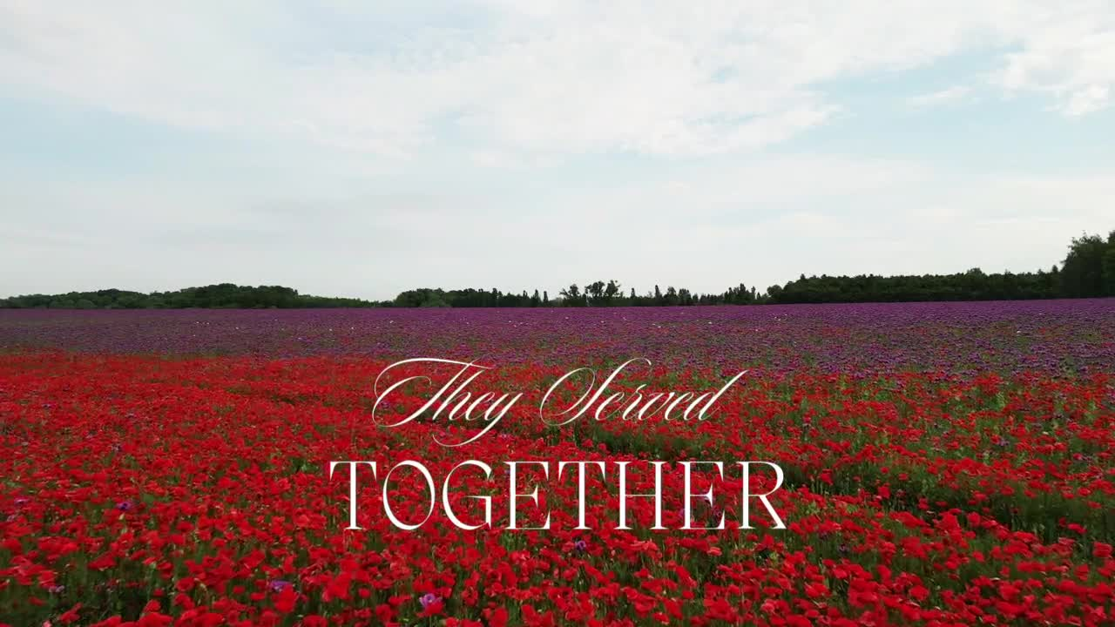
They Served Together

Slide 14
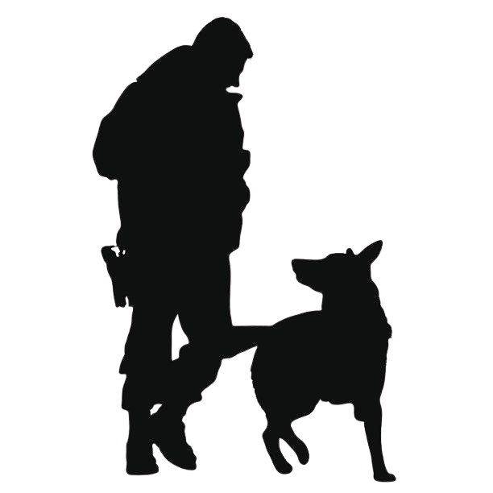
They Served Together
We Will Remember Them
Ancre Somme Association
Registered Charity NIC108368

