Slide 1


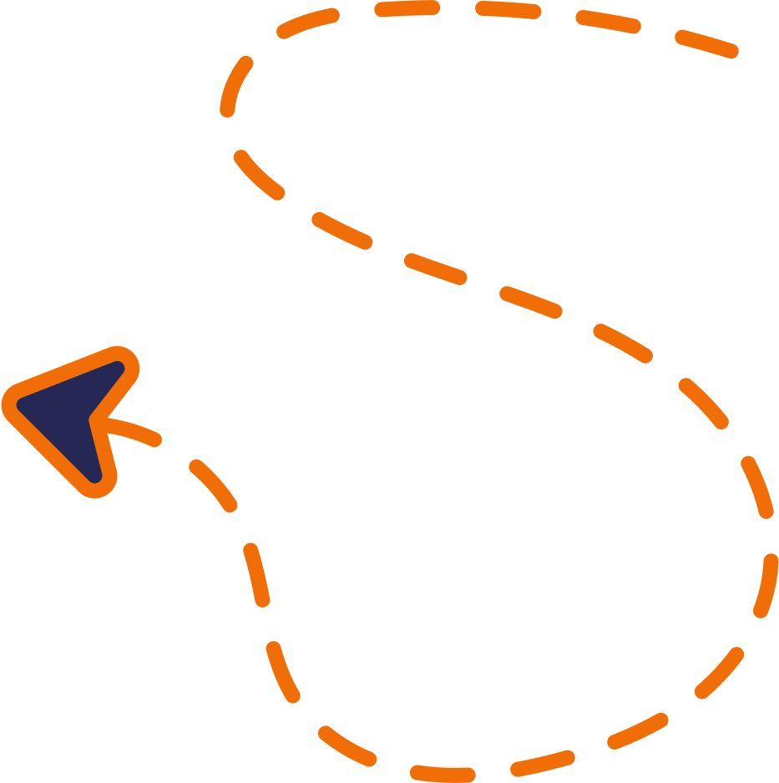







GUIDE TO BUILDING REPLICATE SITES

Slide 2
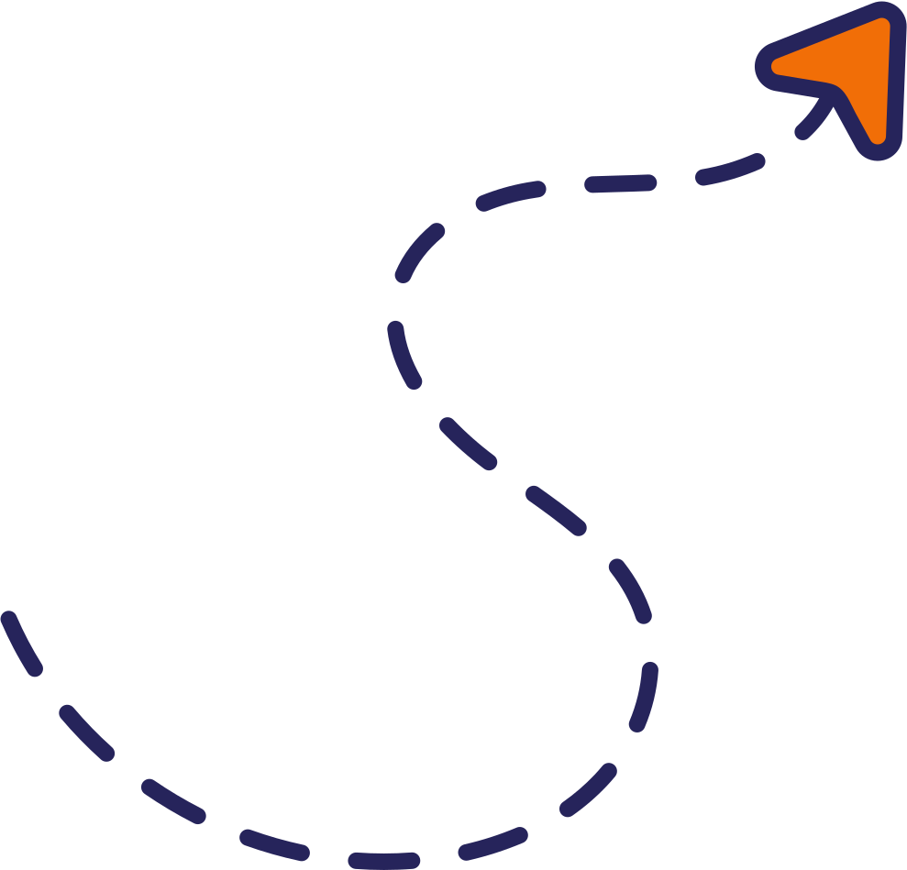
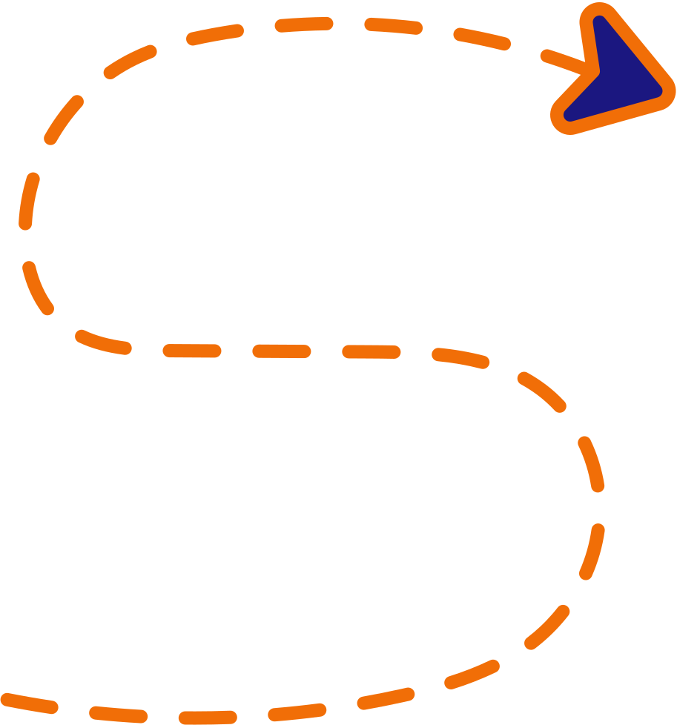




WHAT DOES A REPLICATE SITE BUILD ENTAIL?
Essentially, a replicate site is an “exact” copy of an already exisiting site, re-built in Duda. Clients request this when they like the design of their “legacy,” or current site, but for whatever reason they need a new host/company to manage and update it.

Slide 3


ANALYZE THE LEGACY/ORIGINAL SITE’S CONTENT
REVIEW THE ENTIRE SITE
Focus on every page: Home, About, Contact, etc.
Evaluate number of sections, general layout, and key design aspects.
CHECK CLIENT NOTES
FROM TIME TO TIME, CLIENTS MAY REQUEST SOME ADJUSTMENTS TO THEIR ORIGINAL DESIGN, OR FOR SOME CONTENT TO BE ADDED/EXCLUDED.

Slide 4
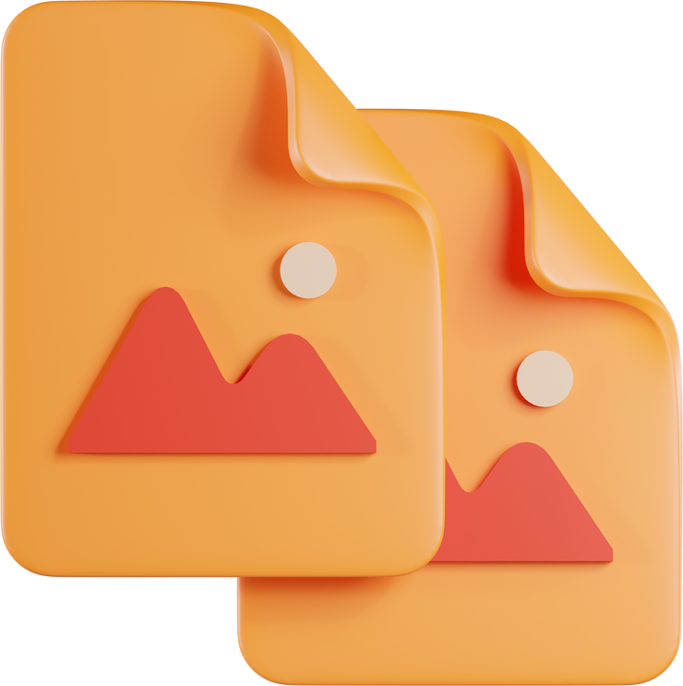

RE-CREATE THE ORIGINAL SITE DESIGN
REPLICATE EVERYTHING
MATch your new build’s design, layout, fonts, images, and interactive elements as closely as possible to the original site. Do not worry about following our design SOPs, focus on accuracy.
USE THESE TOOLS:
IMAGEYE FOR IMAGES
MEDIA DOWNLOADER OR AWESOME SCREEN RECORDER FOR VIDEOS
EYE DROPPER FOR COLORS
FONTS NINJA AND WHAT FONT IS (EXTENSION AND WEBSITE) FOR FONTS
*** NOTE: MAKE SURE THE FONTS YOU USE HAVE THE PROPER LICENSES. IF NOT, TRY TO FIND A SIMILAR FONT INSTEAD.

Slide 5


TEST AND ENSURE FUNCTIONALITY
PRIORITIZE DESIGN OVER FUNCTIONALITY
PRIORITIZE THE REPLICATION OF THE ORIGINAL SITE’S DESIGN ABOVE ALL ELSE.
If there are elements (forms, portals, calendars, etc.) with functionality that can’t be replicated in Duda or with our other tools, get the design as close as possible and leave relevant notes in the “PM Promises & Expectations” field in Bitrix.
You may also contact the PM, then a Dev Lead to seek guidance.
*** NOTE: THERE IS NO NEED TO INCLUDE A FLOATING BUTTON AND COGNITO FORM ON A REPLICATE, UNLESS THE ORIGINAL SITE HAS SIMILAR FEATURES.

Slide 6


SITE STRUCTURE AND BRANDING
REPLICATE THE STRUCTURE
MATch the Header, Footer, and Navigation on the new build as accurately as possible.
Recreate all Sections and Layouts to the best of your ability, using Duda widgets and other tools (Elfsight, Cognito Forms, etc.)
REPLICATE THE BRANDING
EXTRACT COLORS AND FONTS FOR USE IN NEW BUILD.
Match formatting of the original site (padding, font sizing, image sizing, etc.) as closely as possible.
USE THE SAME IMAGES IN THE NEW BUILD, REGARDLESS OF QUALITY.
Keep design consistent with original site throughout the new build.

Slide 7

RESPONSIVENESS AND FINAL CHECKLIST
TEST RESPONSIVENESS
Test site responsiveness and display across mobile, tablet, and desktop.
Prioritize desktop display if mobile/tablet optimization isn't possible due to an legacy outdated site design.
CHECK LINKS & IMAGES
USE WAYBACK Machine for reference or contact PM for brokEN RESOURces.
Make sure any internal links (links that connect to pages within the legacy sites) are updated and replaced as needed.
PERFORM FINAL CHECK WITH DEVELOPER CHECKLIST
Follow the Development Checklist (click to access) for technical aspects.
Ensure functionality and performance checks are completed.
Skip our design SOPs in favor of preserving the original site’s formatting/content.

Slide 8

IMPLEMENT STANDARD SEO PRACTICES AND DYNAMIC CONTENT
ENSURE USE OF OUR STANDARD SEO OPTIMIZATION
Focus on our SEO-related implementations and optimizations, including treatment of FAQ accordions, dynamic pages, SEO meta titles, H1-H6 labels, etc.
Ensure original/legacy site’s overall formatting and design elements (fonts, text sizing, use of and types of images, etc.) are maintained with all additional sections (not found on the original/legacy site.)
***IMPORTANT NOTICE: THINGS YOU SHOULD AVOID
EXCESSIVE PADDING: AVOID OVERUSE OF ROW AND/OR COLUMN PADDING (200+ PX). THIS WILL NEGATIVELY IMPACT MOBILE AND/OR TABLET VIEWS. USE NON-FULL-BLEED ROWS TO MATCH LEGACY DESIGN, IF NEEDED.
INTERNAL LINKS/DONOR CONTENT: Make sure all links are connected within the new build. Ensure any donor content/content leftover from previous host and/or builder is removed (Privacy Policy, Terms of Use, etc.)

Slide 9
BROUGHT TO YOU BY:
GOOD LUCK!
HAPPY REPLICATE BUILDING!

