Slide 1
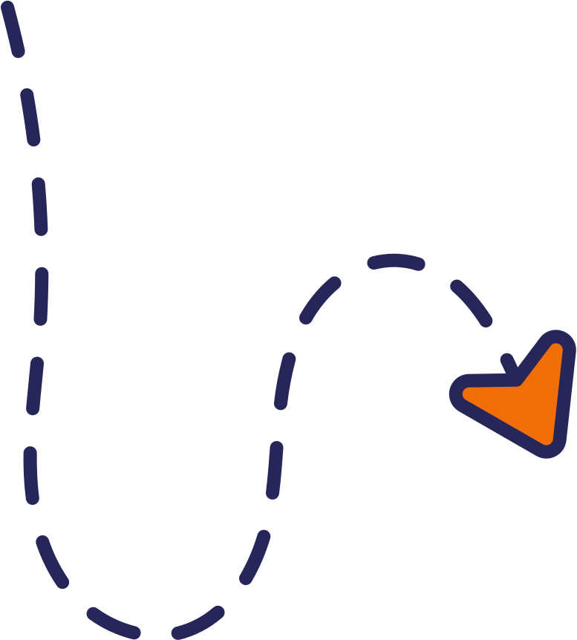
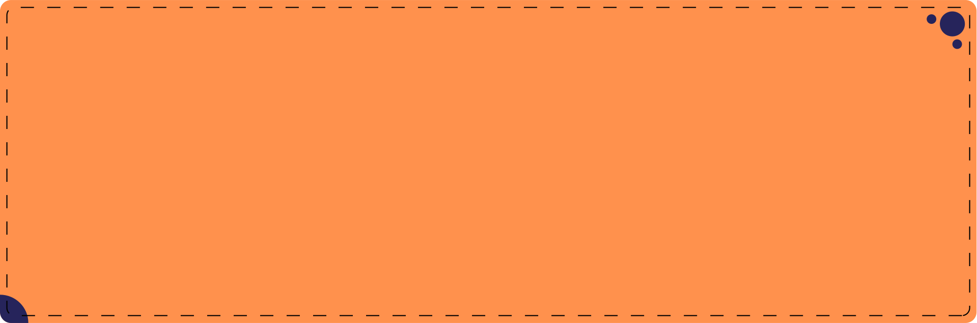

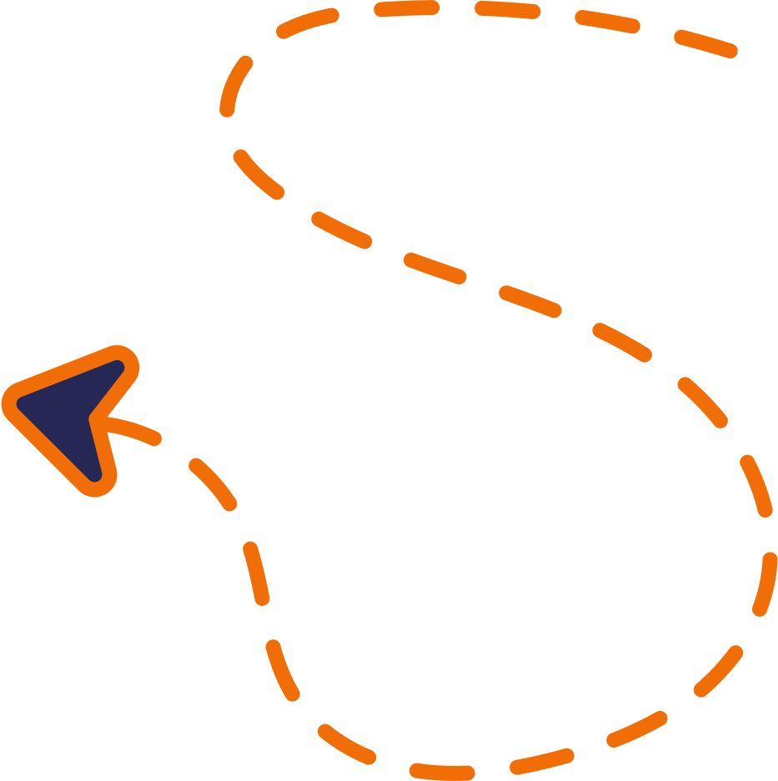

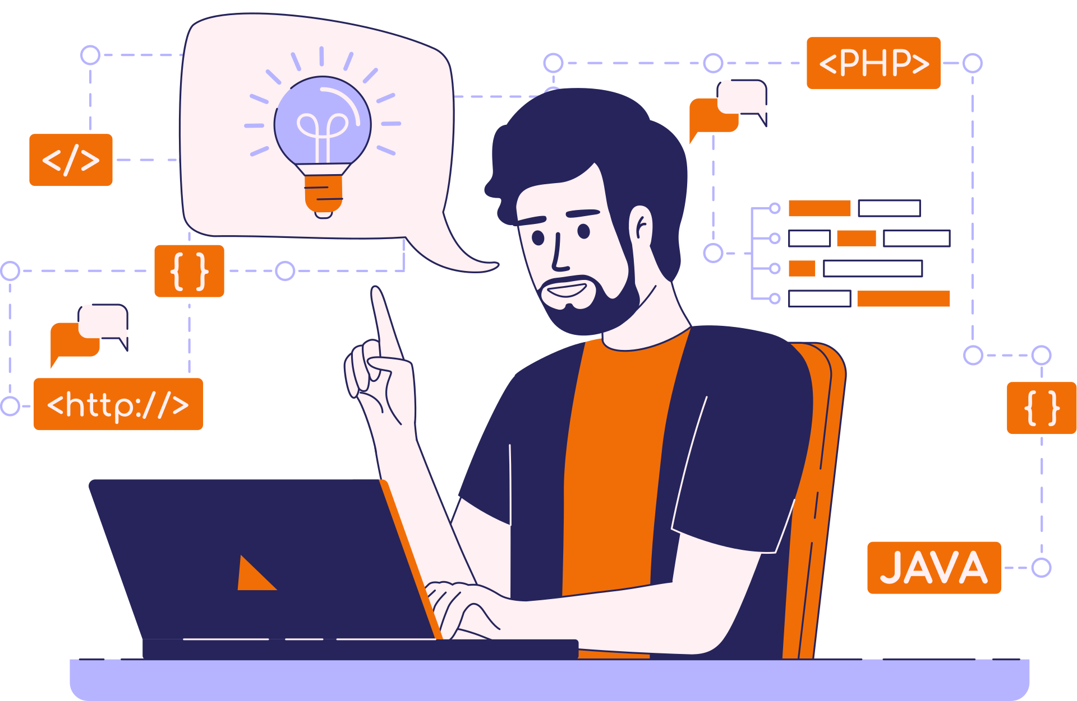
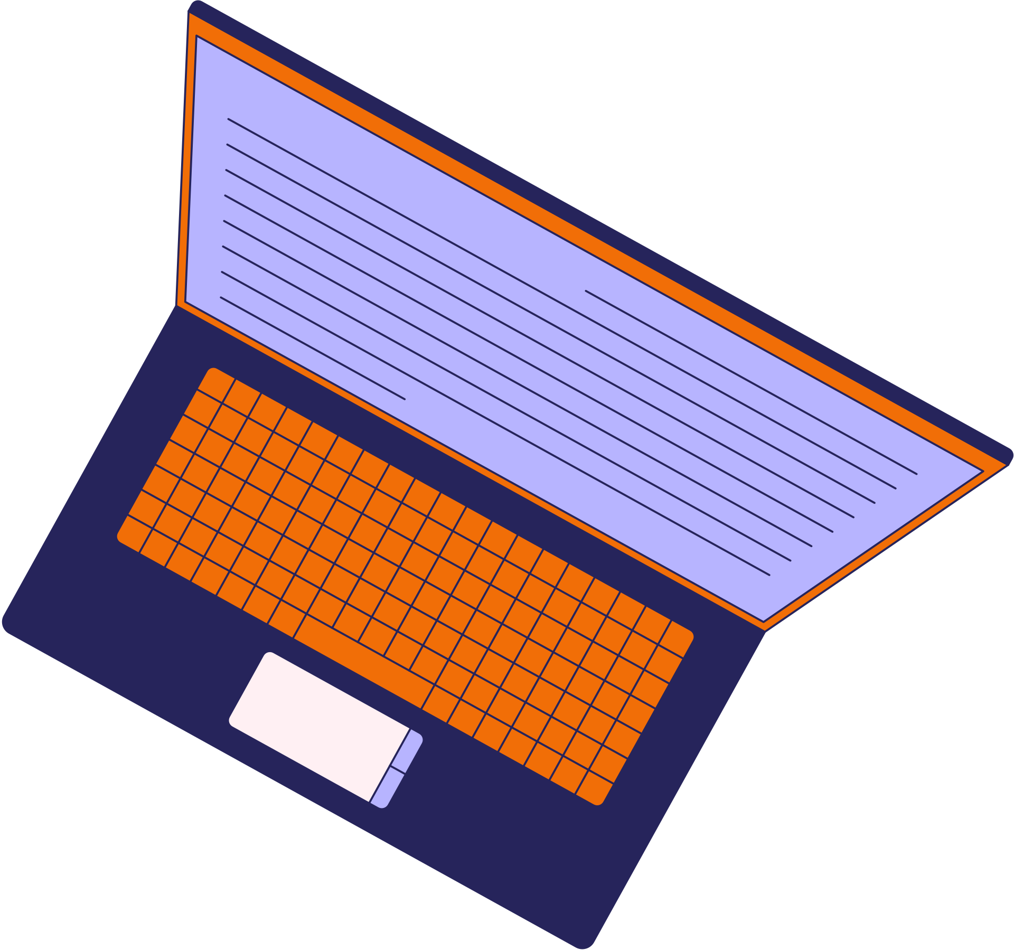



GUIDE TO HANDLING MOJO TICKET EDITS

Slide 2
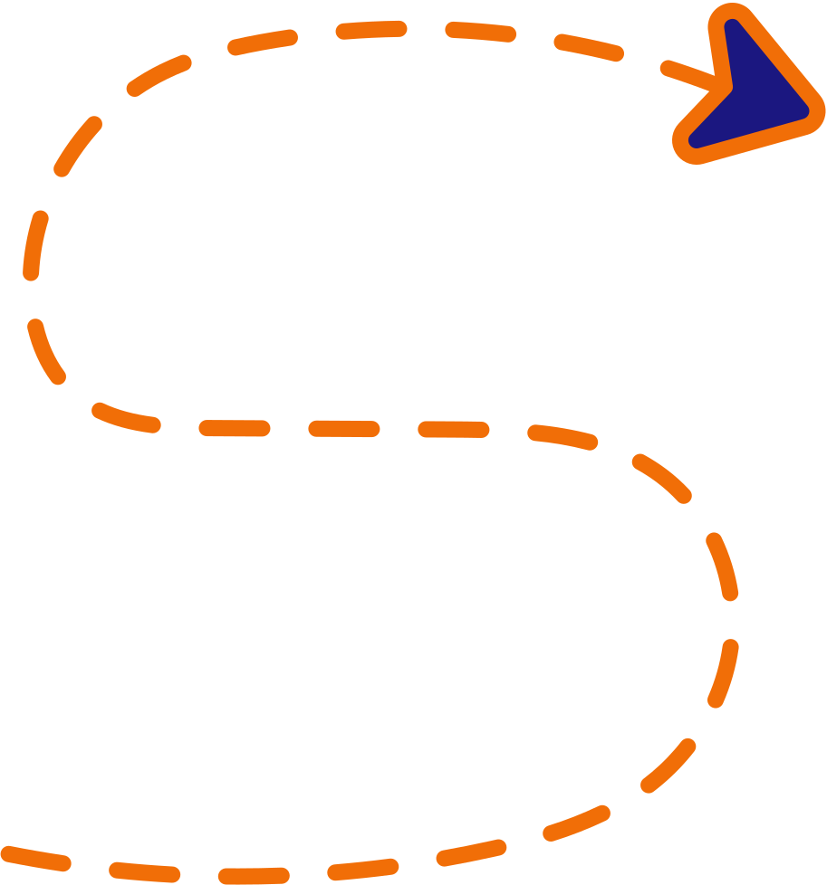
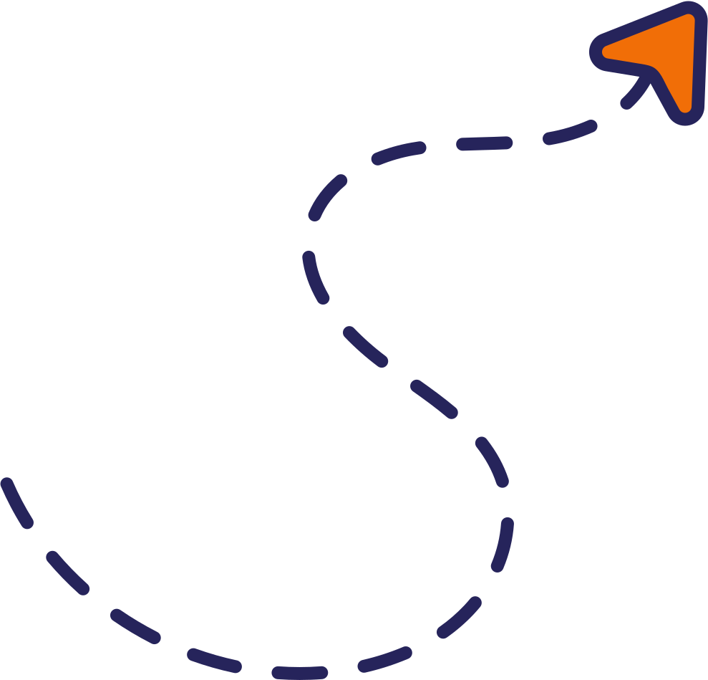
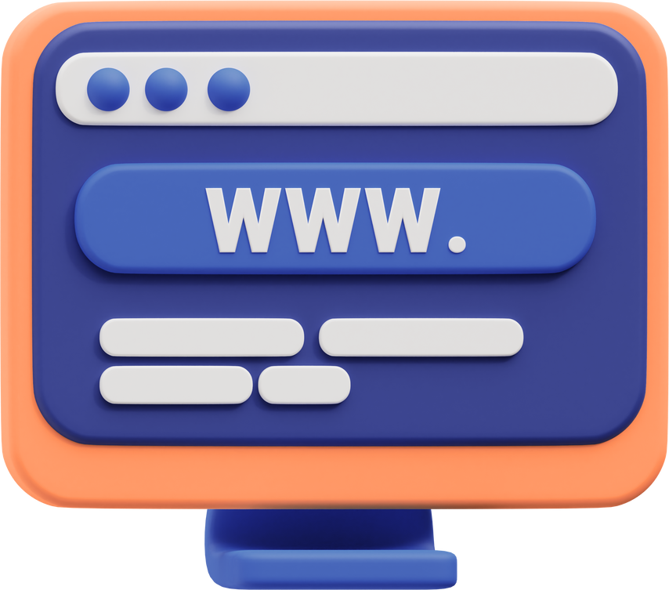



WHAT IS A MOJO TICKET?
Mojo tickets are created when sites return to our team for revisions post-delivery. While the original site may meet Simple's standards, clients sometimes have a different vision. They express requested changes to the design or content structure to the PM, who passes those notes onto us.
DEFINITION OF A MOJO TICKET:
Mojo tickets are revisions requested after site delivery, based on client feedback.
PURPOSE OF A MOJO TICKET:
TO address edits related to design or content structure, requested by the client or project manager, that can be passed to the Dev or Edit teams.

Slide 3
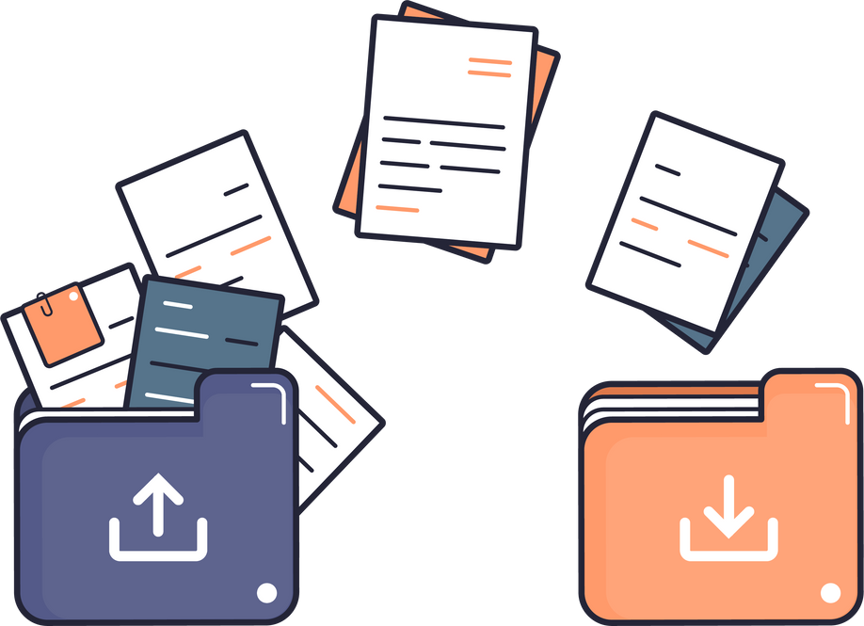

MANAGING YOUR MOJO TICKET
CHECK THE DESIGNATED GOOGLE DRIVE FOLDER
THE CLIENT’S EDIT REQUESTS ARE OUTLINED IN A GOOGLE DOC, FOUND IN YOUR PROJECT’S DESIGNATED GOOGLE DRIVE FOLDER, LINKED IN BITRIX.
These requests can vary greatly in their length and scope, so read through them carefully and apply them thoroughly.
If any of the client’s requests are unclear or impossible, reach out to the PM for clarification (or a Dev Lead, if all else fails.)
CHECK BITRIX FOR ADDITIONAL PROJECT NOTES
PARTIAL OR SUMMARIZED NOTES ARE SOMETIMES INCLUDED IN THE COMMENTS OR PROJECT NOTES SECTIONS IN BITRIX. THERE MAY BE SOME ADDITIONAL DETAILS OR CLIENT REQUESTS HERE THAT SHOULD NOT BE OVERLOOKED.

Slide 4


OUR S.O.P FOR MOJO TICKETS
THE ONLY SOP WE STRICTLY FOLLOW FOR MOJO TICKETS ARE THOSE RELATED TO SEO OPTIMIZATION:
1. An FAQ section on the Homepage and each of the Dynamic pages.
2. Five (5) outbound links embedded in corresponding FAQ paragraphs.
3. An H1 Header, containing the relevant keyword, in 16 pt. font, above the footer.
4. Correct usage of the H1-H6 header tags should be applied, site-wide.
5. Dynamic pages must be created for any additional keywords or locations.

Slide 5


SOME DESIGN AND CONTENT GUIDELINES
The design and content edit requests for Mojo Tickets can vary greatly. Clients often provide resources for inspiration, and some may even request that we rebuild their legacy website. Whatever the particular client’s final vision may be, there are a few guidelines to keep in mind as you handle a Mojo Ticket:
1. Clients may provide reference sites for design or request a Replicate/Semi-replicate of their legacy site.
2. We cannot directly copy any website’s design or content if it is not the property of the client.
3. If Homepage content is redesigned or updated, those changes must also be reflected on the dynamic pages, etc.

Slide 6


THE REVIEW PROCESS AND FINAL STEPS
MOJO TICKET REVIEW PHASES
MOJO TICKETS ONLY GO THROUGH THE REVIEW 2 (LIME) STAGE IN BITRIX.
The Dev Lead checking the ticket/site performs an AI-assisted spell-check in addition to confirming that all client requests were adequately addressed.
If there are any major issues, the site will be changed to the Collaboration (Orange) phase in Bitrix with notes from the Dev Lead.
SITE DELIVERY AND INVOICING
AFTER THE MOJO TICKET/SITE HAS BEEN REVIEWED AND APPROVED BY THE DEV LEAD, IT WILL TRANSFER FROM THE REVIEW 2 PHASE TO THE DELIVERY PHASE.
Once this occurs, the developer is free to invoice the project for payment.

Slide 7
BROUGHT TO YOU BY:
GOOD LUCK WITH
YOUR MOJO MASTERPIECE!

