Slide 1


Slide 2






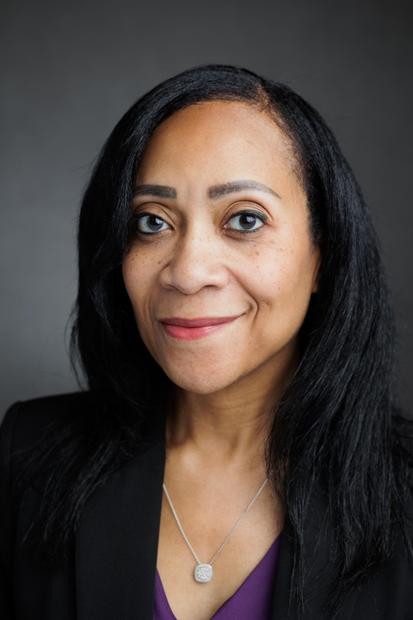
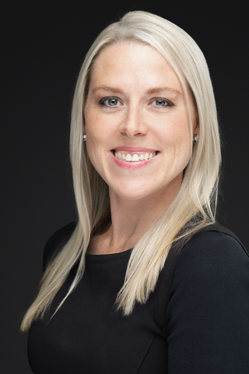

Leadership
Meet
the
Team!
Kelli Houdek
VP Human Capital
Mindy Porter
Sr. Dir. Talent
John Kempe
Sr. Dir. Exec. Recruiting
Laura Peterson
Sr. Dir. HC Strategy
Bren Moore
Dir. Total Rewards
Megan Solko
Dir. L&D

Slide 3







Talent Optimization
Mindy Porter
Sr. Dir. Talent
Jason Libes
Reg. Dir. Recruiting
Bernard Panopio
Reg. Dir. Recruiting
Lindsey Cathey
Sr. Recruiter
Sabrina Bik
Reg. Dir. Recruiting
Kayte Cherry
Recruiter
Paige Puilliam
Recruiter

Slide 4
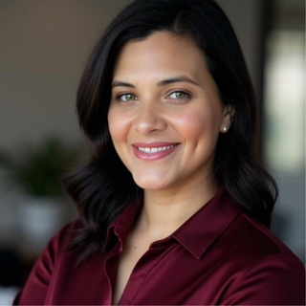
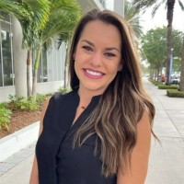


Human Capital Strategy
Laura Peterson
Sr. Dir. HC Strategy
Dorian Velastegui
Reg. HRBP-NE
Amanda Neyer
Mgr. HR Compliance
Carrie Francisco
Sr. HR Generalist
Danielle Williams
HR Associate

Slide 5







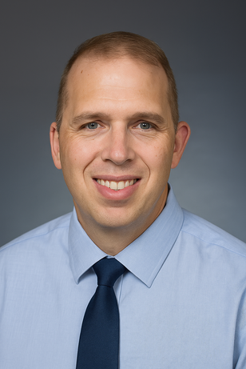
Total Rewards
Bren Moore
Dir. Total Rewards
Rena’ Henry
Manager Payroll
Jamie Root
Payroll Manager
Prabal Shukla
Payroll Admin
Kuldeep Gera
Payroll Admin
Kasia Anderson
Dir. HR Integration
Alexis Rounseville
Mgr. HR Integration
Bianca Snow
HR Generalist
Brant Folken
Sr. Analyst HRIS

Slide 6




Learning & Development
Megan Solko
Dir. L&D
Tim Rigby
Mgr. L&D
Genoa Occhipinti
Analyst, LMS
Hayley Simmerson
Manager, Talent Integ.
Devin Swidecki
Analyst Perf. Sys.

Slide 7




Employee Learning & Development
LCvista is a learning and compliance platform designed for professional services firms. It helps us stay compliant, track Jurisdictions and CPEs, and expands learning opportunities—from technical training to leadership and soft skills.
Leverage LinkedIn Learning as a core part of our development programs, giving our employees on-demand access to thousands of courses that support professional growth, technical skills, and leadership development.
Provides industry-leading review courses with expert instruction, customizable study planners, and practice exams to help employees prepare for professional certifications and advance their careers

Slide 8

Performance Management
Setting SMART goals and acting on them
Monitoring through check-ins and feedback
Planning
Monitoring
Performance
Management
Rating employees and rewarding them
Review goal completion at the end of the cycle
Rating
Reviewing

Slide 9



HR Technology

Slide 10


What is Open Enrollment?
November 3rd – 30th
Active Enrollment – You must enroll in UKG!

Slide 11
Making Changes to Your Benefits:
You may only change your elections during Open Enrollment each year or when you experience a qualifying life event. Qualifying life events include, but are not limited to:
Birth, legal adoption, or placement for adoption
Marital status
Dependent child reaches age 26
Spouse gains or loses employment or eligibility with current employer
Death of a covered dependent
Spouse or dependent becomes eligible or ineligible for coverage
Court ordered change.
Changes to your coverage due to a qualifying life event must be made within 30 days of that life event. Proof of the qualifying life event is required (marriage certificate, divorce decree, birth certificate, or loss of coverage letter).
**Note: Any change you make to your coverage must be consistent with the change in status.

Slide 12
Who is eligible?
Regular, Full-Time Employees Working an Avg. of 30+ hours/weekly
Their spouses/domestic partners
Their dependent children through age 26

Slide 13
Medical Plan
Options

Slide 14
Medical
High PPO
Mid PPO
Base PPO
HDHP with HSA
In-network
Out-of-network
In-network
Out-of-network
In-network
Out-of-network
In-network
Out-of-network
Annual deductible (Individual/Family) | $1,000/ $2,000 | $10,000/ $16,000 | $2,000/ $4,000 | $10,000/ $16,000 | $4,000/ $8,000 | $10,000/ $16,000 | $3,200/ $6,400 | $10,000/ $16,000
Out-of-pocket maximum (Individual/Family) | $4,000/ $8,000 | $15,000/ $30,000 | $5,000/ $10,000 | $15,000/ $30,000 | $6,000/ $12,000 | $15,000/ $30,000 | $5,000/ $10,000 | $15,000/ $30,000
Preventive care | Covered at 100% | Not Covered | Covered at 100% | Not Covered | Covered at 100% | Not Covered | Covered at 100% | 50% Coinsurance
Primary physician office visit | $25 | 50% after Ded. | $30 | 50% after Ded. | $40 | 50% after Ded. | 20% after Ded. | 50% after Ded.
Specialist office visit | $40 | 50% after Ded. | $55 | 50% after Ded. | $65 | 50% after Ded. | 20% after Ded. | 50% after Ded.
Inpatient hospital services | 10% after Ded. | 50% after Ded. | 20% after Ded. | 50% after Ded. | 20% after Ded. | 50% after Ded. | 20% after Ded. | 50% after Ded.
Outpatient hospital services (lab, x-ray, diagnostic) | 10% after Ded. | 50% after Ded. | 20% after Ded. | 50% after Ded. | 20% after Ded. | 50% after Ded. | 20% after Ded. | 50% after Ded.
Advanced diagnostics | 10% after Ded. | 50% after Ded. | 20% after Ded. | 50% after Ded. | 20% after Ded. | 50% after Ded. | 20% after Ded. | 50% after Ded.
Urgent Care | $75 | 50% after Ded. | $75 | 50% after Ded. | 20% after Ded. | 20% after Ded. | 20% after Ded. | 20% after Ded.
Emergency room care | 20% after Ded. | 20% after Ded. | 20% after Ded. | 20% after Ded. | 20% after Ded. | 20% after Ded. | 20% after Ded. | 20% after Ded.

Slide 15

Preventative Healthcare &
Diagnostic Screenings
Go. Know. Take Control.
Diagnostic Screenings
Cigna wants to help you get more out of life. Keeping you healthy is a great place to start.
Go to Cigna.com/takecontrol to find out what basic services you qualify for, and what additional benefits your plan offers
Crete will cover the cost of certain diagnostic screenings at 100%. (mammogram and colonoscopy included)
Common preventative screenings:
Blood Pressure
Cholesterol
Blood Glucose

Slide 16
KAISER PERMANENTE (FOR CA EMPLOYEES ONLY)
Medical | Kaiser HMO (In-network)
Annual deductible (Individual/Family) | $1,000 / $2,000
Out-of-pocket maximum (Individual/Family)* | $3,000 / $6,000
Preventive care | 100% Covered
Primary physician office visit | $30
Specialist office visit | $30
Inpatient hospital services | $400
Outpatient hospital services (lab, x-ray, diagnostic) | $10
Advanced diagnostics | $50
Urgent care | $30
Emergency Room Care | $100
Prescription Drugs | Kaiser HMO (In-network)
Retail (30-day supply) | Retail (30-day supply)
Generic | $10
Brand Preferred | $35 after drug deductible is met
Brand non-preferred | $35 after drug deductible is met
Mail Order (90-day supply) | Mail Order (90-day supply)
Generic | $10
Brand Preferred | $35 after drug deductible is met
Brand non-preferred | $35 after drug deductible is met
Payroll Contributions: Bi-Weekly | Payroll Contributions: Bi-Weekly
Employee Only | $-
Employee + Spouse | $202.87
Employee + Child(ren) | 159.39
Family | 461.85
Brand Preferred | $35 after drug deductible is met
Brand non-preferred | $35 after drug deductible is met

Slide 17



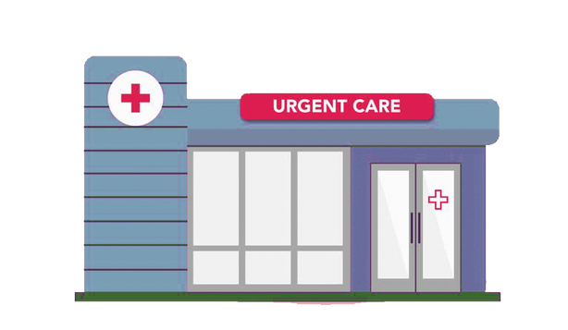

Time, Energy, Effort, Money
Virtual
Conv. Care Clinic
Urgent Care
Emergency Room
Included
$
$$
$$$
Forward Thinking: Every time we use our insurance, it impacts costs for all of us. Choosing the right level of care (ex: virtual visit vs. urgent care vs. the ER for issues) helps protect both our health and our wallets. This will help keep premiums from rising year after year.

Slide 18

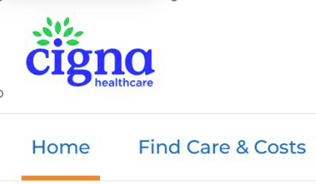
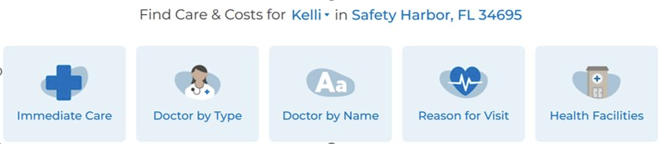
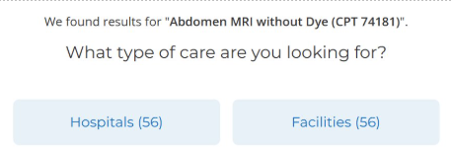
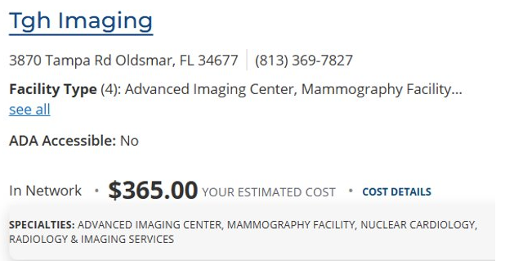
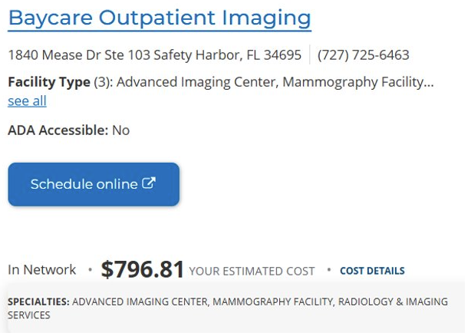


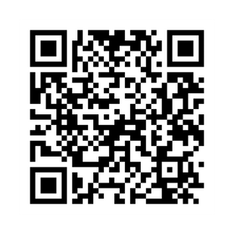
Shop Around For The Same Services​
my.cigna.com/web/secure/consumer/home​

Slide 19
Virtual Healthcare
To schedule an appointment:
Access MDLIVE by logging into myCigna.com and clicking on “Talk to a doctor.”
You can also call MDLIVE at 888.726.3171
Select the type of care you need:
Medical care or counseling
Cost will be displayed on both myCigna.com and MDLIVE.
Follow the prompts for an on-demand urgent care visit, to make an appointment for primary or behavioral care, or to upload photos for dermatology care.
Virtual
Included
Behavioral Health
Schedule appointments online with licensed counselors or psychiatrists through our virtual only provider groups without leaving your home
Autism
Substance Use
Stress, anxiety, & burnout
Talkspace for private text therapy
Headspace Care for text based behavioral health coaching, self-guided learning activities and if needed video-based therapy and psychiatry
Meru Health for app-based virtual counseling for anxiety, depression or burnout
Brightline for virtual behavioral health coaching for families and children ages 18 months through 17 years old

Slide 20
Prescription Drugs
High PPO
Mid PPO
Base PPO
HDHP with HSA
In-network
Out-of-network
In-network
Out-of-network
In-network
Out-of-network
In-network
Out-of-network
Retail (30 Day Supply) | Retail (30 Day Supply) | Retail (30 Day Supply) | Retail (30 Day Supply) | Retail (30 Day Supply) | Retail (30 Day Supply) | Retail (30 Day Supply) | Retail (30 Day Supply) | Retail (30 Day Supply)
Generic | $10 | 50% Coinsurance | $10 | 50% Coinsurance | $15 | 50% Coinsurance | 20% Coinsurance | 50% Coinsurance
Brand Preferred | $30 | 50% Coinsurance | $30 | 50% Coinsurance | $40 | 50% Coinsurance | 20% Coinsurance | 50% Coinsurance
Brand Non-Preferred | $50 | 50% Coinsurance | $50 | 50% Coinsurance | $65 | 50% Coinsurance | 20% Coinsurance | 50% Coinsurance
Mail Order (90 Day Supply) | Mail Order (90 Day Supply) | Mail Order (90 Day Supply) | Mail Order (90 Day Supply) | Mail Order (90 Day Supply) | Mail Order (90 Day Supply) | Mail Order (90 Day Supply) | Mail Order (90 Day Supply) | Mail Order (90 Day Supply)
Generic | $25 | 50% Coinsurance | $25 | 50% Coinsurance | $38 | 50% Coinsurance | 20% Coinsurance | 50% Coinsurance
Brand Preferred | $75 | 50% Coinsurance | $75 | 50% Coinsurance | $100 | 50% Coinsurance | 20% Coinsurance | 50% Coinsurance
Brand Non-Preferred | $125 | 50% Coinsurance | $125 | 50% Coinsurance | $163 | 50% Coinsurance | 20% Coinsurance | 50% Coinsurance
This is a summary of coverage; please refer to your summary plan description for the full scope of coverage. In-network services are based on negotiated charges; Out-of-network services are based on a percentage of Medicare charges.
* Includes Deductible and Copayments

Slide 21



Pharmacy
Helpful Tips & Tricks
GoodRX
Ask the pharmacy, “My copay is $xx with insurance for this prescription — can you tell me the cash price?”
LOCATION
MATTERS!

Slide 22
Pharmacy
Express Scripts Pharmacy
Accredo Specialty Pharmacy
SaveOnSP
Make fills easier. Have your medication sent to your home.
Easily order, manage, track and pay for your medications on your phone or online
Standard shipping at no extra cost
Fill up to a 90-day supply at one time
Helpful pharmacists available 24/7
Automatic refills4 or refill reminders so you don’t miss a dose
Flexible payment op
Move your prescriptions electronically by logging into myCigna.com, calling your doctor’s office, or call Express Scripts Pharmacy at 800.835.3784
Required for certain specialty medications.
Focused on complex medical conditions and personalized support.
Delivers medication to your home, work, doctor’s office, or even vacation spot.
Access 24/7 pharmacists and nurses for help with side effects or questions.
Offers refill reminders, standard shipping at no cost, and financial assistance options.
A specialty medication savings program through your pharmacy benefit.
Pay $0 out-of-pocket for eligible medications (covered by manufacturer copay assistance).
No extra cost to participate — available when filling through Accredo.
Without SaveOnSP, you’ll pay 30% coinsurance.
Use the myCigna app or myCigna.com to check medication pricing.
Note: Not available to those enrolled in the HDHP with HSA plan.
You can find the Formulary list in the benefit resource center

Slide 23
Dental Insurance
Dental
Low DPPO
High DPPO
In-network
In-network
Annual deductible (Individual/Family) | $50/$150 | $50/$150
Annual maximum (per person) | $1,000 | $1,500
Diagnostic and preventive care (includes cleanings, fluoride treatments, sealants, and x-rays) | Covered at 100% | Covered at 100%
Basic services (includes fillings, periodontics, scaling, and root planning, and oral surgery) | Covered at 80% | Covered at 80%
Major services (includes crowns, bridges, and full and partial dentures) | Covered at 50% | Covered at 50%
Orthodontia *for dependents age <19* | Not Covered | Covered at 50%
Lifetime maximum for Orthodontia | N/A | $1,000
Plan includes out-of-network benefits; see plan summary for additional details.
Note: The Low DPPO operates on a MAC pricing model while the High DPPO operates on a UCR pricing model. UCR stands for “Usual, Customary, and Reasonable,” and it refers to the average fee charged by dentists in a specific geographic area for a given procedure. If your dentist’s fee exceeds the UCR amount, you may be responsible for paying the difference. MAC, or “Maximum Allowable Charge,” is a fixed fee set by the insurance company for each procedure. If your dentist charges more than the MAC, you’ll also pay the difference. The High DPPO will offer a better out-of-network reimbursement than the Low DPPO.

Slide 24


Out-of-Network Dental Costs
Balance Billing Explained
When you go out-of-network, your provider does not have a contract with your insurance company.
Insurance will pay only up to what they consider the “allowed amount” or “reasonable and customary charge.”
If the provider charges more than that, they can send you a bill for the difference.
That extra amount = balance billing.
ASK THE RIGHT QUESTIONS!
Do you take my insurance in network?
Get a quote

Slide 25
Vision Insurance
Examination (every 12 months) | $10
Material | $25
Lenses (every 12 months) | Lenses (every 12 months)
Single | $25 copay
Bifocal | $25 copay
Trifocal | $25 copay
Frames (every 24 months) | Frames (every 24 months)
New Frames | $130 allowance + 20% off coverage
Contact lenses (every 12 months) | Contact lenses (every 12 months)
Elective | Up to $130 allowance
Medically Necessary | Covered at 100%
In-network
In-network

Slide 26






Vision
warbyparker.com
paireyewear.com
eyebuydirect.com
zennioptical.com
glasses.com

Slide 27
Payroll Contributions: Bi-Weekly
Medical | High PPO | Mid PPO | Base PPO | HDHP with HSA
Employee | $124.51 | $83.95 | $54.58 | $0.00
Employee + Spouse | $473.73 | $388.57 | $326.87 | $212.28
Employee + Child(ren) | $428.82 | $351.75 | $295.93 | $192.26
Family | $777.69 | $656.03 | $567.90 | $404.20
Dental | Low DPPO | High DPPO
Employee | $0.00 | $6.83
Employee + Spouse | $17.29 | $30.79
Employee + Child(ren) | $29.10 | $47.18
Family | $52.96 | $80.18
Vision
Employee | $3.13
Employee + Spouse | $6.26
Employee + Child(ren) | $6.32
Family | $10.09

Slide 28
Best Case/Worst Case Scenario
​ | Mid PPO ​ | Monthly ​ | Annually ​ | ​ | Deductible ​ | Deductible ​ | OOP Max ​ | ​ | ​ | Best Case ​ | Worst Case ​ | ​
EEO ​ | $83.95 | $ 167.90 | $ 2,014.80 ​ | ​ | $2,000 | $2,000 | $5,000 | ​ | ​ | $ 2,014.80 ​ | $7,014.80 | ​
EES ​ | $388.57 | $ 777.14 ​ | $ 9,325.68​ | ​ | $4,000 | $4,000 | $10,000 | ​ | ​ | $ 9,325.68​ | $ 19,325.68 | ​
EEC ​ | $351.75 | $ 703.50 ​ | $8,442 ​ | ​ | $4,000 | $4,000 | $10,000 | ​ | ​ | $8,442 ​ | $18,442.00 | ​
EEF ​ | $656.03 | $1,312.06​ | $15,744.72 | ​ | $4,000 | $4,000 | $10,000 | ​ | ​ | $15,744.72 | $25,744.72 | ​
​ | HDHP ​ | Monthly ​ | Annually ​ | ​ |  | Deductible ​ | OOP Max ​ | ​ | HSA Seed ​ | Best Case ​ | Worst Case ​ | Savings on worst case ​
EEO ​ | $ - ​ | $ - ​ | $ - ​ | ​ |  | $ 3,200.00 ​ | $5,000 | ​ | $500 | $ (500)​ | $4,500 | $ (2,514.80)​
EES ​ | $212.28 | $424.56 | $5,094.72 | ​ |  | $ 6,400.00 ​ | $ 10,000​ | ​ | $1,000 | $4,094.72 | $14,094.72 | $ (5,230.00)​
EEC ​ | $192.26 | $384.52 ​ | $ 4,614.24 ​ | ​ |  | $ 6,400.00 ​ | $10,000 | ​ | $1,000 | $ 3,614.24 ​ | $ 13,614.24 ​ | $ (4,827.76)​
EEF ​ | $404.20 | $808.40 | $9,700.80 ​ | ​ |  | $ 6,400.00 ​ | $10,000 | ​ | $1,000 | $8,700.80 ​ | $18,700.80 ​ | $ (7,043.92)​

Slide 29



Health Savings Account (HSA)
A health savings account (HSA) is a tax-advantaged savings account that can be used for qualified healthcare expenses. You own your HSA and can contribute to the account with pre-tax payroll deductions.
Manage your HSA at www.ebcflex.com. You’ll set up your payroll contributions during your enrollment period. You can change the contribution amount at any time.
How Much Can I Deposit into an HSA?
HSA Advantages
<55*
Up to $4,400 for individual
Up to $8,750 for family
*
*Not enrolled in Medicare
Up to $5,400 for individual
Up to $9,750 for family
You can use the account to pay for qualified healthcare expenses.
Unspent dollars roll over each year and are yours to keep, even if you retire or leave the company.
You can invest your HSA funds, so your available healthcare dollars can grow over time.
55+*
As an added benefit, Crete Professionals Alliance will contribute $500 for individual coverage and $1,000 for family coverage to your account yearly
Above limits are a combination of your deferral and the company contributions.

Slide 30
Flexible Spending Account (FSA)
A Flexible Spending Account (FSA) is a tax-advantaged account that can reimburse you for qualified healthcare or dependent care expenses. You can fund qualified expenses with pre-tax dollars deducted from your paycheck.
When electing an FSA, you will set an annual contribution amount. Any unused funds over the maximum of $680 will be forfeited if not used by December 31st, 2026.
You can choose to participate in either the Healthcare FSA, the Dependent Care FSA or both, and it’s unnecessary to “sign up” specific family members for these account
Limited Purpose FSA:
Healthcare FSA:
Dependent Care FSA:
Contribute up to $3,400 pre-tax each year to cover eligible out-of-pocket medical expenses like copays, prescriptions, and treatments.
If you have an HSA, you can set aside up to $3,400 pre-tax for dental and vision expenses only (not medical).
Use up to $7,500 pre-tax for dependent care costs such as daycare, babysitters, nursery school, or elder care.

Slide 31



Goodies Available to You via HSA/FSA
Best Sellers:
Full Body Analysis Scale
Red Light Therapy Face Mask
Cosmetic Solutions
Oura Rings
Foot Massager
Massage Gun
Pain Relief Ice Roller
Best Sellers:
Headache/Migraine Relief Hat
Ibuprofen
Forehead Digital Thermometer
Allergy Relief
Electrolyte Drink Mix Pouches
FSAstore.com
HSAstore.com

Slide 32

Supplemental Benefits
Life Insurance
Insurance Coverage | Benefit
Employer Paid: Basic Life and AD&D | 1x your earnings up to $150,000 Basic Life and Accidental Death & Dismemberment (AD&D) insurance is provided to you at no cost!
Voluntary: Employee Life | Choose from $10,000 to $500,000 in $10,000 increments, up to 5 times your earnings. You can get up to $300,000 with no medical underwriting.
Voluntary: Spouse Life | Get up to $100,000 in increments of $5,000. Spouse coverage cannot exceed 100% of the Employee amount. Spouses can get up to $50,000 with no medical underwriting.
Voluntary: Child Life | Birth to 6 months: $1,000 6 months to 26 years: Up to $10,000 in increments of $2,000
You can find additional information on https://cretepa.benefitsinfo.com

Slide 33
Supplemental Benefits
Voluntary Accident Insurance
Voluntary Critical Illness Insurance
Voluntary Hospital Indemnity Insurance
Pays cash benefits directly to you after a covered accident
Helps cover costs your health plan may not fully pay
Includes up to $50 wellness benefit for completing a health screening
Provides financial protection if diagnosed with a serious illness (e.g., heart attack, stroke, cancer, renal failure)
Choose coverage of $10,000, $20,000, or $30,000 during open enrollment (no medical underwriting required)
Includes $50–$100 wellness benefit, depending on coverage level
Pays lump-sum cash benefits for hospital stays and confinements
Helps cover extra out-of-pocket expenses even with insurance
Includes up to $50 wellness benefit for completing a health screening
You can find additional information on https://cretepa.benefitsinfo.com

Slide 34
Supplemental Benefits
Short-Term & Long-Term Disability
Short-term and Long-term Disability benefits are provided at no cost to you!
These plans give you income protection in the event you are ill, suffer a non-work-related injury, and can’t work.
Employer-Paid Short-term Disability Benefits | Employer-Paid Short-term Disability Benefits | Employer-Paid Long-term Disability Benefits | Employer-Paid Long-term Disability Benefits
Elimination period | 7 days (for both accident and illness) | Elimination period | 90 days
Weekly benefit | 60% of weekly earnings | Weekly benefit | 60% of monthly earnings
Maximum weekly benefit | $2,500 weekly benefit | Maximum weekly benefit | $10,000 monthly benefit
Maximum benefit period | 12 weeks | Maximum benefit period | SSNRA (Social Security Normal Retirement Age)
You can find additional information on https://cretepa.benefitsinfo.com

Slide 35








Additional Benefits
Employer Paid
Identity Theft Protection​
Employee Assistance Program
Travel Assist
Life Planning Resources
Voluntary
Pet Insurance
Commuter Benefits
Must actively enroll on ebcflex.com​
You can find additional information on https://cretepa.benefitsinfo.com

Slide 36
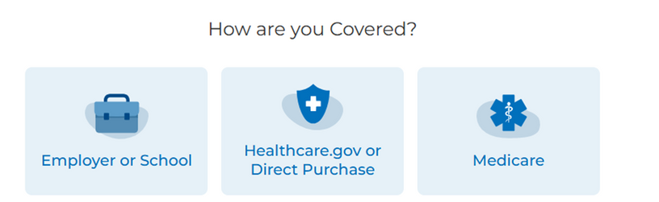
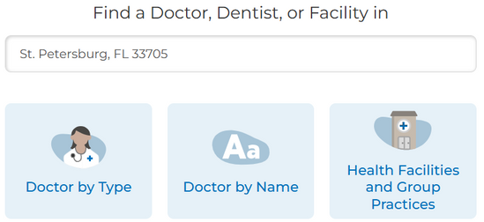



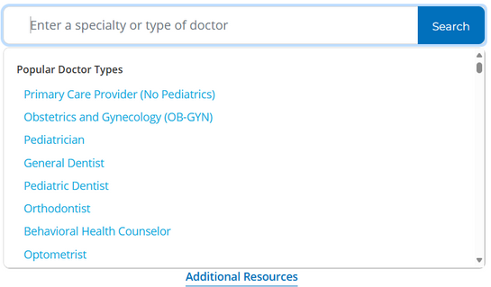
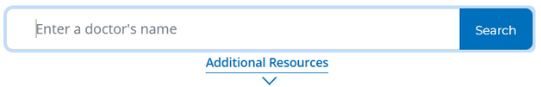
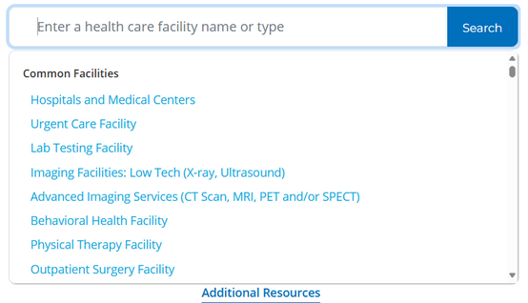
How Do I Know If My Provider
Accepts My Insurance?
hcpdirectory.cigna.com
Dental: Total
Vision: Eyemed
Medical: OAP(Open Access Plus)
Syracuse Area - Mohawk Valley
Plans:

Slide 37
401 (k)

Slide 38


The Catalyst 401 (k)
2026: The 401(k) plan will include an annual true-up to ensure you receive the full employer match, even if your contributions vary throughout the year.
Eligibility:
You’re eligible the first of the month after 60 days of employment.
Enrollment:
A Shell account is created in ~10–15 business days; enroll online with SSN + personal email.
Portability:
The account is yours, even if you leave Crete.
Contributions:
We will match 100% of contributions up to 3%. We will match 50% of contributions between 4-5%.​
MAX: $23,500
Flexibility:
You can change contribution rates or investments anytime.
Investments:
Wide menu of mutual funds plus target-date funds designed for “set it and forget it” retirement savings.
Enroll directly at Transamerica.com/portal
You can find additional information on your
UKG Dashboard

Slide 39
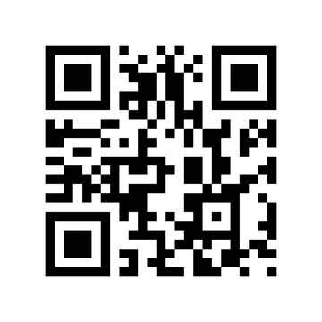
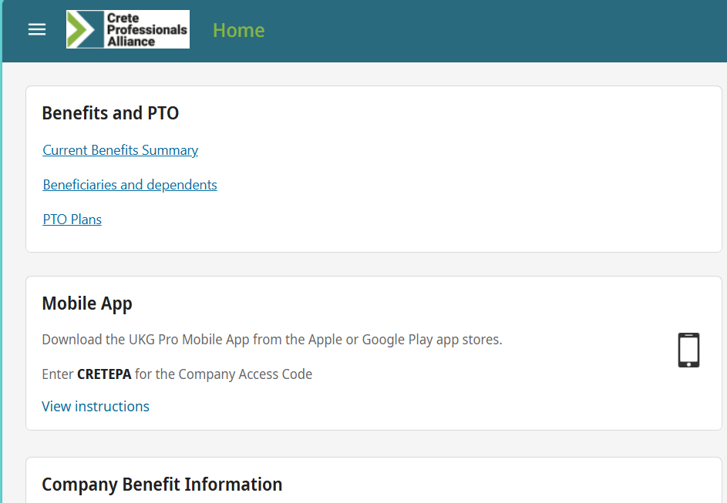
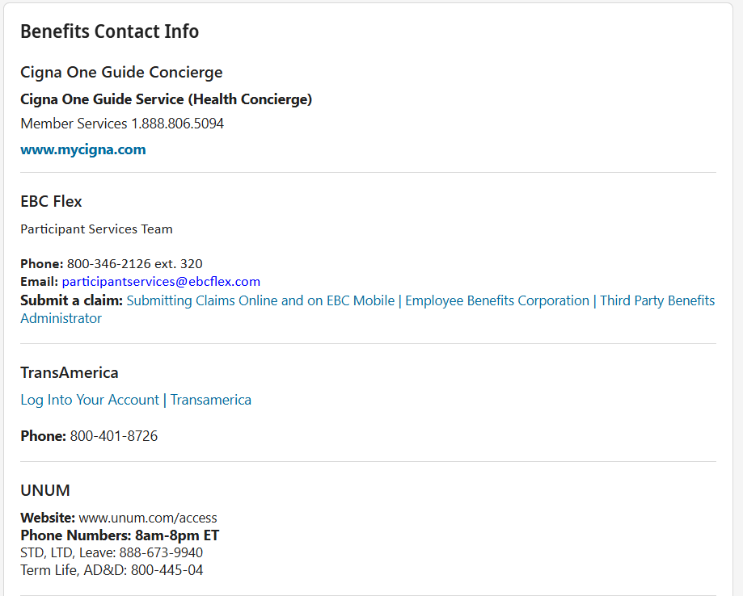
UKG
In UKG, you can...
Enroll in Health Benefits
Update your contact info
Look up Pay Info:
Pay History
YTD Summary
Change Direct Deposit Info

Slide 40
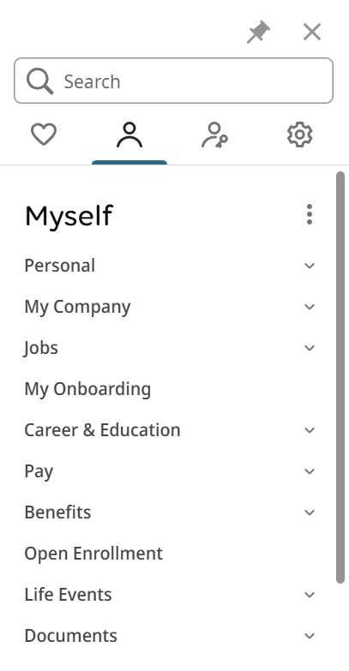
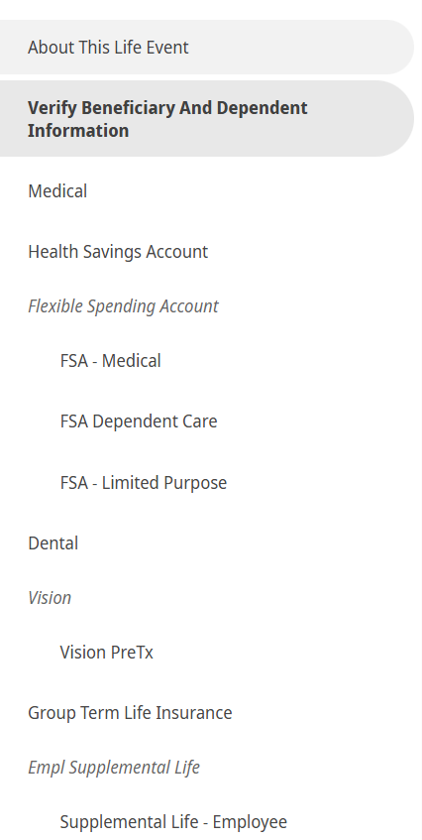
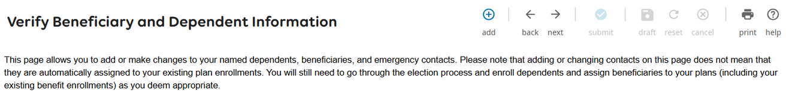
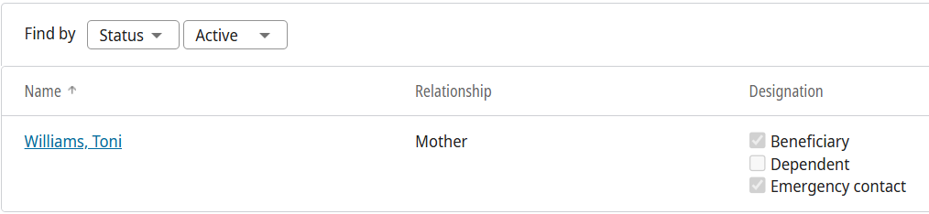

UKG
List clear beneficiary details (full name, DOB, relationship) to avoid confusion or fraud.

Slide 41
Contacts
Medical/Rx: Cigna
Dental: Cigna
Vision: Cigna
800.997.1654
www.cigna.com
Savings Accounts (HSA, FSA, DCFSA, LPFSA) and Commuter Benefits: EBC Flex
800.346.2126, Option 1 www.ebcflex.com
Life & Disability,
Supplemental Health (Accident, Critical Illness, Hospital Indemnity): Unum
866.779.1054 services.unum.com
Telemedicine
866.494.2111 www.MDLIVEforCigna.com
Cigna One Guide Service (Health Concierge)
888.806.5094
www.mycigna.com
Support Line
hr@cretepa.com

Slide 42

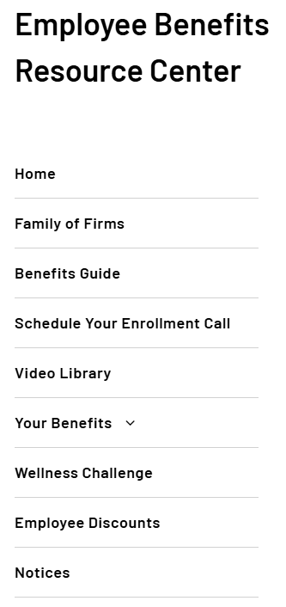


cretepa.benefitsinfo.com

Slide 43

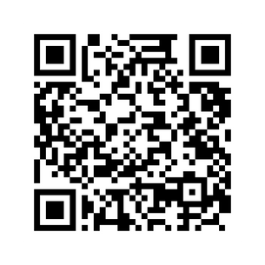
Open Enrollment Assistance
This year’s enrollment is an ACTIVE Enrollment. ALL EMPLOYEES must go into the system and
make their elections. Benefits will not carry over to the next year
Schedule your personalized appointment with a Benefits Counselor to learn more about your benefit options
Review the Benefits Guide and other educational tools to learn more about your benefit offerings
Enroll in Benefits! Be sure to have new dependent and beneficiary SS# and DOB available to complete your enrollment!
Scan the QR Code to Schedule your personalized appointment with a Benefits Counselor

Slide 44


Important Update: Transition to Biweekly
Pay Schedule Beginning January 2026
Final Semi-Monthly Paycheck:
December 31, 2025, covers work from December 16 through December 31, 2025
First Biweekly Pay Period:
December 21, 2025 – January 3, 2026
First Biweekly Paycheck: January 9, 2026
To ensure no gap in pay, Crete will advance five (5) days of pay (January 1–5) as part of the transition to the new schedule. After this, you’ll receive your regular pay every other Friday going forward.*
*If any employee terminates employment before the end of 2026, those advanced funds will be collected from their final paycheck.
Key Details
The total number of pay periods per year will increase from 24 to 26.
Benefit deductions will continue on 24 pay periods per year, which means two paychecks each year will not have benefit deductions on 05/26/2026, and 10/30/2026

