Slide 1
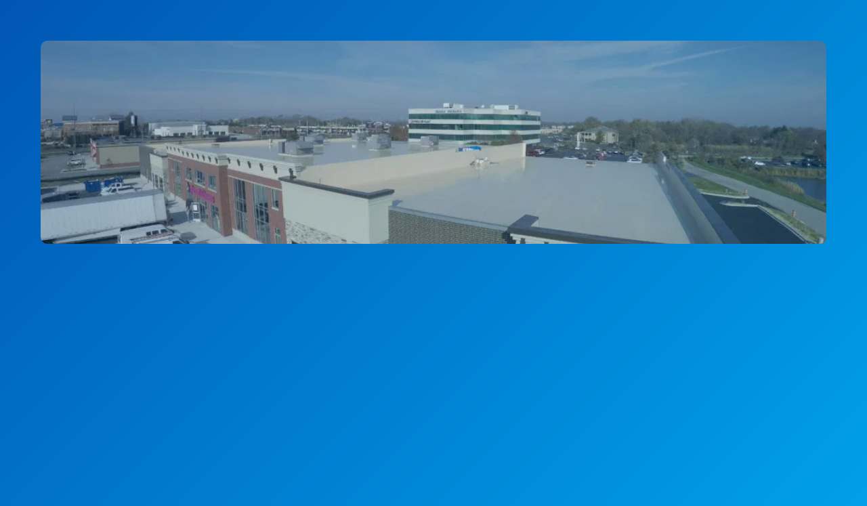
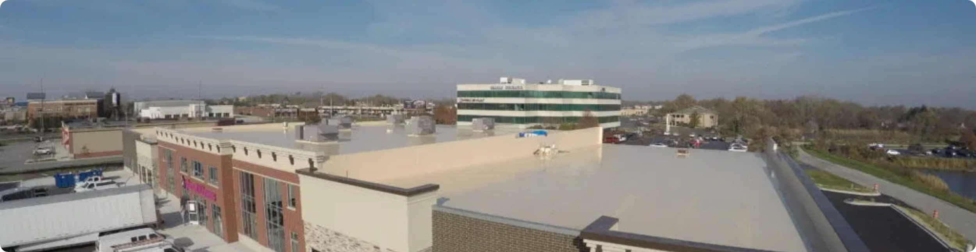
Advanced Silicone Roof Coating Solutions
Extending Roof Life by 20 Years
NL Roofing of Houston
September 4, 2025

Slide 2


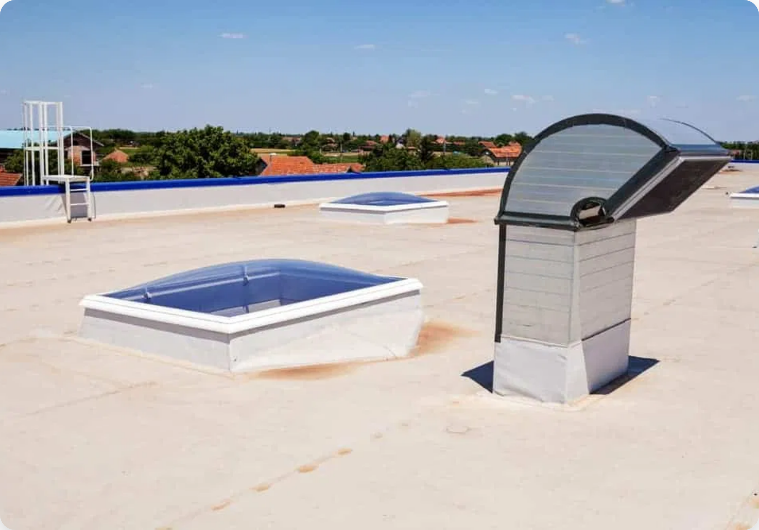



The Challenge: Aging Commercial Roofs
Deterioration:
Existing roofs face wear and tear from
weather, UV exposure, and age.
High Costs:
Traditional roof replacements are
expensive, disruptive, and often require extensive tear-
offs.
Energy Inefficiency:
Dark, older roofs absorb heat,
leading to higher cooling costs and uncomfortable
indoor environments.
Business Interruption:
Lengthy construction projects
can halt or significantly impact business operations.

Slide 3
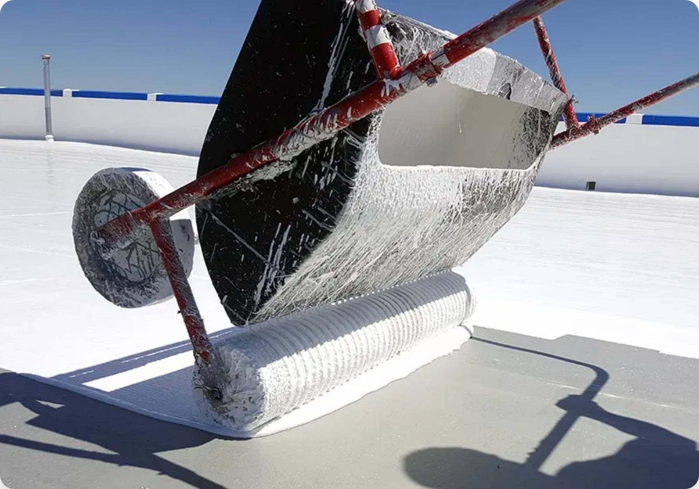

Our Solution: Fluid Applied 100% Silicone Roof Coating
NL Roofing of Houston offers an advanced, sustainable, and cost-effective alternative to traditional roof replacement. Our 100% Fluid Applied Silicone Roof Coating system revitalizes your existing roof, extending its life and enhancing your building's performance.
Advanced roofing solution designed for optimal performance
Sustainable alternative to traditional roof replacement
Cost-effective solution that adds 20 years of roof life
Seamless application with minimal business disruption

Slide 4

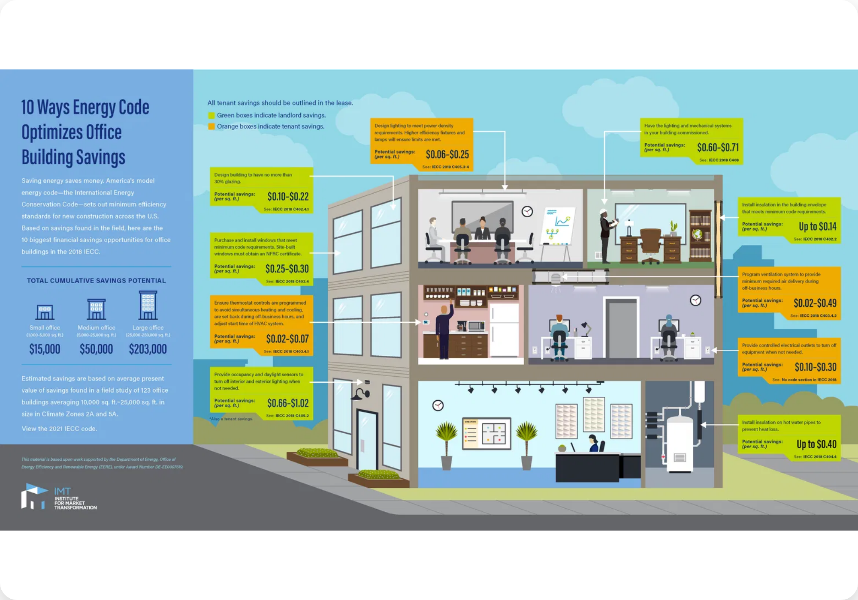



Key Features & Benefits
20-Year Life Extension
Adds an impressive 20 years of life to low and no-slope roofs with comprehensive NDL manufacturer's warranty.
Energy Efficiency
"Super cool" & "ultra-reflective" coating significantly reduces roof surface temperature, lowering cooling costs.
Minimal Disruption
Swift, non-intrusive application allows operations to continue without significant downtime or business interruption.
Environmental Benefits
No solvents, low VOC product with minimal environmental impact. Eliminates waste from roof tear-offs.

Slide 5


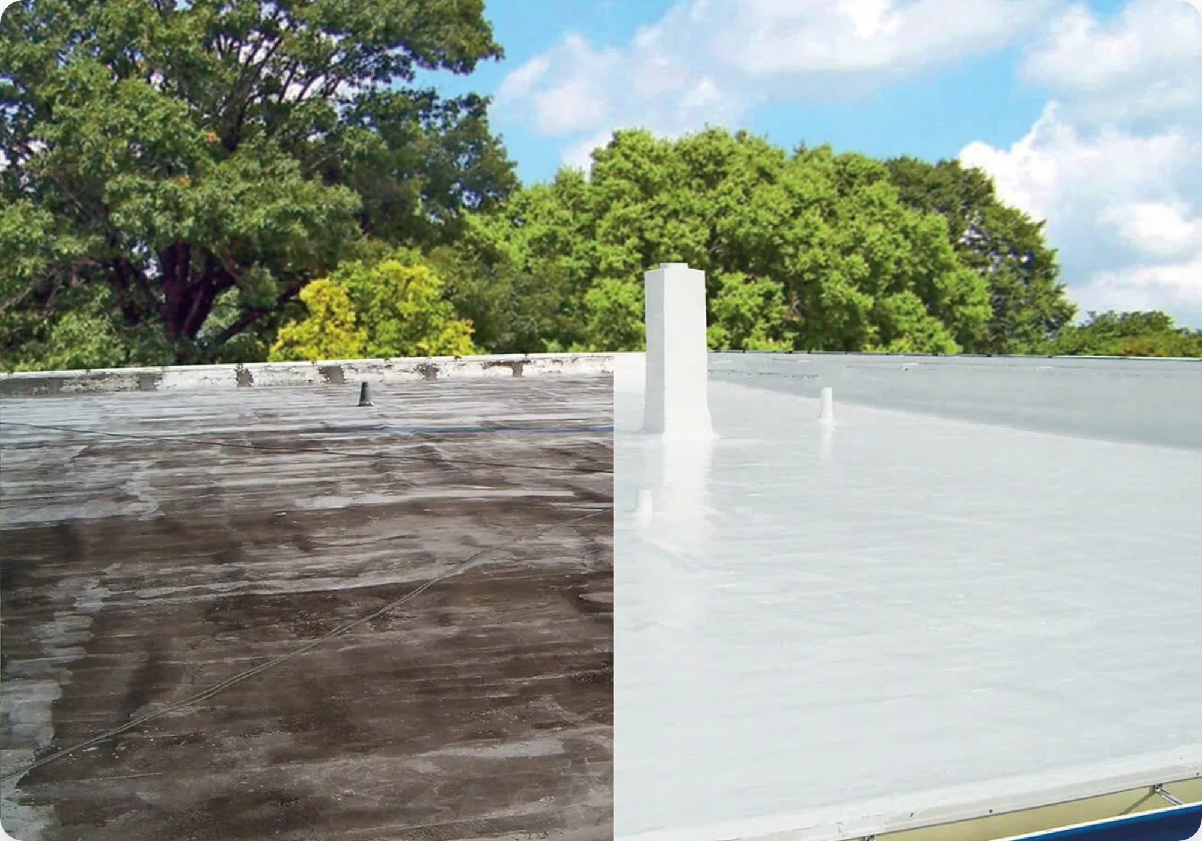



Unmatched Versatility
Our silicone coating is engineered specifically for optimal performance across a wide range of commercial and industrial roofing applications.
Perfect for Low to No Slope Roofs
Specifically engineered to provide a superior roofing
BEFORE
AFTER
solution for buildings with low-slope to no-slope roof
designs.
Compatible with Existing Roof Types
Can be applied directly over metal roofs, built-up
ballasted roofs, modified bitumen, TPO, EPDM, and
PVC.
No Tear-Offs Required
Eliminates costly and time-consuming tear-offs,
reducing project expenses and environmental waste.
Seamless Application
Provides a seamless, durable application that
addresses common issues on these roof pitches.

Slide 6


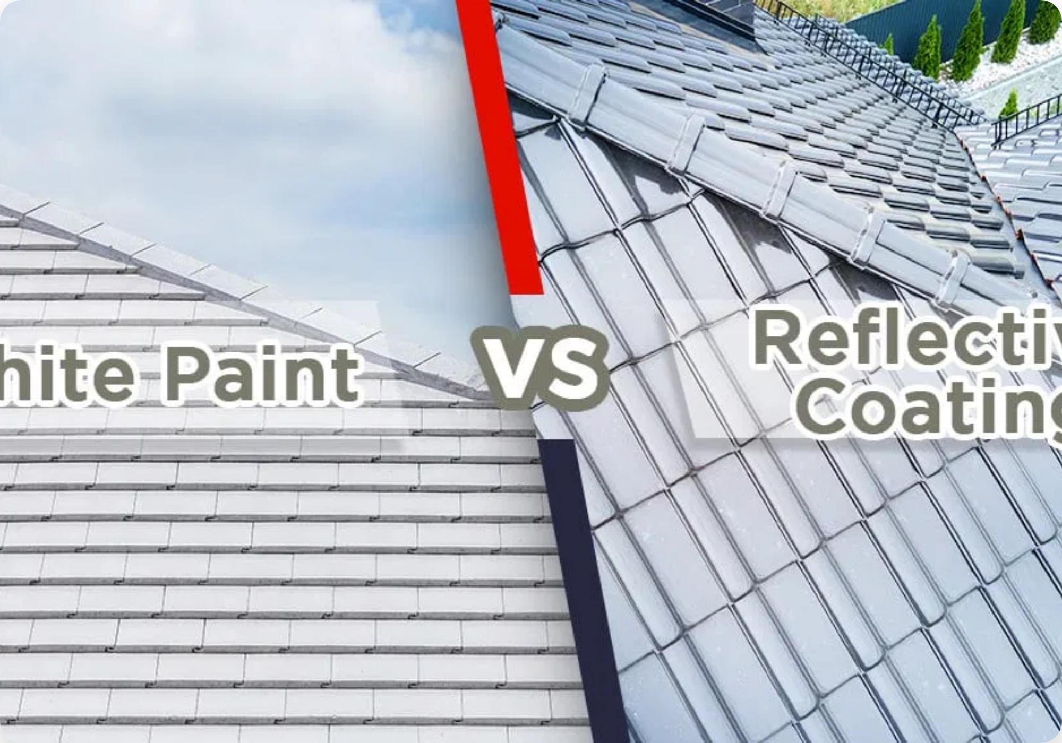




Environmental & Energy Benefits
Environmentally Conscious
No solvents, low VOC product ensuring minimal
environmental impact and improved air quality.
"Super Cool" & "Ultra-Reflective"
Significantly reduces roof surface temperature by
reflecting solar radiation instead of absorbing it.
Exceeds Cool Roof Standards
Our silicone coating surpasses industry standards for
reflectivity and thermal emittance.
Significant Energy Savings
Lower cooling costs contribute to a more energy-
efficient and comfortable interior environment.
Can reduce roof surface temperatures by up to 50-60°F
compared to traditional dark roofing materials.

Slide 7
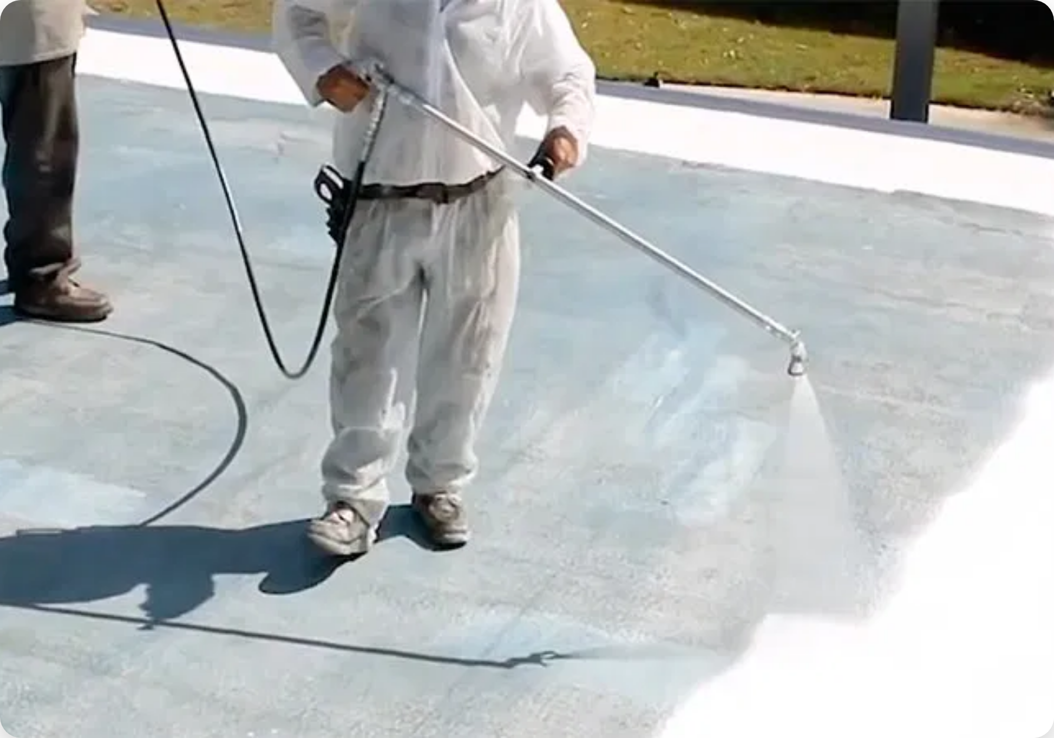




Hassle-Free Application & Minimal Disruption
One of the most compelling advantages of our silicone roof coating is its ease of application and minimal impact on your business operations.
Considered a Repair
In most jurisdictions, applying this coating is considered a repair rather than a new roof installation.
No Permits Required
Streamlined project timeline and reduced administrative burdens with no permit requirements.
No Business Interruption
Your operations continue without significant downtime or disruption to business activities.
Swift Application
The application process is quick and non-intrusive, minimizing any impact on your facility.

Slide 8
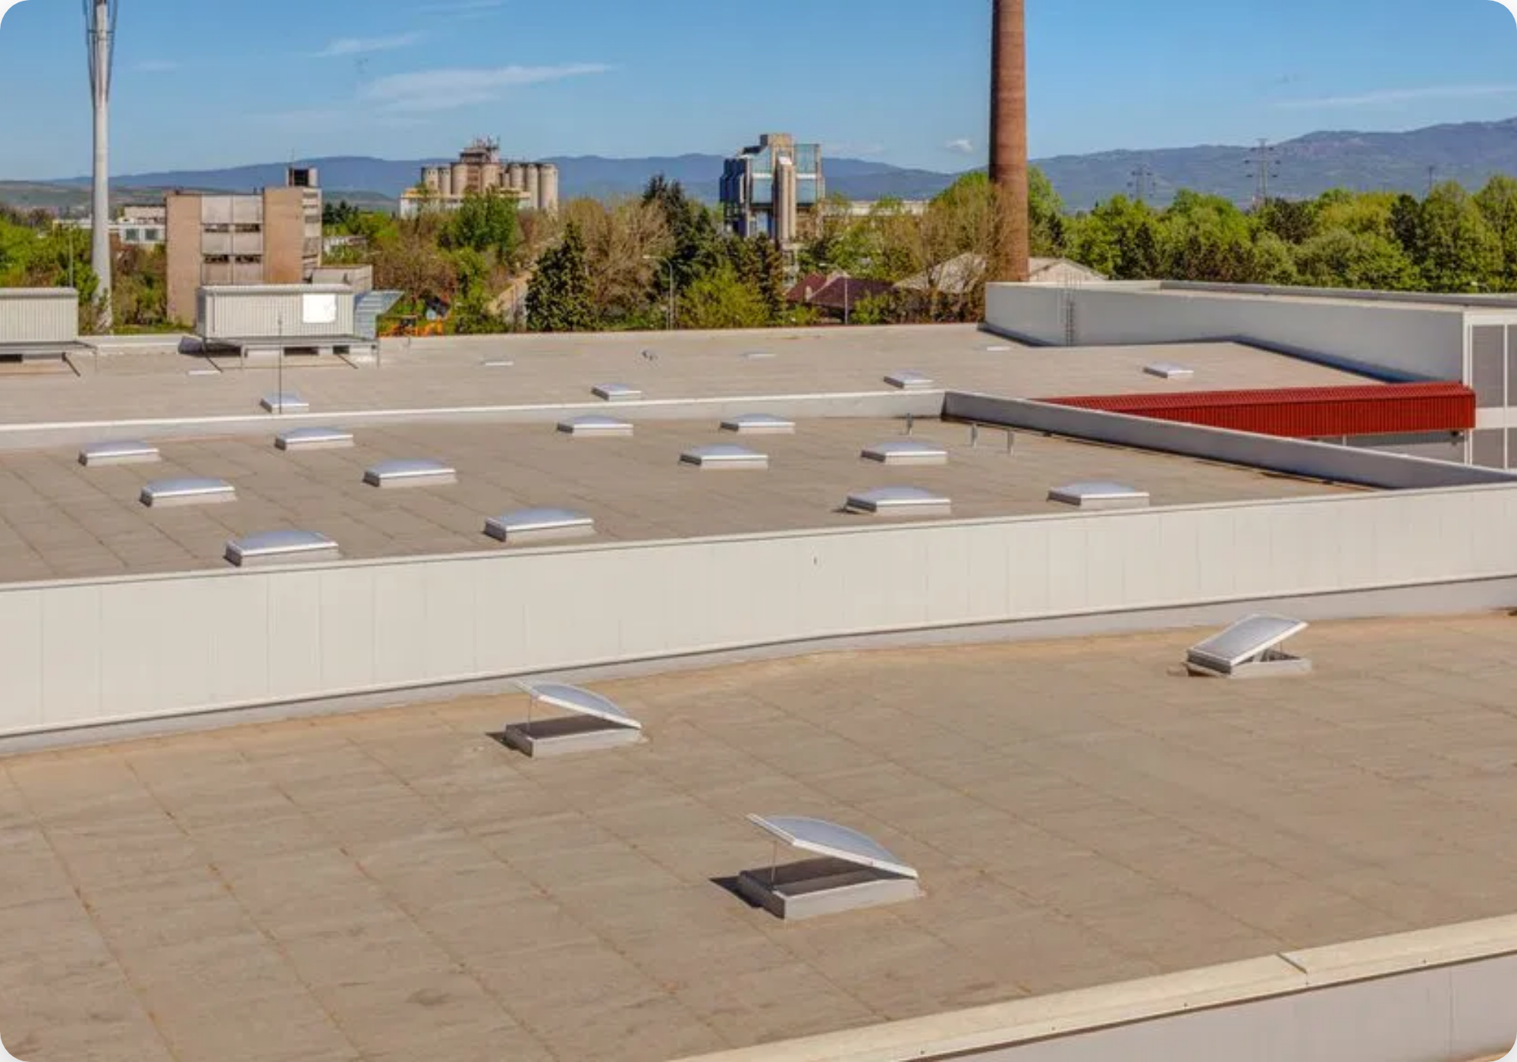




Applicable Over Most Existing Roof Types
Our versatile silicone coating can be applied directly over a wide variety of existing roofing substrates, providing exceptional protection without the need for complete replacement.
Metal roofs
Built-up ballasted roofs
Modified bitumen roofs
TPO (Thermoplastic Polyolefin)
EPDM (Ethylene Propylene Diene Monomer)
PVC (Poly-Vinyl Chloride)
Cost-Saving Benefit:
This compatibility eliminates the need
for costly and time-consuming tear-offs, further reducing
project expenses and environmental waste.

Slide 9
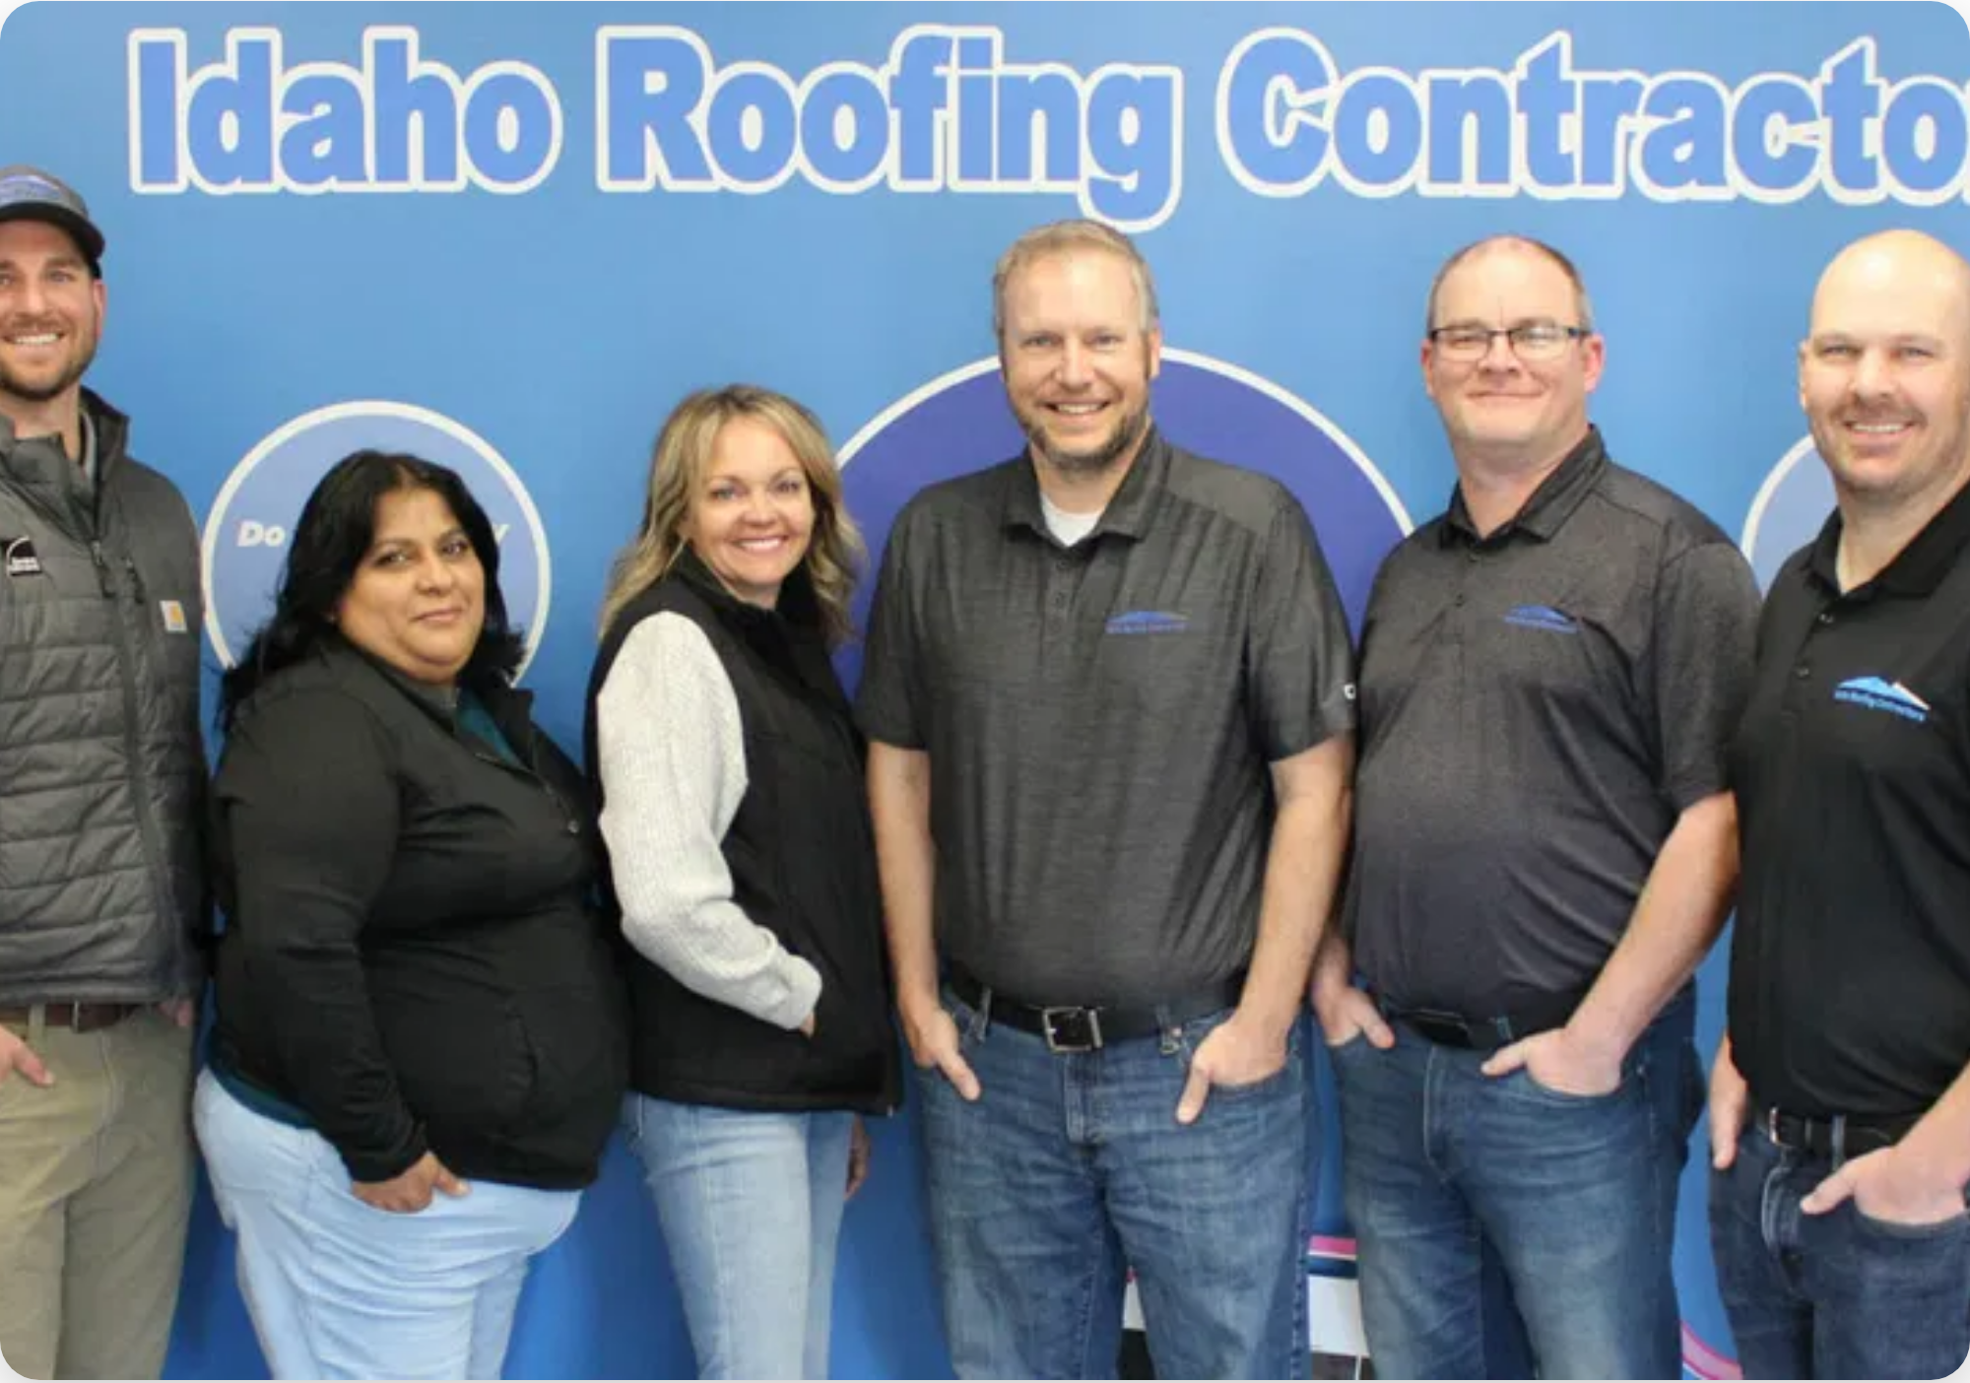





The NL Roofing of Houston Advantage
When you choose NL Roofing of Houston for your silicone roof coating project, you're partnering with a team dedicated to excellence and customer satisfaction.
Proven Expertise
We specialize in advanced roofing solutions designed for optimal performance and longevity.
Certified Application
CERTIFIED
John Wilson, our certified applicator, ensures the highest level of professionalism and adherence to manufacturer specifications.
Customer-Centric Approach
We prioritize minimal disruption and maximum value for your business throughout the entire process.
Quality Assurance
Comprehensive post-application inspection to verify thickness, coverage, and overall quality of installation.

Slide 10

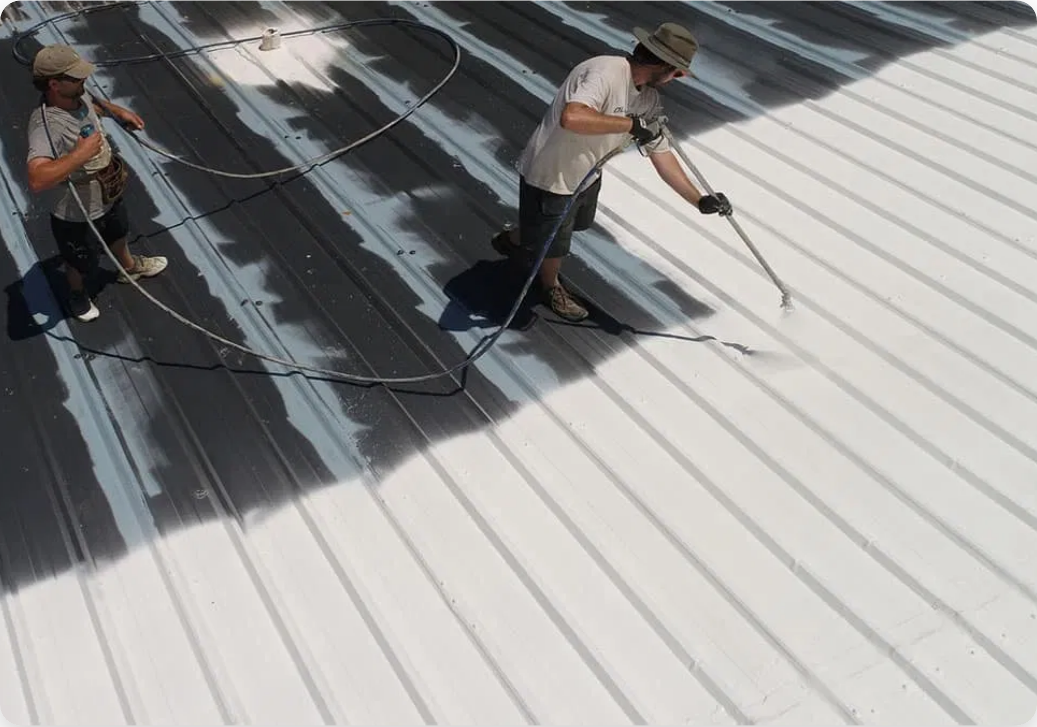





Backed by a 20-Year NDL Manufacturer's Warranty
For your complete peace of mind, our 100% silicone roof coating is backed by a comprehensive warranty that underscores the product's superior quality and long-term performance.
No Dollar Limit (NDL) Coverage
Our warranty has no financial cap on covered repairs, providing maximum protection for your investment.
20-Year Duration
Two decades of coverage demonstrates the manufacturer's confidence in the product's longevity and durability.
Manufacturer Backed
Direct manufacturer support ensures reliable coverage and responsive service throughout the warranty period.
Superior Quality Assurance

Slide 11


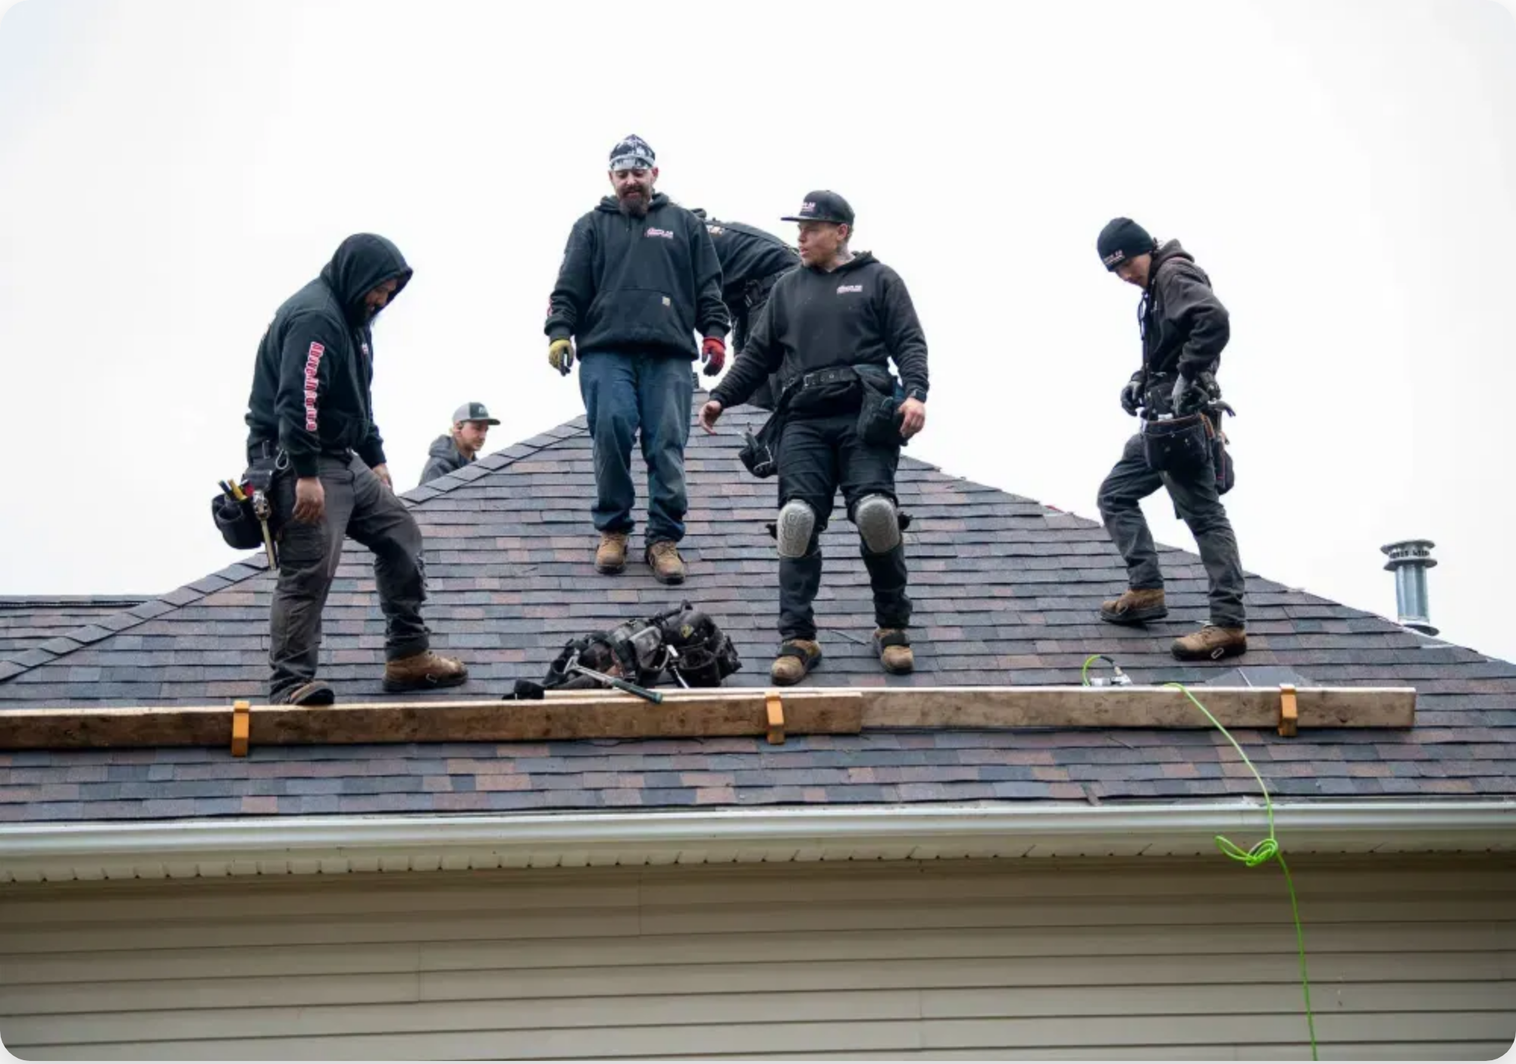


Contact NL Roofing of Houston Today!
Ready to transform your aging roof into a durable, energy-efficient, and long-lasting asset? Our team is here to help you every step of the way.
936-260-7100
john@nlimprovements.net
Next Steps
1
On-Site Consultation
- Schedule a detailed assessment of
your roof for a precise, customized proposal.
2
Detailed Proposal
- Receive a comprehensive proposal with
exact pricing and project timelines.
3
Contract & Scheduling
- Finalize the contract and schedule
the project at your convenience.
Experience the benefits firsthand! Let us bring a demo to your
building to demonstrate the product's properties and discuss how
it can transform your roof.

