Slide 1

Relationships, Sex and Health Education (RSHE)
Parent Meeting
1

Slide 2
What is RSHE?
Relationship, Sex and Health Education is about the emotional, social and cultural development of pupils, and involves learning about personal relationships, sexual health, sexuality, healthy lifestyles, diversity and personal identity.
It is the understanding of the importance of marriage for family life, stable and loving relationships, respect, love and care.
• Since September 2020 it has been a compulsory subject for all schools.
2

Slide 3
The Purpose of RSHE
• The Department for Education ‘continues to recommend that all primary schools should have a sex education programme tailored to the age and the physical and emotional maturity of the pupils’
• All Relationship, Sex and Health Education (RSHE) will be in accordance with the Church’s moral teaching. It will emphasise the central importance of marriage and the family whilst acknowledging that all pupils have a fundamental right to have their life respected whatever household they come from. It will also prepare pupils for life in modern Britain.
3

Slide 4
To embrace the challenges of creating a happy and successful adult life, pupils need knowledge that will enable them to make informed decisions about their wellbeing, health and relationships and to build their self-efficacy. Pupils can also put this knowledge into practice as they develop the capacity to make sound decisions when facing risks, challenges and complex context (DFE).
4

Slide 5
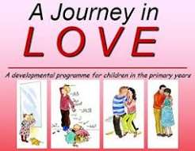
How do we deliver RSHE?
To deliver RSHE, we follow the scheme ‘A Journey in Love’.
It is the recommended programme of study for Catholic schools for Relationship and Sex Education. It is rooted in the Catholic Church’s teaching.
A Journey in Love offers opportunities to teach DFE guidance on Relationships Education and Relationships Sex Education in age-appropriate ways.
In Autumn Term, the children will experience the ‘Social and Emotional’ content;
In the Spring Term, the children will experience the ‘Physical’ content;
In the Summer Term, the children will experience the ‘Spiritual’ content.
5

Slide 6
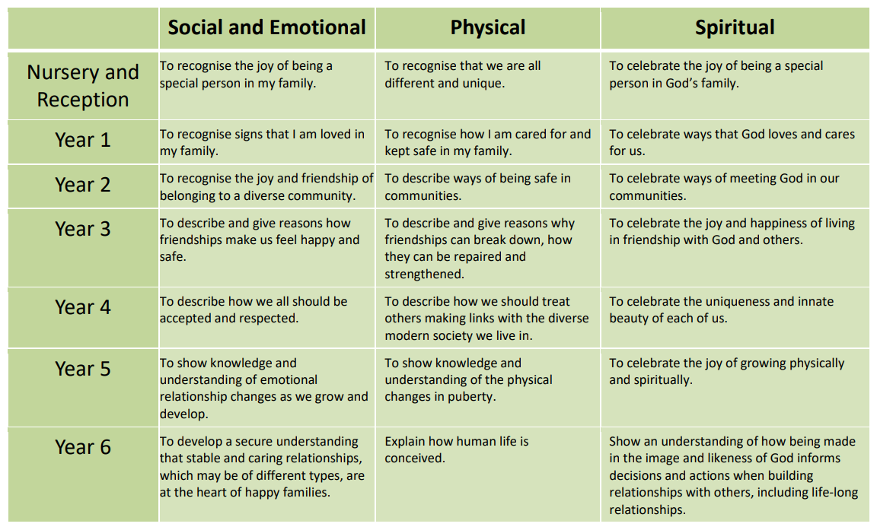
6

Slide 7
The Right to Withdraw
Parents have the right to withdraw their children from the non-statutory component of sex education in Year 6. This is where sexual intercourse is taught discretely as part of the physical aspect within Journey In Love, the Archdiocesan recommended resource. Requests for withdrawal should be made in writing and addressed to Mr Mainwaring. He will discuss the request with parents and take appropriate action.
8

Slide 8
Finally…
We have an open-door policy so if you have any worries or concerns regarding the RSHE curriculum, please come in and see the staff – preferably after school -and we will do our best to help you.
9

