Slide 1

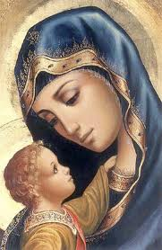
Spiritual Adoption of the Unborn Child
OATH
of
Spiritual Adoption
The Spiritual Adoption begins with a formal oath in the presence of God during the celebration of the Mass:
January 31 @ 4:00 / 5:00 / 6:30 pm
February 1 @ 8:00 & 10:00 am / 12 pm
What are the fruits of the Spiritual Adoption?
Healing of the deep wounds caused by the sin of abortion
Consolation for those who have lost children through miscarriage or other traumas.
Through the prayers of the faithful, God is able to bestow faith in His Mercy on the mothers of the unborn and give them peace of heart.
We begin to fight against our own egoism.
We begin to feel more love & more joy in parenthood.
We begin to see the act of sex with God’s eyes, that is, in context of the love and self-giving.
How do I start?
REGISTRATION ONLINE at or after Masses on January 31-February 1, 2026
Or contact:
Sr. Evan / Sr. Teresa
- Parish Office
- or email: sisterevanmmm@gmail.com
“Any country that accepts abortion is not teaching its people to love but to use violence to get what they want. This is why the greatest destroyer of love and peace is abortion.”
St. Mother Teresa (1910-1997)
The act of Spiritual Adoption:
is a personal gift of prayer, love and sacrifice.
through our participation in it, we benefit ourselves as well.
The Parish Respect Life Ministry meets every First Wednesday and facilitates the Adoration for Life every First Friday at 3-5:30 pm at St. Stephen Church
Everyone is welcome to join!
MARY, MOTHER OF MARTYRS PARISH RESPECT LIFE MINISTRY
St. Stephen Church
1880 Ash Street
Des Plaines, Illinois 60018
Notes:
To change this brochure, replace our sample content with your own. Or, if you'd rather start from a clean slate, press the New Slide button on the Home tab to insert a new page. Now enter your text and pictures in the empty placeholders. To change the logo to your own, select the picture “replace with LOGO” and choose Change Picture on the Picture Tools Format tab.
And did you notice we made fold marks for you? They are really light, but if you don’t like them showing on your brochure, select and delete them before you print.

Slide 2
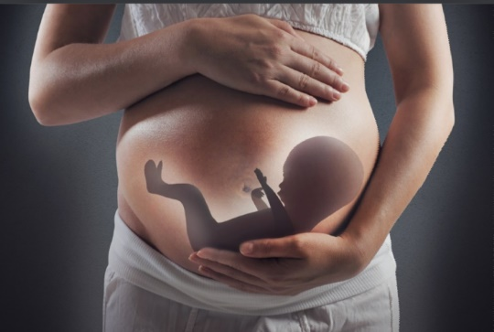

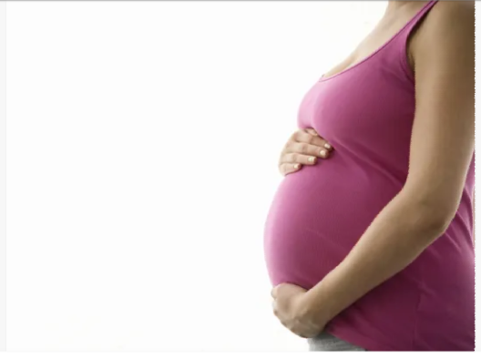

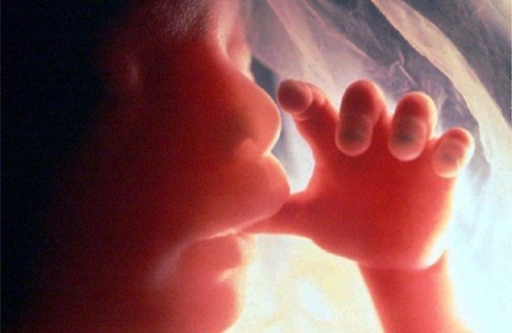
What is Spiritual Adoption?
It is a prayer for the child in the womb who is threatened by abortion.
What do I pray each day?
How long does the Spiritual Adoption last?
The Spiritual Adoption lasts for nine months.
From January 21-February 1 2026 through October 24-25 2026
Any one or all of the following prayers can be prayed for your spiritually adopted child:
My Daily Prayer for My Spiritually Adopted Child
My Lord Jesus Christ, through the intercession of Your Blessed Mother Mary, who gave birth to you out of love, and through the intercession of St. Joseph, the man of faith who cared for You after Your birth, I turn to You on behalf of this conceived child who has been spiritually adopted by me and who is threatened by abortion. Please give to his/her parents the love and courage to allow their child to remain in the womb and have life, the life that You have given him/her. Amen.
1 Our Father
1 Hail Mary
1 Glory Be
It is a prayer of healing for those suffering because of abortion.
“A nation which murders its own children
is a nation without a future.”
- Pope St. John Paull II to the Polish Nation
It is a prayer of consolation for those sorrowing because of a miscarriage.
It is a movement of life and fruitfulness inspired by the Holy Spirit.
Notes:
To change this brochure, replace our sample content with your own. Or, if you'd rather start from a clean slate, press the New Slide button on the Home tab to insert a new page. Now enter your text and pictures in the empty placeholders. To change the logo to your own, select the picture “replace with LOGO” and choose Change Picture on the Picture Tools Format tab.
And did you notice we made fold marks for you? They are really light, but if you don’t like them showing on your brochure, select and delete them before you print.

