Slide 1



acn.com
Notes:
1

Slide 2


What if the right business opportunity was right in front of you?
How about an opportunity
POWERED BY ESSENTIAL SERVICES
FOR HOME AND LIFE.
Notes:
Imagine if by the end of this week you had your own business—no inventory, no shipping, no office lease. Just your phone, a link, and the ability to earn from services people are already using. That’s what we’re talking about today.

Slide 3


Introducing a home-based business
built on essential services people use every day.
Think uber.
Think gig economy.
Your business.
You're timing.
Your Pace.
Built with Your Customers.
Notes:
Think about Uber or Lyft. They didn’t invent driving—they made it easier, faster, more profitable for the driver. Now imagine that instead of rides, you connect people to things they already pay for every single month—like mobile, energy, and healthcare. And you get paid… every time they pay their bill.

Slide 4











ACN provides everyday people with the chance to become purpose-driven entrepreneurs and step into the gig-driven economy
COMPANY
An Established Track Record
Started
in the U.S.
January 1993
Specializing in Customer Acquisition
Millions of Customers Acquired
U.S. and Canada
Billions
in Sales
© 2026 ACN Opportunity, LLC | ACN Business Opportunity Presentation-USEN | 012826

Slide 5

















ESSENTIAL SERVICES
Business Residential
WIRELESS
INTERNET
TV
ENERGY
HEALTHCARE
SECURITY &
AUTOMATION
PAYMENT
PROCESSING
IDENTITY
THEFT PROTECTION
Coming Soon: FinTech Cloud Based Banking
Health Insurance Premiums sky-rocketed in 2026!
Save 30-50% on health care plan cost with IMPACT Health
No network restrictions - keep your doctors
Text Impact to 469-727-1414
© 2026 ACN Opportunity, LLC | ACN Business Opportunity Presentation-USEN | 012826

Slide 6









OUR BUSINESS MODEL
Most Service Providers
What Makes us Different?
Media & Internet Marketing
More Choices for Consumers
YOU
Income Generating Opportunity for you
CUSTOMERS
© 2026 ACN Opportunity, LLC | ACN Business Opportunity Presentation-USEN | 012826

Slide 7








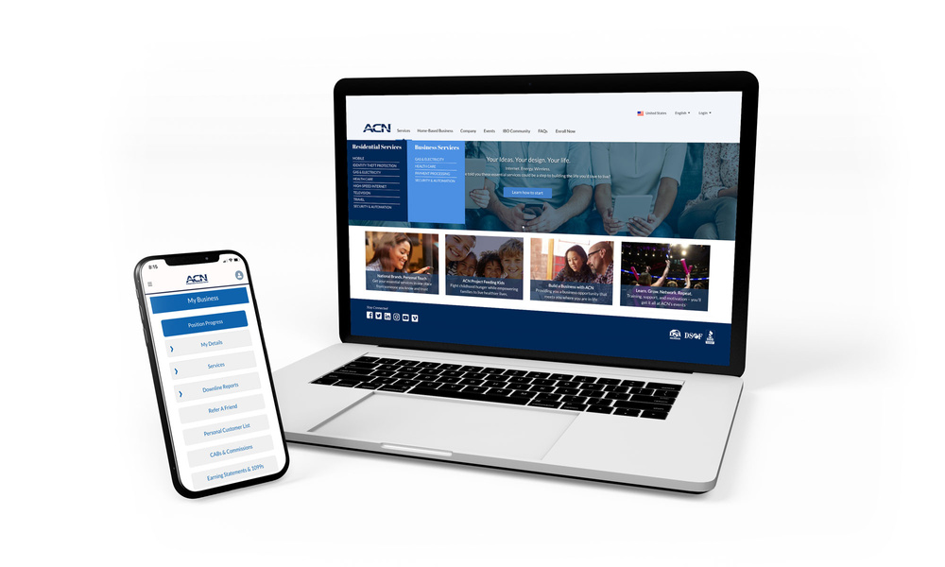

Become an Independent Business Owner (IBO)
$299 Start-Up + $30/month Business Support
Personalized Website
Training
& Marketing
Tools
Business Tracking
& Reporting on the Salesforce Platform
IBO &
Customer
Support
Exclusive IBO Savings & Rebates
ACN AI App
All you have to do:
Direct people to your website
DOES THE REST!
Assist them in becoming customers
© 2026 ACN Opportunity, LLC | ACN Business Opportunity Presentation-USEN | 012826

Slide 8
Personal Monthly Income
Your Customers
Acquire Customers Totaling:
Residual Income
3 Services / 8 Points = $400
6 Services / 16 Points = $1000
9 Services / 24 Points = $1,500
12 Services / 32 Points = $2,000
3% TO 20%
Paid monthly on your customers Monthly Commissionable Revenue*
Plus $500
for Every Additional 3 Services & 8 Points
Paid weekly as earned when YOU acquire customers.*
*Refer to the ACN Compensation Plan for complete details!
© 2026 ACN Opportunity, LLC | ACN Business Opportunity Presentation-USEN | 012826

Slide 9



IBO Referral Programs
Refer-a-Friend For EVERY 5 Flash Mobile referred customers, earn a monthly CREDIT equal to one line of your service.*
PowerUP For 12+ XOOM Energy Residential Natural Gas or 12+ Residential Electricity customers, earn a monthly BONUS equal to the average commodity-only charges of your customers’ bills.*
Refer-a-Friend For EVERY 5 referred customers who enroll in and authenticate an IDSeal Annual plan, earn a monthly BONUS equal to the monthly cost of your Annual subscriptions on your flagged accounts, up to 4 BONUSES.*
Get rewarded month after month when you meet referral goals!
* Excludes taxes and surcharges. Additional terms and conditions apply. For full details, refer to the service-specific program in the IBO Back Office
© 2026 ACN Opportunity, LLC | ACN Business Opportunity Presentation-USEN | 012826

Slide 10

Overriding Income
Your Team’s Customers
Overriding Residual Income
Paid monthly on customers your team enrolls
4%
Commissionable
Revenue
You 3% - 20%
4%
4%
4%
4%
4%
Earn 4% Overriding Residual Income on all “Commissionable Revenue” generated by your Team’s Customers through 5 Levels
*Refer to the ACN Compensation Plan for complete details!
© 2026 ACN Opportunity, LLC | ACN Business Opportunity Presentation-USEN | 012826

Slide 11


Overriding Income
Your Team’s Customers
Overriding Customer Acquisition Bonuses
Earned once, when every team member becomes customer qualified
CQ
ETL
RC
RD
RVP
SVP
$50
Up to
$150
Up to
$250
Up to
$350
Up to
$400
*Refer to the ACN Compensation Plan for complete details!
© 2026 ACN Opportunity, LLC | ACN Business Opportunity Presentation-USEN | 012826

Slide 12
Overriding Income
Your Team’s Customers
Fast Start Bonuses
ETL
RC
30 Days
90 Days
+
$400
$1,600
Total $2,000
*Refer to the ACN Compensation Plan for complete details!
© 2026 ACN Opportunity, LLC | ACN Business Opportunity Presentation-USEN | 012826

Slide 13

Training & Support
ACN In-Person
Online
Presentations
& Trainings
Your Team’s
In-Person
& Virtual Events
Training Events
IN BUSINESS FOR YOURSELF, NEVER BY YOURSELF
© 2026 ACN Opportunity, LLC | ACN Business Opportunity Presentation-USEN | 012826

Slide 14
1) Get Started
Have your Sponsor ID ready
www.acninc.com
2) Register for the Elevate National Orlando, FL
March 13-15th, 2026
https://acn.swoogo.com/
elevateorlando2026/begin
NEXT STEPS
1. Not for You
2. Have Questions?
3. Ready to Start
© 2026 ACN Opportunity, LLC | ACN Business Opportunity Presentation-USEN | 012826

Slide 15

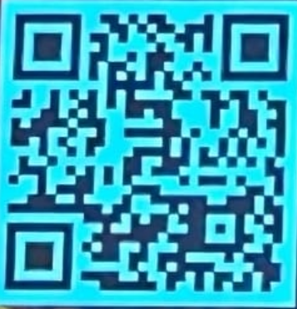
MARCH 13 - 15 | 2026
TRAVEL SCHEDULE:
ACN RC & ABOVE LEADERSHIP 13TH 3PM - 5PM
ACN GENERAL SESSION SATURDAY 14TH & SUNDAY 15TH
TEAM HANG OUT SUNDAY NIGHT 15TH
FLY HOME MONDAY THE 16TH IF YOU CAN!

Slide 16

Customer Acquisition
Let’s start making money
TODAY

Slide 17

Your First Goal
3 Services & 8 Points
WHY?
Customer Qualified (CQ) = first promotion
Positioned to earn residual income
Graduate to Friday Night Leadership
MARCH 13-15, 2026 – ORLANDO, FL

Slide 18





Fast Start Bonus
Healthcare
TV/Internet
Cell Phone
Electric & Gas
ID Theft Protection Home Security Merchant
$1000
+$400
6 Services
6 Services
6 Services
ETL in your first 7 days =$1400
RC in your in 90 days + $1600

Slide 19
30 DAY FAST TRACK
$4,500 → 30 Services $400 → ETL Bonus
$1,600 → RC Bonus
$6,500+ in your first 30 days!
Halfway Qualified to Regional Director and getting an ALL Expense Paid trip to Arizona for your Family
*See ACN Compensation Plan for full details.
Your results may vary. Earnings are not guaranteed.

Slide 20





Customer Sources
Everyone Else (Warm Market,
and referrals)
PROSPECTS WHO DO NOT BECOME IBOs
THOSE YOU DO BUSINESS WITH
YOURSELF

Slide 21





Top 5 Most Simple & Lucrative Services
Mobile Service
2 Points Per Line
1-866-643-8164
Flash Mobile Concierge
Health Care
2-6 Points
Smart Security
2-5 Points
Gas & Electric
2 Points
ID Theft Protection
2-4 Points

Slide 22
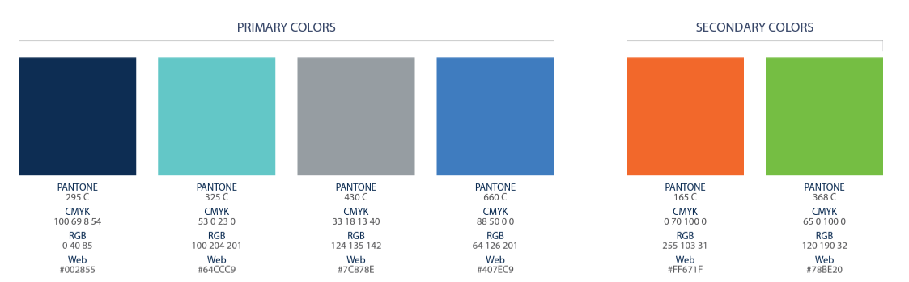
Overriding Customer Acquisition Bonuses
Earned once, when your team becomes customer qualified
CQ
ETL
RC
RD
RVP
SVP
SVP
Platinum
Up to
$150
Up to
$250
Up to
$350
Up to
$400
Up to
$450
$50
Understand the Earned Position Bonuses?
FRIDAY LEADESHIP ( ZOOM)
*Refer to the ACN Compensation Plan for complete details!

Slide 23








GET YOUR BILLS COVERED
Refer-a-Friend
PowerUP
Refer-a-Friend
Refer 5+ Flash Mobile customers to earn Free Lifetime Service
Up to 45% Savings with Flash
Get Access to America’s Largest and Fastest 5G Network
Refer 12+ XOOM Energy Residential
Natural Gas or 12+ XOOM Energy and your service can be FREE
Enroll & authenticate 5+ customers with an IDSeal Annual plan and your service can be FREE
*Excludes taxes and surcharges. Terms and conditions apply.
IMAGINE HOW MUCH YOU CAN SAVE YEAR AFTER YEAR!

Slide 24

CALL TO ACTION
Set A Goal
3 Services = $400
6 Services = $1,000
9 Services = $1,500
12 Services = $2,000
Plus $500
For Every Additional
3 Services & 8 Points
DALLAS, TX - JUNE 20 & 21, 2025

Slide 25
Building A Team
Launching Your Business
Create Overriding Residual Income

Slide 26
Fast Start Bonus
Healthcare
TV/Internet
Cell Phone
Electric & Gas
ID Theft Protection Home Security Merchant
$1000
+$400
6 Services
6 Services
6 Services
ETL in your first 7 days =$1400
RC in your in 90 days + $1600

Slide 27
30 DAY FAST TRACK
$4,500 → 30 Services $400 → ETL Bonus
$1,600 → RC Bonus
$6,500+ in your first 30 days!
Halfway Qualified to Regional Director and getting an ALL Expense Paid trip to Arizona for your Family
*See ACN Compensation Plan for full details.
Your results may vary. Earnings are not guaranteed.

Slide 28

BUILDING A TEAM
Pick a Time That Works for YOU
Schedule a ZOOM meeting ASAP
Set it up now by texting the person you’re working with!
2. Make a List. 100 Names and Numbers. Do Not Prejudge!
Your “A” List
Business owners (Health Share customers)
Network Marketing experience
Real Estate professionals
Everyone else
3. Invite, Invite, Invite...
50% Will Not Show (OVER INVITE)
Set a goal to have double-digit invites
The person who puts the most people on ZOOM presentations the fastest wins

Slide 29

- PRACTICE IT!
SAMPLE SCRIPT
Do you look at other ways of making money?
(Share Your Why) … and that’s why I started looking.
Edify Speaker – e.g.: “I met an individual who is having massive success, expanding an online business with Essential Services. They are hosting a short ZOOM meeting on (Date/Time).”
Promote ZOOM meeting and set up confirmation call.
15 Minutes BEFORE Presentation, Send a Reminder Text

Slide 30
WHAT IF THEY HAVE QUESTIONS?
Be new and say “That is what the call is for…”
Talk about the person, not the thing
Have posture when inviting

Slide 31

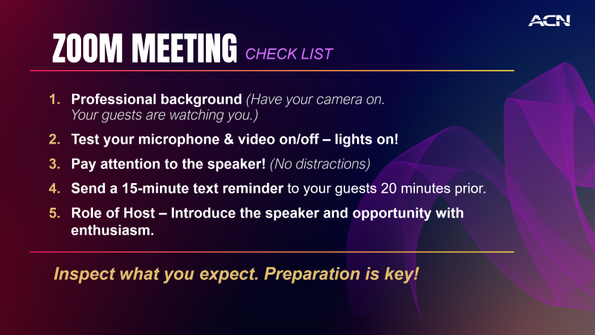
ZOOM MEETING
CHECK LIST
Professional background (Have your camera on. Your guests are watching you.)
Test your microphone & video on/off – lights on!
Pay attention to the speaker! (No distractions)
Send a 15-minute text reminder to your guests 20 minutes prior.
Role of Host – Introduce the speaker and opportunity with enthusiasm.
Inspect what you expect. Preparation is key!

Slide 32
SORTING AFTER ZOOM PRESENTATION
ARE YOU READY TO GET STARTED?
Yes
Questions
No
Sign up as
an IBO
Thank them!
Answer Questions
Ask to be a customer
Promote Training!
Promote Training!

Slide 33
Mindset
&
Events

Slide 34
ADOPT
A WINNING MINDSET
Professionals SORT Amateurs SELL and CONVINCE Sorting is fun! Convincing is draining! Be a professional listen, sort and move on …and remember a NO may NOT be a NO FOREVER

Slide 35

Emotional Rollercoaster
is totally NORMAL
Don’t let your HIGH’s get too
high & your LOW’s get you too low.
Remember your WHY!

Slide 36


THE ACN SYSTEM
Elevate Event
Provided by ACN’s Co-Founders, Executives and ACN’s SVPs/RVPs
( IN Person)
4
Friday Night
Leadership
In person
& Zoom( Hybrid)
3
2
Host A
Meeting
& CQ
1
SATURDAY
TRAINING
IN- PERSON
& Tuesday Zoom
Meeting
Follow The System To Success
Become
An IBO

Slide 37
CALL TO ACTION
Get 3 Customers / 8 Points = $400
Schedule your Launch Meeting & Grand Opening
Schedule your Coaching Call BEFORE you start inviting
Pre-register for the National Convention in Orlando, FL *March 13-15th, 2026*

Slide 38
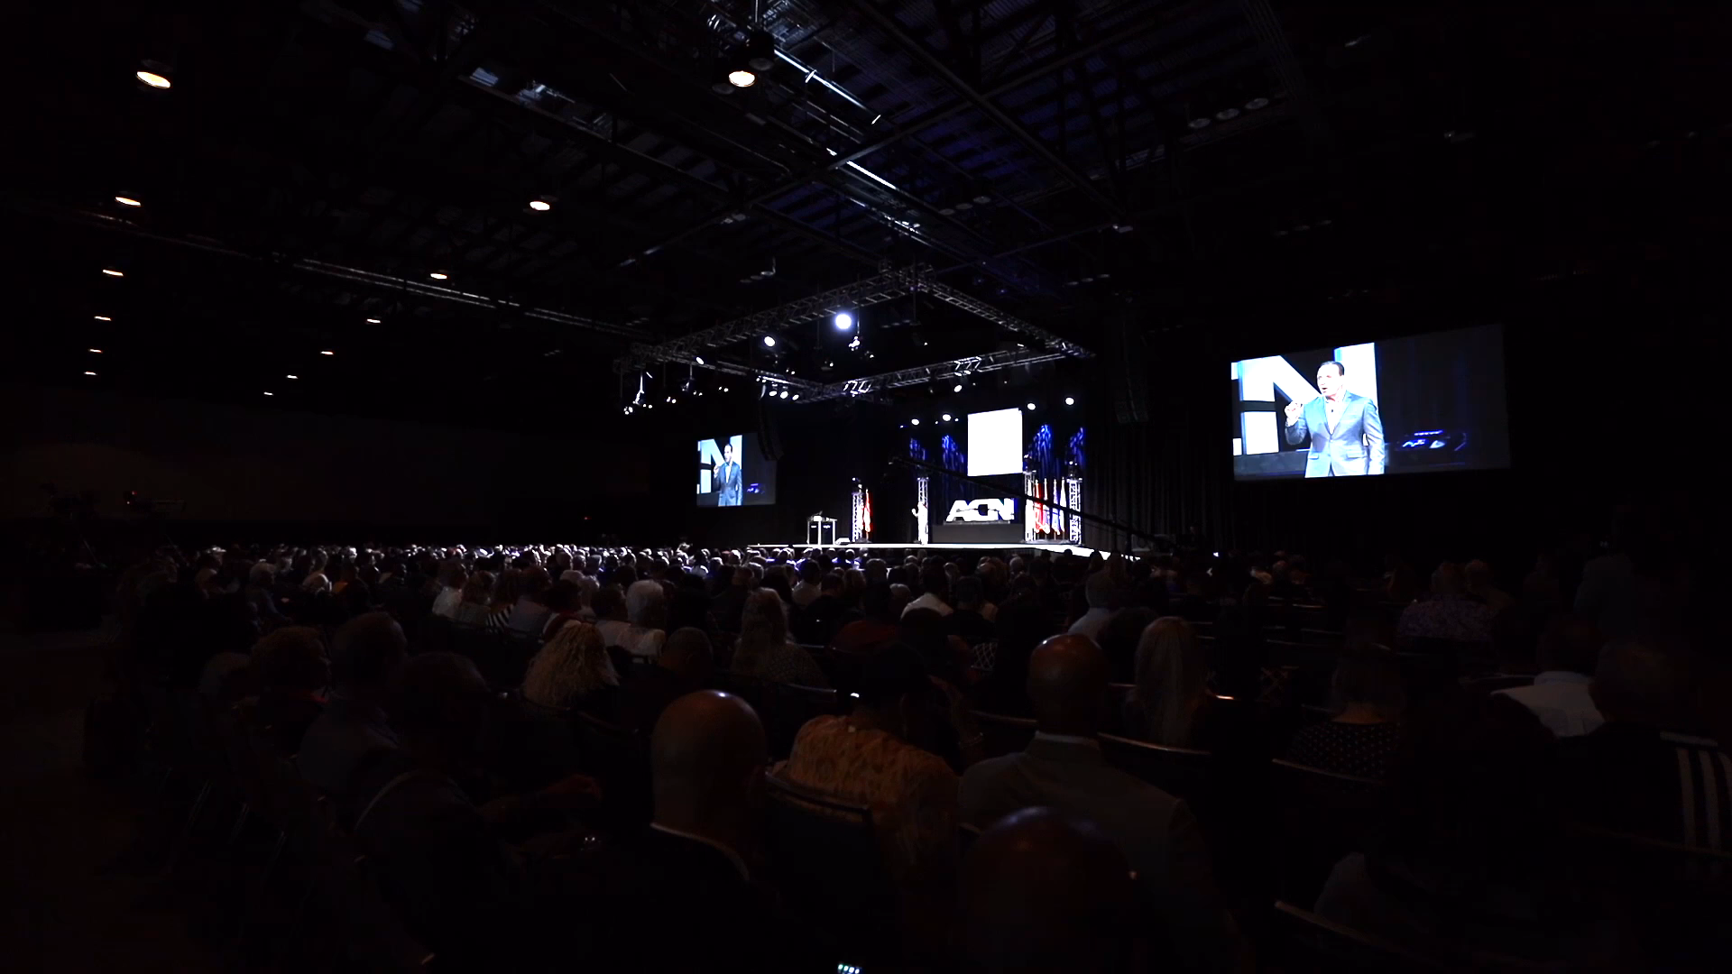

ELEVATE – ORLANDO, FLORIDA OCTOBER 12-13, 2024

Slide 39


Slide 40
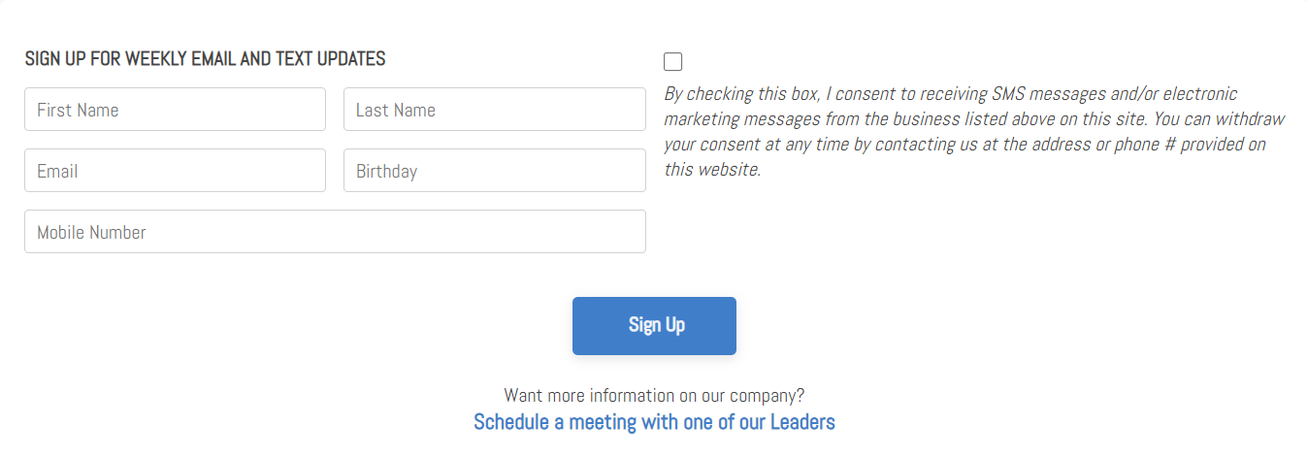
SIGN UP FOR WEEKLY EMAIL & TEXT UPDATES ROCKSTAR TEAM WEBSITE www.wealthinstituteinc.com

