Slide 1



acn.com
Notes:
1

Slide 2


What if the right business opportunity was right in front of you?
How about an opportunity
POWERED BY ESSENTIAL SERVICES
FOR HOME AND LIFE.
Notes:
Imagine if by the end of this week you had your own business—no inventory, no shipping, no office lease. Just your phone, a link, and the ability to earn from services people are already using. That’s what we’re talking about today.

Slide 3


Introducing a home-based business
built on essential services people use every day.
Think uber. Think gig economy.
Your business. You're timing.
Your Pace. Built with Your Customers.
Notes:
Think about Uber or Lyft. They didn’t invent driving—they made it easier, faster, more profitable for the driver. Now imagine that instead of rides, you connect people to things they already pay for every single month—like mobile, energy, and healthcare. And you get paid… every time they pay their bill.

Slide 4











ACN provides everyday people with the chance to become purpose-driven entrepreneurs and step into the gig-driven economy
COMPANY
An Established Track Record
Started
in the U.S.
January 1993
Specializing in Customer Acquisition
Millions of Customers Acquired
U.S. and Canada
Billions
in Sales
© 2026 ACN Opportunity, LLC | ACN Business Opportunity Presentation-USEN | 012826

Slide 5

















ESSENTIAL SERVICES
Business Residential
WIRELESS
INTERNET
TV
ENERGY
HEALTHCARE
SECURITY &
AUTOMATION
PAYMENT
PROCESSING
IDENTITY
THEFT PROTECTION
Coming Soon: FinTech Cloud Based Banking
Health Insurance Premiums sky-rocketed in 2026!
Save 30-50% on health care plan cost with IMPACT Health
No network restrictions - keep your doctors
Text Impact to 469-727-1414
© 2026 ACN Opportunity, LLC | ACN Business Opportunity Presentation-USEN | 012826

Slide 6









OUR BUSINESS MODEL
Most Service Providers
What Makes us Different?
Media & Internet Marketing
More Choices for Consumers
YOU
Income Generating Opportunity for you
CUSTOMERS
© 2026 ACN Opportunity, LLC | ACN Business Opportunity Presentation-USEN | 012826

Slide 7








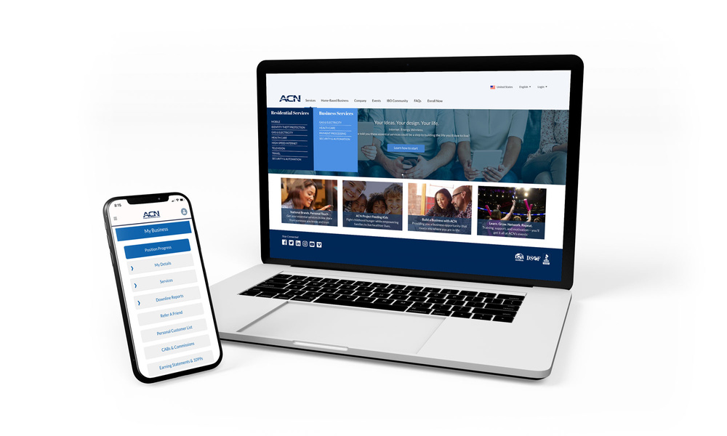

Become an Independent Business Owner (IBO)
$299 Start-Up + $30/month Business Support
Personalized Website
Training
& Marketing
Tools
Business Tracking
& Reporting on the Salesforce Platform
IBO &
Customer
Support
Exclusive IBO Savings & Rebates
ACN AI App
All you have to do:
Direct people to your website
DOES THE REST!
Assist them in becoming customers
© 2026 ACN Opportunity, LLC | ACN Business Opportunity Presentation-USEN | 012826

Slide 8
Personal Monthly Income
Your Customers
Acquire Customers Totaling:
Residual Income
3 Services / 8 Points = $400
6 Services / 16 Points = $1000
9 Services / 24 Points = $1,500
12 Services / 32 Points = $2,000
3% TO 20%
Paid monthly on your customers Monthly Commissionable Revenue*
Plus $500
for Every Additional 3 Services & 8 Points
Paid weekly as earned when YOU acquire customers.*
*Refer to the ACN Compensation Plan for complete details!
© 2026 ACN Opportunity, LLC | ACN Business Opportunity Presentation-USEN | 012826

Slide 9



IBO Referral Programs
Refer-a-Friend
For EVERY 5 Flash Mobile referred customers, earn
a monthly CREDIT equal to one line of your service.*
PowerUP
For 12+ XOOM Energy Residential Natural Gas or 12+ Residential Electricity customers, earn a monthly BONUS equal to the average commodity-only charges of your customers’ bills.*
Refer-a-Friend
For EVERY 5 referred customers who enroll in and authenticate an IDSeal Annual plan, earn a monthly BONUS equal to the monthly cost of your Annual subscriptions on your flagged accounts, up to 4 BONUSES.*
Get rewarded month after month when you meet referral goals!
* Excludes taxes and surcharges. Additional terms and conditions apply. For full details, refer to the service-specific program in the IBO Back Office
© 2026 ACN Opportunity, LLC | ACN Business Opportunity Presentation-USEN | 012826

Slide 10

Overriding Income
Your Team’s Customers
Overriding Residual Income
Paid monthly on customers your team enrolls
4%
Commissionable
Revenue
You 3% - 20%
  4%
  4%
  4%
  4%
  4%
Earn 4% Overriding Residual Income on all “Commissionable Revenue” generated by your Team’s Customers through 5 Levels
*Refer to the ACN Compensation Plan for complete details!
© 2026 ACN Opportunity, LLC | ACN Business Opportunity Presentation-USEN | 012826

Slide 11


Overriding Income
Your Team’s Customers
Overriding Customer Acquisition Bonuses
Earned once, when every team member becomes customer qualified
CQ
ETL
RC
RD
RVP
SVP
$50
Up to
$150
Up to
$250
Up to
$350
Up to
$400
*Refer to the ACN Compensation Plan for complete details!
© 2026 ACN Opportunity, LLC | ACN Business Opportunity Presentation-USEN | 012826

Slide 12
Overriding Income
Your Team’s Customers
Fast Start Bonuses
ETL
RC
30 Days
90 Days
+
$400
$1,600
Total $2,000
*Refer to the ACN Compensation Plan for complete details!
© 2026 ACN Opportunity, LLC | ACN Business Opportunity Presentation-USEN | 012826

Slide 13

Training & Support
ACN In-Person
Online
Presentations
& Trainings
Your Team’s
In-Person
& Virtual Events
Training Events
IN BUSINESS FOR YOURSELF, NEVER BY YOURSELF
© 2026 ACN Opportunity, LLC | ACN Business Opportunity Presentation-USEN | 012826

Slide 14
1) Get Started
Have your Sponsor ID ready
www.acninc.com
2) Register for the Elevate National Orlando, FL
March 13-15th, 2026
https://acn.swoogo.com/
elevateorlando2026/begin
NEXT STEPS
  1. Not for You
  2. Have Questions?
  3. Ready to Start
© 2026 ACN Opportunity, LLC | ACN Business Opportunity Presentation-USEN | 012826

