Slide 1


Compensation Plan
Learn it and It will Motivate You

Slide 2
How do we get paid?
We get paid 2 ways:
Residual Income- over time
Customer Acquisition Bonuses

Slide 3

Personal Customer Bonuses
Acquire Customers Totaling:
3 Services & 8 Points Earn a total of $400
6 Services & 16 Points Earn a total of $1,000
9 Services & 24 Points Earn a total of $1,500
12 Services & 32 Points Earn a total of $2,000
PLUS $500 for Every additional 3 Services and 8 points
UNLIMITED
12 Services per month = $2,000 Per Month
(12 – Month Total: $24,000 of Bonus Money)

Slide 4

Monthly Personal Residual Income
Personal Points | Personal Residual Income
7 – 39 | 3%
40 – 59 | 5%
60 – 99 | 10%
100 – 149 | 14%
150 – 199 | 17%
200+ | 20%
3% - 20%

Slide 5

4%
4%
4%
4%
4%
Overriding Residual Income
25 Personal Customer Points
50 Personal Customer Points
75 Personal Customer Points
RVP and Higher get paid below Level 5

Slide 6
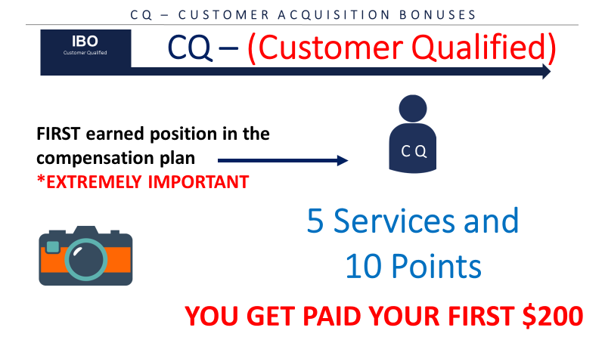
CQ – CUSTOMER ACQUISITION BONUSES
3 SERVICES
8 POINTS
YOU WILL GET PAID $400
*Example is for training purposes only*

Slide 7


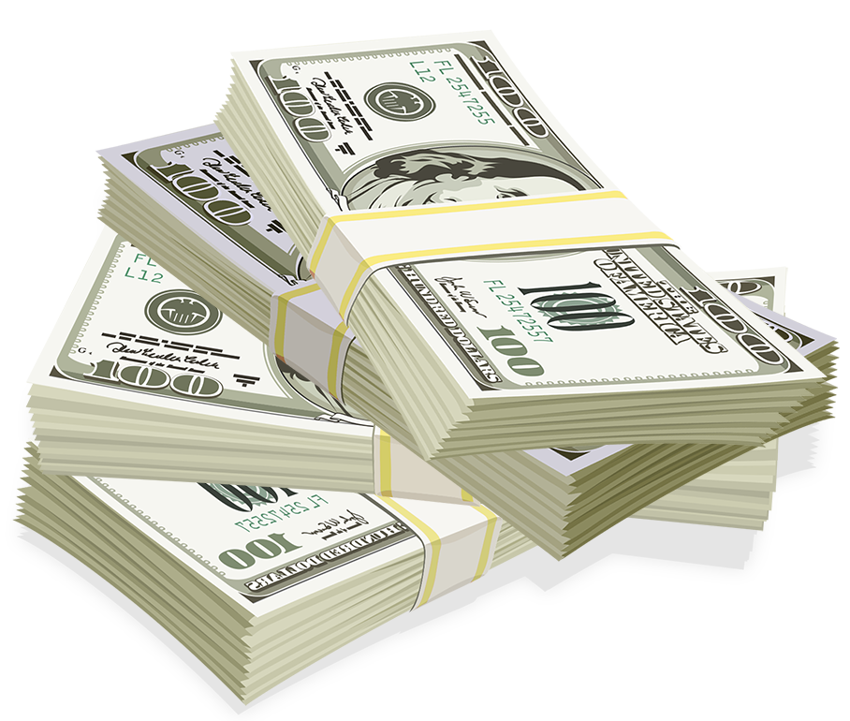


Fast Start Bonus
Healthcare
TV/Internet
Cell Phone
Electric & Gas
ID Theft Protection Home Security Merchant
$1000
+$400
6 Services
6 Services
6 Services
= $1400 in your first 7 days!
*See ACN Compensation Plan for full details.
Your results may vary. Earnings are not guaranteed.

Slide 8

ETL – CUSTOMER ACQUISITION BONUSES
ETL –Executive Team Leader
IBO
$50 for Every
CQ
ETL
*Hypothetical example for training purposes only*
30 Points
(between You & Team)
Example*:
10 CQ’s X $50 = $500
IBO
*Example is for training purposes only*

Slide 9
30 DAY FAST TRACK
$4,500 → 30 Services $400 → ETL Bonus
$1,600 → RC Bonus
$6,500+ in your first 30 days!
Halfway Qualified to Regional Director and getting an ALL Expense Paid trip to Arizona for your Family
*See ACN Compensation Plan for full details.
Your results may vary. Earnings are not guaranteed.

Slide 10
30 DAY FAST TRACK
$2,000 → 12 Services $400 → ETL Bonus
$1,600 → RC Bonus
$4,000+ in your first 30 days!
Halfway Qualified to Regional Director and getting an ALL Expense Paid trip to Arizona for your Family
*See ACN Compensation Plan for full details.
Your results may vary. Earnings are not guaranteed.

Slide 11
RC – CUSTOMER ACQUISITION BONUSES
RC -Regional Coordinator
IBO
200 Points
(between You & Team – Min. 15 Personal)
*Hypothetical example for training purposes only*
Up to $150 for Every
CQ
RC
Example*:
10 CQ’s x $150 = $1,500
IBO
IBO
IBO
IBO
Max
100 Points
Per Leg
Max
100 Points
Per Leg
*Example is for training purposes only*

Slide 12
RD – CUSTOMER ACQUISITION BONUSES
RD –Regional Director
IBO
*Hypothetical example for training purposes only*
600 Points
(between You & Team – Min. 15 Personal)
Up to $250 for Every
CQ in your RD Open Line
RD
Example*:
10 CQ’s x $250 = $2,500
IBO
IBO
IBO
IBO
Max
200 Points
Per Leg
Max
200 Points
Per Leg
Max
200 Points
Per Leg
*Example is for training purposes only*

Slide 13
RVP – REGIONAL VICE PRESIDENT
RVP-Regional Vice President
IBO
3,000 Points
(between You & Team – Min. 15 Personal)
Up to $350 for Every
CQ
RVP
IBO
IBO
IBO
IBO
Max
750 Points
Per Leg
Max
750
Points
Per Leg
Max
750
Points
Per Leg
Max
750
Points
Per Leg

Slide 14
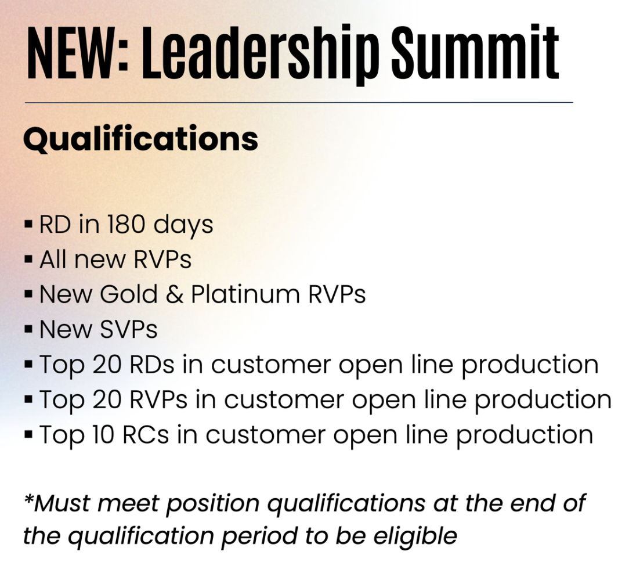


Slide 15
*Hypothetical example for training purposes only*
R D
ETL
CQ
ETL
RD
ETL
ETL
ETL
WEEK 1
CQ
CQ
RC
CQ
CQ
CQ
WEEK 2
CQ
CQ
ETL
CQ
CQ
CQ
WEEK 3
CQ
CQ
ETL
CQ
CQ
CQ
WEEK 4
CQ
CQ
CQ
CQ
CQ
CQ
Example*: 24 CQ’s X $150 = $3,600 that’s $43,200/Year
24 IBOS GET 10 Points EACH = 240 points/ Month
10 Months Later YOU’RE RVP!!!!
*Example is for training purposes only*

Slide 16


“Celebration of Human Potential”

Slide 17


Testimonial
Name
Occupation
Time in ACN
# of Customers
All Due to Training and Support
of The Rockstar System

