Slide 1



Slide 2





An Established Track Record
The Leading Direct Seller of Telecommunications,
Energy, & other Essential Services.
Started in the U.S. January 1993
U.S. and Canada
Specializing in Customer Acquisition
Millions of Customers Acquired
Billions in Sales
©️2025 ACN Opportunity, LLC | ACN Business Opportunity Presentation-USEN | 031625

Slide 3












Essential Residential & Business Services
WIRELESS
HEALTH CARE
ENERGY
TRAVEL
SECURITY & AUTOMATION
HIGH-SPEED INTERNET
TELEVISION
IDENTITY THEFT PROTECTION
PAYMENT PROCESSING
PAYROLL & HR SOLUTIONS
DIGITAL PHONE & CLOUD SOLUTIONS
INSURANCE
NEW INDUSTRIES COMING SOON!
FINTECH
HOME & AUTO INSURANCE
ONLINE &TECHNOLOGY BANKING
Columbus, Ohio - NOVEMBER 8TH, 2025

Slide 4










OUR BUSINESS MODEL
What Makes us Different?
Most Service Providers
More Choices for Consumers
Media & Internet Marketing
YOU
Income Generating Opportunity for you
CUSTOMERS
Columbus, Ohio - NOVEMBER 8TH, 2025
©️2024 ACN Opportunity, LLC | ACN Business Opportunity Presentation-USEN | BS-062624

Slide 5
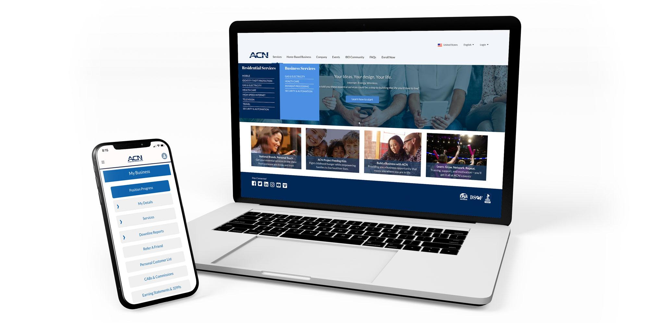

Become an Independent Business Owner (IBO)
$299 Start-Up + $25/month Business Support
Personalized Website
IBO & Customer Support
Business Tracking
& Reporting
Training & Marketing
Tools
All you have to do:
Direct people
to your website
DOES THE REST!
Assist them in becoming customers
Columbus, Ohio - NOVEMBER 8TH, 2025
©️2024 ACN Opportunity, LLC | ACN Business Opportunity Presentation-USEN | BS-062624

Slide 6
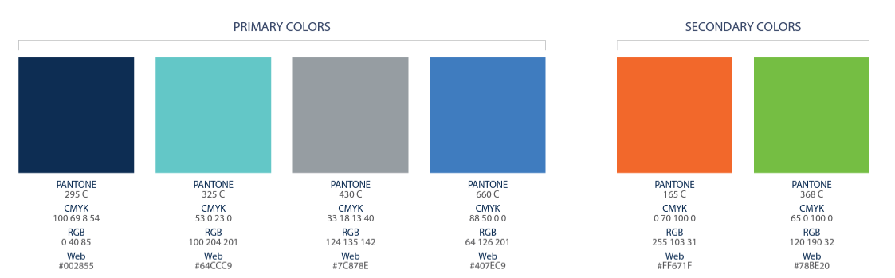
Personal Income
Personal Customer Acquisition Bonuses (Personal CABs)
Your Customers
Acquire Customers Totaling:
Residual Income
5 Services = $200
3% TO 20%
Monthly Commissionable Revenue*
Plus $200
For Every Additional 3 Services
Paid weekly as earned when
YOU acquire customers.
Paid Monthly on your customer Monthly Commissionable Revenue*
*Refer to the ACN Compensation Plan for complete details!
Columbus, Ohio - NOVEMBER 8TH, 2025

Slide 7

Income from YOUR Team’s Acquired Customers*
Overriding Residual Income
Paid monthly on customers your team enrolls
4%
Commisionable
Revenue
Overriding Customer Acquisition Bonuses
Earned once, when your team becomes customer qualified
CQ
ETL
RC
RD
RVP
SVP
Up to
$150
Up to
$250
Up to
$350
Up to
$400
$50
*Refer to the ACN Compensation Plan for complete details!
Columbus, Ohio - NOVEMBER 8TH, 2025

Slide 8




In Business for yourself…never by yourself!
Training and Support
Online Presentations and Training
Your Team’s In-Person and Virtual Events
National and International Events
Columbus, Ohio - NOVEMBER 8TH, 2025

Slide 9
ROCKSTAR TRAININGS
Training = MASSIVE SUCCESS
Your success will always have a direct correlation to your
level of training & knowledge.
Tuesday & Sunday Nights
7pm ET / 6pm CT / 5pm MT / 4pm PT
Saturday Morning
10am ET / 9am CT / 8am MT / 7am PT
Zoom meeting ID #: 740 835 041
https://zoom.us/j/740 835 041

Slide 10





Fast Start Bonus
Healthcare
TV/Internet
Cell Phone
Electricity & Gas
ID Theft Protection Home Security Merchant
$300
+$500
5 Services
5 Services
5 Services
= $800 in your first 30 days!
*See ACN Compensation Plan for full details.
Your results may vary. Earnings are not guaranteed.
Columbus, Ohio - NOVEMBER 8TH, 2025

Slide 11




BECOME AN INDEPENDENT BUSINESS OWNER TODAY!
Your Friend
1
2
3
4

Slide 12
