Slide 1




Welcome To
acn.com
Notes:
1.7.2013
‹#›

Slide 2
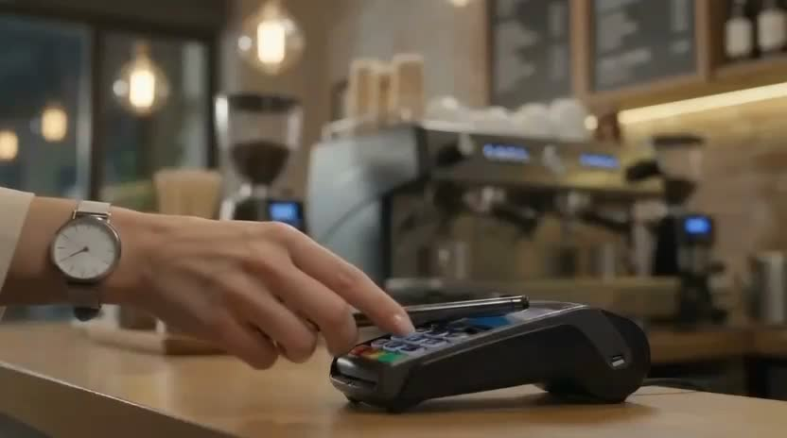

Slide 3











ACN provides everyday people with the chance to become purpose-driven entrepreneurs and step into the gig-driven economy
COMPANY
An Established Track Record
Started
in the U.S.
January 1993
Specializing in Customer Acquisition
Millions of Customers Acquired
Billions
in Sales
U.S. and Canada
© 2026 ACN Opportunity, LLC | ACN Business Opportunity Presentation-USEN | 012826

Slide 4

















ESSENTIAL SERVICES
Business Residential
WIRELESS
INTERNET
TV
ENERGY
HEALTHCARE
SECURITY &
AUTOMATION
PAYMENT
PROCESSING
IDENTITY
THEFT PROTECTION
DingoBlu
Get Paid on Monthly Savings & Checking Balances
Get Paid on EVERY Card Swipe
© 2026 ACN Opportunity, LLC | ACN Business Opportunity Presentation-USEN | 012826

Slide 5
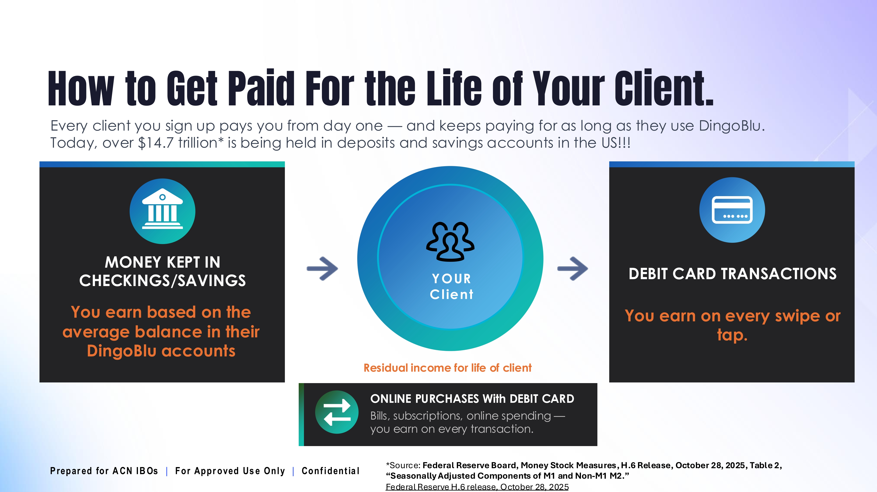

Slide 6









OUR BUSINESS MODEL
Most Service Providers
What Makes us Different?
More Choices for Consumers
Media & Internet Marketing
YOU
Income Generating Opportunity for you
CUSTOMERS
© 2026 ACN Opportunity, LLC | ACN Business Opportunity Presentation-USEN | 012826

Slide 7








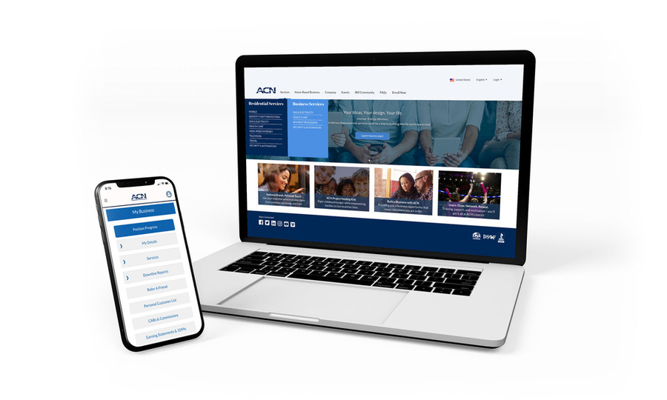


Become an Independent Business Owner (IBO)
$299 Start-Up + $30/month Business Support
Personalized Website
Training
& Marketing
Tools
Business Tracking
& Reporting on the Salesforce Platform
IBO &
Customer
Support
Exclusive IBO Savings & Rebates
ACN AI App
All you have to do:
Direct people to your website
DOES THE REST!
Assist them in becoming customers
© 2026 ACN Opportunity, LLC | ACN Business Opportunity Presentation-USEN | 012826
Notes:
1.7.2013
‹#›

Slide 8
Personal Monthly Income
Residual Income
Acquire Customers Totaling:
3 Services / 8 Points = $300
6 Services / 16 Points = $700
9 Services / 24 Points = $1100
12 Services / 32 Points = $1500
3% TO 20%
Paid monthly on your customers Monthly Commissionable Revenue*
Plus $400
for Every Additional 3 Services & 8 Points
Paid weekly as earned when YOU acquire customers.*
*Refer to the ACN Compensation Plan for complete details!
© 2026 ACN Opportunity, LLC | ACN Business Opportunity Presentation-USEN | 012826
Notes:
1.7.2013
‹#›

Slide 9
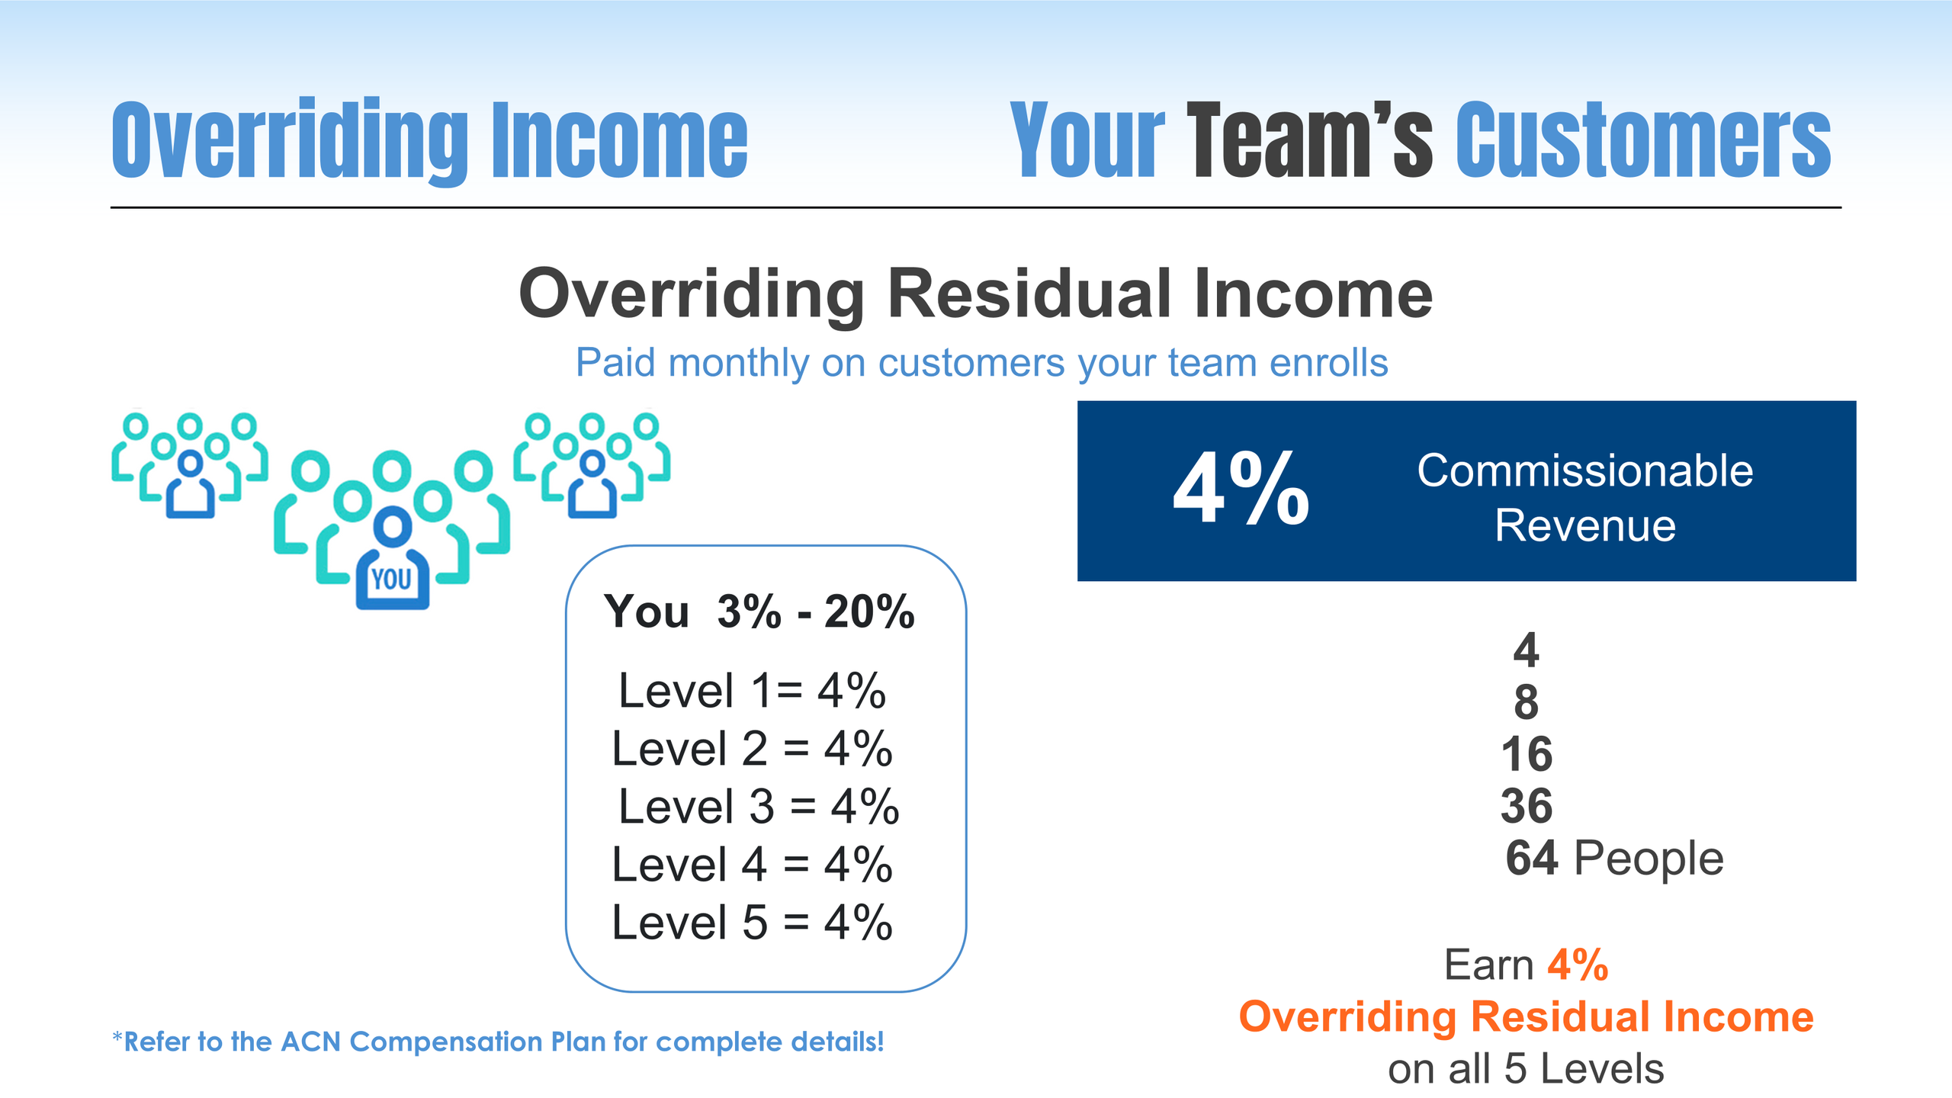

Slide 10
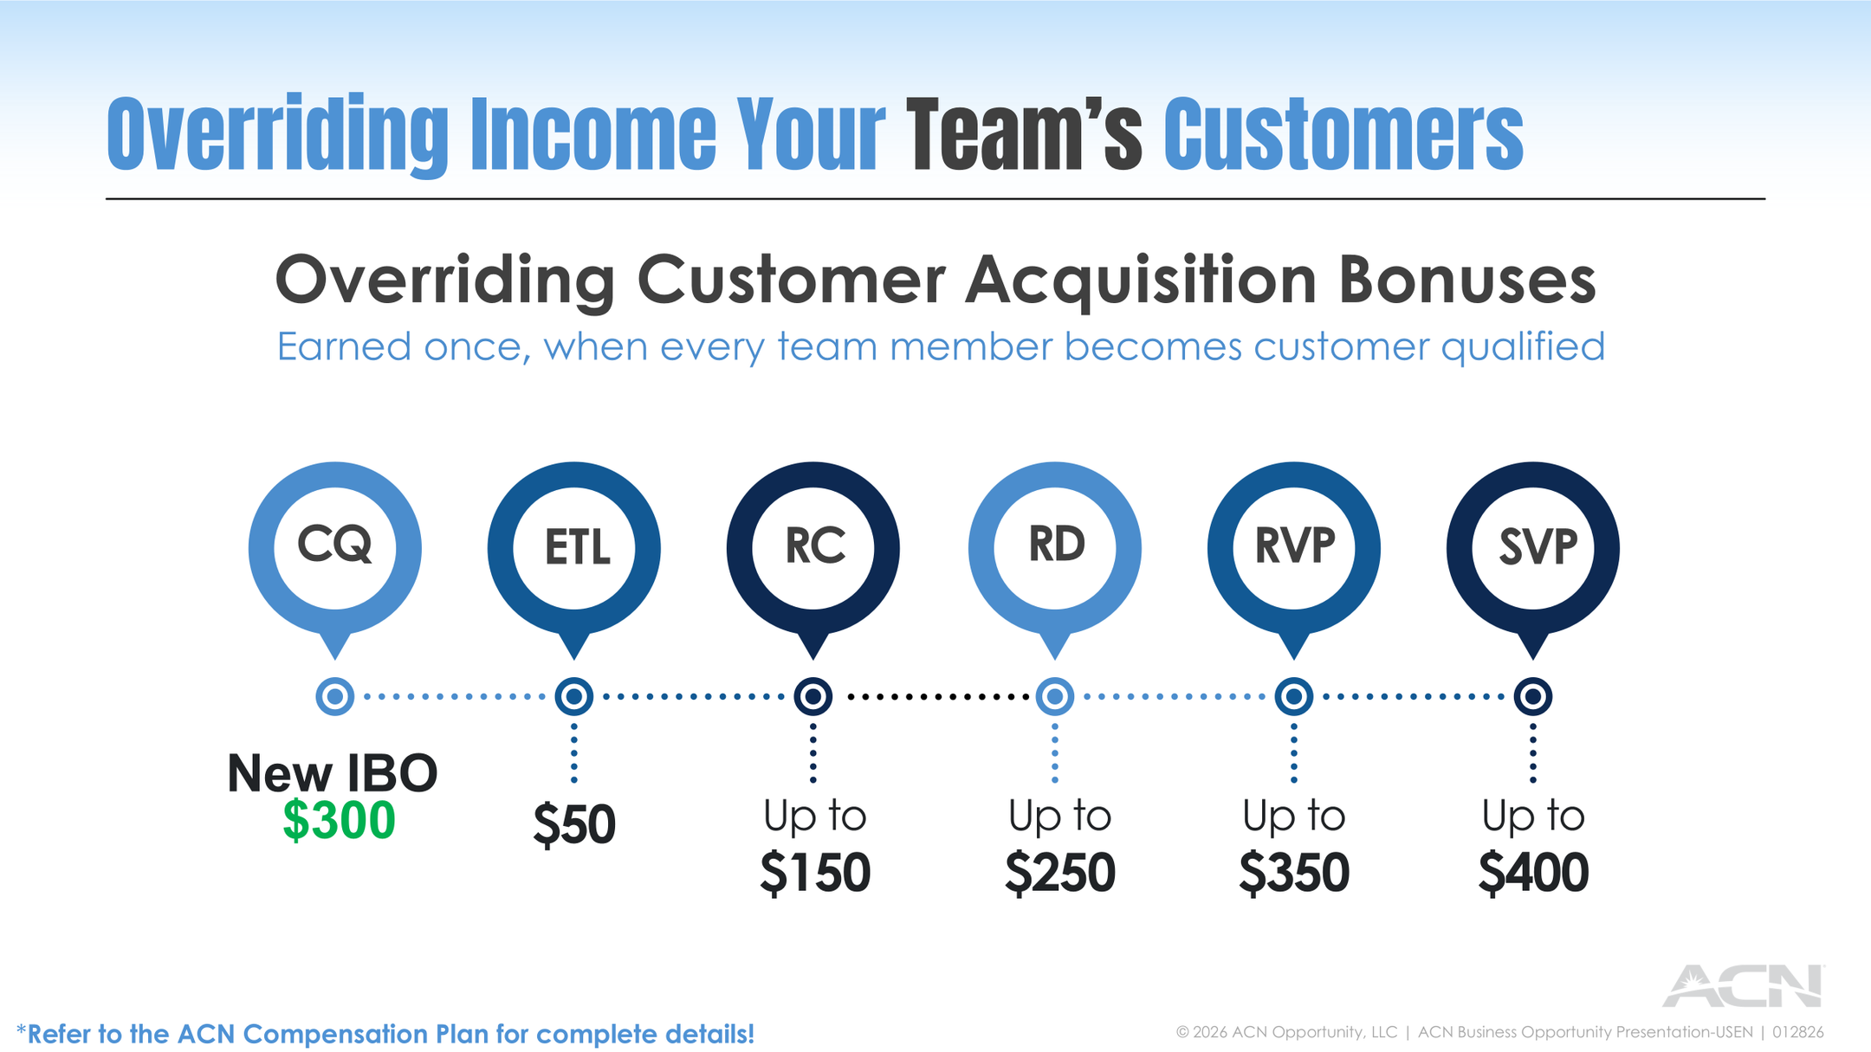

Slide 11

Training & Support
Online
Presentations
& Trainings Saturday 10am ET
Meeting ID#
740 835 041
Your Team’s
In-Person
& Virtual Events
Training Events
IN BUSINESS FOR YOURSELF, NEVER BY YOURSELF
© 2026 ACN Opportunity, LLC | ACN Business Opportunity Presentation-USEN | 012826
Notes:
1.7.2013
‹#›

Slide 12
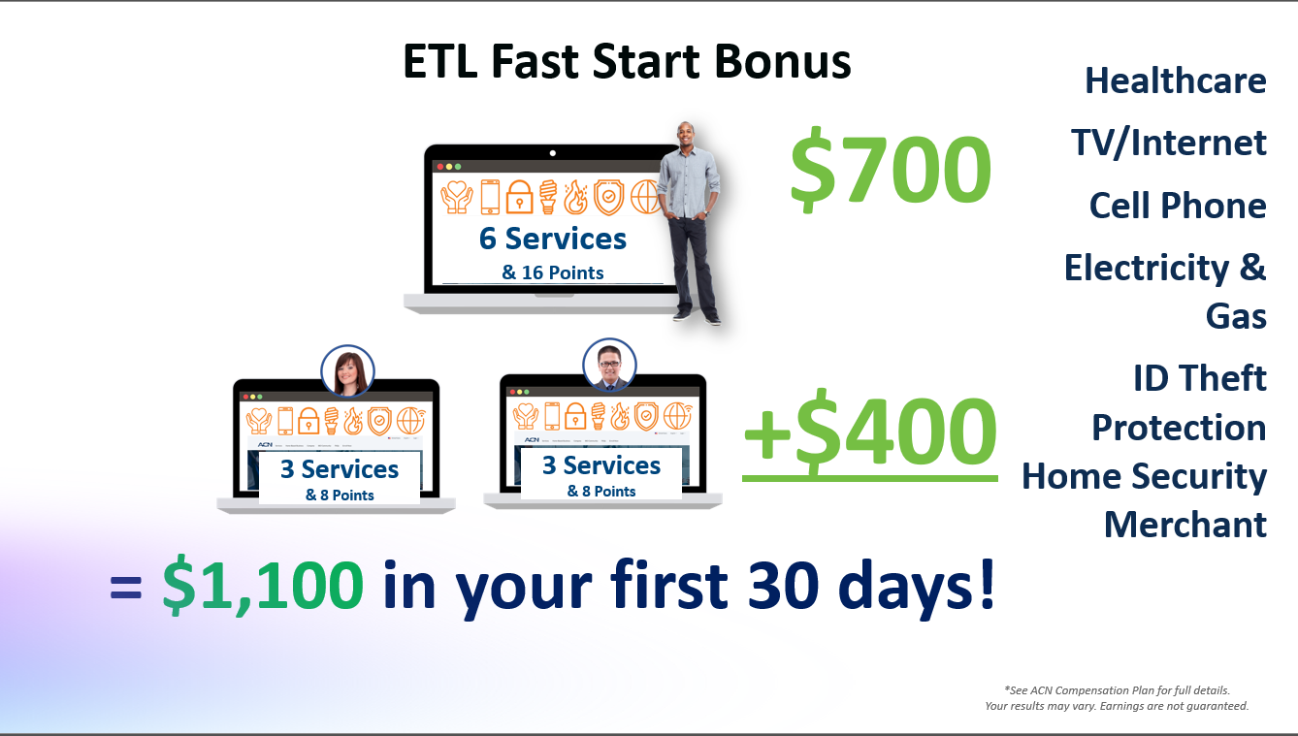

Slide 13
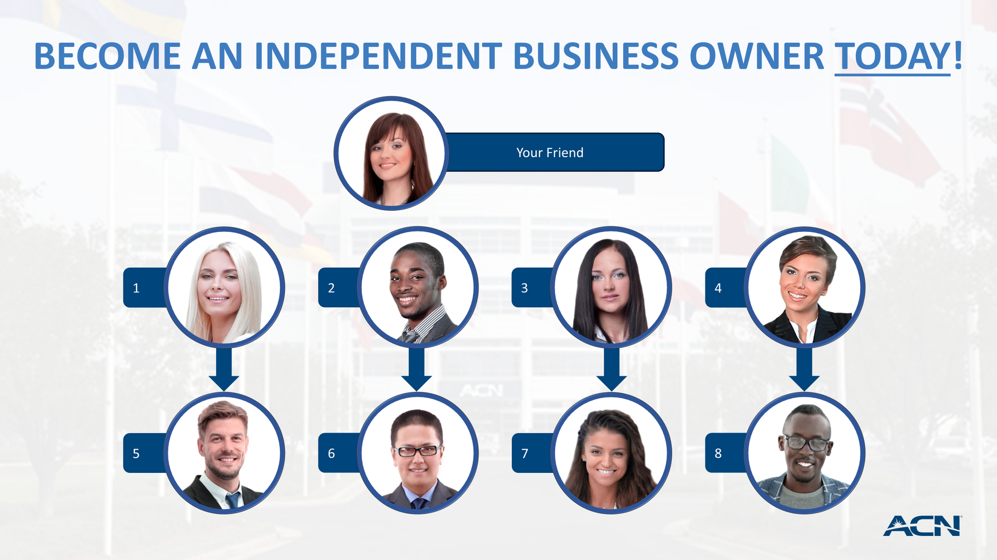

Slide 14

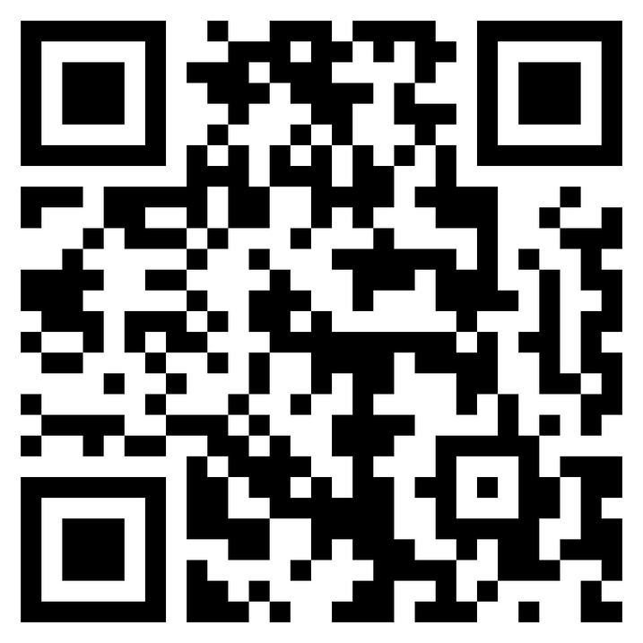
NEXT STEPS
1. Have Questions?
2. Not For You
3. Ready to Start
© 2026 ACN Opportunity, LLC | ACN Business Opportunity Presentation-USEN | 012826
Notes:
1.7.2013
‹#›

Slide 15
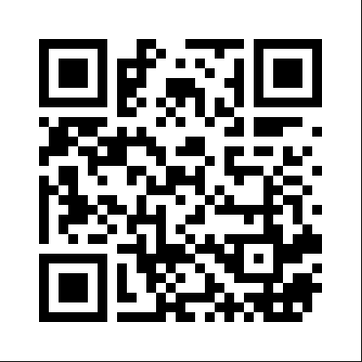
Don’t Miss
Important Info!
JOIN THE TEAM NEWSLETTER
SCAN THE QR CODE FOR TEAM WEBSITE
UPCOMING EVENTS AND ANNOUNCEMENTS

Slide 16


Slide 17


