Slide 1



Slide 2












THE LEADING
Direct Seller of Telecommunications,
Energy & Other Essential Services
1
COMPANY
An Established Track Record
Started
in the U.S.
January 1993
Specializing in Customer Acquisition
U.S. and Canada
Millions of Customers Acquired
Billions
in Sales
©️2025 ACN Opportunity, LLC | ACN Business Opportunity Presentation-USEN | 031625

Slide 3













2
ESSENTIAL SERVICES
Business Residential
INSURANCE
NEW INDUSTRIES COMING END OF 2025!
FINTECH
HOME & AUTO INSURANCE
ONLINE &TECHNOLOGY BANKING

Slide 4


OUR FLAGSHIP SERVICES
Save up to 40% a month on avg.
Nationwide 5g & 4g Coverage
IBOs can earn Free Cell service
Save 30-50% a month on avg.
Visit ANY Doctor
Monthly Health & Wellness $150 Credit

Slide 5










OUR BUSINESS MODEL
What Makes us Different?
Most Service Providers
More Choices for Consumers
Media & Internet Marketing
YOU
Income Generating Opportunity for you
CUSTOMERS
DALLAS, TX – JULY 26TH, 2025
©️2024 ACN Opportunity, LLC | ACN Business Opportunity Presentation-USEN | BS-062624

Slide 6


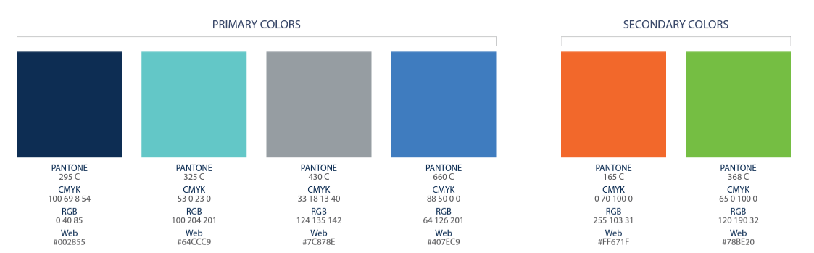

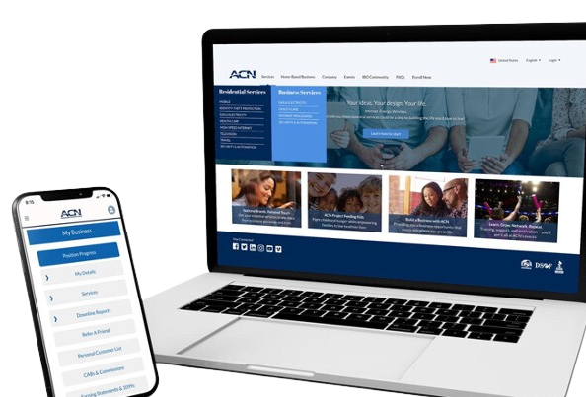


BECOME an Independent Business Owner (IBO)
$299 Start-Up + $25/month Business Support
All you do:
Personalized Website
Direct people to your website
Assist them in becoming a customer
Training and Marketing Materials
Business Tracking and Reporting
IBO & Customer Support
DALLAS, TX – JULY 26TH, 2025

Slide 7
Income from YOUR Personally Acquired Customers*
1
2
Monthly Customer Bonuses
Monthly Residual Income
Acquire Customers Totaling:
Earn Monthly On Your Customers
5 Services = $200
8 Services = $400
11 Services = $600
3% to 20%
Commissionable Revenue*
Plus $200
for Every Additional 3 Services*
Paid monthly on your customers Monthly Commissionable Revenue*
*Refer to the ACN Compensation Plan for complete details!
DALLAS, TX – JULY 26TH, 2025

Slide 8

Income from YOUR Team’s Acquired Customers*
Overriding Residual Income
Paid monthly on customers your team enrolls
up to 4%
Commissionable Revenue
Overriding Customer Acquisition Bonuses
Earned once, when your team becomes customer qualified
CQ
ETL
RC
RD
RVP
SVP
SVP
Platinum
Up to
$150
Up to
$250
Up to
$350
Up to
$400
Up to
$450
$50
DALLAS, TX – JULY 26TH, 2025
*Refer to the ACN Compensation Plan for complete details!

Slide 9

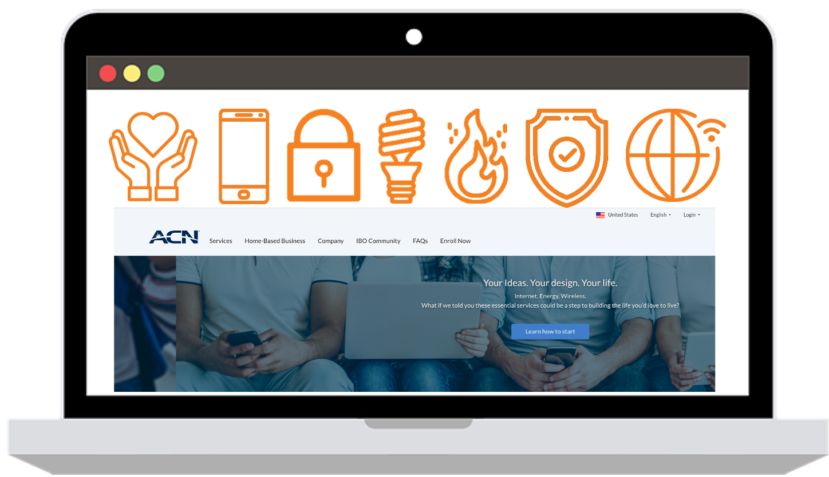


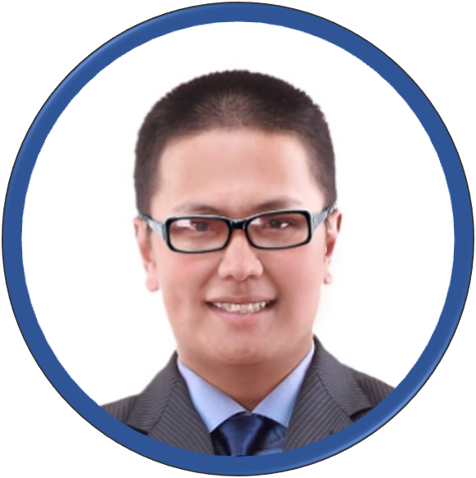
Fast Start Bonus
Healthcare
TV/Internet
Cell Phone
Electricity & Gas
ID Theft Protection
Home Security
Merchant
$400
+$600
8 Services
8 Services
8 Services
= $1000 in your first 30 days!
*See ACN Compensation Plan for full details.
Your results may vary. Earnings are not guaranteed.

Slide 10




In Business for Yourself…NEVER by Yourself!
Training and Support
Online Presentations and Training
Your Team’s In-Person and Virtual Events
National and International Events
DALLAS, TX – JULY 26TH, 2025

Slide 11
ROCKSTAR TRAININGS
Training = MASSIVE SUCCESS
Your success will always have a direct correlation to your
level of training & knowledge.
Tuesday & Sunday Nights
7pm ET / 6pm CT / 5pm MT / 4pm PT
Saturday Morning
10am ET / 9am CT / 8am MT / 7am PT
Zoom meeting ID #: 740 835 041
https://zoom.us/j/740 835 041

Slide 12
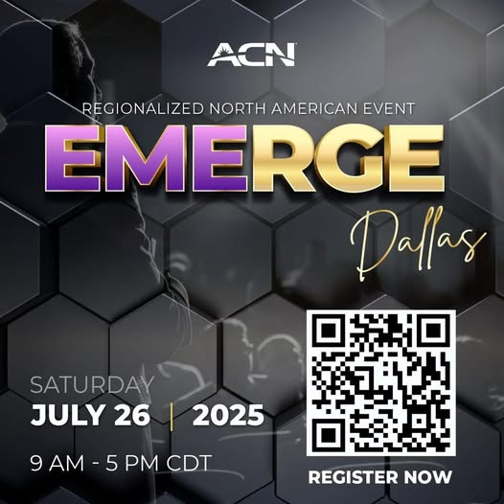

Slide 13


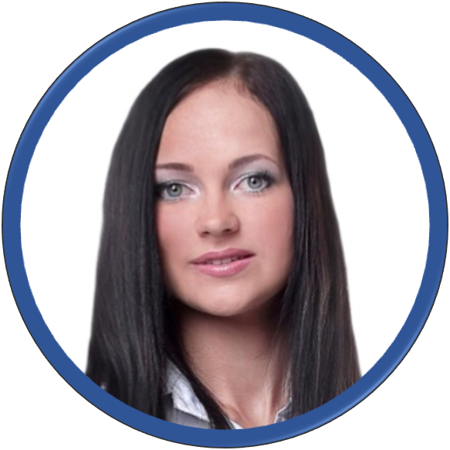




BECOME AN INDEPENDENT BUSINESS OWNER TODAY!
Your Friend
1
2
3
4
5
6
7
8

Slide 14

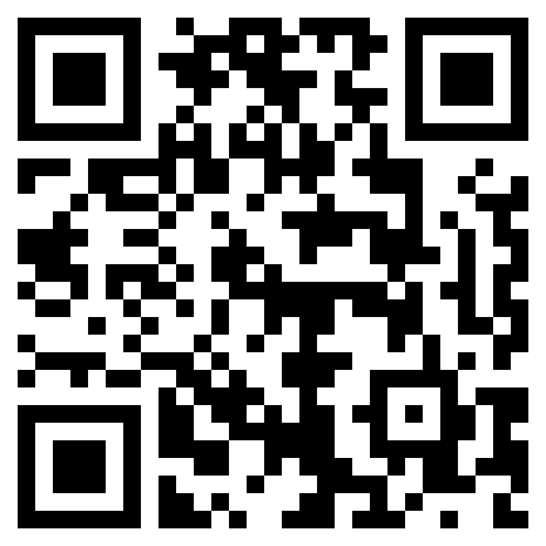

8
Training & Support
NEXT STEPS
Enroll as an IBO
Utilize Support System
Participate in Training
Acquire Customers
Get with the person who showed you this presentation and they’ll send you a link to their website OR scan the QR code and input the IBO’s number.
©️2024 ACN Opportunity, LLC | ACN Business Opportunity Presentation-USEN | BS-062624

Slide 15
Customer Acquisition
Let’s start making money
TODAY

Slide 16
Your First Goal
5 Services & 10 Points
WHY?
Customer Qualified (CQ) = first promotion
Positioned to earn residual income
Graduate to Friday Night Leadership
DALLAS, TX – JULY 26TH, 2025

Slide 17
Monthly Customer Acquisition Bonuses
5 Services = $200
8 Services = $400
11 Services = $600
Plus $200
for Every Additional 3 Services
DALLAS, TX - JUNE 20 & 21, 2025
There is no maximum!
*Paid weekly as earned when YOU acquire customers.*
*Refer to the ACN Compensation Plan for complete details!

Slide 18




Top 6 Most Simple & Lucrative Services
Mobile Service
1-14 Points
Health Care
2-6 Points
Smart Security
8 Points
Gas & Electric
1-2 Points
Travel Savings
2-8 Points
ID Theft Protection
2-8 Points
DALLAS, TX – JULY 26TH, 2025

Slide 19
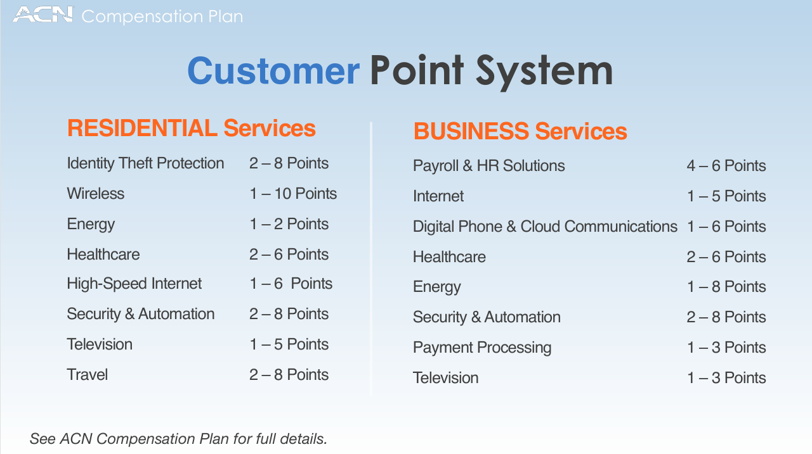

Slide 20
Where will I find my customers?
3 Sources
Yourself
Prospects who don’t become IBO’s
Everyone Else
Use the “Favor, Why, Help, Try” approach
DALLAS, TX – JULY 26TH, 2025

Slide 21
Who should be your first customer?
Most important source is YOU
Think Like A Business Owner
\
Create BELIEF in your services
Learn the sign-up process
Earn up to 20% of your own services
Next: Tutorial video for flagship services – Flash & Impact
DALLAS, TX – JULY 26TH, 2025

Slide 22
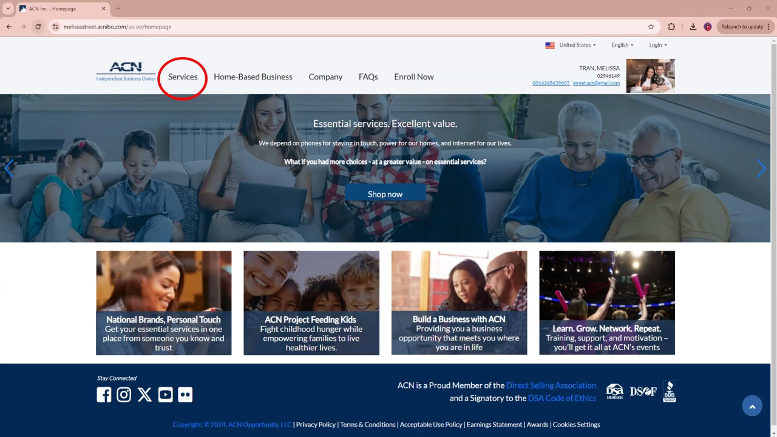

Slide 23
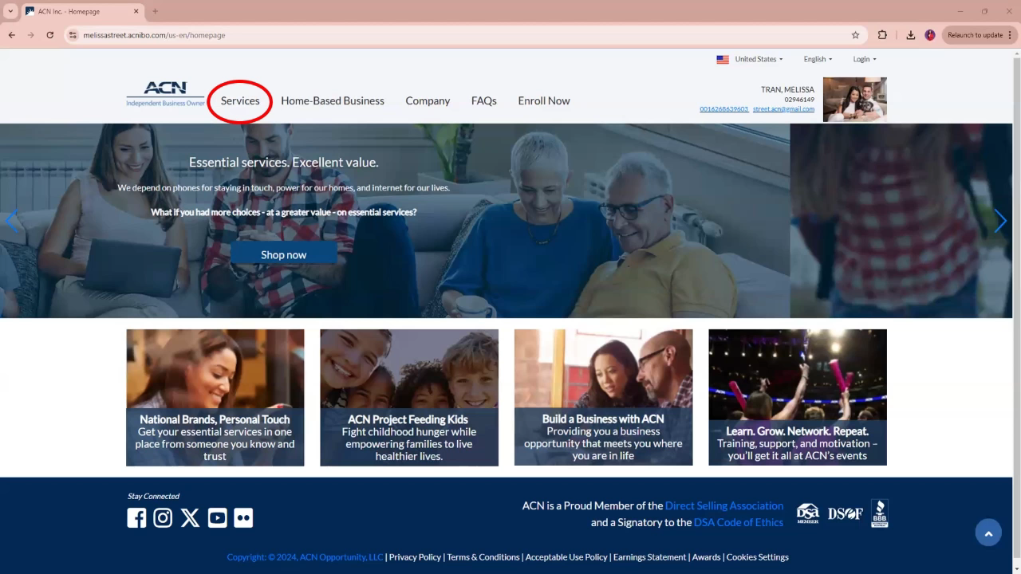

Slide 24
Building A Team
Launching Your Business
Create Overriding Residual Income

Slide 25


BOOK A ZOOM MEETING ASAP (24-48 HOURS)
Set A Date In The Next 24 – 48 Hours
  Set Up Your Zoom Meeting NOW – TEXT the person that invited you
  Pick A Time That Works for YOU
2. Make A List. 100 names and numbers. Do Not Prejudge!
  Your “A” List
    Business Owners
    Network Marketing Experience
    $100,000 Earners
    Everyone Else
3. Invite, Invite, Invite...
  50% Will Not Show (OVER INVITE)
  Set a goal to have double digit invites
  The Person That Put The Most People On Zoom Presentations the Fastest Wins

Slide 26
SCHEDULE A MEETING!
WHY?
1) You get 8 services = $600
2) Get 2 IBO’s with 8 services each
Promotion to ETL = $400
$1,000
in your first 30 days

Slide 27
SCHEDULE A MEETING ASAP
1. Pick a time that works for YOU
Set it up now by texting the person you’re working with!
2. Make a list – 100 Names & Numbers. Do not prejudge.
Business Owners / Self Employed / Real Estate Pro’s
Network Marketing / Direct Sales Experience
$100,000+ Income Earners
Everyone Else
3. Invite. Invite. Invite.
50% will not show up – TIP: Over Invite
Set a goal to have double digit invites
The person that put the most people on presentations the fastest, WINS!
DALLAS, TX – JULY 26TH, 2025

Slide 28
SAMPLE SCRIPT – PRACTICE IT!
Do you look at other ways of making money?
(Share your WHY) – this is why I started looking.
Edify Speaker - Ex: “I met an individual that is having success, expanding a business with essential services and new technology.
Promote the meeting and set up the confirmation call.
Host: 15 minutes before the meeting, text a reminder!

Slide 29

Let’s Schedule Your
ZOOM Meeting
within the next
24-48 hours!

Slide 30
Mindset
&
Events

Slide 31
Pro’s Sort – Amateur’s Sell & Convince
Sorting is FUN!
Convincing is draining
Be a Professional
Listen, Sort and Move On
And Remember –
A “NO” may not be a “NO” forever
SW, SW, SW, SW, NEXT!
DALLAS, TX – JULY 26TH, 2025

Slide 32

Emotional Rollercoaster
is totally NORMAL
Don’t let your HIGH’s get too high & your LOW’s get you too low. Remember your WHY!
DALLAS, TX – JULY 26TH, 2025

Slide 33
ACN IS THE SAME FOR EVERYONE
The company is the same
The services are the same
The only difference is YOU
Learn to invest in YOU
by participating in events.

Slide 34


5 Steps to Success
ELEVATE
Conventions
Friday Night
Leadership
Host a Zoom
& CQ
Quick Start
& Workshop
Become
an IBO
Events build your Business
Events build your Belief
Events build YOU

Slide 35
Call to Action
Get Promoted to CQ
Schedule & Host a Zoom
Enroll for upcoming events
5 Services & 10 Points
Invite people to a presentation
Propel your business forward

Slide 37
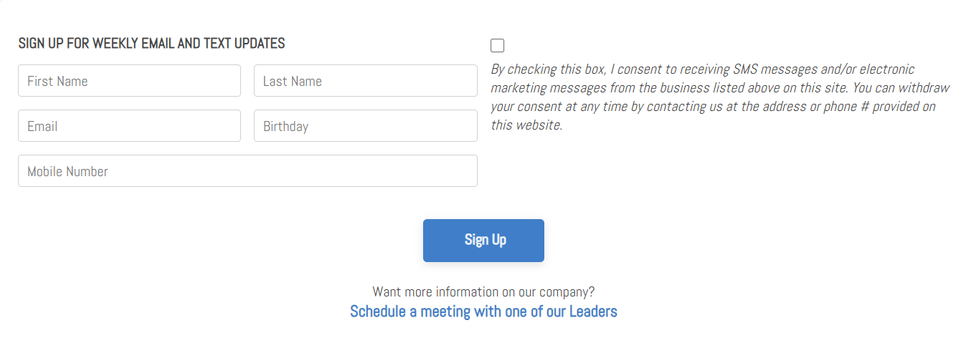
SIGN UP FOR WEEKLY EMAIL & TEXT UPDATES
ROCKSTAR TEAM WEBSITE www.wealthinstituteinc.com

