Slide 1



Slide 2












THE LEADING
Direct Seller of Telecommunications,
Energy & Other Essential Services
1
COMPANY
An Established Track Record
Started
in the U.S.
January 1993
Specializing in Customer Acquisition
U.S. and Canada
Millions of Customers Acquired
Billions
in Sales
©️2025 ACN Opportunity, LLC | ACN Business Opportunity Presentation-USEN | 031625

Slide 3













2
ESSENTIAL SERVICES
Business Residential
INSURANCE
NEW INDUSTRIES COMING END OF 2025!
FINTECH
HOME & AUTO INSURANCE
ONLINE &TECHNOLOGY BANKING

Slide 4


OUR FLAGSHIP SERVICES
Save up to 40% a month on avg.
Nationwide 5g & 4g Coverage
IBOs can earn Free Cell service
Save 30-50% a month on avg.
Visit ANY Doctor
Monthly Health & Wellness $150 Credit
DALLAS, TX - JULY 26TH, 2025

Slide 5










OUR BUSINESS MODEL
What Makes us Different?
Most Service Providers
More Choices for Consumers
Media & Internet Marketing
YOU
Income Generating Opportunity for you
CUSTOMERS
DALLAS, TX - JULY 26TH, 2025
©️2024 ACN Opportunity, LLC | ACN Business Opportunity Presentation-USEN | BS-062624

Slide 6






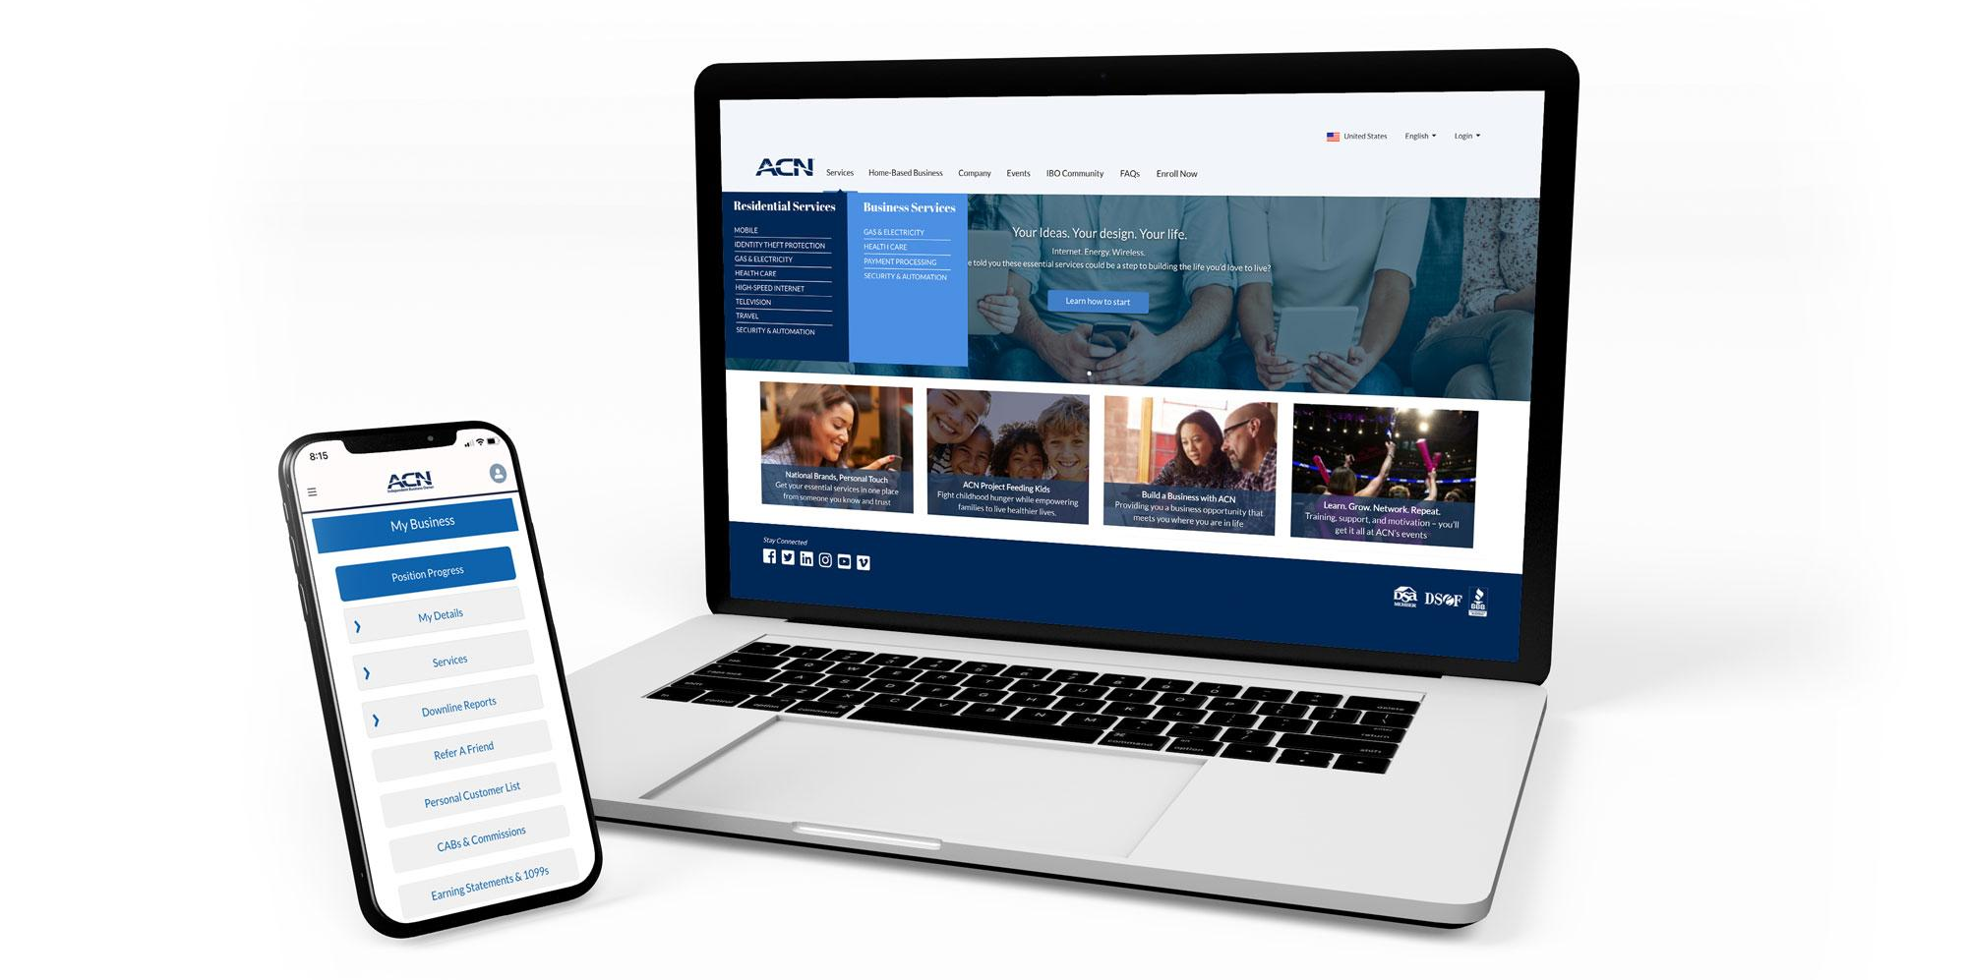

Become an Independent Business Owner (IBO)
$299 Start-Up + $25/month Business Support
Personalized Website
Training
& Marketing
Tools
Business Tracking
& Reporting on the
Salesforce Platform
IBO &
Customer
Support
Exclusive IBO Savings & Rebates
All you have to do:
Direct people
to your website
DOES THE REST!
Assist them in becoming customers
DALLAS, TX - JULY 26TH, 2025
©️2024 ACN Opportunity, LLC | ACN Business Opportunity Presentation-USEN | BS-062624

Slide 7
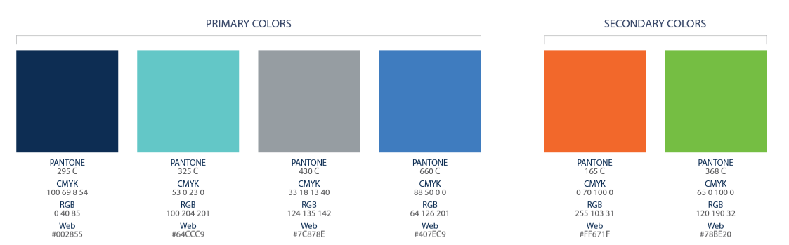
Income from YOUR Personally Acquired Customers*
1
2
Monthly Customer Bonuses
Monthly Residual Income
Acquire Customers Totaling:
Earn Monthly On Your Customers
5 Services = $200
8 Services = $400
11 Services = $600
3% to 20%
Commissionable Revenue*
Plus $200
for Every Additional 3 Services*
Paid monthly on your customers Monthly Commissionable Revenue*
*Refer to the ACN Compensation Plan for complete details!
DALLAS, TX - JULY 26TH, 2025

Slide 8

Income from YOUR Team’s Acquired Customers*
Overriding Residual Income
Paid monthly on customers your team enrolls
up to 4%
Commissionable Revenue
Overriding Customer Acquisition Bonuses
Earned once, when your team becomes customer qualified
CQ
ETL
RC
RD
RVP
SVP
SVP
Platinum
Up to
$150
Up to
$250
Up to
$350
Up to
$400
Up to
$450
$50
DALLAS, TX - JULY 26TH, 2025
*Refer to the ACN Compensation Plan for complete details!

Slide 9




In Business for yourself…never by yourself!
Training and Support
Online Presentations and Training
Your Team’s In-Person and Virtual Events
National and International Events
DALLAS, TX - JULY 26TH, 2025

Slide 10
ROCKSTAR TRAININGS
Training = MASSIVE SUCCESS
Your success will always have a direct correlation to your
level of training & knowledge.
Tuesday & Sunday Nights
7pm ET / 6pm CT / 5pm MT / 4pm PT
Saturday Morning
10am ET / 9am CT / 8am MT / 7am PT
Zoom meeting ID #: 740 835 041
https://zoom.us/j/740 835 041

Slide 11





Fast Start Bonus
Healthcare
TV/Internet
Cell Phone
Electricity & Gas
ID Theft Protection
Home Security
Merchant
$400
+$600
8 Services
8 Services
8 Services
= $1000 in your first 30 days!
*See ACN Compensation Plan for full details.
Your results may vary. Earnings are not guaranteed.

Slide 12







BECOME AN INDEPENDENT BUSINESS OWNER TODAY!
Your Friend
1
2
3
4
5
6
7
8

Slide 13


