Slide 1



acn.com
Notes:
1

Slide 2












ACN provides everyday people with the chance to become purpose-driven entrepreneurs and step into the gig-driven economy
COMPANY
An Established Track Record
Started
in the U.S.
January 1993
Specializing in Customer Acquisition
Millions of Customers Acquired
U.S. and Canada
Billions
in Sales
© 2026 ACN Opportunity, LLC | ACN Business Opportunity Presentation-USEN | 012826

Slide 3

















ESSENTIAL SERVICES
Business Residential
WIRELESS
INTERNET
TV
ENERGY
HEALTHCARE
SECURITY &
AUTOMATION
PAYMENT
PROCESSING
IDENTITY
THEFT PROTECTION
Coming Soon: FinTech Cloud Based Banking
Health Insurance Premiums sky-rocketed in 2026!
Save 30-50% on health care plan cost with IMPACT Health
No network restrictions - keep your doctors
Text Impact to 469-727-1414
© 2026 ACN Opportunity, LLC | ACN Business Opportunity Presentation-USEN | 012826

Slide 4









OUR BUSINESS MODEL
Most Service Providers
What Makes us Different?
Media & Internet Marketing
More Choices for Consumers
YOU
Income Generating Opportunity for you
CUSTOMERS
© 2026 ACN Opportunity, LLC | ACN Business Opportunity Presentation-USEN | 012826

Slide 5








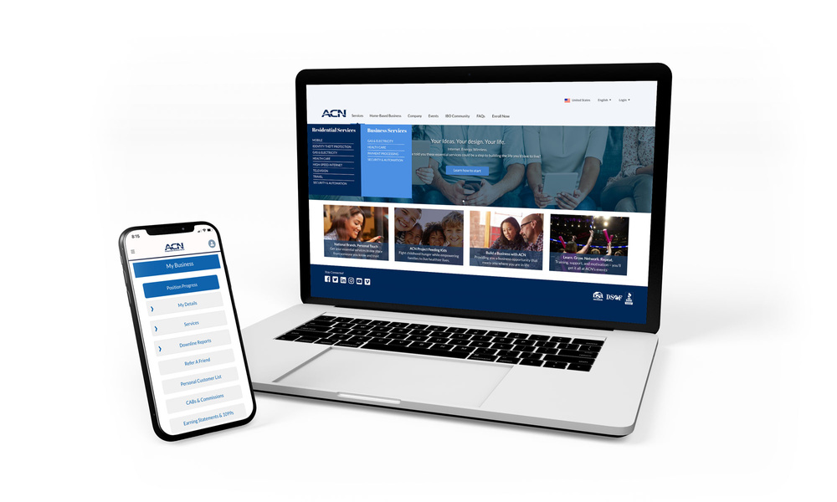

Become an Independent Business Owner (IBO)
$299 Start-Up + $30/month Business Support
Personalized Website
Training
& Marketing
Tools
Business Tracking
& Reporting on the Salesforce Platform
IBO &
Customer
Support
Exclusive IBO Savings & Rebates
ACN AI App
All you have to do:
Direct people to your website
DOES THE REST!
Assist them in becoming customers
© 2026 ACN Opportunity, LLC | ACN Business Opportunity Presentation-USEN | 012826

Slide 6
Personal Monthly Income
Your Customers
Acquire Customers Totaling:
Residual Income
3 Services / 8 Points = $400
6 Services / 16 Points = $1000
3% TO 20%
Plus $500
for Every Additional 3 Services & 8 Points
Paid monthly on your customers Monthly Commissionable Revenue*
Paid weekly as earned when YOU acquire customers.*
*Refer to the ACN Compensation Plan for complete details!
© 2026 ACN Opportunity, LLC | ACN Business Opportunity Presentation-USEN | 012826

Slide 7



IBO Referral Programs
Refer-a-Friend For EVERY 5 Flash Mobile referred customers, earn a monthly CREDIT equal to one line of your service.*
PowerUP For 12+ XOOM Energy Residential Natural Gas or 12+ Residential Electricity customers, earn a monthly BONUS equal to the average commodity-only charges of your customers’ bills.*
Refer-a-Friend For EVERY 5 referred customers who enroll in and authenticate an IDSeal Annual plan, earn a monthly BONUS equal to the monthly cost of your Annual subscriptions on your flagged accounts, up to 4 BONUSES.*
Get rewarded month after month when you meet referral goals!
* Excludes taxes and surcharges. Additional terms and conditions apply. For full details, refer to the service-specific program in the IBO Back Office
© 2026 ACN Opportunity, LLC | ACN Business Opportunity Presentation-USEN | 012826

Slide 8

Overriding Income
Your Team’s Customers
Overriding Residual Income
Paid monthly on customers your team enrolls
4%
Commissionable
Revenue
You 3% - 20%
4%
4%
4%
4%
4%
Earn 4% Overriding Residual Income on all “Commissionable Revenue” generated by your Team’s Customers through 5 Levels
*Refer to the ACN Compensation Plan for complete details!
© 2026 ACN Opportunity, LLC | ACN Business Opportunity Presentation-USEN | 012826

Slide 9


Overriding Income
Your Team’s Customers
Overriding Customer Acquisition Bonuses
Earned once, when every team member becomes customer qualified
CQ
ETL
RC
RD
RVP
SVP
$50
Up to
$150
Up to
$250
Up to
$350
Up to
$400
*Refer to the ACN Compensation Plan for complete details!
© 2026 ACN Opportunity, LLC | ACN Business Opportunity Presentation-USEN | 012826

Slide 10
Overriding Income
Your Team’s Customers
Fast Start Bonuses
ETL
RC
30 Days
90 Days
+
$400
$1,600
Total $2,000
*Refer to the ACN Compensation Plan for complete details!
© 2026 ACN Opportunity, LLC | ACN Business Opportunity Presentation-USEN | 012826

Slide 11

Training & Support
ACN In-Person
Online
Presentations
& Trainings
Your Team’s
In-Person
& Virtual Events
Training Events
IN BUSINESS FOR YOURSELF, NEVER BY YOURSELF
© 2026 ACN Opportunity, LLC | ACN Business Opportunity Presentation-USEN | 012826

Slide 12

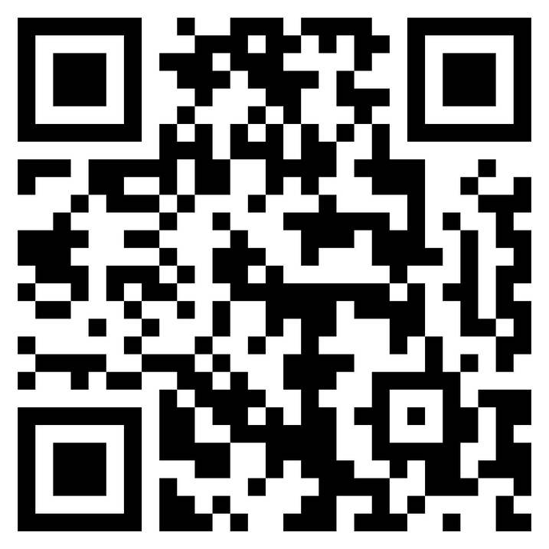
NEXT STEPS
1. Not for You
2. Have Questions?
3. Ready to Start
© 2026 ACN Opportunity, LLC | ACN Business Opportunity Presentation-USEN | 012826

