Slide 1



acn.com
Notes:
1

Slide 2
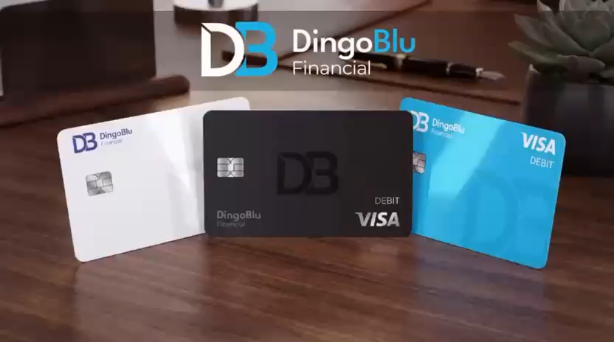
acn.com
Notes:
1

Slide 3
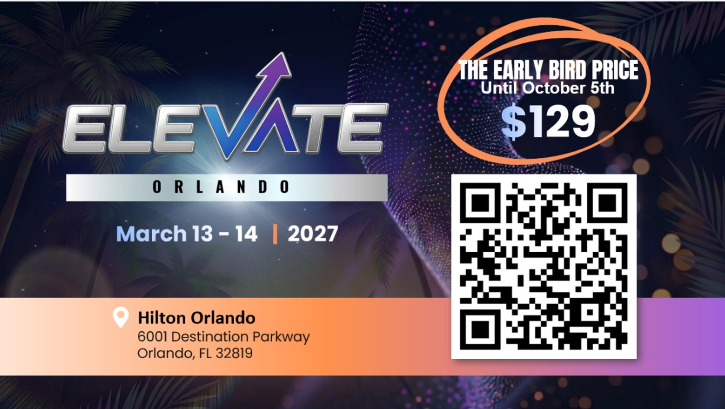
Notes:
1

Slide 4

What if the right business opportunity was right in front of you?
How about an opportunity
POWERED BY ESSENTIAL SERVICES
FOR HOME AND LIFE.
Notes:
Imagine if by the end of this week you had your own business—no inventory, no shipping, no office lease. Just your phone, a link, and the ability to earn from services people are already using. That’s what we’re talking about today.

Slide 5


Introducing a home-based business
built on essential services people use every day.
Think uber.
Think gig economy.
Your business.
You're timing.
Your Pace.
Built with Your Customers.
Notes:
Think about Uber or Lyft. They didn’t invent driving—they made it easier, faster, more profitable for the driver. Now imagine that instead of rides, you connect people to things they already pay for every single month—like mobile, energy, and healthcare. And you get paid… every time they pay their bill.

Slide 6










ACN provides everyday people with the chance to become purpose-driven entrepreneurs and step into the gig-driven economy
COMPANY
An Established Track Record
Started
in the U.S.
January 1993
Specializing in Customer Acquisition
Millions of Customers Acquired
U.S. and Canada
Billions
in Sales
© 2026 ACN Opportunity, LLC | ACN Business Opportunity Presentation-USEN | 012826

Slide 7










ESSENTIAL SERVICES
Business Residential
WIRELESS
INTERNET
TV
ENERGY
HEALTHCARE
SECURITY &
AUTOMATION
PAYMENT
PROCESSING
IDENTITY
THEFT PROTECTION
Coming Soon: FinTech Cloud Based Banking
Health Insurance Premiums sky-rocketed in 2026!
Save 30-50% on health care plan cost with IMPACT Health
No network restrictions - keep your doctors
Text Impact to 469-727-1414
© 2026 ACN Opportunity, LLC | ACN Business Opportunity Presentation-USEN | 012826

Slide 8







OUR BUSINESS MODEL
Most Service Providers
What Makes us Different?
Media & Internet Marketing
More Choices for Consumers
YOU
Income Generating Opportunity for you
CUSTOMERS
© 2026 ACN Opportunity, LLC | ACN Business Opportunity Presentation-USEN | 012826

Slide 9






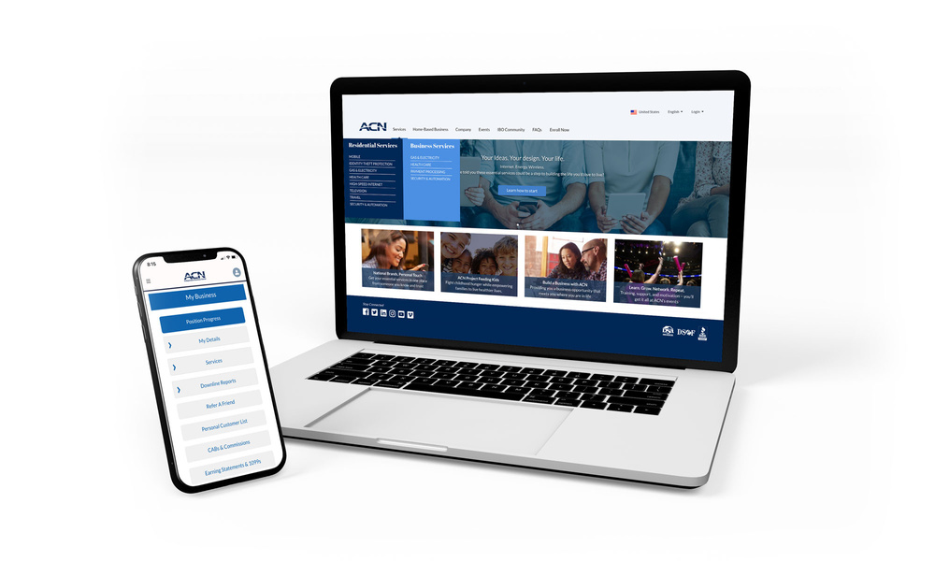

Become an Independent Business Owner (IBO)
$299 Start-Up + $30/month Business Support
Personalized Website
Training
& Marketing
Tools
Business Tracking
& Reporting on the Salesforce Platform
IBO &
Customer
Support
Exclusive IBO Savings & Rebates
ACN AI App
All you have to do:
Direct people to your website
DOES THE REST!
Assist them in becoming customers
© 2026 ACN Opportunity, LLC | ACN Business Opportunity Presentation-USEN | 012826

Slide 10
Personal Monthly Income
Your Customers
Acquire Customers Totaling:
Residual Income
3 Services / 8 Points = $400
6 Services / 16 Points = $1000
9 Services / 24 Points = $1,500
12 Services / 32 Points = $2,000
3% TO 20%
Paid monthly on your customers Monthly Commissionable Revenue*
Plus $500
for Every Additional 3 Services & 8 Points
Paid weekly as earned when YOU acquire customers.*
*Refer to the ACN Compensation Plan for complete details!
© 2026 ACN Opportunity, LLC | ACN Business Opportunity Presentation-USEN | 012826

Slide 11



IBO Referral Programs
Refer-a-Friend
For EVERY 5 Flash Mobile referred customers, earn
a monthly CREDIT equal to one line of your service.*
PowerUP
For 12+ XOOM Energy Residential Natural Gas or 12+ Residential Electricity customers, earn a monthly BONUS equal to the average commodity-only charges of your customers’ bills.*
Refer-a-Friend
For EVERY 5 referred customers who enroll in and authenticate an IDSeal Annual plan, earn a monthly BONUS equal to the monthly cost of your Annual subscriptions on your flagged accounts, up to 4 BONUSES.*
Get rewarded month after month when you meet referral goals!
* Excludes taxes and surcharges. Additional terms and conditions apply. For full details, refer to the service-specific program in the IBO Back Office
© 2026 ACN Opportunity, LLC | ACN Business Opportunity Presentation-USEN | 012826

Slide 12

Overriding Income
Your Team’s Customers
Overriding Residual Income
Paid monthly on customers your team enrolls
Commissionable
Revenue
4%
You 3% - 20%
  Level 1= 4%
  Level 2 = 4%
  Level 3 = 4%
  Level 4 = 4%
  Level 5 = 4%
4
8
16
36
64 People
Earn 4%
Overriding Residual Income
on all 5 Levels
*Refer to the ACN Compensation Plan for complete details!

Slide 13
Overriding Income
Your Team’s Customers
Overriding Customer Acquisition Bonuses
Earned once, when every team member becomes customer qualified
CQ
ETL
RC
RD
RVP
SVP
New IBO
$400
$50
Up to
$150
Up to
$250
Up to
$350
Up to
$400
*Refer to the ACN Compensation Plan for complete details!
© 2026 ACN Opportunity, LLC | ACN Business Opportunity Presentation-USEN | 012826

Slide 14
Overriding Income
Your Team’s Customers
Fast Start Bonuses
ETL
RC
30 Days
90 Days
+
$400
$1,600
Total $2,000
*Refer to the ACN Compensation Plan for complete details!
© 2026 ACN Opportunity, LLC | ACN Business Opportunity Presentation-USEN | 012826

Slide 15

Training & Support
ACN In-Person
Online
Presentations
& Trainings
Your Team’s
In-Person
& Virtual Events
Training Events
IN BUSINESS FOR YOURSELF, NEVER BY YOURSELF
© 2026 ACN Opportunity, LLC | ACN Business Opportunity Presentation-USEN | 012826

Slide 16
1) Get Started
Have your Sponsor ID ready
www.acninc.com
2) Register for Elevate Arlington,TX
September 26 & 27, 2026
https://acn.swoogo.com/
elevatearlington2026/begin
NEXT STEPS
  1. Not for You
  2. Have Questions?
  3. Ready to Start
© 2026 ACN Opportunity, LLC | ACN Business Opportunity Presentation-USEN | 012826

Slide 17
Notes:
1

Slide 18

Customer Acquisition
Let’s start making money
TODAY

Slide 19
Your First Goal
3 Services & 8 Points
Earn your $400 Bonus
Create your “Story”
Customer Qualified (CQ) = first promotion
Positioned to earn residual income
Graduate to Friday Night Leadership
ARLINGTON, TX – SEPT 26 & 27, 2026

Slide 20





Fast Start Bonus
Healthcare
TV/Internet
Cell Phone
Electric & Gas
ID Theft Protection
Home Security
Merchant
$1000
+$400
6 Services
6 Services
6 Services
ETL in your first 7 days =$1400
RC in your in 90 days + $1600

Slide 21
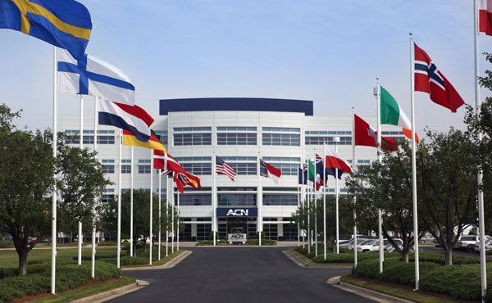




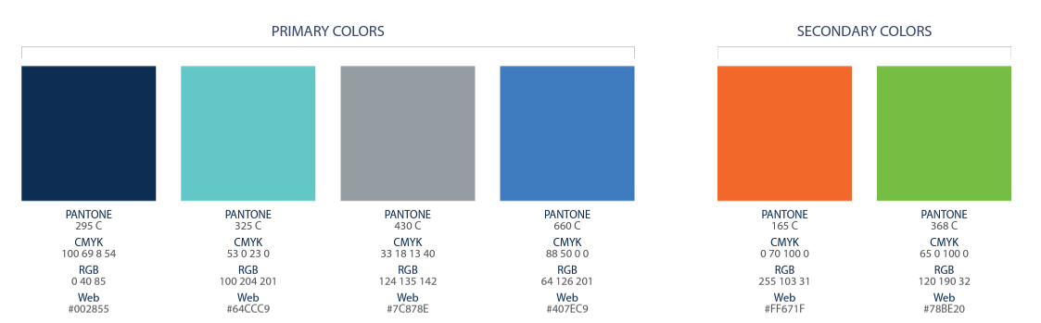



BECOME AN INDEPENDENT BUSINESS OWNER TODAY!
Your Friend
1
2
3
4
5
6
7
8

Slide 22
30 DAY FAST TRACK
$4,500 → 30 Services
$400 → ETL Bonus
$1,600 → RC Bonus
$6,500+ in your first 30 days!
Halfway Qualified to Regional Director and getting an ALL Expense Paid trip to Arizona for your Family
*See ACN Compensation Plan for full details.
Your results may vary. Earnings are not guaranteed.

Slide 23





Customer Sources
Everyone Else
(Warm Market,
and referrals)
PROSPECTS WHO DO NOT BECOME IBOs
THOSE YOU DO BUSINESS WITH
YOURSELF

Slide 24





Top 5 Most Simple & Lucrative Services
Mobile Service
2 Points Per Line
1-866-643-8164
Flash Mobile Concierge
Health Care
2-6 Points
Smart Security
2-5 Points
Gas & Electric
2 Points
ID Theft Protection
2-4 Points

Slide 25








GET YOUR BILLS COVERED
Refer-a-Friend
PowerUP
Refer-a-Friend
Refer 5+ Flash Mobile customers to earn Free Lifetime Service
Up to 45% Savings with Flash
Get Access to America’s Largest and Fastest 5G Network
Refer 12+ XOOM Energy Residential
Natural Gas or 12+ XOOM Energy and your service can be FREE
Enroll & authenticate 5+ customers with an IDSeal Annual plan and your service can be FREE
*Excludes taxes and surcharges. Terms and conditions apply.
IMAGINE HOW MUCH YOU CAN SAVE YEAR AFTER YEAR!

Slide 26


CALL TO ACTION
Set A Goal
3 Services = $400
6 Services = $1,000
9 Services = $1,500
12 Services = $2,000
Plus $500
For Every Additional
3 Services & 8 Points
DALLAS, TX - JUNE 20 & 21, 2025

Slide 27
Building A Team
Launching Your Business
Create Overriding Residual Income

Slide 28
Fast Start Bonus
Healthcare
TV/Internet
Cell Phone
Electric & Gas
ID Theft Protection
Home Security
Merchant
$1000
+$400
6 Services
6 Services
6 Services
ETL in your first 7 days =$1400
RC in your in 90 days + $1600

Slide 29
30 DAY FAST TRACK
$4,500 → 30 Services
$400 → ETL Bonus
$1,600 → RC Bonus
$6,500+ in your first 30 days!
Halfway Qualified to Regional Director and getting an ALL Expense Paid trip to Arizona for your Family
*See ACN Compensation Plan for full details.
Your results may vary. Earnings are not guaranteed.

Slide 30

BUILDING A TEAM
  Pick a Time That Works for YOU
  Schedule a meeting ASAP
  Set it up now by texting the person you’re working with!
2. Make a List. 100 Names and Numbers. Do Not Prejudge!
  Your “A” List
    Business owners (Health Share customers)
    Network Marketing experience
    Real Estate professionals
    Everyone else
3. Invite, Invite, Invite...
  50% Will Not Show (OVER INVITE)
  Set a goal to have double-digit invites
  The person who puts the most people in a meeting the fastest wins

Slide 31
- PRACTICE IT!
SAMPLE SCRIPT
Do you look at other ways of making money?
(Share Your Why) … and that’s why I started looking.
Edify Speaker – e.g.: “I met an individual who is having massive success, expanding an online business with Essential Services. They are hosting a short meeting on (Date/Time).”
Promote your meeting and set up confirmation call.
15 Minutes BEFORE Presentation, Send a Reminder Text

Slide 32
WHAT IF THEY HAVE QUESTIONS?
Be new and say “That is what the call is for…”
Talk about the person, not the thing
Have posture when inviting

Slide 33

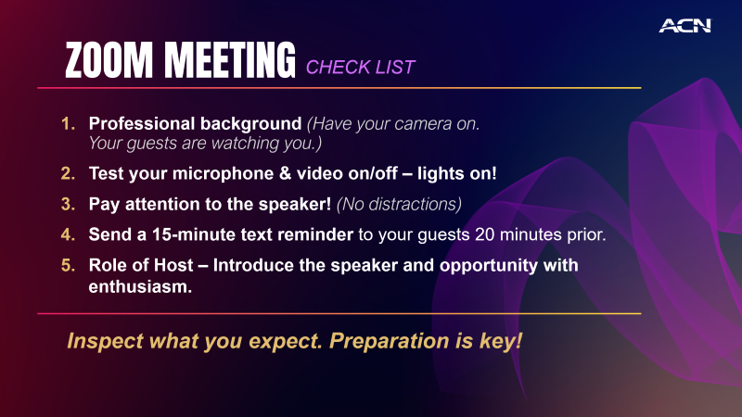
MEETING
CHECK LIST
Professional background (Have your camera on. Your guests are watching you.)
Test your microphone & video on/off – lights on!
Pay attention to the speaker! (No distractions)
Send a 15-minute text reminder to your guests 20 minutes prior.
Role of Host – Introduce the speaker and opportunity with enthusiasm.
Inspect what you expect. Preparation is key!

Slide 34
SORTING AFTER THE PRESENTATION
ARE YOU READY TO GET STARTED?
Yes
Questions
No
Sign up as
an IBO
Thank them!
Answer Questions
Ask to be a customer
Promote Training!
Promote Training!

Slide 35
Mindset
&
Events

Slide 36
ADOPT
A WINNING MINDSET
Professionals SORT
Amateurs SELL and CONVINCE
Sorting is fun!
Convincing is draining!
Be a professional
listen, sort and move on
…and remember
a NO may NOT be a NO FOREVER

Slide 37

Emotional Rollercoaster
is totally NORMAL
Don’t let your HIGH’s get too
high & your LOW’s get you too low.
Remember your WHY!

Slide 38

THE ACN SYSTEM
Elevate Event
Provided by ACN’s
Co-Founders, Executives and ACN’s SVPs/RVPs
( IN Person)
4
Friday Night
Leadership
In person
& Zoom( Hybrid)
3
2
Host A
Meeting
& CQ
1
SATURDAY
TRAINING
IN- PERSON
& Tuesday Zoom
Meeting
Follow The System To Success
Become
An IBO

Slide 39
CALL TO ACTION
Get 3 Customers / 8 Points = $400
Schedule your Launch Meeting & Grand Opening
Schedule your Coaching Call – BEFORE you start inviting
Pre-register for the National Convention in Arlington, TX *September 26-27th, 2026*

Slide 40

  1. Not for You
  2. Have Questions?
  3. Ready to Start
© 2026 ACN Opportunity, LLC | ACN Business Opportunity Presentation-USEN | 012826

Slide 41
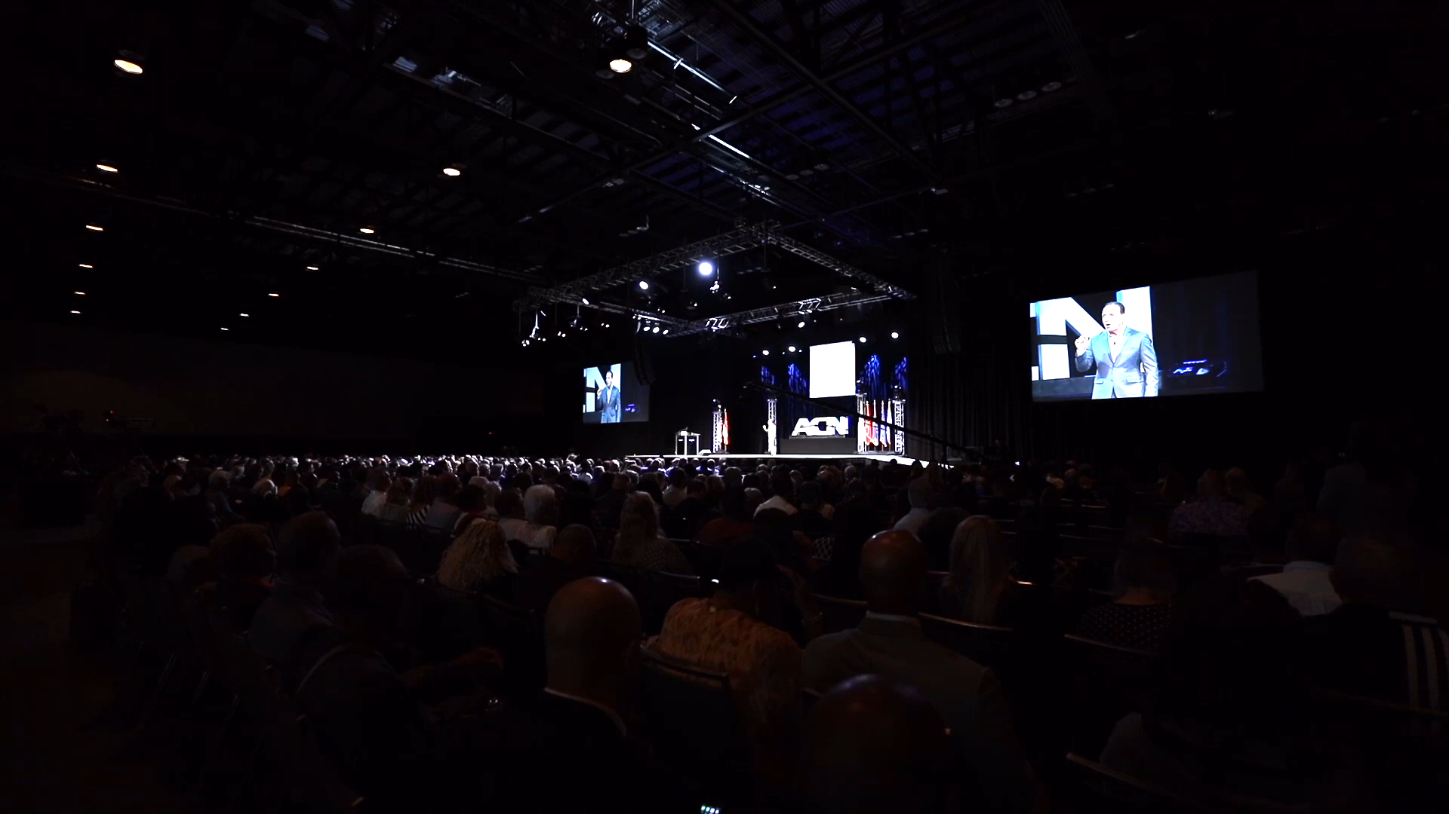

ELEVATE – ORLANDO, FLORIDA OCTOBER 12-13, 2024

Slide 42
Notes:
1

Slide 43
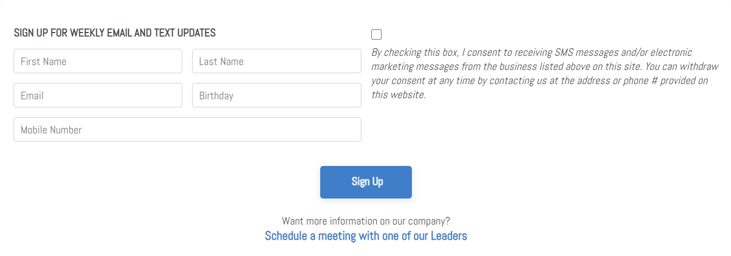
SIGN UP FOR WEEKLY EMAIL & TEXT UPDATES
ROCKSTAR TEAM WEBSITE www.wealthinstituteinc.com

