Slide 1

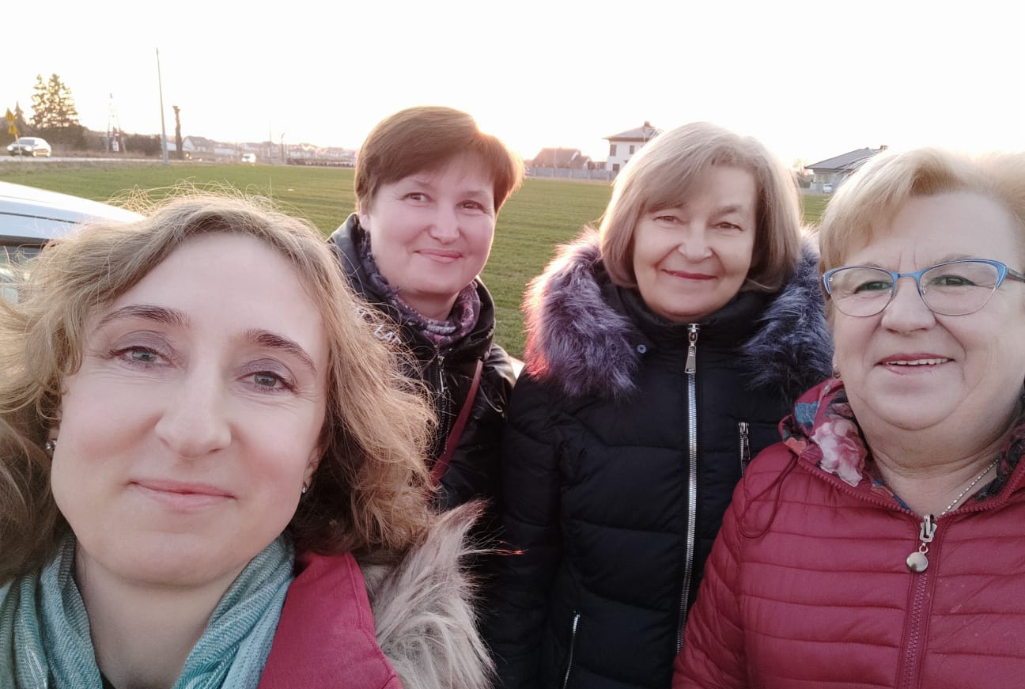
FROM CONFLICT TO NEGOTIATIONS IN EMEIS POLAND
Notes:
Exploitation, conflict and bogus social dialogue in Emeis Poland.

Slide 2
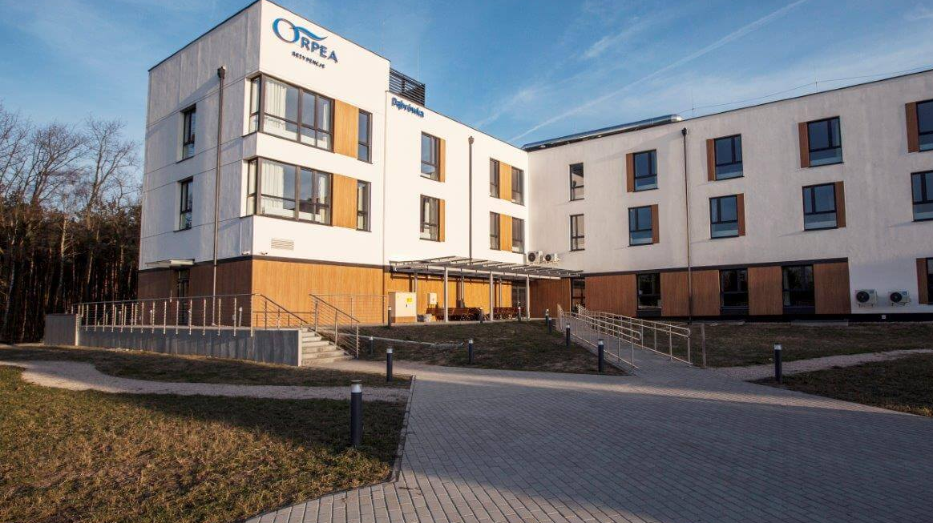
EMEIS POLAND THE BIGGEST PROVIDER OF LONG-TERM CARE (PRIVATE SECTOR)
15 FACILITIES (NURSING HOMES AND CLINICS)
1500 WORKERS

Slide 3
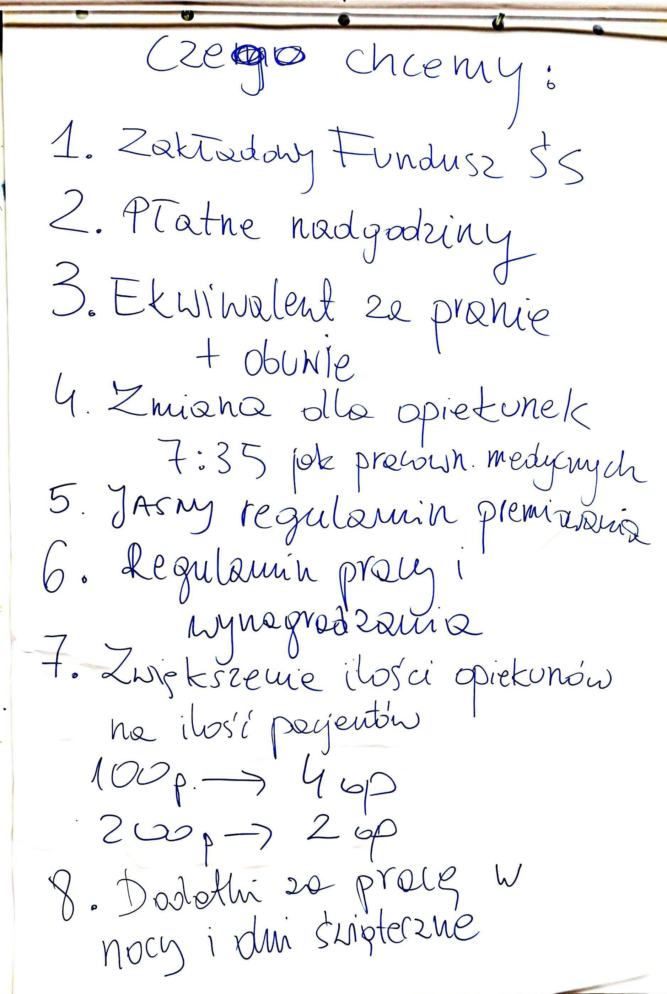
END OF 2018
BEGINNING OF THE UNION IN EMEIS (FORMER ORPEA)

Slide 4
HOW WE STARTED
30 union members vs „corpo-giant”
Harsh anti-union campaign:
Intimidation
Bribing
SLAPP (Strategic lawsuits against public participation)
Union representative got fired (April 2019)
Notes:
SLAPP – orpea pozwała związek na początku w kilku kwestiach, m.in. Tego że związek jest nielegalny, nie pamiętam ile było tych spraw

Slide 5
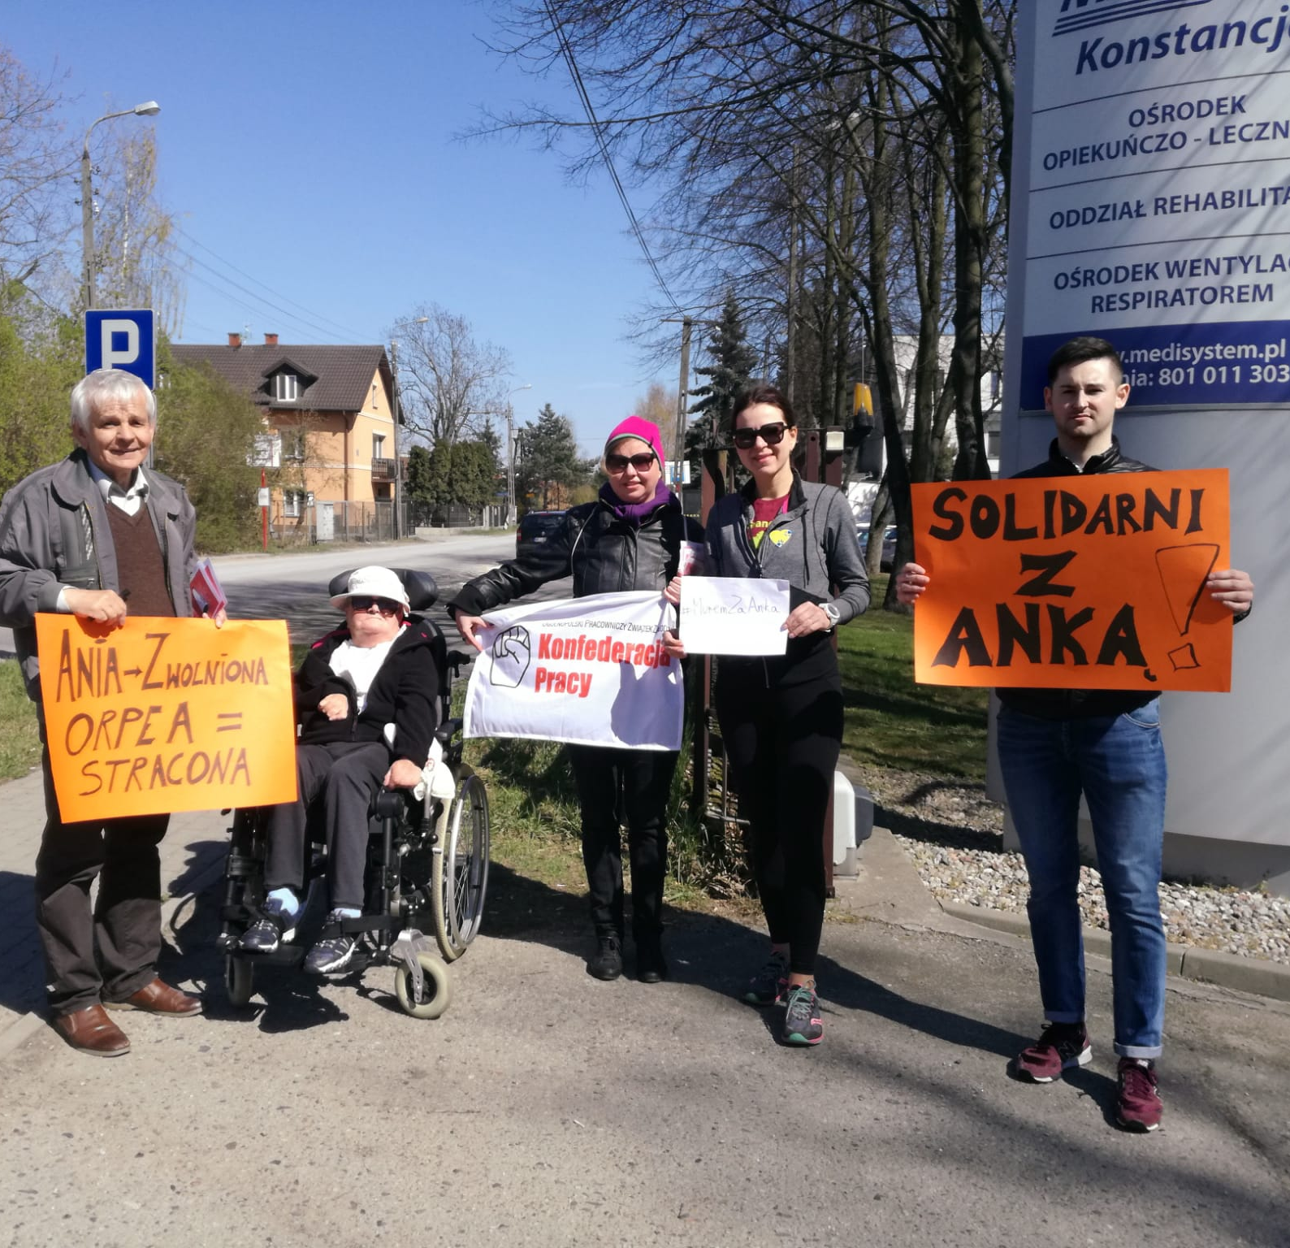
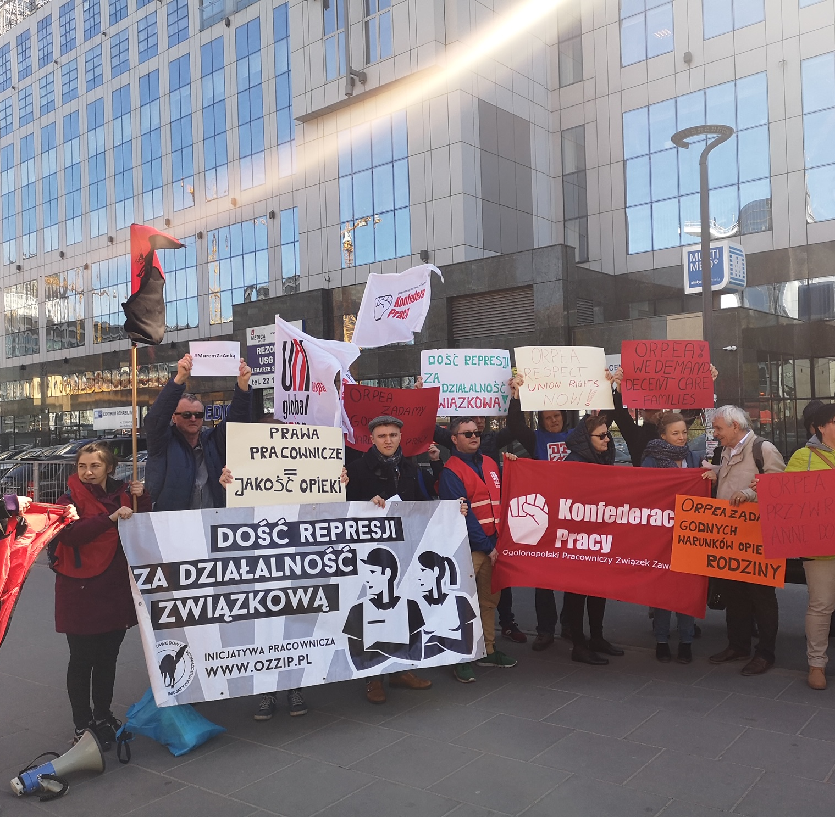
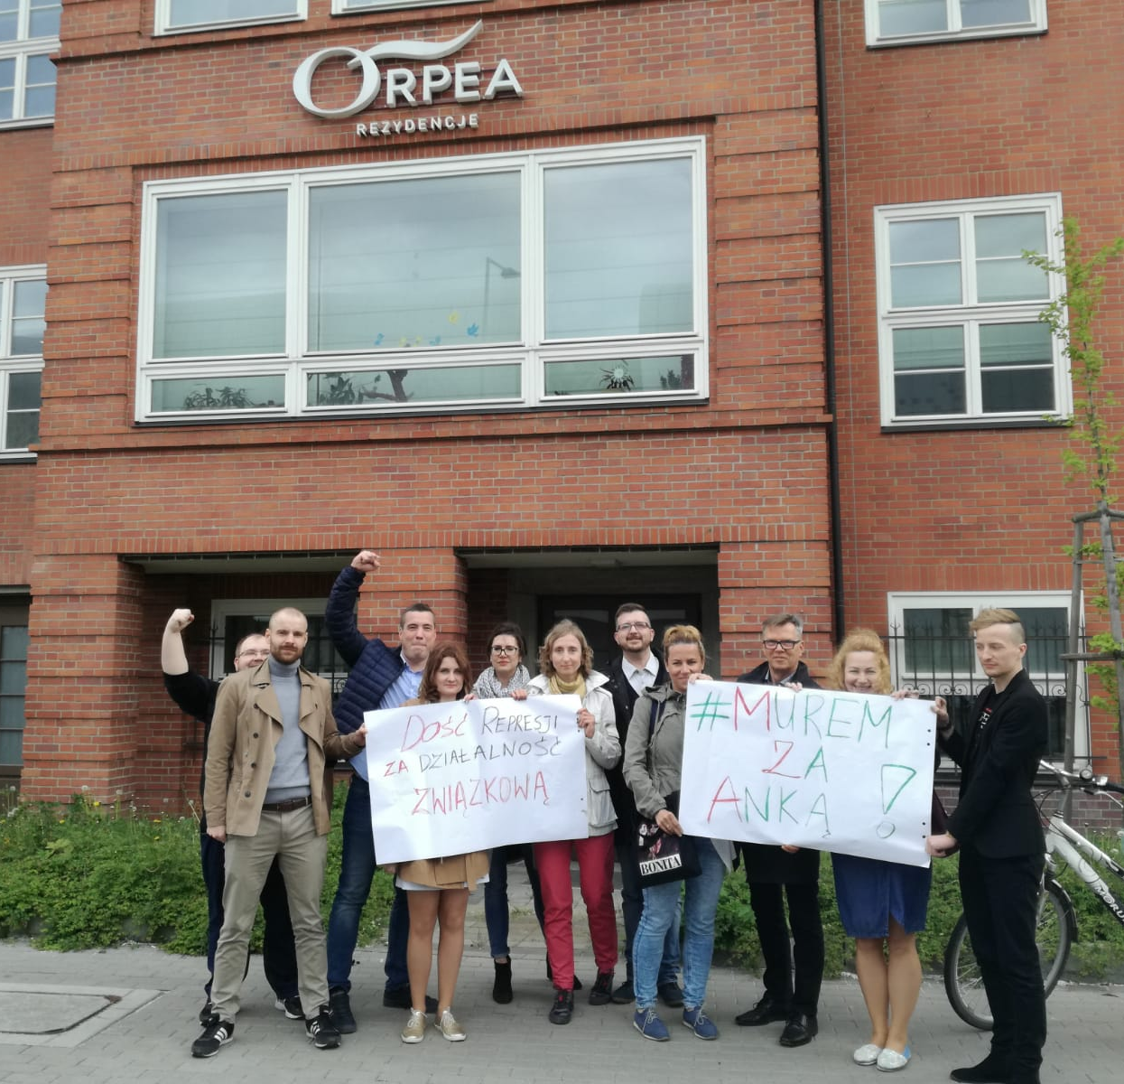
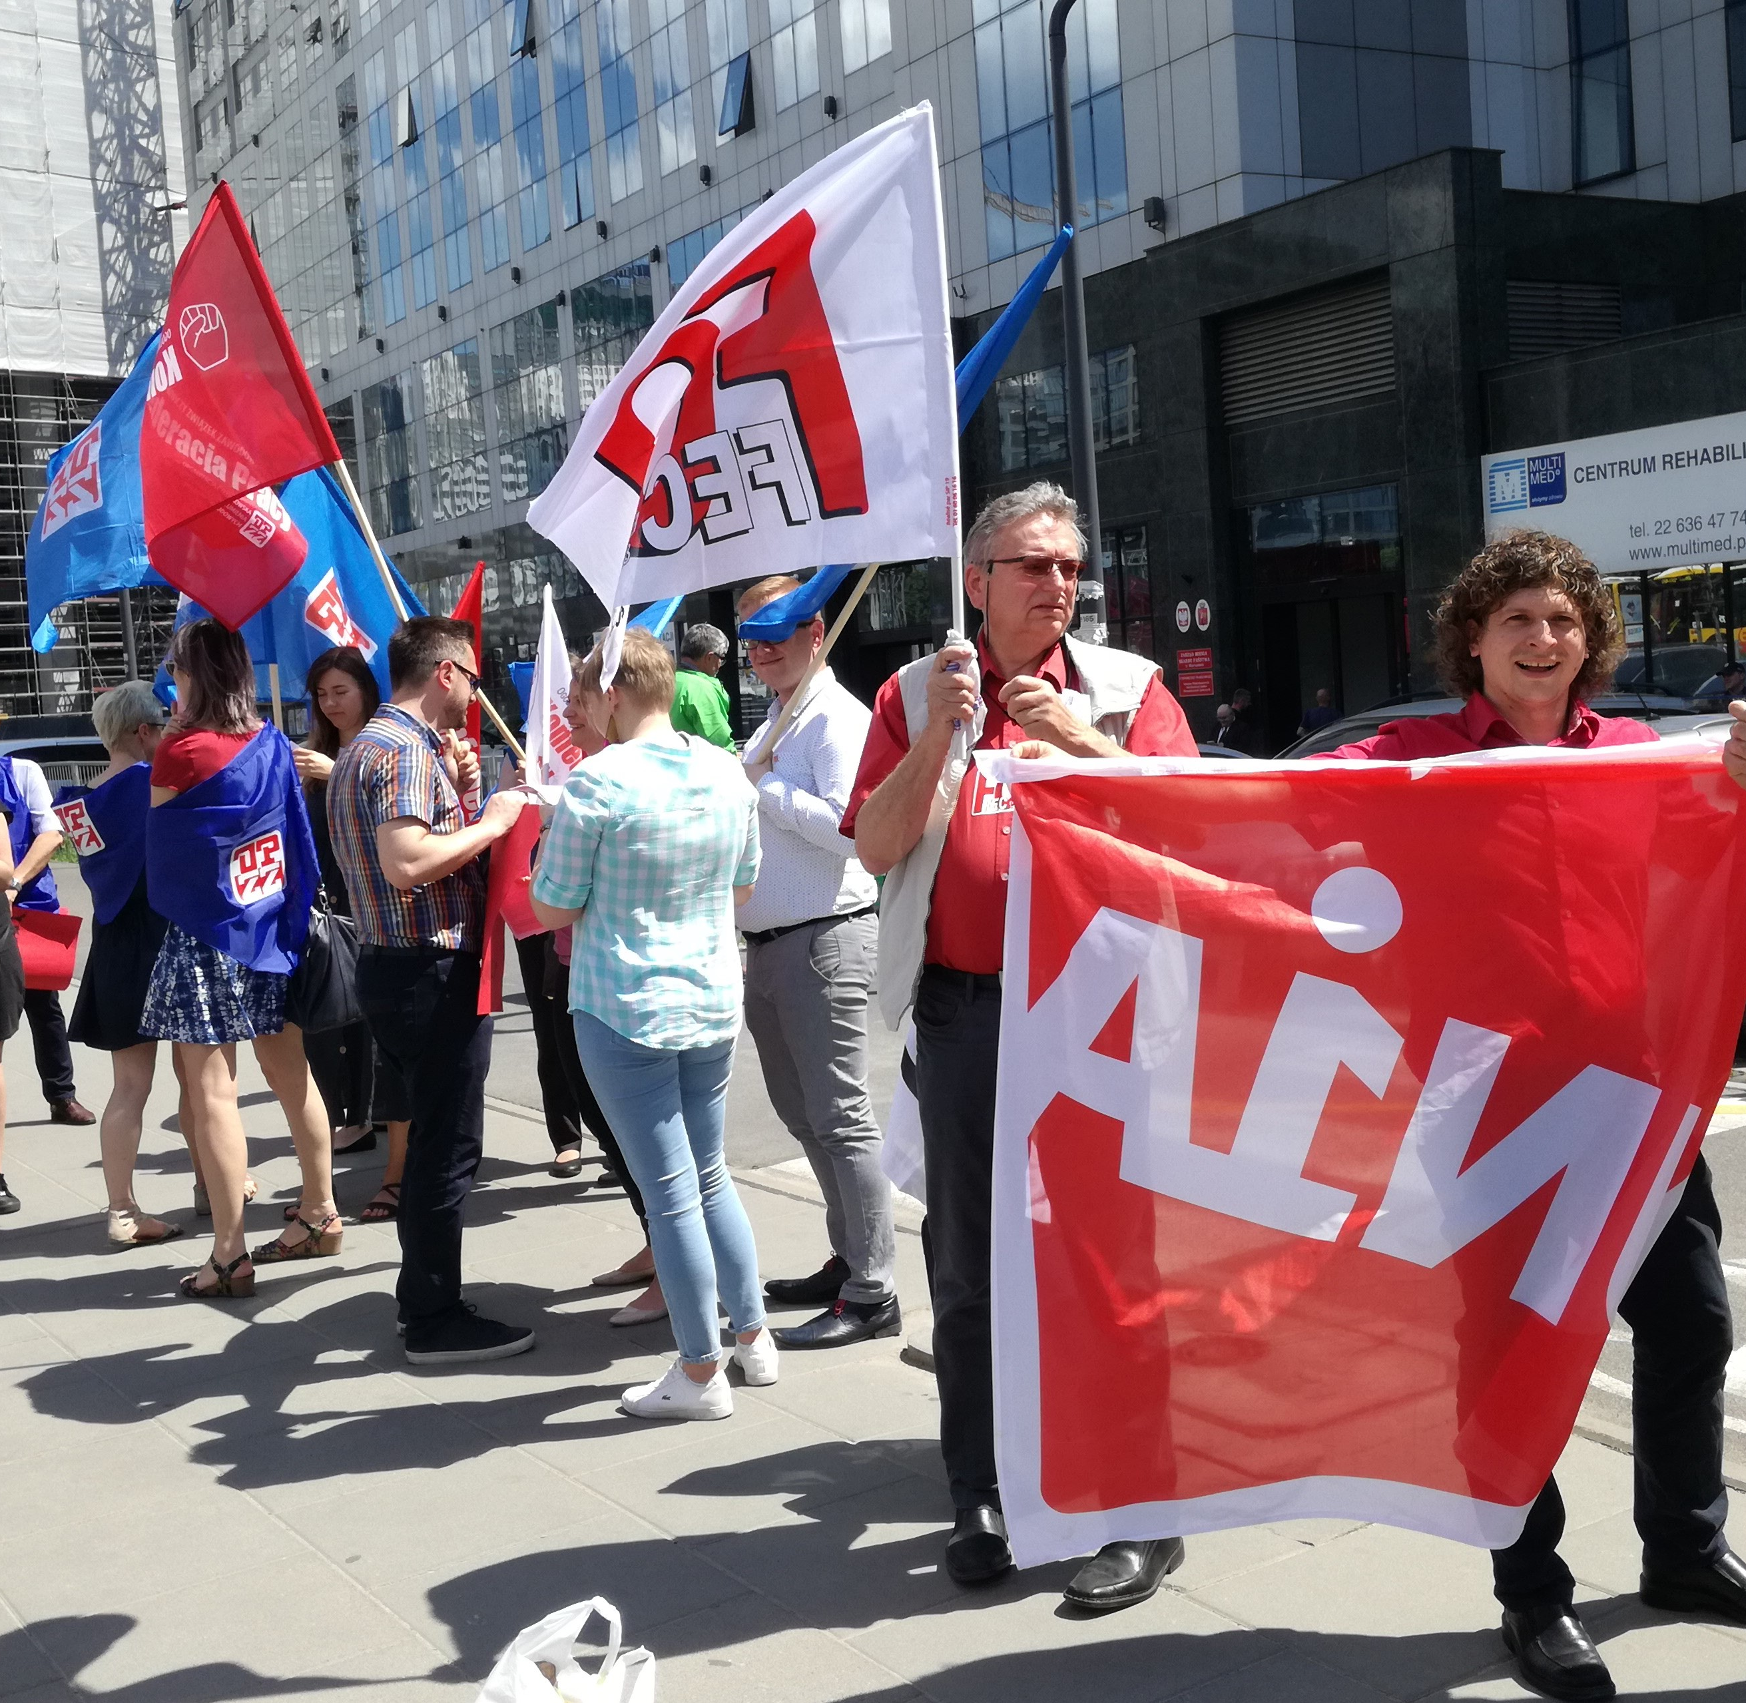
How did we fight back in Orpea?
International support
Union power and solidarity
Petition run by patients and their families
Protests in front of Orpea headquarters and nursing homes
Wins in labour court

Slide 6
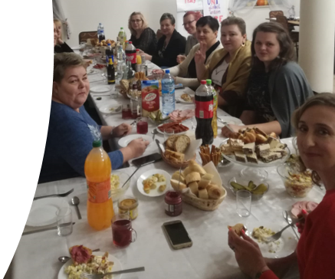

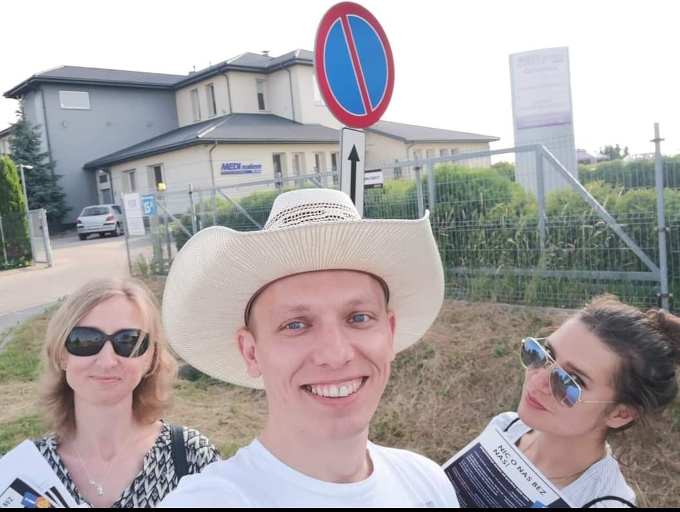
TWO YEARS IN COURT = TWO YEARS OF "UNDERGROUND" UNION
30-40 union members (rotating)
No union actions (formal)
A few workers' actions (collective)

Slide 7

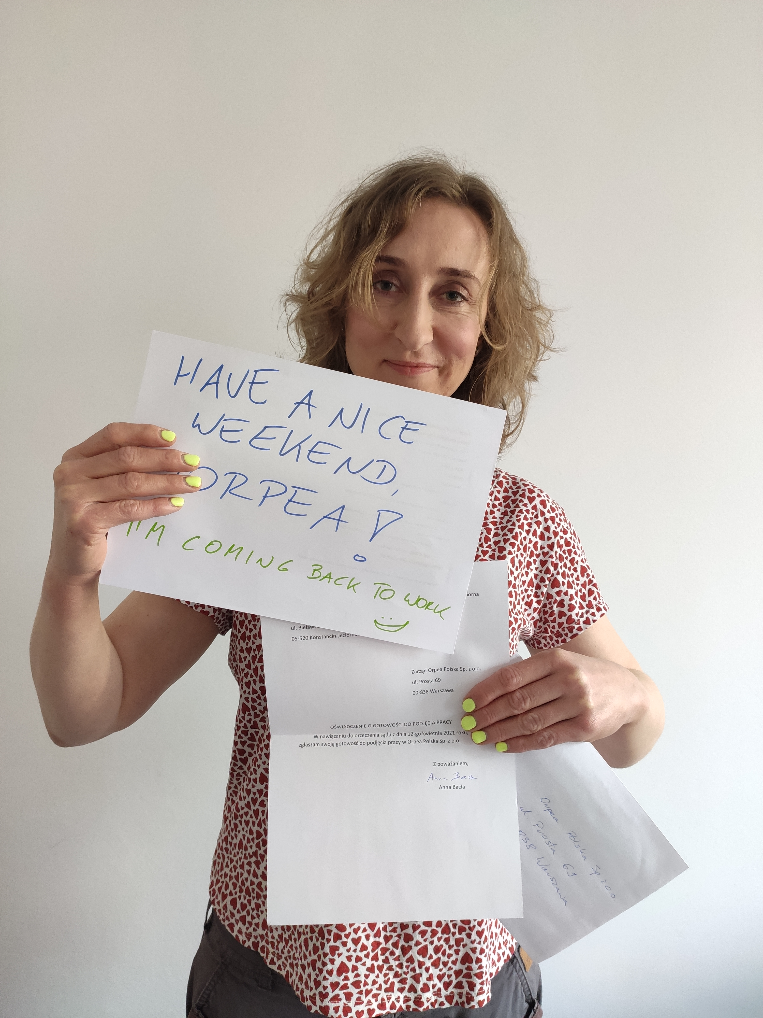
April 2021 Union representative came back to work (by court judgement)

Slide 8
UNION GROWS IN POWER & NUMBERS:
END OF 2021
BEGINNING OF 2022
AGREEMENT OF COOPERATION BETWEEN UNION AND ORPEA​​
END OF 2022
168 MEMBERS! = FULL-TIME UNION HOURS FOR THE UNION BOARD​
END OF 2025
304 UNION MEMBERS​
51 UNION MEMBERS​
BEGINNING OF 2025
COLLECTIVE DISPUTE HAS STARTED

Slide 9
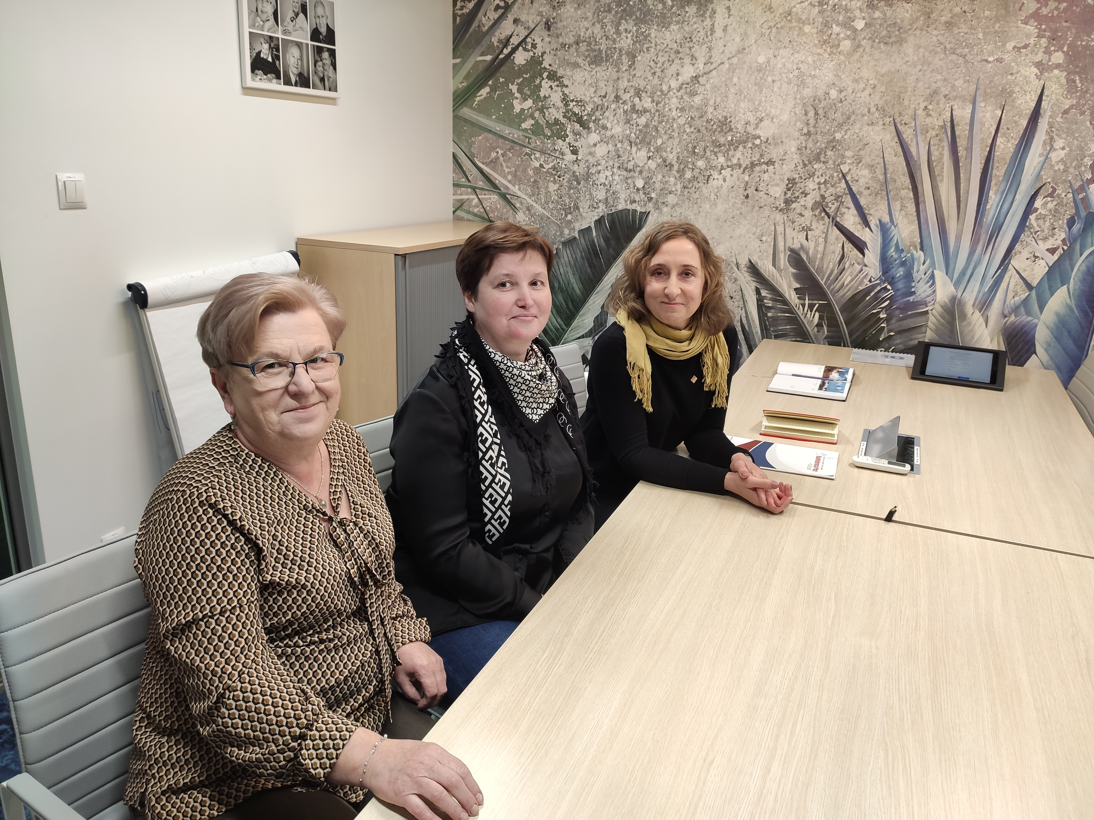
FEBRUARY 2022
AGREEMENT OF COOPERATION
OPEN NEGOTIATIONS WITH ORPEA
UNION VISITS – 1x / MONTH / EVERY FACILITY
FIRST COLLECTIVE ACTIONS:
SURVEY (200 surveys)
PETITION (500 signatures)
PHOTOS WITH DEMANDS (30 photos)

Slide 10
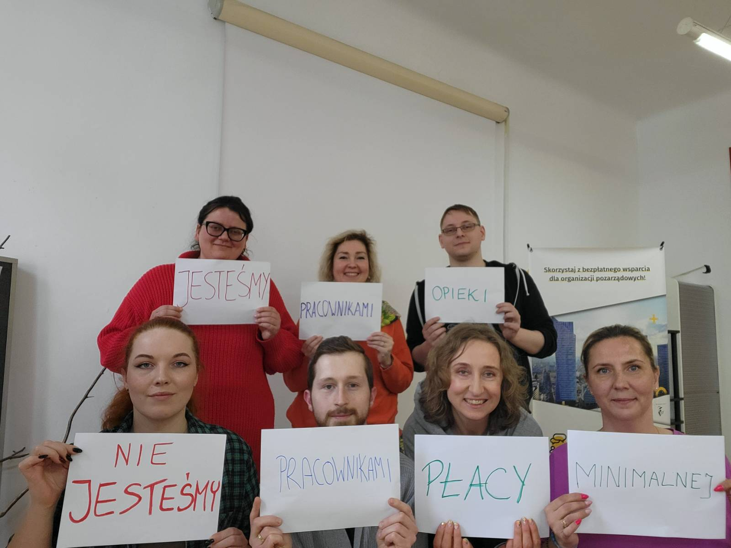
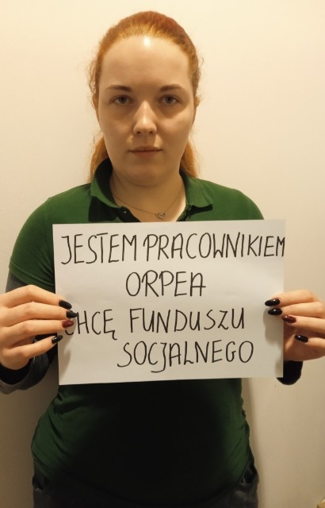
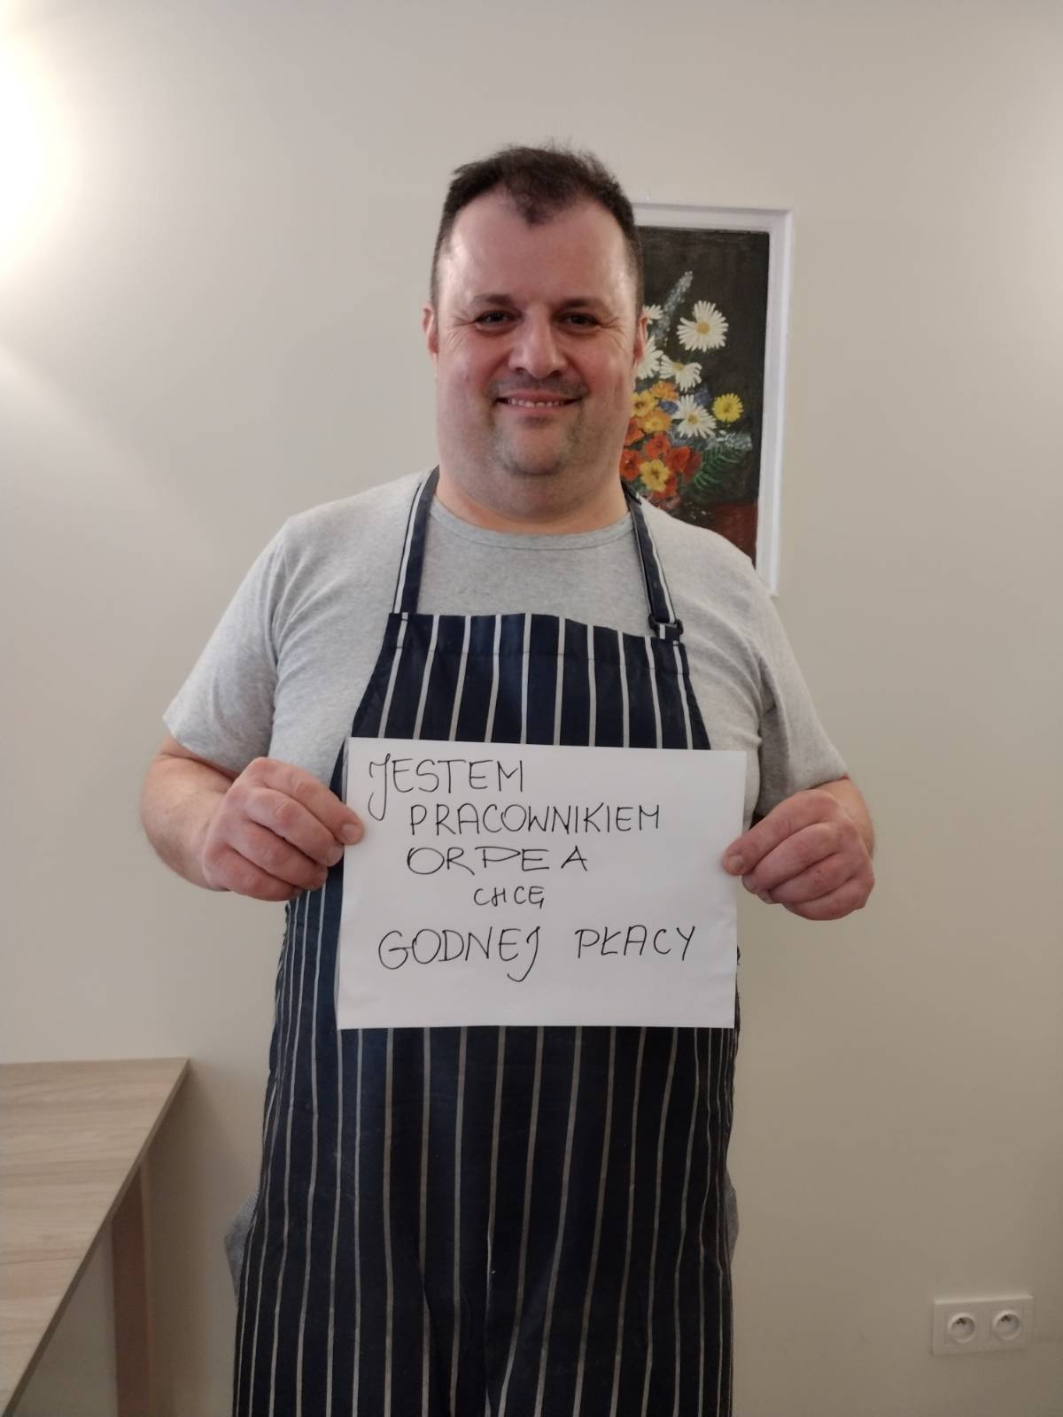
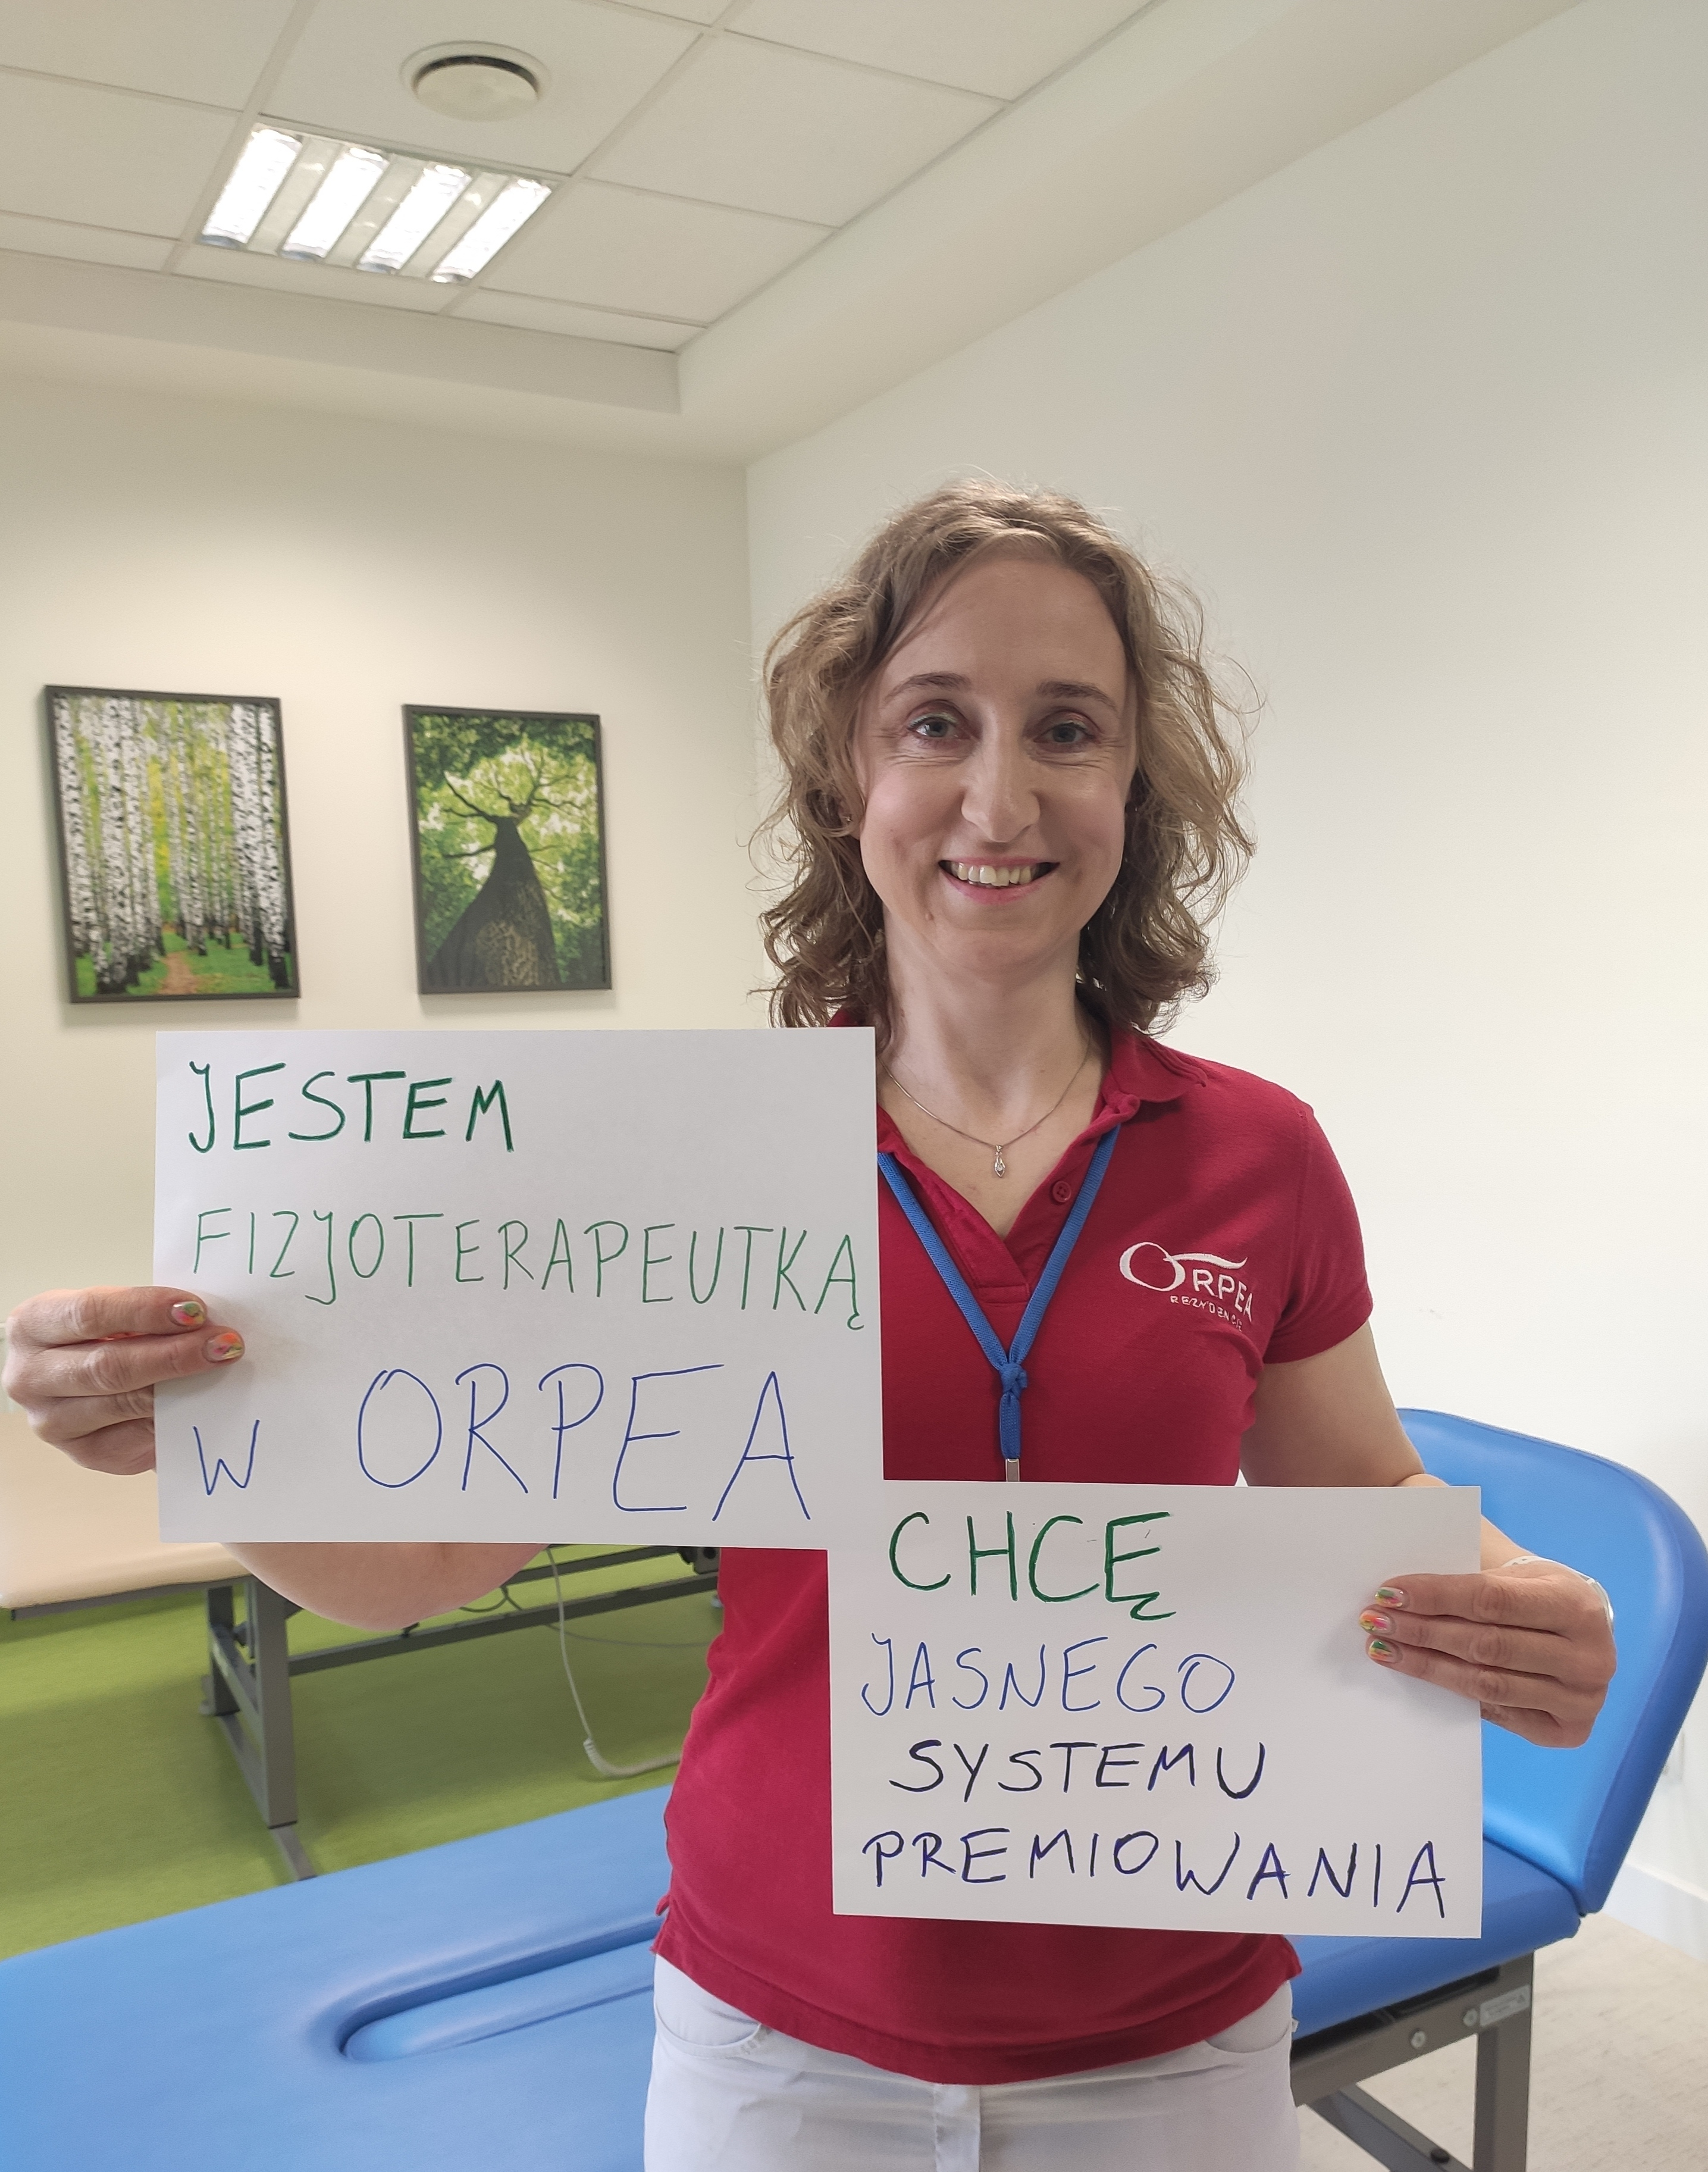
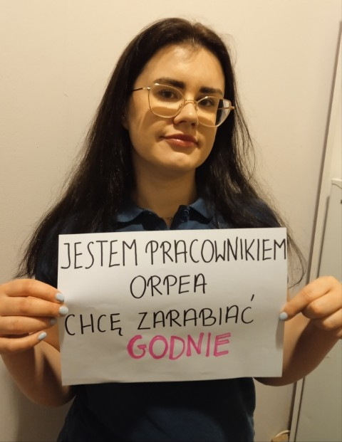
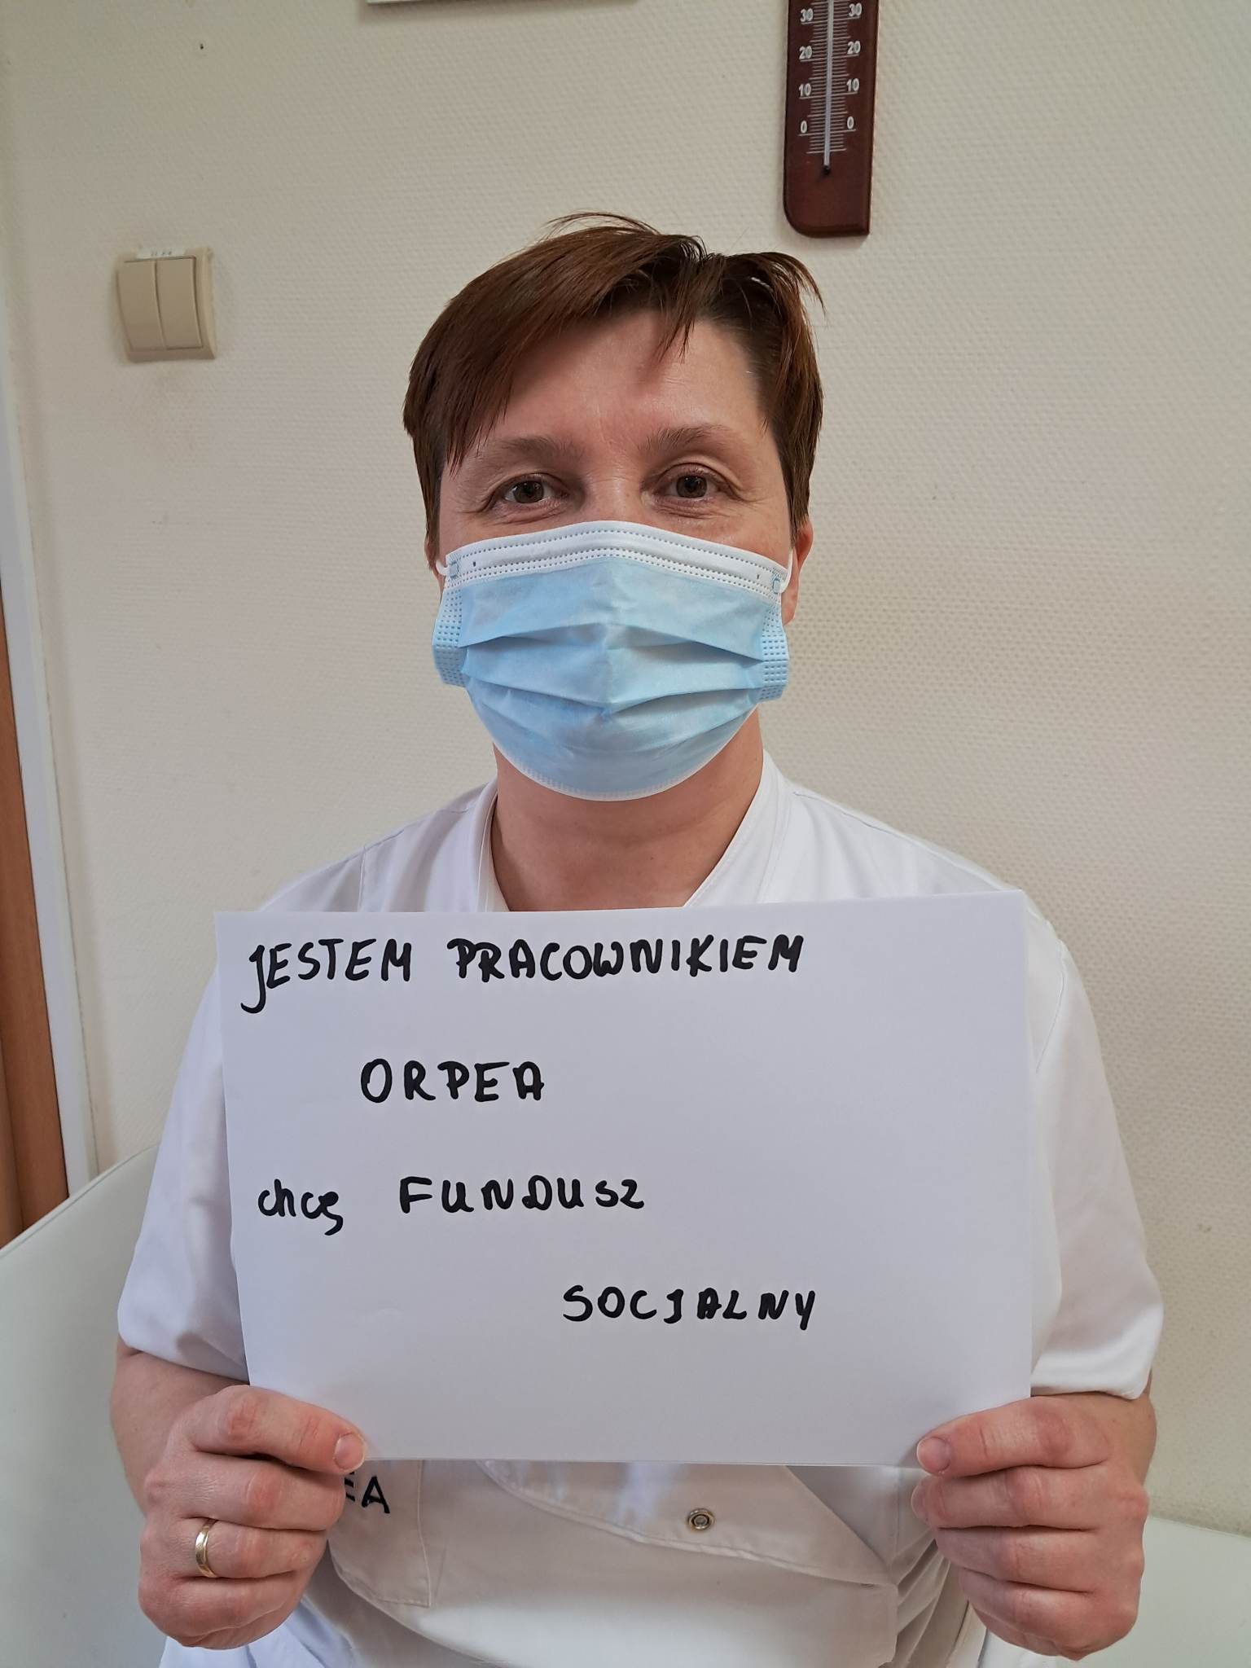
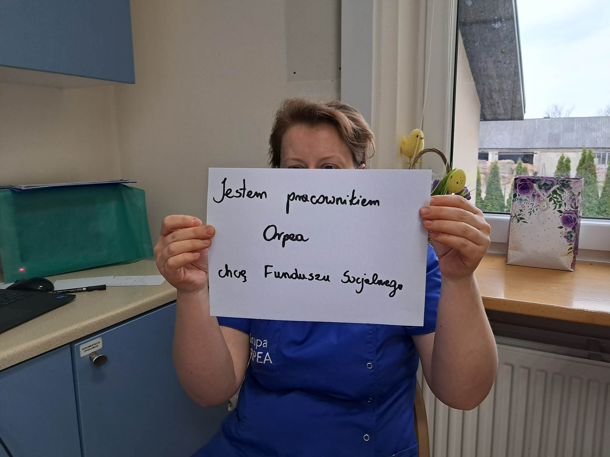
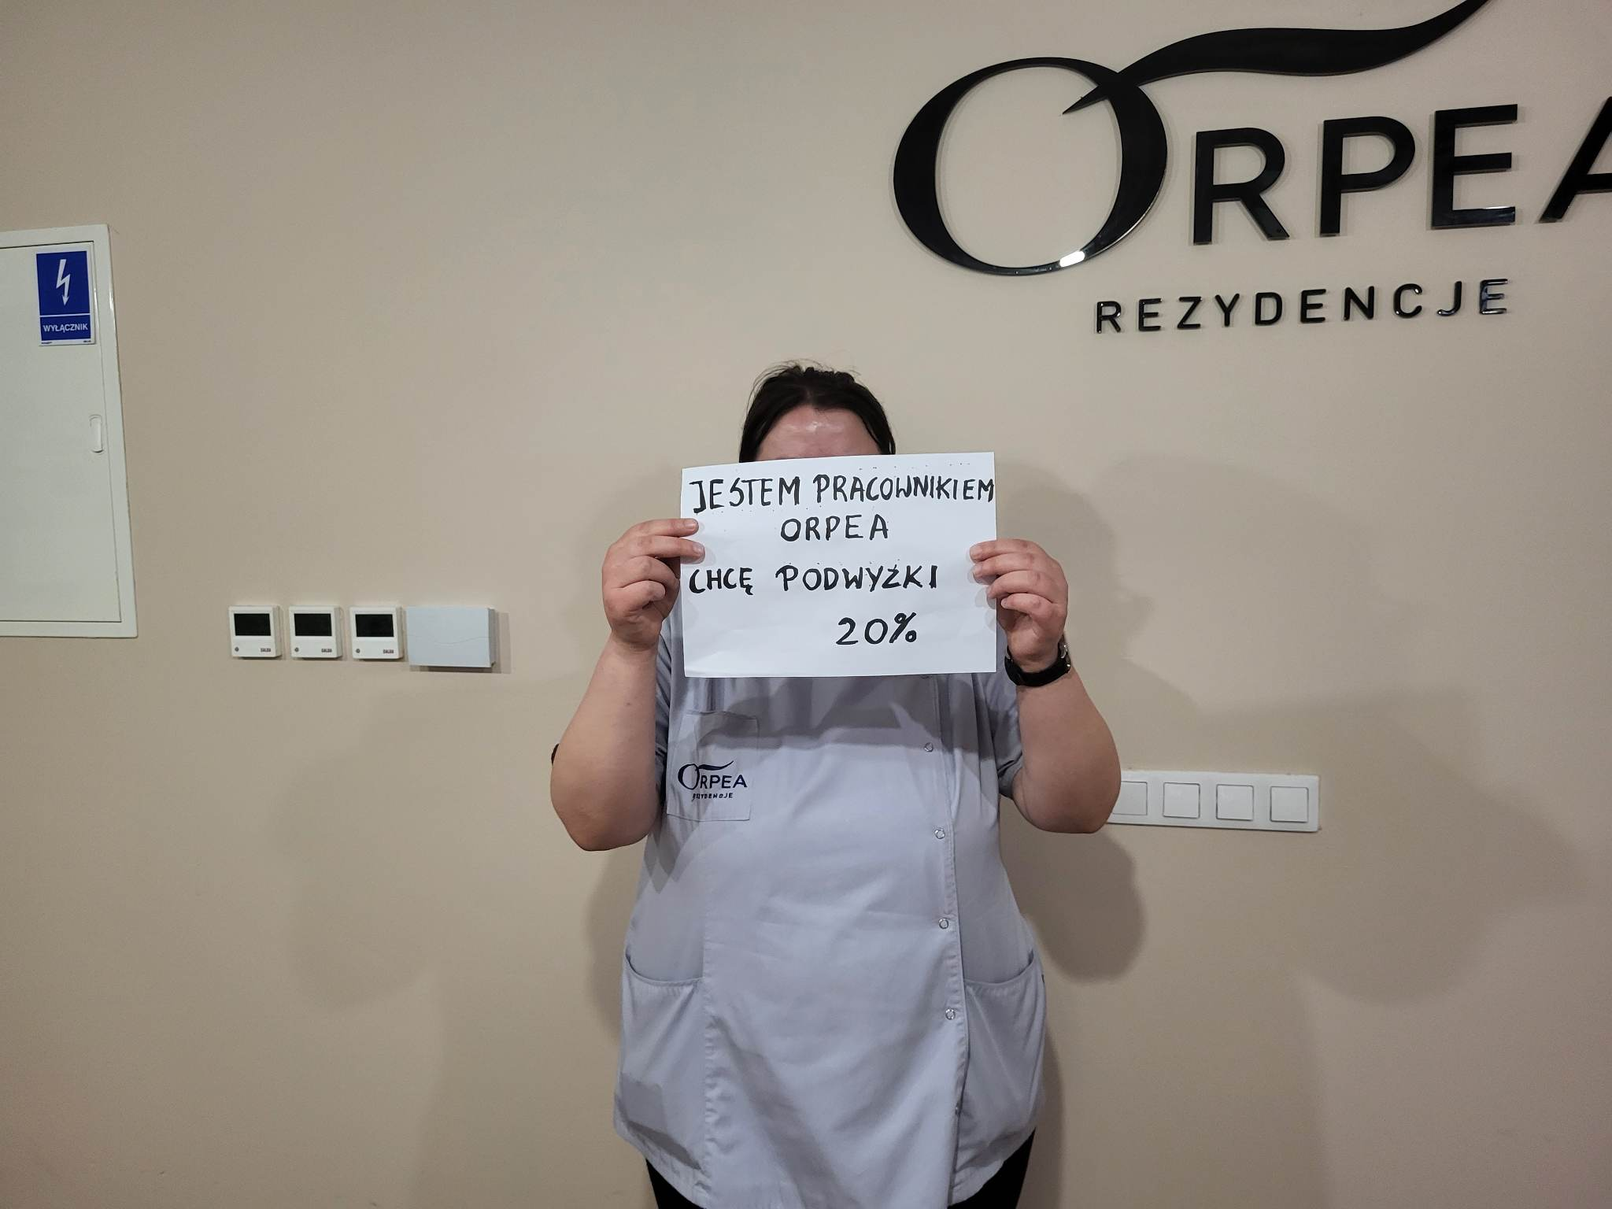

Slide 11
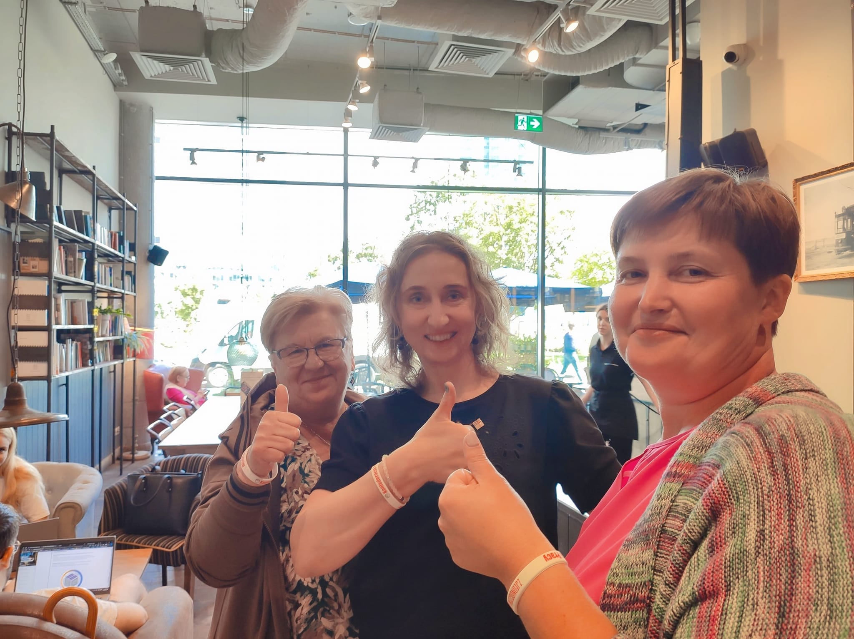
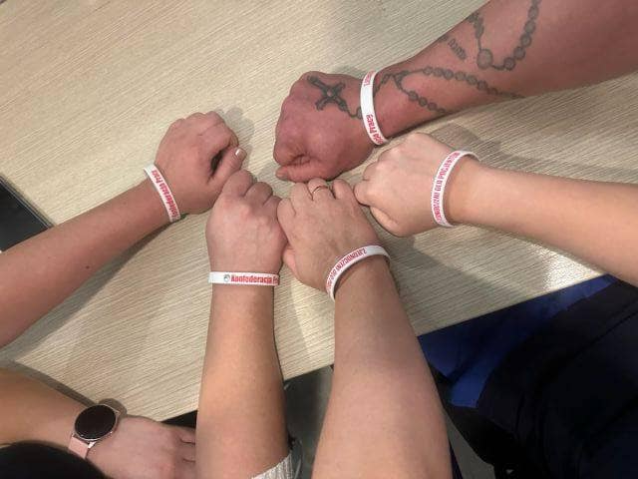
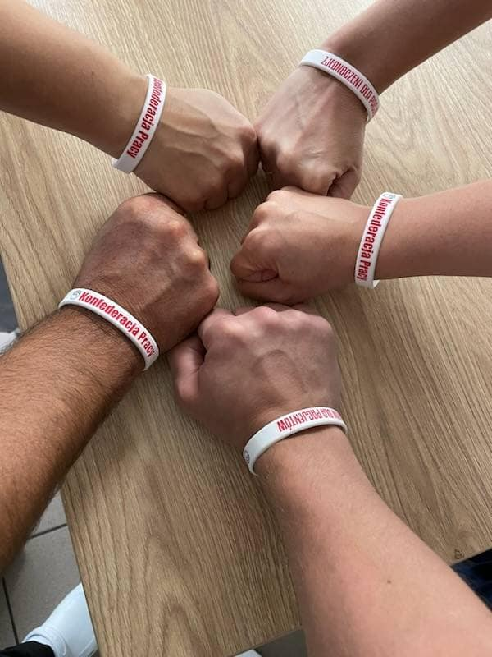
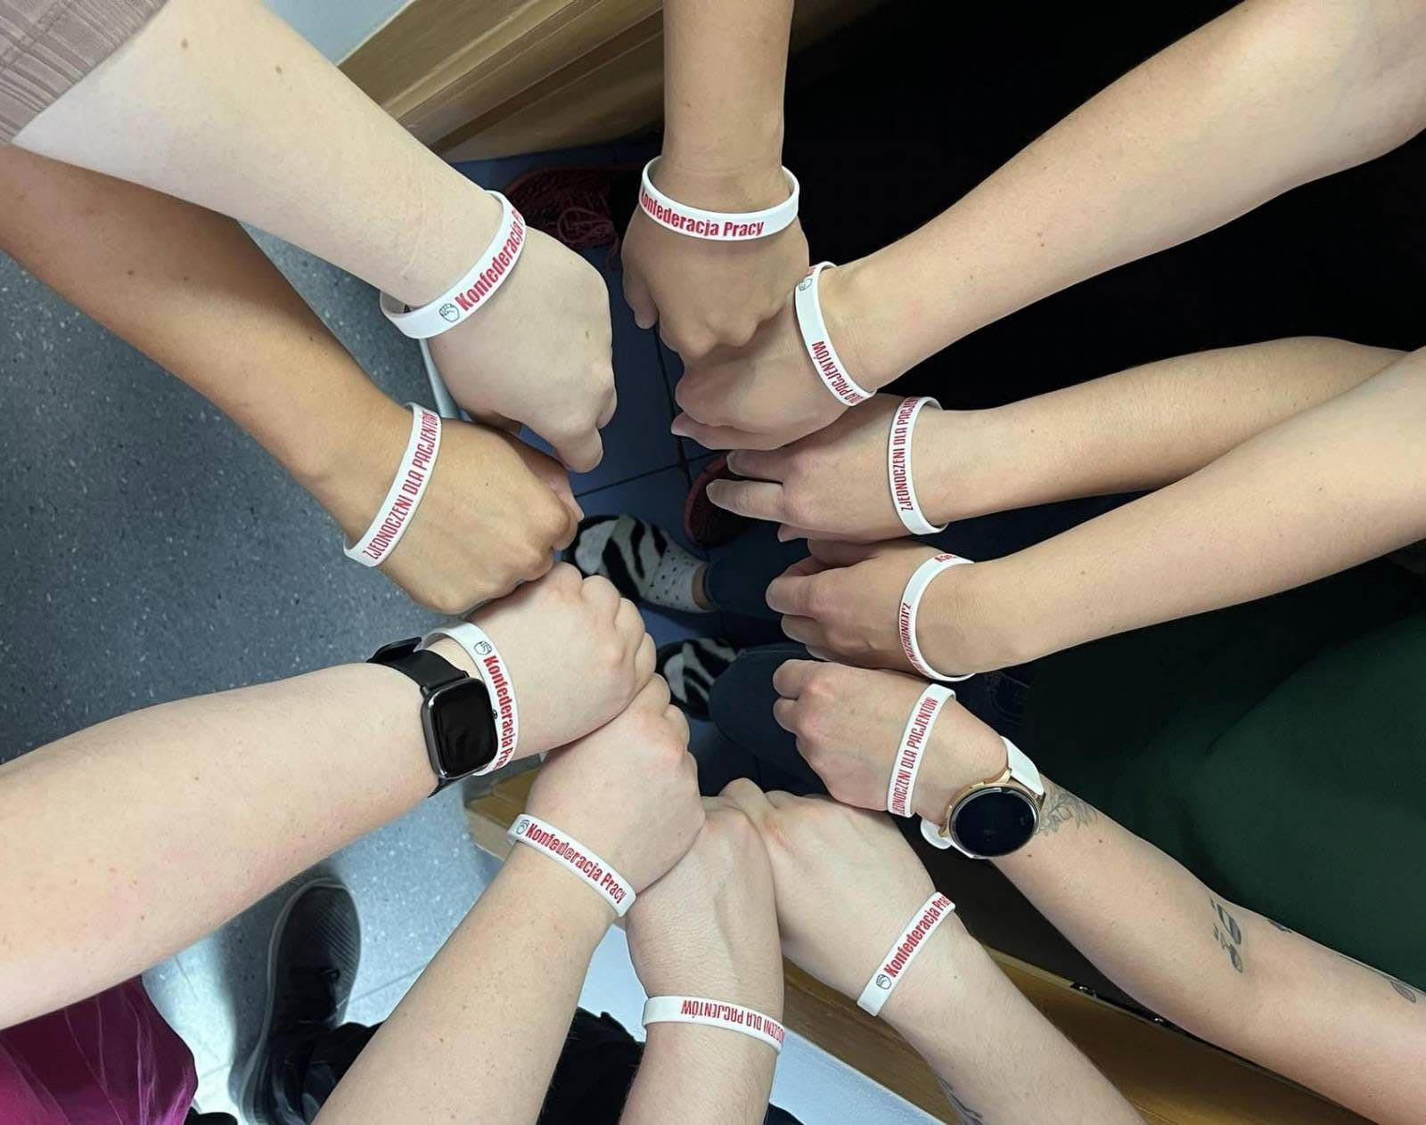
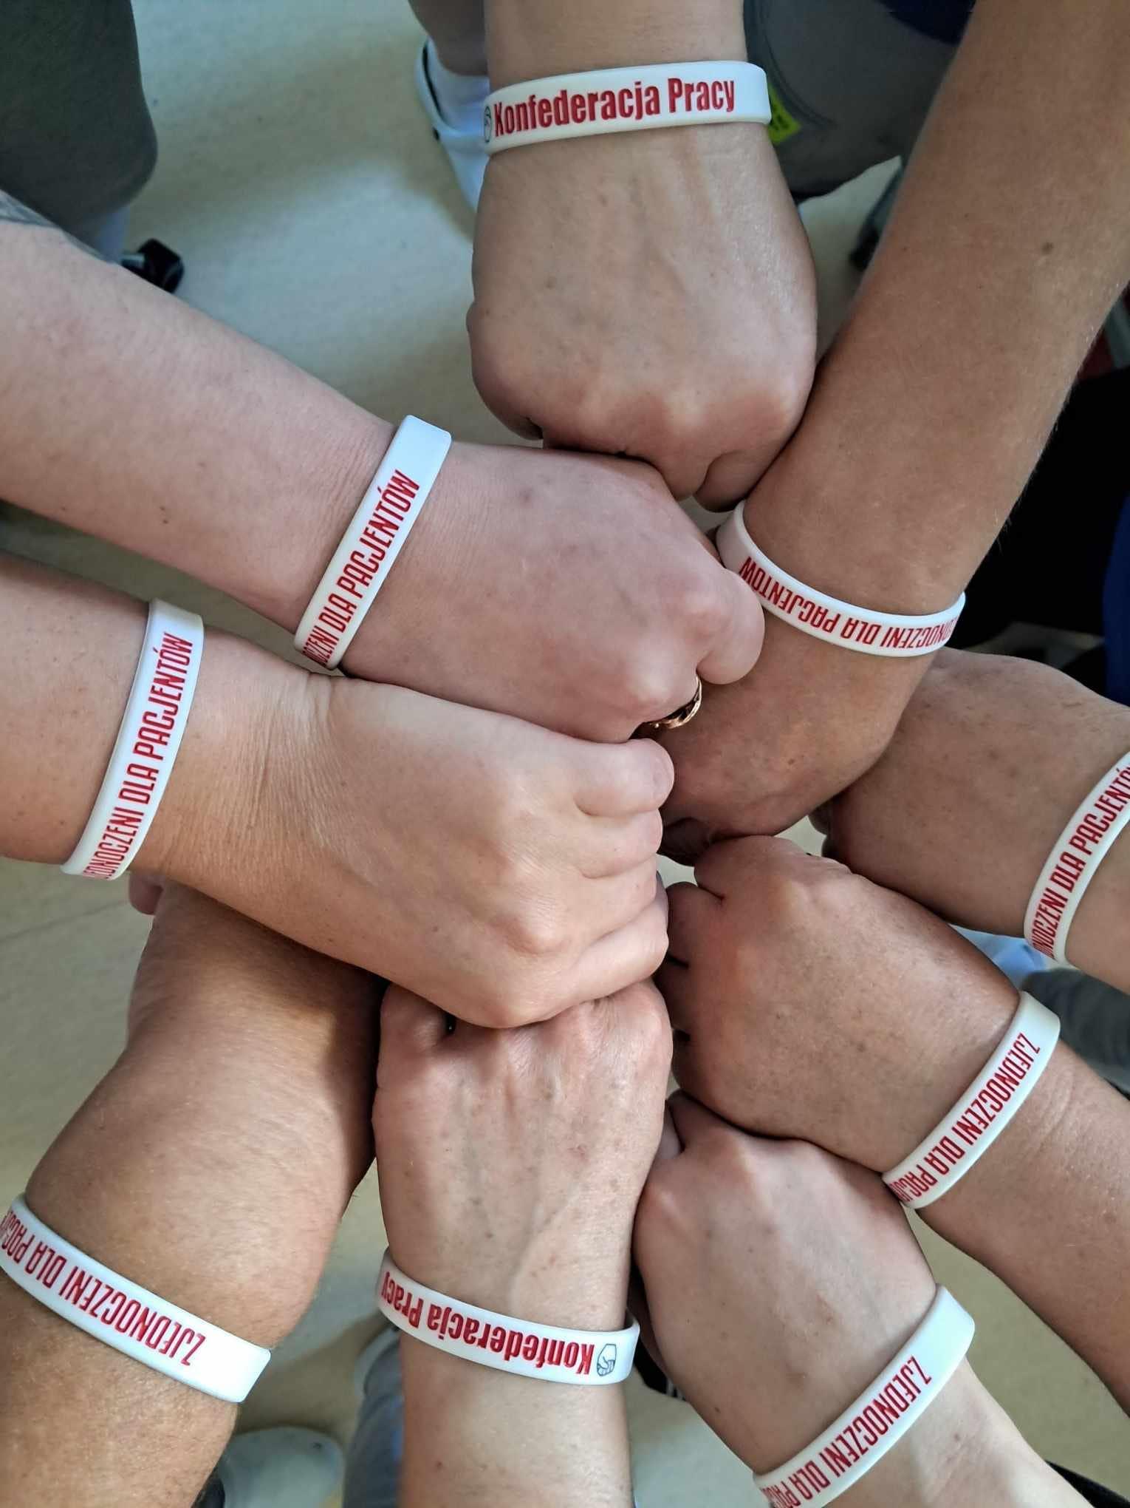
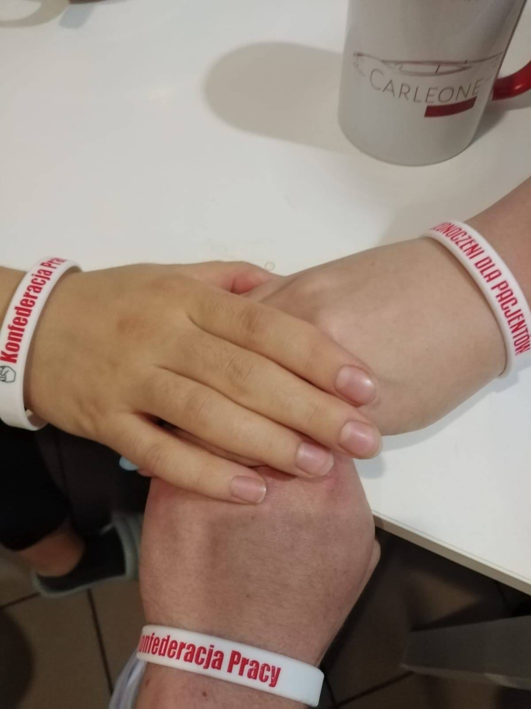
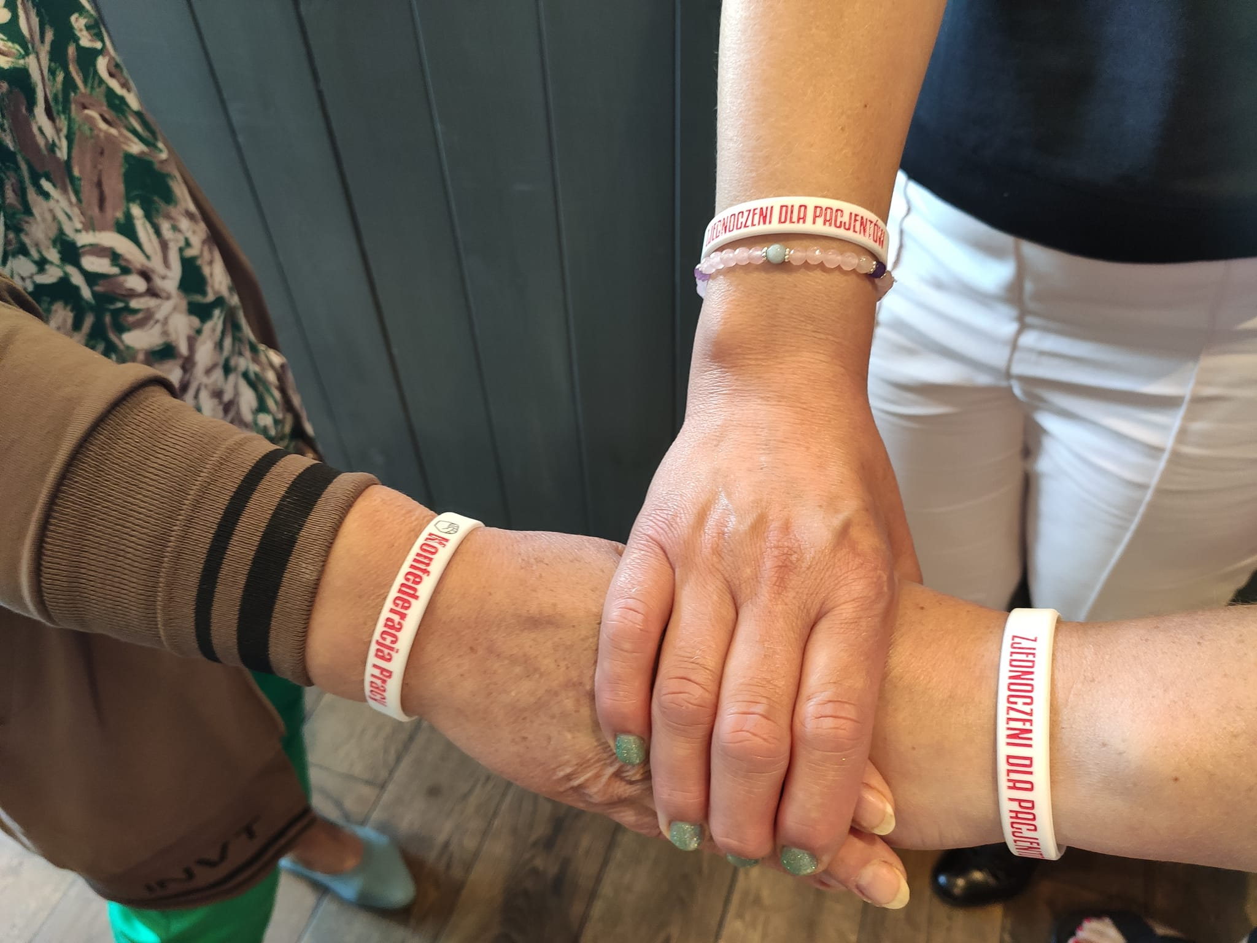
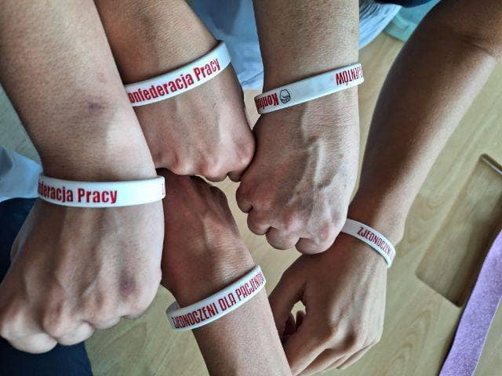
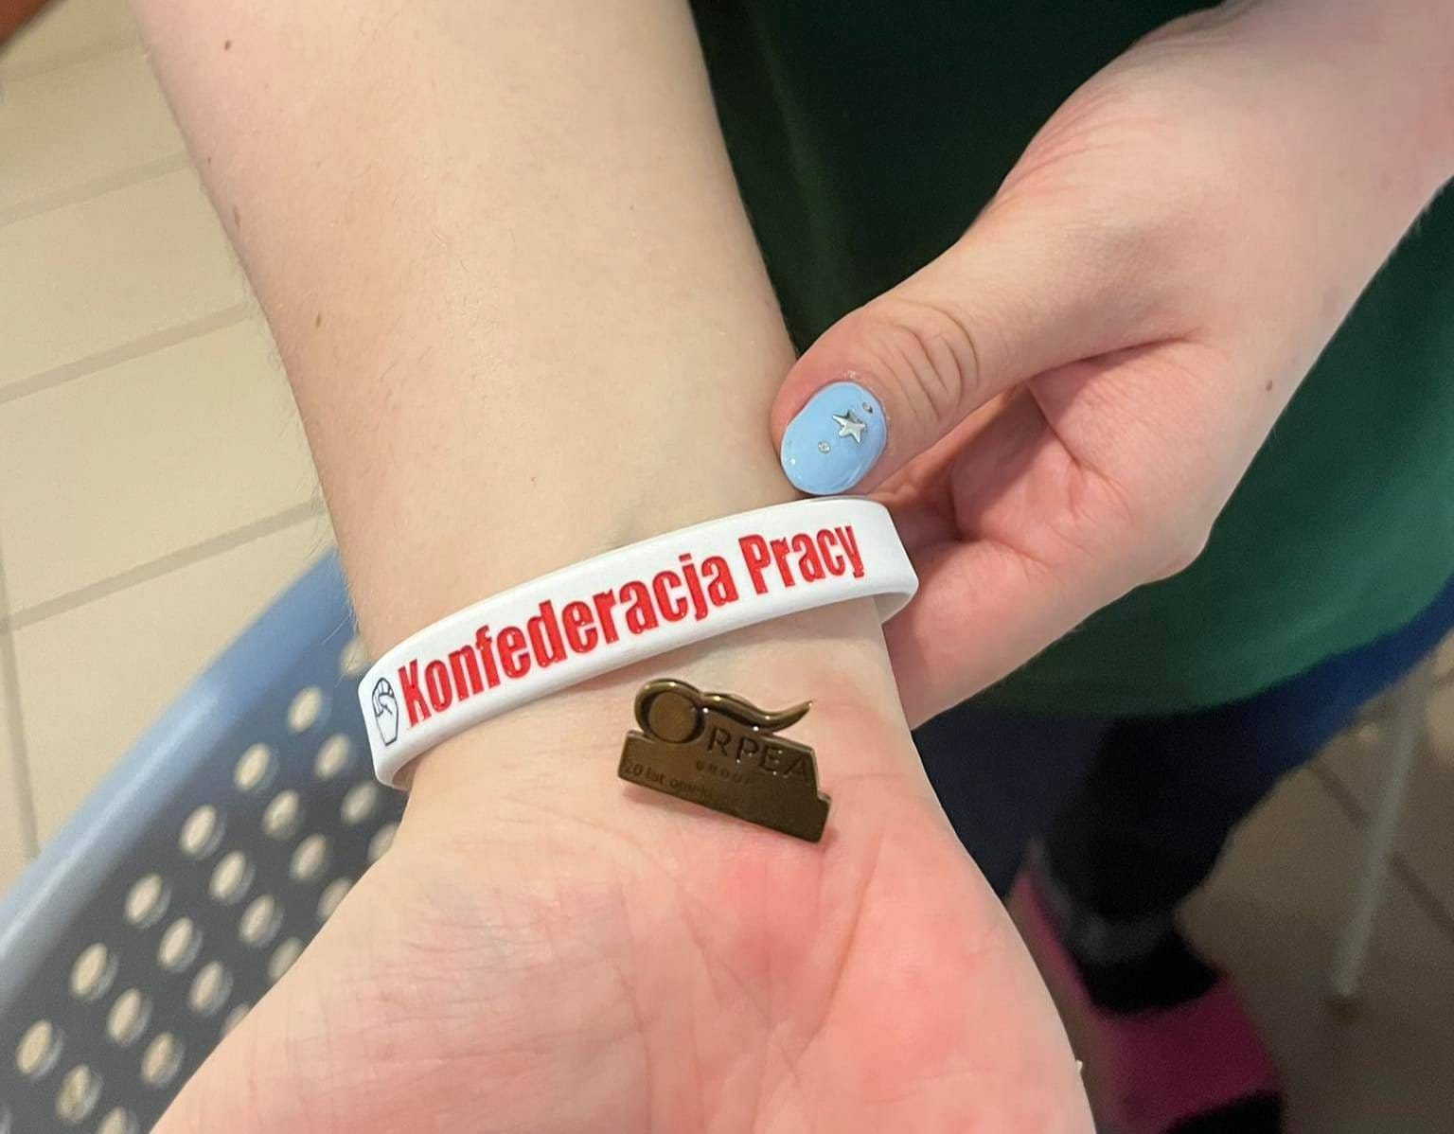

Slide 12
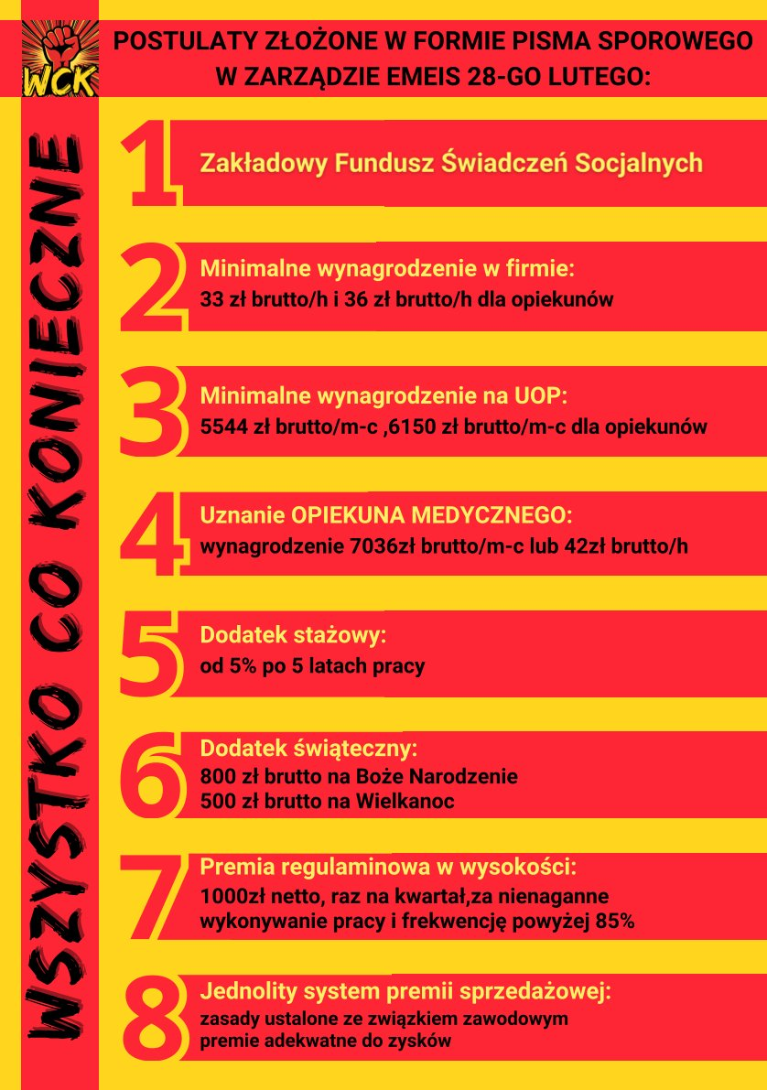
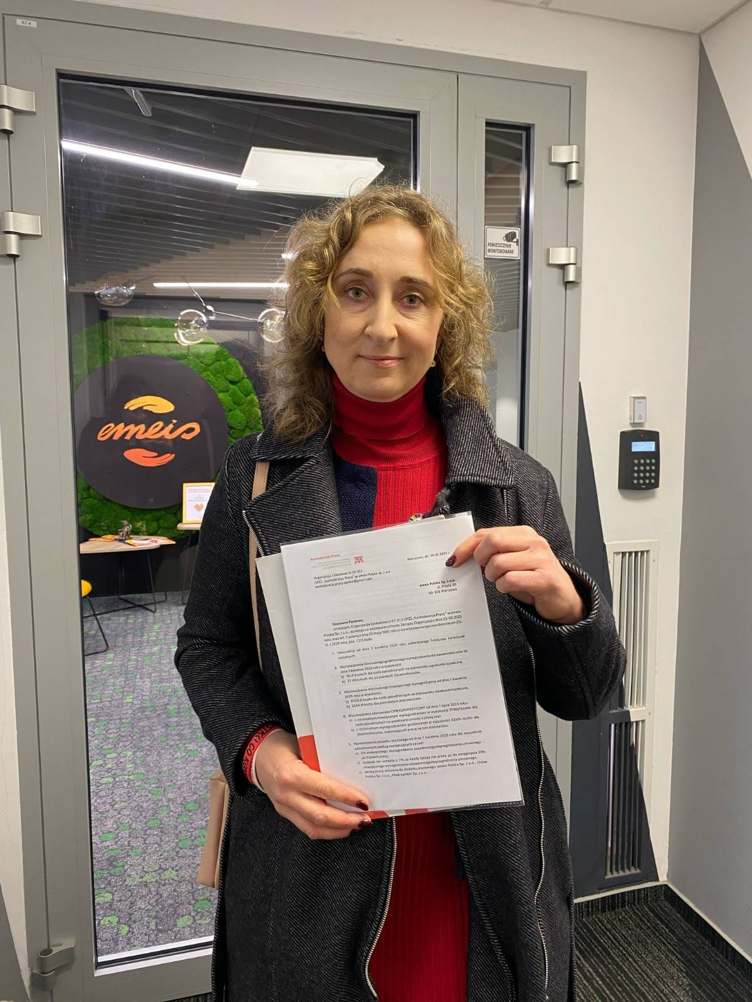
MARCH 2025 COLLECTIVE DISPUTE
1. SOCIAL FUND
2-3. PAY RISE FOR NON-MEDICAL STAFF
4. APPROVAL OF MEDICAL CAREGIVER
5. SENIORITY BONUS
6. CHRISTMAS&EASTER BONUSES
7. REGULATORY BONUS
8. SALES BONUS

Slide 13
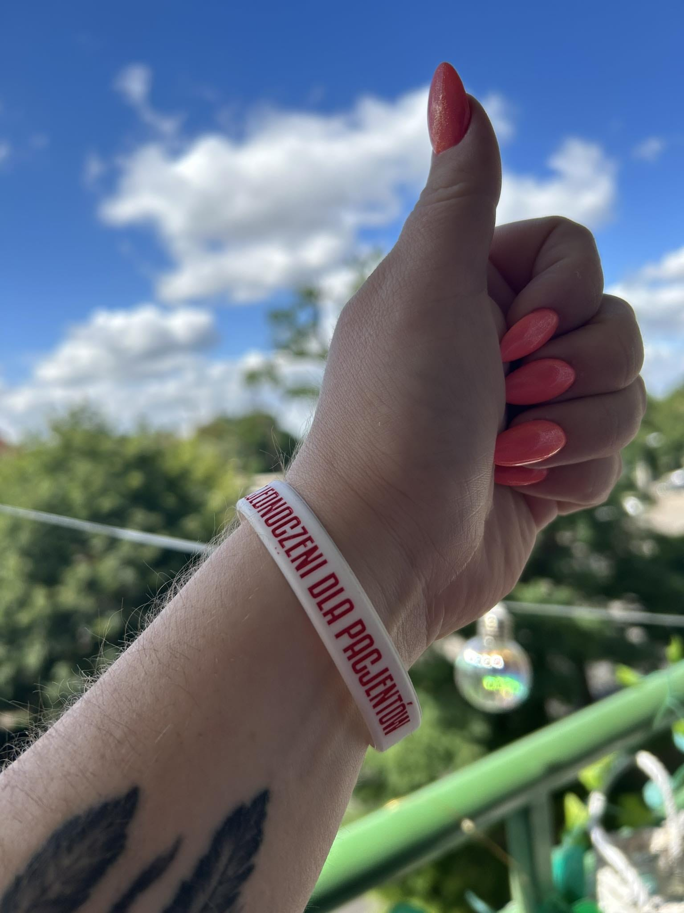
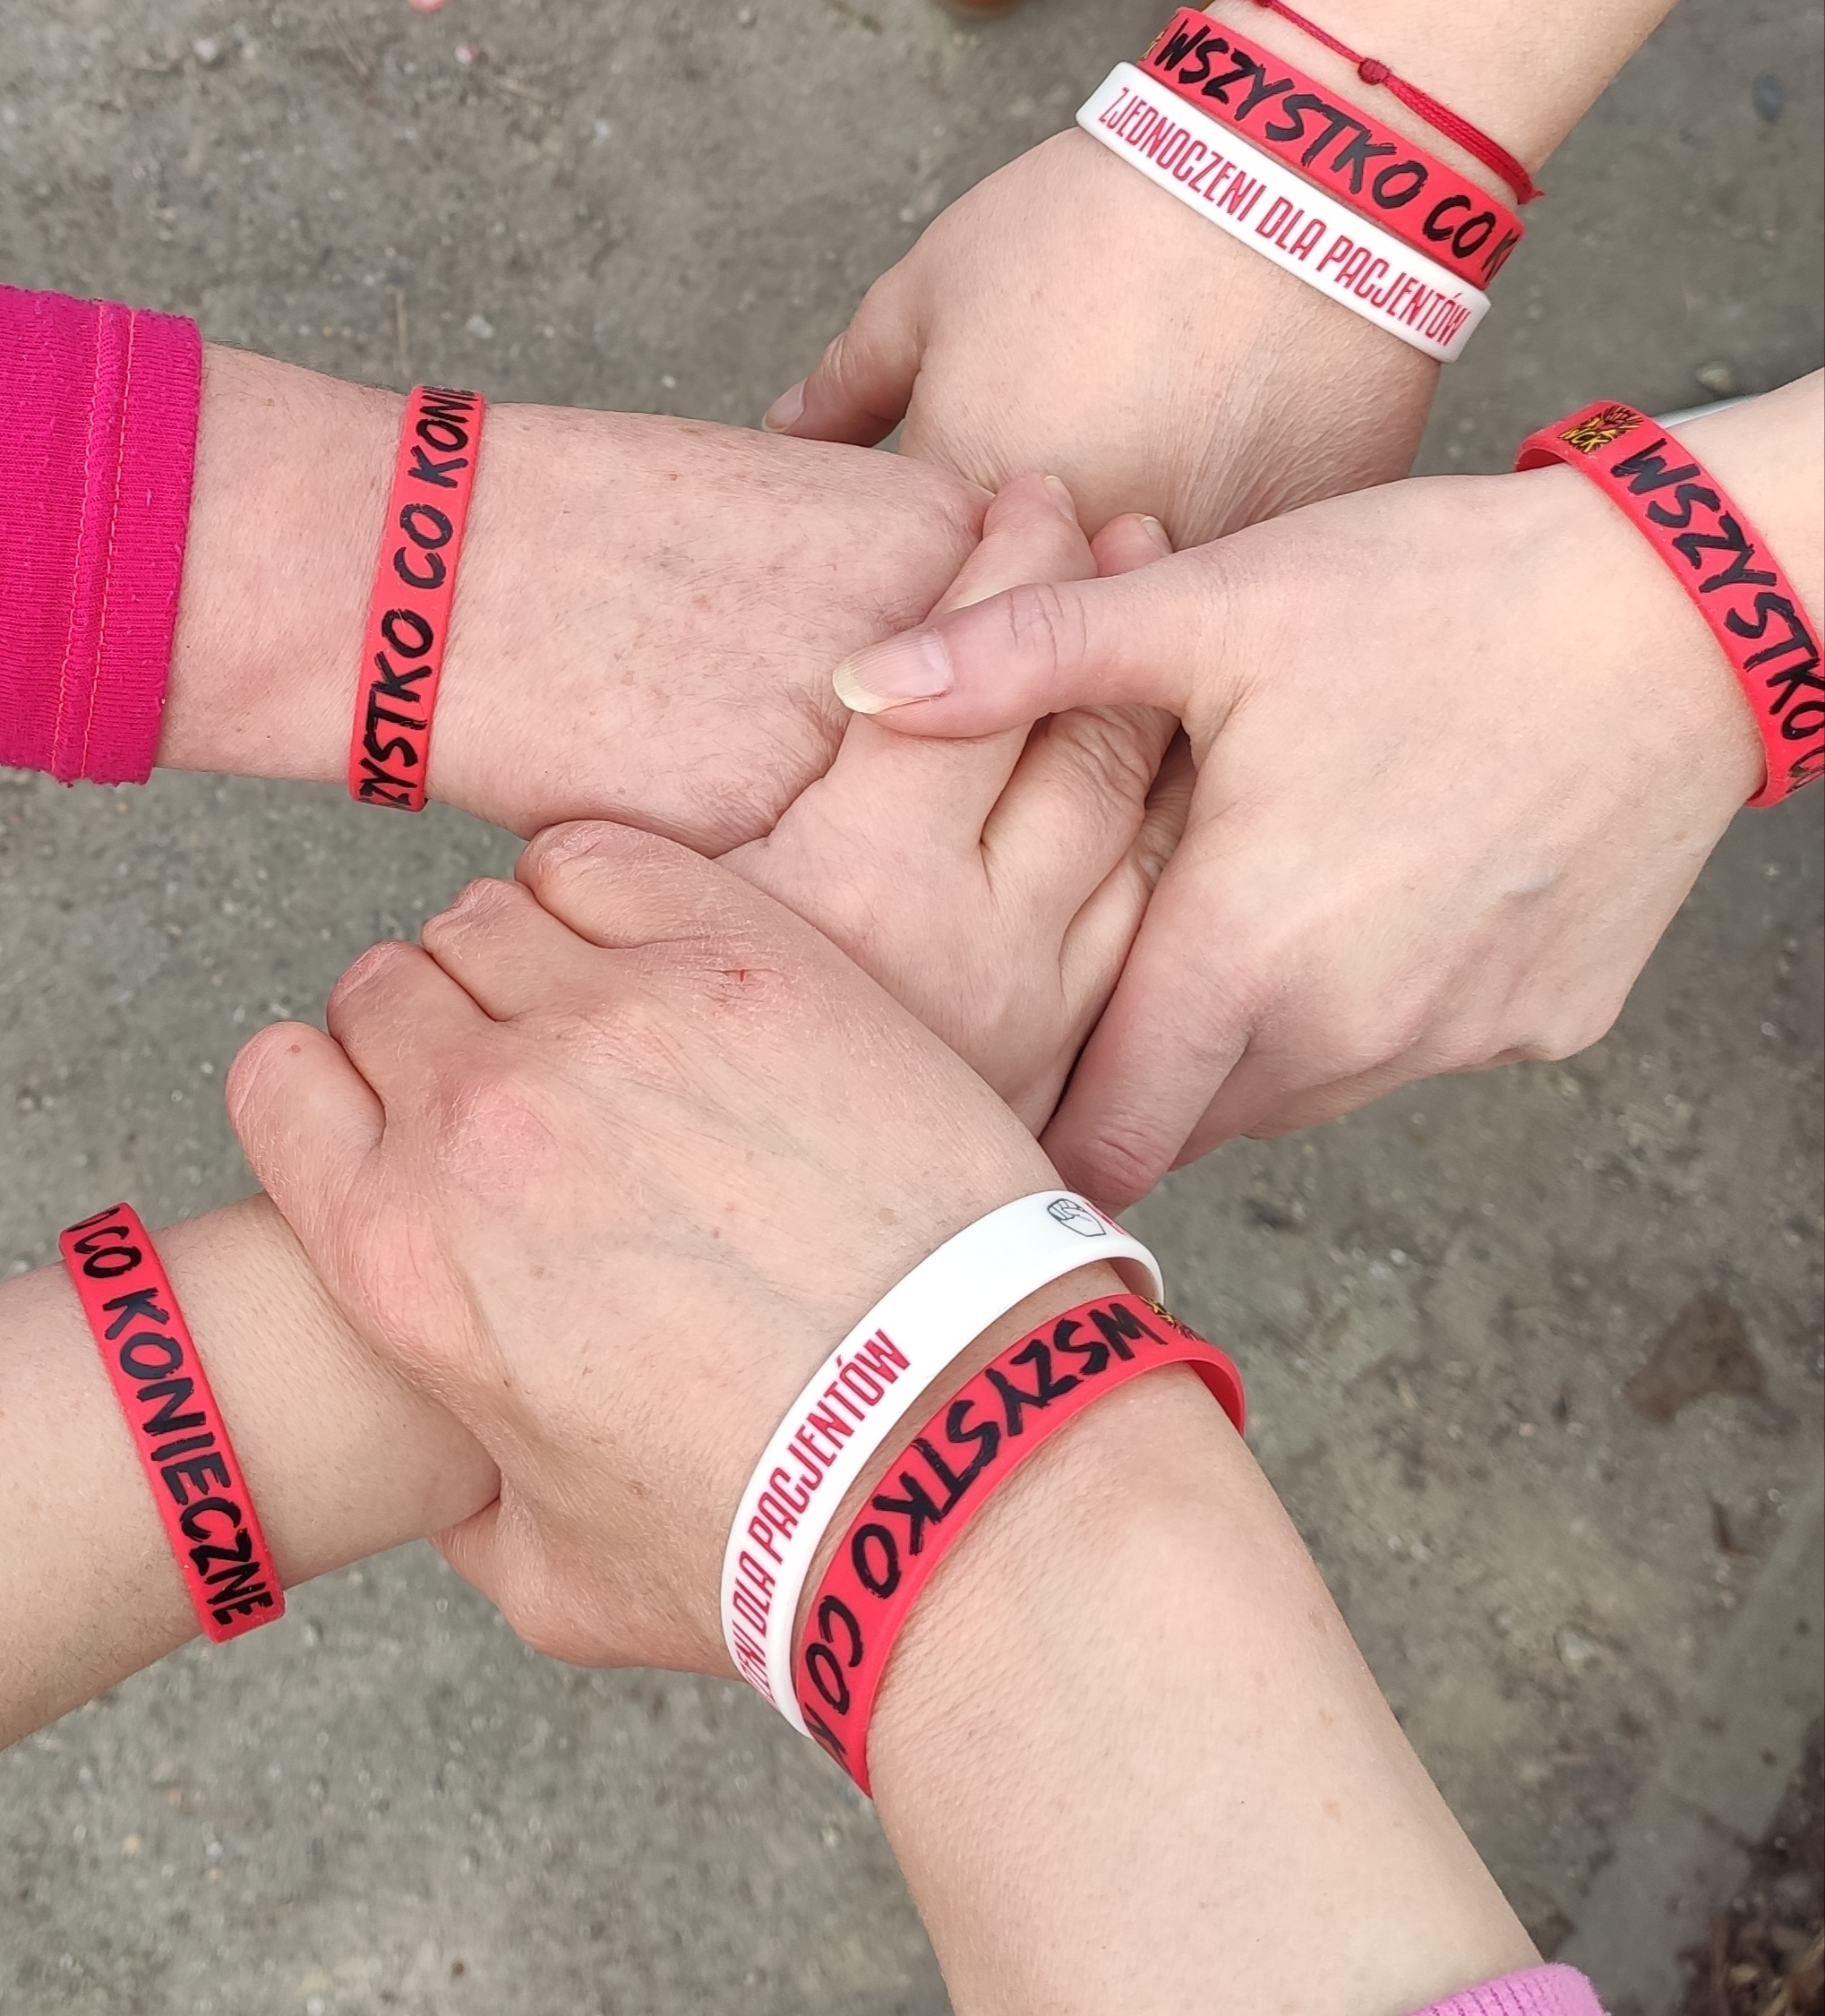
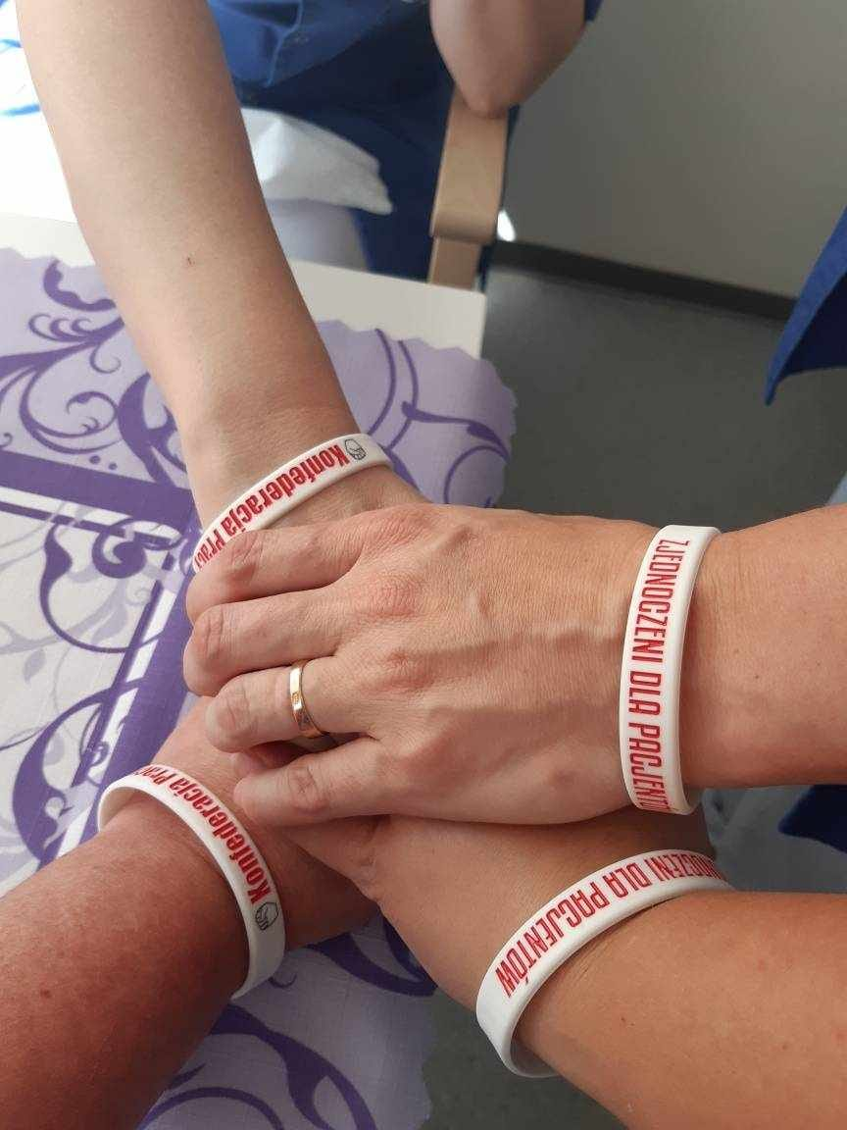
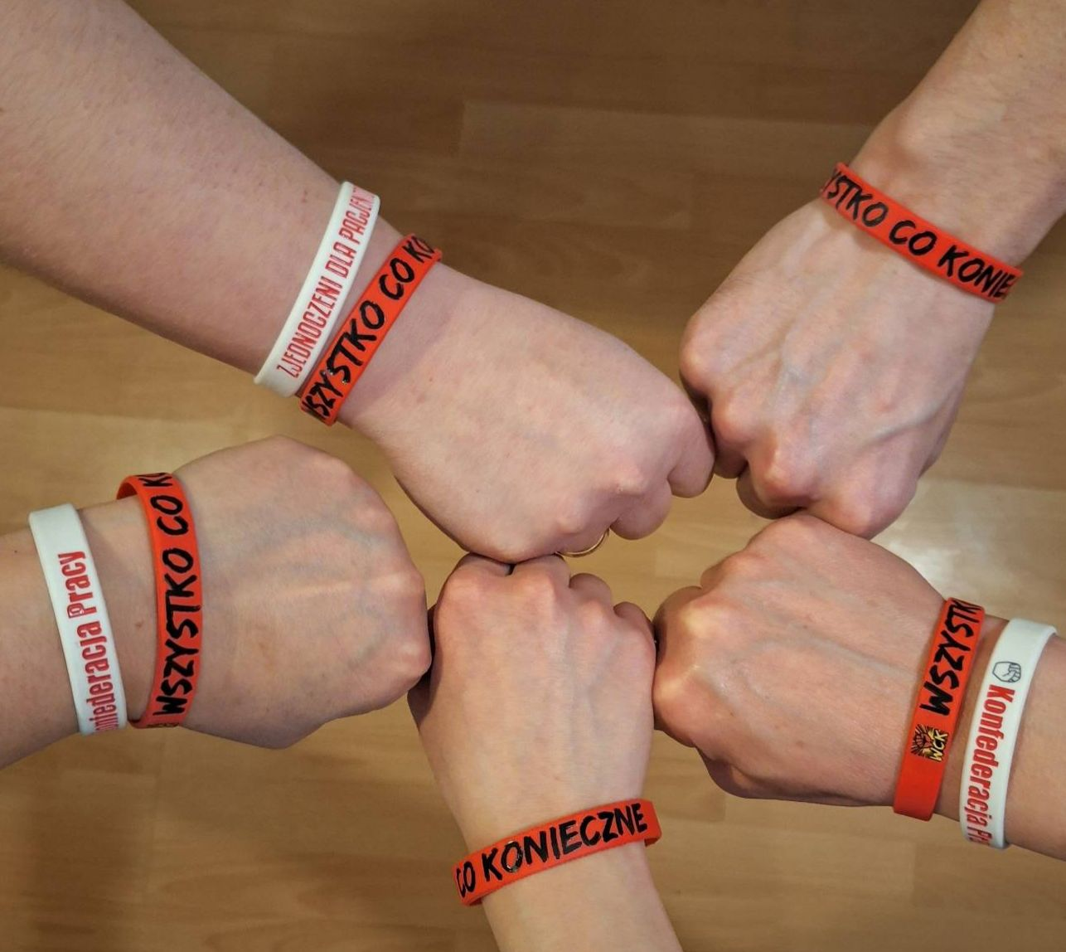
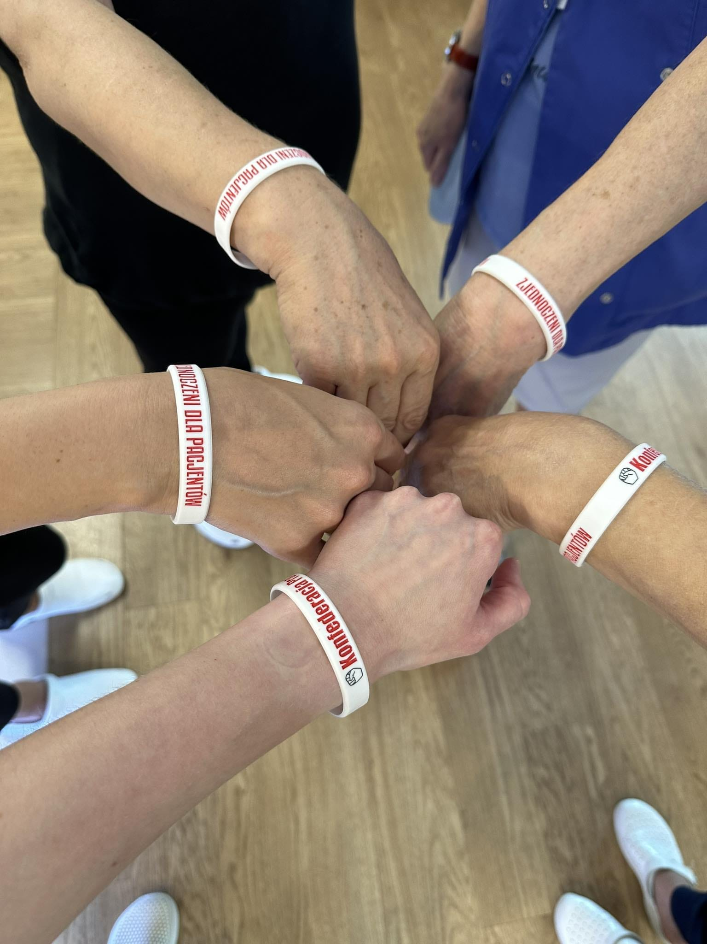
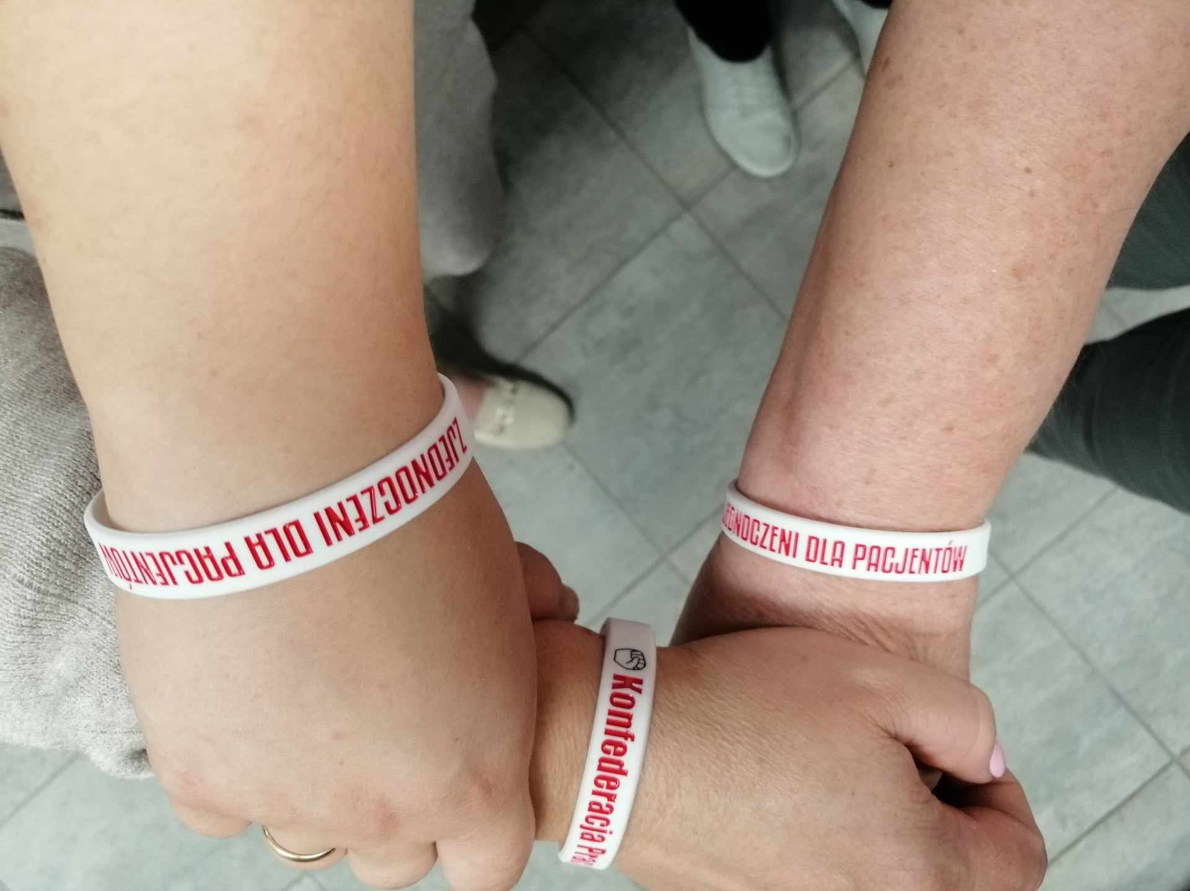
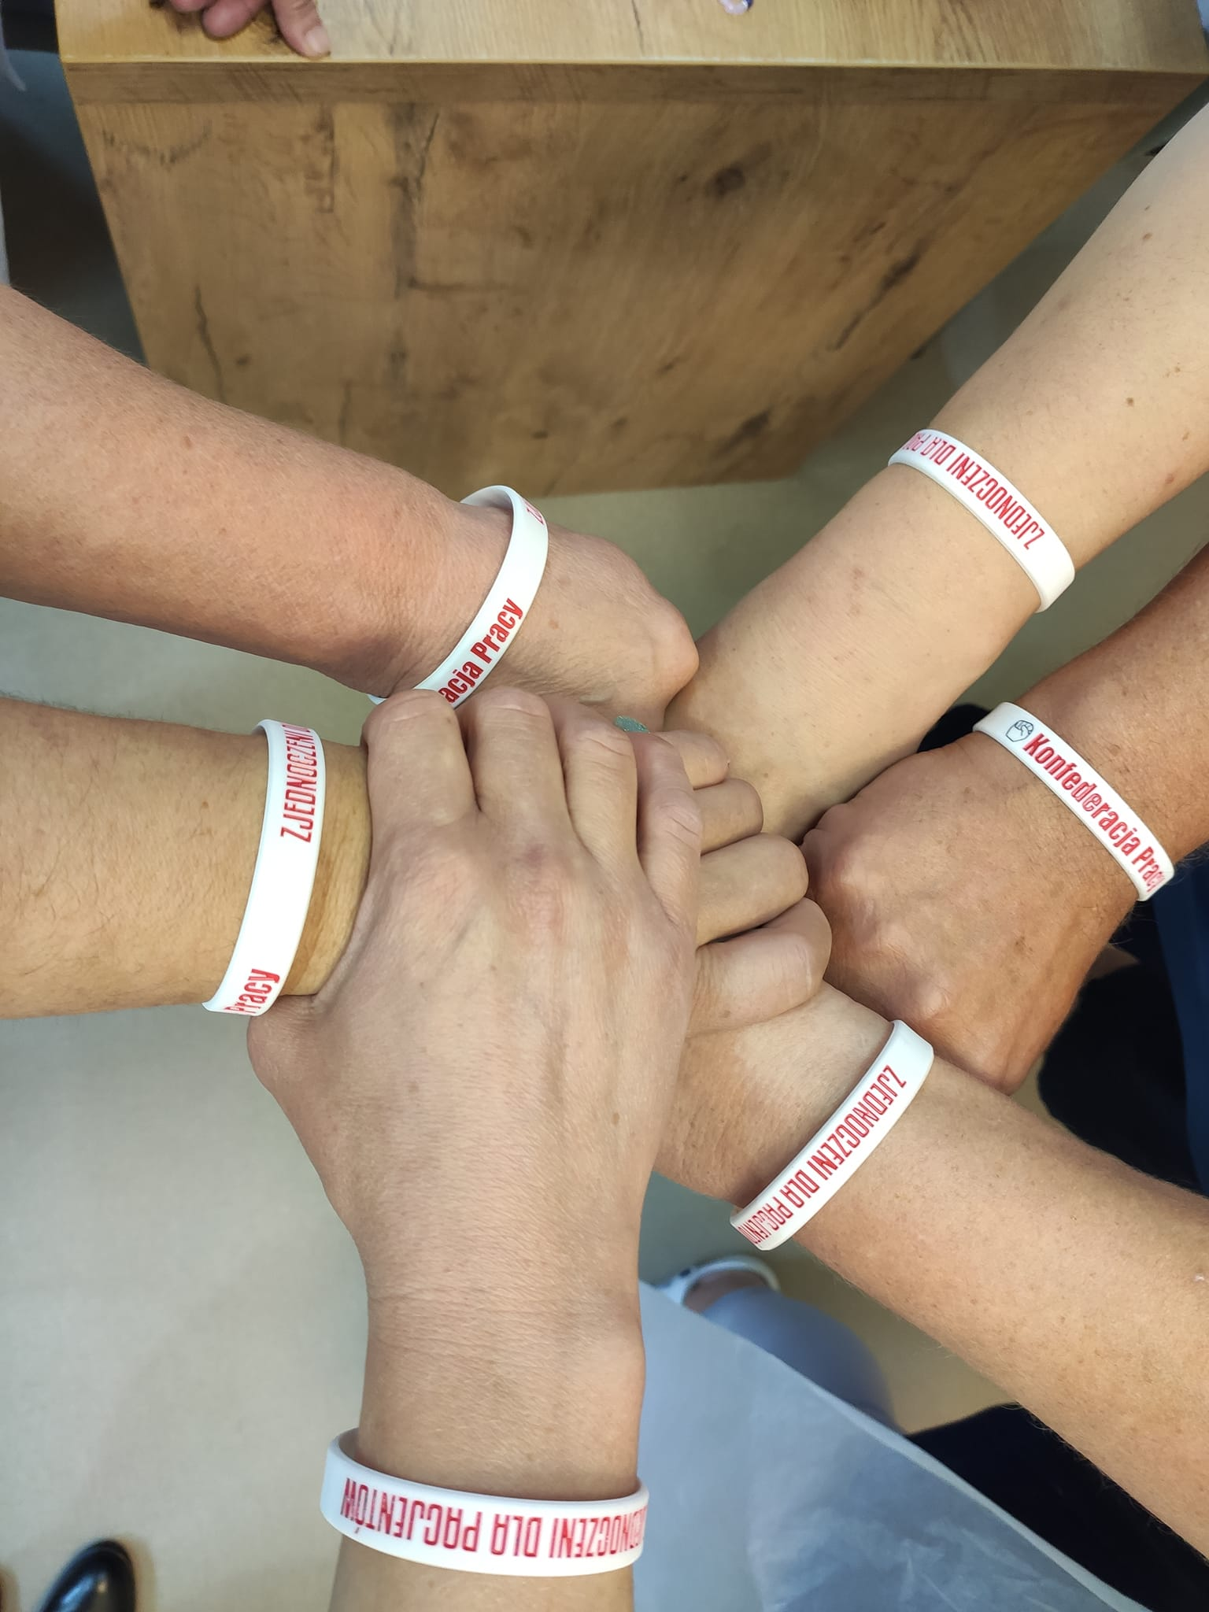
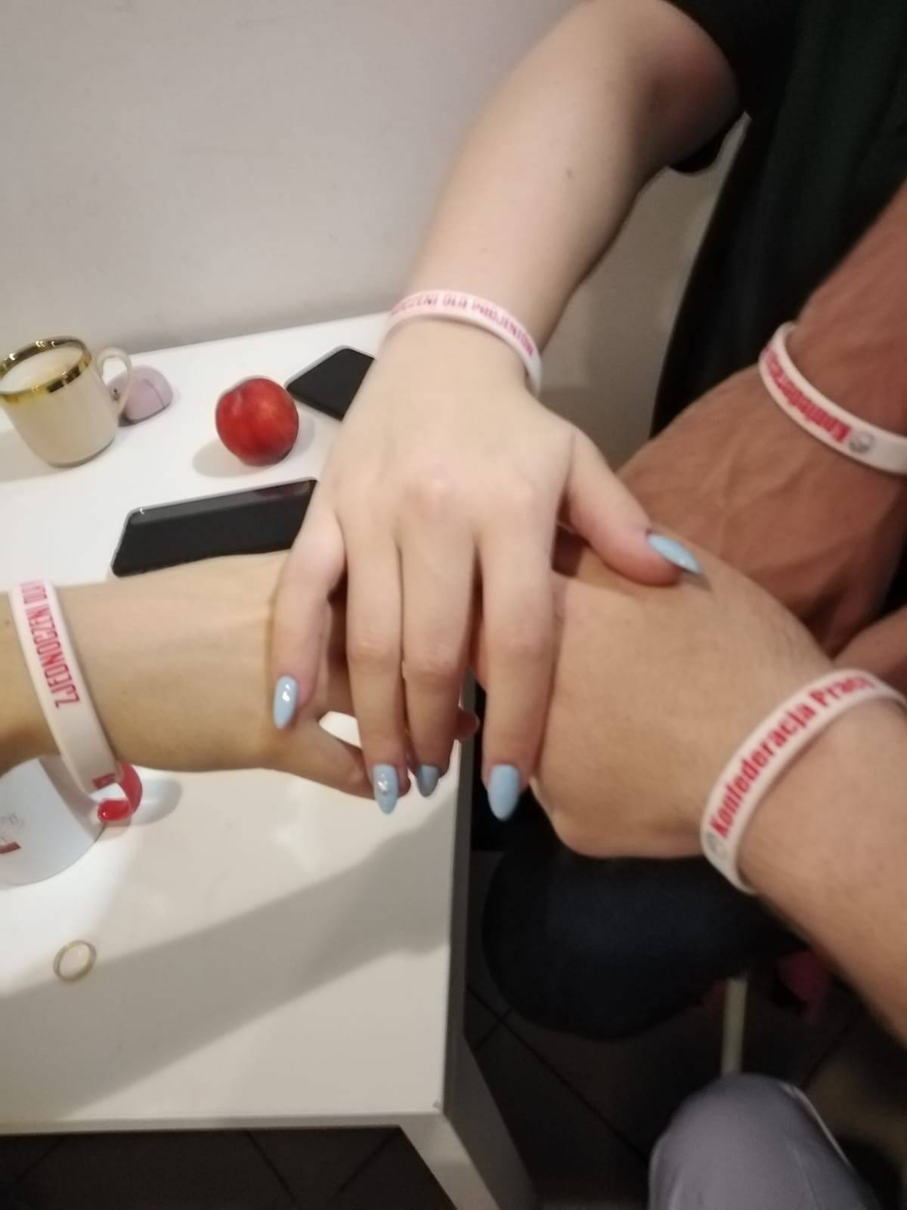
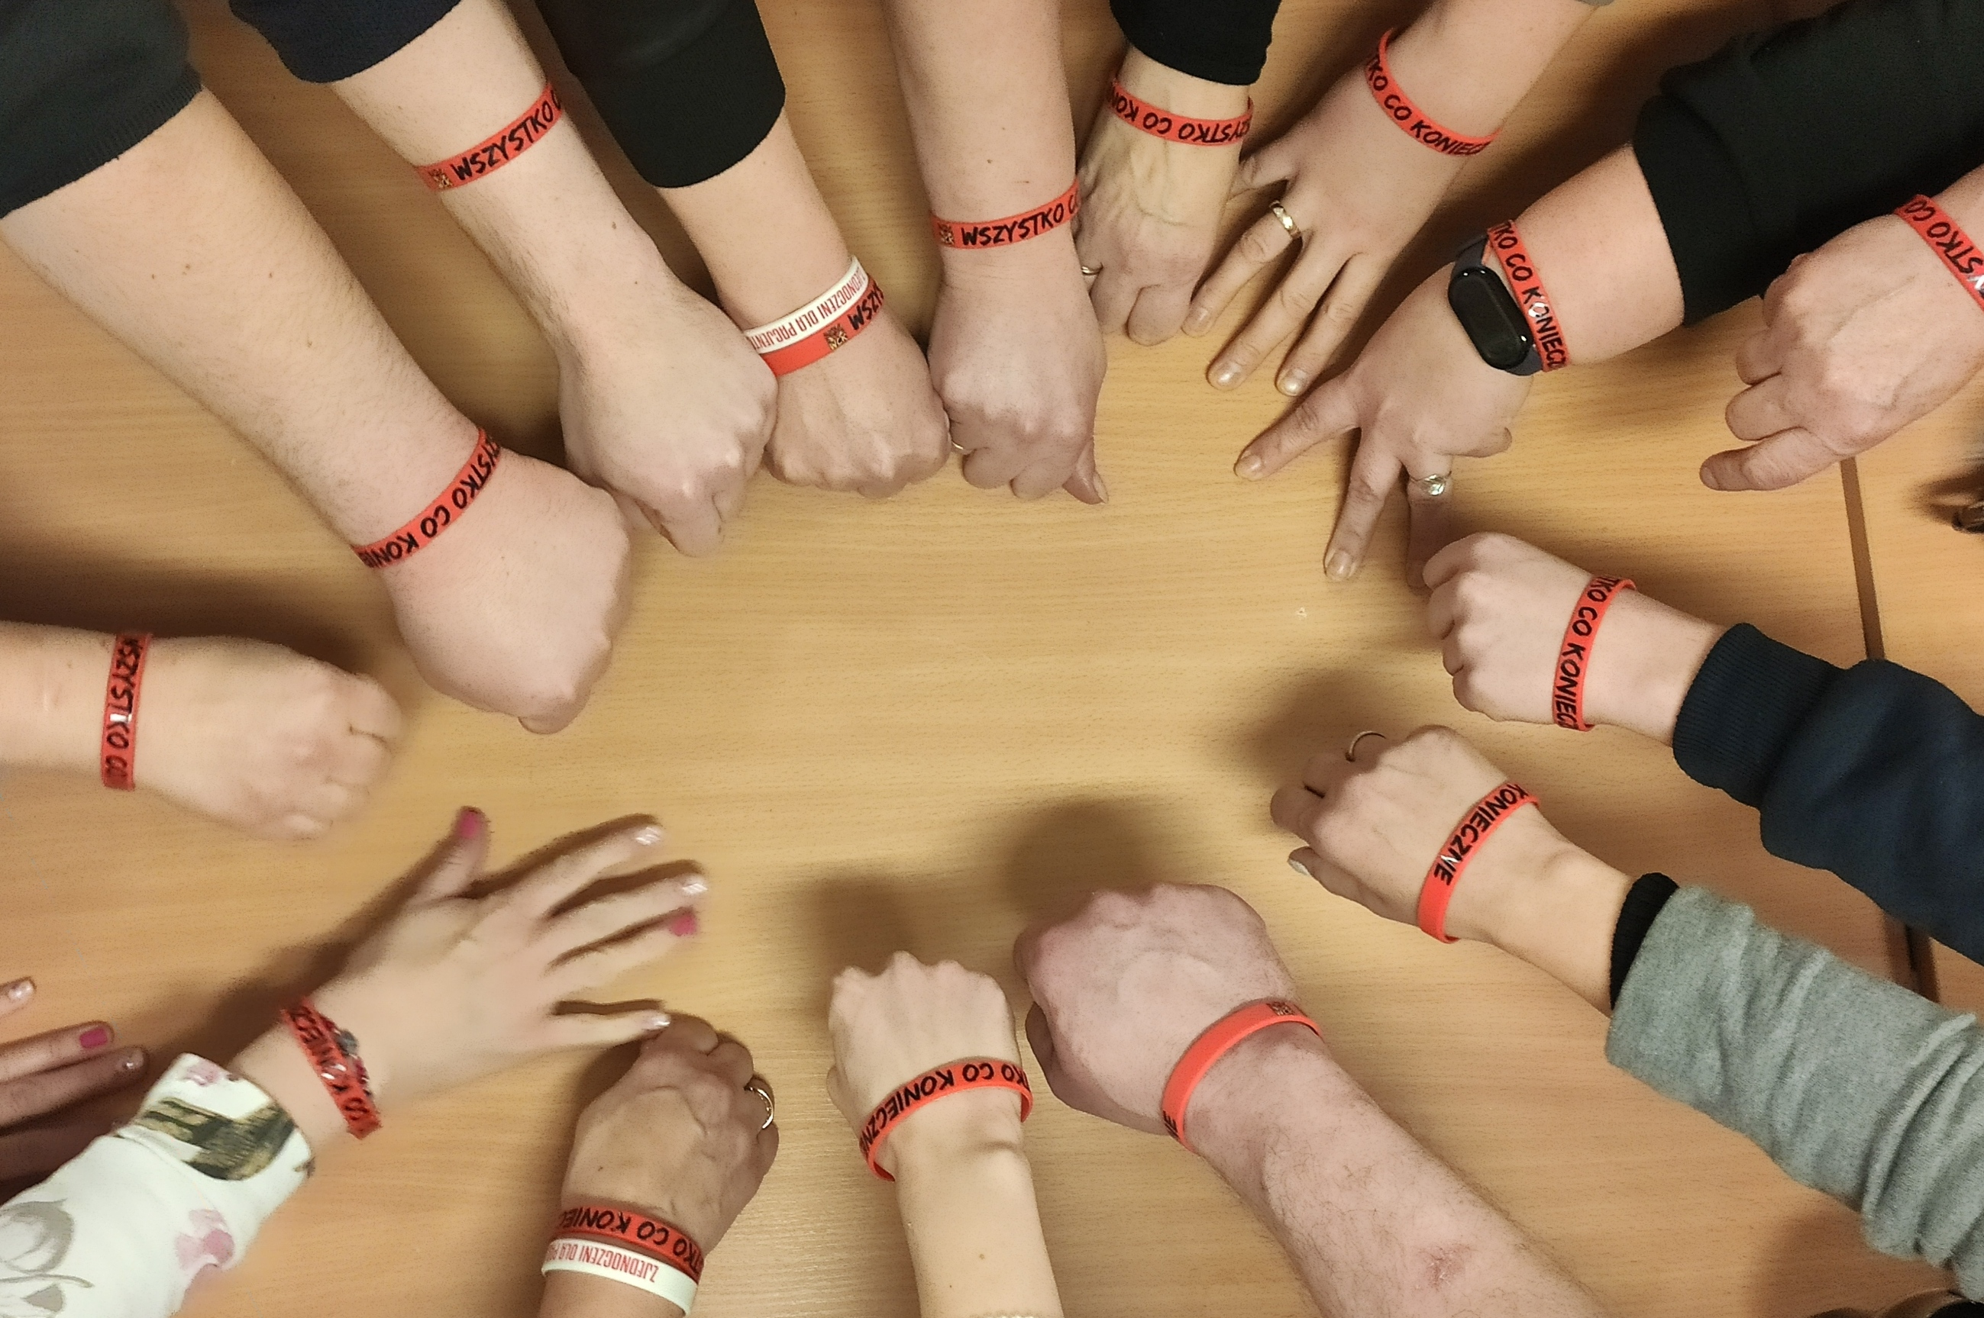
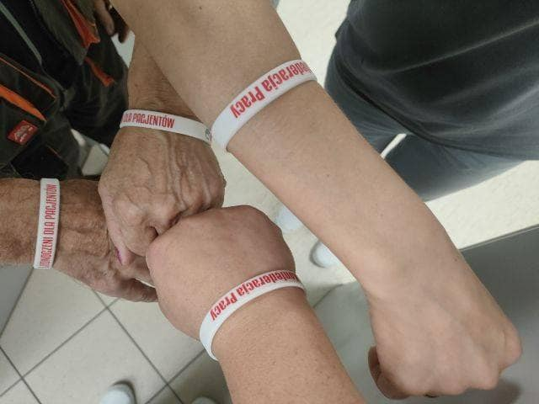
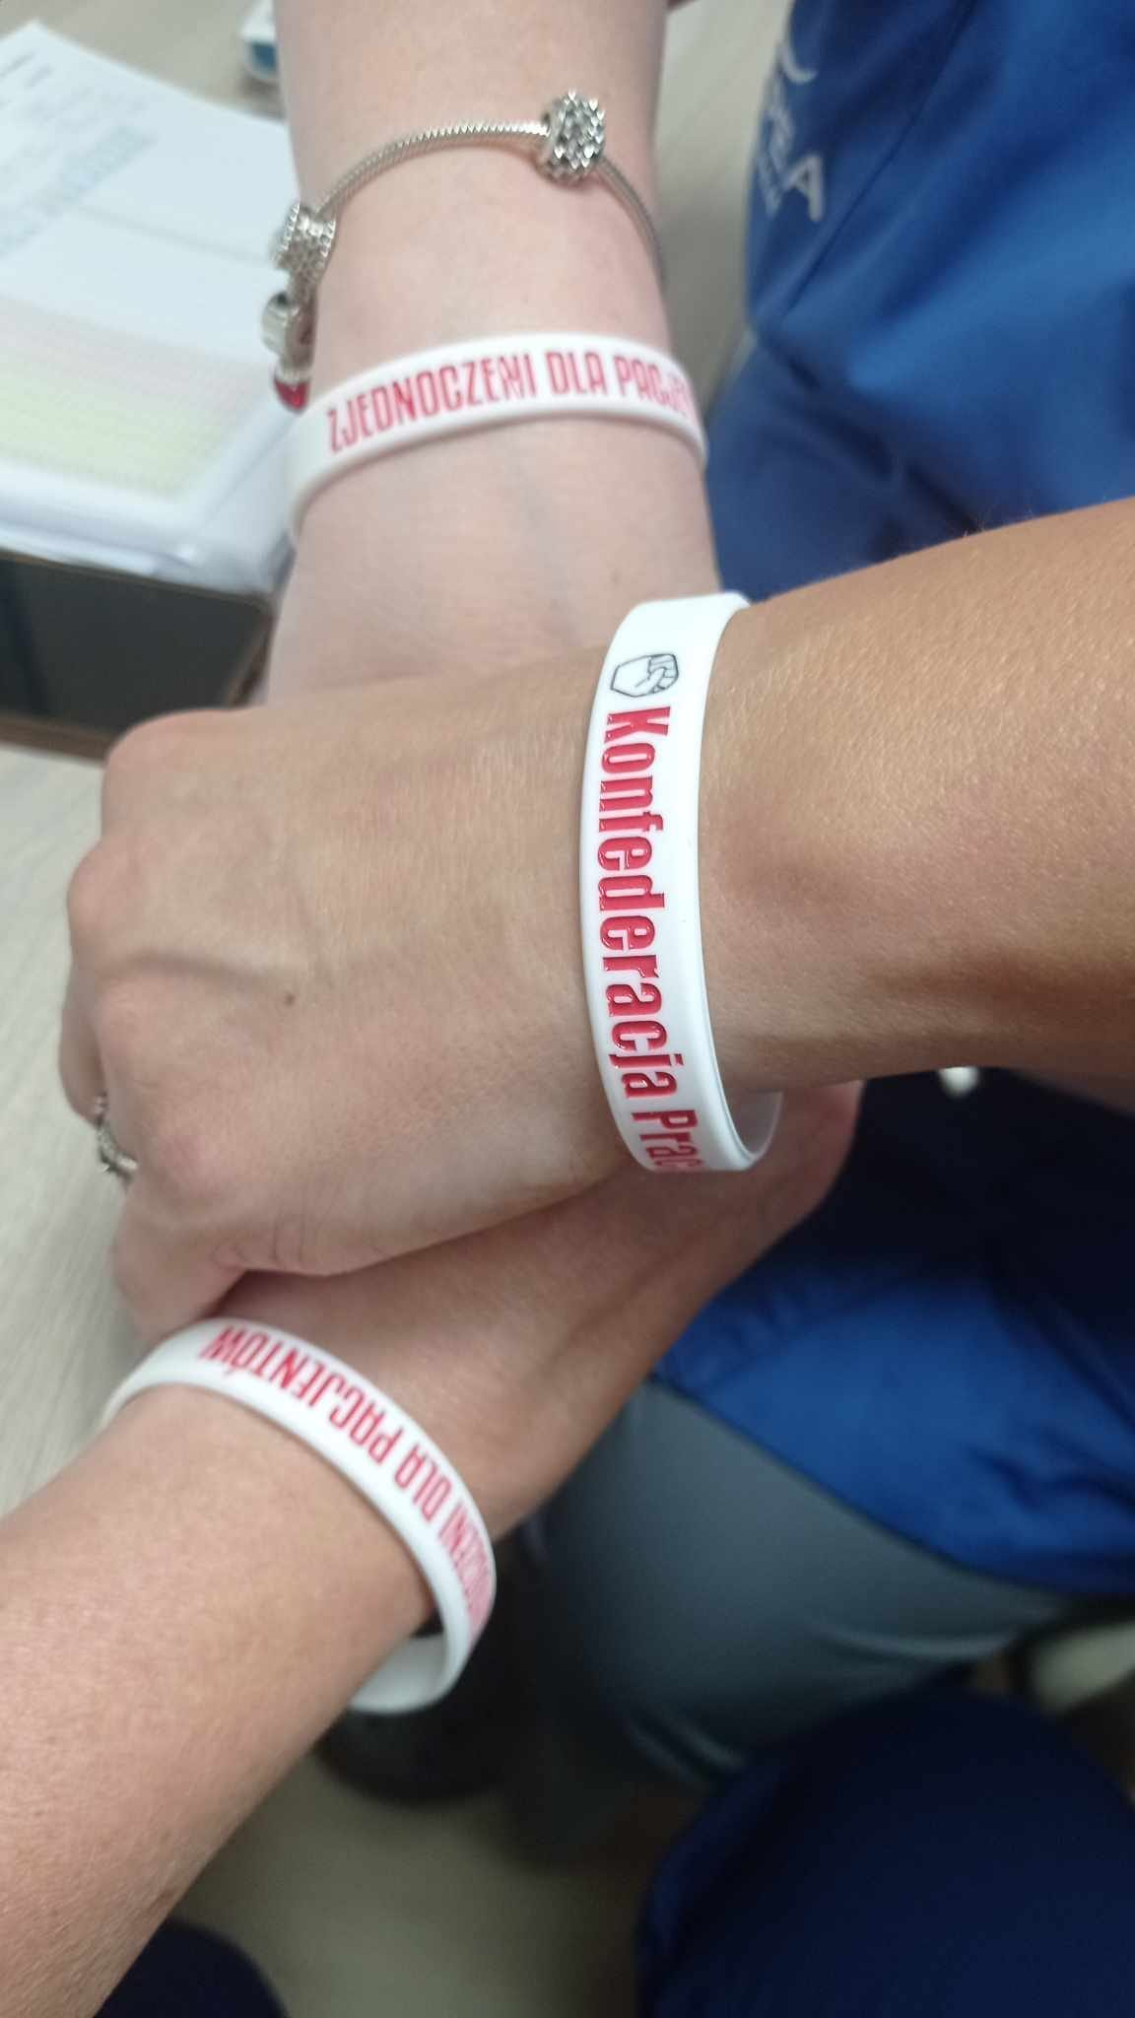
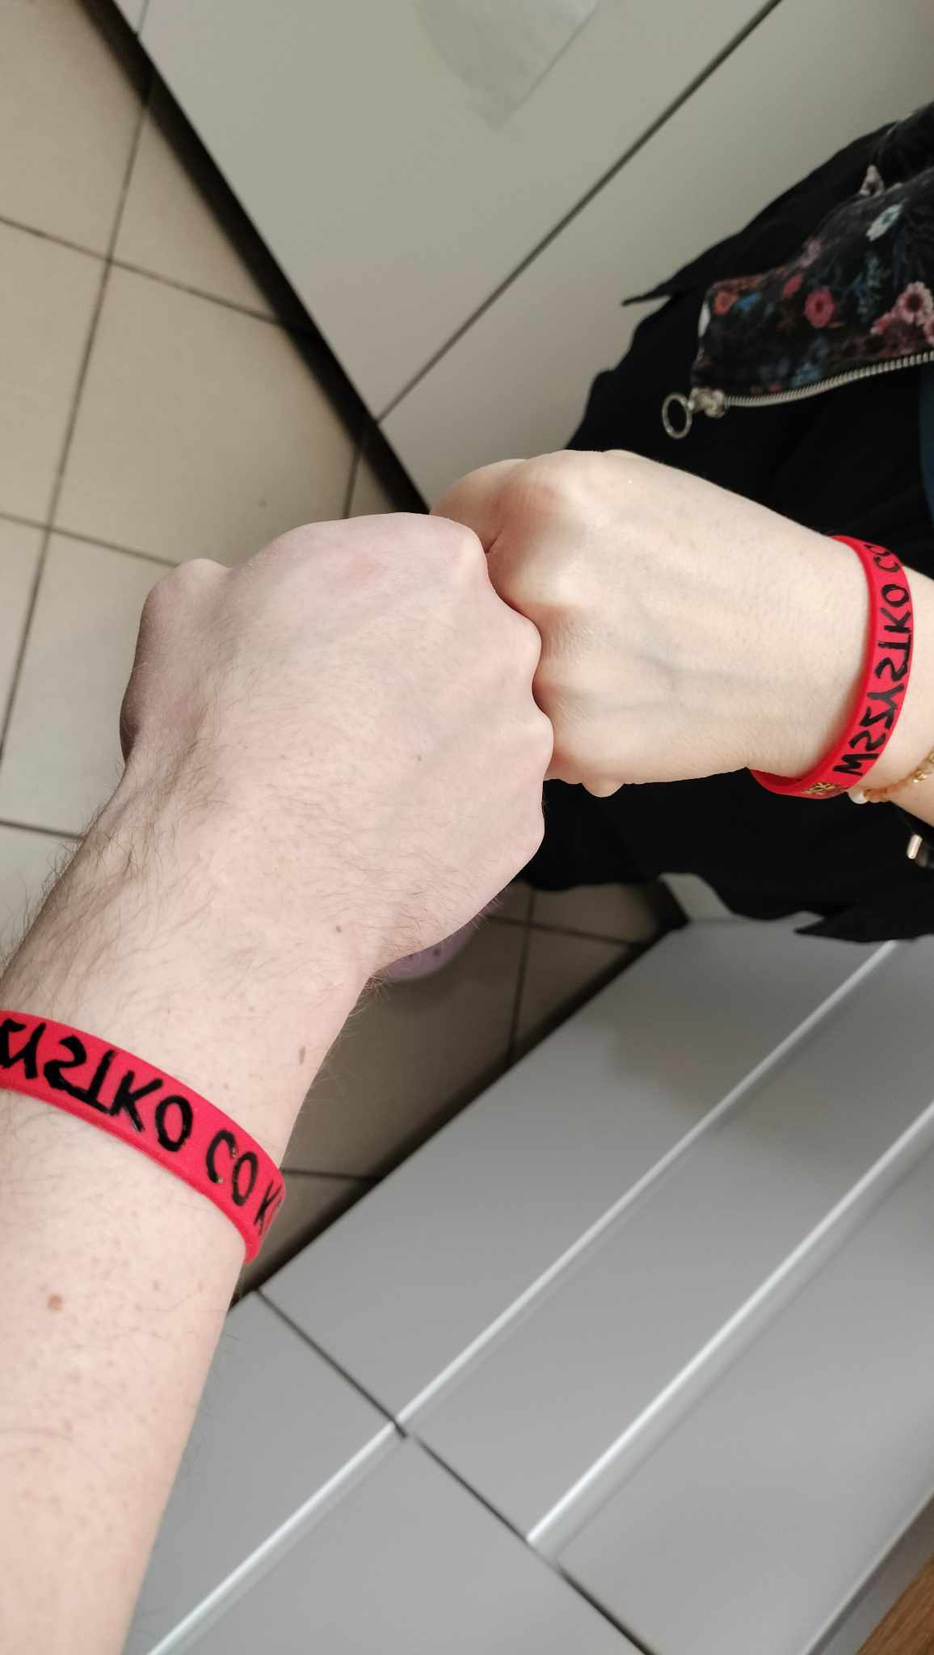
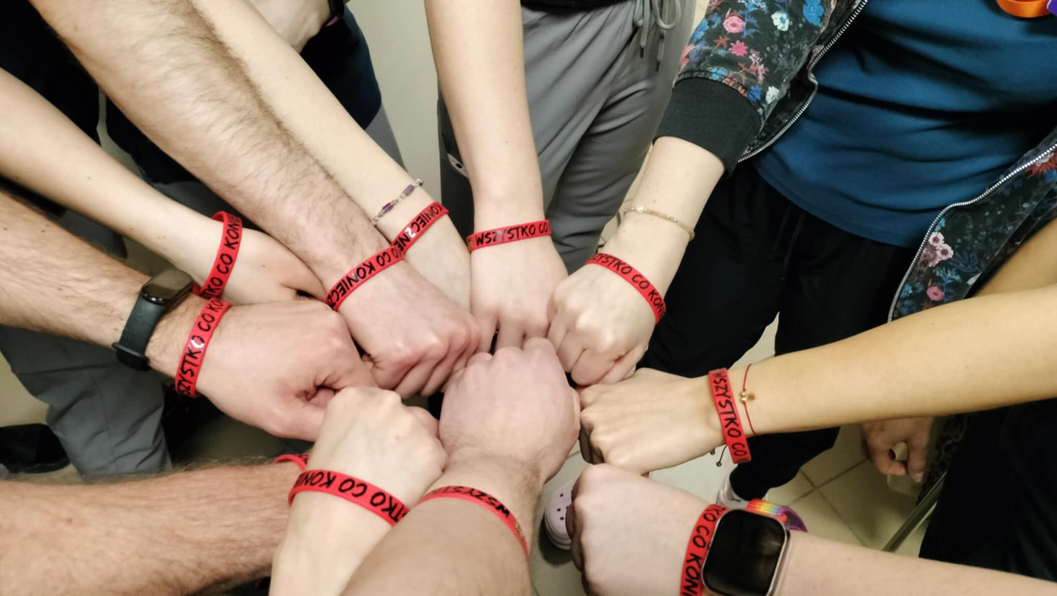
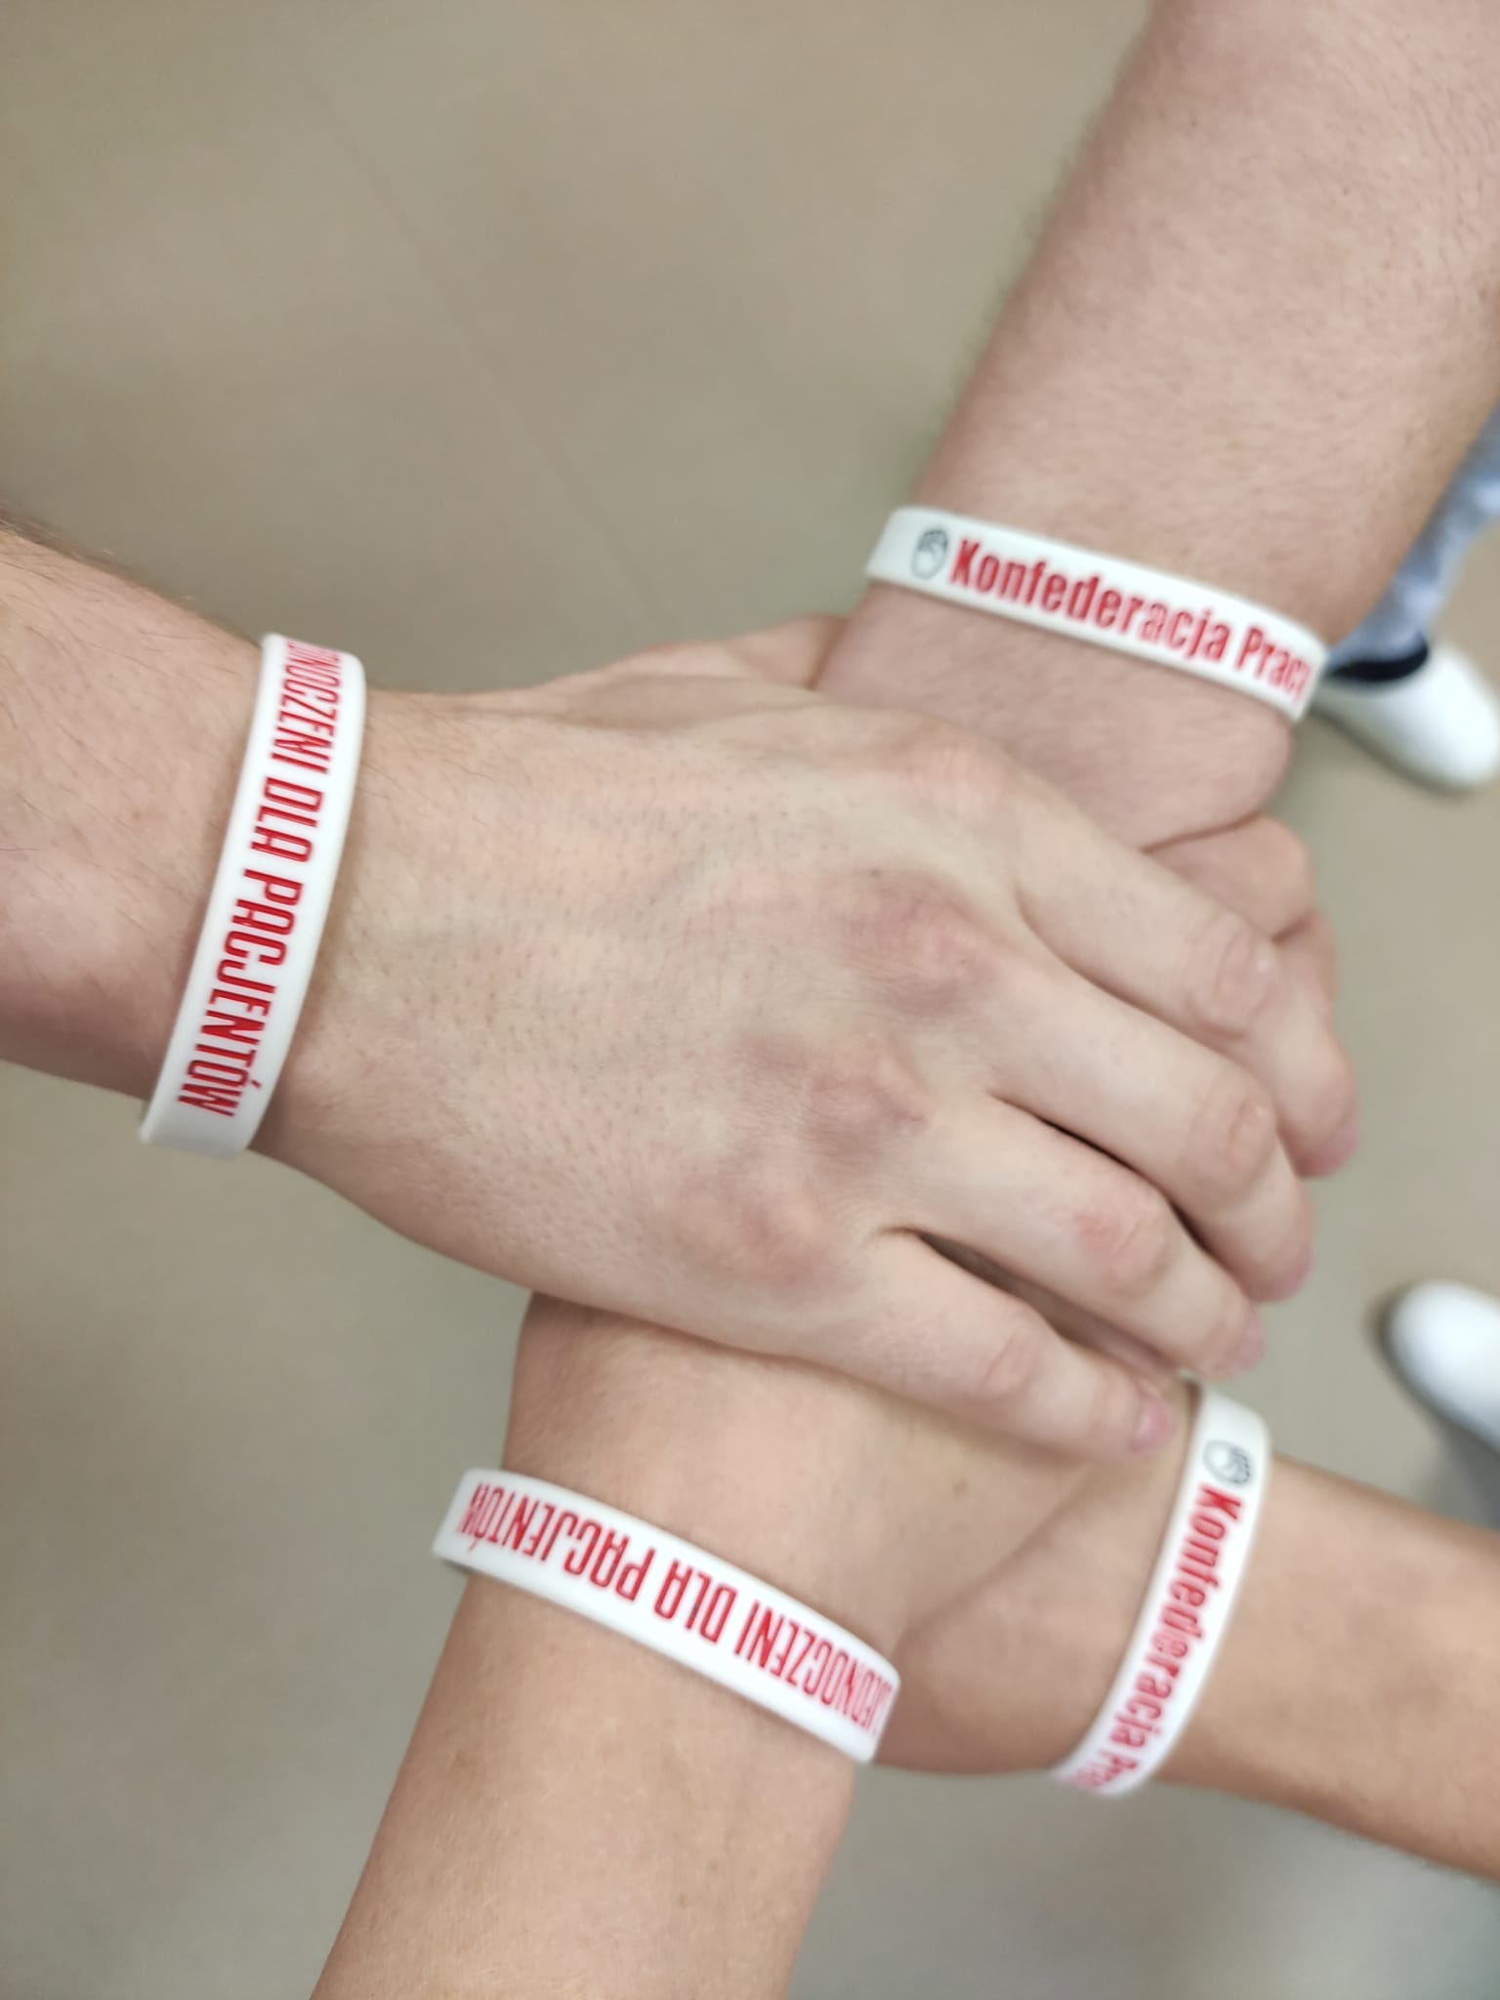
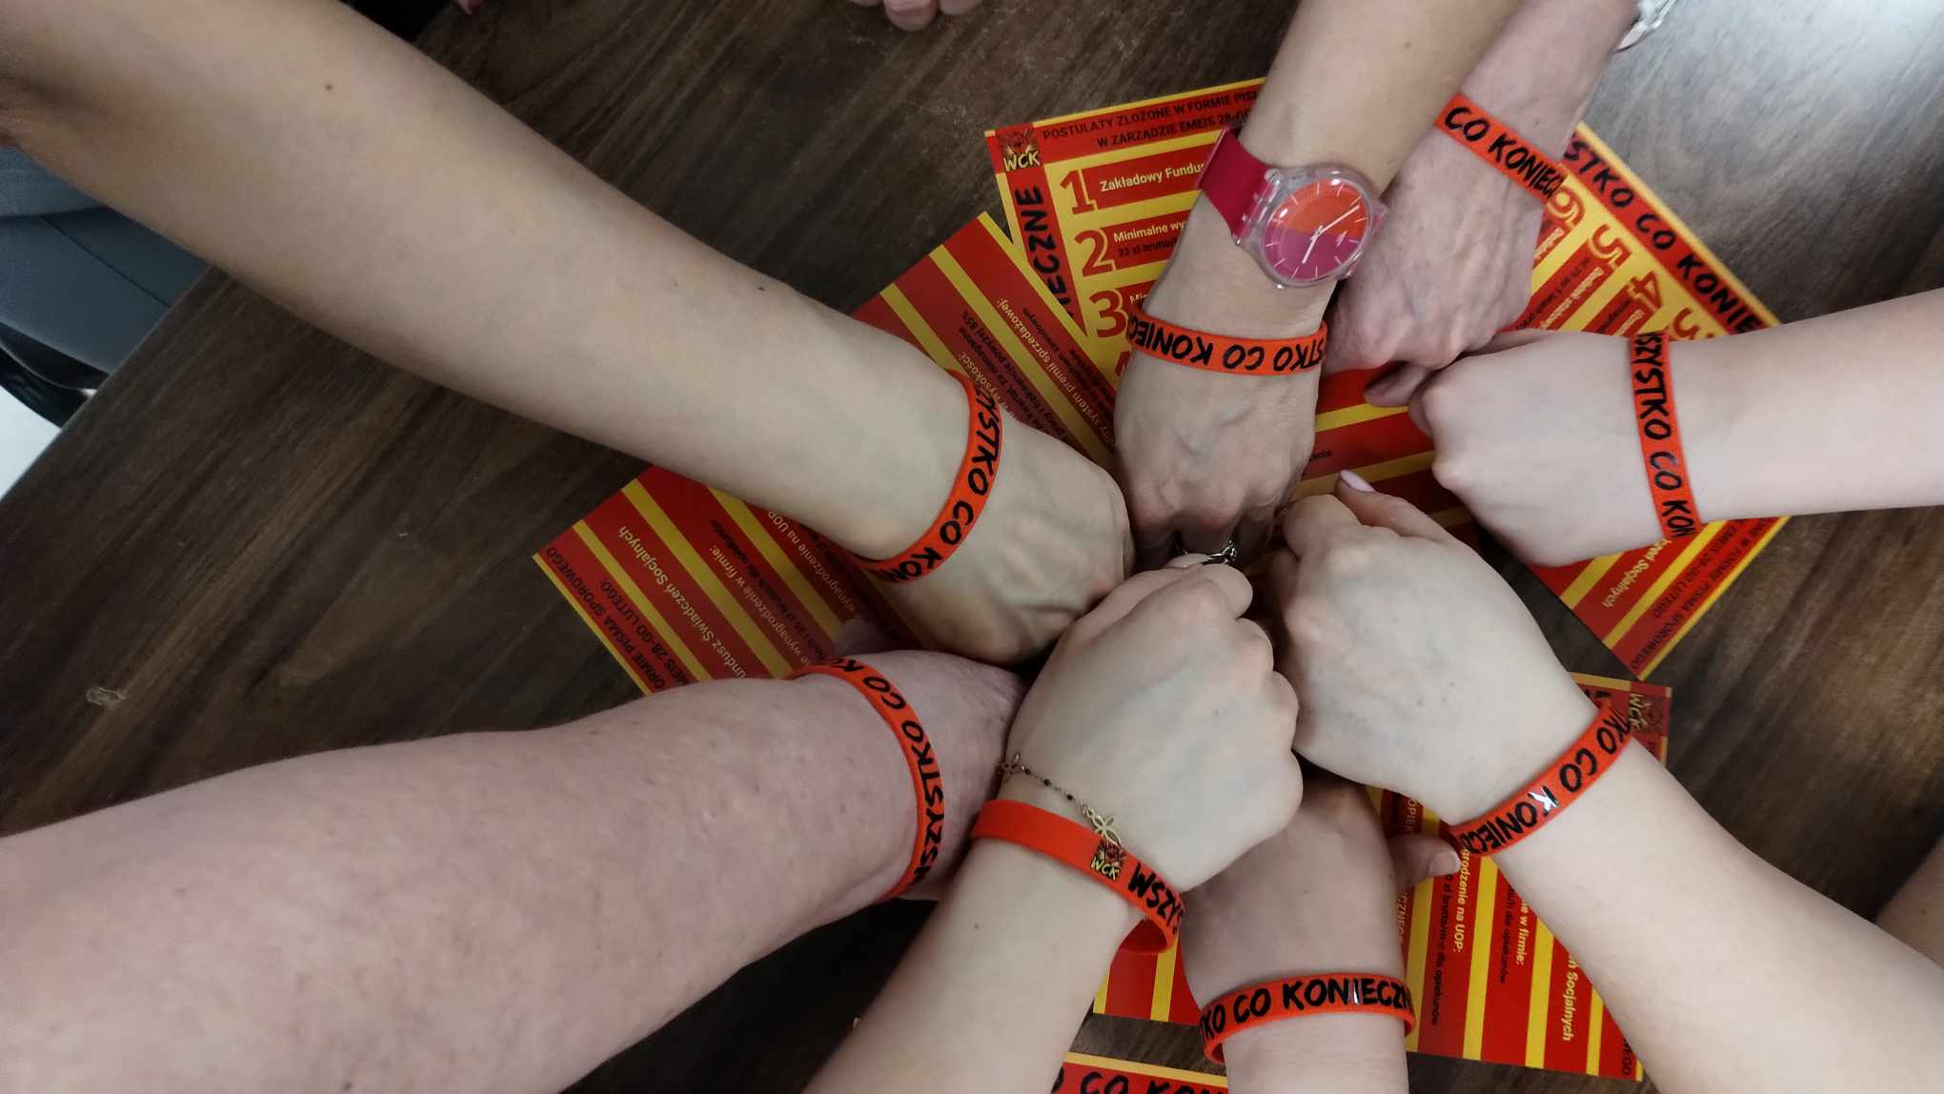
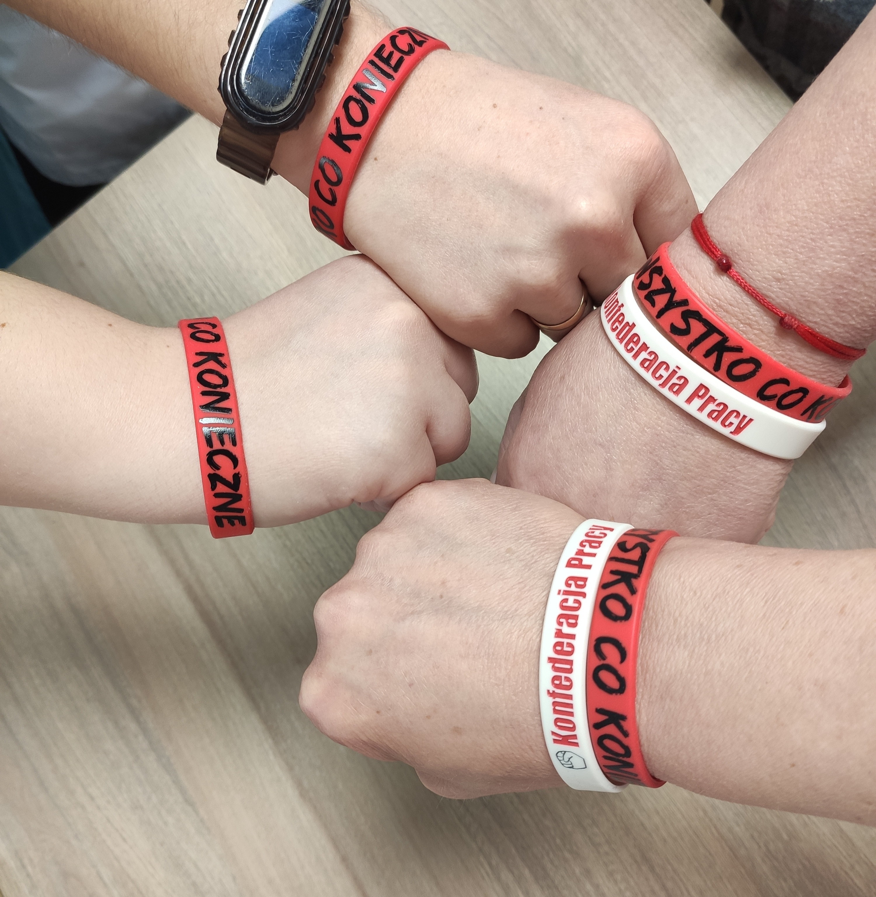
WHATEVER IT TAKES

Slide 14
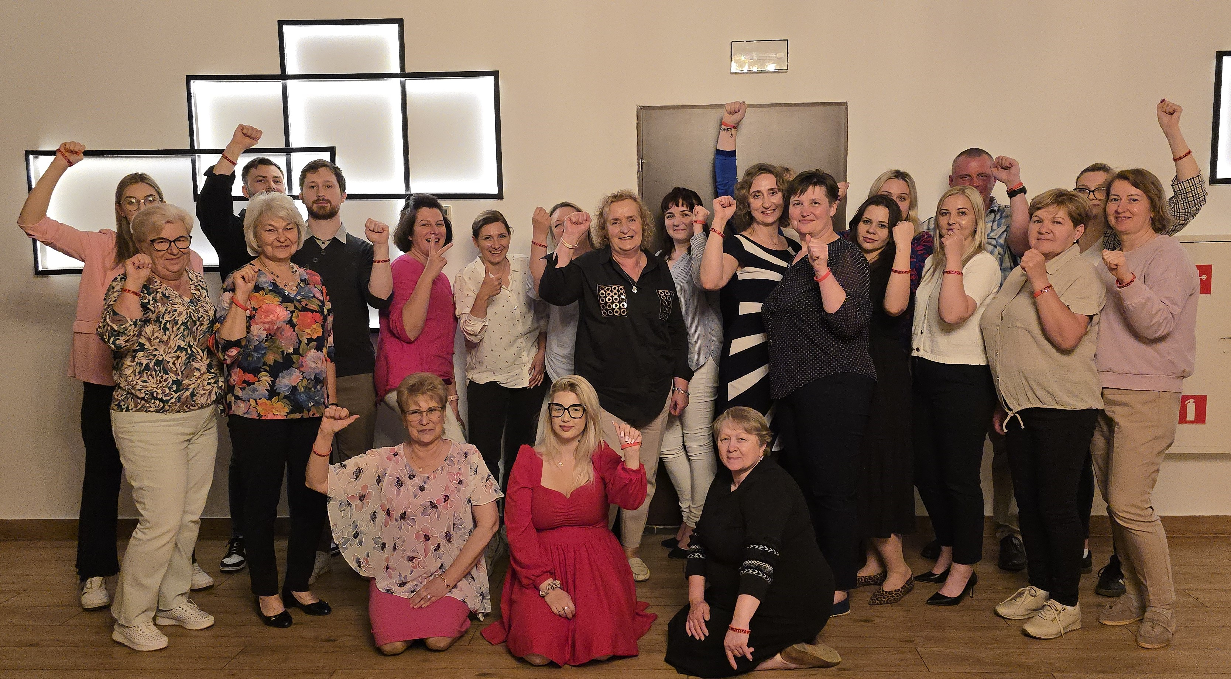
MAY 2015
LEADERS & ACTIVISTS FROM EMEIS:
INTEGRATION MEETING & RECORDING MOVIES WITH DEMANDS

Slide 15
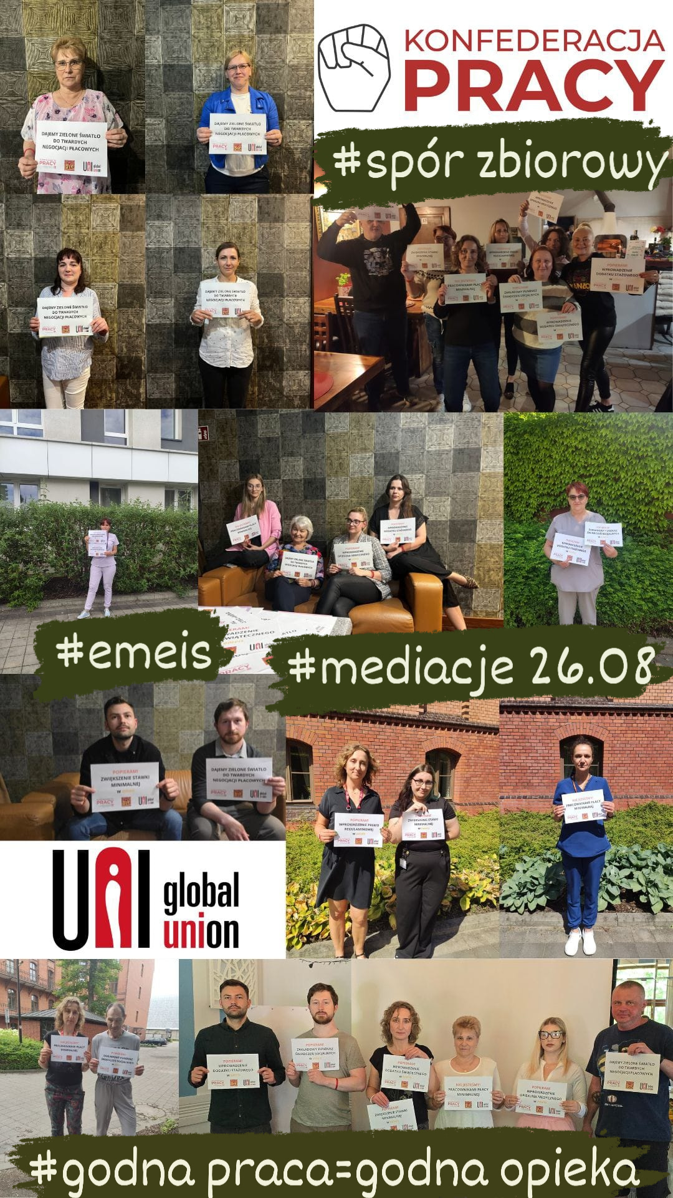

AUGUST 2026
FIRST COLLECTIVE ACTION "WITH FACES" ON SOCIAL MEDIA

Slide 16
FEBRUARY 2026
THE MEDIATION PROCESS FINISHED WITH THE PROTOCOLE OF DISAGREEMENT
NEXT
STEPS???
COOPERATION ON NATIONAL LEVEL:
COALITION BETWEEN THE TWO LARGEST UNION KONFEDERATIONS
SUBMIT A PROPOSAL TO THE GOVERNMENT OF CBA FOR THE WHOLE CARE SECTOR
STRIKE IN EMEIS?
ARE WE READY?

Slide 17
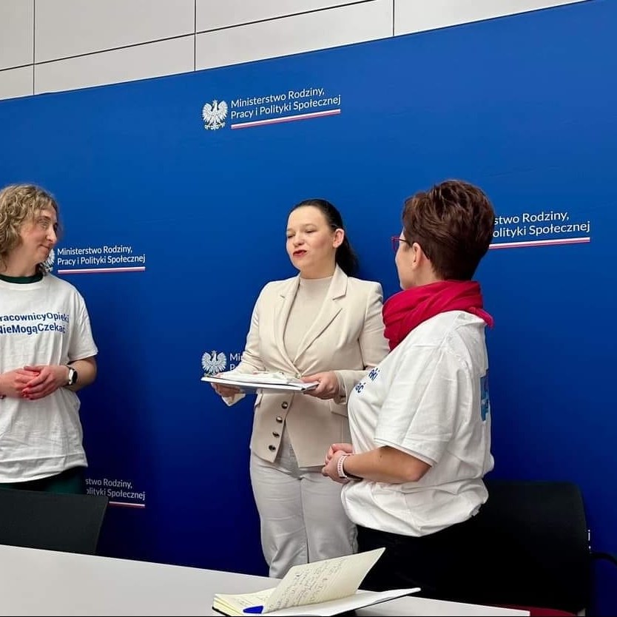
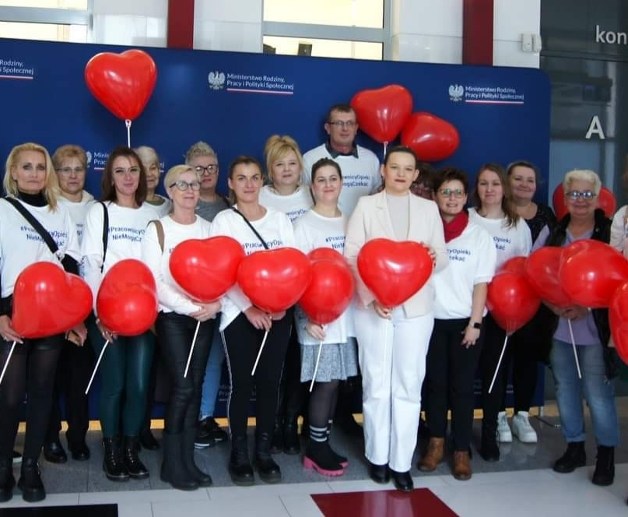


NOVEMBER 2024
THE MINISTRY OF LABOUR:
TWO CARE UNIONS:
FROM PUBLIC & PRIVATE SECTOR

Slide 18



NOVEMBER 2025
FIRST INTER-UNION MEETING:
DISCUSSING & PLANNING
OF CARE NATIONAL CBA
Notes:
Marsz 100 serc, Kolacija związkowa, żądanie realnego dialogu z rządem dla PUZP

Slide 19

THANK YOU FOR YOUR ATTENTION :)

