Slide 1
Methods of Bible Study
Basic Christian Beliefs
Lesson 1

Slide 2
How did or does your family accomplish the movement of meaning through stories, symbols, and traditions?
In life, Families tell stories to communicate meaning through time (e.g. pictures on the wall, annual update letters, anniversaries, etc.).
Families create traditions that form patterns of valued behavior based on the interpretation of those stories (Anderson & Guernsey,1985, p. 105).

Slide 3
Symbols – are the elements of a society to develop, transport, and maintain those meanings. They are created and designed by the tool of abstraction; they hold the ideas and practices that sustain social order.
“Languages, mathematical notations, and signs are all sets of symbols” (Brim &Lie, 2006, p. 39).

Slide 4
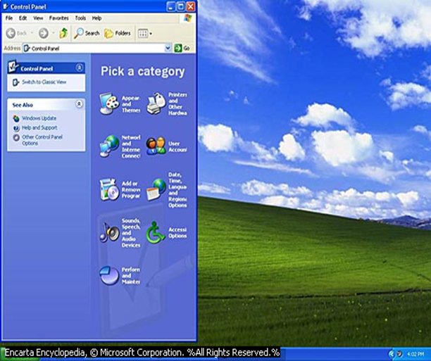
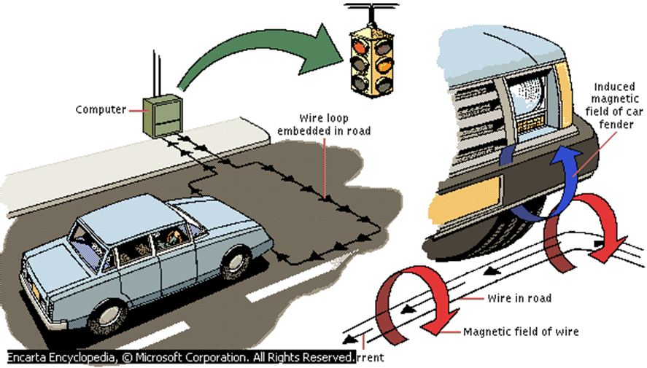
“Language symbols do not merely stand for something else—they also indicate the significance of things for human behavior, and they organize toward the thing symbolized…We organize things into systems or categories in terms of their significance for behavior” (Curra, 2005, p. 130).

Slide 5
Language
Everyone is socialized through language, experience and relationships within a particular context.
Words as symbols enable us to communicate with one another.
“Communication plays an important role in the construction of society” (Newman, 2004, p.18).

Slide 6
Language
Communication is essential for the construction, maintenance, and affirmation of the reality of society.
Humans require contact with others in order to develop socially and to learn how to interpret and attach meaning to people, environments, and events.
All social systems produce language and meaning that construct the socio-cultural nature of that system and is best described by those within it.

Slide 7
Permuting = to rearrange things: to change the order of items in a group, especially to rearrange them in every possible way (Encarta® 2006)
This capability of our minds provides the single most distinct attribute that we share in the image of God. He gave to us the power to rearrange meanings.
Notes:
We are to arrange the meaning gathered and process them in our minds in interaction with Holy Spirit guiding by sharing Kingdom reality.

Slide 8
her·me·neu·tics [hùrmə nootiks]
noun (takes a singular verb)
1. | science of interpreting texts: the science and methodology of interpreting texts, especially the books of the Bible
2. | theology of religious concepts: the branch of theology that is concerned with explaining or interpreting religious concepts, theories, and principles
Notes:
We all use math everyday but we are not all mathematician; We use scientific methods everyday, even to cook or bake, but we would not call ourselves scientist. We do not need to be turned off by the fact that some have refined into a science.

Slide 9
German philosopher Hans-Georg Gadamer focuses on the dynamic relationship between text and interpreter, arguing that reading is a creative act that necessarily places the text in new and different interpretive contexts (Encarta 2006)
Hermeneutics provided scientific methods for the interpretation of texts to explain concepts, theories, and principles and to derive appropriate application for those meanings being conveyed by an author.
Notes:
German philosopher Hans-Georg Gadamer published Truth and Method, a work of literary theory that distinguishes him as a leading thinker in 20th-century hermeneutics (the science of interpretation).

Slide 10
1. Observation
Observation is the act, power, or habit of seeing and noting with thorough and careful notice.
It is also to watch closely and/or to look intently.
The skill of observation emerges as the art of seeing things as they are. You should take notice of the following:
Key words
Advice
Admonitions
Warnings
Promises
Reasons
Results
Contrast
Comparisons
Illustrations
Repetition
Questions
Progression of ideas
Important connectives (prepositions, conjunctions, etc.)
Grammar (verb ,nouns, pronouns, adverbs, adjectives, etc)
Atmosphere
Emphatic statement
Literary form

Slide 11
1 John:1-4
1) That which was from the beginning, which we have heard, which we have seen with our own eyes, which we have looked at and our hands have touched—this we proclaim concerning the Word of Life. 2) The life appeared; we have seen it and testify to it, and we proclaim to you the eternal life, which was with the Father and has appeared to us. 3) We proclaim to you what we have seen and heard, so that you also may have fellowship with us. And our fellowship is with the Father and with His Son, Jesus Christ. 4) We write this to make our joy complete.

Slide 12
2. Questions for Understanding
Questions bridge your observations to your interpretations and stimulate you to think seriously about what the author or story is trying to tell the original audience. Possible questions you may wish to consider:
Meaning: What is the meaning of a word, phrase, or statement? How did the definition get constructed (i.e. Literary event point)? What other meanings might the word, phrase, or statement represent (i.e. multimodal point)?
Significance: What significance does the word, phrase, statement, or event have for the original audience? What is the significance of the verb tenses, connectives, and/or grammatical constructions? Or the use of comparisons, contrasts, repetitions, or structure?
Relationships: What relationships exist between persons and the literary event, context, and/or other persons? How does interaction go between these relationships?

Slide 13
3. Interpretation
in·ter·pre·ta·tion (inˌtərprəˈtāSH(ə)n/) noun; plural noun: interpretations
the action of explaining the meaning of something. "the interpretation of data" synonyms: explanation, elucidation, expounding, clarification, exegesis, etc.
an explanation or way of explaining. "this action is open to a number of interpretations” synonyms: meaning, understanding, construal, connotation, inference, etc.
a stylistic representation of a creative work or dramatic role. "two differing interpretations, both bearing the distinctive hallmarks of each writer's perspective“ synonyms: rendering, execution, presentation, portrayal, performance.

Slide 14
4. Application
Once we have discovered the truth about one’s story or a literary event, what should our response reflect?
What am I to believe about:
God? Jesus? the Holy Spirit?
Grace? Mercy? Sin? Forgiveness? Hope?
What am I to do or what action is required from this learning?
What do I learn about relationships and the application of God’s love?
How does the Good News change me?

Slide 15
5. Actualization: Serves to bring into action those insights gained through study and interpretations. This serves as a means for Meaning Making
Express what was learned in creative and concrete ways.
Share your convictions and concerns with others
Make verbal commitments
Establish accountability
Pray that God will strengthen you to carry out your commitment without compromise.

