Slide 1
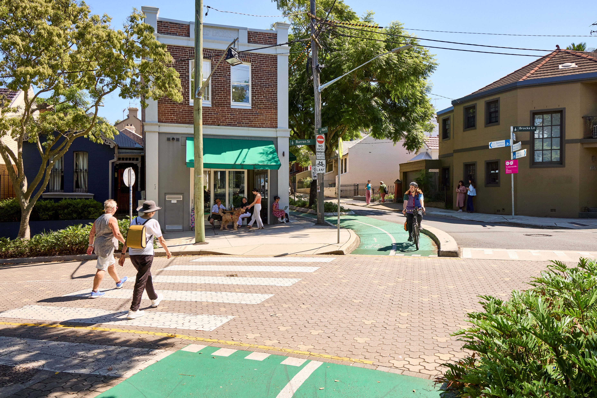

Insert date
Shared measures for the design and delivery
of healthy built environments
Notes:
Thank participants for attending.
Introduce self

Slide 2
Acknowledgement of Country
The Heart Foundation acknowledges the Traditional Owners and Custodians of Country throughout Australia and their continuing connection to land, waters and community.
We pay our respect to them and their cultures, and Elders past, present and emerging.
Notes:
Personalise your own Welcome to Country

Slide 3
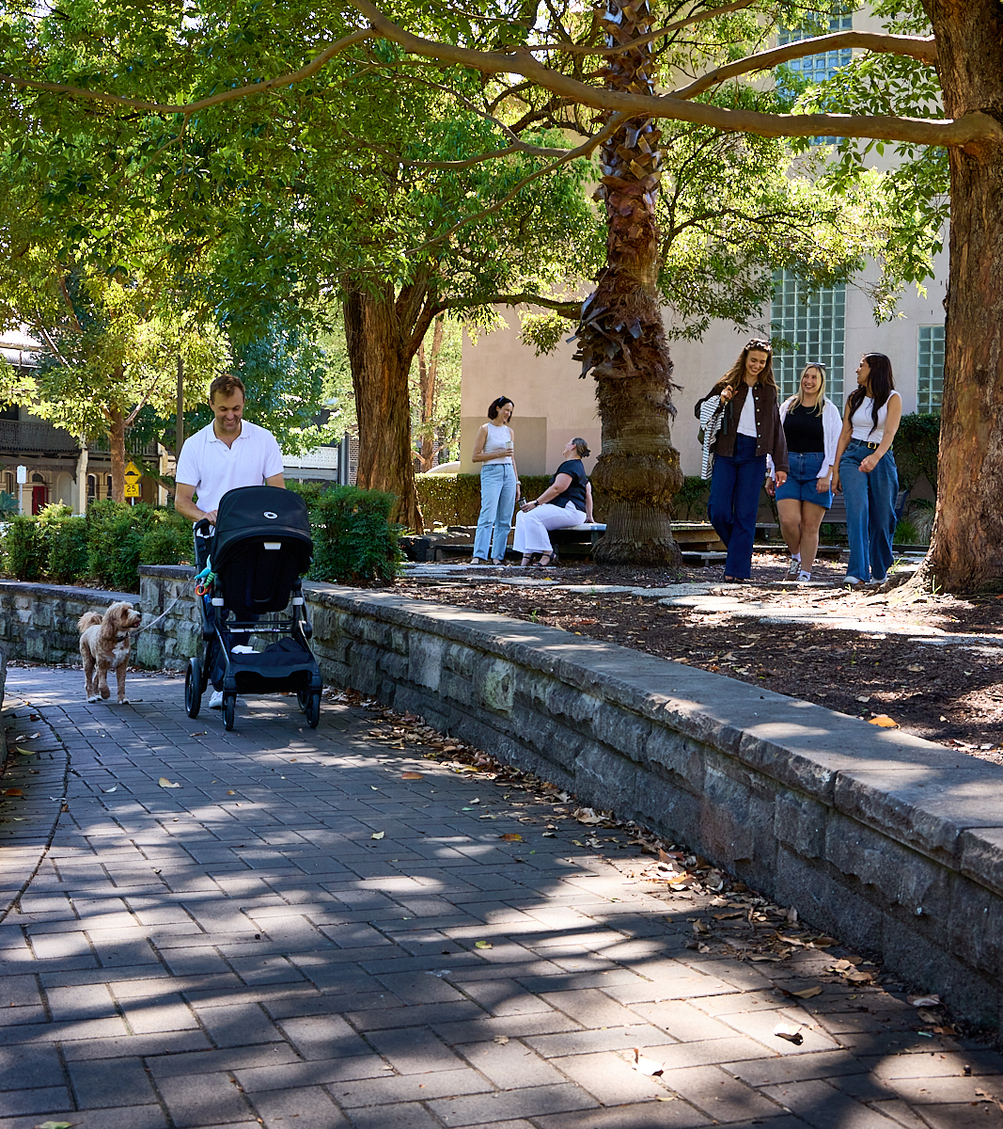
Overview
time Welcome
time Healthy Active by Design (presentation)
Translating evidence into practice
Community support
time Capability building (workshop)
time Morning tea/lunch
time Walkshop
time Debrief
time Next steps
Notes:
Round table introductions
Agenda:
Role of public health in built environments
Overview of Healthy Active by Design digital toolkit – resources to make your job easier
Giving voice to silent supporters - New ways of engaging with community and building strong partnerships
Evidence-based messaging and narrative
Ways to work together and demonstrate why and how health is everyone's business
Intent is to leave this session feeling inspired, empowered, armed with new knowledge and with a collective understanding about the importance of healthy built environments; and the ability to identify and implement new approaches to interdepartmental planning and community outcomes for health and wellbeing.

Slide 4
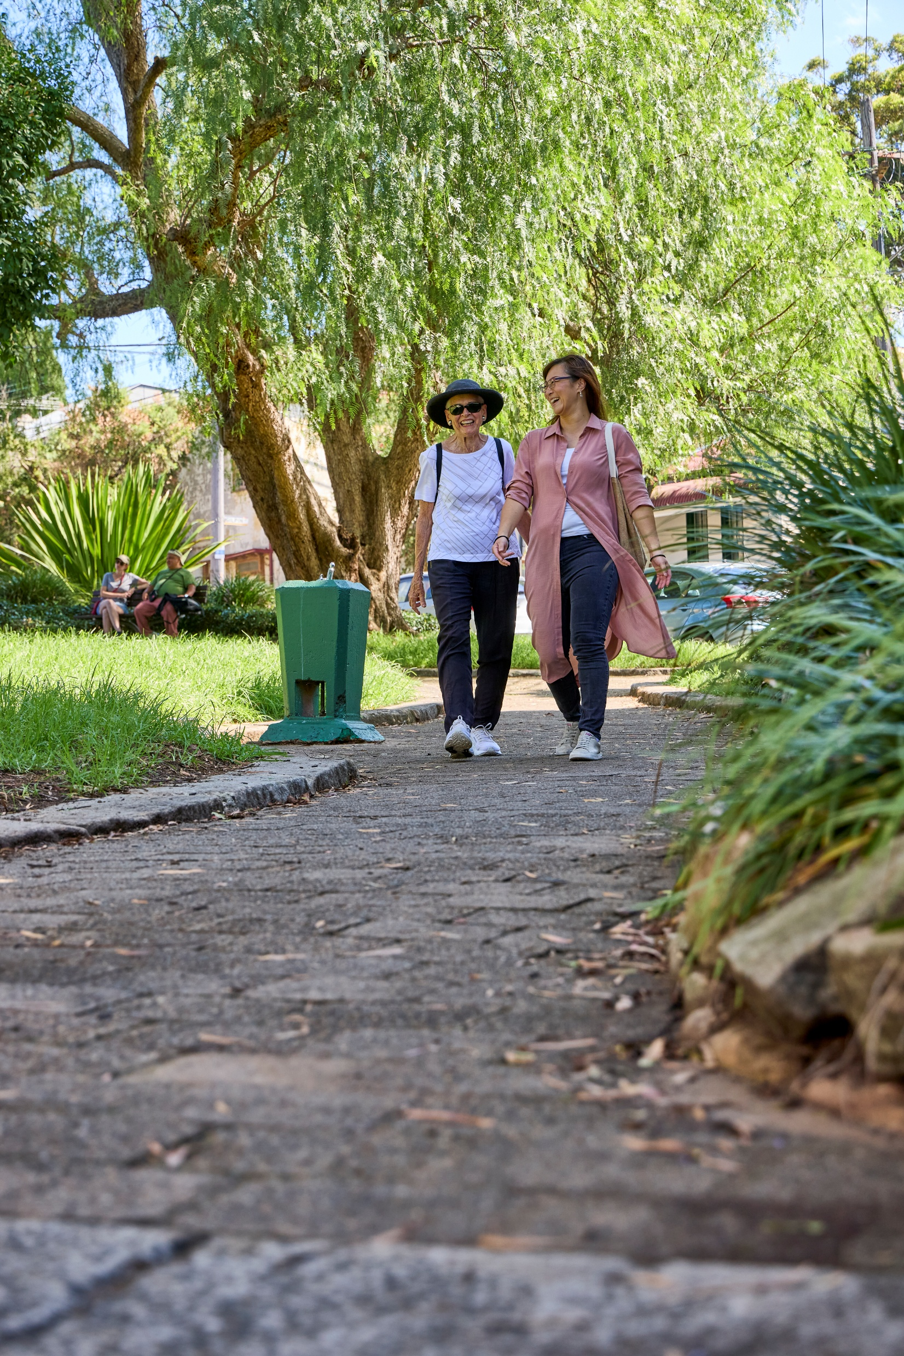
The Built Environment and Heart Health
Broader context
Cardiovascular disease is a leading cause of death in Australia.¹
Most cardiovascular disease risk factors are preventable.²
Four in five people in Australia do not get enough regular exercise.³
A key factor is that the built environment does not support/encourage walking, wheeling, bike riding and use of public transport.⁴
Walking is the most popular form of physical activity for people living in Australia.
References:
¹Australian Bureau of Statistics, 2022. Causes of Death 2021. https://www.abs.gov.au/statistics/health/causes-death/causes-death-australia/latest-release
² World Health Organisation, 2022, ‘Physical Activity’ Fact Sheet, accessed 29 November 2023, https://www.who.int/news-room/fact-sheets/detail/physical-activity
³Australian Bureau of Statistics, 2018. National Health Survey. First results, 2017-18, cat no. 4364.0.55.001. December
⁴McKoy, J., 2023, ‘US Neighbourhood Walkability Influences Physical Activity, BMI Levels’, published in Boston University School of
⁴ Chandrabose et. Al., 2022, ‘Built Environments and Cardiovascular Health: Review and Implications’ published in Journal of Cardiopulmonary Rehabilitation and Prevention, 1 November 2022, Issue 42 Vol 6, pp 416-422, https://pubmed.ncbi.nlm.nih.gov/36342684/
Notes:
The Heart Foundation’s vested interest in built environments:
Cardiovascular disease is the cause of one in four of all deaths in Australia, with more than half of the population having three or more key risk factors.
Physical inactivity is one such risk factor and remains a major health issue.
Research shows that people who live in walkable neighbourhoods are 58% more likely to have a healthy cardiovascular health profile than those who live in areas where walking is unsafe, inconvenient or difficult.

Slide 5

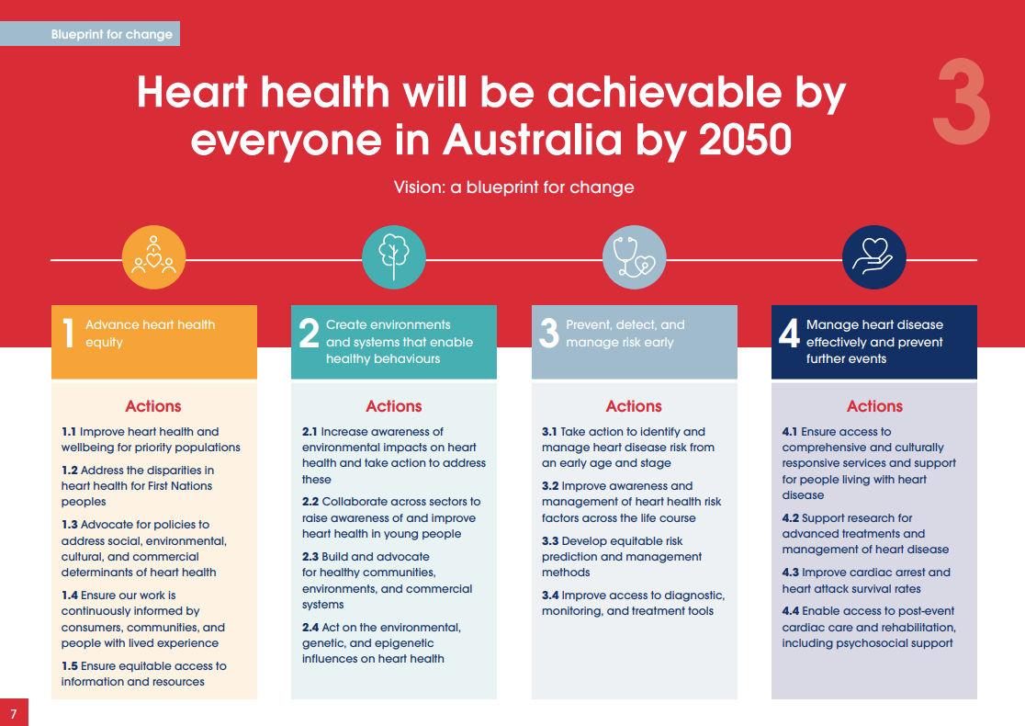
Heart Foundation
25-year Strategy – A generational vision
www.heartfoundation.org.au/health-for-every-heart
Notes:
Health for Every Heart: the Heart Foundation’s 25-year organisational strategy
Goal 2 (of 4): Create environments and systems that enable healthy behaviours.
Critical to preventive health
There are interconnections across the other three organisational pillars – including for equity and priority populations.
This is important, recognizing that health is impacted by postcode.
A key social determinant of health is the neighbourhood in which we live.
Addressing disparities across built environments and accessibility can help reduce inequity.
We need to design neighbourhoods with public health front and centre – for all people living in Australia.

Slide 6
Embedding public health into built environment outcomes
It’s everyone’s job
Arts and culture
Animal control
Asset management
Building approvals
Community services
Economic development
Emergency management
Environment protection
Food safety
Health
Land use planning
Parking
Public works
Roads
Sport and recreation
Transport & traffic management
Waste management
Aesthetics, amenity
Air and water quality
Housing
Libraries
Parks and open spaces
Playgrounds
Safety, security
Street lighting
Urban trees
Walking environment
…
Notes:
Embedding public health into built environment outcomes is a holistic, systems-based approach to local areas that puts community health and wellbeing front and centre in planning and design outcomes.
Everyone has a role to play in creating healthy built environments – council, practitioners, elected representatives, community.
Planning, funding, design, advocacy and education are all needed, to make it happen.
Local Government is central to this, as the tier of government with the closest ties to local communities.
The domains of influence are significant and far-reaching.
Increasingly, Council vision is tied to preventive health outcomes through community health and wellbeing vision.
Long gone are the days when local council had responsibility primarily just for roads, rates and rubbish!
Public health and built environments offer a holistic approach to neighbourhood design.
Investment made here can create significant savings elsewhere.
If you consider ‘why’ you do your job, why it’s important, your purpose in fronting up to work each day; likely this will relate back to doing something that achieves a community good – that services your local community and improves their quality of life, health, wellbeing and other outcomes.

Slide 7
Embedding public health into built environment outcomes
It’s already embedded in your plans and policies!
Identify relevant key strategies and policies; action items, specific to your area
Notes:
Identify key strategic documents, and current project plans to demonstrate how public health already forms part of the picture.
Provide local, real-world examples of how it all fits together – public works, asset management, roads, public parks, land use zoning...
Use existing case studies if you have them – or from neighbouring council areas
Community health and wellbeing are often key starting points. These can include:
Zero Carbon
Greening Strategy / Climate resilience plan
Integrated transport
Active Transport
Public Health
Community Plans
Housing Supply
Growth / Development Plans
Inclusion Plans

Slide 8
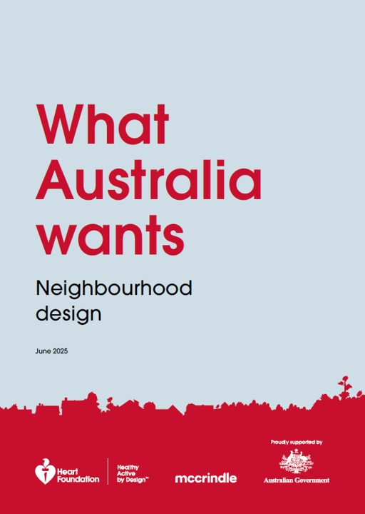
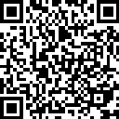

Community views
93% of survey respondents want to be active in their local neighbourhood.
But only 23% are getting enough exercise.
Neighbourhood design needs to improve
to address the mis-match.
Key considerations when deciding where to live:
Proximity to destinations
Sense of place
Access to healthy foods
Public open space
Movement networks
Notes:
Good news – our community already supports the work we do in creating more walkable local neighbourhoods.
The Heart Foundation engaged McCrindle Research in early 2025 to conduct a national survey.
3,000 people across the country were asked questions about what’s important to them in a local neighbourhood and their local area.
Overwhelmingly, people want to live in neighbourhoods that support them to be physically active as part of everyday life.
Access to local destinations was top of the list.
66% of respondents supported directing more road funding into walking and cycling infrastructure.
65% supported reducing speed limits in neighbourhood streets to help create safer streets for people.
Only 6% and 9% respectively were opposed, with the remainder neutral.
The report details can be used to bolster efforts in advocacy, communication and engagement.
There’s a wealth of information available about community sentiment for healthy built environments and more walkable local neighbourhoods.
The Heart Foundation may be able to support us to emulate a similar survey for our local community.

Slide 9
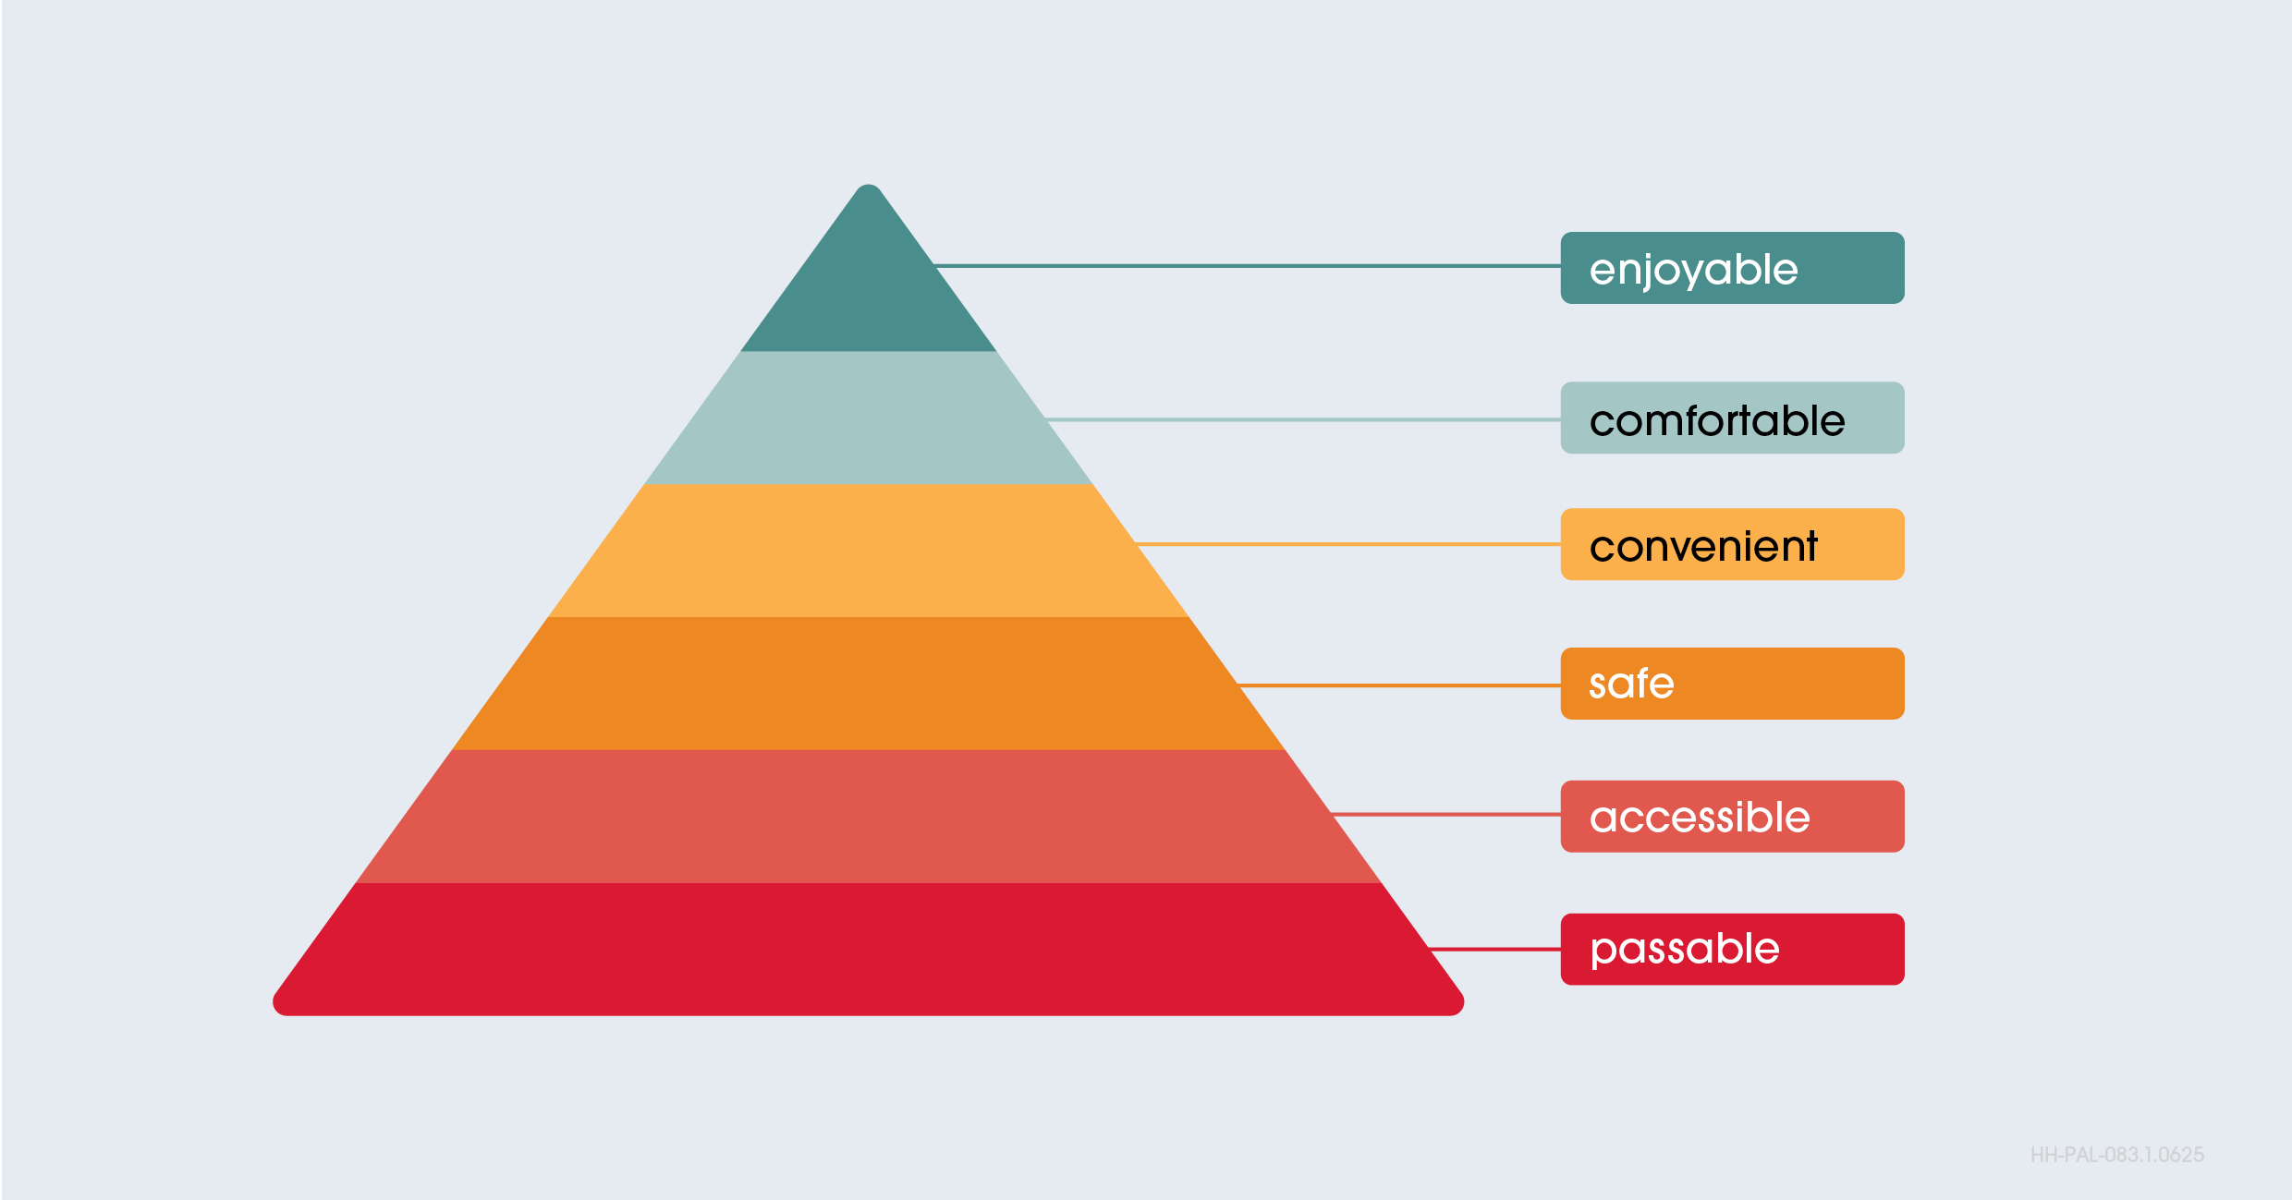
Walkability – how well an area supports and encourages walking
Hierarchy of walkability
Notes:
Walkability refers to how well an area supports and encourages walking — as well as wheeling and bike riding.
There are features at both the macro and micro scales that contribute to walkability.
A useful way to assess walking environments is the hierarchy of walking needs.
This hierarchy starts with ‘passable’ and then ascends through ‘accessible’, ‘safe’, ‘convenient’ and ‘comfortable’, with ‘enjoyable’ at the top.
Enjoyable is where people will walk voluntarily, regularly. This is what we want to be aiming for.

Slide 10
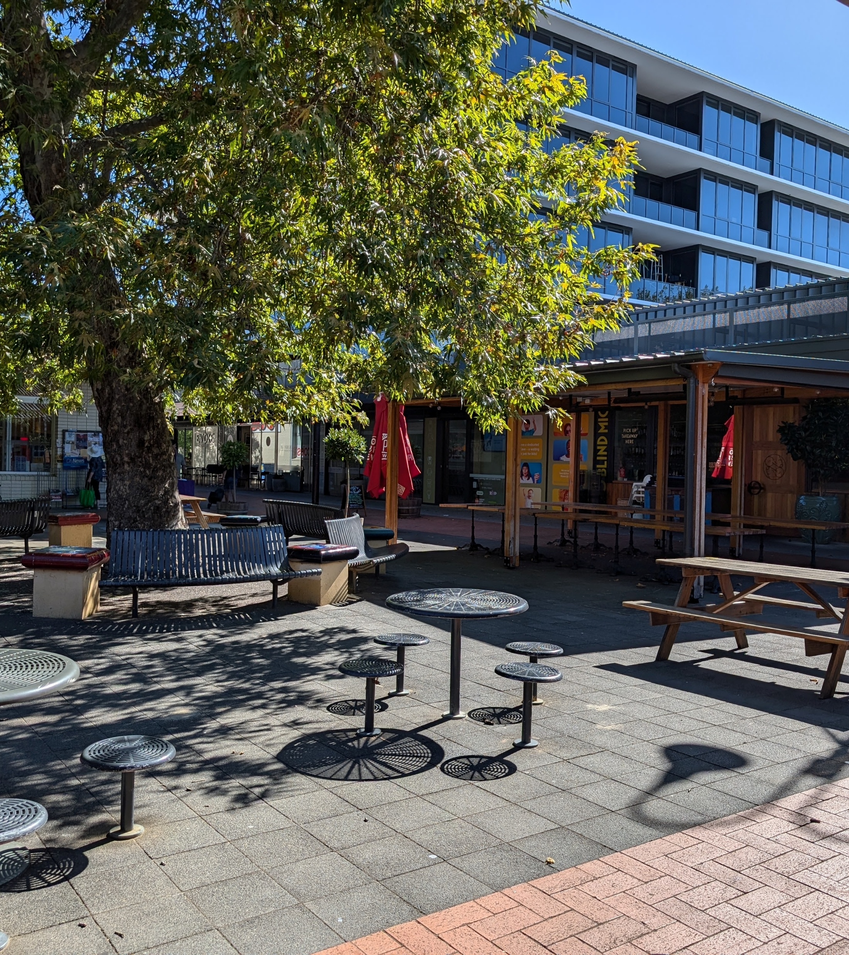
Walkability
What is a walkable neighbourhood?
Macro-scale elements
Land zoning that provides:
  a complementary mix of land uses
  density and diversity of housing
  destinations to walk to - including fresh, healthy food
Integrated transport planning that:
  prioritises walking, wheeling and bike riding
  provides convenient access to public transport
  manages the volume and speed of traffic
Sense of place and community - places to connect with others
Notes:
At the macro-scale, walkability features are (as identified on the slide)
We can break walking into walking for transport and walking for recreation.
Walking for transport means a person is walking to get from point A to point B, to reach a destination, for a purpose.
Examples include walking to the local shops, community facilities, park or playground, a public transport stop or somewhere else.
Recreation walking is walking for the purpose of being physically active, and/or for mental and social health.
It might include walking the dog, walking with friends, walks in nature or other types of walking.
Macro-scale walkability features are particularly important to enable walking for transport purposes.

Slide 11
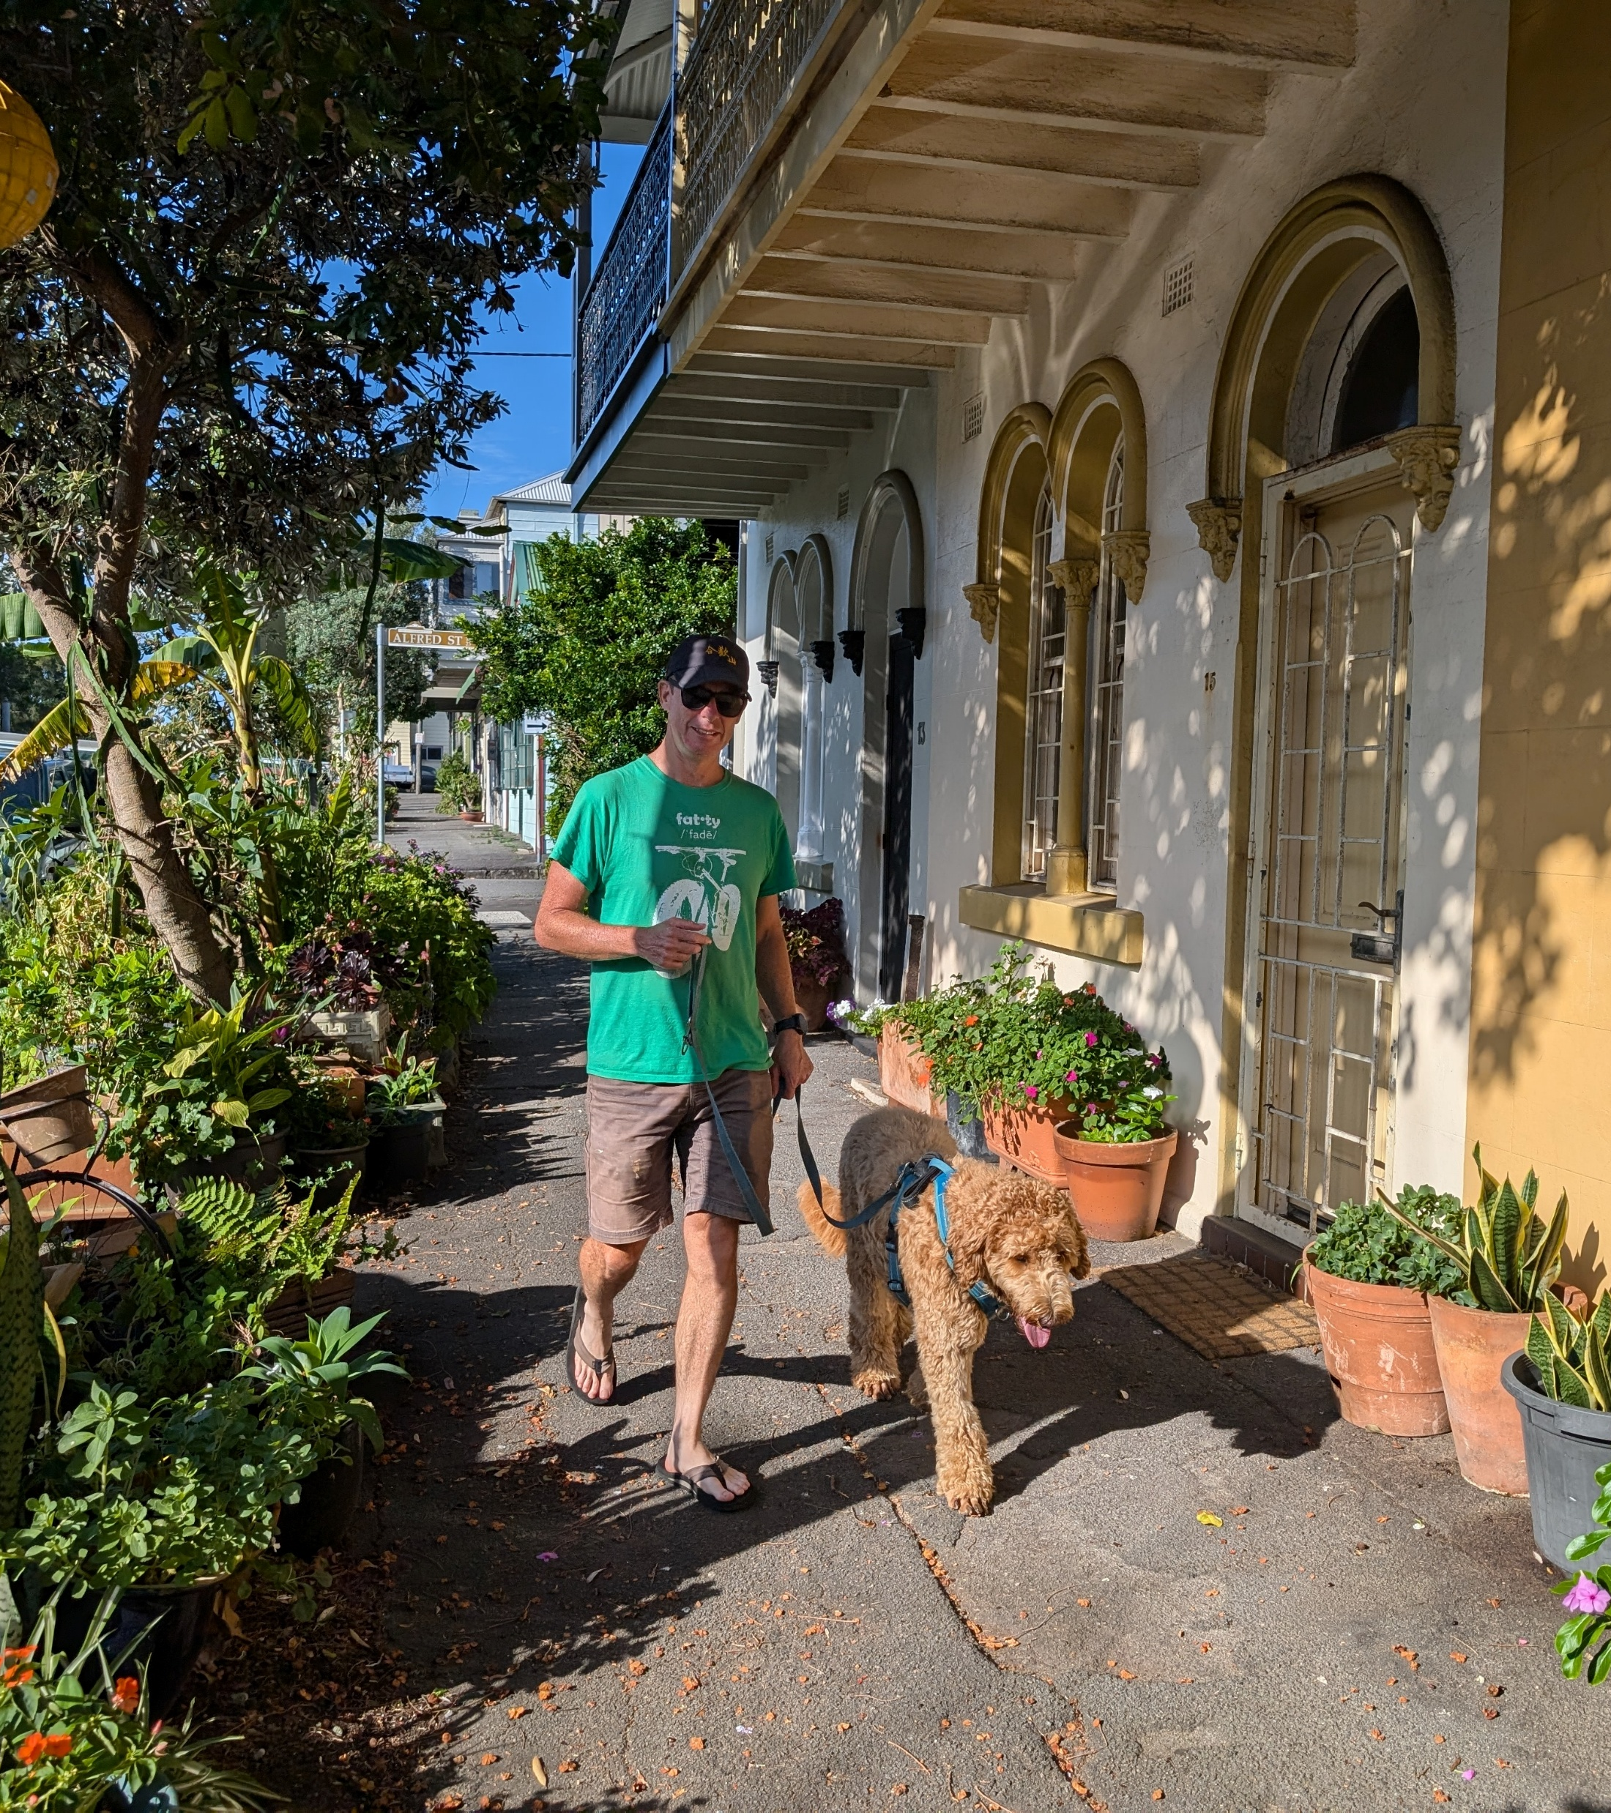
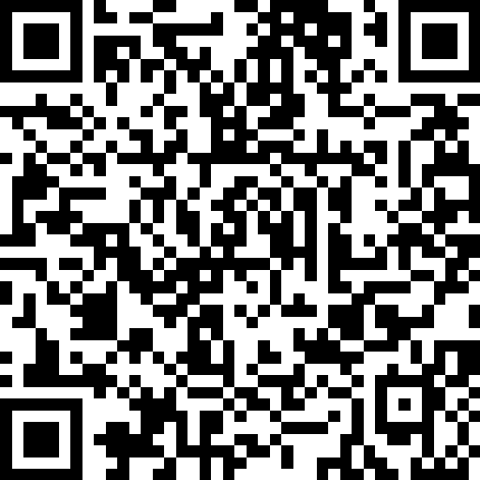
Walkability
What is a walkable neighbourhood?
Micro-scale
Network design
  Condition, maintenance and width of footpaths
  Connectivity – intersections and road crossings
  Separation from other modes of transport
Tree canopy, greening and shade
Shelter
Amenity
  Personal safety – street lighting
  Places to stop and rest
  Low levels of noise and air pollution
  Active street frontages
Sense of place and aesthetics
  Points of interest and public art
  Streetscape facades
Notes:
At the micro-scale, features of walkability are those outlined on this slide.
These features are important for both transport and recreation walking.
You can see on the slide here, these are (read from the slide)

Slide 12
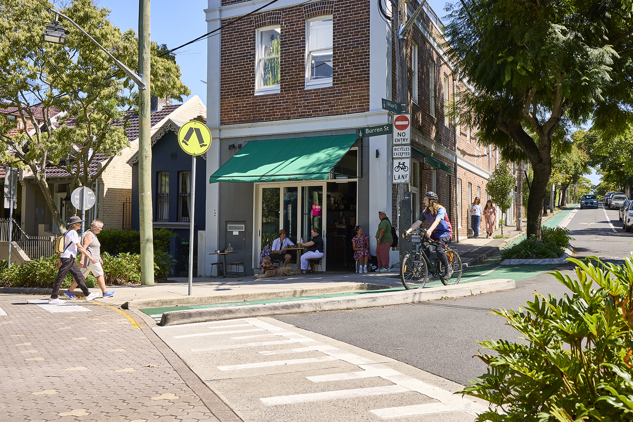
Healthy Active by Design
Notes:
This section of slides provides an overview on Healthy Active by Design – what it is, why it’s been developed, what resources it includes, and how it can be put into practice for real world outcomes
The digital toolkit can help with:
Facilitating better decision making
Explaining benefits to the community
Enhancing collaboration
Explaining benefits internally

Slide 13
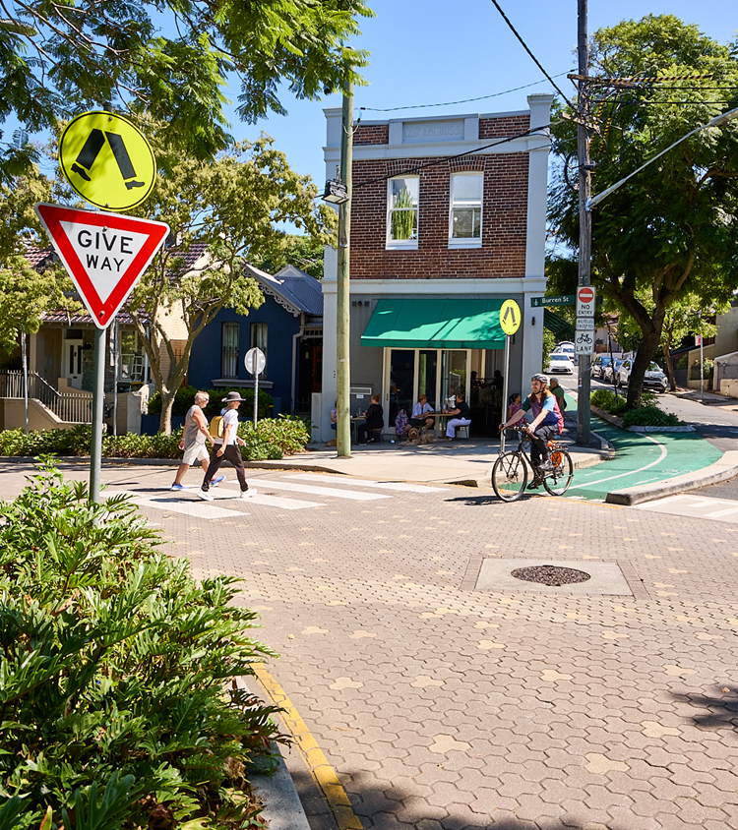
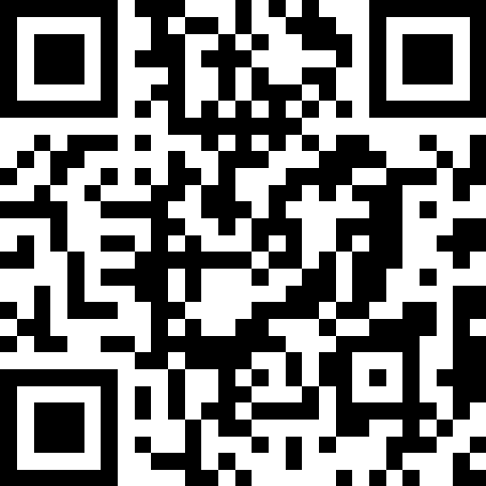
Healthy Active by Design
A digital toolkit to support decision makers, practitioners and others
to embed public health outcomes into
the design and delivery
of urban environments
Est. 2008
In partnership with:
Australian Local Government Association
Planning Institute of Australia
www.healthyactivebydesign.com.au/
Notes:
Healthy Active by Design was established in 2008.
It was initially called ‘Healthy Spaces, healthy Places’, and was developed as a partnership between the Heart Foundation, the Planning Institute of Australia, and the Australian Local Government Association.
The Heart Foundation maintains strong working relationships with both organisations, although they now own and manage the program outright.
It’s won national and international awards.
Specifically, the program translates evidence on the link between heart health and built environments into practical guidance for real-world outcomes and solutions.
It’s a comprehensive toolkit of materials and resources about the design and delivery of healthy built environments.
The resources are applicable in urban, rural and regional contexts.
And for established and new growth areas.
All the materials available are positive and constructive; enabling and empowering

Slide 14
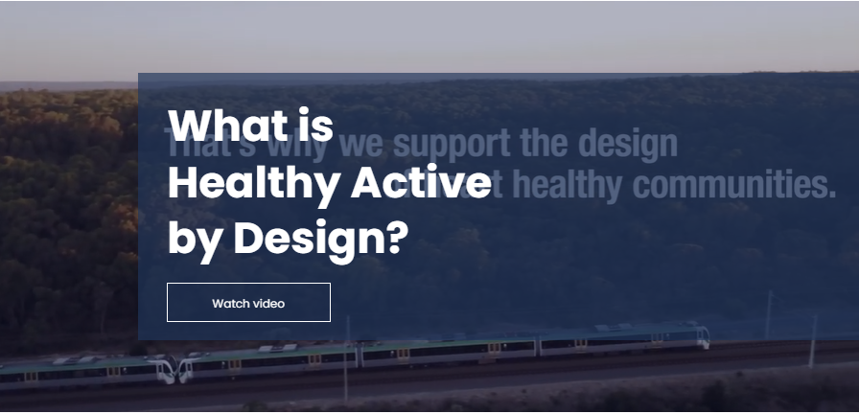
Making it easier for you to create healthier places
Having the mandate for change
Three key avenues:
Evidence and data to support change through:
  advocacy
  funding
  project design & delivery.
Community support
Support from decision makers and elected leaders
Notes:
Healthy Active by Design is intended to make it easier for us to do our job!
It’s intentionally designed as principles and guidance, and not another layer of technical or design specifications.
It’s designed to be flexible enough to incorporate and embed easily into our work; while also providing robust evidence to support change for active living.
The resources are all easy to use; and non-linear. We can simply select what we need to support our projects and purpose, from anywhere within the program.
And best of all, it’s all available free of charge, online, downloadable; and accessible for anyone to use; at anytime.
The three main ways that the resources make our job easier are through the aspects noted on this slide:
The provision of evidence
Ways to gain community support and
Influencing change with decision makers.

Slide 15
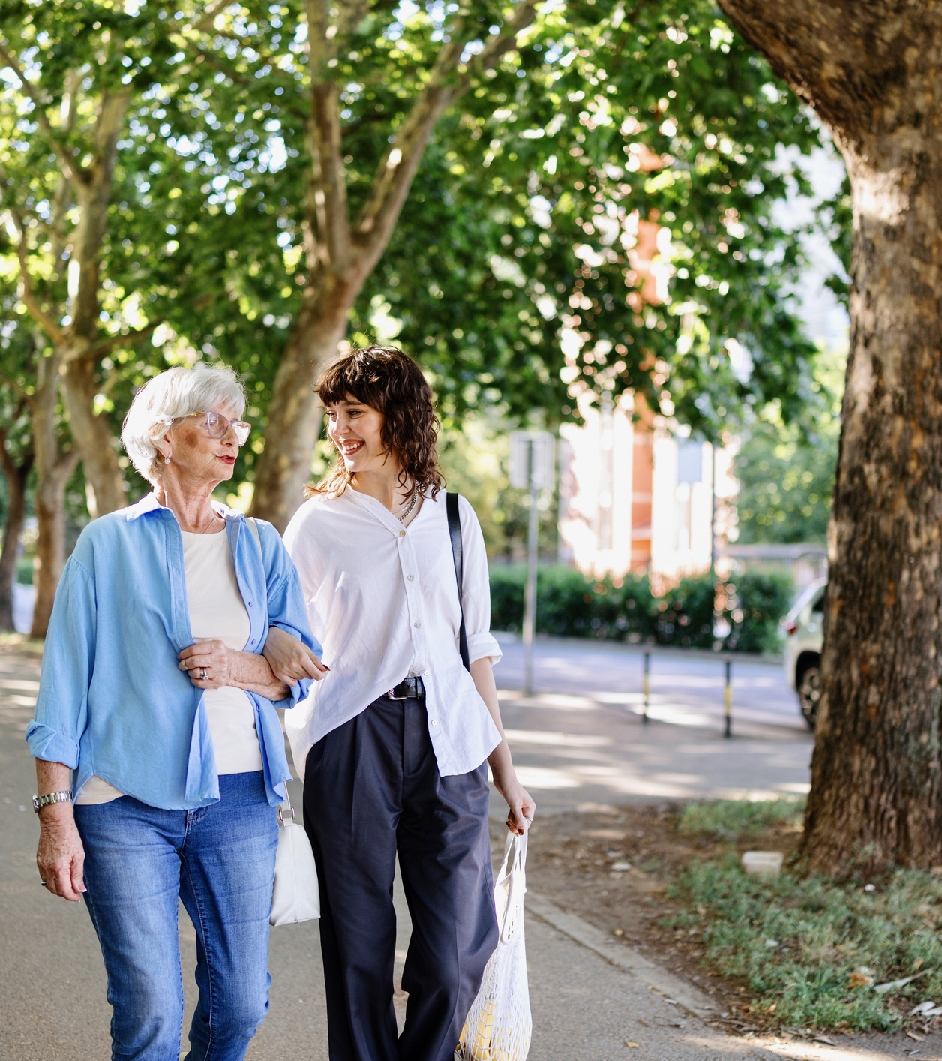
Healthy built environments
Audiences
Two key programs:
Healthy Active by Design – industry
Walkability – community
Notes:
The program has two key audiences – industry and community.
Industry includes urban and transport planners, urban designers, traffic engineers, architects and landscape architects, civil works and asset managers, decision makers, elected leaders and others.
Anyone who has a role to play in shaping outcomes in the built environment.
And, as already noted – that’s everyone! Including community members.

Slide 16
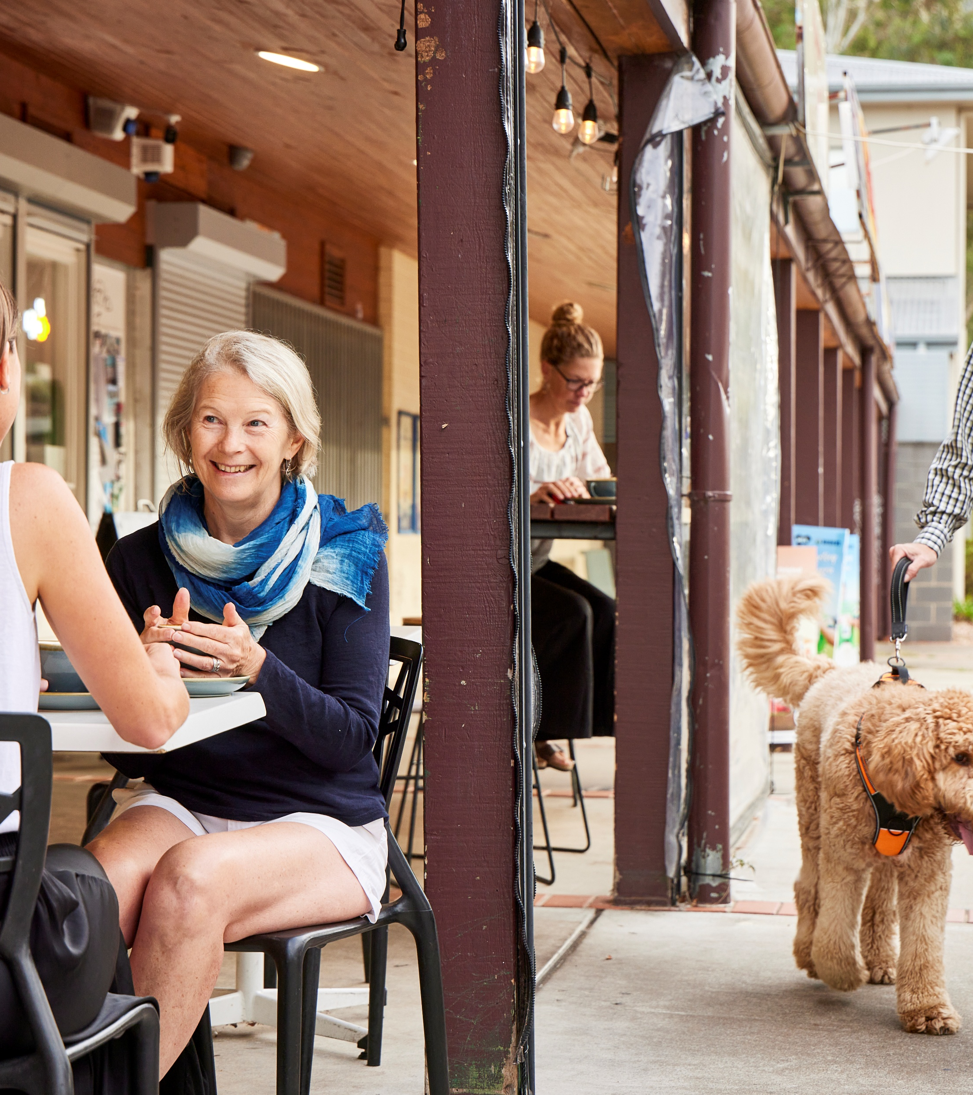
Industry resources
For industry practitioners
For industry practitioners
Introductory training module
Design features
Supporting modules
Evidence papers
Monthly blogs
LinkedIn and e-newsletters
Advocacy submissions
Supporters' Toolkit
Notes:
The main resources available for industry are noted on this slide.
We’ll step through each of these over the next few slides (or via a site walk-through)

Slide 17
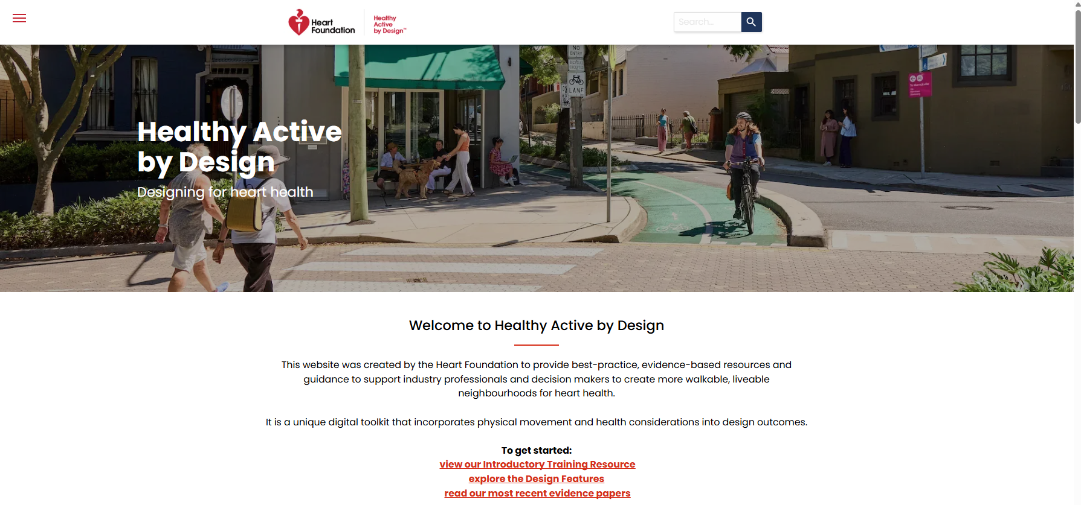
Site walk through for industry
Notes:
Walk through the site – click the link on the text to open Healthy Active by Design.
The next few slides can be used to support this; or the speaking notes accompanying each slide can be used to support the site walk-through.

Slide 18
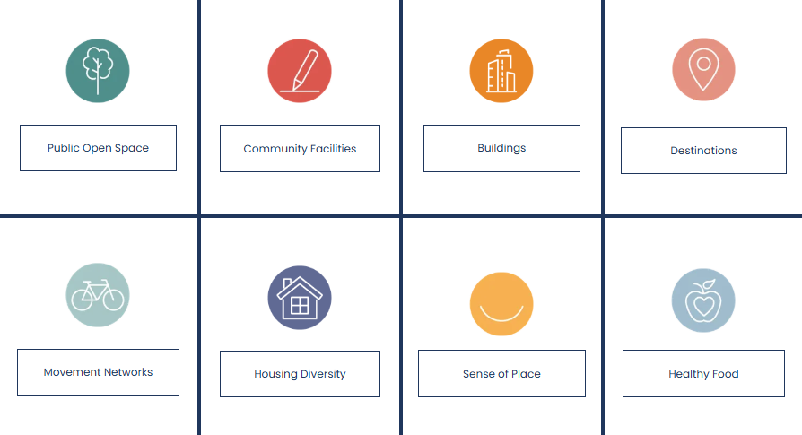
Healthy Active by Design
For industry
Eight design features
Each design feature includes:
impacts on health
evidence base
case studies
international examples
design checklists
Notes:
There are eight design features, covering the key aspects of walkable local areas.
(As listed on this slide)
Each Design Feature contains information on the evidence and health impact, case studies, international examples and a design checklist.
Recent industry surveys have identified that movement networks and public open spaces are the most valuable design features.
However, all are relevant and applicable across different projects and areas of council

Slide 19
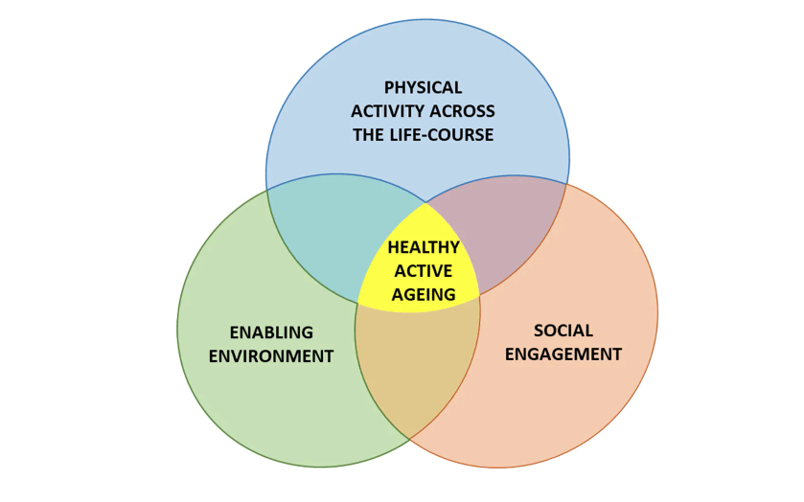
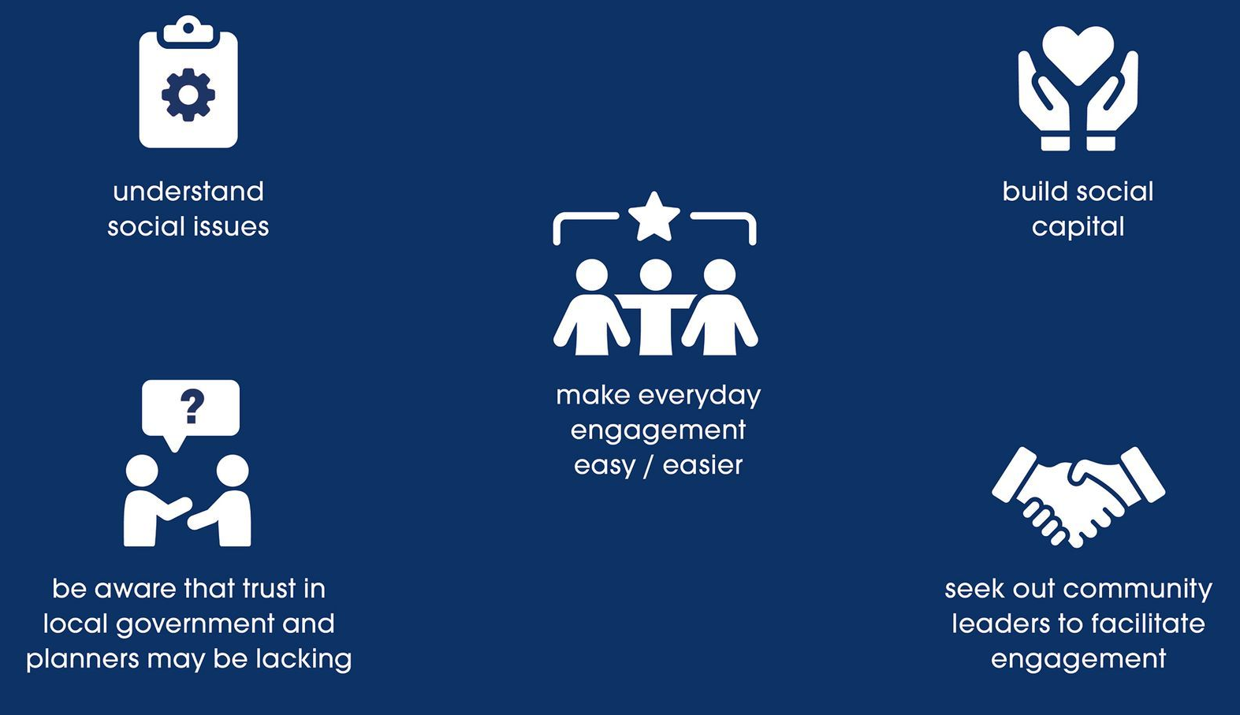
Healthy active ageing
Supporting modules
Walkability
in less advantaged areas
Source: Baldassar, L. & Atkins, M.T. (2020) Healthy Active Ageing Rapid Evidence Review, Heart Foundation
Notes:
There are also two supporting modules – one for Healthy active ageing, and another for Walkability in less advantaged areas.
Both have been developed in recent years to recognise and address nuanced circumstances relating to heart health and walkability for priority populations.
Their format and structure is the same as each of the eight design features; with information about the health evidence and impact, case studies, international examples and design checklist.
Both are intended to apply as an overarching ‘umbrella’ overlaid across the eight design features.

Slide 20
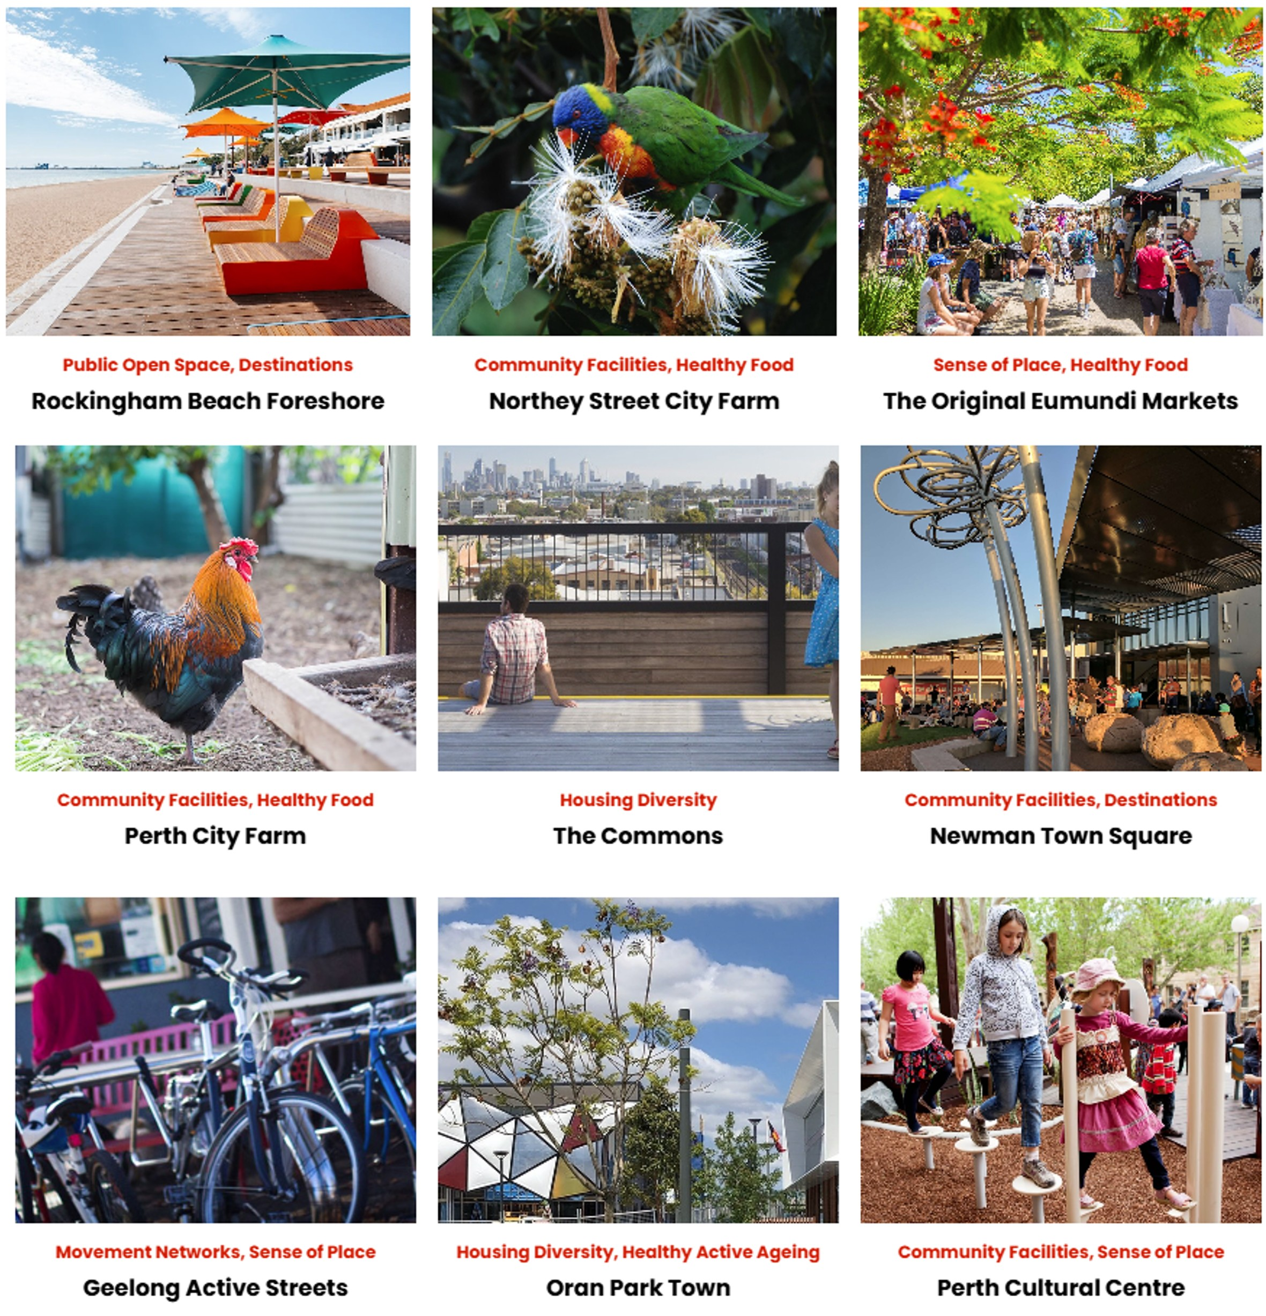
Case studies
Notes:
Case studies are one of the most valued features of Healthy Active by Design.
They’re useful as sources of inspiration; and can readily demonstrate to elected members, decision makers and community about how projects have been undertaken successfully elsewhere.
It’s rare that there isn’t a precedent for a similar project to a new proposal we might be developing.
And, with around 170 case studies available on Healthy Active by Design, it’s rare that we wouldn’t be able to find a similar example to help support our projects.
Each case study follows the same format, with information about cost, benefits, impacts and more. These consider environmental, social, economic and health benefits and costs.
The Heart Foundation welcomes the submission of case studies at any time, and love to help showcase and promote best practice and councils who are undertaking great work.
A submission template is available on the Case Study page. It takes around 30 minutes to complete.
New case studies are promoted via upload to the Case Study webpage; Healthy Active by Design LinkedIn, the bi-monthly EDM, and other communication channels

Slide 21
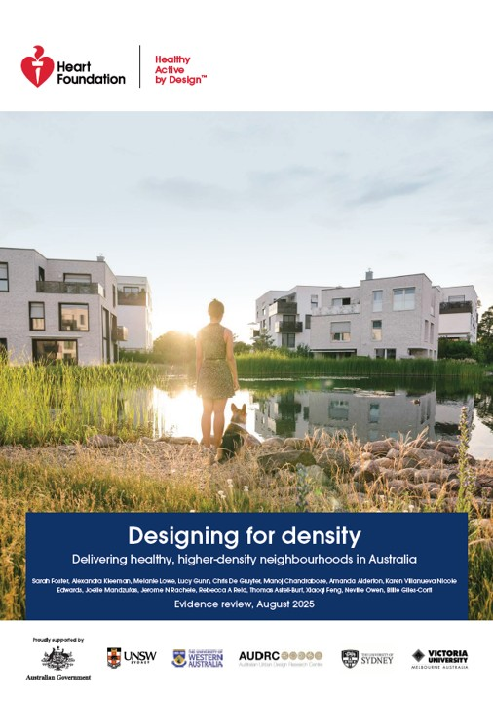
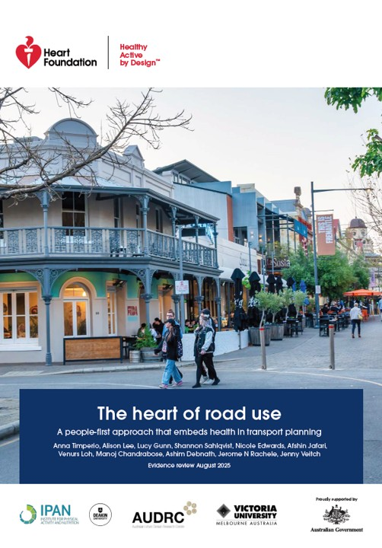
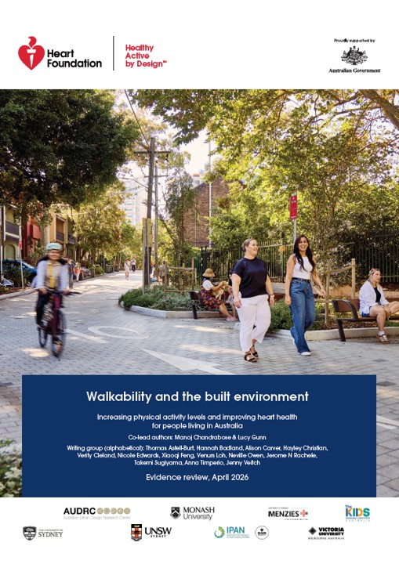
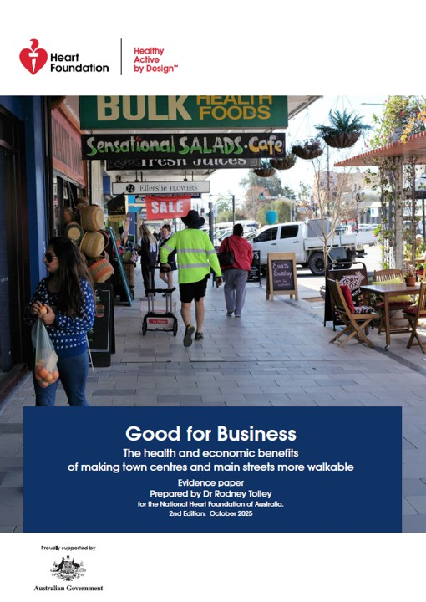

Evidence papers
Publications and policies
Publications and policies
Recently launched (2025)
Active school travel
Designing for density
The heart of road use
Good for business
Walkability and the built environment
Notes:
A range of publications and policies are available.
Many of these have been developed by the Heart Foundation, in collaboration with the generosity of esteemed academics and researchers from various institutions across the country.
The program would not be what it is without these contributions, and the Heart Foundation notes their gratitude to the many, many people who have, and who continue to contribute time and effort.
Resources are continually being updated and enhanced.
In 2025/26 new evidence papers were launched:
Designing for density
The heart of road use
Good for business
Active school travel
Walkability and the built environment
In each of these papers there’s a wealth of evidence on the relationship with heart health, and the importance to design walkable local neighbourhoods and prioritise a people-first approach that supports community health and wellbeing.
Each paper includes clear recommendations and actions to readily translate the evidence into practice.
There are also a range of other publications and policies developed nationally and internationally; and relevant policies are grouped by state and territory.
These are all great to help frame messaging and narrative for project support – internally and externally.
The papers and other resources can be used particularly to support:
Policy and strategic vision
Business cases and budget bids
Project outcomes
Advocacy

Slide 22
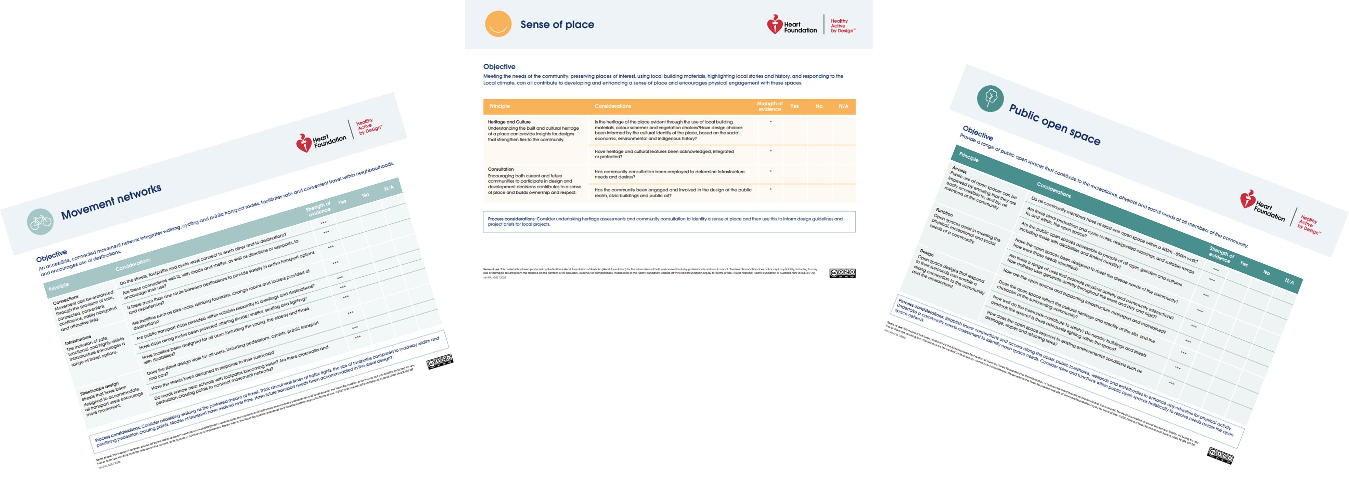
Design checklists
Available for each of the:
8 design features
2 supporting modules
Notes:
The Healthy Active by Design point of difference in urban design outcomes is embedding public health principles in built environment outcomes – particularly from a heart health lens.
Design Checklists are perhaps one of the most practical ways in which this can be achieved.
Design Checklists can be applied to:
audit established/existing built environments
Inform improvements and upgrades
Inform new projects – at small or large scale
Serve as a useful list of things to consider

Slide 23
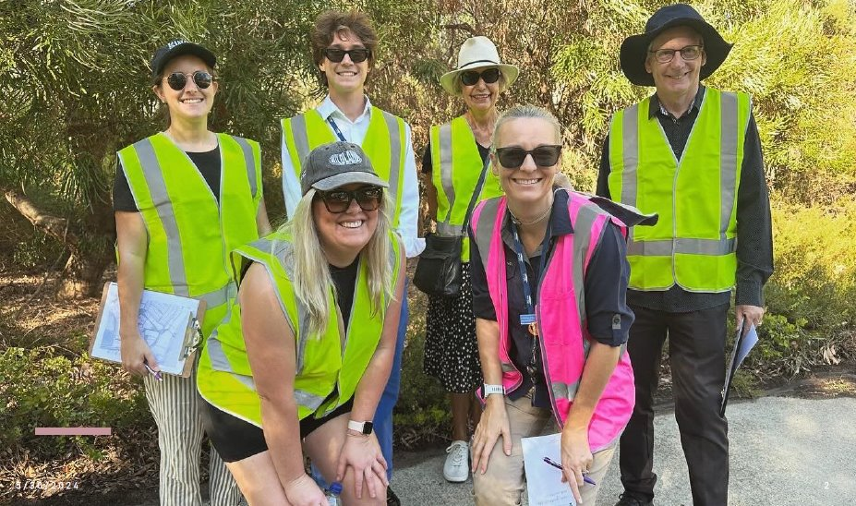

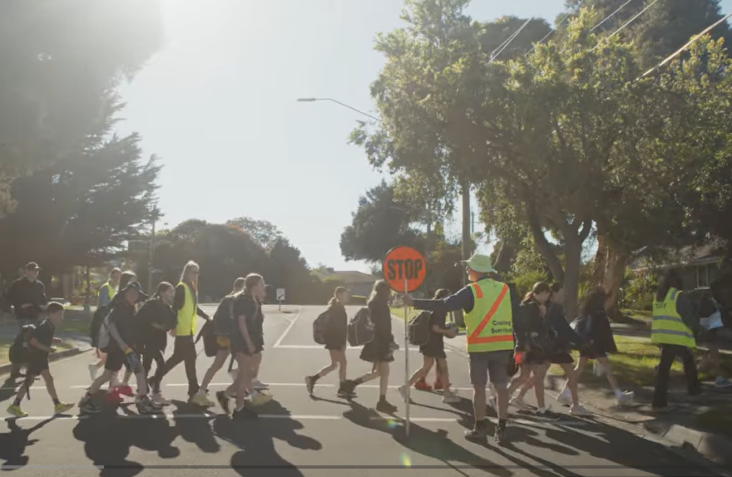
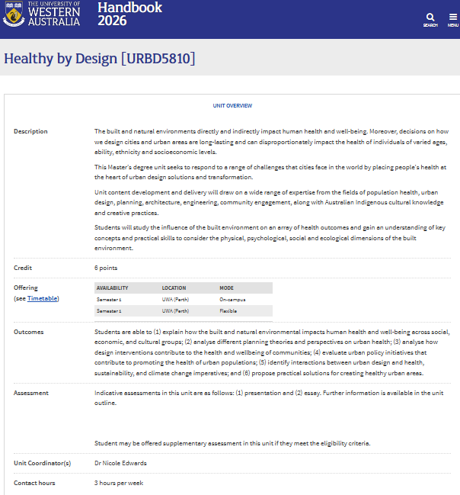
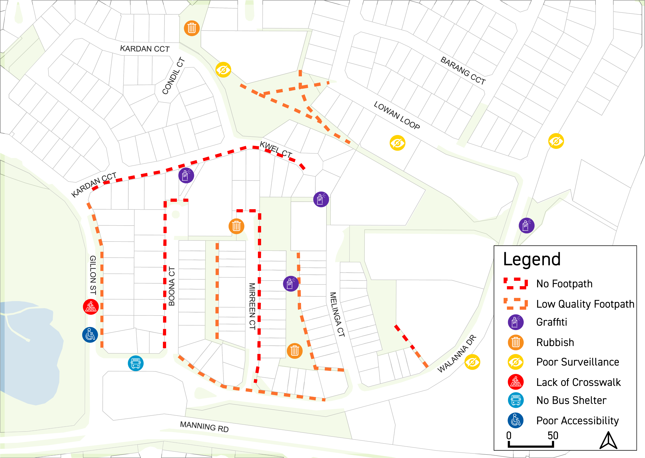
Real world examples
1
2
3
Karrawarra Issues plan
Notes:
Some real-world examples on ways in which Healthy Active by Design resources have been put into practice include:
1. The City of South Perth, WA has embedded Healthy Active by Design principles in their local Public Health Plan. This has enabled them to use Design Checklists to carry out an audit of the suburb of Karrawarra. Results of their audit have informed works programs within council and have been welcomed by City Planning teams to inform priorities.
2. The Access Health and Community Health Promotion team in Victoria were involved in a collaboration between two local schools and with the Infrastructure/Engineering team at Yarra Ranges Council in an Active Travel/Walk to School initiative. The work was strongly guided by the evidence in the Heart Foundation’s Active school travel evidence paper, to develop a multifaceted approach. Short video about the project available: https://www.youtube.com/watch?v=QzYoRVEtpUc
3. Resources are incorporated in various University courses across the country – training the next generation of public health practitioners and urban planners, transport planners and others to embed healthy built environments from a cross-disciplinary approach.

Slide 24
Pause for questions
Notes:
Pause for questions

Slide 25
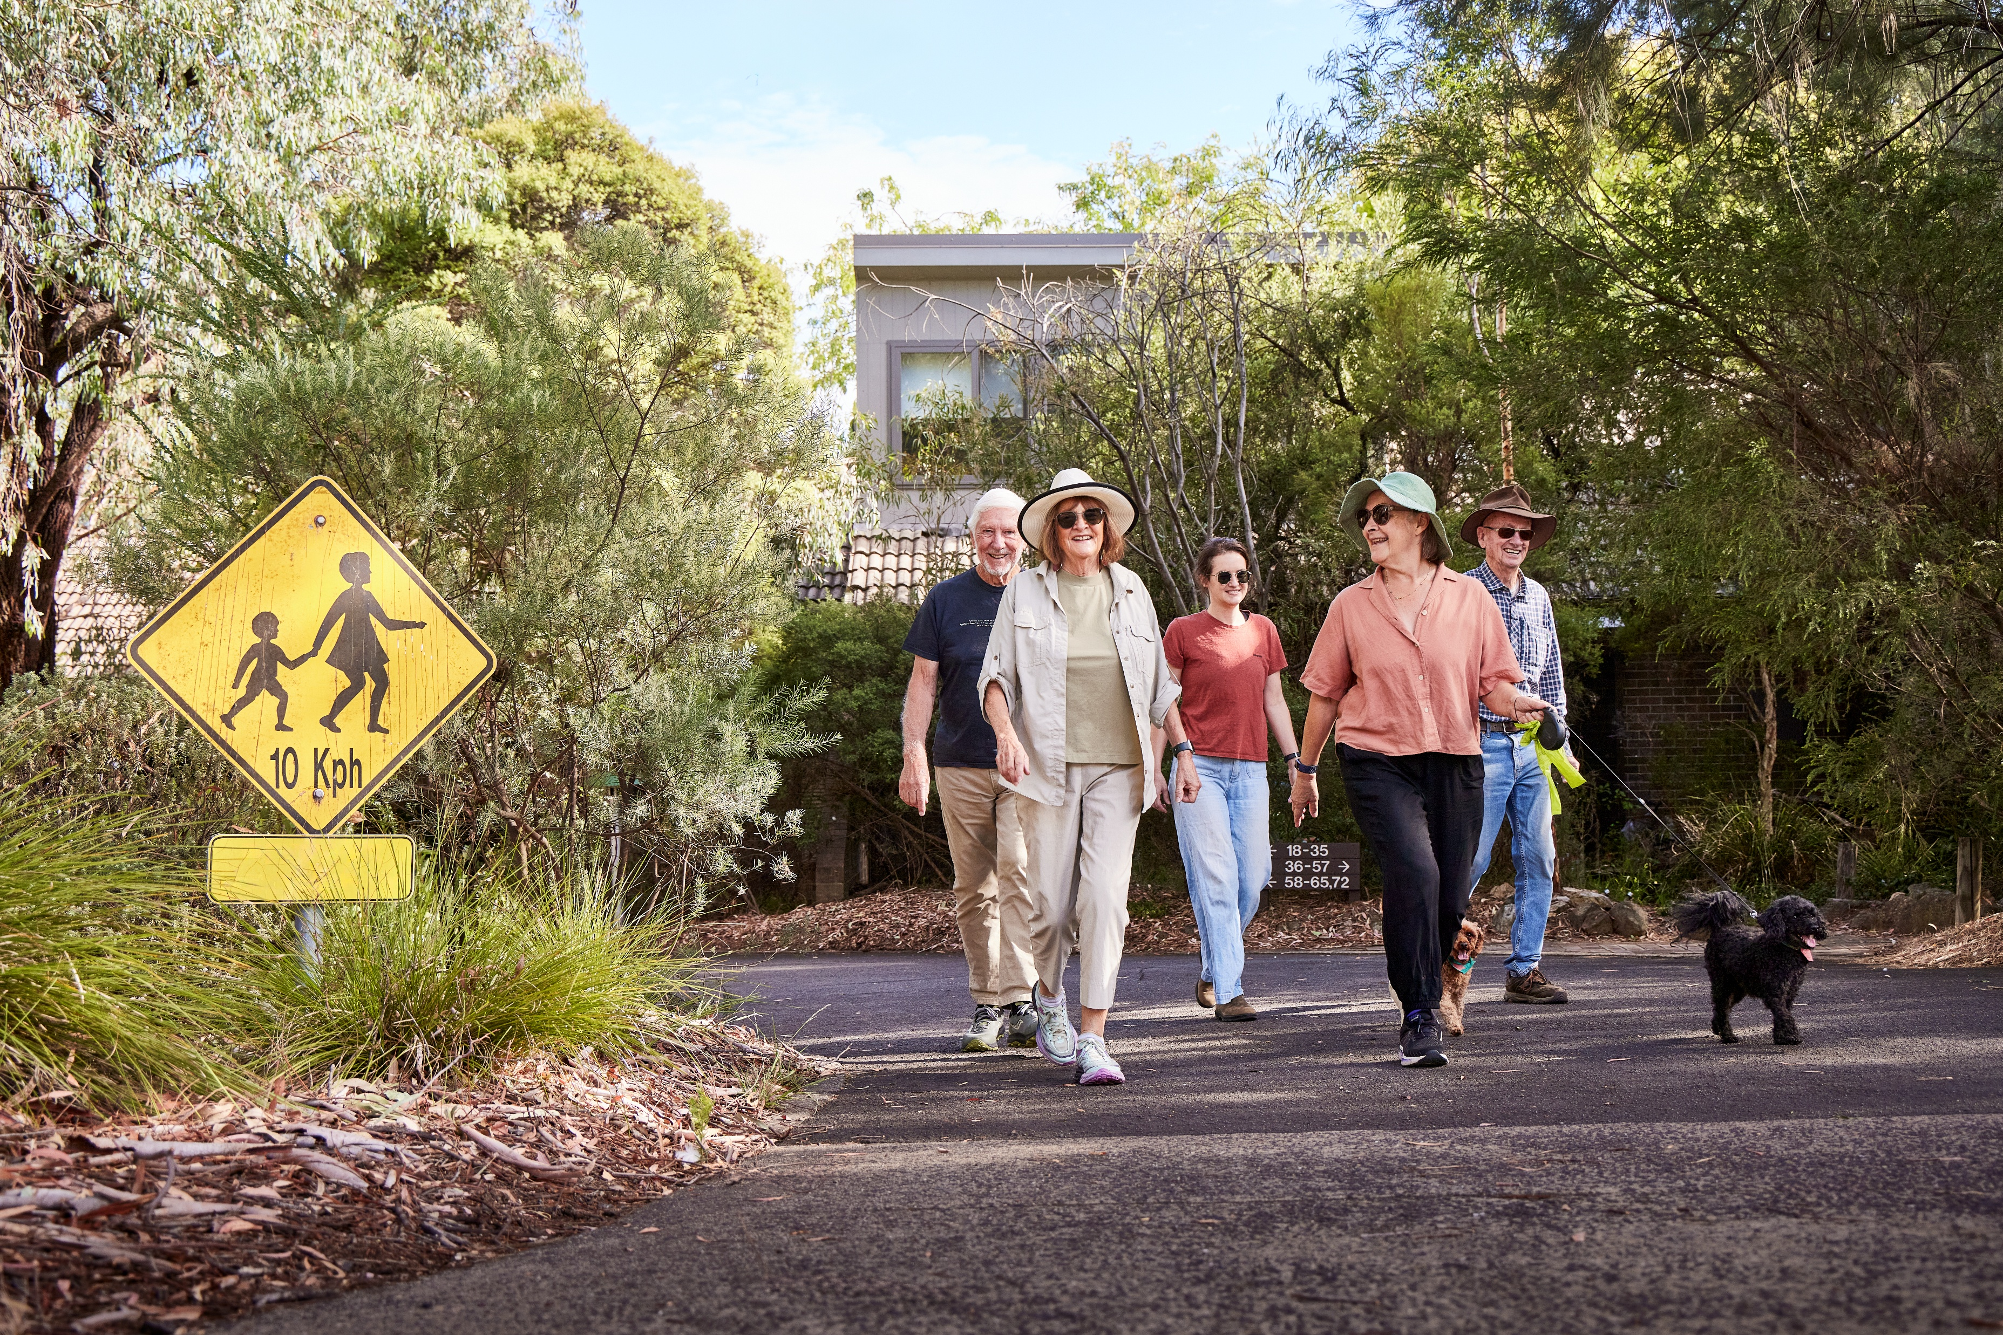
Building relationships with the local community
Notes:
This next section of slides provides an overview on building positive relationships with the community.
The community are our allies; and Healthy Active by Design provides a range of tools to help us and them; to help build positive relationships so that we’re all on the same page; and to ensure that we have support when we need it.

Slide 26
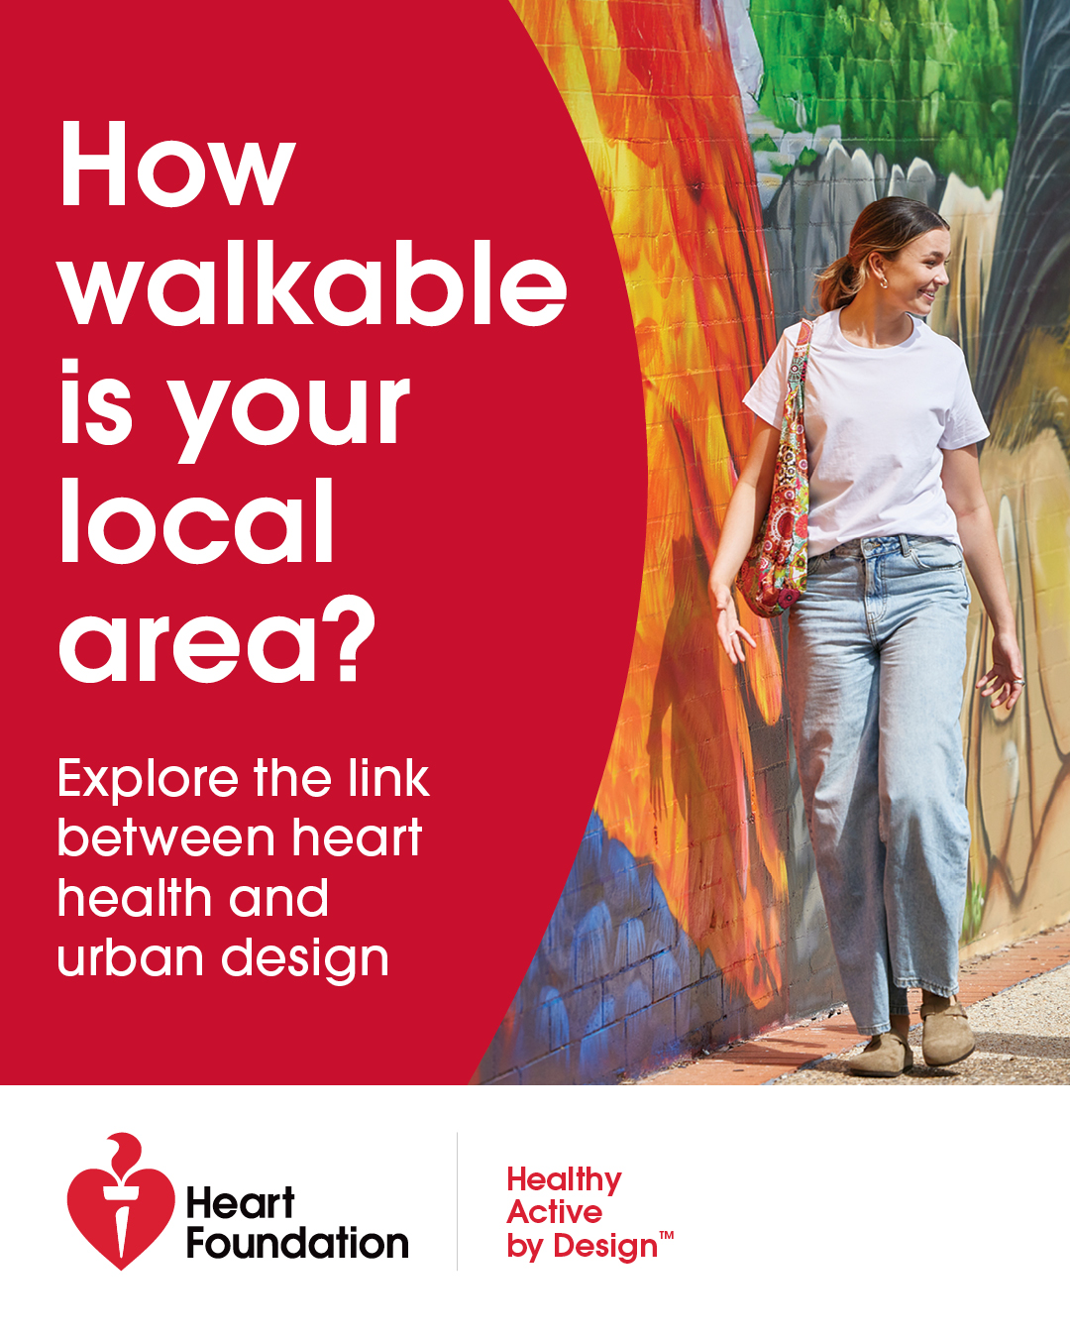
Building relationships with the local community
A partnership approach
The role of community members
Awareness
Advocacy
Action
Behaviour change
Notes:
Healthy Active by Design resources are intended to align community expectations with council objectives.
They help develop a shared understanding and build trust.
There are lots of ways that community members can be involved, and support our work, through awareness, advocacy, action and behaviour change.

Slide 27
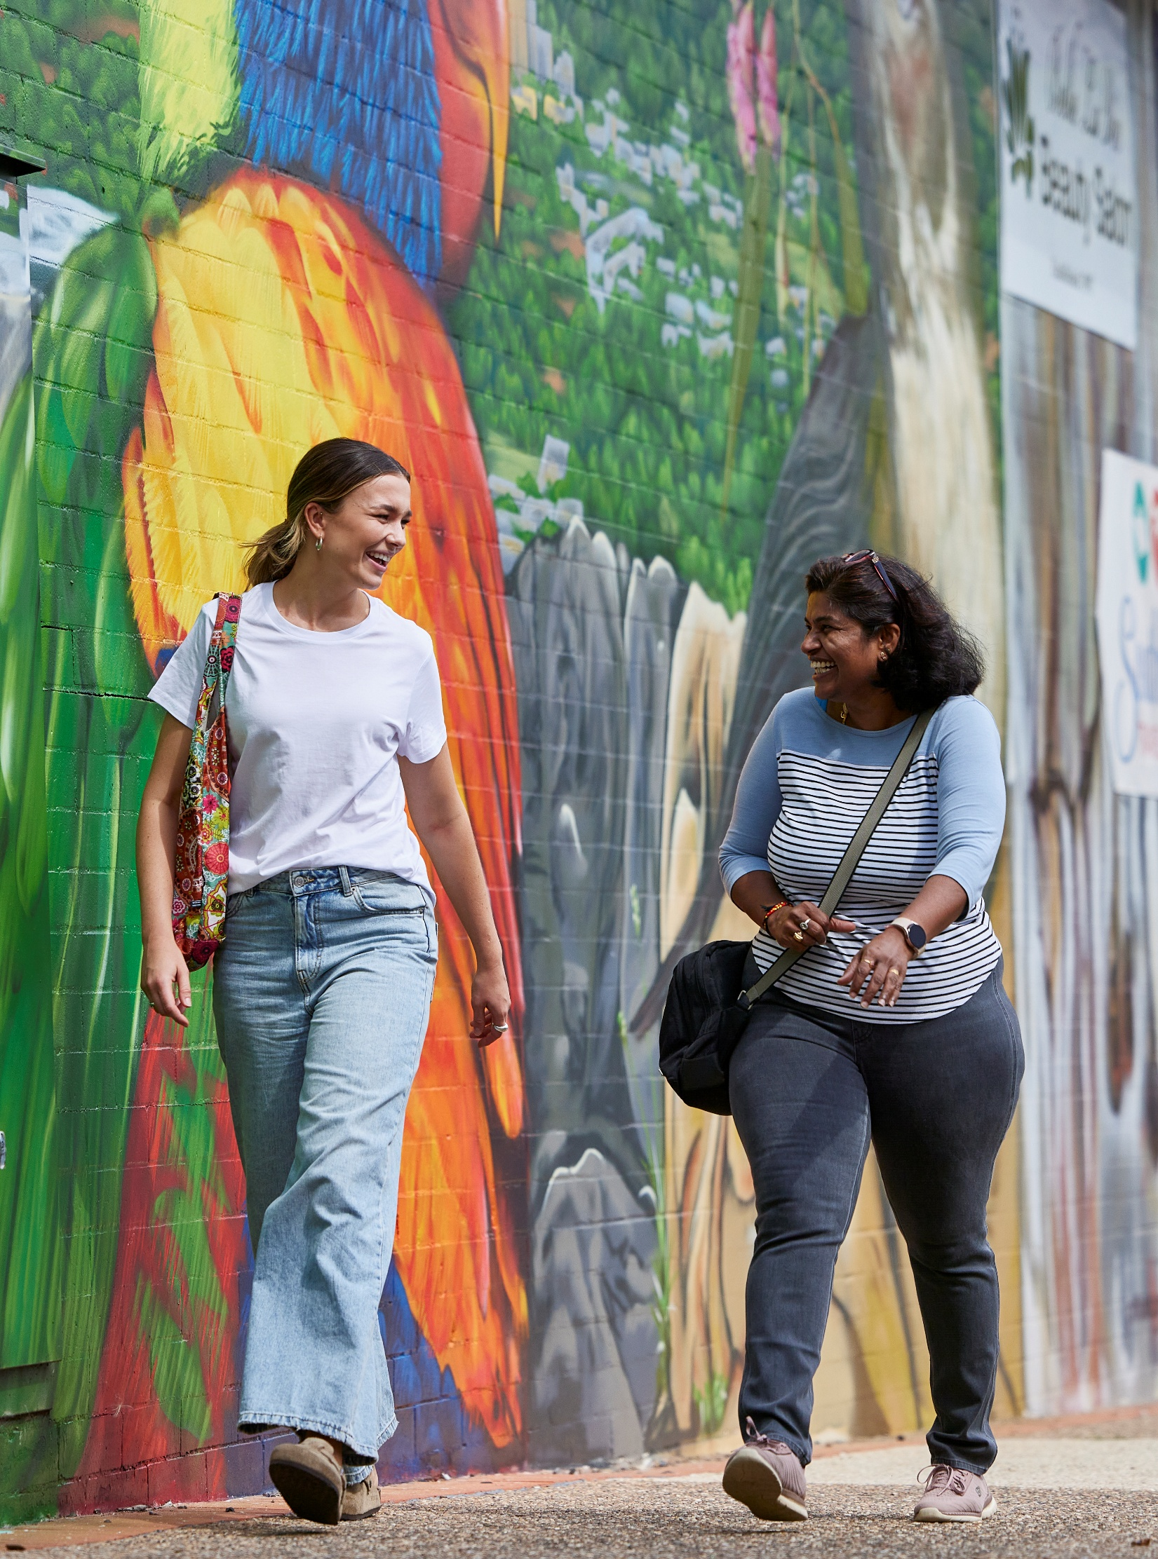
Community resources
For community
Fact sheets
Petition
Community Walkability Checklist
Interactive Map
Local Action guidance
Supporters’ Toolkit
Notes:
The next few slides will step through each of these key resources in detail, outlining their role in supporting our work; and how we can use them.

Slide 28
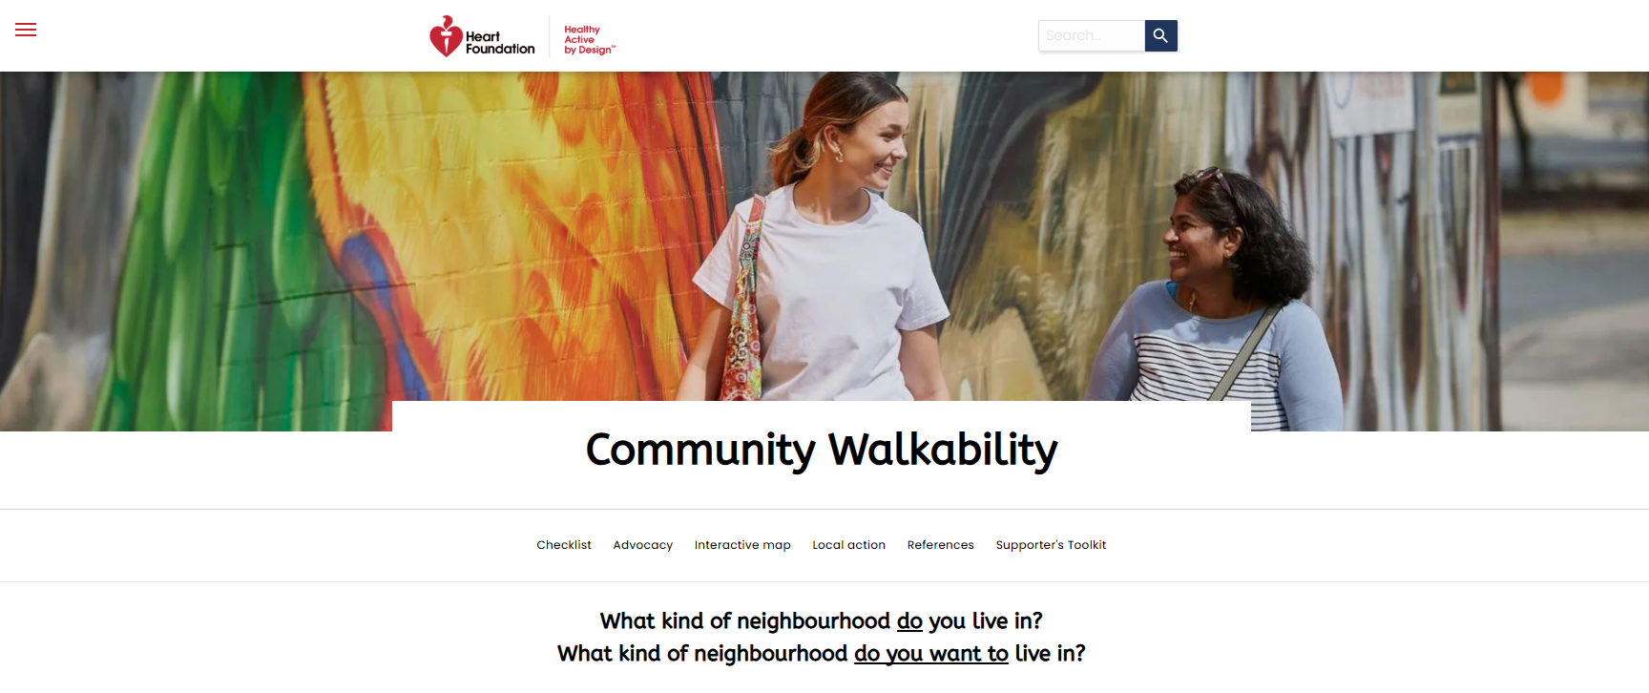
Site walk through for community
Notes:
It’s often interesting to think that people generally enjoy visiting walkable places when they go on holiday; and sometimes express how nice it is to leave the car behind and explore by foot or using local public transport. It would be nice to think that we would value this same experience in our local neighbourhoods. Yes, people tend to have more time when they’re on leave and the experience is quite different. But there’s an opportunity to translate some of this into everyday lives too.
We can also use this to our advantage in messaging about walkable local neighbourhoods.
We’ll talk more about this in a later slide.
Walk through the site

Slide 29
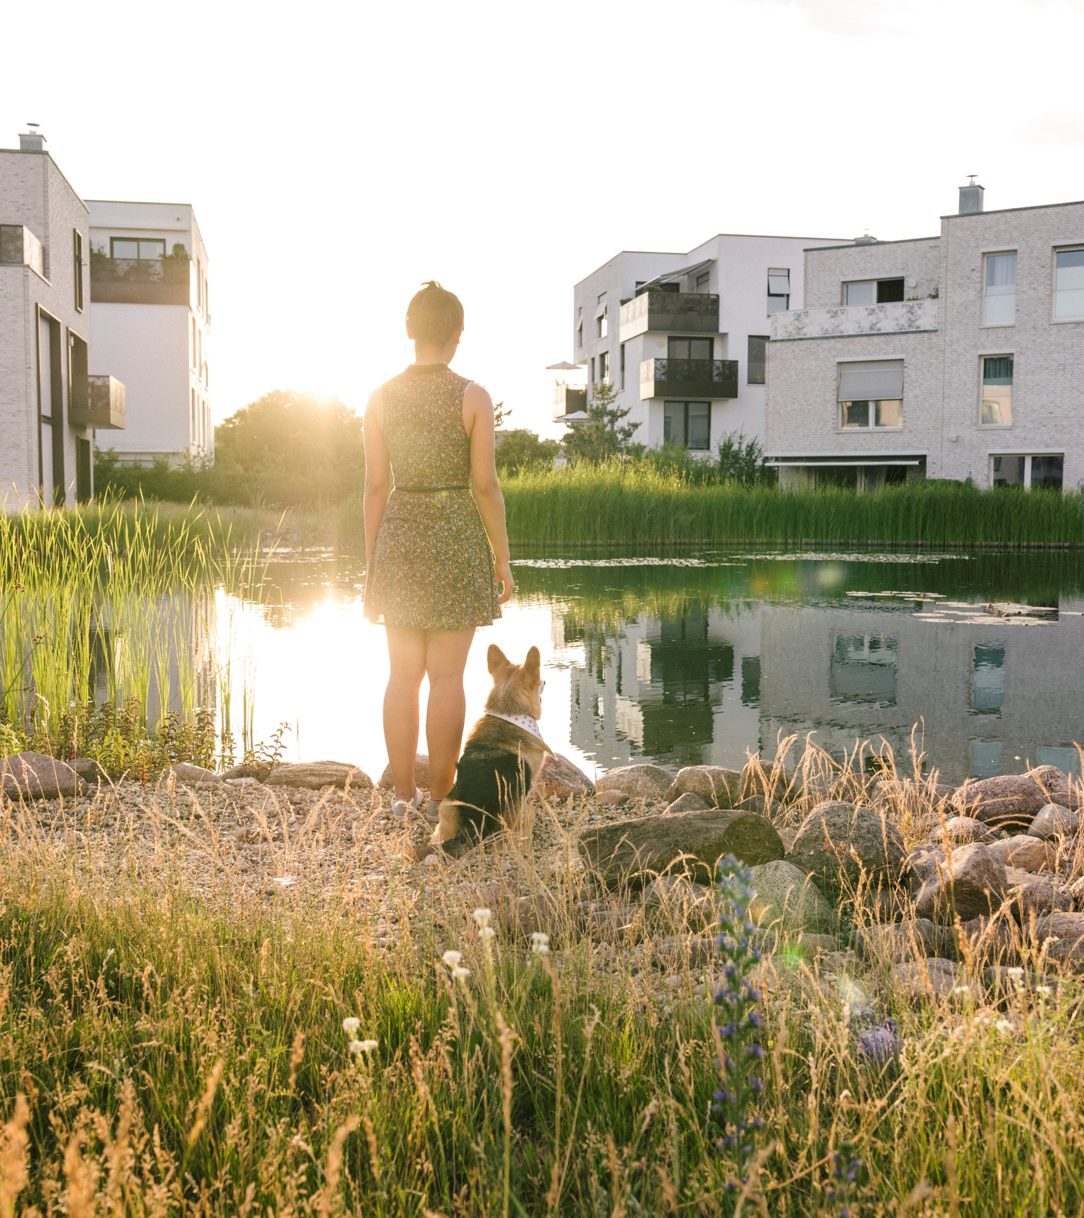
Fact sheets
Awareness
Community awareness about how local neighbourhoods can impact heart health
Fact sheets available:
Heart health, walkability and the built environment
Designing for density
Active school travel
Benefits of walkability for local business
Green and blue spaces in urban areas
Road use allocation for more walkable local areas
Equity and inclusion in walkable neighbourhoods
Impacts of climate change on walkable neighbourhoods
Walkability, social connection and heart health
Notes:
First in the series of community resources, is a series of short fact sheets to help raise community awareness and understanding about healthy, walkable neighbourhoods.
Some of these help tackle subjects that can be challenging and controversial, and which can result in community opposition – things like density, road use allocation and climate change.
These fact sheets can be used in our engagement with local communities.
This can help frame messaging and narrative with local communities.
We’ll talk more about this in later slides.

Slide 30
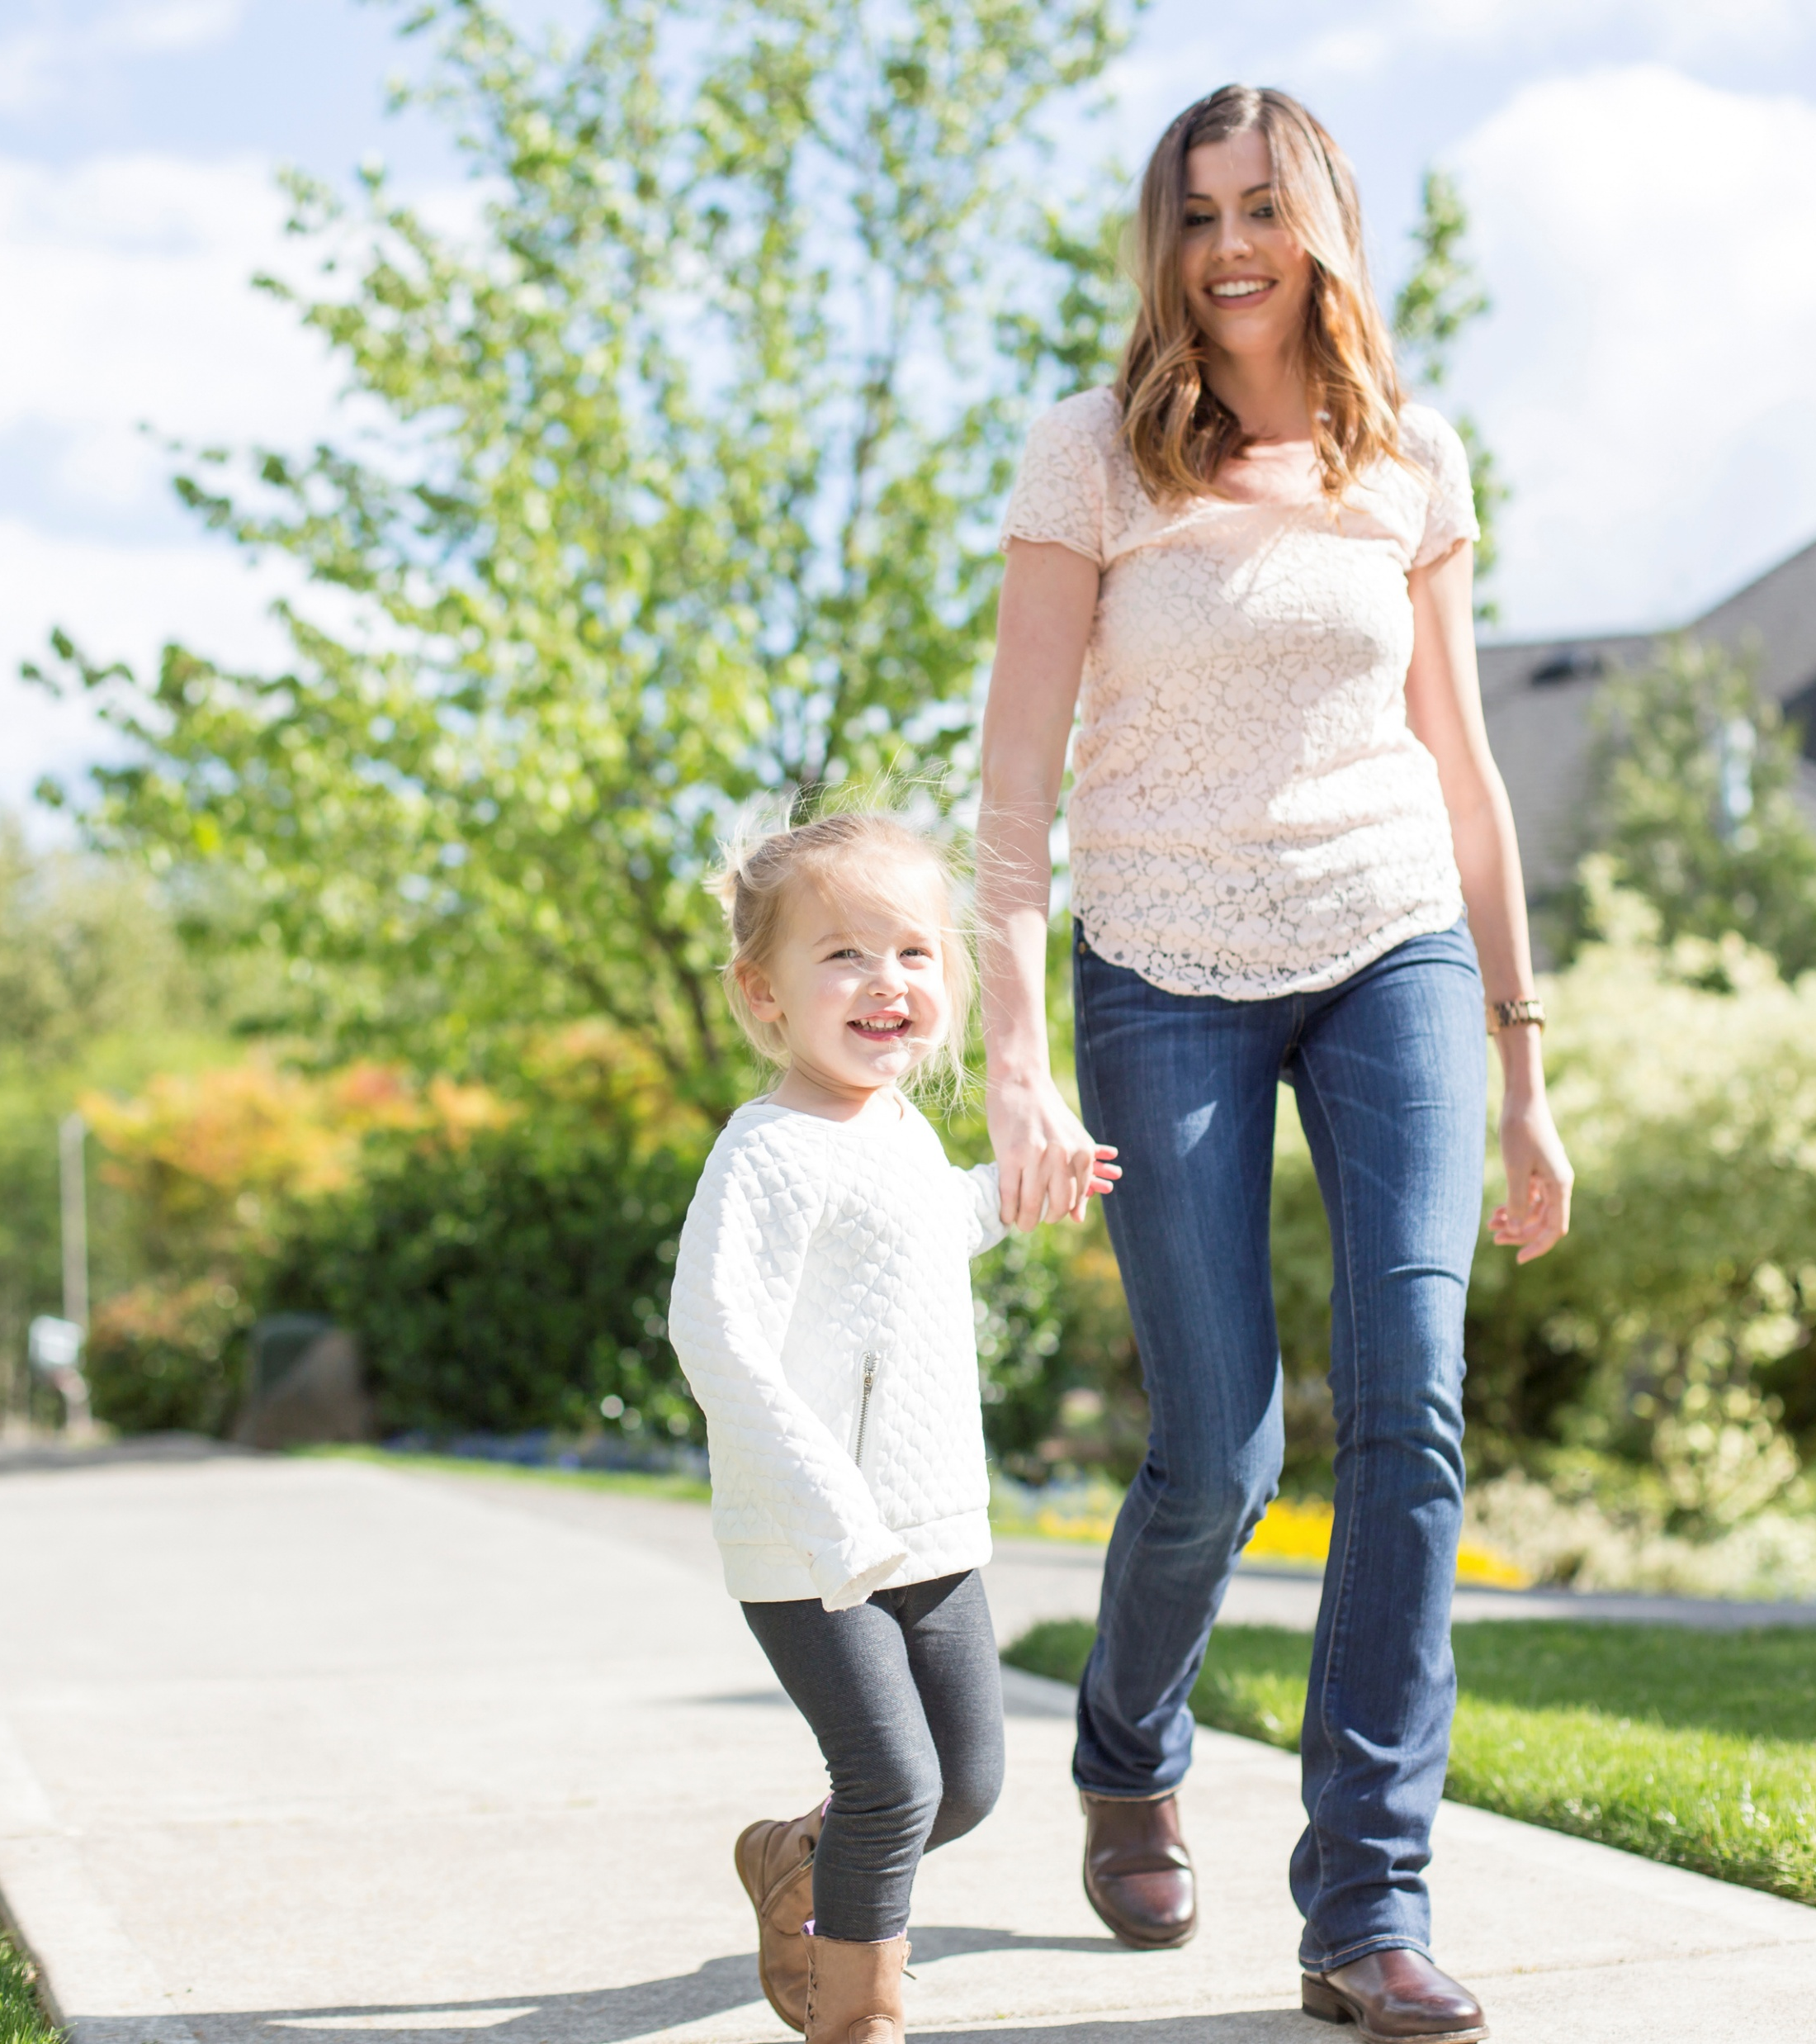
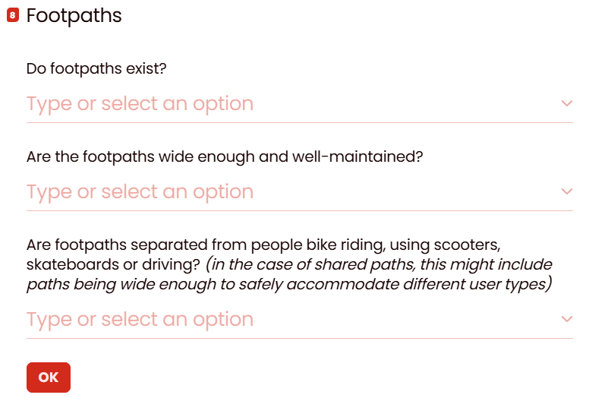
Community Walkability Checklist
Advocacy
Awareness | Advocacy
Community audit of local area walkability
Notes:
The Community Walkability Checklist has been developed as a detailed way for communities to engage with local council at a granular, local level.
There’s a short and long version of the Checklist, depending how much time someone wants to invest.
The Checklist allows community members to undertake an audit, or assessment, of the walkability of their local area.
It also serves as an awareness and educational tool for community members – helping them understand different features and aspects of their local area that contribute to walkability – at both the micro and macro levels.
The completion of the short version, online, will provide someone with a walkability rating; helping them understand the relative level of walkability of their local area.
This is relatively subjective, dependent on how they have input data and rated their local area.
The Checklist can be used to develop ongoing relationships with the local community, whereby audits/assessments at different times can help monitor an area and identify improvements made.
On completion of digital versions of the Checklist:
The respondent receives a PDF of the completed Checklist via email
The email includes the contact address to email PDF to local council
The PDF is also automatically provided to Heart Foundation
They keep a copy for their records, but don’t necessarily conduct a grouped analysis of these – largely because there often aren’t enough received in one area for analysis purposes
On completion of print versions:
The respondent can post or email and scan it to the local council and/or Heart Foundation
The Heart Foundation may be able to tailor a bespoke version of the Checklist to help support our activities.
This has been done successfully with the public health district and local councils in the Portland District Health Unit, Victoria; and as a citizen science project with researchers at the University of Tasmania

Slide 31
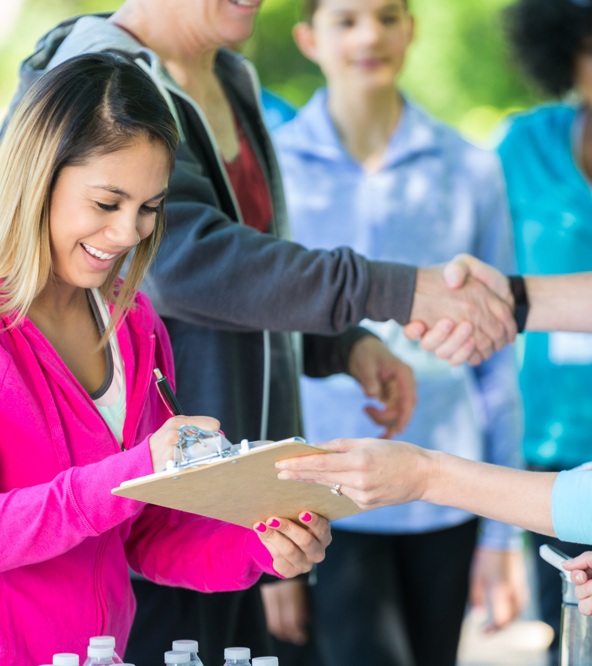
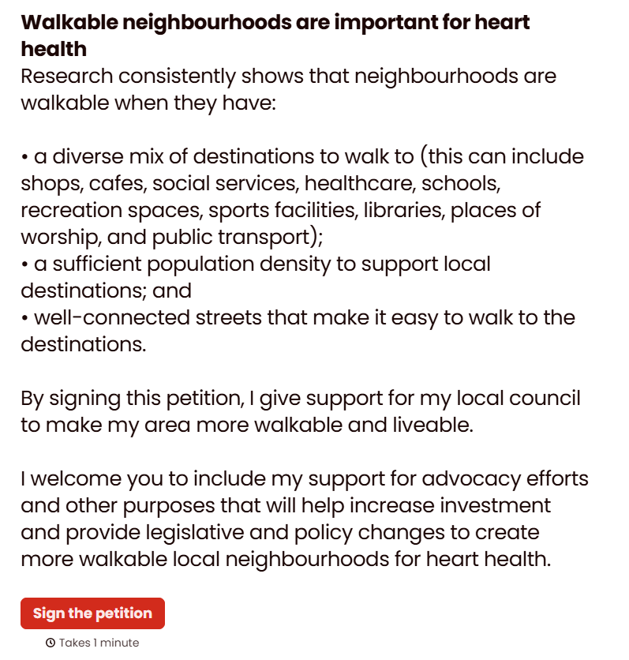
Petition
Inspiring community advocacy
Building support for more walkable local neighbourhoods
Notes:
The community petition has been developed as a quick, easy and simple way for community members to demonstrate in-principle support, at a high, strategic level, for more walkable local neighbourhoods.
It also acts as an awareness and educational tool, with some basic information about walkable neighbourhoods – what they are, what they look like and why they’re important.
It can be used to help local councils demonstrate the support of their local community in advocacy efforts, and funding bids, with state and federal governments.
On signing:
Contact details, and any comments, are provided to the Heart Foundation
The Heart Foundation consolidates responses and engages with the relevant local council at the appropriate time, to provide amalgamated responses. This timing might be:
To support a project specific outcome of the local council
Election or budget timing
There may be opportunity to collaborate with the Heart Foundation to tailor a specific petition to help meet our needs.

Slide 32
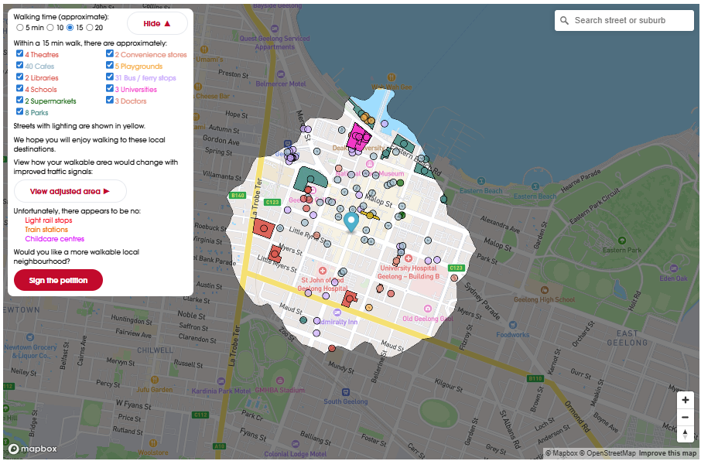
Interactive map
Community resources
Drop a pin anywhere in Australia and discover destinations
within a 5-, 10-, 15- or 20-minute walking catchment.
Map developed by Jake Coppinger
Notes:
The interactive Community Walkability map allows a person to drop a pin anywhere on the map, across Australia, and select a 5-, 10-, 15- or 20-minute radius and see what destinations are available in their area. The list of destinations also identifies common types of destinations that aren’t nearby.
The map links to the petition and also acts as an important tool to help create behaviour change – for more people to walk to local destinations, more often.
A toggle field allows someone to see how their walking catchment might expand if traffic signals were altered to prioritise (and speed-up) wait times at signalized crossings.

Slide 33
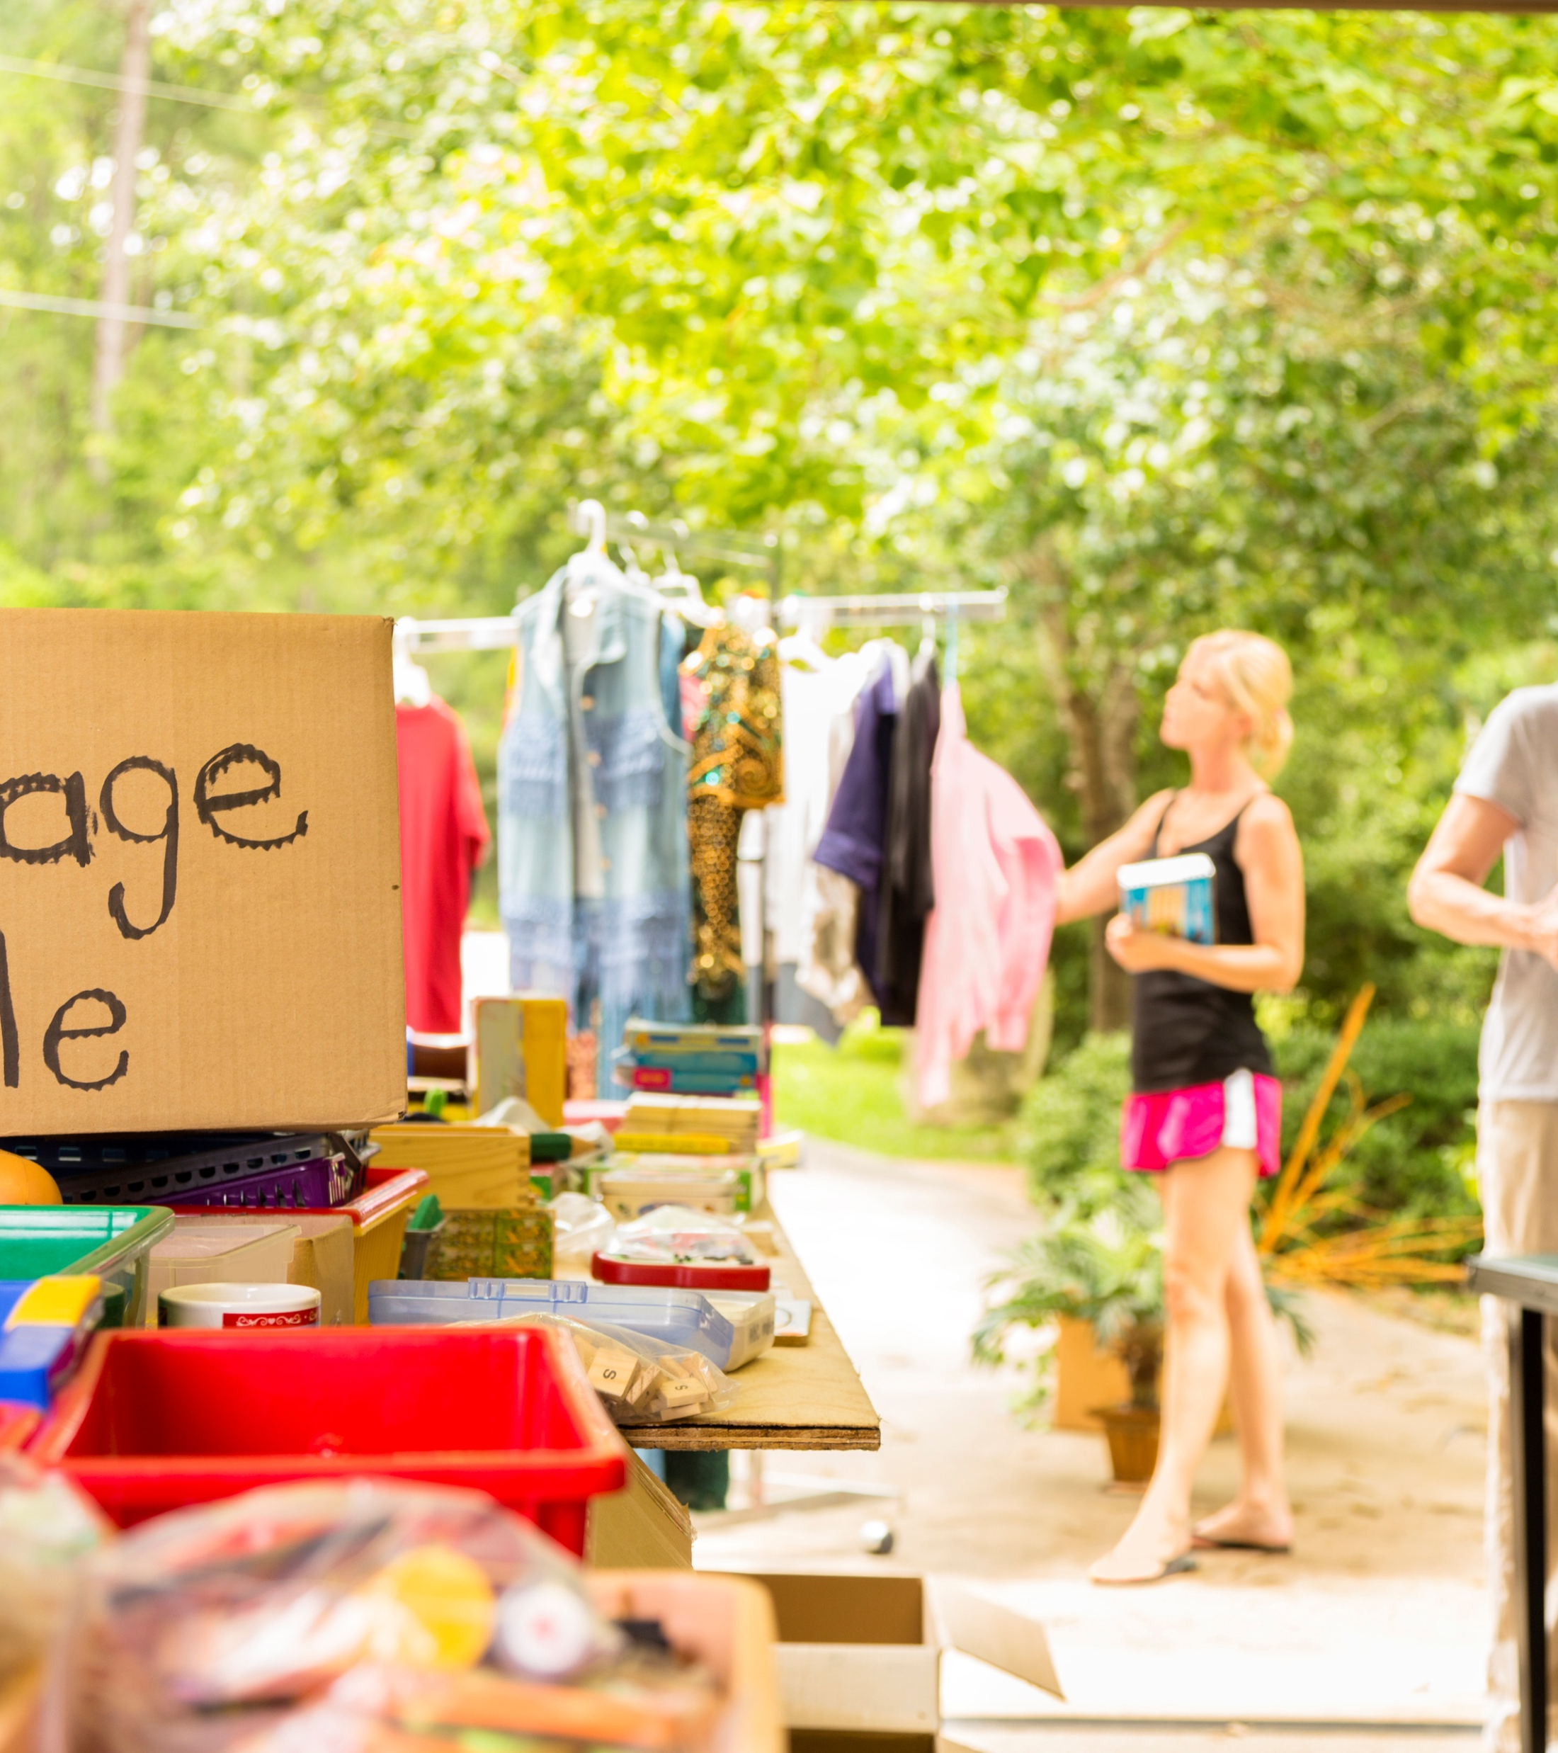
Local action
Action
Community actions for local area improvements
Examples of activities include:
chalk drawings
providing a water bowl for dogs
creating a street library
having a garage sale
creating a place to rest or install temporary seating
planting a verge garden or small urban orchard
placing a box of free produce for passers-by
installing a planter box with flowers or fruit/herbs/vegetables
Notes:
The Heart Foundation recognises that responsibility for more walkable local neighbourhoods doesn’t rest entirely with local council.
Communities also have responsibility and opportunity to take local action to help improve their neighbourhood.
There’s a list of recommended actions that community members can take – some quite small, and others larger.
It includes a disclaimer to always seek permission and check council guidelines before carrying out works.
Local councils can also develop a guideline of activities that our local community can do, without needing to seek permission.
We can empower our local community to act.
This can help build trust, and a sense of ownership, belonging and place.

Slide 34
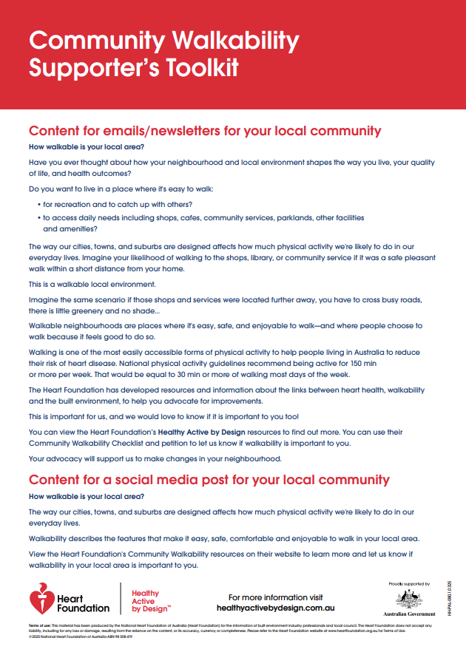
Supporters’ Toolkit
Resources to support industry engagement with community
The toolkit includes:
promotional materials
social media tiles
messaging
email content
Notes:
The Supporters’ Toolkit provides councils with resources to help engage local communities about upcoming projects, policies and planning for healthy built environments.
It includes the resources listed on this slide.

Slide 35
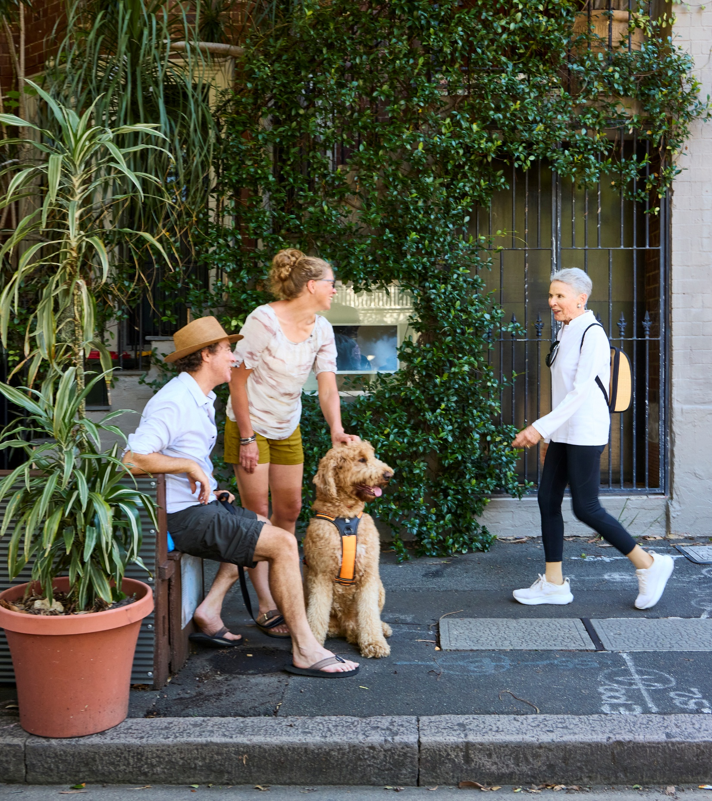
Narrative for change
Deliver a compelling message that resonates
Balance Subject Matter Expertise with community experience and ownership
Paint a picture of what’s possible
Focus on what’s being created, not what’s being taken away
Quality of life, not detailed design
Openness and transparency
What’s being considered/ what’s not
Why a decision has been made
Realistic timeframes and expectations
Notes:
So much of our success in engaging with community and decision makers hinges on the way we’re able to deliver a compelling message with influence.​
​
Public comment can often give an impression of strong opposition to policies and projects that would create more walkable, liveable neighbourhoods.​
Strong support can be found, but how the subject is introduced and framed is critical.​
It’s important to give voice to the silent supporters.
Generally, communities don't like to feel that outcomes are forced upon them – though sometimes this can be necessary for a greater, long-term good. Particularly where subject matter experts understand what's at stake and can see the bigger picture. This approach requires political will and courage.​
More often, there's a need to bring people on the journey, and to understand local contexts and lived experience.​
We should always be open about what’s not on the table – what we can’t change or deliver (at least not as part of the current policy or project being considered).
And always close the loop with the community on any consultation that’s been undertaken.
​
There can be value in keeping the subject high level and principles focused; rather than focusing – at least initially – on detailed design.​
A focus here can be on lifestyle, quality of life, and health and wellbeing.​
Also, kids! The benefits of kids being able to be active in local areas is a hard one to argue with.​
​
Using Healthy Active by Design principles and evidence can provide a narrative for change which is hard to dispute.​
Cardiovascular disease and heart health is a matter which, unfortunately, touches most of us in some way or another. ​
Most people – if not affected themselves – know of a family member, friend or neighbour who has heart health concerns.​
​
Presenting the need for healthy built environments in this context can help gain acceptance and willingness for change.​
And, as shown already in the results of our What Australia Wants survey – most people want change.​
Sometimes they just need a little help understanding what it means and how those changes will help improve their lives.​
​
An equity lens is also important.​
A decision in one geographical area or neighbourhood can have flow-on effects elsewhere.​
For instance, opposition to greater density in inner city areas can have a direct negative effect on others who are forced to live in outer suburbs because there's limited affordable housing elsewhere.​
​
As subject matter experts, council staff and industry practitioners play an incredibly pivotal role in helping paint a picture for the community, and for elected leaders and decision makers, about how good things can be.​
There's a need to focus on what benefits the change is delivering; and not on what's being taken away; instead, what's being created.​
​
Sometimes, in community consultation, it’s easy to forget that the community don’t necessarily have our understanding on the benefits of change, and a longer-term picture.​
It’s our role to help them understand this.​
​
Storytelling and narrative from an evidence-based approach should focus on the way a place makes a person feel.​
​
The tone of all the Heart Foundation’s resources is constructive, positive and empowering.​
​

Slide 36
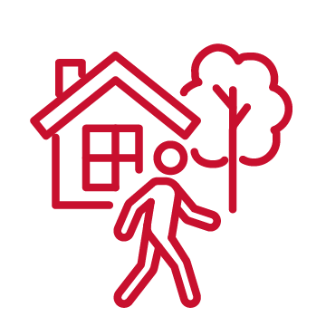
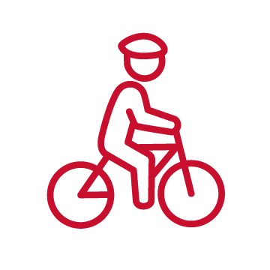
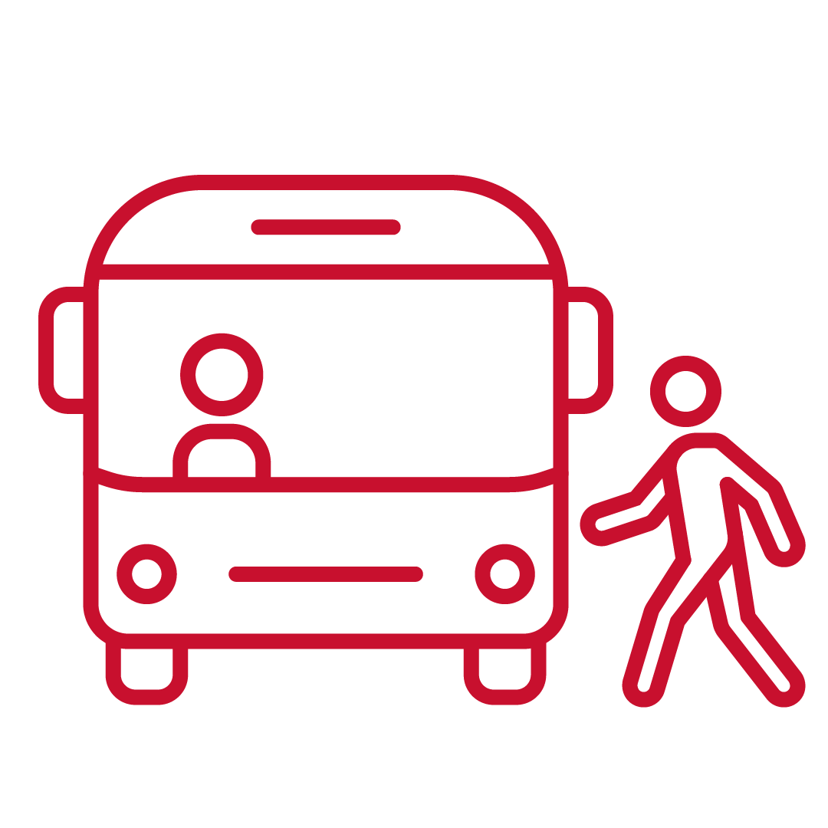

Messaging
people walking or wheeling
Community and media
people riding bikes
Evidence-based narrative
Positive and constructive
People-first language
Local storytelling
Media
people using public transport
people driving cars
Notes:
Also, terminology counts. We should talk about ‘people’: people walking, people wheeling, people riding bikes or using public transport. People driving.​
This helps avoid situations of ‘us and them’, avoids tribalism, and places emphasis on community.​
​
Finally – the media has such a powerful role to play!​
Wherever we can, we need to get them on board.​
Be proactive – help them shape the narrative and messaging; and to get the terminology right.

Slide 37
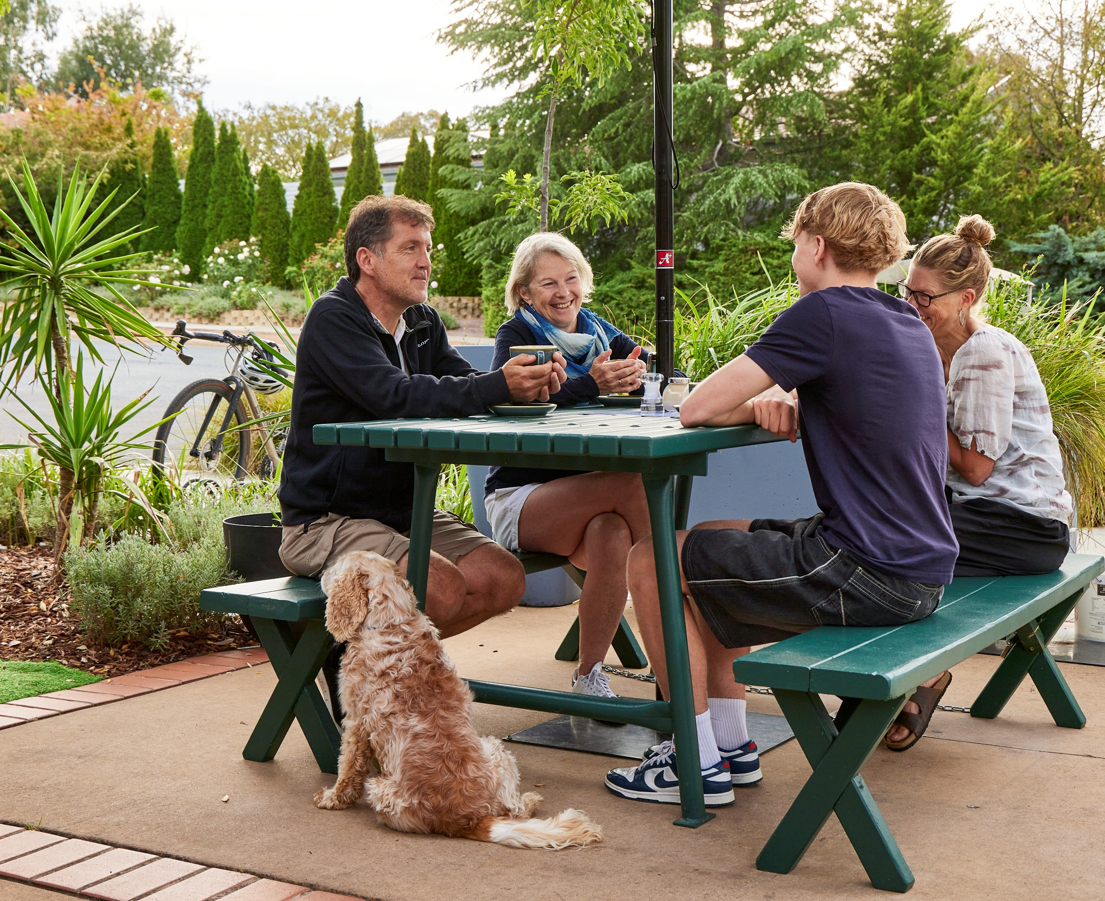
Engaging with communities
Community relationship
Gaining support
Giving voice to silent supporters
Ensuring equity in representation
Broad community representation
Hear from those who have the most to gain (priority populations)
Build positive relationships
Notes:
There’s often a lot more support for healthy built environment projects than the results of community engagement practices might suggest.
Engagement approaches can sometimes result in hearing from a minority of people who oppose a proposal.
It’s harder to mobilise those who support a proposal and even harder again to mobilise those who are neutral.
Sometimes there’s a particular demographic who might have more time, motivation and empowerment to participate in community engagement.
And, often, it’s those who have the most to gain – those most marginalized or vulnerable within society – who are the least represented in community engagement activities.
It can be worth identifying their barriers and seeking to overcome them.
This is also where Healthy Active by Design resources can help make our job easier in engaging communities who are harder to reach.
The Healthy Active by Design community resources are intended to help give voice to the silent supporters, and to help build a positive relationship with these people; empowering and enabling them to speak up.
Building positive relationships and trust with local communities takes time and effort.
It’s an ongoing relationship, and not just about engaging on a single project or policy.
Openness and transparency, about things that can and can’t be done, and realistic timeframes, are vital.
We need to encourage our community not to give up – that we listen to everything they put forward and just because we’re not able to action something doesn’t mean it wasn’t a good idea, or that it didn’t make a difference to the process of consultation and consideration. Help them understand how to engage differently with us next time; and how they can help us to help them.

Slide 38
Pause for questions/ short break

Slide 39
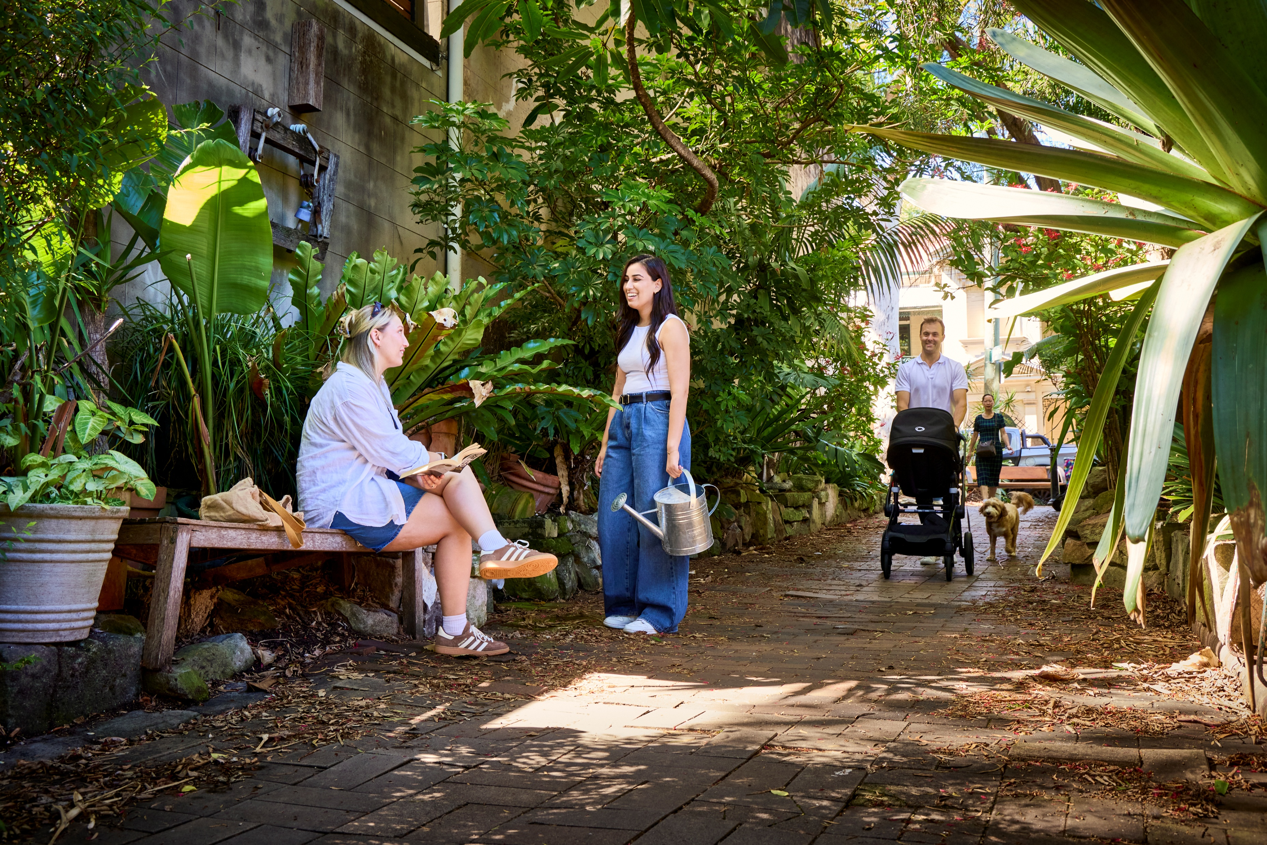
Capability building – shared measures of success
Notes:
Group session to identify barriers, challenges and opportunities… And a shared way forward.
We all have a different role to play; and different perspectives, objectives, purposes and KPIs.
How do we bring this together, and work collaboratively together towards shared measures of success for community health and wellbeing?

Slide 40
Common barriers to designing for public health
Co-design outcomes and solutions
Lack of funding
Silos across council
Lack of collaboration
Lack of support from:
elected leaders, decision makers
community
Existing design and standards
Challenges associated with retrofits
Lack of policy direction
Competing priorities
Do more with less
Better allocation of resources
Efficient use of resources
Extend asset lifespan
Manage related risks and costs
Agreed set of community services
Align with Council objectives
Shared measures of success
within council
with community
Others…
Notes:
There are many commonly stated barriers to the design and delivery of healthy built environments.
This slide lists some of them.
As well as some opportunities to help overcome commonly stated barriers.
Barriers commonly include:
funding
approvals and regulation
community and political dynamics
fragmented processes across agencies
And, what’s been termed: ‘the gap between the strategy and the street’
We’re going to discuss how to overcome these.

Slide 41
Developing shared measures of success
Group brainstorm
QUESTION 1 - Vision
What is your vision/the change you want to see?
What does success for healthy built environments look like to you?
QUESTION 2 – Measuring impact
How can we measure the change?
What tools are needed (available or new)
QUESTION 3 – Community relationships
What does a positive community relationship look like?
What needs to be done to make it reality?
QUESTION 4 - Collaboration
How can we break silos and work collaboratively?
QUESTION 5 – Creating shared commitment
How do we work together from here for shared measures of success?
Notes:
Suggested group discussion and brainstorm questions:
QUESTION 1 - Vision
What's your vision/what’s the change you want to see?
What does success look like for healthy built environments in your area (Blue Sky thinking)
Describe it…
What support or resources do you need to make that happen; to make your job easier and ensure success?
QUESTION 2 – Measuring change
How do we measure this change, and with what tools?
QUESTION 3 – Community relationship
What does a positive community relationship look like to you?
What do you need to do to make this happen?
Do you already have a positive relationship with your community – how has this been achieved?
QUESTION 4 - Collaboration
How can we all break down silos and work more collaboratively?
QUESTION 5 – Creating shared commitment
How can we work together from here to:
Use Healthy Active by Design resources
Embed principles in existing frameworks and decision-making processes
Position walkability as a core part of strategic planning
Build stronger community-council relationships
Community Walkability Checklist – ongoing monitoring tool
Petition
Clarify pathways from community input to action
reduce consultation fatigue and build trust

Slide 42
Morning tea/Lunch and walkshop

Slide 43
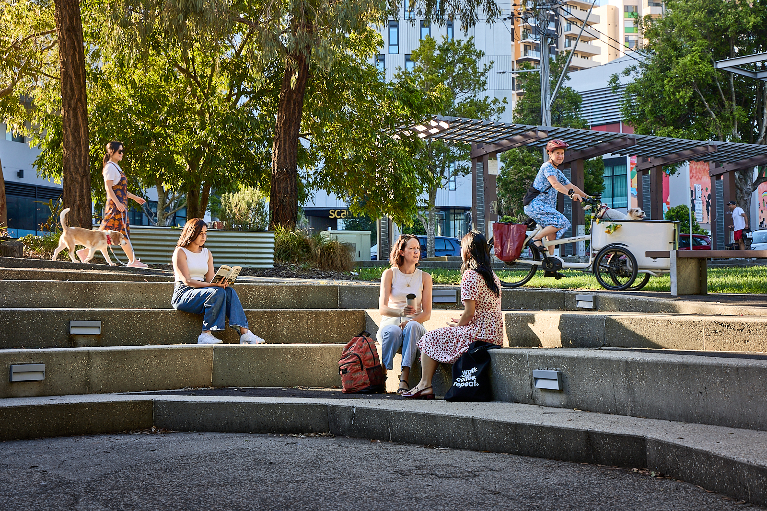
Debrief and next steps

Slide 44
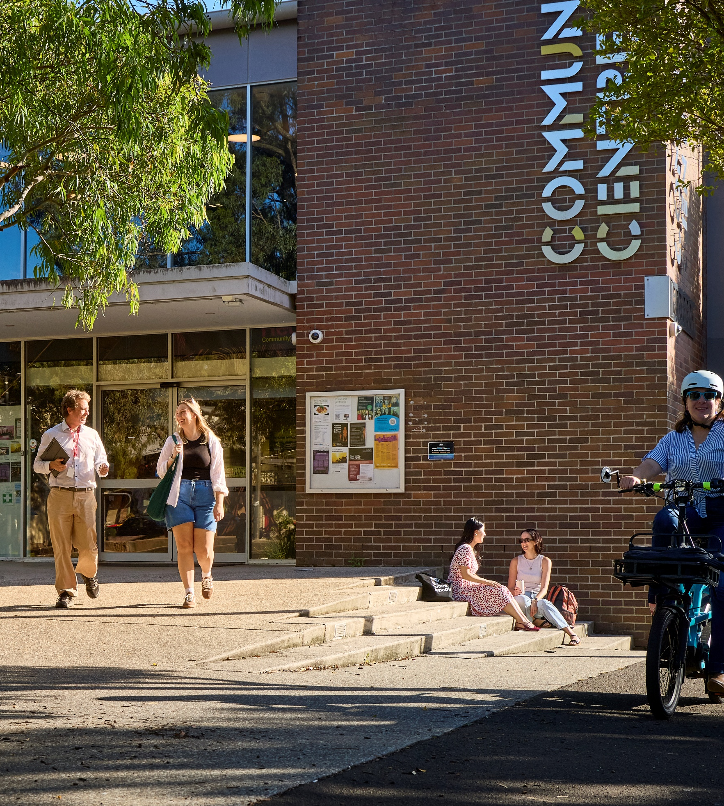
Commit to Healthy Active by Design
Organisational commitment to Healthy Active by Design principles
Standard template (can be tailored to meet your needs)
Signed by your executive
Return to HealthyActivebyDesign@heartfoundation.org.au
Place a copy on your website
Review in three years
Communicates intent and commitment to community and stakeholders
Gives license for policy and projects
Notes:
An initiative for organisations to commit to Healthy Active by Design
A Statement of Support allows an organisation to formally commit to embed active living principles into policy, programs, strategy and objectives.
It requires signature from the CEO.
It’s a straightforward approach to give license and permission for project-specific or other purposes.
By providing endorsement at a high, strategic level, we can leverage this when it comes to detailed implementation and funding.
Through this approach we can
Embed walkability into policy and planning frameworks
Position walkability as a core part of strategic planning

Slide 45
Potential collaborators for local council:
Planning Institute of Australia
Australian Local Government Association
Transport Professionals Australia
Mainstreet Australia
National Growth Areas Alliance
Institute of Public Works Engineering Australasia
Town Team Movement
Messaging frameworks/ community engagement:
Common Cause Australia
Wayfinder Labs
VillageWell
Notes:
There are a whole host of organisations working together for healthy built environments.
This represents many opportunities to obtain support, use existing resources, build your case…
This is just the start of a list – we can identify more, based on our local area and context.
Recruit allies.
Identify who they are and ways that they can support our work.
Identify how we can work together – potentially from different perspectives – to achieve a louder, united voice.
Different angles of messaging can build a bigger, stronger compelling message
Include other locally-based organisations and allies

Slide 46

Questions and discussion
Contact
Active Living
National Heart Foundation of Australia
HealthyActivebyDesign@heartfoundation.org.au

