Slide 1

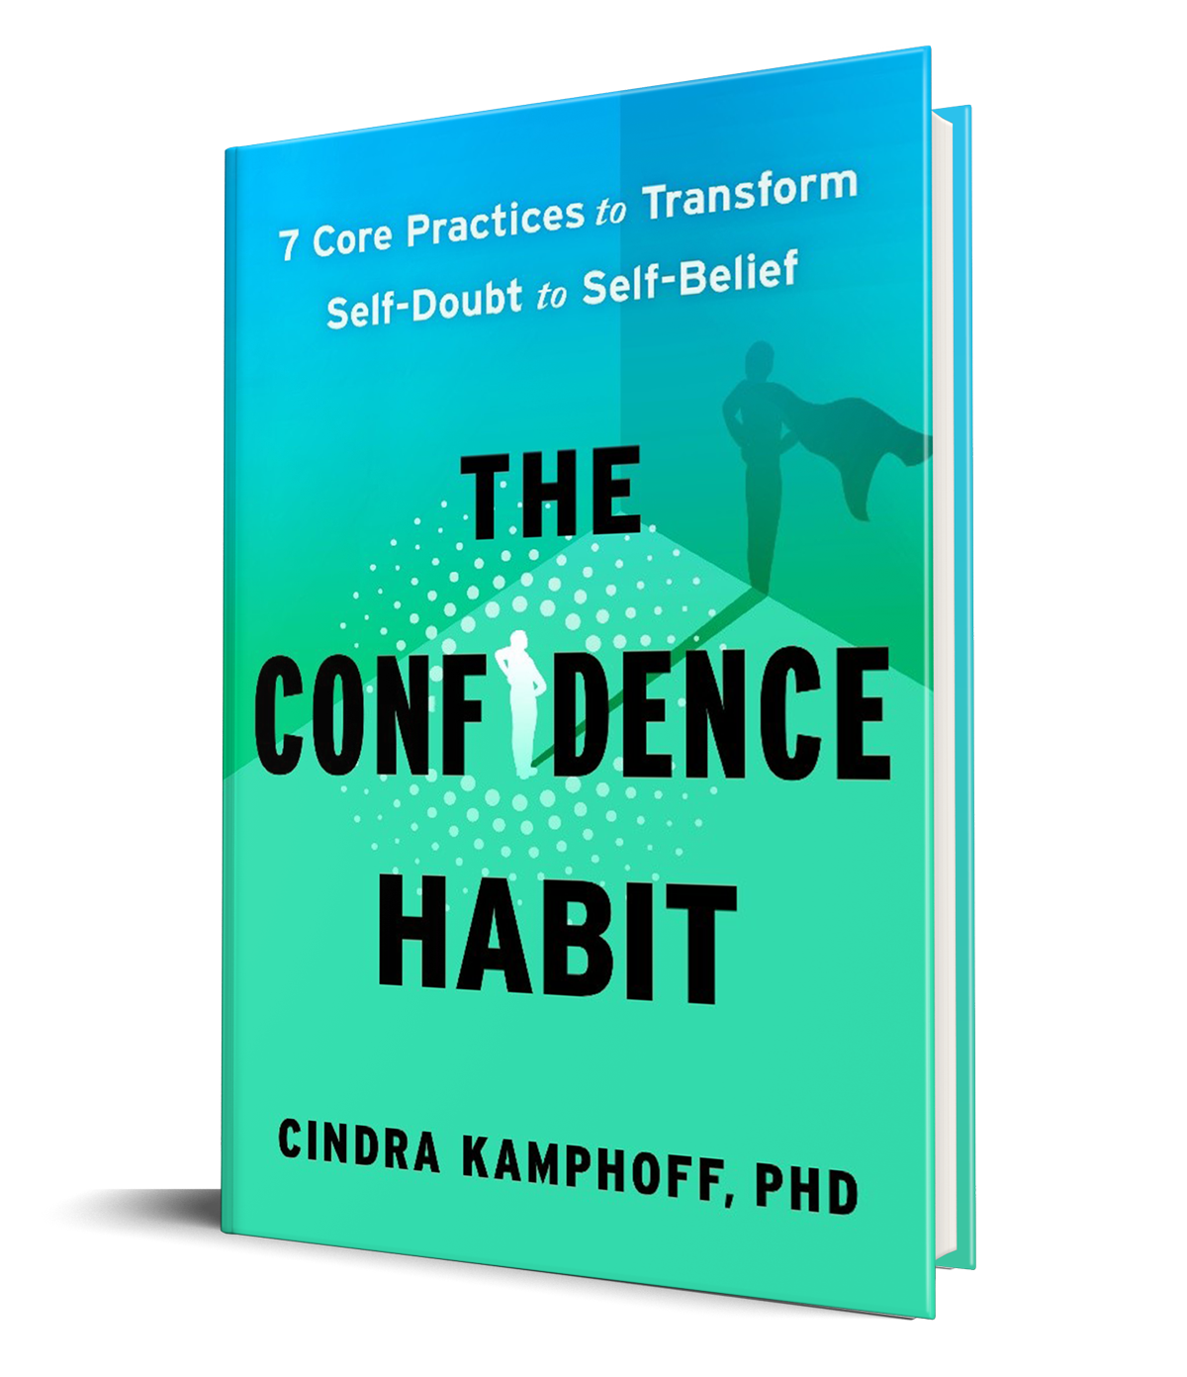
Build unshakeable confidence that transforms fear and self-doubt into self-belief.
Partnership Opportunities 2026

Slide 2
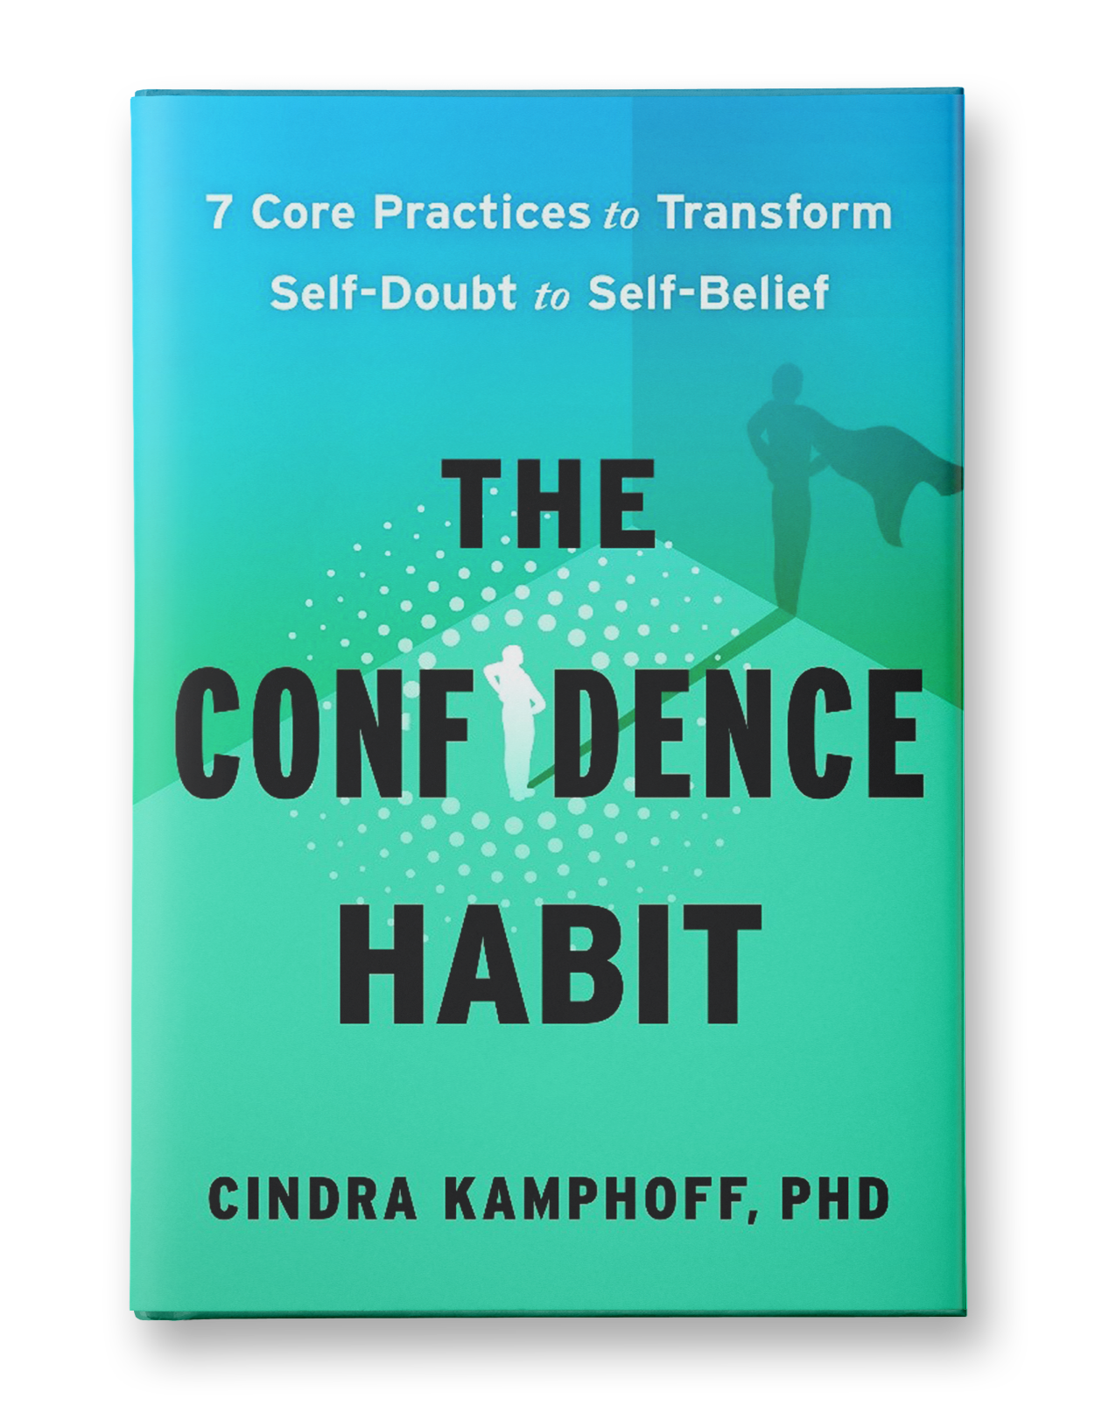
Break free from crippling self-doubt, readjust your mindset, and step into confidence—no matter the situation.
As Dr. Cindra Kamphoff knows from working as a top sports and performance psychologist to business leaders and professional athletes, confidence isn’t an elusive trait reserved for the lucky few; it’s a skill that anyone can master. In The Confidence Habit, Dr. Kamphoff shows you how to build this skill through an actionable and a proven framework based on cutting-edge research in performance psychology, neuroscience, and positive psychology.
Here’s the truth: confidence isn’t about never experiencing doubt—it’s a skill you can learn. Dr. Kamphoff walks you through nineteen confidence-boosting strategies built from seven core practices and step-by-step methods that help you shift self-doubt into self-belief, transform fear into action, and create a rock-solid inner foundation. Each practice is a habit you build, while the tools are the techniques you use to implement them in real life.

Slide 3


Slide 4


Cindra Kamphoff, PhD, CMPC, PCC, CSP, is an award-winning keynote speaker and certified mental performance coach for leaders, educators, athletes, and championship teams. She has provided mental training for the Minnesota Vikings for four years, working one-on-one with the players. Cindra worked with the United States Olympic Track and Field team while they were in Tokyo working with the athletes one-on-one to help them train their minds.
Cindra is the author of The Confidence Habit: 7 Core Practices to Transform Self-Doubt to Self-Belief, as well as Beyond Grit: Ten Powerful Practices to Gain the High Performance Edge and Beyond Grit for Business. She is the owner of the Mentally Strong Institute, a firm that provides coaching to educators, leaders and athletes. She also leads a non-profit, Mentally Strong Kids, which provides curriculum to schools to help kids build their confidence, resilience, and mental strength.

Slide 5

“The best leaders and performers aren’t fearless—they’ve simply learned how to work through doubt and keep moving forward. The Confidence Habit provides a fresh, research-backed framework for building lasting confidence from the inside out. This book is an invitation to stop questioning your worth and start owning your voice.”
— Molly Fletcher, #1 USA Today bestselling author of Dynamic Drive
“Most people treat confidence as something that happens to them—a streak of luck, a good day, a favorable crowd. Cindra Kamphoff reframes it entirely: confidence is a habit, built through seven concrete practices grounded in performance psychology and two decades coaching elite athletes and executives. The Confidence Habit is rigorous, practical, and long overdue.”
—Dr. Marshall Goldsmith is the Thinkers50 #1 Executive Coach and New York Times bestselling author
“Competing at the highest level demands physical preparation and mental resilience. Cindra Kamphoff breaks confidence down into practical habits and tools that athletes, leaders, and everyone can actually use. The Confidence Habit will help you strengthen your mindset and perform with more freedom and belief.”
—Kendell Williams, Two-Time Olympian, Track & Field
“The Confidence Habit delivers a powerful roadmap for quieting the inner critic, recovering from setbacks quickly, and inspiring confidence in others. It blends compelling research with practical strategies leaders can apply immediately.”
—BJ Hellyer, Managing Partner, Northwestern Mutual Twin Cities
“Every athlete faces moments where fear and doubt threaten to take over. Cindra Kamphoff taught me how to reset mentally, move through anxiety, and believe in my future again. The Confidence Habit is a gift to competitors everywhere.”
—Quanesha Burks, OLY, 3 time USA Champion, Track and Field

Slide 6

Confidence is a decision we make every day. It takes constant nurturing, and it isn’t something people simply obtain for the rest of their lives without putting in the work. Dr. Kamphoff helps readers take control of their confidence with practical research-based tools throughout, helping them achieve their dreams.

Slide 7
THE CONFIDENCE HABIT
IS FOR EVERYONE,
BUT ESPECIALLY FOR THOSE UNDER HIGH PERFORMANCE PRESSURE:
Business Professionals and Managers
Leaders, Executives, CEOs
CHROs + HR Managers
Entrepreneurs and Founders
Elite and Aspiring Elite Athletes
Early Career and Young Professionals
…as well as those who support them, including coaches, consultants, teachers, and mentors

Slide 8

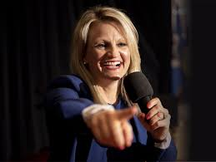
PARTNER WITH
For Professional Development + Training of Fall Interns, New Hires, and ERGs
Engaging Talks for Internal Meetings, Organizational Town Halls, and Partner/Team Retreats
Convenings + Conference Bag Gifts with an On-site Book Signing Experience
Custom Mailings to Partners, Clients, Employees, Associates, Customers, Students, and Virtual Attendees

Slide 9
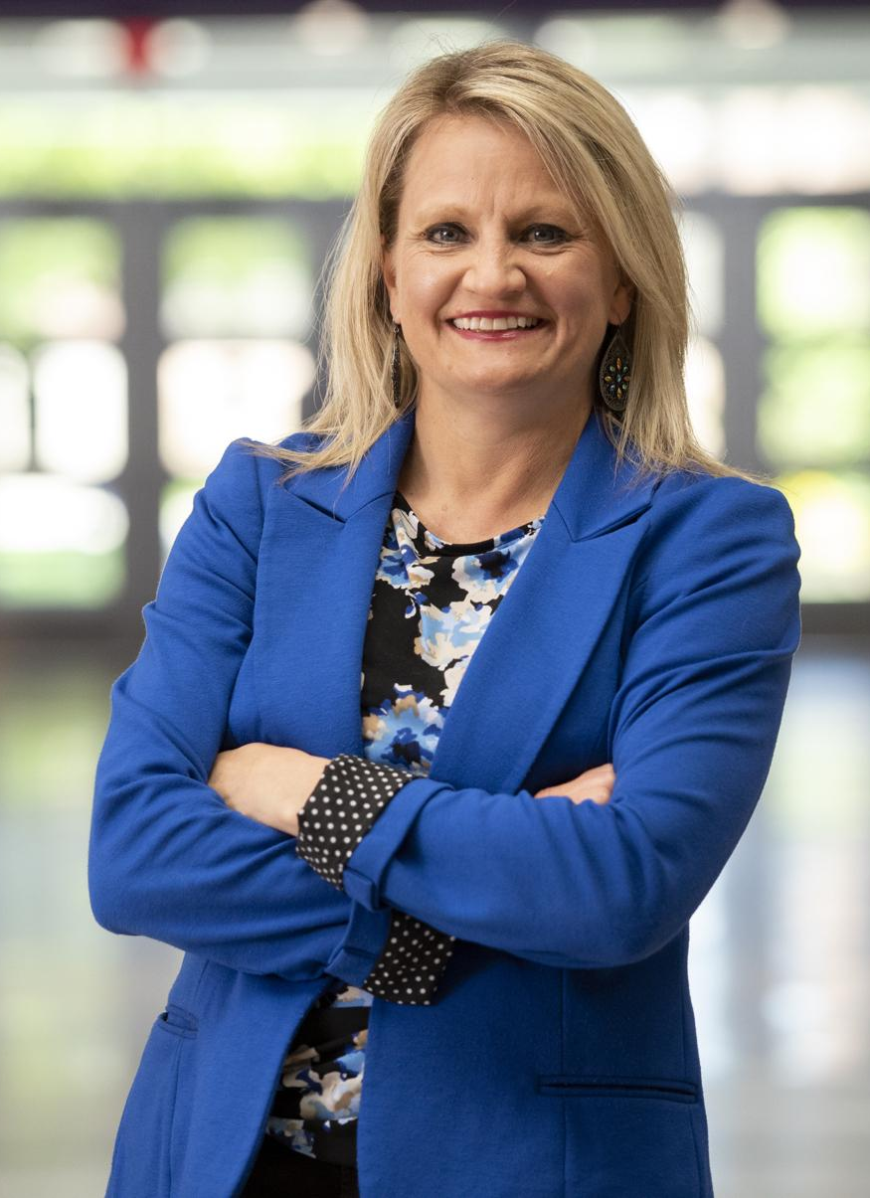
PARTNERSHIP PACKAGES
All packages listed below are inclusive of tax and custom shipping
(in individual and bulk quantities) to domestic addresses starting Sept. 1, 2026. This pricing is a limited time offer expiring Aug. 18, 2026. Speaking date contingent upon mutual availability.
BRONZE
-The Ultimate Confidence Toolkit Digital Resources
-Access to The Confidence Habit Book Club Live Event
Live Confidence Summit Event
-10 Copies of
The Confidence Habit
Retail Value: $750
BRONZE: $309
SILVER
-The Ultimate Confidence Toolkit Digital Resources
-Access to The Confidence Habit Book Club Live Event
-Live Confidence Summit Event
-Access the Mentally Strong Academy for the next 6 months
-25 Copies of
The Confidence Habit
Retail Value: $,1457
SILVER $799
GOLD
-The Ultimate Confidence Toolkit Digital Resources
-Access to The Confidence Habit Book Club Live Event
-Access the Mentally Strong Academy for the next 6 months
-Live Confidence Summit Event
-A Confidence-Breakthrough Coaching Call with a Certified Mentally Strong Coach
-50 Copies of
The Confidence Habit
Retail Value: $,2445
GOLD: $1,799
PLATINUM
-The Ultimate Confidence Toolkit Digital Resources
-Access to The Confidence Habit Book Club Live Event
-Access the Mentally Strong Academy for the next 6 months
-A Confidence-Breakthrough Coaching Call with a Certified Mentally Strong Coach
-Live Confidence Summit Event
-A 60-minute Virtual, Live, Personalized Confidence Keynote to Your Team by Dr. Cindra
-A Pre-event call with Dr. Cindra
-100 Copies of
The Confidence Habit
Retail Value: $8,882
PLATINUM: $3,599
Notes:
$2795 = 100 // $6885 = 250 // $13,770 = 500
$27.54

Slide 10
The Confidence Habit Book Club Live Event
Perfect for teams, leadership groups, or organizations looking to spark reflection, dialogue, and behavior change around confidence.
This live, interactive Book Club experience brings The Confidence Habit to life. Dr. Cindra Kamphoff will guide participants through the core concepts of the book, unpack key insights, answer questions, and highlight the most impactful tools from each section. This session is designed to help readers move from insight to action—building confidence together in a shared experience that creates alignment, momentum, and meaningful conversation.
A Confidence-Breakthrough Coaching Call
with a Certified Mentally Strong Coach
This private, confidential coaching session provides focused, personalized support to help you overcome confidence barriers and apply the tools from The Confidence Habit to their real challenges.
Led by a Certified Mentally Strong Coach, this session helps individuals:
Identify confidence traps that are holding you back
Build a personalized confidence action plan
Gain clarity, momentum, and accountability
This is a powerful catalyst for breakthrough moments and lasting change.
Access to the Mentally Strong Academy for 6 Months
The Mentally Strong Academy is your team’s on-demand hub for building confidence, resilience, and high performance. Members gain access to monthly virtual trainings
led by Dr. Cindra, practical tools, guided exercises, and monthly content grounded in performance psychology.
Over six months, your team will learn how to:
Apply confidence tools in real-world situations
Strengthen mental habits that support focus, decision-making, and adaptability
Build sustainable confidence through repetition and practice
This is where The Confidence Habit becomes a daily practice—not just a one-time read.
Live, Personalized Confidence Keynote with Dr. Cindra Kamphoff
This exclusive keynote is fully customized for your organization and delivered live—virtually or in person—by bestselling author and performance psychologist Dr. Cindra Kamphoff.
Based on The Confidence Habit and Dr. Cindra’s signature Mentally Strong frameworks, this engaging, high-energy keynote blends story, science, and practical tools to help your team:
Build confidence during change and uncertainty
Perform under pressure
Adapt, lead, and communicate more effectively
This experience transforms the book into a shared language and actionable mindset for your entire organization.

Slide 11
IN-PERSON PARTNERSHIP PACKAGES
All packages listed below are inclusive of tax and custom shipping (in individual and bulk quantities) to domestic addresses starting Sept. 1, 2026. This pricing is a limited time offer expiring Aug. 18, 2026. Speaking date contingent upon mutual availability and agreement.
THE CONFIDENCE COACH
1 Hour Custom In-Person Event Cindra in Minnesota
The Ultimate Confidence Toolkit Digital Resources
Access the Mentally Strong Academy for 1 full year
up to 200 hardcover copies of: The Confidence Habit
Includes Custom Book Distributions | Shipping Begins Sept. 1, 2026
Retail Value: $18,999 | Package Cost: $9,499
Notes:
$2795 = 100 // $6885 = 250 // $13,770 = 500
$27.54

Slide 12

ADDITIONAL OPPORTUNITY:
SPONSOR STICKERS
Partners may wish to take advantage of the very valuable real-estate on the hardcover cover of The Confidence Habit to add their logo sticker (and/or inserting a postcard inside) as an exclusive educational partner, as the main takeaway for employees, events, attendees, customers, or VIP partners and/or be the exclusive sponsor of an upcoming keynote by Cindra Kamphoff to put their brand/messaging literally in the hands of their ideal audiences for association and awareness. [*Limited Quantity]
SPONSOR STICKER

Slide 13

x
Cindra Kamphoff has partnered with WorthyBooks, a 501(c)3 nonprofit organization, for tax-deductible donations to distribute among students, nonprofits, university and public libraries, and underserved communities across the country.
DONATE FOR REACH + IMPACT

Slide 14
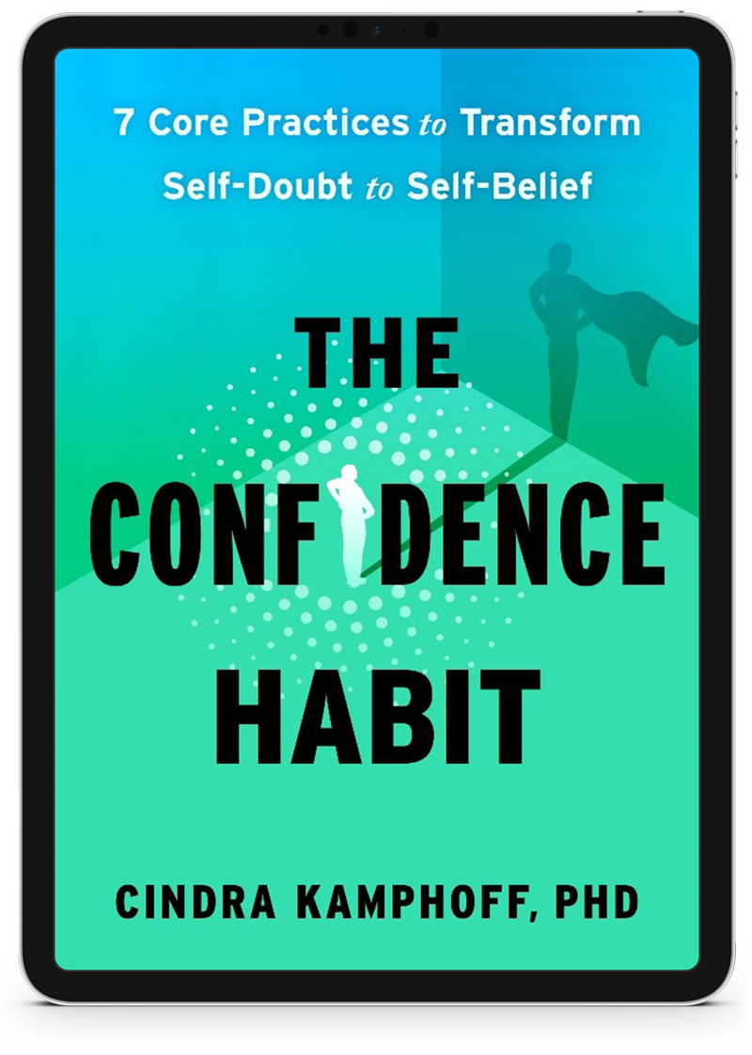
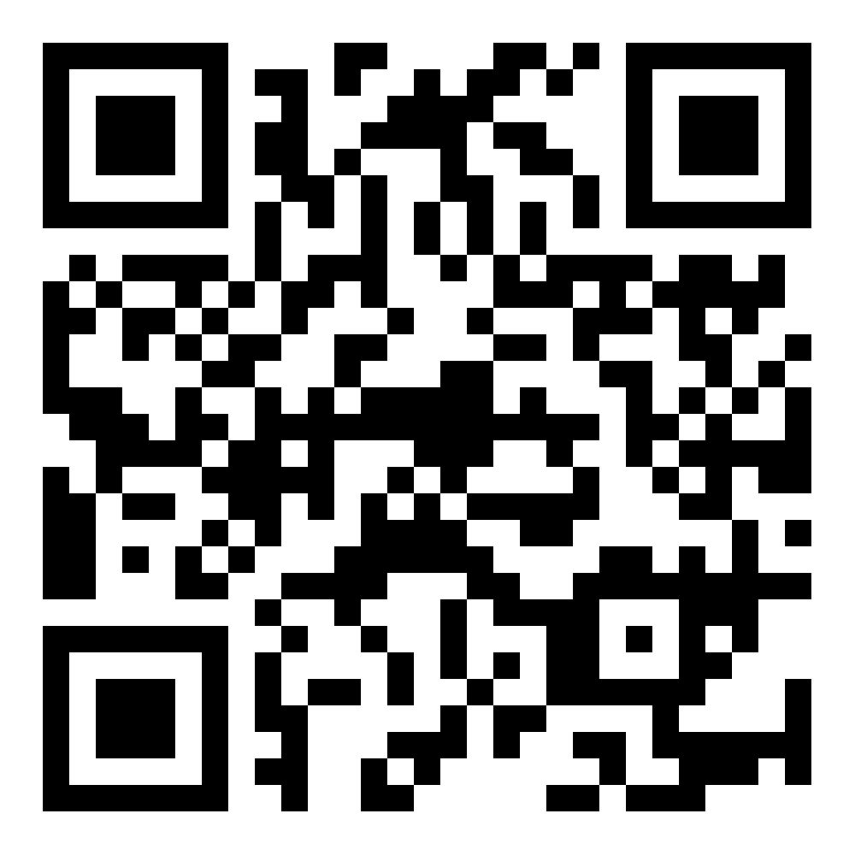
CONFIDENCETOOLS.COM
START READING

