Slide 1
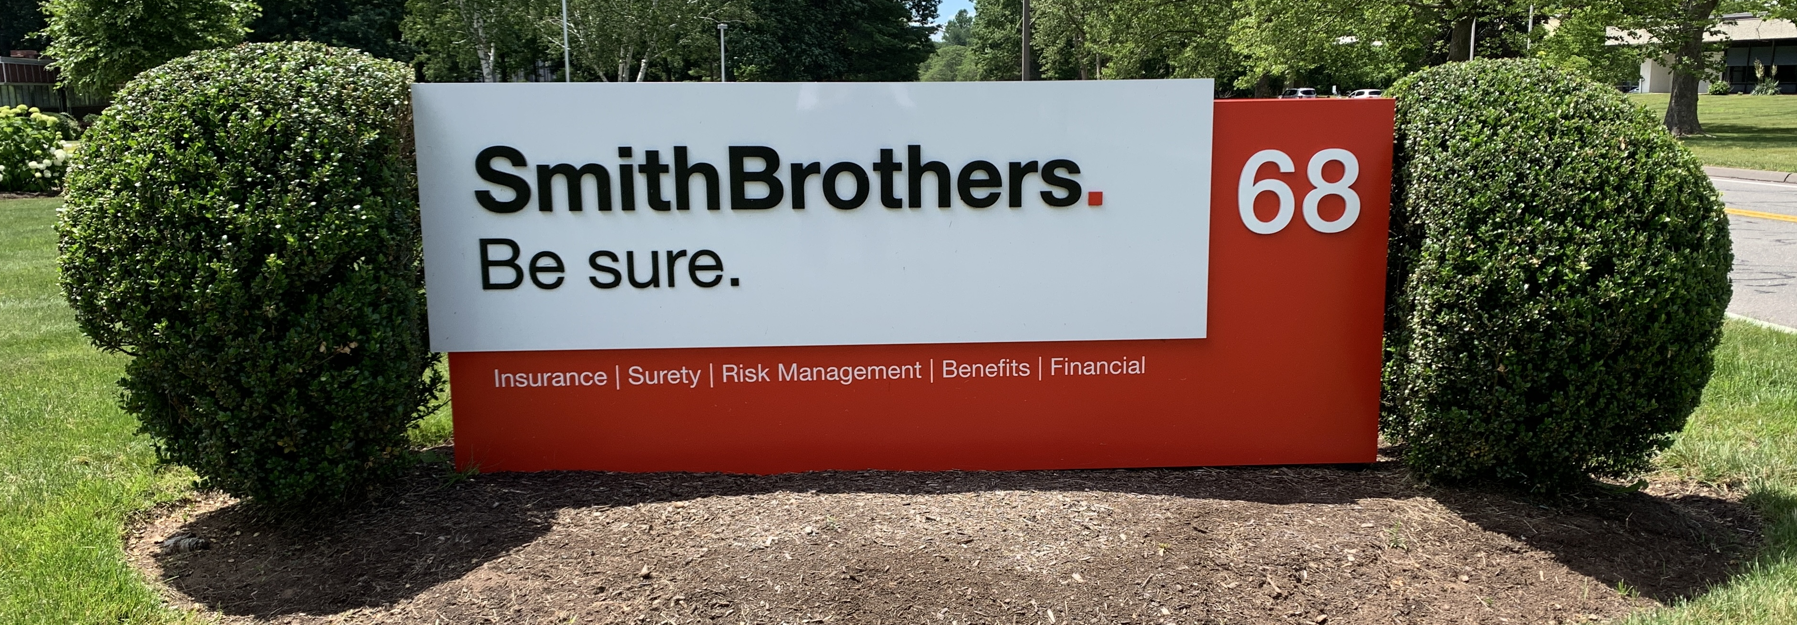
Smith Brothers is Here to Help
Enrollment Assistance:
Call or email anytime with questions or help enrolling.
All enrollments are done online through the John Hancock secure website. (See Hancock materials)
Our team can help determine how much to contribute, what investment(s) to choose, and help designate a beneficiary.
One-on-One conversations:
Assessment of current account investment strategy
Consolidate retirement plans from previous employers
Project retirement income needs and provide solutions
Complimentary External Portfolio evaluation and fee assessment
Provide a complete Insurance Risk assessment
Help to understand Social Security and Medicare Options
Create a budget and help with debt elimination
What to expect:
Unbiased financial guidance
To be treated as our client and part of the SBF family
All information is treated with privacy and confidentiality
Ongoing reviews and follow up meetings available upon request
USA Waste and Recycling, Inc.
401(k) Plan
Ashley Winn
PARTICIPANT ADVISOR
Email: awinn@smithbrothersfs.com
Phone: (860) 335-1265
Stephen Michaels, CPFA
CERTIFIED PLAN FIDUCIARY ADVISOR
Email: smichaels@smithbrothersfs.com
Phone: (860) 430-3293
Jill Yaconiello
CLIENT ASSOCIATE
Email: jyaconiello@smithbrothersfs.com
Phone: (860) 370-3272
Smith Brothers Financial, LLC www.SmithBrothersfs.com (860) 430-3293
Smith Brothers Financial, LLC (“Smith Brothers Financial”) is a registered investment advisor. Securities offered through LPL Financial, Member FINRA/SIPC.
Investment Advice offered through Smith Brothers Financial, a registered investment advisor and separate entity from LPL Financial.

