Slide 1

November 18-22, 2025
St Louis, MO

Slide 2
2025 ITAA Award Ceremony
November 18-22, 2025
St Louis, MO

Slide 3
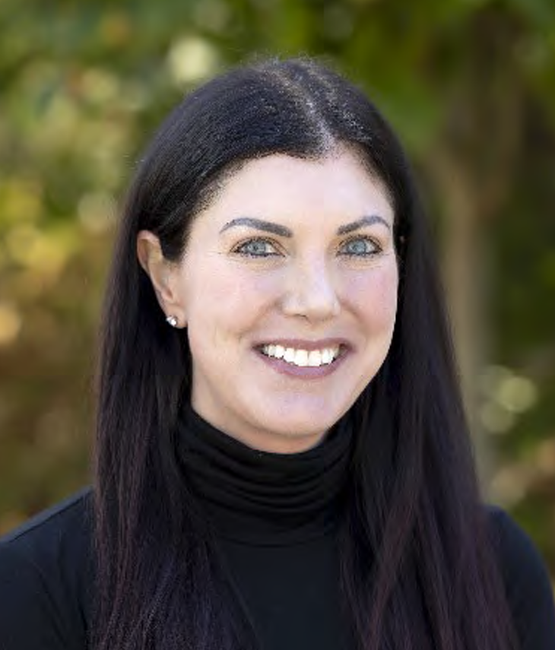


Special thanks to RayeCarol Cavender and Laurie Apple for all their hard work in making this conference a success!

Slide 4
Outgoing Council Members

Slide 5
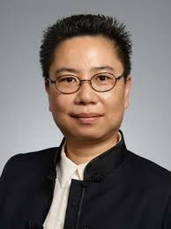
Jung Ha-Brookshire Counselor University of Missouri

Slide 6
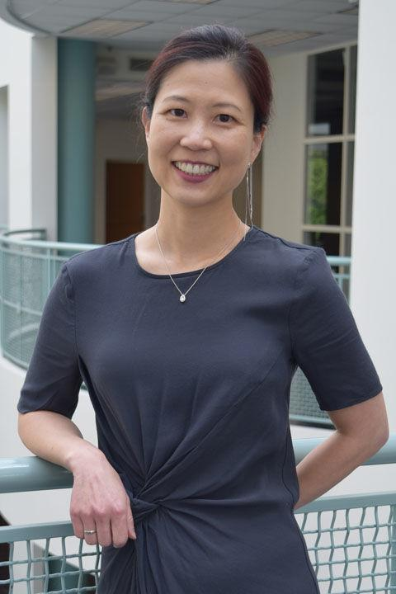
Kim Hahn Treasurer Kent State University

Slide 7

Charles Freeman VP of Professional Development Texas Christian University

Slide 8
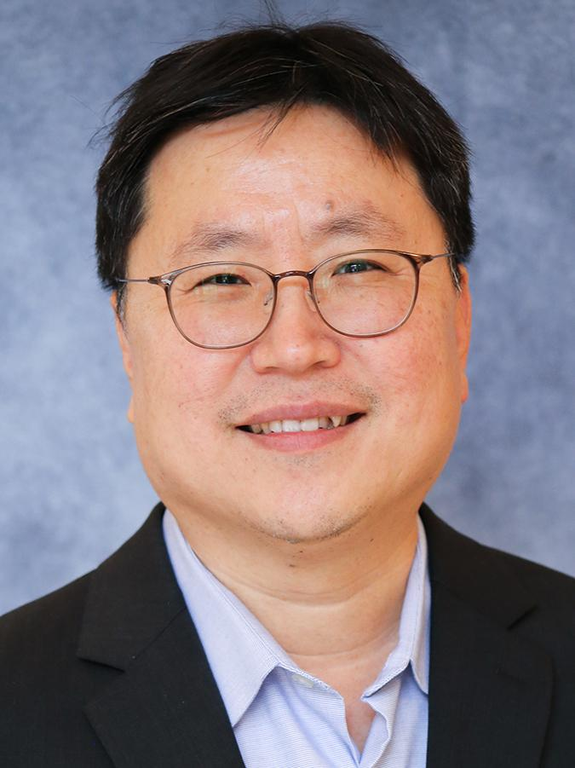
Jeong-Ju (Jay) Yoo VP of Scholarship Baylor University

Slide 9
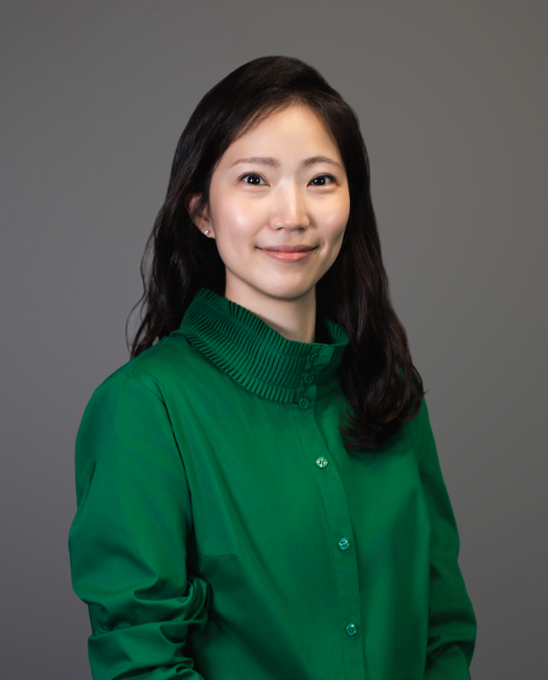
Hye Seung Jeong Graduate Student Liaison University of Georgia

Slide 10
Thank you for your service to ITAA!

Slide 11
ITAA Fellowship, Scholarships and Distinguished Awards 2025

Slide 12
Thank You to All Reviewers and Judges!
Notes:
Names listed in the program

Slide 13
Faculty Awards

Slide 14
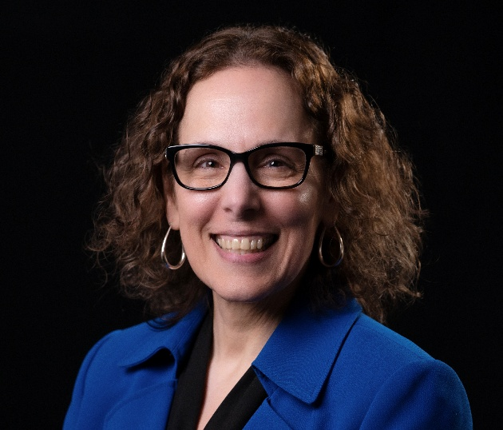
ITAA Fellow Lynn Boorady Oklahoma State University

Slide 15
Thank you to: Andy Reilly, Nominator Susan P. Ashdown Elizabeth Bye Jung Ha-Brookshire Jana Hawley Seung-Hee Lee Beth Myers Heeju Terry Park Hyejune (June) Park Jon Pedersen Jessica Lee Ridgway Clayton Arlesa Shephard

Slide 16

ITAA Fellow Nancy Nelson Hodges University of North Carolina at Greensboro

Slide 17
Thank you to: Elena Karpova, Nominator Elizabeth Bye Julie Chang Ann Marie Fiore Tammy Kinley Karen L. LaBat Gwendolyn S. O’Neal Tim Pickett Carol Warfield

Slide 18
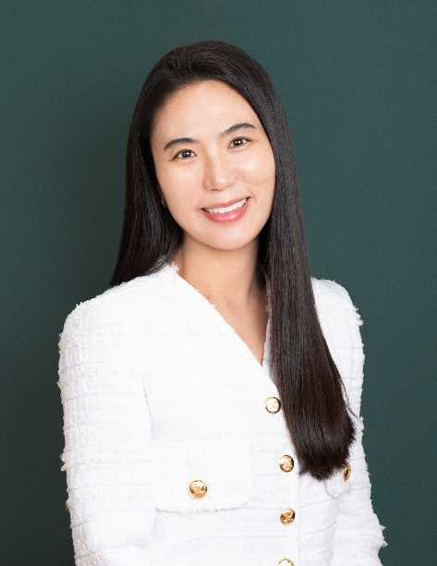
Mid-Career Excellence Award Jiyun Kang Purdue University

Slide 19
Thank you to: Byoungho “Ellie” Jin, Nominator Youn-Kyung ‘Lydia’ Kim Chuanlan Liu Jay Yoo Cosette M. Joyner Martinez Seung-Hee Lee Liping A. Cai Jonathan Bauchet

Slide 20
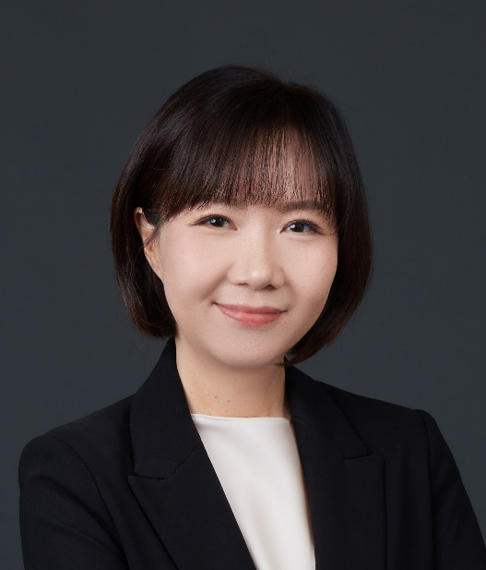
Mid-Career Excellence Award Tunmin (Catherine) Jai Texas Tech University

Slide 21
Thank you to: Tracie Tung, Nominator Lynn M. Boorady Veena Chattaraman Hyunjoo Im Juanjuan Wu Ruoh-Nan (Terry) Yan

Slide 22
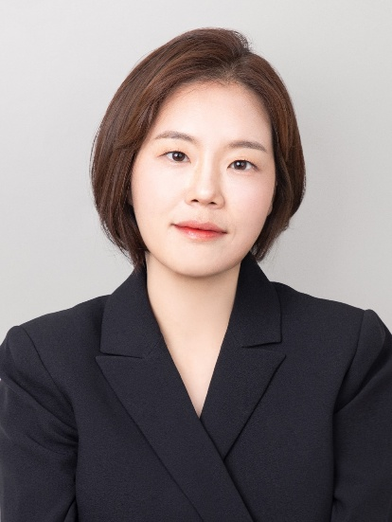
Rising Star Award Song-yi Youn University of Missouri

Slide 23
Thank you to: Jung Ha-Brookshire, Nominator Sejin Ha Kyu-Hye Lee Tracie Tung Li Zhao Jin Su

Slide 24
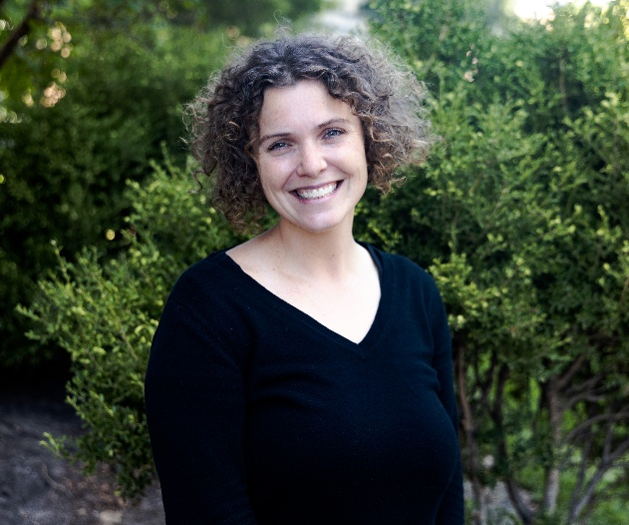
Teaching Excellence Award Kelly Reddy-Best Illinois State University

Slide 25
Thank you to: Dina Smith-Glaviana , Nominator Michael Mamp Susan Kaiser Jessica Lee Ridgway Clayton Rachel Eike Cydni M. Robertson Jeremy M. Bernardoni Dorothy Vernon Sarah West Hixson Zahra Falsafi Dyese Matthews Sophia Strathearn

Slide 26
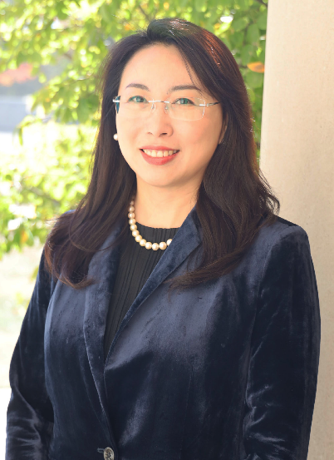
Teaching Excellence Award Ling Zhang Iowa State University

Slide 27
Thank you to: Ann Marie Fiore, Nominator Belange Mutunda Bingyue Wei Constance R. Spotts Eulanda A. Sanders Chanmi Gloria Hwang Li "Lily" Jiang Rachel J. Eike Sophia Luu Elizabeth Bye Elena Karpova Jean L. Parsons

Slide 28
No nomination received for Ha-Brookshire Distinguished Scholar Award, and Service Excellence Award this year.

Slide 29
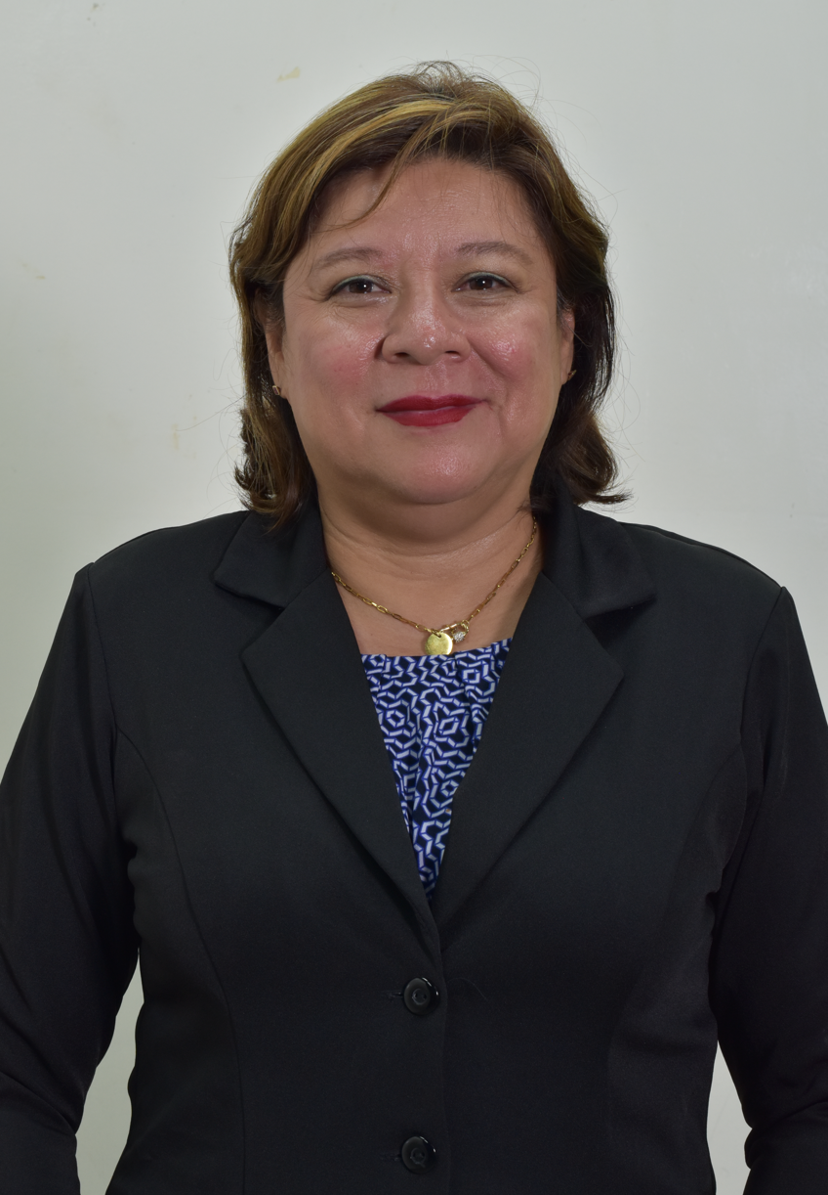
Janet Else Visiting Scholar Award Patricia Quintana Universidad Catolica de El Salvador
Notes:
Dr. Zhao-Hua Ho

Slide 30
CTRJ Awards
Notes:
Sept 2021-August 2022

Slide 31
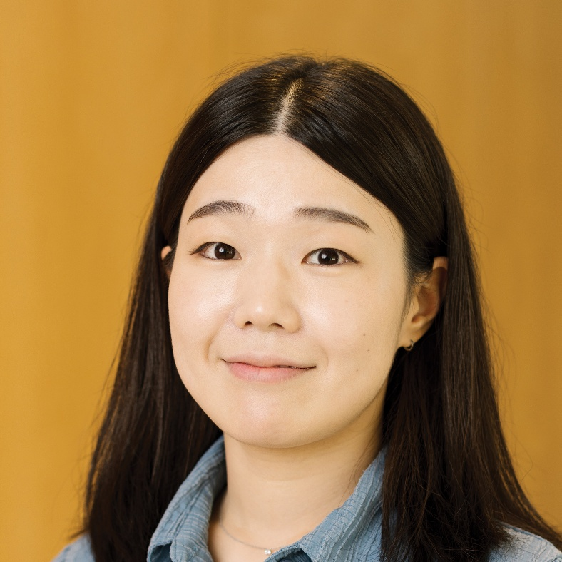
Garim Lee Indiana University-Bloomington
CTRJ Best Reviewer Award
Notes:
Sept 2021-August 2022

Slide 32
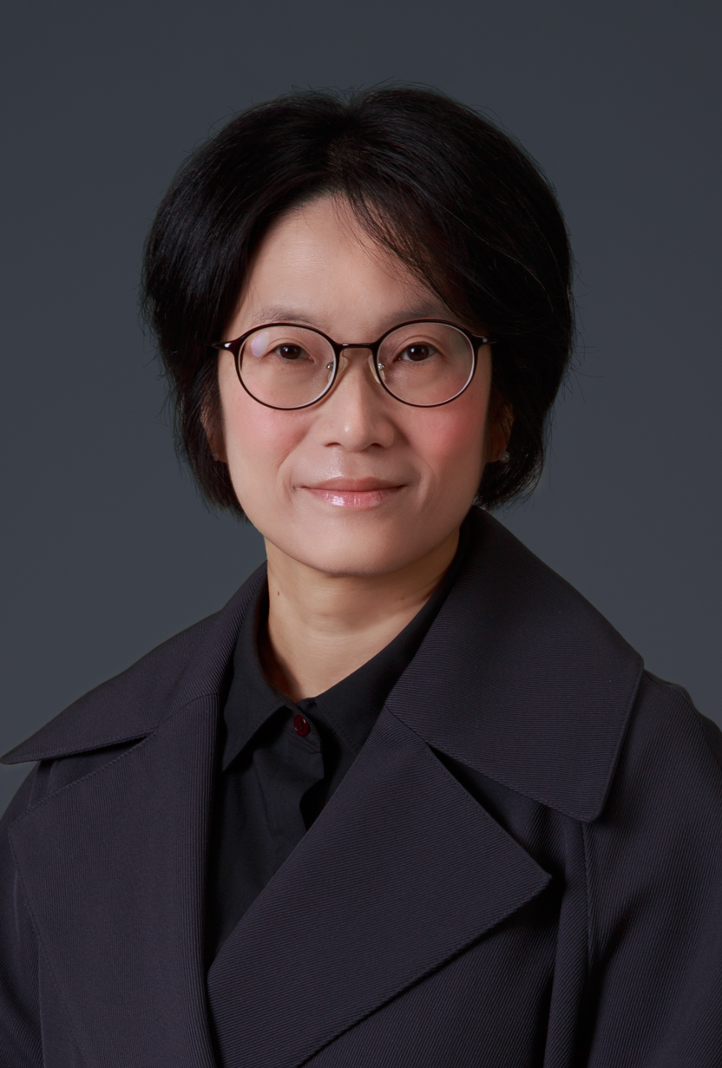
Soo In Shim Jeonbuk National University
CTRJ Best Reviewer Award
Notes:
Sept 2021-August 2022

Slide 33
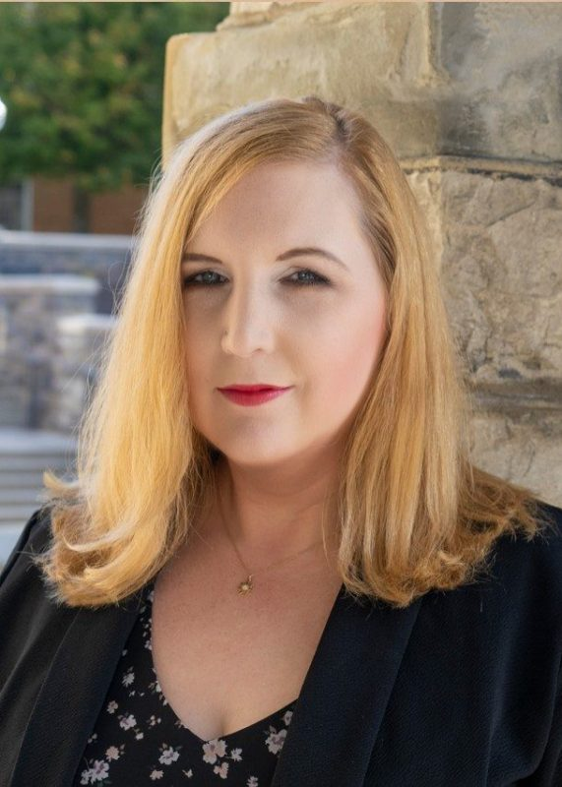
Dina Smith-Glaviana Virgina Tech
CTRJ Best Reviewer Award
Notes:
Sept 2021-August 2022

Slide 34

Stanciel, G., Reddy-Best, K. L., Simon, J. D., Streck, K. G., Green, D. N., Matthews, D., & Gordon, J. (2022). Radical Structural Change in North American Dress and Textile Museums and Collections: Critically Analyzing Social Justice, Oppression, and Empowerment.
CTRJ Most Cited Publication Award

Slide 35

Chan, C. K., Shin, J., & Jiang, S. X. K. (2017). Development of Tailor-Shaped Bacterial Cellulose Textile Cultivation Techniques for Zero-Waste Design.
CTRJ Highest Altmetric Score Award

Slide 36

ITAA Publications Policy Committee Haejung (Maria) Kim, University of North Texas
CTRJ Recognition of Service 2025 outgoing members
Notes:
For outgoing members

Slide 37
Graduate Student Fellowships

Slide 38
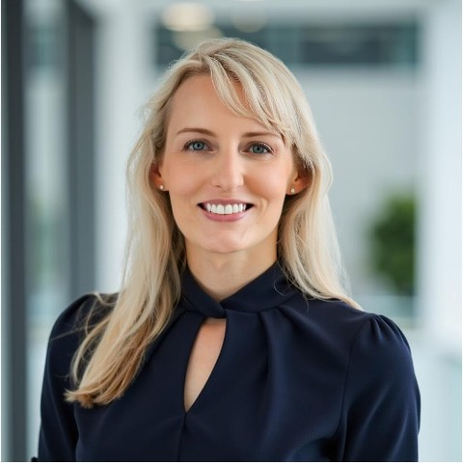
Kitty Dickerson Fellowship for Professional Promise – Doctoral Ashley Chenn Hong Kong Polytechnic University

Slide 39
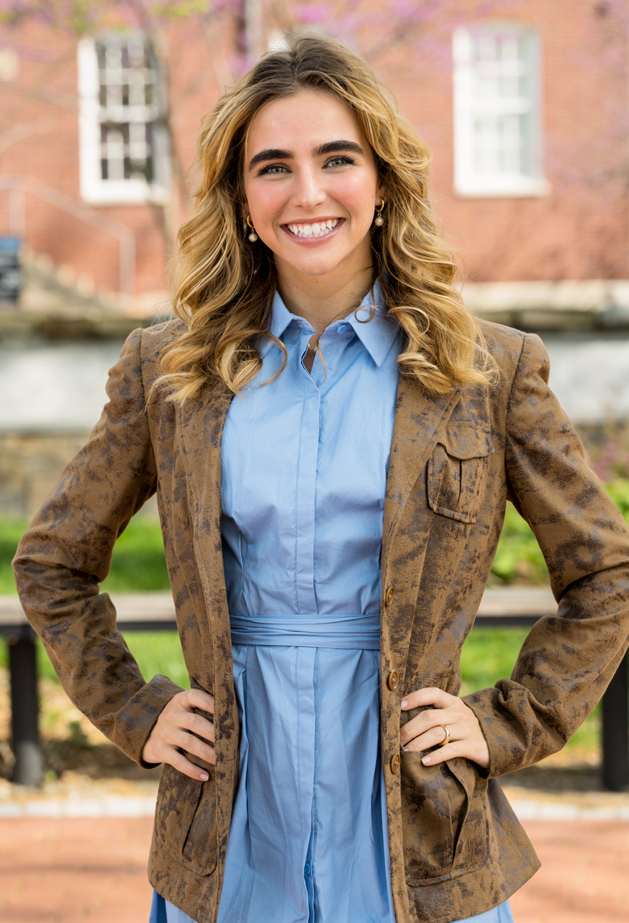
Kitty Dickerson Fellowship for Professional Promise – Masters Emilie Delaye University of Delaware

Slide 40

Sara Douglas Fellowship for Professional Promise – Doctoral Shahbaj Kabir Auburn University

Slide 41
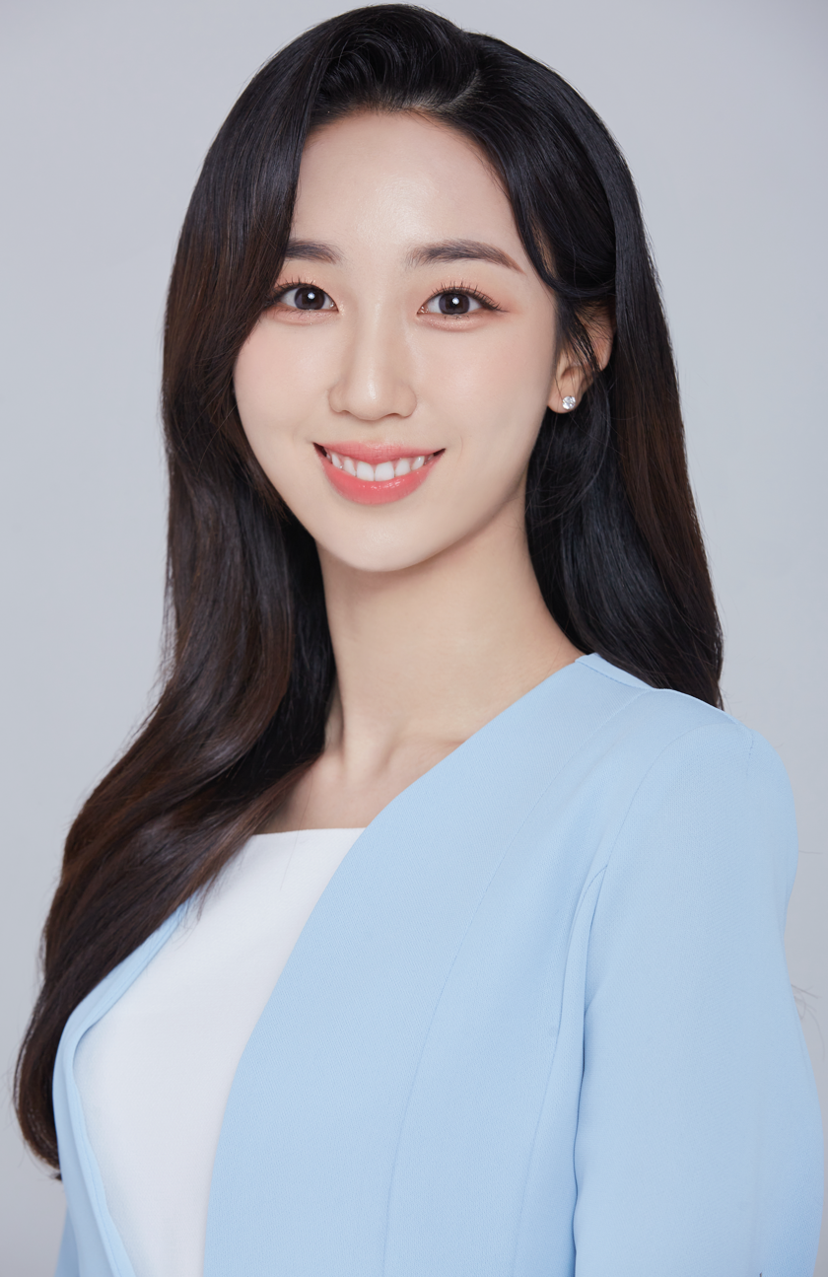
Sara Douglas Fellowship for Professional Promise – Doctoral Yoo-Won Min North Carolina State University

Slide 42

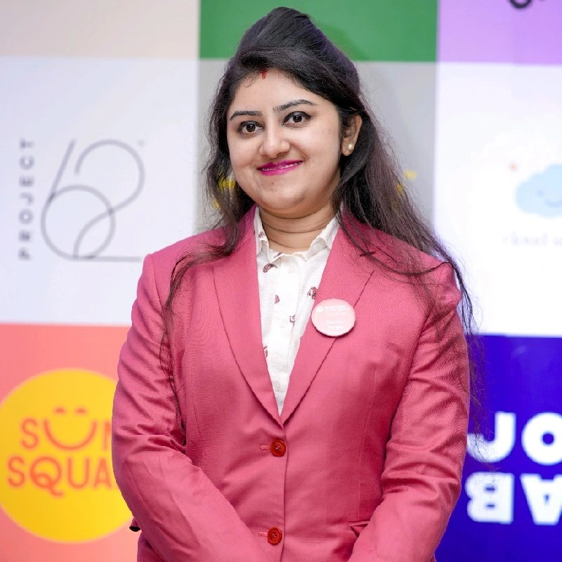
Sara Douglas Fellowship for Professional Promise – Masters Suchi Acharjya University of North Texas

Slide 43
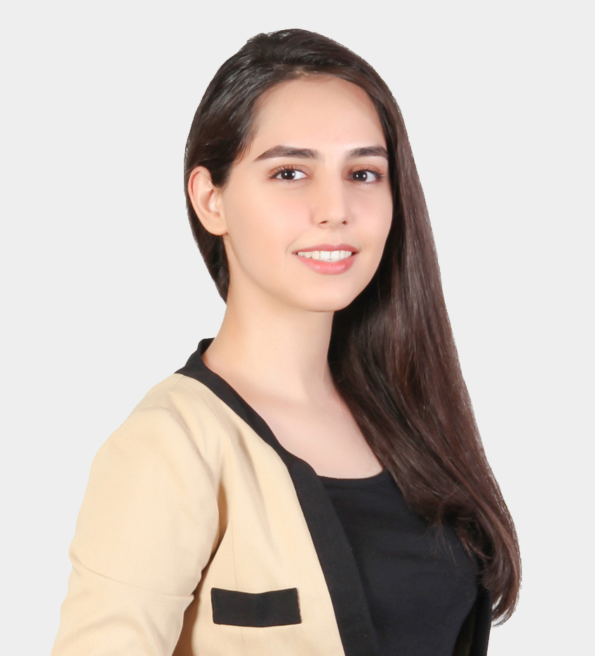
Sara Douglas Fellowship for Professional Promise – Masters Zhara Falsafi Iowa State University

Slide 44
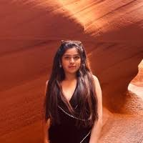
Sara Douglas Fellowship for Professional Promise – Masters Manika Sai Tejaswini Vallabhajosyula University of North Texas

Slide 45

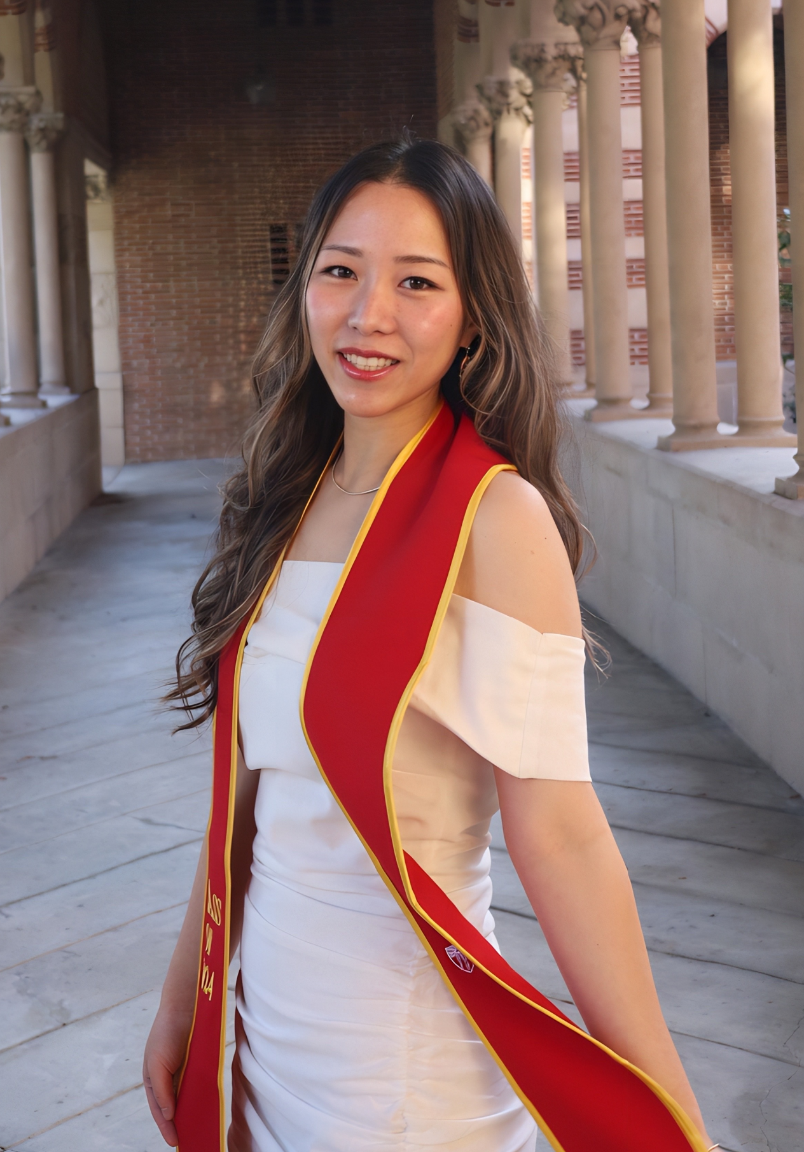
Oris Glisson Fellowship - Outstanding Beginning Masters Student Sujin Yoo Cornell University
Notes:
Attending conference

Slide 46
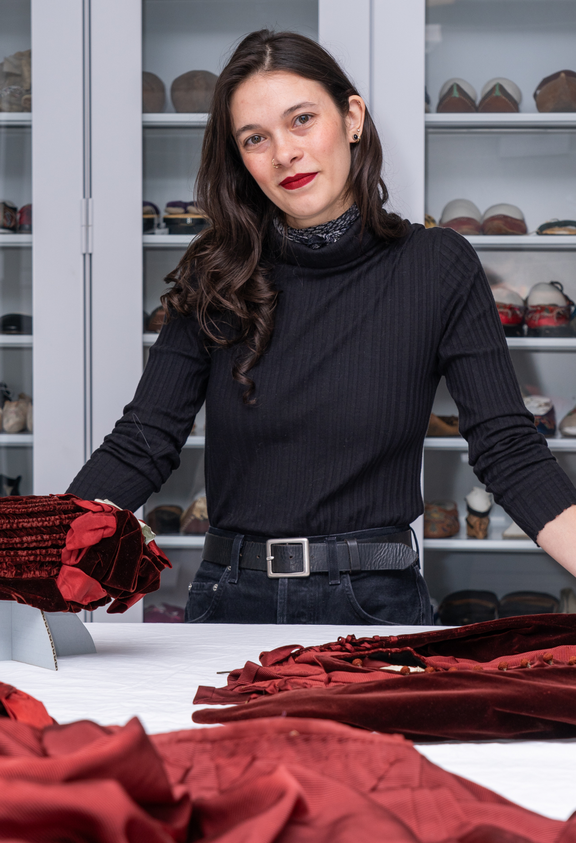
Robert C. Hillestad Fellowship: Outstanding Student in the Study of Historic Textiles or Costume Award Sephra Lamothe Cornell University

Slide 47
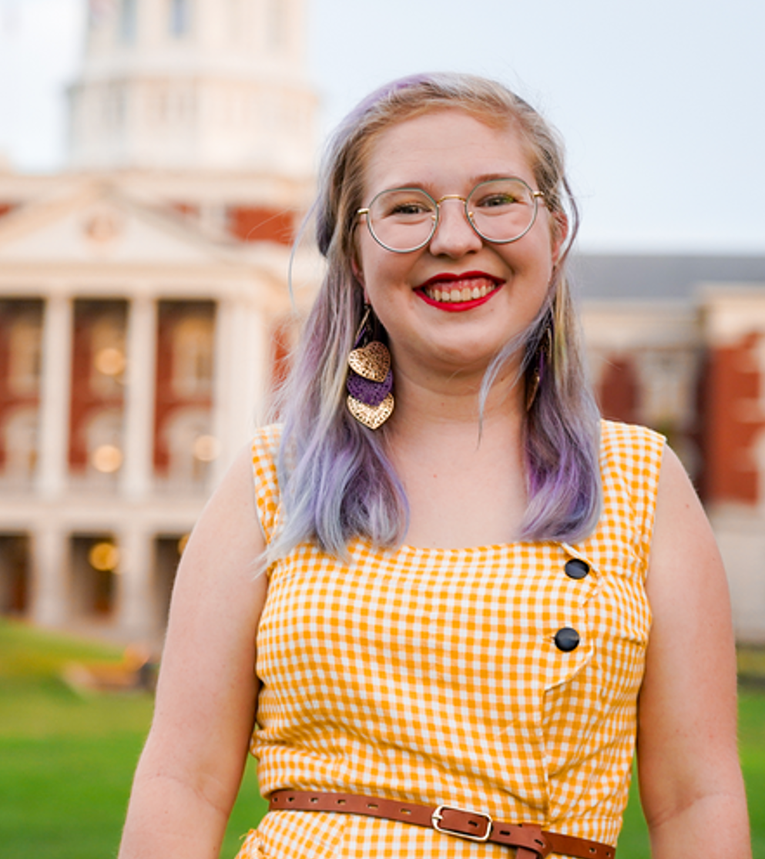
Robert C. Hillestad Fellowship: Outstanding Student in the Study of Historic Textiles or Costume Award Mackenzie Miller University of Missouri

Slide 48
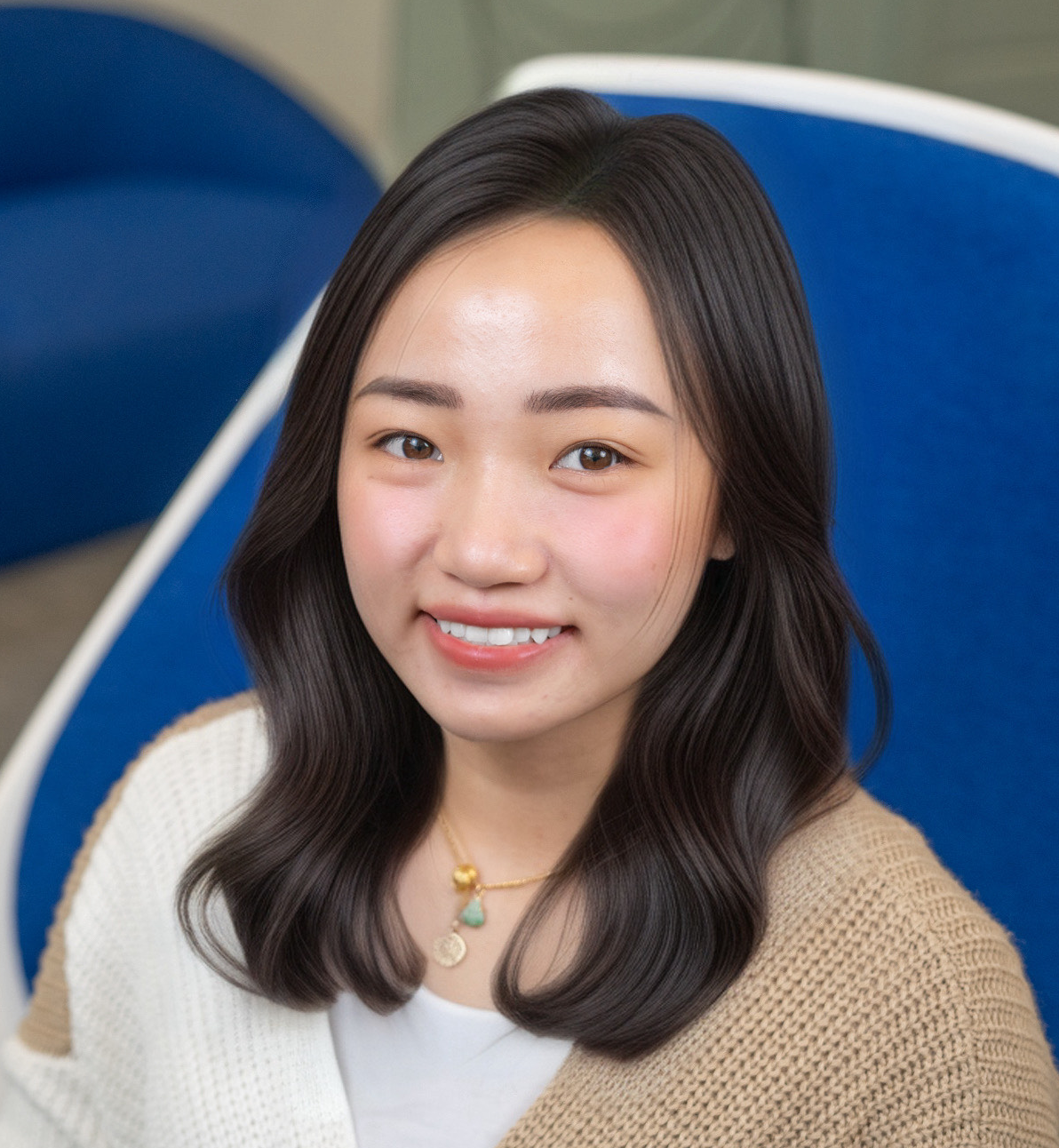
Robert C. Hillestad Fellowship: Outstanding Student in the Study of Historic Textiles or Costume Award Kim Phung Nguyen Cornell University

Slide 49
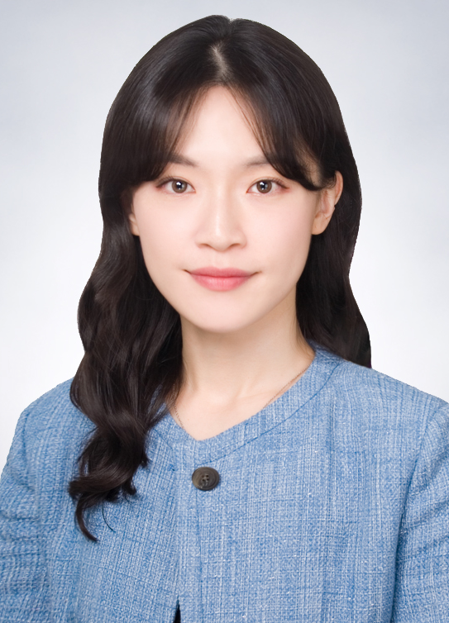
Marjorie Joseph Fellowship – Outstanding Beginning Doctoral Student Hyunjeong (Lacy) Rhee University of Missouri

Slide 50
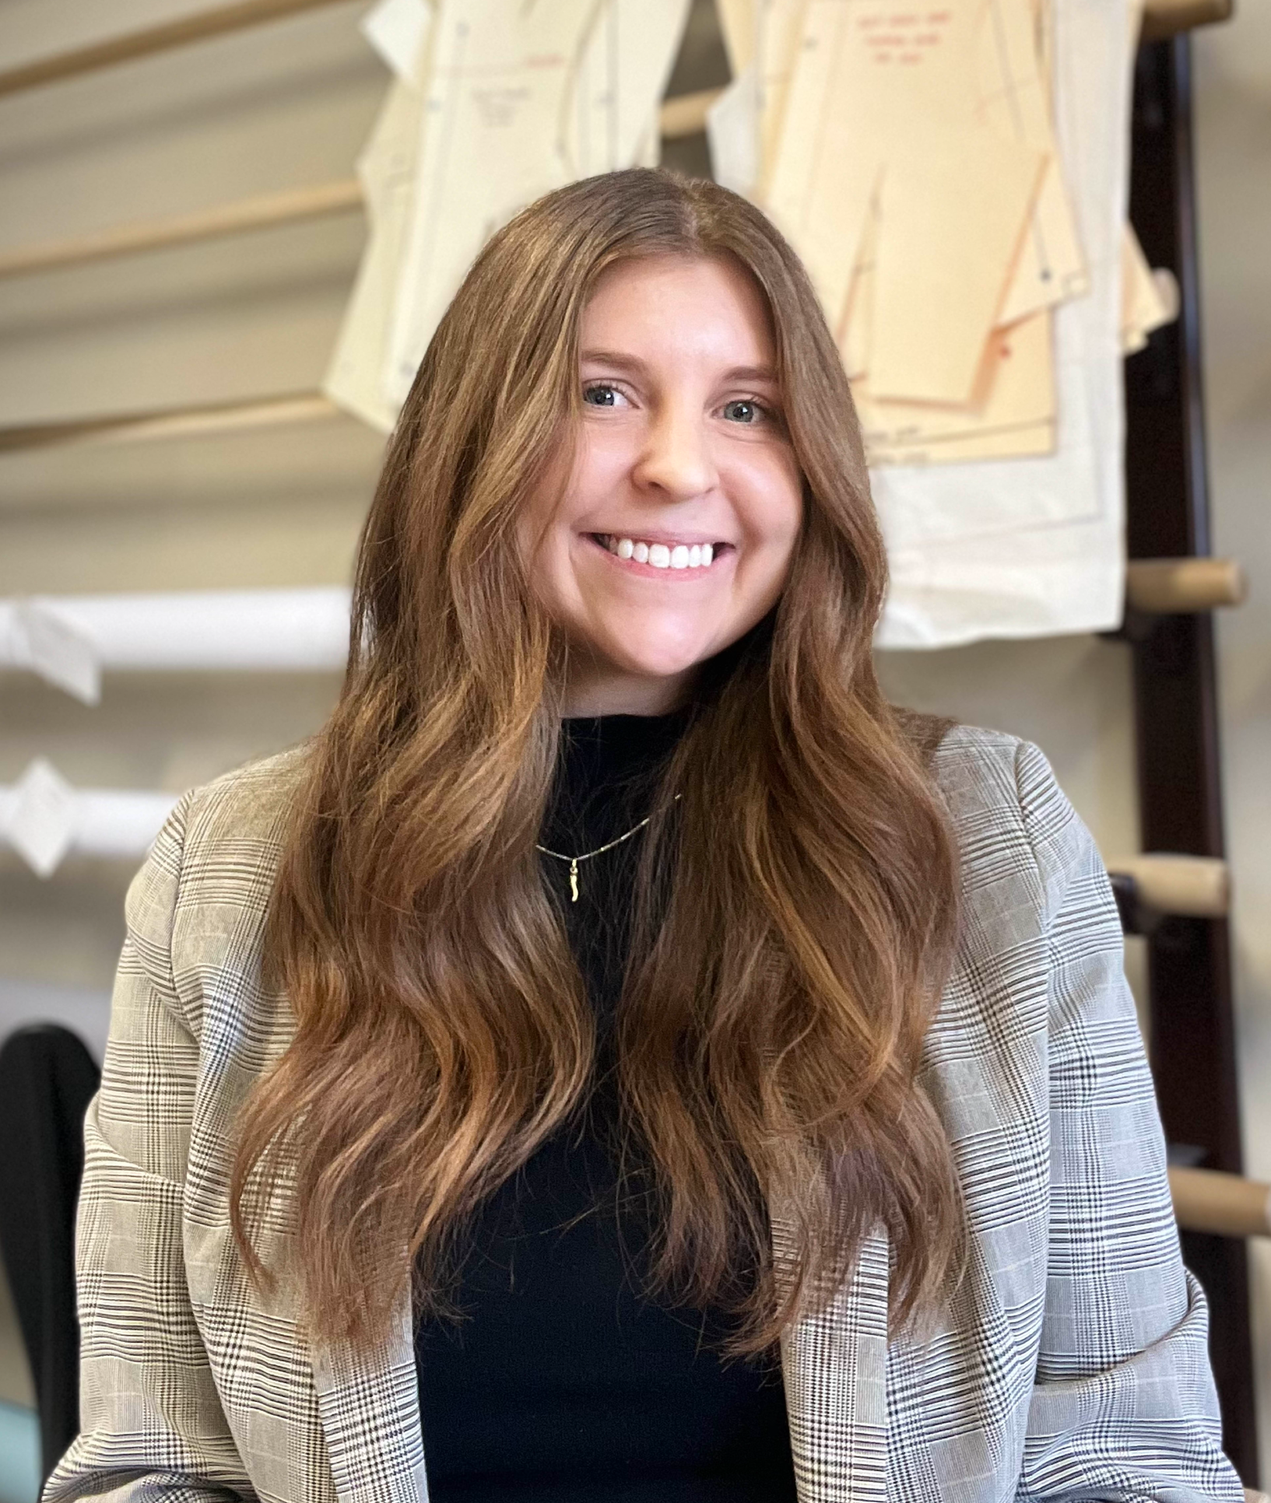
Joan Laughlin Fellowship for Outstanding Continuing Doctoral Student Emma Nicoson University of Missouri

Slide 51
Undergraduate Student Scholarships

Slide 52
The Blanche Payne Scholarship in Apparel or Fashion Design
is awarded to undergraduate students, who demonstrate outstanding design scholarship and professional promise based on a submitted portfolio.
Notes:
$1,000 each

Slide 53
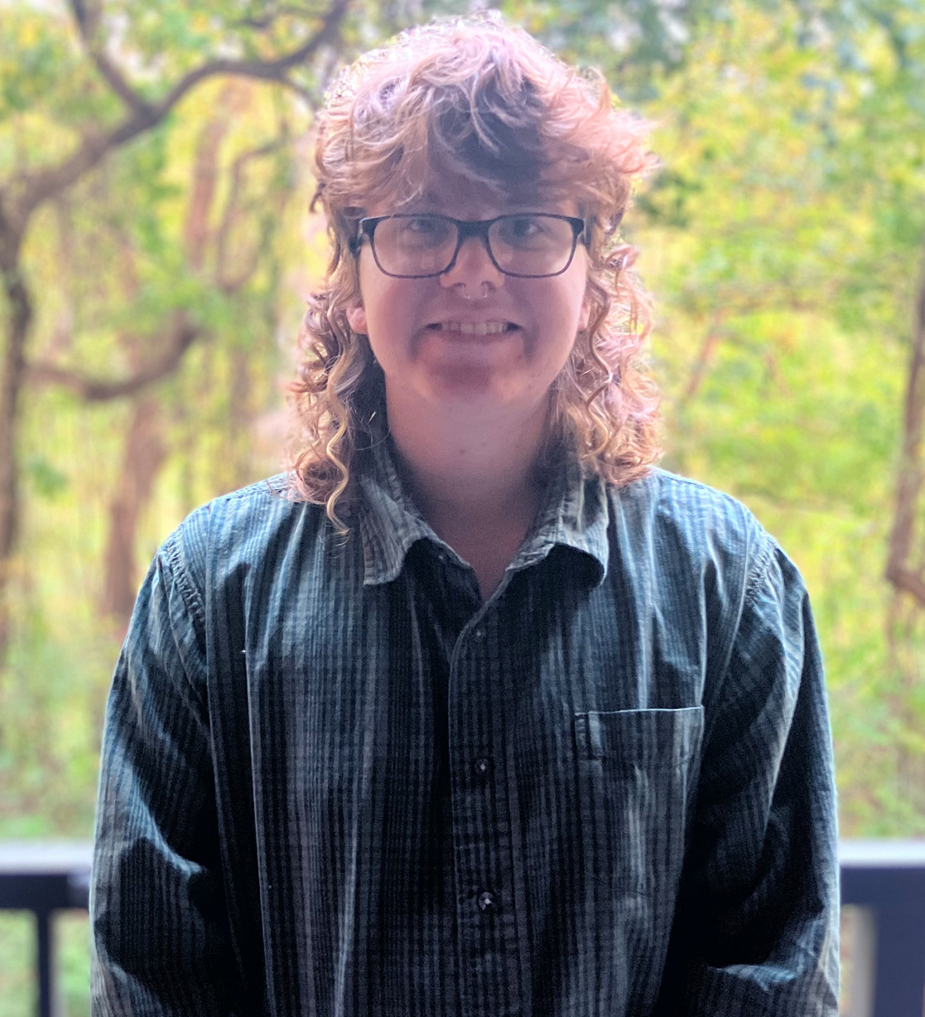
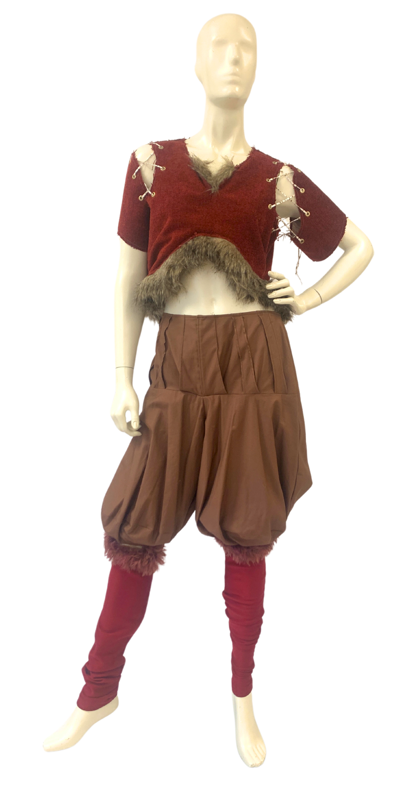
Blanche Payne Scholarship in Apparel or Fashion Design
Alex Culley
University of Delaware

Slide 54
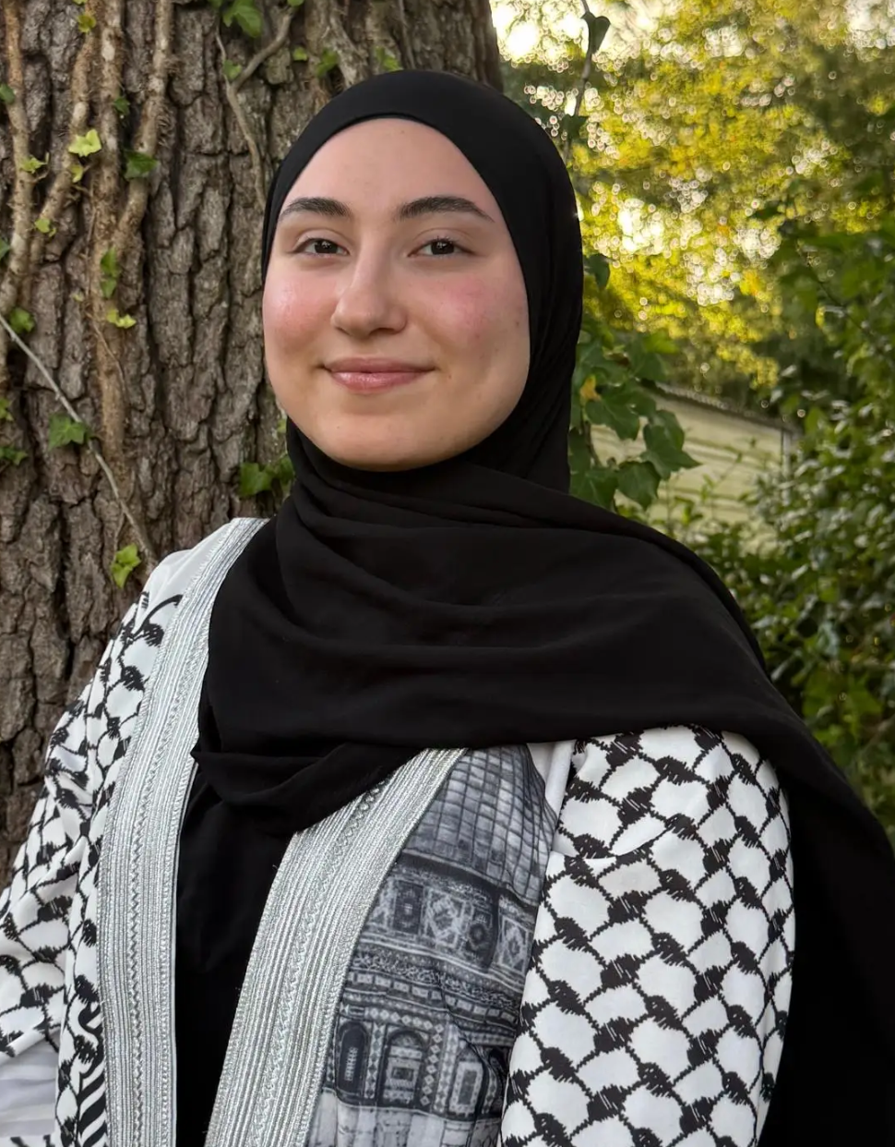
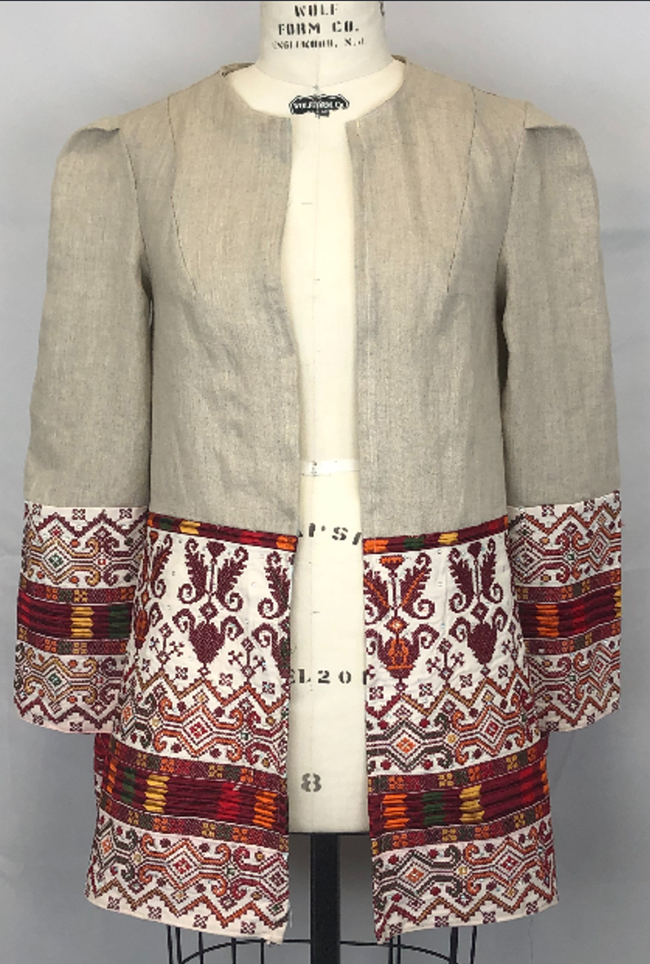
Blanche Payne Scholarship in Apparel or Fashion Design
Nijma Lara
Georgia Southern University

Slide 55
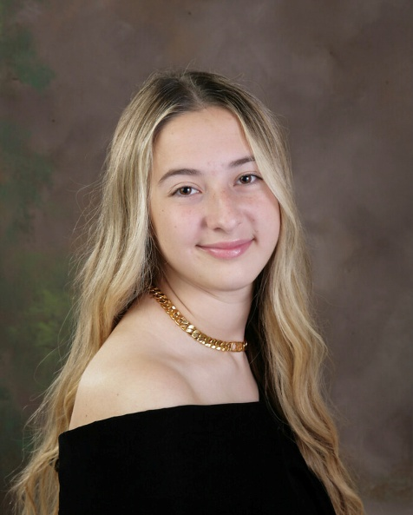
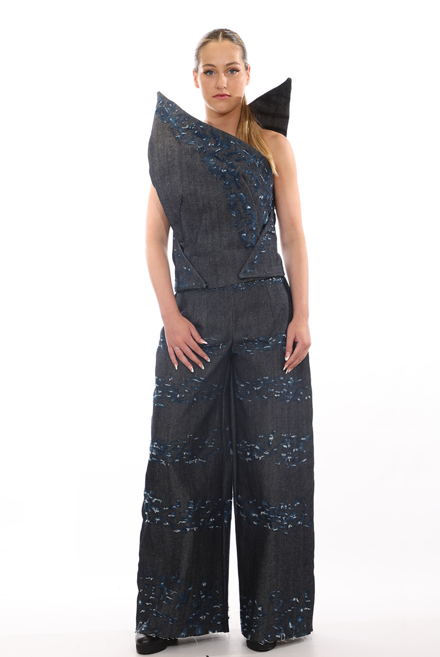
Blanche Payne Scholarship in Apparel or Fashion Design
Ella Renshaw
West Virginia University

Slide 56
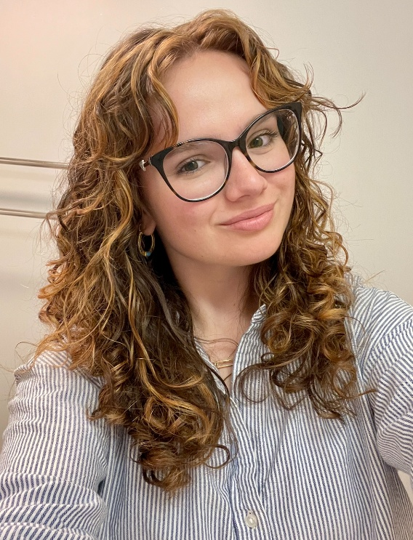
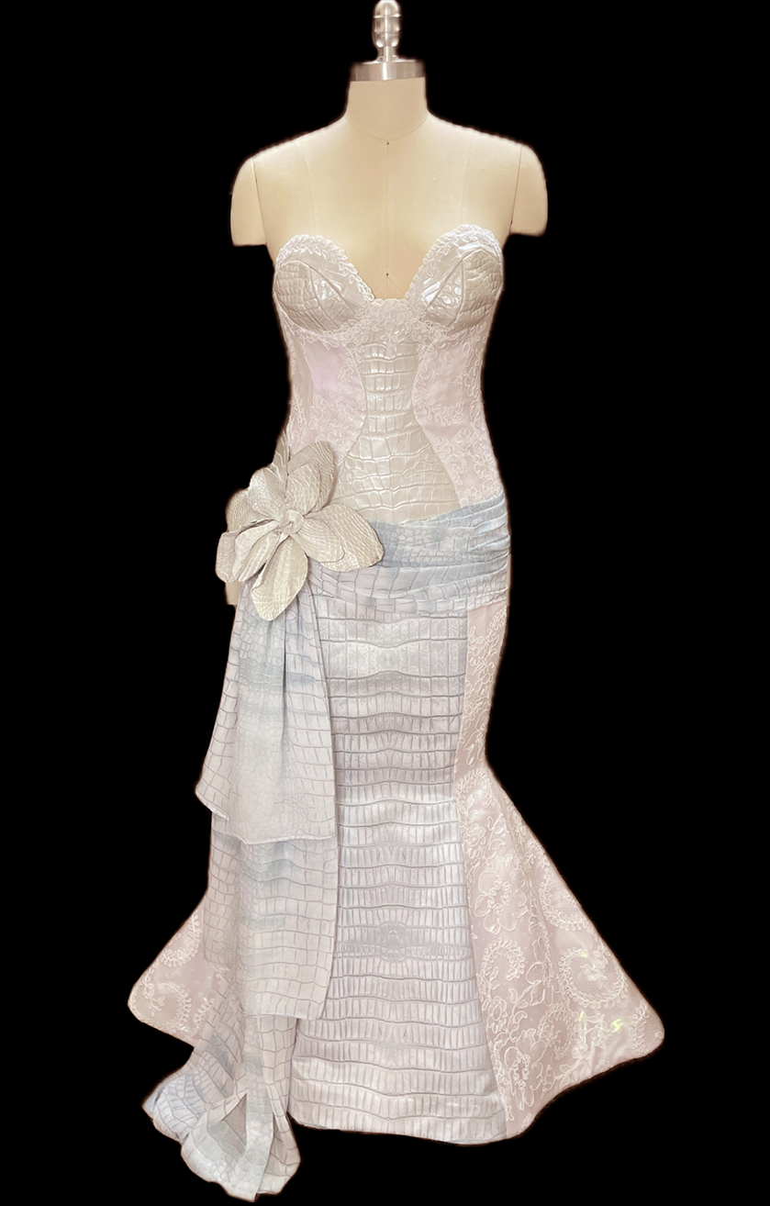
Blanche Payne Scholarship in Apparel or Fashion Design
Martha Rigney
Louisiana State University

Slide 57
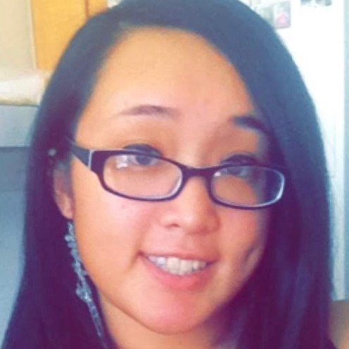
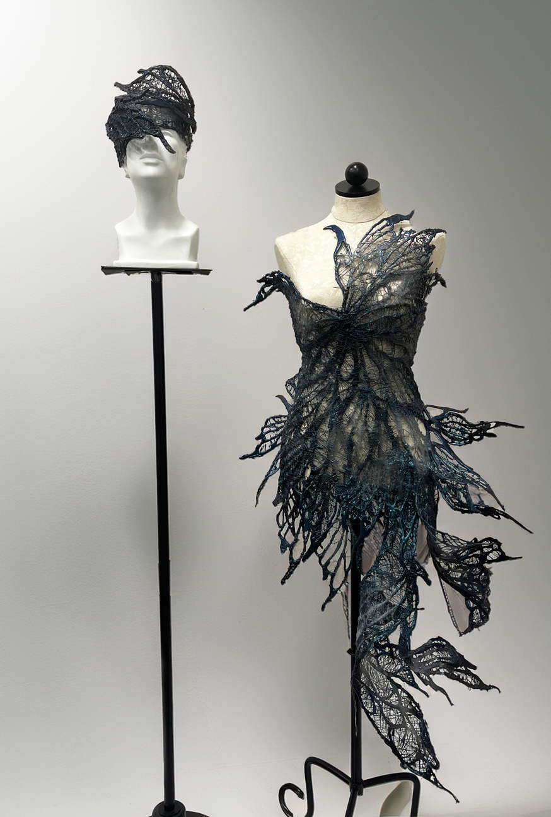
Blanche Payne Scholarship in Apparel or Fashion Design
Kimngan Tran
Texas Women’s University

Slide 58
Congratulations to all the winners!

Slide 59
Scholarship Awards: Research and Teaching Student Best Paper Award

Slide 60
Best Doctoral Student Paper Award 1st Place Sanghee Kim, Texas Tech University The Coolness of AI-Generated Luxury Ads: Effects of Luxury Purchase Types and Advertising Visuals on Perceived Verisimilitude and Creativity

Slide 61
Best Doctoral Student Paper Award 2nd Place (tie) April Elisha Stanley, Iowa State University Analyzing Irish Whitework: The Pim’s Collection of Mountmellick Embroidery Patterns in Ireland

Slide 62
Best Doctoral Student Paper Award 2nd Place (tie) Seong Eun Kim, University of Missouri What is Dupe? Discovering the Consumer-Perceived Legally Copied Products in the Fashion Industry

Slide 63
Master Level 1st Place Huieun Do, Cornell University Ice Hockey Elbow Pad Design Tailored for Female Athletes

Slide 64
Master Level 2nd Place Fnu Al-Amin, Auburn University Going Green or Green Sheen: Investigating Consumer Perceptions Towards Apparel Made From Recycled Polyester Fabric

Slide 65
Rutherford Teaching Innovation Awards

Slide 66
Nancy Rutherford Teaching Innovation Award 1st Place Xun (Catherine) Sun1,2, Li Zhao1, Jia Wu3 1University of Missouri. 2Illinois State University. 3Auburn University Advancing Students’ Generative AI Literacy: A Fashion Merchandising Toolkit and Teaching Guide
Notes:
$500 with certificate

Slide 67
Nancy Rutherford Teaching Innovation Award 2nd Place Mahendran Balasubramanian, Texas Tech University Enhancing Fashion Design Pedagogy with Generative AI Tools
Notes:
$300 with certificate

Slide 68
Nancy Rutherford Teaching Innovation Award 3rd Place Swagata Chakraborty, University of North Texas Technology And Generative Artificial Intelligence for Compelling Visual Communication
Notes:
$200 with certificate

Slide 69
Sponsored Papers of Distinction Awards

Slide 70
Marilyn DeLong Curatorial Exhibition Excellence Award Dyese Matthews1, Catherine Blumenkamp2, Denise Green2. 1Parsons, The New School. 2Cornell University Harlem Noire: Fashion Movement, Moment & Memory
Notes:
$200 with certificate

Slide 71
Margaret Rucker Paper of Distinction Award – Sustainability Li Jiang, Ling Zhang Iowa State University Advancing Sustainable Fashion Through Usercentric Computational Design: Enhancing User Engagement and Creative Experiences in Garment Customization
Notes:
$200 with certificate

Slide 72
Margaret Rucker Paper of Distinction Award – Textile and Apparel Industries Md. Rafiqul Islam Rana University of South Carolina When Global Goals Fail Local Lives: A Critical Study of the Gap Between Sustainable Development Goal Commitments and Garment Worker Realities
Notes:
$200 with certificate

Slide 73
Youngone Paper of Distinction Award – Sustainability and Social Responsibility Liwen Gu1, Sibei Xia2, Yanwen Ruan3, Cynthia Istook4 1Donghua University. 2Louisiana State University. 3Shanghai University of Engineering Science. 4North Carolina State University Automated 3D Garment Flattening with an Improved Feature Curve Morphing Technique for Ease Distribution
Notes:
$200 with certificate

Slide 74
Youngone Paper of Distinction Award – Textile and Apparel Industries Blake Mudd1, Kelly Reddy-Best2 1University of Houston. 2Illinois State University The Role of Government in Sustaining or Creating Barriers Towards Ethical Textile and Apparel Manufacturing Practices in the United States
Notes:
$200 with certificate

Slide 75
Papers of Distinction

Slide 76
Consumer Behavior Track Hyunjeong (Lacy) Rhee & Li Zhao, University of Missouri Revisiting Fashion Product Reviews: AI-Driven Analysis of the Pre-Purchase vs. Post-Purchase Divide

Slide 77
Culture Track Andy Reilly, Jordan Antonio, Youngjin Bahng University of Hawai`i, Manoa sustʻĀINAble Fashion: Kānaka Maoli (Native Hawaiian) Fashion Designers Sustainability Efforts

Slide 78
Design/Product Development Track Colleen Pokorny, Bolanle Dahunsi Oregon State University Integrating AI Image Generation in an Introductory Design Course

Slide 79
Historic Track Constance Spotts, Ling Zhang Iowa State University Empowering Architects of Economic Independence: Keister’s Ladies’ Tailoring College’s Journey from Home Sewing to Industry Design Across Five Decades

Slide 80
Management Paper of Distinction Jisu Jang and Jiyun Kang Purdue University Mitigating Consumer Stress Through Blockchain Based Digital Product Passports in Luxury Fashion Retail Platforms

Slide 81
Pedagogy and Professional Development Paper of Distinction Xun (Catherine) Sun1,2, Li Zhao1, Jia Wu3 1University of Missouri. 2Illinois State University. 3Auburn University Advancing Students’ Generative AI Literacy: A Fashion Merchandising Toolkit and Teaching Guide

Slide 82
Sociology and Psychological Aspects Jonghan Hyun & Swagata Chakraborty University of North Texas Cosmopolitanism, Ethnocentrism, and Sustainable Consumption: The Mediating Roles of Self Expression and Self-Presentation

Slide 83
Undergraduate Paper of Distinction Eduardo Cazares Avila, Yuli Liang, Texas State University College Students’ Awareness and Concerns about Data Collection on Fashion Social Commerce

Slide 84
Creative Design Awards
Notes:
These awards are determined by a secondary set of on site judges.

Slide 85
Creative Design Awards –
Professional

Slide 86

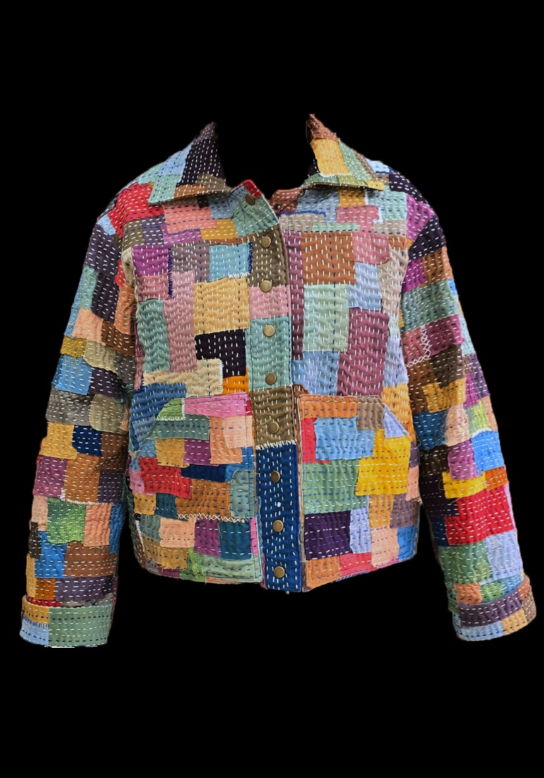
Sandra Hutton Award for Excellence in Fiber Arts
Colleen Pokorny, Bolanle Dahunsi, Marianne Dickson
Crafting Community: A Kantha- Inspired Approach to Addressing Academic Loneliness
Notes:
certificate

Slide 87
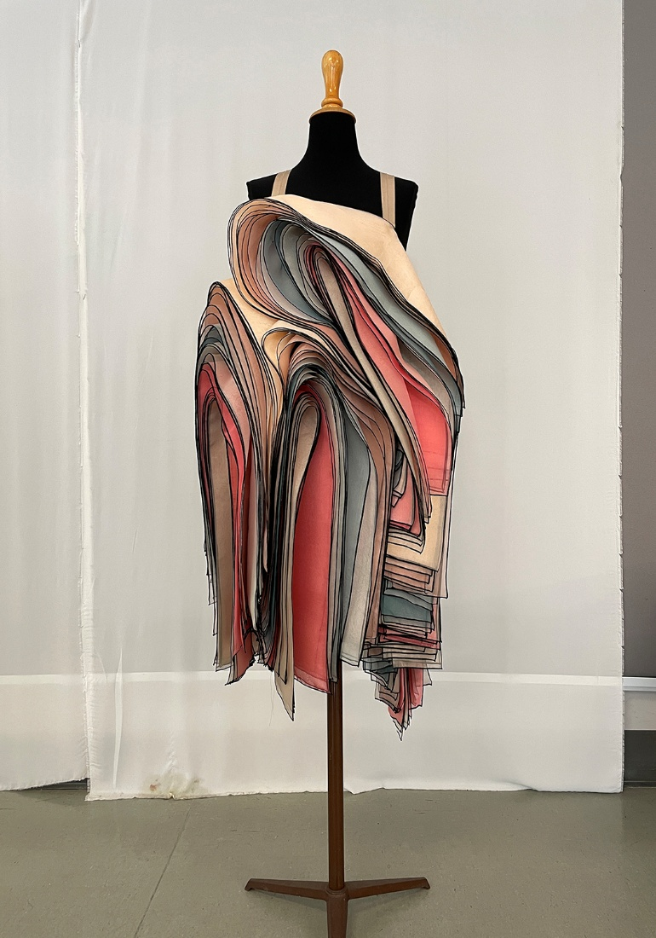
ITAA Award for Innovative Design Scholarship
Danielle Martin, Niloufar Ashournia, Haya Abdelhamid, Shantine Li
inBetween3dPrintDress: A 3D Printed Structured Draped Dress
Notes:
certificate

Slide 88
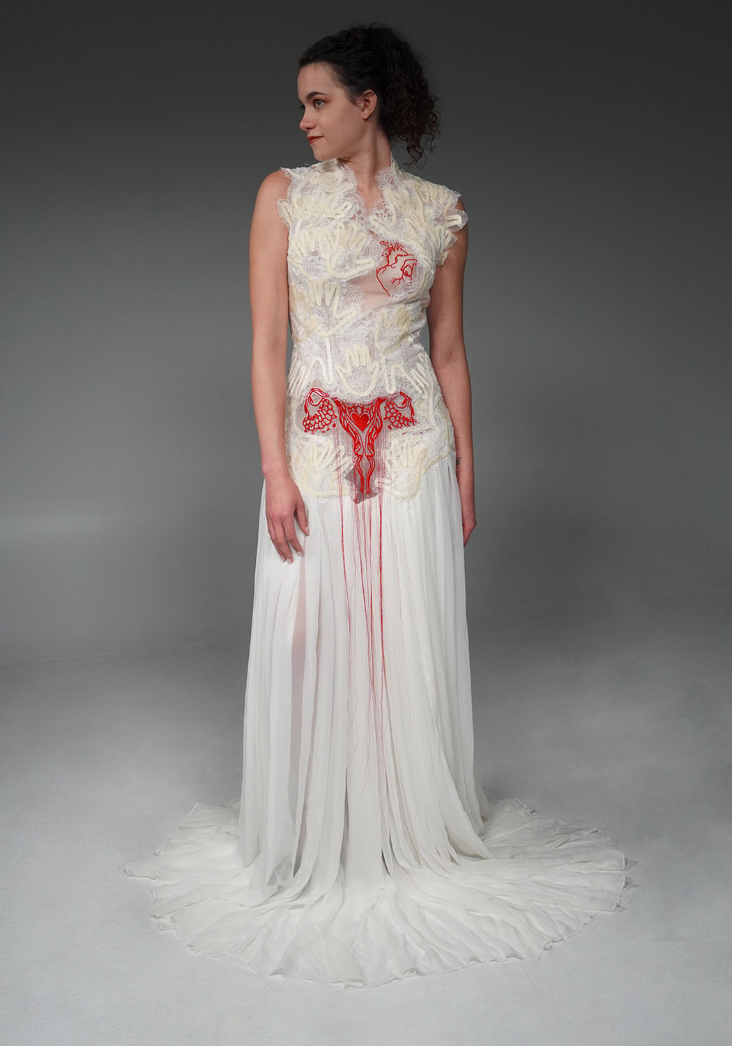
ITAA Award for Creative and Innovative Employment of Techniques
Ling Zhang, Chanmi Hwang
Bound Between Fingers: A Maternal Narrative in Collaborative Creative Practice
Notes:
certificate

Slide 89
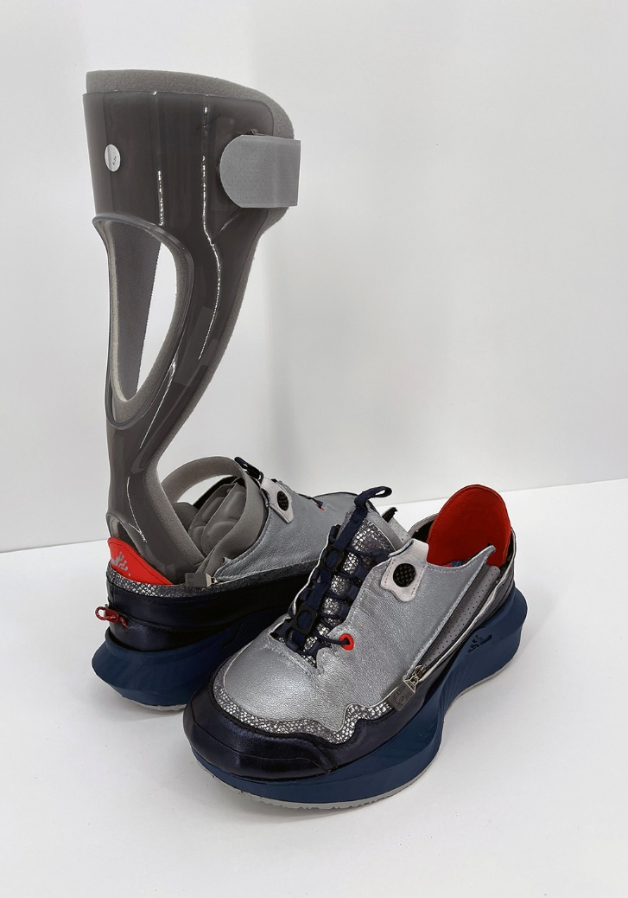
Margaret Rucker Best Design Award
Lida Aflatoony, Kristen Morris
From Sneaker to Boot: A Modular Footwear Design to Enhance Fit and Function for Ankle-Foot Orthosis Users
Notes:
certificate

Slide 90
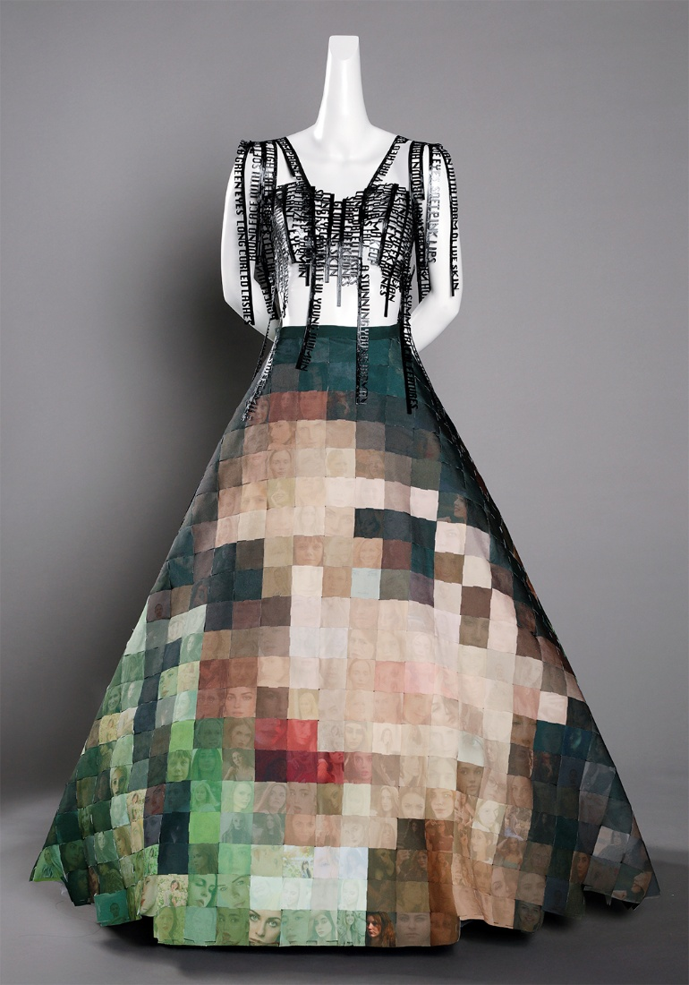
Schofield Summit Design Award
Chanjuan Chen
Her Algorithmic Beauty
Notes:
certificate

Slide 91
Creative Design Awards –
Graduate

Slide 92
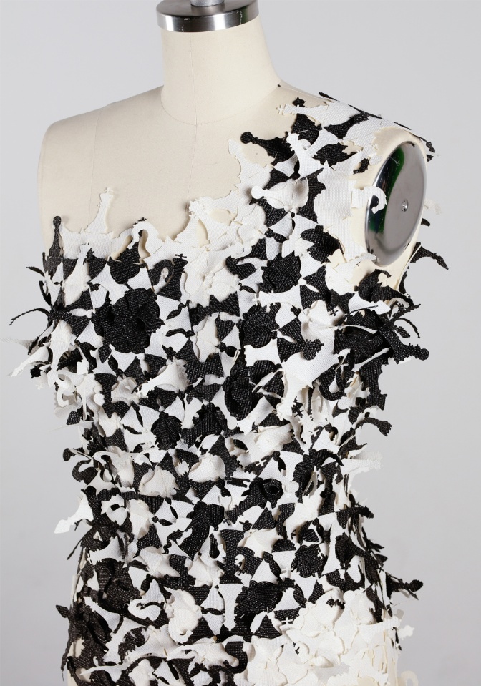
ITAA Award for Innovative Design Scholarship
Lasya Aji Silpa
Modular Gambit: A Reconfigurable Chess-Inspired Dress Exploring Playful User Agency
Notes:
certificate

Slide 93
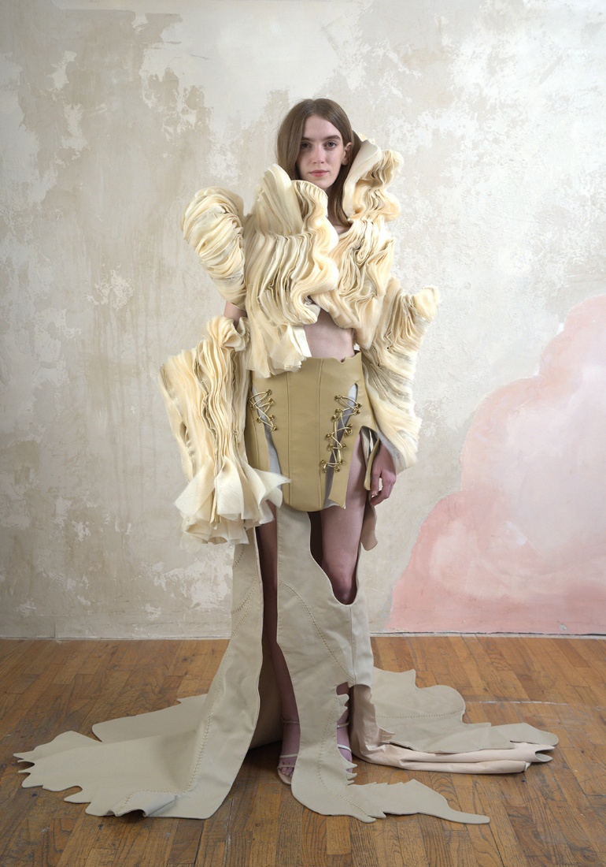
ITAA Award for Creative and Innovative Employment of Techniques
Yawen Chen
Kiss of Time: Translating Aging, Wrinkles, and Scars into Feminist Couture
Notes:
certificate

Slide 94
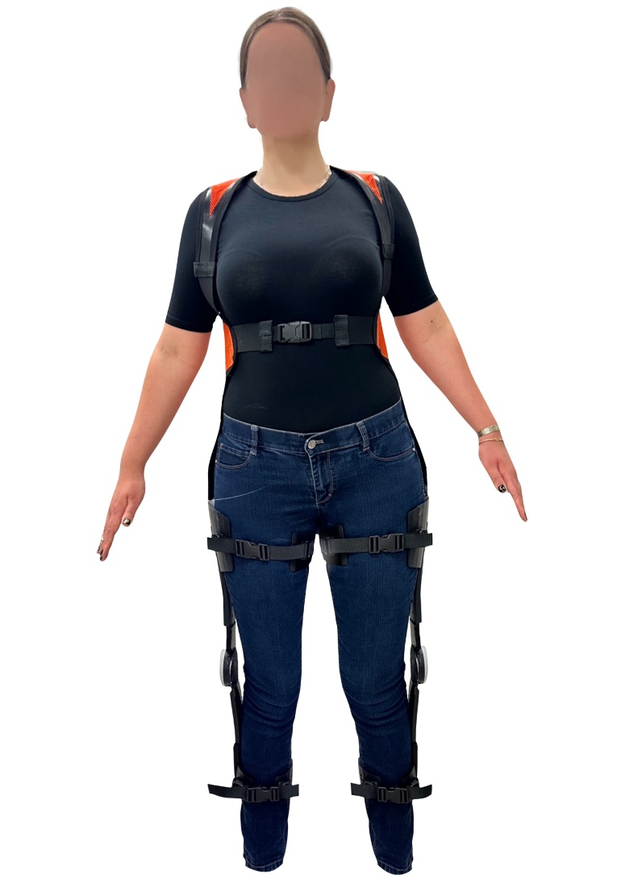
Margaret Rucker Best Design Award
Gwynedd Taylor
Work Assisted Exoskeleton Harness for Female Construction Workers- Mary
Notes:
certificate

Slide 95
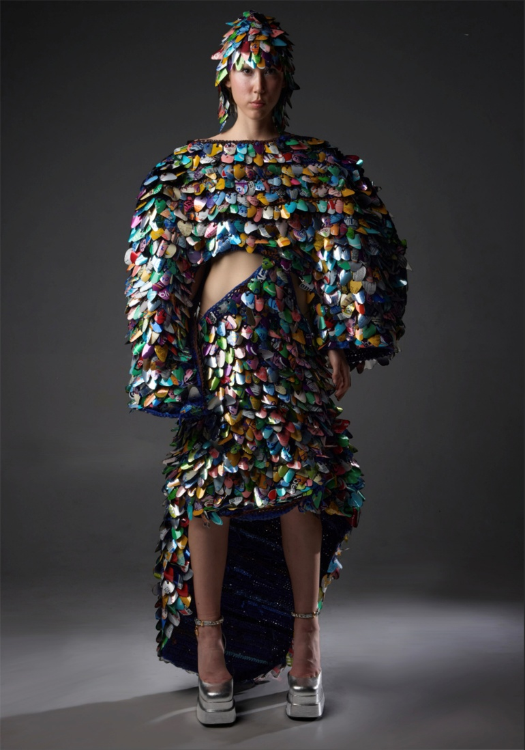
Schofield Rising Designer Award
Jacqueline Schmidt
Iridescence: How the Chaos Theory and Innovation Upcycling Techniques Redirects the Life Path of Materials
Notes:
certificate

Slide 96
Creative Design Awards –
Undergraduate

Slide 97
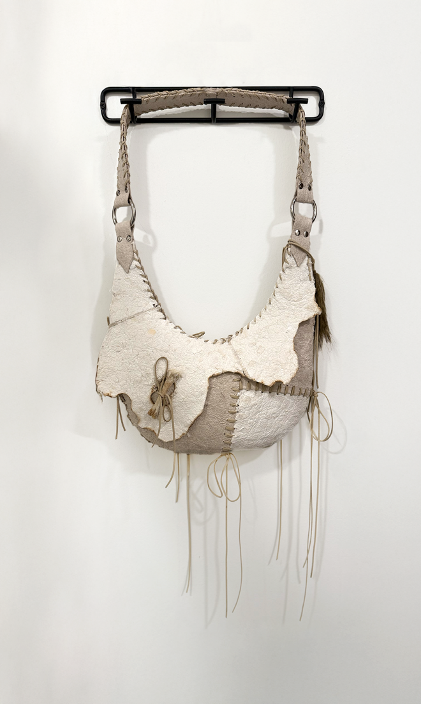
Schofield Emerging Designer Award
Samantha Huynh
SCAURA
Notes:
certificate

Slide 98
Schofield Guiding Mentor Award
Rachel Eike
SCAURA
Notes:
certificate

Slide 99
Best KSCT Oral Presentation Saenim Kwack, Jihye Kim, Sunwoo Kim, Yuri Lee Seoul National University Understanding Elderly Consumers' Intention to Use Smart Clothing: Psychological Influences and the Role of Introducers
Notes:
$1,000

Slide 100
Best KSCT Poster Presentation Seowon Heo, Jisoo Ha Seoul National University A Practical Study on Overcoming Design Compromises in 3D Fashion Design Implementation
Notes:
$1,000

Slide 101
Congratulations, Recipients! Thank you, Sponsors!

