Slide 1

Let’s Talk Myo:
The Therapy You Didn’t Know Your
Patients Needed
Samantha Dieringer, BSDH, RDH, CMT®
Myo Works, LLC

Slide 2
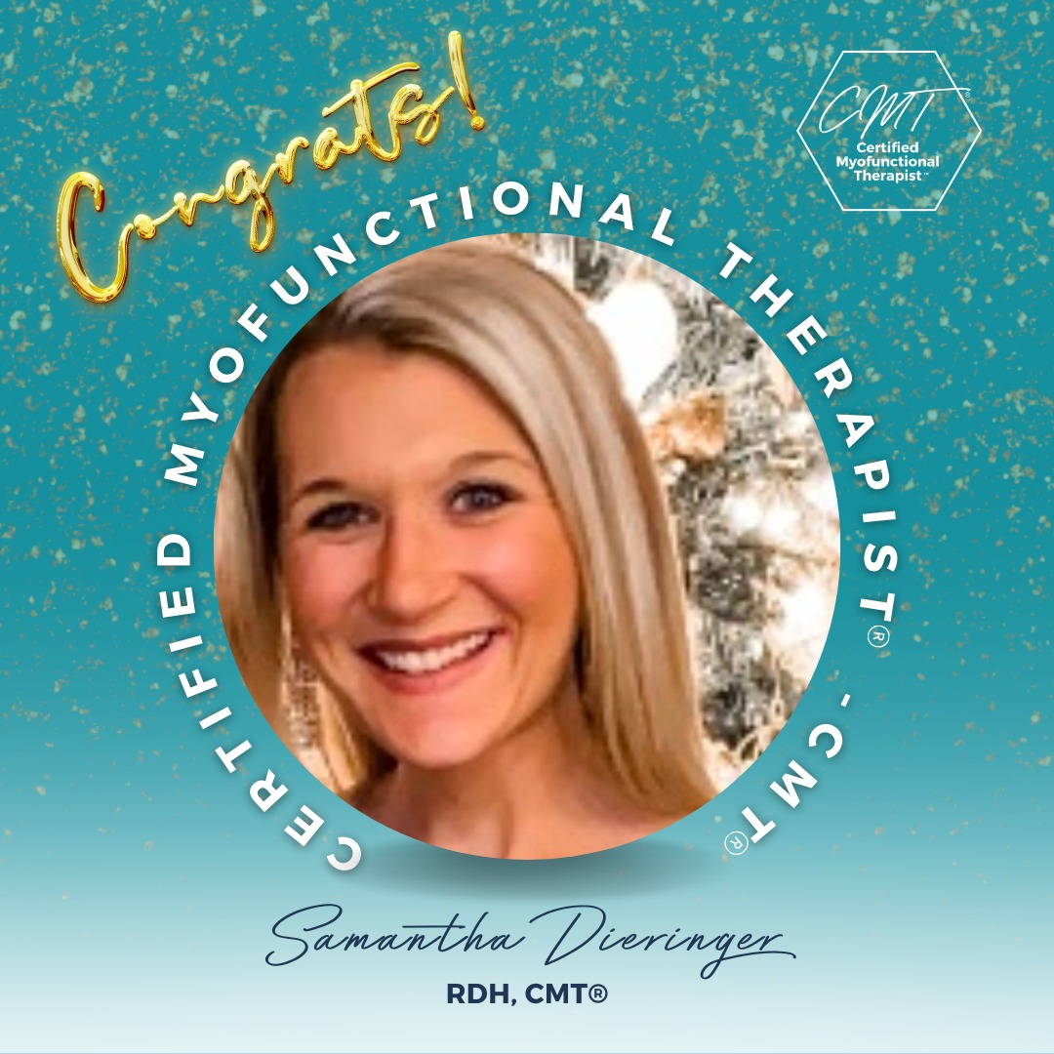
How Did I Get Into Orofacial Myofunctional Therapy?
Fall 2023
First learned of myofunctional therapy, started researching and enrolled in my first course.
Feb 2024
Became an Orofacial Myofunctional Therapist - OMT.
May 2025
Took a second myo course.
Dec 2025
Became a Certified Myofunctional Therapist - CMT®.
Feb 2026
Launched my business, Myo Works, LLC!

Slide 3
IAOM DEFINITION OF OMD
An orofacial myofunctional disorder (OMD) includes one or more of the following:
Abnormal labial-lingual rest posture
Bruxism (teeth grinding)
Poor nasal breathing
Tongue protrusion while swallowing
Poor mastication and bolus management
Atypical oral placement for speech
Lip incompetency and/or digit and sucking habits (e.g., nail biting)
These conditions can co-occur with speech misarticulations. In such cases the articulation disorder is not developmental or phonological in nature but rather results from poor oral placement and inappropriate muscle development. OMD may reflect the interplay of functional, physical/structural, genetic, and environmental factors.
(Doshi & Bhad-Patil, 2011; Elad et al., 2014; Ferreira, Mangili, Sassi, Fortunato-Tavares, Limongi, & Andradem, 2011; Garretto, 2001; Hanson, 1988; Homem, Vieira-Andrade, Faci, Ramos-Jorge, & Marques, 2014; Langmore & Pisegna, 2015; Levrini et al., 2014; Maspero, Prevedello, Giannini, Galbiati, & Farronato, 2014; Som & Naudich, 2013)

Slide 4
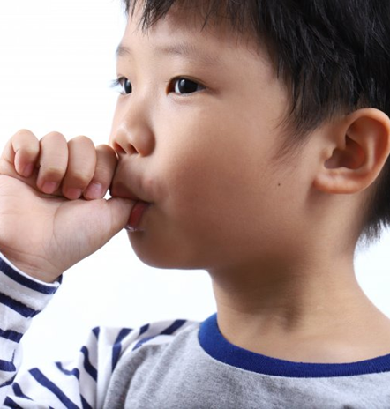
What are OMDs ?
(Orofacial Myofunctional Disorders)
OMDs are atypical, adaptive patterns that emerge in the absence of normalized patterns within the orofacial complex. The regular presence of these adaptive movements can often result in a variety of disturbances.
Examples of Orofacial Myofunctional Disorders include one or a combination of the following:
Thumb/finger sucking
nail biting or other harmful oral habits
A routine habit of resting with the lips apart
A forward resting posture of the tongue between or against the teeth
Tongue Thrust

Slide 5
History of Myo
Believed main cause of malocclusion:
1. Orofacial muscles and
mouth breathing due
to nasal obstruction
2.Lip/tongue habits
Did you know Orofacial Myofunctional therapy has been around for more than 115 years!!!
Let’s dive into the 1890s-1930s
The Father of Modern Orthodontics
Dr. Edward H. Angle
1890s
Classification of malocclusions
1892
First to solely practice orthodontics
1907
Created first pre-fabricated orthodontic appliance system: E-arch Appliance
1922
Founded society of Orthodontists: American Society of Ortho.
1930
Established "The Angle Orthodontics" publication

Slide 6
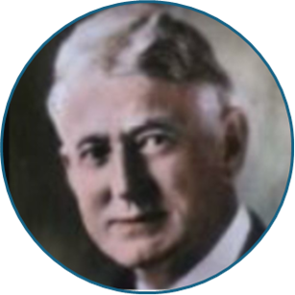
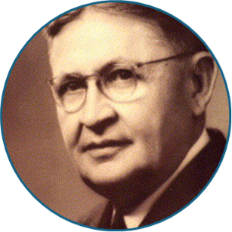
History of Myo
General body posture and an imbalance of facial muscles resulted in malocclusion!
Orofacial Myology is NOT new--It is
evidence based. It is a
therapeutic service that improves the outcomes of orthodontics (when needed)
Let's dive into 1900s-1950s
More Influential Dentists in the Myo space
In 1906, DR. ALFRED P. ROGERS (L): Developed corrective exercises to improve tonicity and muscle function.
Benno E. Lischer (R) credited with being the first person to use the term “myofunctional therapy” to describe Rogers exercises
In 1918 - first to put in writing that general body posture and an ‘imbalance’ of facial muscles resulted in malocclusion.
Muscles as living orthodontic appliances
Believed swallowing not involved with OMDs and open bite was result of tongue sucking
No expansion or retention appliances needed, felt myo was sufficient.
Created and recommended lingual appliances (later ruled out)

Slide 7
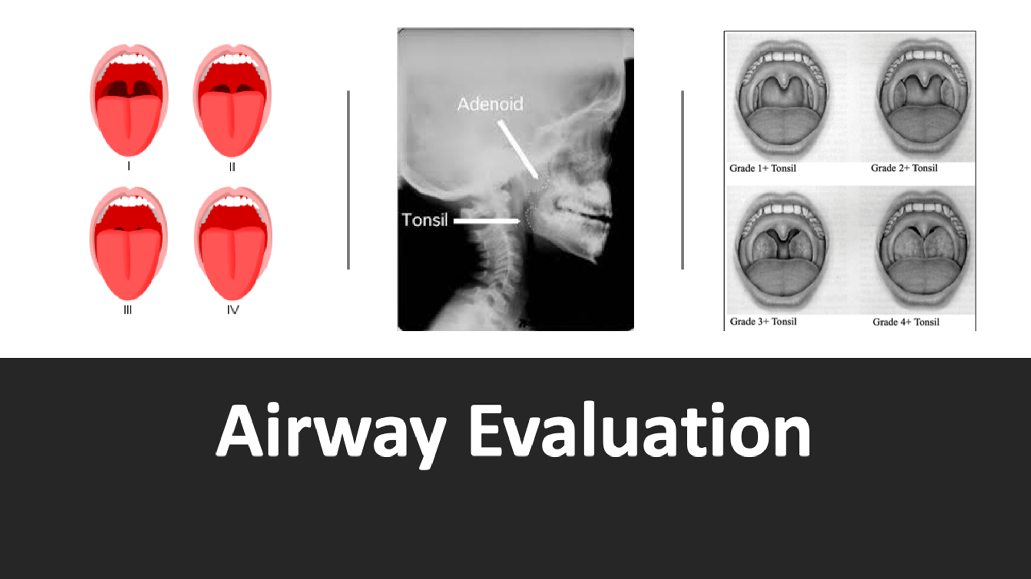

Slide 8
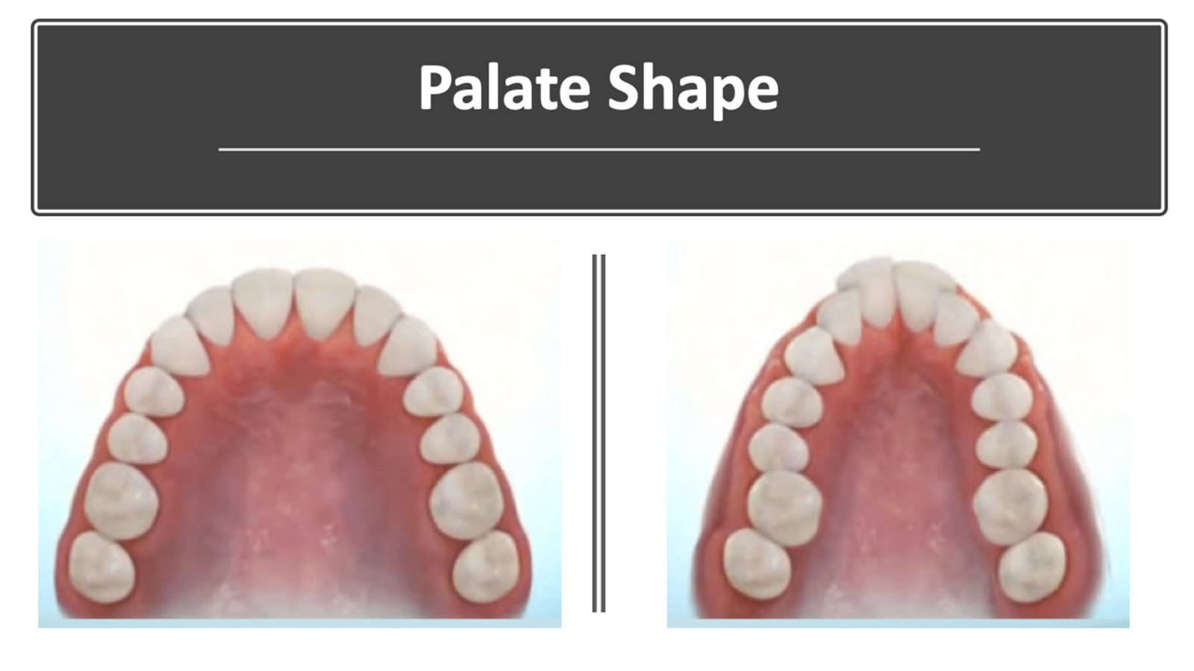

Slide 9
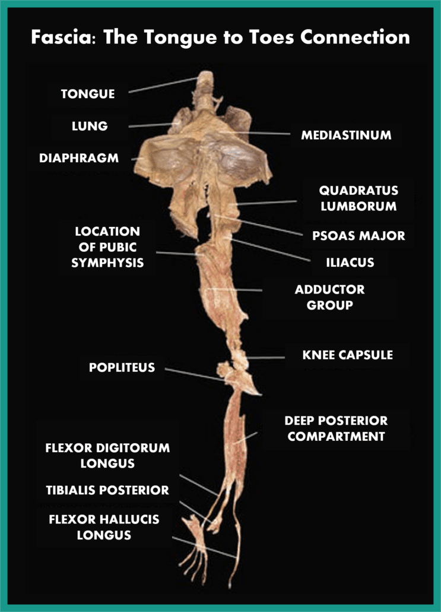
Fascia and Compensations

Slide 10
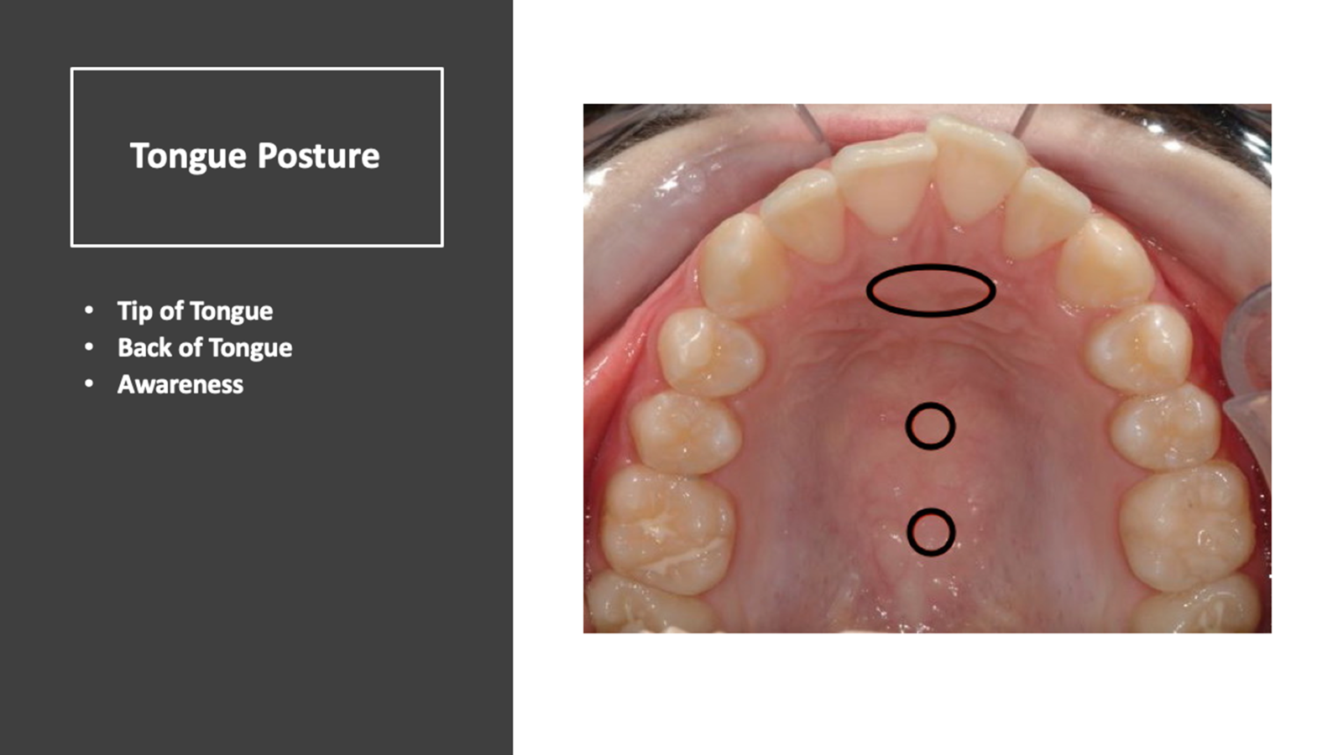

Slide 11
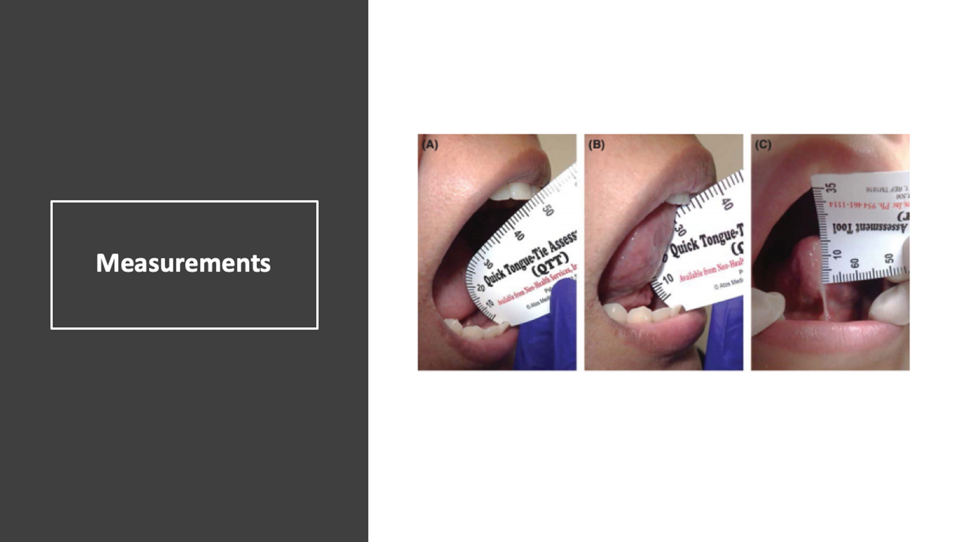

Slide 12
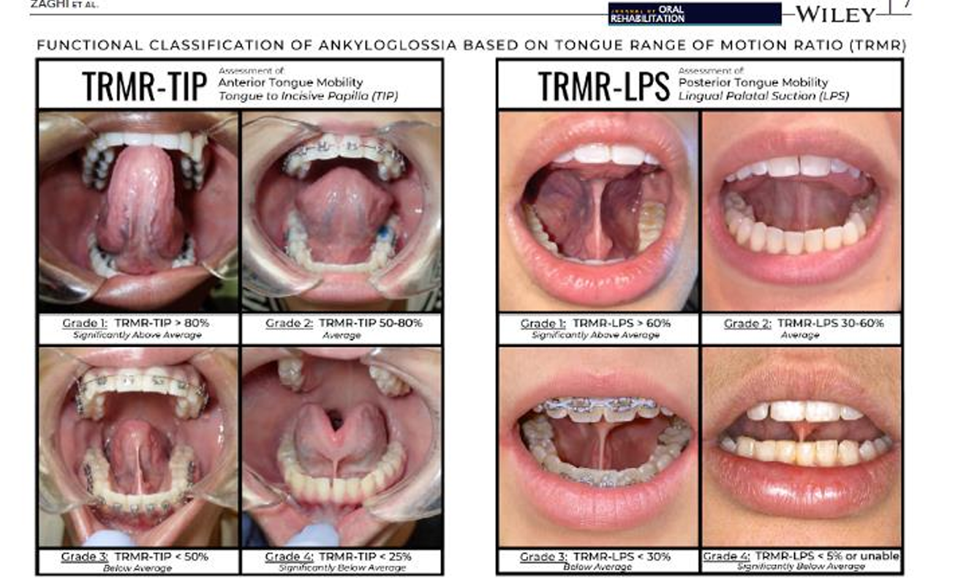
What are TOTs?
Ankyloglossia or partial ankyloglossia
• “Congenital anomaly characterized by an abnormally short lingual frenum, which may restrict the mobility of the tongue”
• “Restricted lingual frenum”
• Tethered Oral Tissue (TOT) is the newest term and refers to all ties – lip, buccal, and lingual

Slide 13
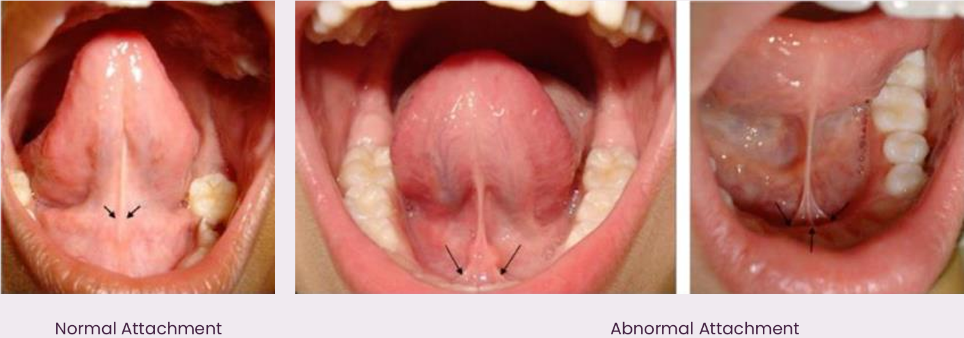
Lower Frenum Attachment
Into floor of mouth or alveolar ridge?

Slide 14
A TONGUE TIE CAN AFFECT AIRWAY AND TMJ
TONGUE TIE- RESTRICTED TONGUE MOBILITY = LOW TONGUE POSTURE
LOW TONGUE POSTURE = MORE LIKELY FOR THE TONGUE TO FALL BACK INTO THE AIRWAY DURING SLEEP
CLENCHING/GRINDING = IN RESPONSE TO A COMPROMISED AIRWAY
TMJ DYSFUNCTION = PAIN AND TENSION

Slide 15
Four Main Goals of Myofunctional Therapy
Nasal Breathing
Lip Seal
Correct Tongue Posture
Correct Swallowing/Chewing

Slide 16

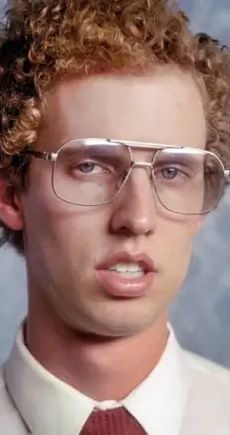
Nasal Breathing vs Mouth Breathing
WHAT DO YOU SEE?
What problems do you think are associated with mouth breathing?

Slide 17
The Dangers of Mouth Breathing
Prevents the proper function of the tongue and other orofacial muscles that we need to speak, swallow, chew and function properly
Can be a contributing factor to a compromised airway and the need for orthodontic treatment
Improper exchange of carbon dioxide and oxygen
Sleep Disordered Breathing / Sleep Apnea Risks
Can cause the delicate tissues of the tonsils and adenoids to swell and become enlarged, further impacting a restricted airway
Can cause enlarged tonsils/ adenoids
Can lead to misdiagnosis of ADHD

Slide 18
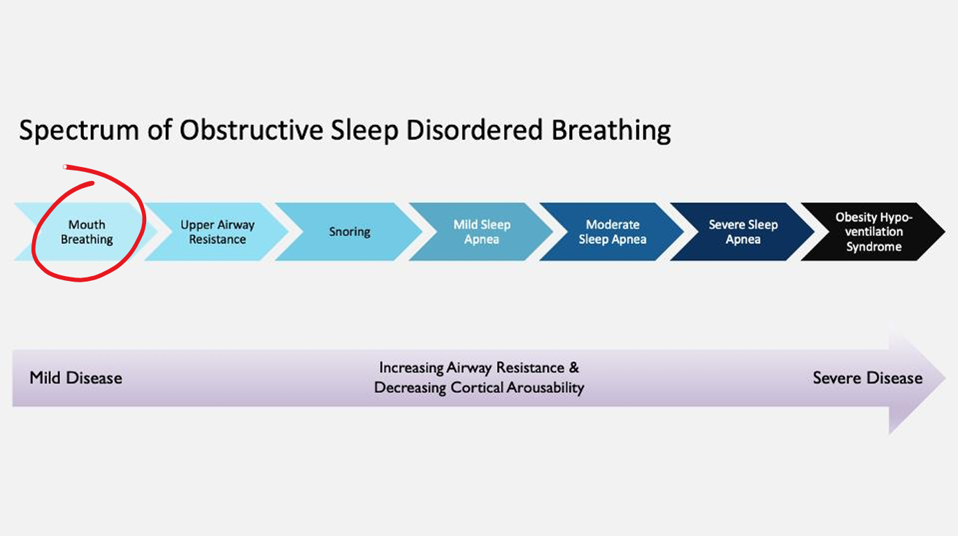
Slide by Dr. Soroush Zaghi

Slide 19

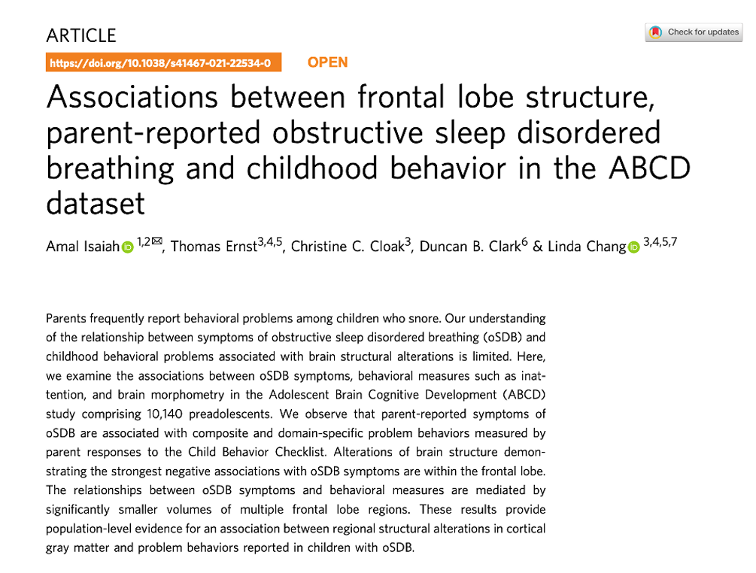
Mouth Breathing Research
10,000 kids
oSDB includes snoring, noisy breathing, and mouth breathing – not OSA
It shows reductions in gray matter
The grey matter includes regions of the brain involved in muscle control, and sensory perception such as seeing and hearing, memory, emotions, speech, decision making, and self-control.
This explains why children with snoring issues may have problems with aggression, emotional regulation, ADHD, among other behavioral and learning issues.

Slide 20

Talk to your patients about sleep!
Mouth breathing is dysfunctional breathing and is a risk factor for SDB in children and adults.
Tongue-tie is a risk factor for SDB in children and adults.
Discussing these risk factors with patients becomes a very important conversation.
Patients with any form of Sleep Disordered Breathing usually need myofunctional therapy!

Slide 21
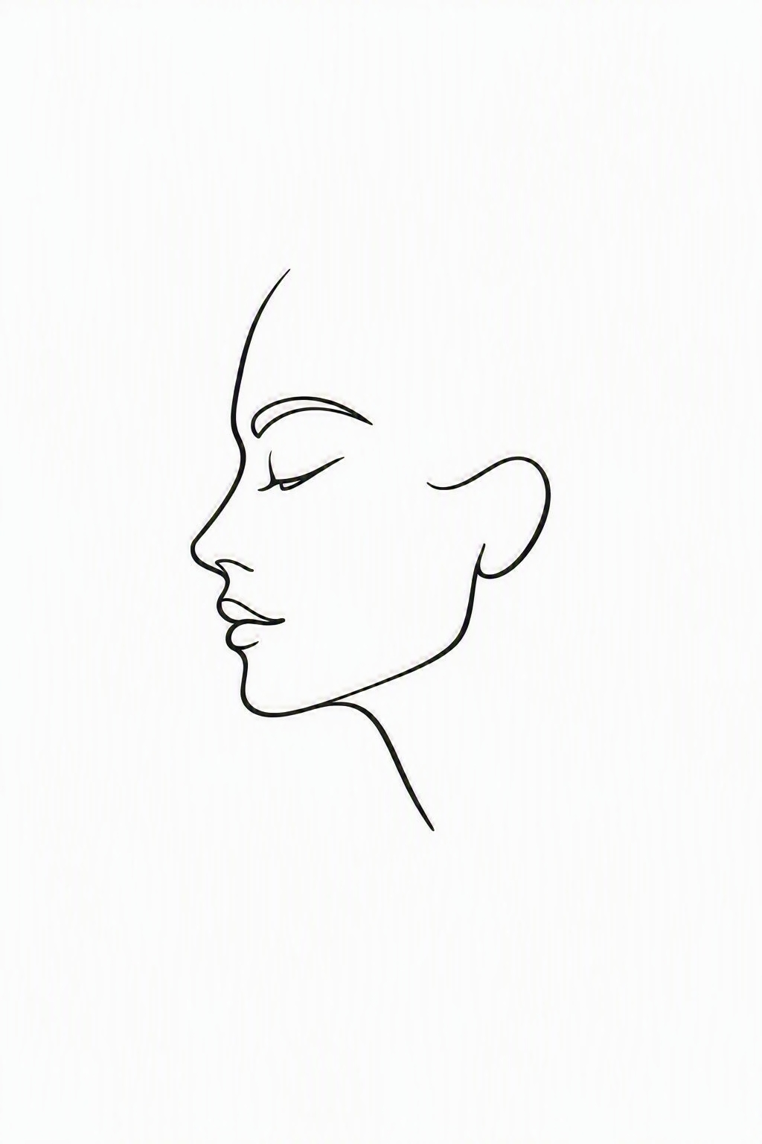
The way your face grows is greatly influenced by breathing habits and the resting posture of the Tongue + Lips
Mouth Breathing and low tongue posture can lead to structural characteristics such as:
a narrow palate
cavities
caries
a long face
crowded teeth
a recessed jaw
a gummy smile

Slide 22
THINGS TO LOOK FOR THAT WOULD WARRANT A REFERRAL
ANY CHILD NEEDING PALATAL EXPANSION
PROLONGED THUMB SUCKING, PACIFIER USE, OR SIPPY CUP USE
COMPLAINTS OF EXHAUSTION, SLEEP QUALITY, AIRWAY RELATED, ETC FOR ANY AGE
TONGUE-TIE/ ANKYLOGLOSSIA
ORTHODONTIC RELAPSE
EARLY SIGNS OF GRINDING IN CHILDREN, CHRONIC HEADACHES, TMJD OR NECK PAINS

Slide 23
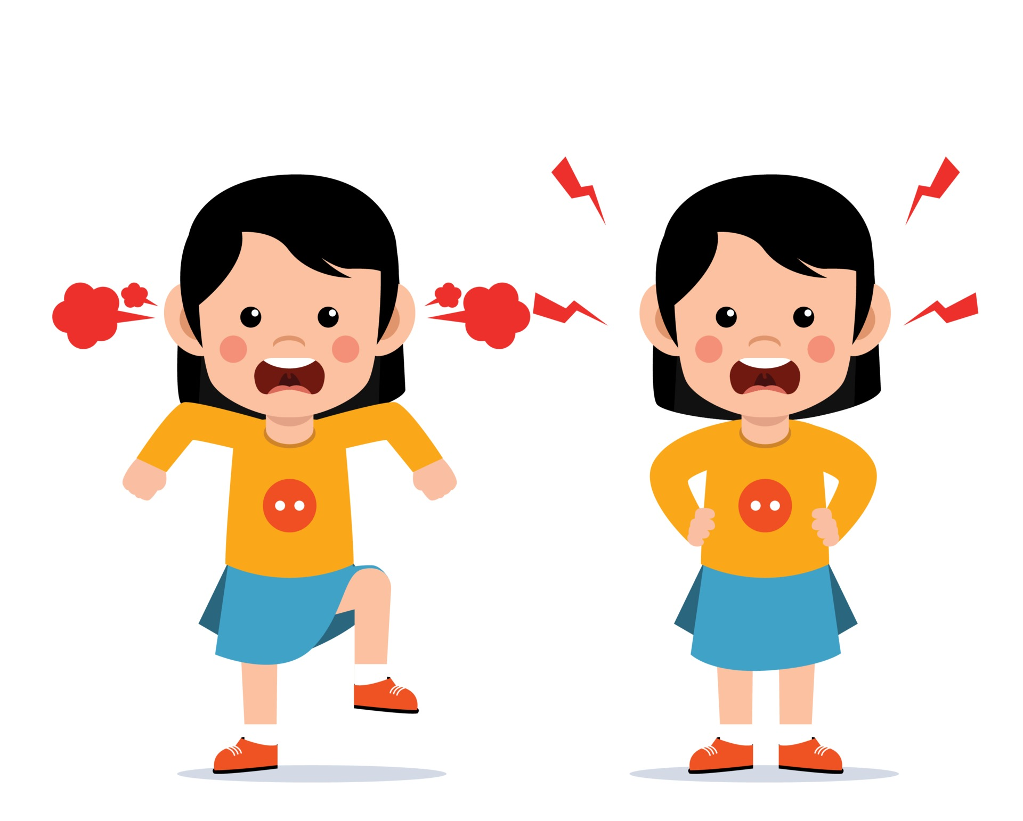
Potential Signs of SDB in Kids
1. Snoring
2.Grinding Teeth
3.Bedwetting Beyond 3 Years of Age
4.Dark Eye Circles
5.Frequent Ear Infections
6.Tossing & Turning in Sleep
7.Waking Tired and/or “Cranky” Regularly
8.Sleeping in Odd Positions
9.Waking Frequently Throughout the Night
10.Waking with Cracked, Dry Lips Regularly
11.ADHA
12.Mouth Breathing

Slide 24
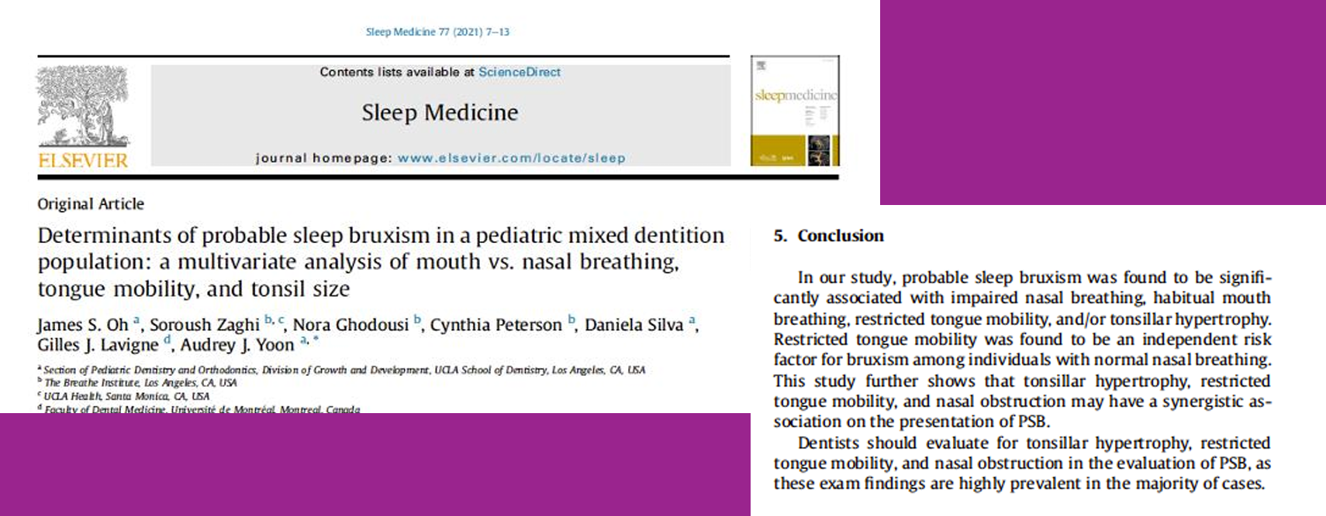
Bruxism and SDB

Slide 25
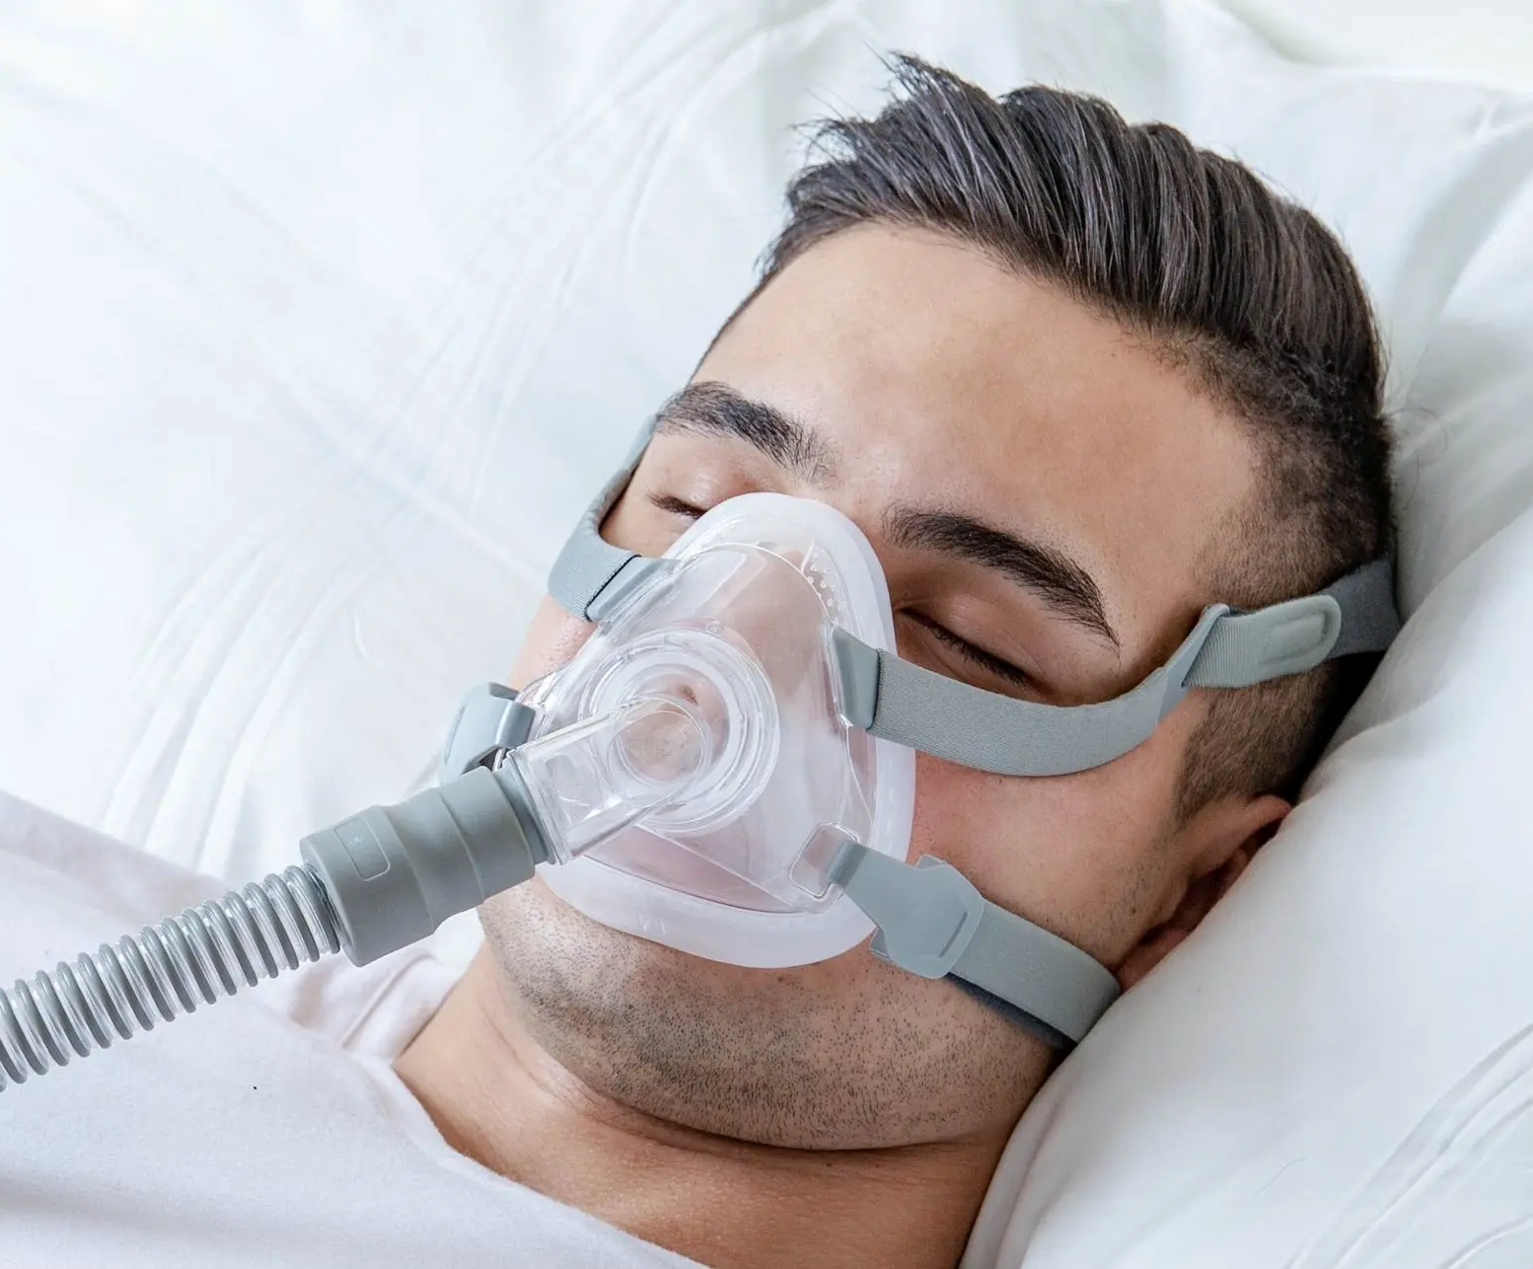
Myofunctional Therapy & Sleep Apnea
Myofunctional Therapy to Treat Obstructive Sleep Apnea: A Systematic Review and Meta-Analysis 2015 Current literature demonstrates that myofunctional therapy decreases apnea-hypopnea index by approximately 50% in adults and 62% in children. Lowest oxygen saturations, snoring, and sleepiness outcomes improve in adults.
Myofunctional therapy could serve as an adjunct to other obstructive sleep apnea treatments

Slide 26
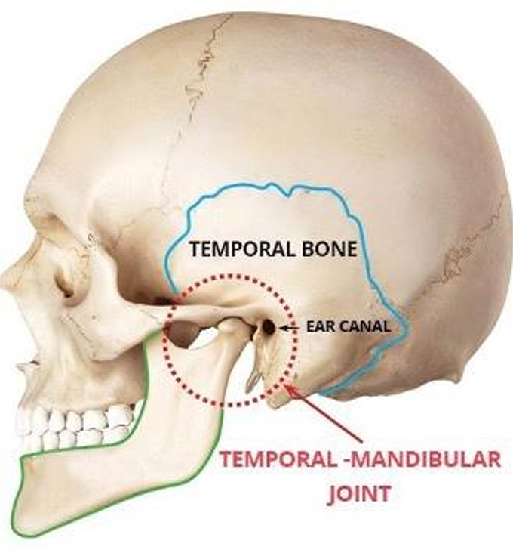
Many Patients with SDB also have TMD
Some sources say up to 50%
These conditions go hand-in-hand
Most sources online talk about the mandible moving forward to open the airway at night - this is just one piece to the puzzle.
No tongue-to-palate contact = no stability/support for the TMJs

Slide 27


Recommended Books

Slide 28
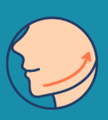
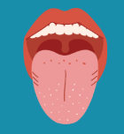

What does therapy look like?

Slide 29

THANK YOU!
WANT TO LEARN MORE? LET’S CONNECT!
MYOWORKSLLC@GMAIL.COM
304-566-9581 (BUSINESS)
304-629-2118 (PERSONAL)

