Slide 1
Chairside Glucose Testing in the Dental Office

Slide 2
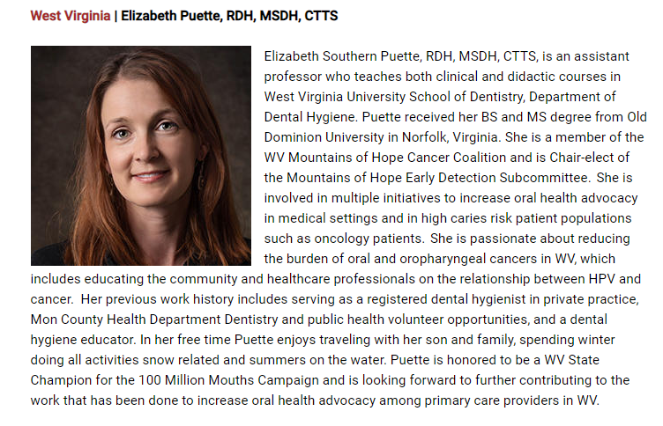

Slide 3



Contributors
Kim Zaremba-Rabatin, DMD, Associate Professor
WVU School of Dentistry, Periodontics
Medical School Mentor with 100 MMC Initiative:
Diabetes and Perio Systemic Link project with
WV AHEC Scholars, WV School of Osteopathic Medicine
Kaitlyn McQuain, RDH, MSDH, Assistant Professor
WVU School of Dentistry, Dental Hygiene
Quality Improvement, Glucometer Simulation prior to
peer practice in dental hygiene curriculum
100 Million Mouths Campaign
  Harvard School of Dental Medicine and Umass Chan Medical School,
  WV Champion Funding from Delta Community Care Foundation

Slide 4
Oral health professionals are urged to check all regulations and consult their state dental board for current requirements pertaining to diabetes screening in dental settings, including the chairside use of glucometers. This 10-minute presentation is intended to raise awareness about chairside glucometer use in the dental setting and to raise awareness about interprofessional integration of healthcare professionals.

Slide 5
Objectives
Discuss the concept, considerations and benefits of chairside screening for diabetes mellitus in dental settings.
Briefly review the oral health considerations and possible treatment ramifications for dental patients presenting with diabetes.
Review current research related to chairside blood glucose screening in the dental office.
Present WVBOD scope of practice for chairside glucose testing.
Present American Dental Association (ADA) clinical protocols, coding guidelines, and regulatory frameworks that govern how a dental team must manage chairside glucose testing.
List resources, guides and recommendations oral health professionals can use to implement prediabetes assessment and point-of-care screening for diabetes mellitus.

Slide 6
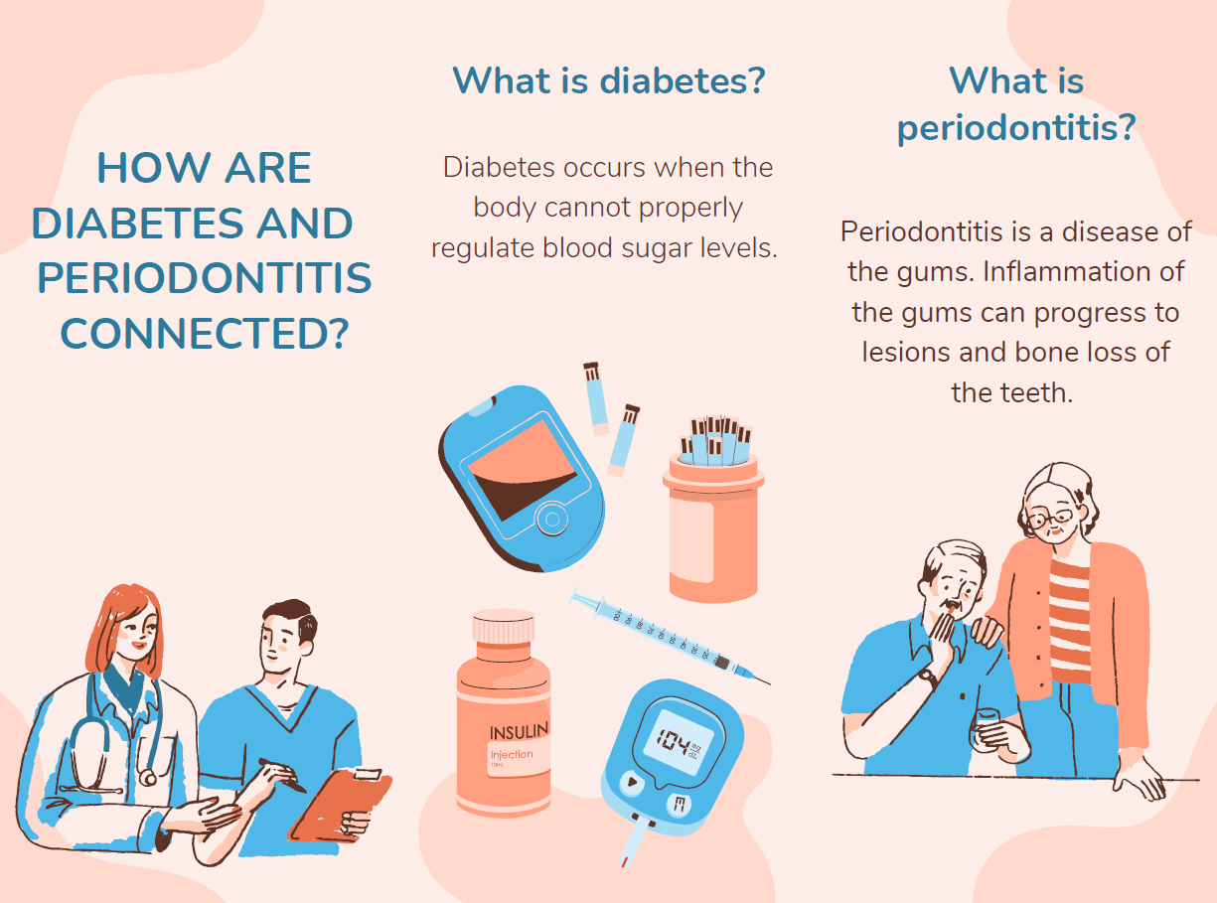
Pamphlet created by Trevor Lovell DO c as an OMS-III. and Kaitlynn Lopes OMS-III – as part of the WV AHEC Scholars Immersion, organized by A Alston and team , WV School of Osteopathic Medicine.

Slide 7
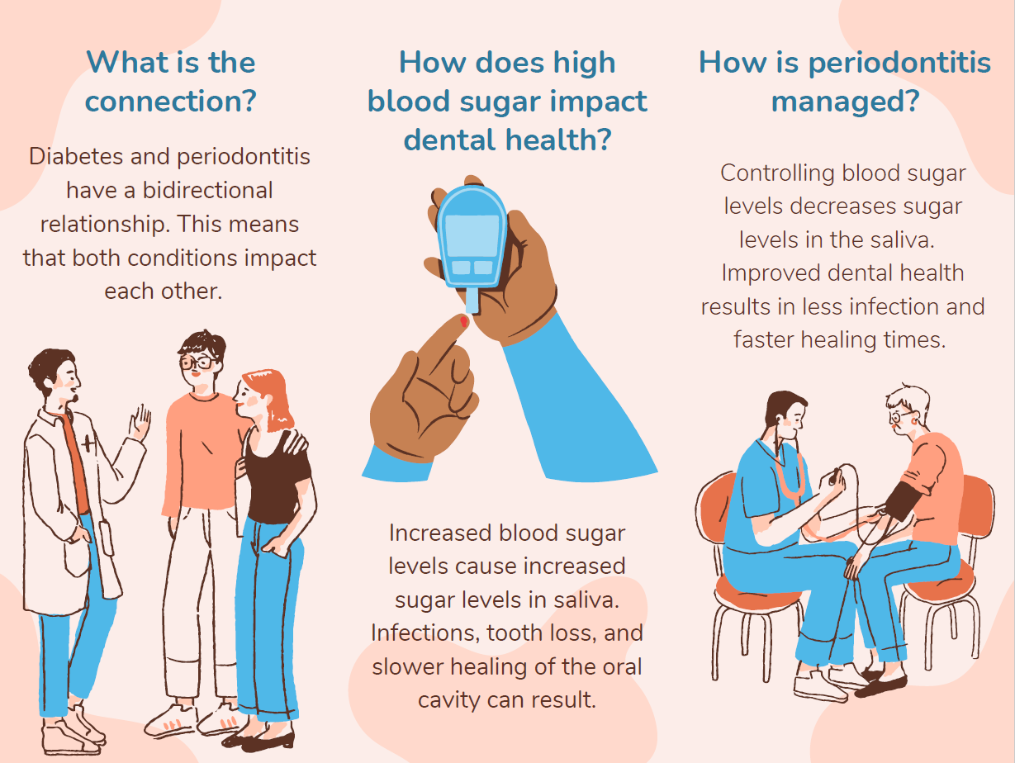
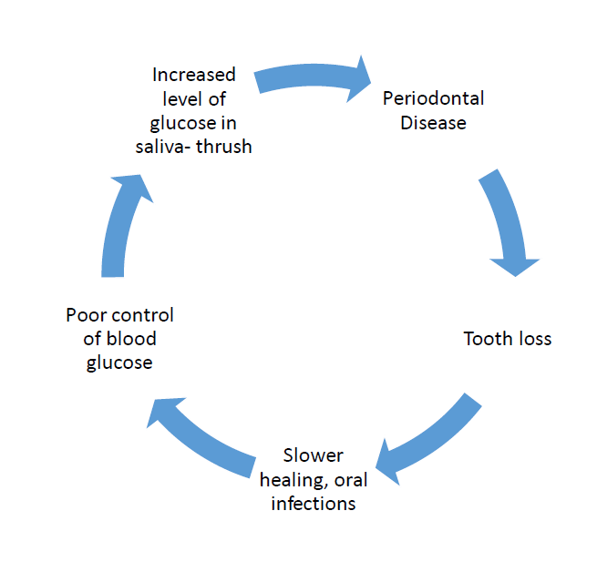

Slide 8
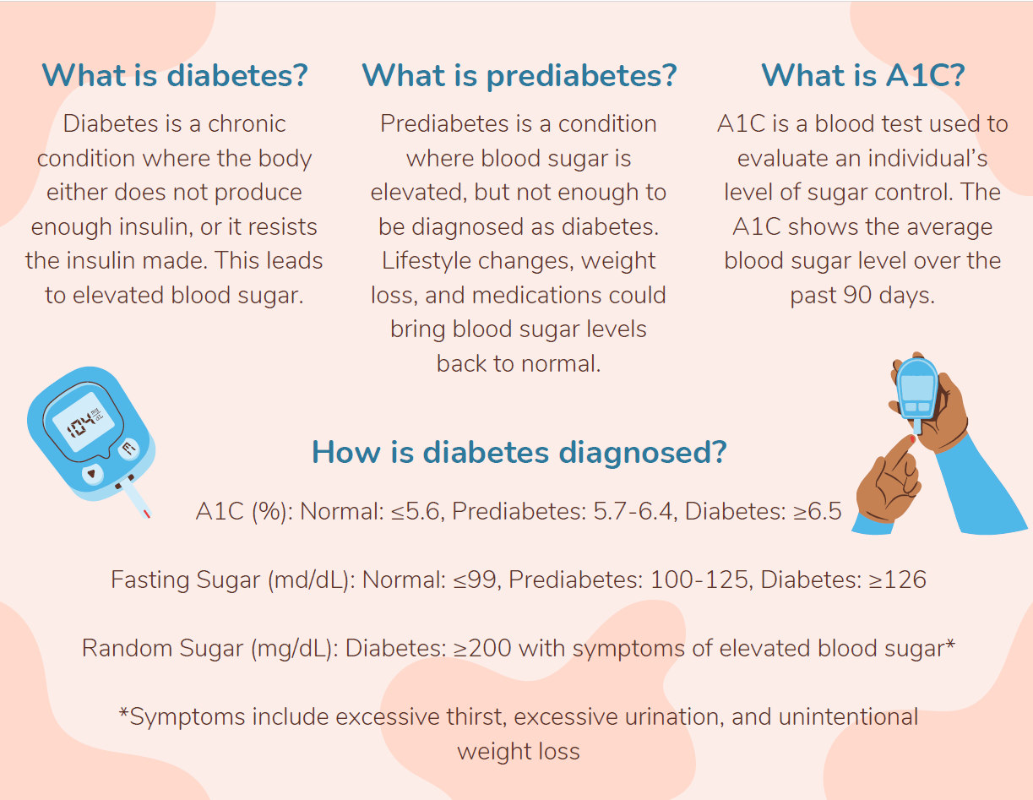

Slide 9
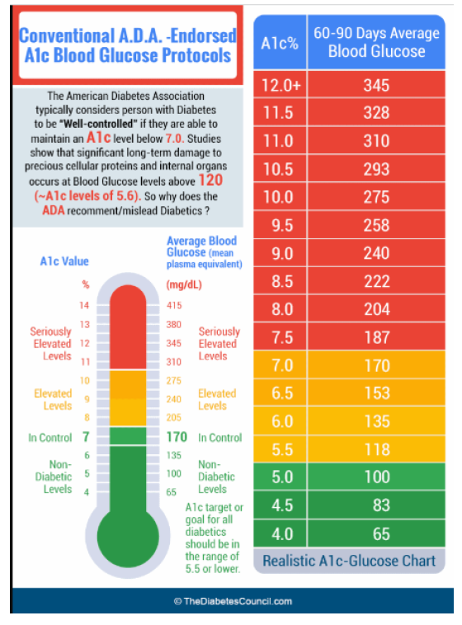


Slide 10
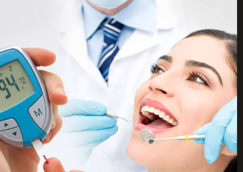
According to the National Diabetes Statistical Report, approximately 27.6% of adults aged ≥18 years with diabetes who are undiagnosed, representing 11.0 million people.
Dexcom.com

Slide 11

Medical and Dental Collaboration to Manage Diabetic Patient Populations
• Primary Care Providers have a unique opportunity to collaborate with dental providers to optimize patient care and quality of life.
• Dental providers have an important role in collaborating with primary care providers to best manage oral conditions and optimize overall body wellness and QOL

Slide 12
Why Take the Time To Screen?
Screening offers a service to refer and collaborate with the patients PCP to maximize treatment outcomes
Screening may reduce medical emergencies in the dental office
  Ex: screening high-risk periodontal patients using a glucometer helps the dental team safely manage chairside risks such as hypoglycemia during procedures
Beneficence: Identify patients who need referral to primary care physicians

Slide 13
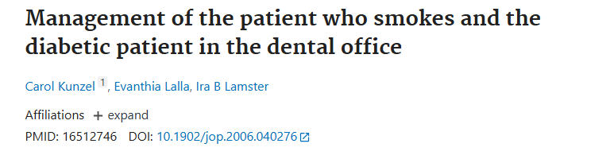
Abstract
Background: Approaches to patient care consistent with a greater emphasis on the importance of risk factors associated with periodontal disease should include measures to reduce risk. In this article, we investigate the extent to which periodontists' and general practice dentists' (GPs) behaviors and attitudes reflect current understanding of the most important environmental risk factor for periodontitis (smoking) and the most important systemic disease risk factor for periodontitis (diabetes mellitus).
Methods: A mail survey of active periodontists and GPs in the Northeastern United States was conducted during the fall of 2002. Random samples of periodontists and GPs listed in the designated Northeastern states were drawn from the 2002 American Academy of Periodontology Directory and the 2001 American Dental Directory, respectively. Responses were received from 103 periodontists (for a response rate of 73%) and from 105 GPs (for a response rate of 80%).
Results: Although periodontists generally perform risk identification and management behaviors for patients who smoke or who have diabetes more frequently than GPs, both groups tend to engage in activities that inquire, discuss, and inform more than they tend to undertake measures to control or manage these risk factors. Rates of proactive patient management activities are quite low in both clinician groups.
Conclusions: There is a need to increase periodontists' and GPs' involvement in the active management of the patient who smokes and in the diabetic patient. Such actions can be expected to result in improved periodontal and general health outcomes.

Slide 14
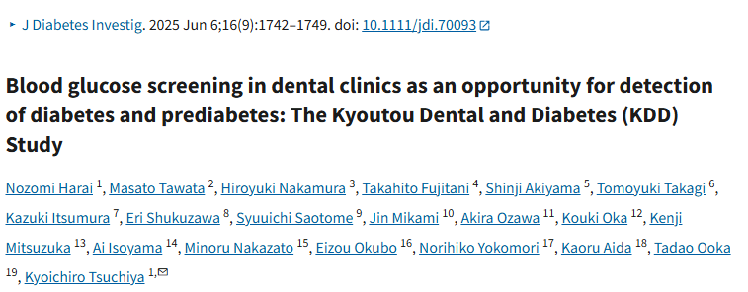
This study aimed to determine the prevalence and characteristics of positive blood glucose screening for diabetes or prediabetes among dental patients.
Materials and Methods
This prospective cohort study recruited 749 dental patients aged 18 years and older from October 1, 2023 to August 9, 2024. Patients undergoing treatment for diabetes were excluded. Blood glucose measurements were taken using fingerstick, with screening positivity defined as fasting blood glucose levels of 100 mg/dL or more or non‐fasting blood glucose levels of 140 mg/dL or more. Positive individuals were referred to internal medicine clinics. The background and dental results of the positive and negative screening groups were compared, and multivariate logistic regression was performed.
Results
Participants' average age was 54.5 ± 16.2 years, with 369 men (49.2%) and 19 women (2.5%) with a history of diabetes. Blood glucose screening was positive in 139 individuals (18.6%). Among the 34 patients who visited the internal medicine clinics, eight were diagnosed with diabetes and 10 with prediabetes. Patients in the positive group were significantly older, included more men, had more individuals with a history of diabetes, and exhibited a higher bleeding on probing (BOP) rate and alveolar bone loss (BL). The BOP rate and BL remained significant after adjustment.
Conclusions
Blood glucose measurements in dental clinics may provide a practical and valuable opportunity for the early detection and intervention of diabetes and prediabetes.

Slide 15
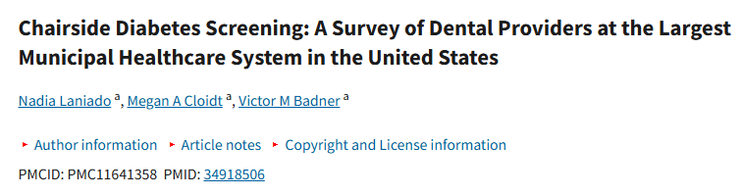
Purpose:
To assess the knowledge and attitudes of dentists at the largest municipal healthcare system in the United States with regard to point-of-care chairside diabetes testing in the dental clinic.
Materials and Methods:
A 29-item survey was designed in a web-based platform (Survey Monkey) and distributed in November 2020 to 264 dental providers (attending dentists and residents) within eleven dental departments of the New York City Health + Hospitals municipal healthcare system. The questionnaire included sections on demographics, current practices, level of diabetes training, scope of practice, and attitudes regarding chairside diabetes testing. Descriptive statistics, bivariate analyses, and logistic regression analyses were performed, with statistical significance set at 0.05.
Results:
Dentists’ willingness to provide chairside HbA1c screening was positively associated with their agreement that this was part of their role (OR = 7.2, p = 0.001) and that screening has an impact on diabetes control (OR = 4.3, p = 0.04). The two most commonly reported barriers to willingness to provide chairside HbA1c screening were amount of time required to obtain and discuss a patient’s test results (82.3%) and lack of reimbursement (70.6%).
Conclusion:
Among the largest municipal healthcare systems in the US, there is very limited integration of diabetes screening and management in the dental setting. Given the epidemic of diabetes among the vulnerable population that these hospitals serve, the dental setting is a critical but underutilized site for diabetes screening and medical referral. Increased efforts should be directed towards implementing workflows that incorporate auxiliary dental staff in order to address barriers to chairside screening.

Slide 16
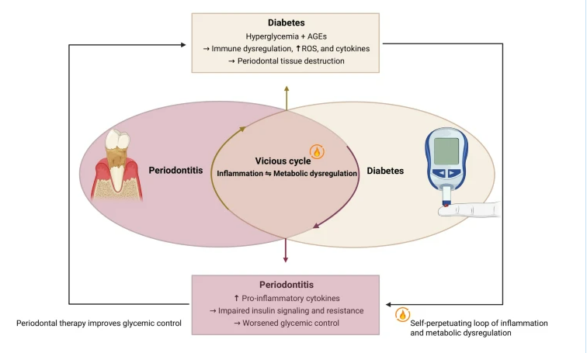
The Bidirectional Relationship Between Diabetes and Periodontitis.
Poorly controlled diabetes leads to hyperglycemia, the formation of advanced glycation end-products (AGEs), and activation of inflammatory pathways, which contribute to the destruction of periodontal tissues.
Conversely, periodontitis induces local and systemic inflammation that disrupts glucose homeostasis, thereby exacerbating diabetic conditions
Periodontitis and diabetes: a bidirectional link | Acta Diabetologica | Springer Nature Link 2026

Slide 17
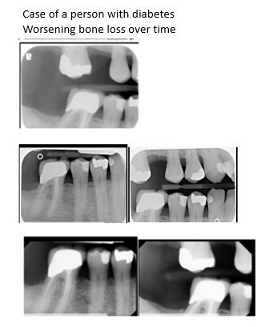
Chairside oral tests for diabetes in dentistry provide a practical approach for early detection of diabetes and prediabetes.
These tests can be integrated into routine dental visits, allowing dental professionals to screen patients conveniently and effectively.
From WV AHEC Scholar Immersion, WV hosted by WV School of Osteopathic Medicine “Diabetes and Oral Health- What’s The Link, What’s My Role- How Can I Help” Puette, Salman, Zaremba 2023

Slide 18
Point of Service Tests
Check blood/blood test
Check for scope of practice in your State: RDH, DDS
Finger stick
Gingival fluid from gums

Slide 19
Blood glucose test- screening
  Measures immediate blood sugar level at the exact time of the visit
HbA1c Test
  Estimates your average blood sugar levels over the past two or three months
  Measures glycated hemoglobin levels to assess long-term glucose control.
  https://www.webmd.com/diabetes/glycated-hemoglobin-test-hba1c

Slide 20
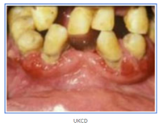
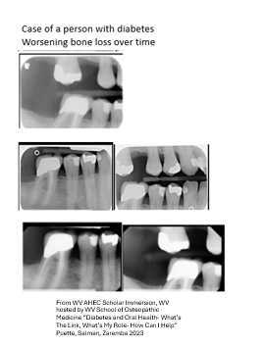
Blood Glucose Screening
Not a formal diagnosis
Quick in office test
  Screening
    Blood glucose measurements in dental clinics may provide a practical and valuable opportunity for the early detection and intervention of diabetes and prediabetes.
  Assess risk assessment
  Treatment planning
  Oral hygiene instruction topics- perio and diabetes systemic link
    The Oral Link: Severe gum disease (periodontitis) and high blood sugar share a strong, two-way relationship. Inflammation in the mouth can worsen blood sugar control, and high blood sugar makes gum infections harder to heal.
Method of referral to PCP to evaluate for diabetes

Slide 21
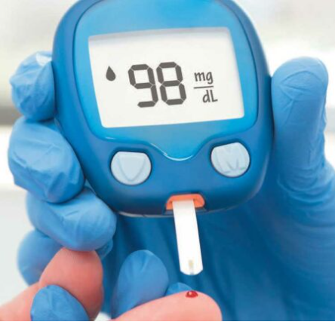
State Dental Practice Act
blood glucose finger-stick screening is generally regulated under individual state dental practice acts and broader federal/state laboratory rules
https://decisionsindentistry.com/article/diabetes-screening-dental-practice/

Slide 22
Screening for Diabetes in WV Dental Offices
6.1.7.b.15. performing screenings and diagnostic tests Of teeth and surrounding tissues, including but not limited to restorative chartings, caries activity test, cytology smears, salivary analysis and smears, vitality tests, and recording findings for interpretation by a supervising dentist;
5.1.7. Supra • and subgingival scaling Of teeth; Polishing of coronal and/or exposed surfaces of teeth; Dental health education; Nutritional counseling; Recording periodontal findings; Scaling excessive cement from the surfaces of teeth and restorations; Performing screenings and diagnostic tests of teeth and surrounding tissues and recording findings for interpretation by a supervising dentist (including such procedures as restorative chartings, caries activity test, cytology smears, salivary analysis and smears, vitality test, etc.)

Slide 23
While an RDH can physically collect health data—such as recording medical histories, taking vital signs, or performing a finger-prick glucometer test—the data must be recorded for interpretation by a supervising dentist. An RDH cannot independently diagnose diabetes or medical conditions.
6.1.6. The dental hygienist shall consult with the supervising dentist or an attending physician if a significant change has occurred in the patient's medical history to determine that the patient is in a medically stable condition prior to receiving dental hygiene services.

Slide 24
Target Patient Protocol- ADA
The American Dental Association (ADA) recommends screening patients who present with oral manifestations of poorly controlled diabetes (e.g., severe periodontitis, xerostomia, oral candidiasis) or those meeting high-risk criteria (overweight, sedentary lifestyle, family history).
From www.ada.org

Slide 25
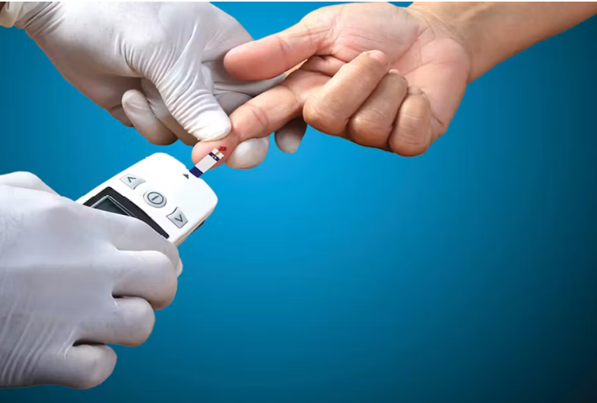
ADA Stance
The American Dental Association (ADA) does not issue a specific, standalone "collaborative agreement template" for glucometers between dentists and RDHs, as scope-of-practice delegation is strictly regulated at the state level.
However, the ADA provides clear clinical protocols, coding guidelines, and regulatory frameworks that govern how a dental team must manage chairside glucose testing.
From www.ada.org
https://www.rdhmag.com/patient-care/article/16408174/d0411-diabetes-and-the-dental-hygienist

Slide 26
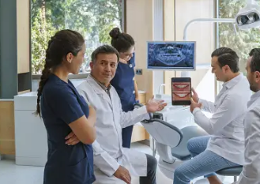
The protocol established between a dentist and an RDH must incorporate the following ADA-backed criteria:
1. ADA Point-of-Care (POC) Testing Guidelines
Role Distinction: The ADA notes that dental teams are not expected to diagnose diabetes. The protocol must state that the RDH performs the finger-stick test strictly for screening, risk assessment, or emergency management, while the dentist reviews the data to modify the treatment plan or initiate a medical referral. [1, 2, 3]
From www.ada.org

Slide 27
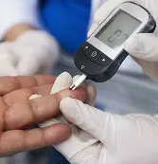
ADA Stance
Monitoring Glucose Levels.
  Blood-glucose levels can be checked chairside using a drop of blood.
  Glucometers designed for use in a variety of settings, such as nursing homes, health fairs or dental clinics, are available by prescription.
  Because they are intended for use by multiple individuals, they are designed to facilitate thorough cleaning and disinfection between uses to help prevent the spread of bloodborne pathogens.²⁰ After each use, the device must be cleaned and disinfected according to the manufacturer’s instructions.^{20,21}
Staff should be familiar with glucometer use to help avoid errors that could affect glucose readings, such as improper use, problems with the device or reagents used with the device, or environmental problems like lighting.
^{www.ada.org}

Slide 28
Federal CLIA Regulatory Madate-
ADA Website
Even though an RDH performs the physical test, the ADA highlights that chairside glucose testing is legally considered a laboratory test regulated under the Clinical Laboratory Improvement Amendments (CLIA). [, 2]
From www.ada.org

Slide 29
CLIA Compliance- Check with your BOD
CLIA Compliance: Under federal law via the Centers for Medicare & Medicaid Services, any in-office or chairside finger-stick blood glucose test using a glucometer classifies the facility as a medical laboratory. Even though it typically qualifies as a simple "waived test," the practice must obtain a CLIA Certificate of Waiver, which affects whether and how staff can perform the test on-site.
Cannot bill without a CLIA waiver.
What is a CLIA Certificate of Waiver?
A CLIA Certificate of Waiver is issued to laboratories that perform only waived tests, which are defined as simple laboratory examinations and procedures with an insignificant risk of erroneous results when performed according to manufacturer instructions (CMS, CDC, FDA) Centers for Medicare & Medicaid Services+1. These tests include common point-of-care procedures such as rapid strep tests, urine pregnancy tests, glucose monitoring, and urine dipsticks integralclinicsolutions.com. Facilities must obtain a CoW before performing any FDA-waived testing.
https://dimensionsofdentalhygiene.com/article/getting-started/

Slide 30

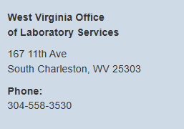
Clinical Laboratory Improvement Amendments (CLIA)

Slide 31
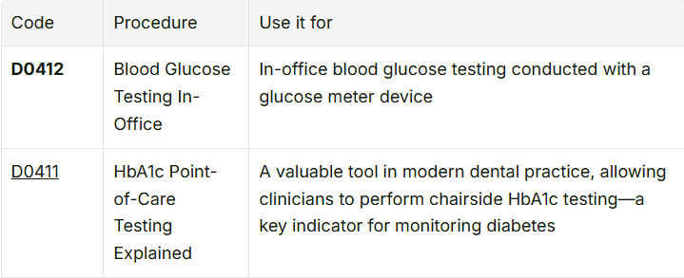

ADA CDT Code
Code on Dental Procedures and Nomenclature (CDT)
Notes:
ADA CDT Insurance Coding Protocol
To properly track and document the service within the patient record, the ADA implemented specific Code on Dental Procedures and Nomenclature (CDT) codes. The office protocol should outline how the RDH documents the procedure: [, 2]
Code D0412: Blood glucose level test – in-office using a glucose meter. This code records immediate findings at the point of service.
Code D0411: In-office pre-procedure HbA1c test.

Slide 32
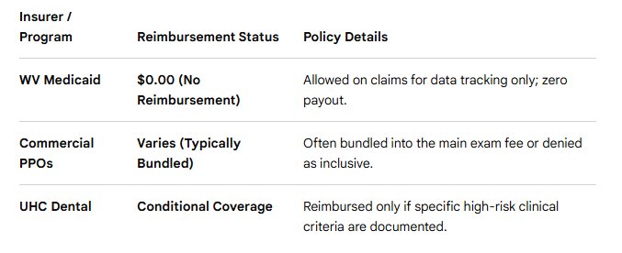
Summary of Coverage Examples in WV
Notes:
Commercial PPO’s- Delta Dental & Blue Cross Blue Sheild (WV)- These providers typically bundle D0412 into the primary comprehensive or periodic oral evaluation (e.g., D0120 or D0150) rather than paying a separate fee. Dental Bunding Info
Aetna Dental PPO: Often treats D0412 as a non-covered service or an inclusive component of the overall diagnostic visit.
Whether Delta Dental reimburses for D0412 (in-office blood glucose test) in West Virginia depends entirely on your specific employer or individual policy tier, as diagnostic adjunctive codes are frequently classified as non-covered or bundled services
WV Medicaid does not reimburse for D0412- for tracking purposes only. WV Bureru for Medical Services Dental Fee Schedule 4_26-3_27
United Healthcare Dental- reviewed under specific criteria for medical necessity, consider perio and diabetes- see dental clinical pplicies and guidelines United Healthcare Dental Clinical Policies and Guidelines
Commercial PPO’s- (WV)- v

Slide 33
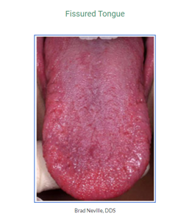
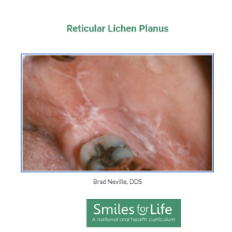
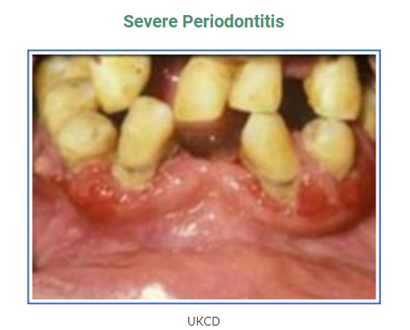
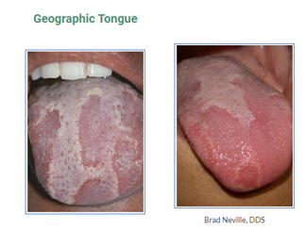

Need a Refresher Course?
Examples of clinical findings often noted in a patient with diabetes
https://www.smilesforlifeoralhealth.org/topic/diabetes/

Slide 34
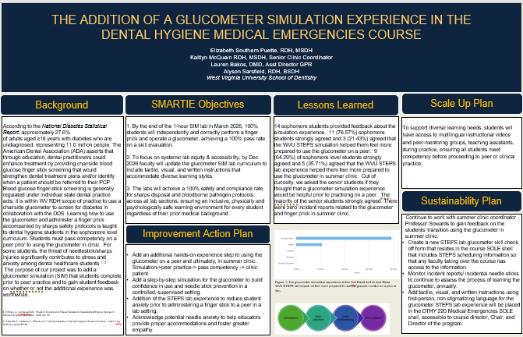
Glucometer in Dental and Dental Hygiene Curriculum

Slide 35
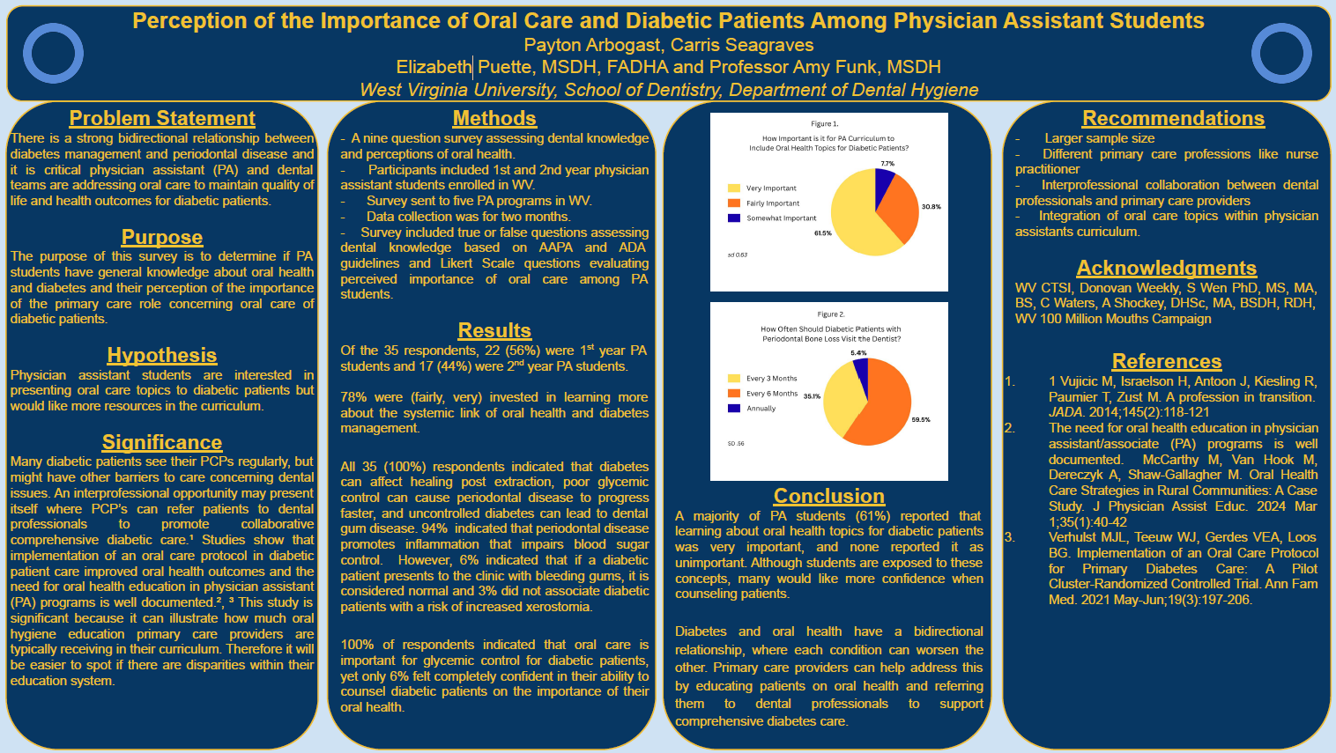
Interprofessional Research
Related to Diabetes and Oral Health in
Dental and Dental Hygiene Curriculum
WVU IRB approval 2508208605

Slide 36
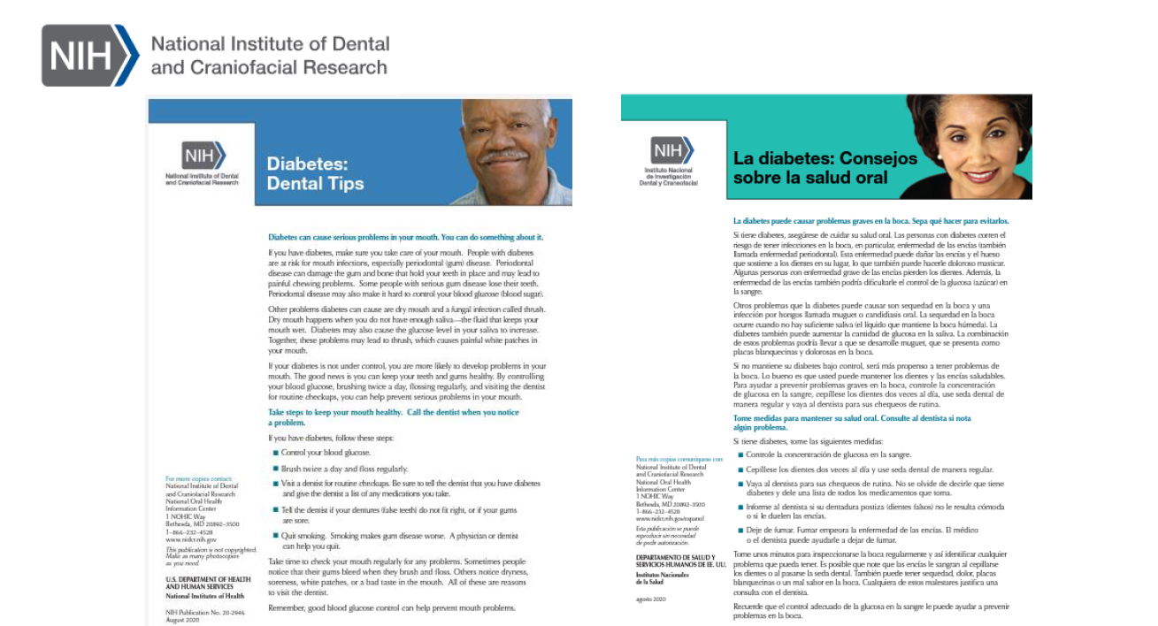
https://catalog.nidcr.nih.gov/catalog/diabetes-dental-tips

Slide 37
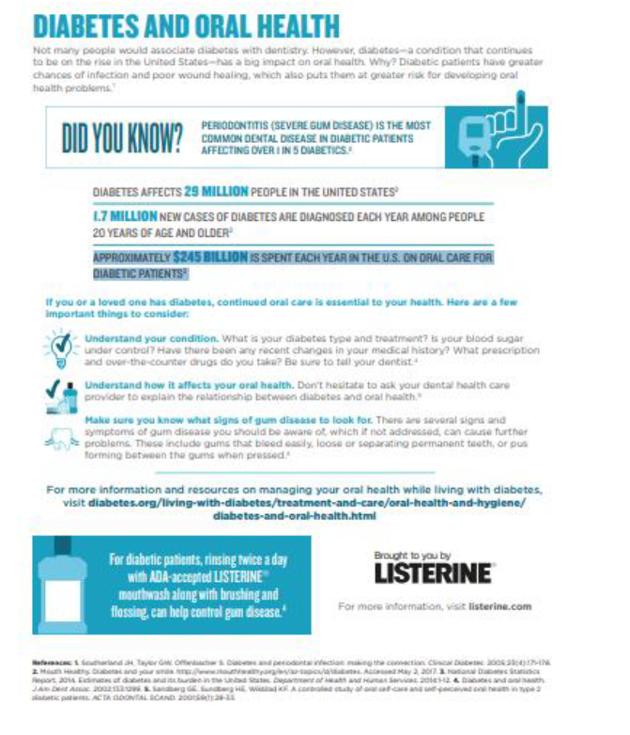
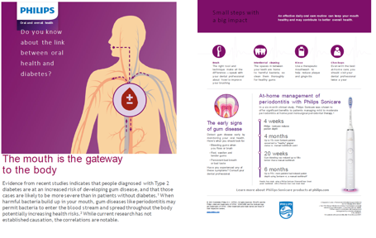

Slide 38

References
Diabetes Screening in the Dental Practice. T Siu DMD, MS and D Beals DDS, MS. 2021 Decisions in Dentistry. https://decisionsindentistry.com/article/diabetes-screening-dental-practice/
Glucometer Testing in the Dental Office. B Mealey DDS, MS. 2007. Dimensions of Dental Hygiene peer reviewed journal.
Kunzel C, Lalla E, Lamster IB. Management of the patient who smokes and the diabetic patient in the dental office. J Periodontol. 2006 Mar;77(3):331-40. doi: 10.1902/jop.2006.040276. PMID: 16512746.
D0411, diabetes, and the dental hygienist. RDH magazine. J Collins, RDH, CDA, 2018
American Diabetes Association (ADA). https://diabetes.org/health-wellness/keeping-your-mouth-healthy accessed 8/26
Harai N, Tawata M, Nakamura H, Fujitani T, Akiyama S, Takagi T, Itsumura K, Shukuzawa E, Saotome S, Mikami J, Ozawa A, Oka K, Mitsuzuka K, Isoyama A, Nakazato M, Okubo E, Yokomori N, Aida K, Ooka T, Tsuchiya K. Blood glucose screening in dental clinics as an opportunity for detection of diabetes and prediabetes: The Kyoutou Dental and Diabetes (KDD) Study. J Diabetes Investig. 2025 Sep;16(9):1742-1749. doi: 10.1111/jdi.70093. Epub 2025 Jun 6. Erratum in: J Diabetes Investig. 2026 Feb;17(2):375. doi: 10.1111/jdi.70219. PMID: 40474748; PMCID: PMC12400372.

Slide 39

References Continued
ADA American Dental Association https://www.ada.org/resources/ada-library/oral-health-topics/diabetes
U.S. Food & Drug Administration. Blood glucose monitoring test systems for prescription point-of-care use: Guidance for industry and Food and Drug Administration staff. August 2026. "https://www.fda.gov/regulatory-information/search-fda-guidance-documents/blood-glucose-monitoring-test-systems-prescription-point-care-use". Accessed January 12, 2022.
Teero CDT Code D0421: Blood Glucose Testing In-Office
https://www.teero.com/cdt-codes/dental-code-d0412-blood-glucose-testing-in-office

Slide 40
Additional Information

Slide 41
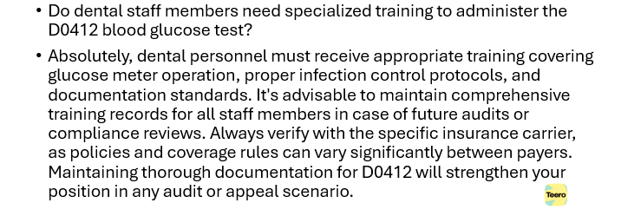
FAQ about D0412

Slide 42
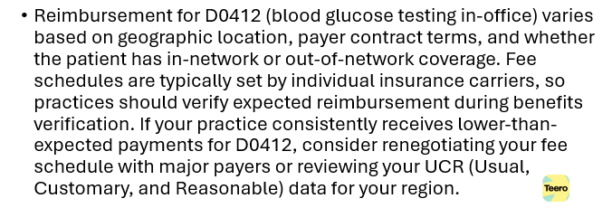
FAQ: What is the typical reimbursement range for D0412

Slide 43
Codes- fingerstick blood sugar test
CPT 82962 is the code for a blood glucose test performed using an FDA‑cleared home‑use glucose monitoring device, typically via fingerstick, with a 2026 Medicare national reimbursement rate of $3.28

Slide 44
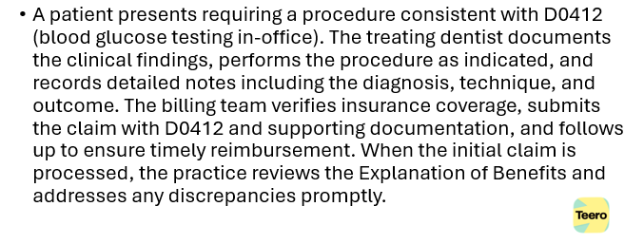
Case Example for Billing D0412

Slide 45
Clinical Tip: Documentation
Patient chief complaint and relevant medical/dental history clearly recorded.
  For example, uncontrolled diabetes, risk factors for diabetes
Testing rationale (e.g., diabetes diagnosis, unusual symptoms, pre-sedation evaluation)
Clinical findings that support the use of D0412 specifically (not a more general or more specific code).
  For example, severe periodontal disease or rapidly progressing perio disease
Any diagnostic tests, imaging, or supplementary data that justify the procedure.
Treatment plan with rationale connecting the diagnosis to the procedure coded as D0412.
Test findings (specific reading and normal range)
Follow-up steps based on findings (e.g., procedure adjustments, doctor referral)
Post-procedure notes, including outcomes and follow-up recommendations.

Slide 46
Three common complications that can occur when glucose levels are not well controlled are hypoglycemia, hyperglycemia and diabetic ketoacidosis.
Hypoglycemia. Hypoglycemia is a condition in which blood glucose levels drop below normal. For many people with diabetes, this means a blood glucose level of 70 milligrams/deciliter (mg/dL) or less.^{12, 13} Hypoglycemia also may be referred to as “insulin shock” or “insulin reaction.” Untreated hypoglycemia can result in unconsciousness, coma or death.
Several situations can lead to hypoglycemia:¹²
Adverse effect of insulin or other diabetes medications;
Disruption in food intake (due to, for example, illness/nausea, vomiting, diarrhea, skipping or delaying a meal, or timing of a medical or dental appointment);
Drinking too much alcohol for the amount of food being eaten;
An unexpected/unplanned increase in physical activity.

Slide 47
The following is a summary from ADA pages

Slide 48
Treatment. If hypoglycemia is suspected, immediate treatment should be implemented.
Check the patient’s blood glucose levels using a glucometer. Levels that are ≤70 mg/dL indicate hypoglycemia.
Provide the patient with 15-20 grams of oral carbohydrates to eat or drink, such as:^{12, 13}
  4 glucose tablets or one tube of glucose gel;
  ½ cup of fruit juice* or regular (non-diet) soda;
  1 tablespoon of sugar, honey or corn syrup;
  8 ounces of non-fat or 1% milk;
  Hard candies, jelly beans or gumdrops;
  2 tablespoons of raisins.
(*NOTE: People who have concomitant kidney disease should not drink orange juice for their 15 grams of carbohydrates because of the high potassium content.¹² Apple, grape, or cranberry juice cocktail are good alternatives.)
Wait 15 minutes, then check blood glucose levels again.
Repeat these steps until blood glucose levels are above 70 mg/dL.
In severe cases, hypoglycemia can cause unconsciousness, seizures or coma. If the dental patient is not awake and/or unable to eat or drink, emergency medical help should be summoned.¹³

Slide 49
Hyperglycemia. Hyperglycemia occurs when blood glucose levels are abnormally high. This can occur anytime there is not enough insulin in the bloodstream or the body is not using insulin properly.
Several conditions can lead to hyperglycemia (e.g., pancreatitis, Cushing’s syndrome, pancreatic cancer, adrenal hormone insufficiency), but it is a primary symptom of diabetes. Untreated hyperglycemia can damage the cardiovascular, circulatory or nervous systems, the kidneys or vision.¹⁵ It can also result in delayed wound healing.¹⁶ In more serious cases, extreme or prolonged hyperglycemia, can cause a life-threatening condition called ketoacidosis (see below for further discussion).
A number of circumstances can lead to hyperglycemia in people with diabetes:¹⁷
Low insulin levels, which can occur either when insufficient insulin is used (e.g. miscalculation in the amount injected or an insulin-pump malfunction) or when insulin is not used efficiently by the body;
Eating more than planned or exercising less than planned according to the amount of insulin taken;
Stress, either physical (e.g., illness-related or medical/dental procedure-related) or emotional (e.g., conflict, personal loss).
Symptoms. Symptoms of hyperglycemia include:
high levels of sugar in the urine;
frequent urination;
increased thirst;
fatigue;
blurred vision.
Treatment. Lifestyle changes, like increased exercise or eating a healthy, well-proportioned diet,¹⁸ may help control hyperglycemia. (NOTE: People with diabetes whose glucose level is above 240 mg/dL are advised to check their urine for ketones. If ketones are present, they should not exercise and should consult their physician for other ways to reduce their blood sugar levels.¹⁷) If these changes do not help resolve hyperglycemia, a physician may recommend adjusting current medications or prescribing new or additional medication to better manage glucose levels.

Slide 50
Diabetic Ketoacidosis. Diabetic ketoacidosis is a serious condition that can develop when there is not enough insulin to help the body adequately use glucose.
Diabetic ketoacidosis develops when the balance between glucose and insulin levels is not well controlled. The body typically metabolizes glucose to generate energy. When insulin levels are too low, the body begins to break down fat cells for energy instead, which results in the production of acidic ketones in the blood. Buildup of ketones in the blood can be toxic. Without intervention, which usually must be done in a hospital, coma or death can occur.¹⁹
Symptoms. The following symptoms may indicate diabetic ketoacidosis:¹⁹
breath that smells fruity;
very dry mouth;
high blood glucose levels;
high levels of ketones in the urine;
frequent urination;
shortness of breath;
constant tired feeling;
dry or flushed skin;
nausea, vomiting or abdominal pain;
difficulty concentrating or confusion.
Treatment. If ketoacidosis is suspected, the symptomatic person should be taken to the nearest emergency room or that person’s physician should be immediately contacted.¹⁹

Slide 51
Diabetes can arise in individuals at any age. As with all patients, it is recommended that dentists review the patient’s medical history, take vital signs, and evaluate for oral signs and symptoms of inadequately controlled diabetes, which may be common^{.42} Oral manifestations of uncontrolled diabetes can include xerostomia, burning sensation in the mouth (which may possibly be related to neuropathy), impaired/delayed wound healing, increased incidence and severity of infections, secondary infection with candidiasis; parotid salivary gland enlargement; gingivitis and/or periodontitis.^{22, 42}
A dentist may want to ask a patient with diabetes questions such as:⁴²
How old were you when you were diagnosed with diabetes and what type of diabetes do you have?
What medications do you take?
How do you monitor your blood sugar levels?
How often do you see your doctor about your diabetes? When was your last visit to the doctor?
What was your most recent HbA1c (A1C) result?
Do you ever have episodes of very low (hypoglycemia) or very high blood sugar (hyperglycemia)?
Do you ever find yourself disoriented, agitated, and anxious for no apparent reason?
Do you have any mouth sores or discomfort?
Does your mouth feel dry?
Do you have any other medical conditions related to your diabetes, such as heart disease, high blood pressure, history of stroke, eye problems, limb numbness, kidney problems, delays in wound healing, history of gum disease? Please describe.

Slide 52
In general, morning appointments are advisable for patients with diabetes since endogenous cortisol levels are typically higher at this time; because cortisol increases blood sugar levels, the risk of hypoglycemia is less.^{43, 44} For patients using short- and/or long-acting insulin therapy, appointments should be scheduled so they do not coincide with peak insulin activity, which increases the risk of hypoglycemia.⁴³ It is important to confirm that the patient has eaten normally prior to the appointment and has taken all scheduled medications.⁴³ If a procedure is planned with the expectation that the patient will alter normal eating habits ahead of time (e.g., conscious sedation), diabetes medication dosing may need to be modified in consultation with the patient’s physician.⁴³ Patients with well-controlled diabetes can usually be managed conventionally for most surgical procedures.⁴² If the patient’s food consumption will be affected after oral or dental surgery, a plan to balance the patient’s diabetes medications and food intake should be established in advance.⁴²
When treating patients with marginally or poorly controlled diabetes, elective dental treatment may need to be delayed until the patient’s diabetes is considered stable or better controlled.⁴²
Dental implant placement is generally safe and reliable in patients with properly controlled diabetes, and possibly in those with moderately controlled disease. Two recent systematic reviews concluded that implants in patients with diabetes have predictably high survival rate at least within the first three years, provided that the patients maintain good glycemic control,⁴⁵ and that implant procedures are safe and predictable in patients with well-controlled diabetes.⁴⁶ However, systematic reviews have also advised that clinicians consider HbA1c values for risk assessment of patients with diabetes prior to implant placement (and throughout the implant’s lifespan), and to consider hyperglycemia as a significant risk factor associated with peri-implant inflammation.^{45, 47} In patients with poorly controlled diabetes, implant placement may have an unpredictable prognosis, delayed osseointegration and higher risk of failure.^{42, 46}
Coordination with the patient’s physician may be necessary to determine the patient’s health status and whether planned dental treatment can be safely and effectively accomplished.⁴² Physicians should make laboratory test results available to the dentist upon request, and inform the dentist of any diabetic complications of relevance to the individual patient prior to dental procedures.⁴² The physician may need to adjust the patient’s diabetes medication to help ensure sustained metabolic control, before, during, and after surgical procedures.⁴² Patients with diabetes should obtain regular medical and dental care, including regular dental visits for full evaluation of their dental and periodontal condition.²⁸

Slide 53
Emergency Management. Although patients with diabetes often recognize signs and symptoms of hypoglycemia and self-intervene before changes in or loss of consciousness occurs, they may not be fully cognizant of such signs.² As a result, a hypoglycemic event may arise in a clinical setting without any initial signs or visible indications from the patient with diabetes. Training staff to recognize signs of hypoglycemia (e.g., mood changes, unusual behavior or profuse sweating), and to use a glucometer to test a diabetic patient’s blood glucose levels can help prevent hypoglycemic episodes.^{2, 44} Every dental office is advised to have a protocol for managing hypoglycemia in conscious and unconscious patients.² Having snack foods or oral glucose tablets or gels available, especially in practices where a large number of surgical procedures are performed, is also prudent.²

Slide 54
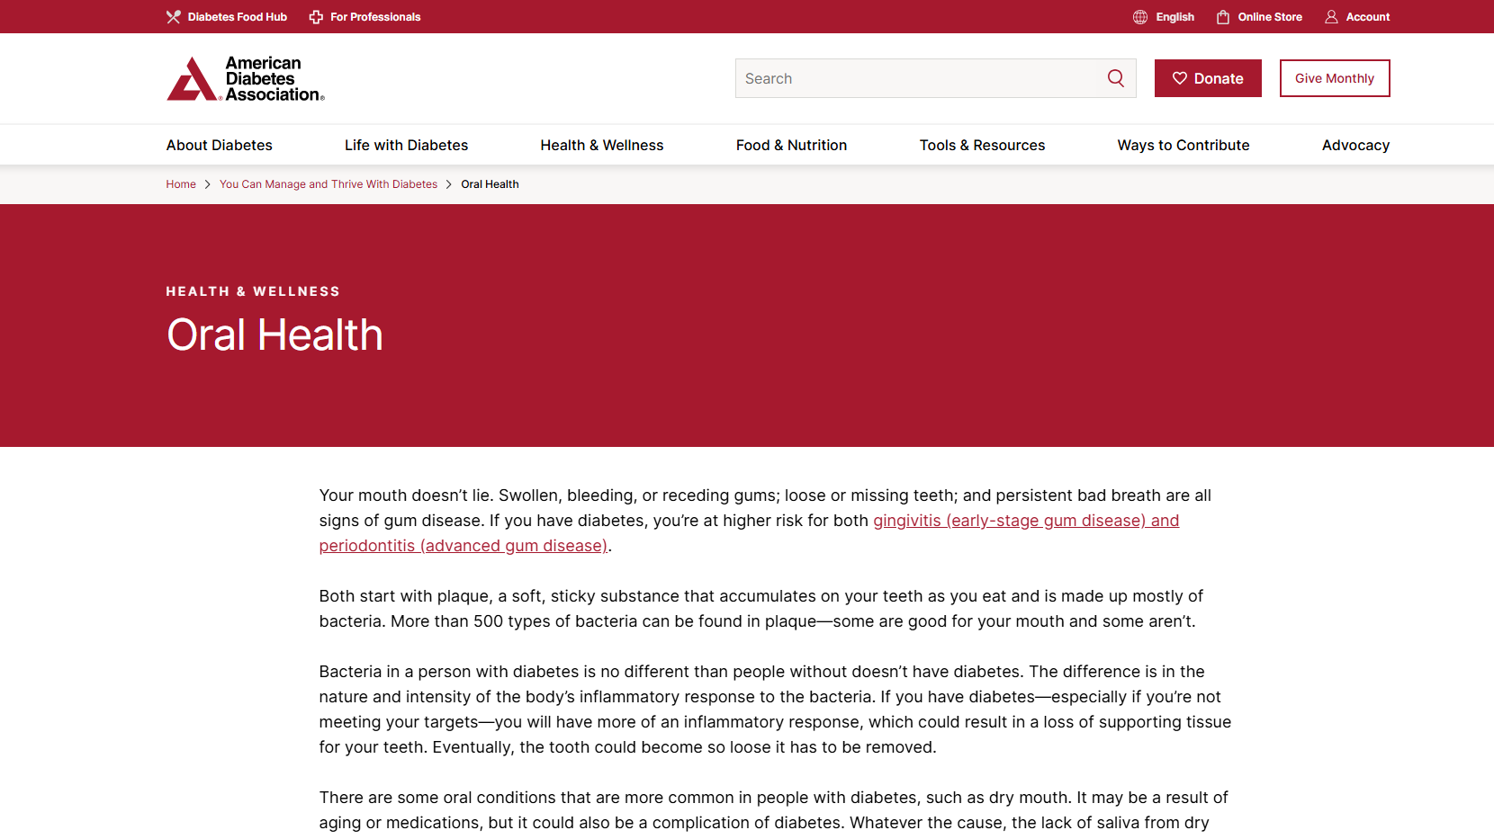
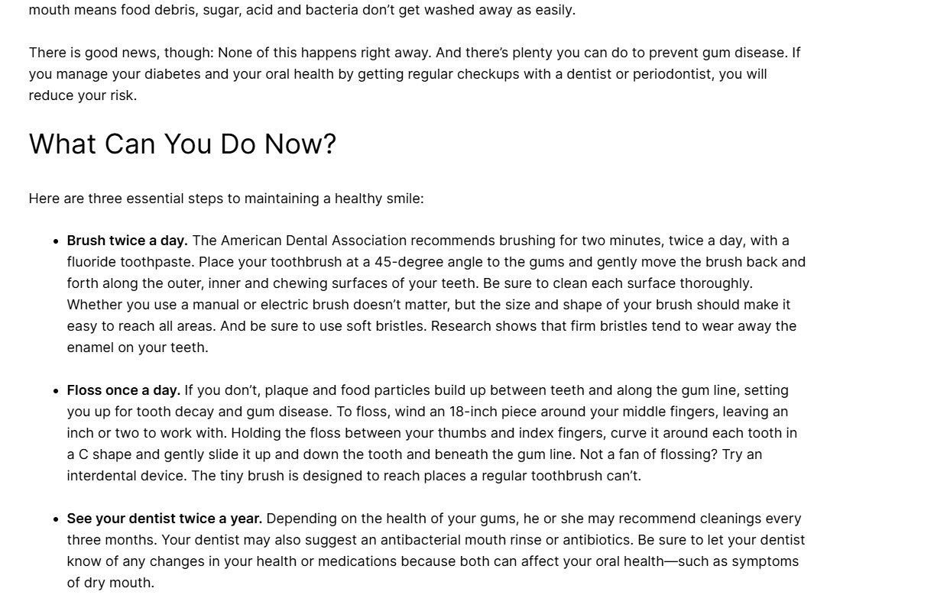
https://diabetes.org/health-wellness/keeping-your-mouth-healthy

Slide 55
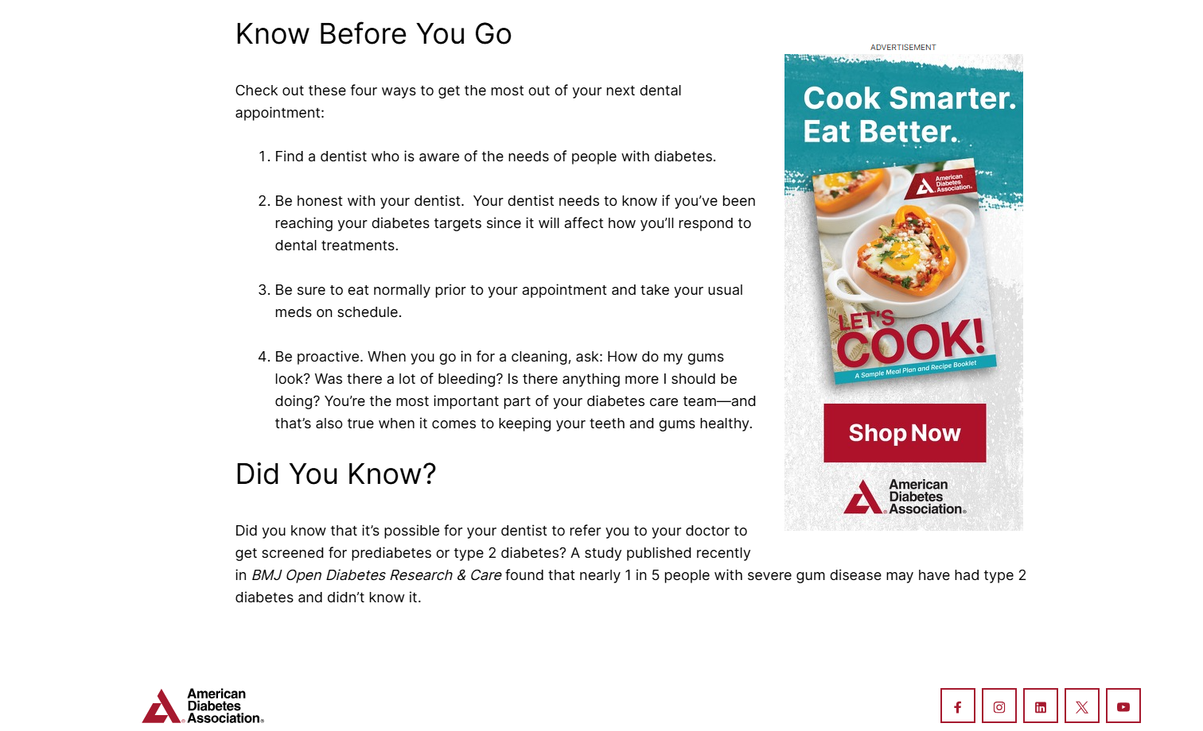
https://diabetes.org/health-wellness/keeping-your-mouth-healthy

Slide 56
What Is D0412? (CDT Code Overview)
CDT code D0412 (Blood Glucose Testing In-Office) is the dental procedure code for in-office blood glucose testing conducted with a glucose meter device. It belongs to the Diagnostic category of CDT codes (Tests and Examinations subcategory).
When Should You Use D0412?
The D0412 dental code applies to in-office blood glucose testing conducted with a glucose meter device. This CDT code is utilized when dental professionals need to check a patient's blood sugar levels during dental care, especially for diabetic patients or those who may experience low blood sugar during treatment procedures. Proper application of D0412 helps ensure practices follow clinical standards while addressing patient medical requirements in treatment planning.
Quick reference: Use D0412 when the clinical scenario specifically matches blood glucose testing in-office. Do not use this code as a substitute for related procedures in the same category. Consider whether D0411 (HbA1c Point-of-Care Testing Explained) or D0414 (Laboratory Microbial Specimen Processing) might be more appropriate instead.

Slide 57
What are the target ranges?
Blood glucose targets are individualized based on:
duration of diabetes
age/life expectancy
conditions a person may have
cardiovascular disease or diabetes complications
hypoglycemia unawareness
individual patient considerations
The American Diabetes Association suggests the following targets for most nonpregnant adults with diabetes. A1C targets differ based on age and health. Also, more or less stringent glycemic goals may be appropriate for each individual.
A1C: Less than 7%
A1C may also be reported as eAG: Less than 154 mg/dL
Before a meal (preprandial plasma glucose): 80–130 mg/dL
1-2 hours after beginning of the meal (postprandial plasma glucose)*: Less than 180 mg/dL

Slide 58
American Diabetes Association Check your Blood Glucose

Slide 59
