Slide 1
SEPTEMBER 11, 2026
Age One and Done!
Implementing the first dental visit with confidence
Meghan Bastin, DMD, MPH, TTS

Slide 2

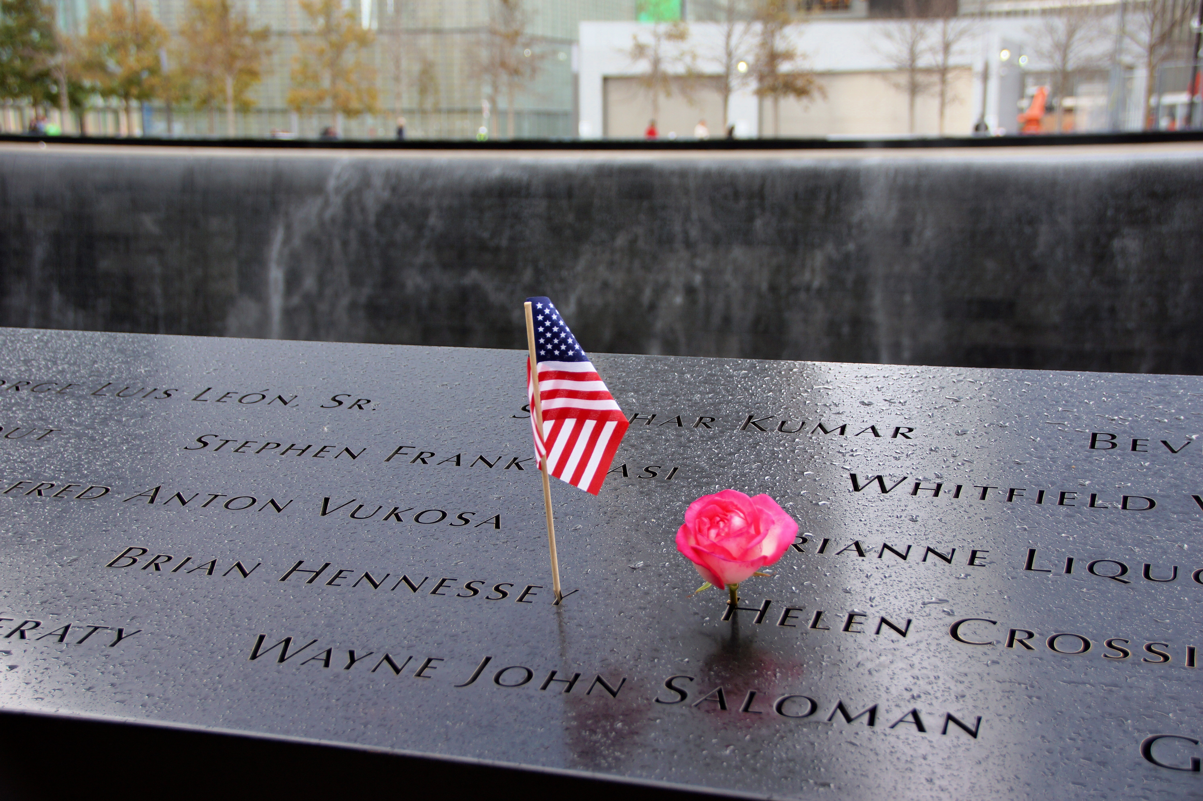
IN REMEMBRANCE
September 11, 2001 — 2026
Twenty-five years.

Slide 3
Learning Objectives
Familiarize yourself with current experiences of families and providers regarding the age one dental exam recommendation and implementation.
Implement at least one practice or workflow change to increase your office’s readiness to establish a dental home for children under three years of age.
Identify three strategies to consciously manage your physiological and emotional response to crying infants and toddlers during dental exams.

Slide 4

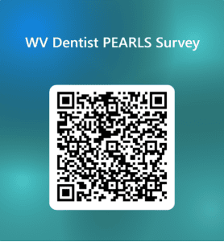
From remembrance to resilience
The initiative at the center of today is called PEARLS — Perinatal & Early Action for Resilient Little Smiles. Resilience is exactly what we build when we care for the very young: healthier children, stronger families, a stronger state.
Let’s talk about the youngest smiles in our communities and why so few of them are being seen.
Age One and Done! · Meghan Bastin, DMD, MPH, TTS

Slide 5
THE RECOMMENDATION
First dental visit by age one
ADA
AAPD
AAP
American Dental Association
Am. Academy of Pediatric Dentistry
Am. Academy of Pediatrics
All three recommend a first dental visit — a dental home — by 12 months of age, or within 6 months of the first tooth.
Here’s the question: if everyone agrees, why are so few one-year-olds actually being seen?
Age One and Done! · Meghan Bastin, DMD, MPH, TTS

Slide 6
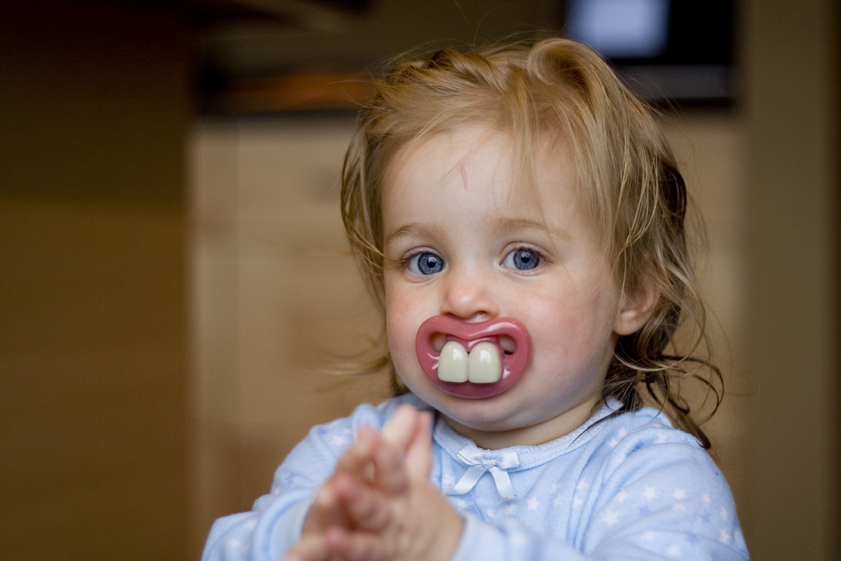

THE EVIDENCE — A STUDY FROM OUR REGION
Parents are being told to wait
“Come back when they're three.”
— what mothers repeatedly heard from dental providers
Researchers from Pitt, WVU, and COHRA interviewed 126 mothers of young children across Pennsylvania and West Virginia. A recurring theme: the dentists in mothers' own social networks contradicted the age-one recommendation — telling families to wait until age three. The opposition came from providers themselves.
Burgette JM, et al. Opposition to Early Dental Visit by Dentists: A Qualitative Study on Mothers' Social Networks. JDR Clin Transl Res. 2023;8(1):48–55.
Age One and Done! · Meghan Bastin, DMD, MPH, TTS

Slide 7

THE NUMBERS — WEST VIRGINIA
What the report card shows
The recommendation is age 1. Yet most of the youngest children with Medicaid insurance are not seen in WV
~16.9%
28.8% of children ages 3-5 have decay experience, treated or untreated decay.
of WV children ages 1-2 enrolled in Medicaid received preventive dental care
The youngest are the gap. Our best chance to prevent disease is the age we're most likely to skip.
WV Oral Health Coalition, Oral Health Report Card (2026). National first-visit recommendation: AAPD/AAP/ADA.
https://irp.cdn-website.com/4cb23709/files/uploaded/2026+WV+Children-s+OH+Report+Card_Final.pdf
Age One and Done! · Meghan Bastin, DMD, MPH, TTS

Slide 8



Three objections from providers
“They cry and it disrupts my office.”
“I'm not comfortable with babies.”
“It'll wreck my schedule.”
Age One and Done! · Meghan Bastin, DMD, MPH, TTS

Slide 9
YOU’RE WIRED TO RESPOND
A crying child is a biological siren.
It reaches your nervous system in 100–200 milliseconds
The good news: our nervous system has a brake and we can use it on purpose. Let’s breathe.

Slide 10



THE PROVIDER'S PRIMAL REACTION
Why a crying child hijacks you
FAST RESPONSE
UNCLEAR THINKING
LACK OF COPING MECHANISMS
Auditory, emotional, and motor regions fire before you've decided anything.
The cry recruits the amygdala and competes with the fine-motor control you need.
Let the vagus nerve help you manage your responses.
Age One and Done! · Meghan Bastin, DMD, MPH, TTS

Slide 11



Your 30-second reset
Physiological sigh
Box breathing
Prosodic voice
Fastest reset
4 · 4 · 4 · 4
Co-regulate
Two breaths in through the nose, one long breath out. Repeat 1–3×.
In four, hold four, out four, hold four. The exhale is the brake.
Sing-song pitch signals safety to the child; humming calms you both.
TRY IT NOW Three physiological sighs together. That feeling is the most important skill to call upon in the future.
Age One and Done! · Meghan Bastin, DMD, MPH, TTS

Slide 12
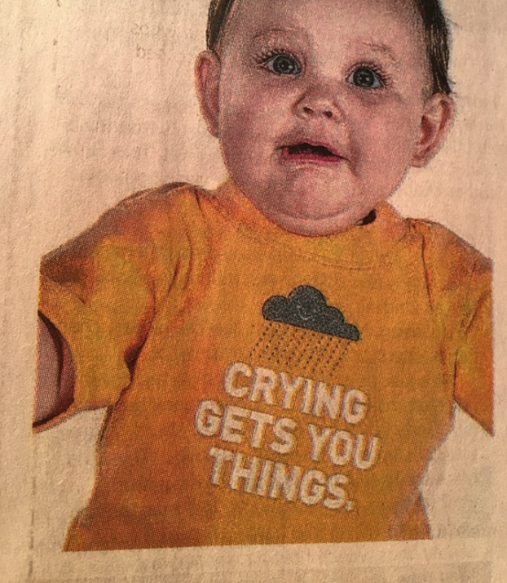
THE MINDSET
Brushing is a daily-living skill — not a negotiation
A thrashing toddler defeats most parents; we need to model the skill.
Infants and toddlers cry over everything:
hair-brushing
bath time
the wrong cheese
[ drop your photo here ]
the “Crying Gets You Things” baby
shoes on
the car seat
leaving the park
SAY THIS TO THE PARENT
“This is normal. He's not hurt. Watch how we help him.”
Image credit: Dr. Gerald Rosen · AAPD Toronto 2024
Age One and Done! · Meghan Bastin, DMD, MPH, TTS

Slide 13


THE MOVEMENT YOU CAN JOIN
Perinatal & Early Action for Resilient Little Smiles
A multi-year, ADA-sponsored initiative — with West Virginia as a focus, because our Medicaid children rank poorly for early visits.
1
Educate pediatricians, OB-GYNs, dentists, and other providers on why these visits matter.
2
Strategize work with MCOs to remove barriers to early visits
3
Increase raise the number of young children seen by the end of 2027
WV Dental Association / ADA, PEARLS initiative (goals through 2027).
Age One and Done! · Meghan Bastin, DMD, MPH, TTS

Slide 14
The age-one visit is not what you fear
It’s short hands-on time. Less than five minutes, not a full restorative appointment.
It's low-tech. A lap, a toothbrush, a light, and a fluoride varnish.
It's mostly counseling. You're coaching the caregiver as much as examining the child.
Crying is expected. A crying toddler is normal — and not a failed visit.
Age One and Done! · Meghan Bastin, DMD, MPH, TTS

Slide 15
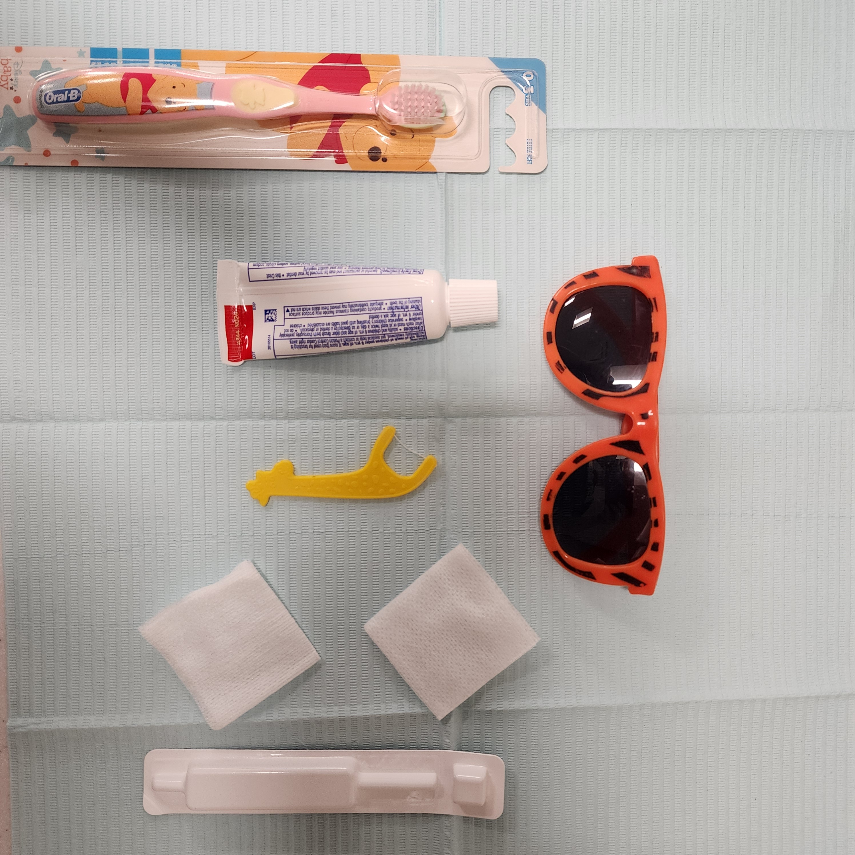
THE POSITION
The knee-to-knee exam
Caregiver
1
Child faces caregiver with legs around caregiver’s waist. When lowered into the provider’s lap, caregiver is responsible for holding child’s hands and verbally reassuring them.
You
2
The provider manages the patient’s head. You might need to provide stabilization to prevent side-to-side movements.
3
Lift the lip, dry the teeth, visual + tactile exam, brush, rinse, dry, and apply fluoride varnish.
4
Whole thing takes minutes — narrate to the caregiver beforehand (tell-show-do) as well as while you do it. Celebrate!
Age One and Done! · Meghan Bastin, DMD, MPH, TTS

Slide 16

LET'S PRACTICE
Knee-to-knee, at your table
Pair up. One of you is the caregiver, one is the provider. Use the puppet at your table and position it knee-to-knee. Lift the lip, look, and narrate to your 'caregiver' as you go. Two minutes.

Slide 17






Anticipatory guidance is the visit
The exam takes minutes. The value is what you send home with the caregiver. Personalize the message and you’ve added value to the visit and prevented disease:
Brushing & fluoride
Pacifier & sucking
Bottle & sippy habits
Diet & juice
Teething & trauma
Dental home & recall
Age One and Done! · Meghan Bastin, DMD, MPH, TTS

Slide 18
ANTICIPATORY GUIDANCE
Brushing & fluoride
Birth – first tooth
Wipe gingiva with a clean, damp cloth after feeds.
First tooth – age 3
Brush 2×/day with a SMEAR — a grain of rice — of fluoride toothpaste.
Ages 3 – 5
A PEA-SIZED amount, two minutes, twice a day.
Until ~age 6
Adults supervise brushing and go over it themselves too; child learns to spit.
Age One and Done! · Meghan Bastin, DMD, MPH, TTS

Slide 19
ANTICIPATORY GUIDANCE
Habits: pacifiers, bottles, diet
Pacifier & thumb
Bottle & sippy
Diet & juice
Fine in infancy. Aim to wean the pacifier by age 2-3 to protect the bite; discourage prolonged thumb-sucking.
No bottle in bed with milk or juice. Wean from the bottle around 12–15 months. Water between meals.
It's frequency, not just amount. No juice under 12 months; limit after. Sipping sugar all day feeds decay.
Age One and Done! · Meghan Bastin, DMD, MPH, TTS

Slide 20
ANTICIPATORY GUIDANCE
Teething & toddler trauma
Teething
Toddler trauma
Chilled (not frozen) teething ring; clean finger to rub gums.
Avoid benzocaine gels (FDA warning) and amber necklaces (choking/strangulation).
New walkers fall — lip/tooth injuries are common.
An avulsed BABY tooth is NOT replanted.
https://www.aapd.org/media/policies_guidelines/e_injuries.pdf
Age One and Done! · Meghan Bastin, DMD, MPH, TTS

Slide 21
GET PAID FOR GOOD CARE
The codes to document your services
D0145
Oral evaluation, patient under 3 + caregiver counseling
D1206
Topical fluoride varnish
D1330
Oral hygiene instruction
D1310
Nutritional counseling for control of dental disease
D1120
Prophylaxis — child (when appropriate)
D0602/03
Caries risk assessment (moderate / high)
Don't unbundle: counseling that's part of D0145 shouldn't be billed twice. Document what you covered.
Age One and Done! · Meghan Bastin, DMD, MPH, TTS

Slide 22

GET PAID FOR GOOD CARE (CONT.)
Yes — a toothbrush prophy is a real prophy
D1120, prophylaxis – child: “Removal of plaque, calculus, and stains from the tooth structures… in the primary and transitional dentition. It is intended to control local irritational factors.”
Defined by what you remove
The age-appropriate technique
A service, not a lesson
Real clinical value
CDT 2025 (ADA), descriptor for D1120.

Slide 23


SCHEDULE FOR SUCCESS
See them in the morning
Book infants and toddlers before lunch. Afternoons collide with naps.
Cluster your under-3 visits into one morning block — brace the office once.
Keep exam short—less than five minutes total time.
Communicate to the front desk and waiting room: little ones may be heard, and that's okay.
Age One and Done! · Meghan Bastin, DMD, MPH, TTS

Slide 24
YOU ARE NOT ALONE
Refer when needed
You CAN handle
Refer to a pediatric dentist
Well-baby exams, varnish, counseling, early risk assessment, small cooperative care.
Extensive decay, behavioral or medical needs beyond your comfort, sedation/GA, trauma to permanent teeth.
Early exams often mean you're referring less over time.
Age One and Done! · Meghan Bastin, DMD, MPH, TTS

Slide 25


Take the pledge — pick up a book
I pledge to see children under 3.
Sign the pledge on your way out. Then visit the Book Nook and choose a dental-themed book for your waiting room — with a sticker inside:
A book in the waiting room tells every family: little ones are welcome here.
“My dental provider pledged to see children under 3 years old.”
One pledge. One book. One more open door for the youngest patients in our community.
Age One and Done! · Meghan Bastin, DMD, MPH, TTS

Slide 26

BEFORE YOU GO
Take one page with you
In your bag: a one-page chairside guide — the exam, the amounts, the codes, and the reset — everything from today on a single sheet.
Resources
ADA “Tiny Smiles” (Give Kids A Smile) — free professional packet to build confidence seeing babies.
AAPD Reference Manual — Perinatal & Infant Oral Health Care best practices.
Burgette JM, et al. Opposition to Early Dental Visit by Dentists. JDR Clin Transl Res. 2023;8(1):48–55.
WV Oral Health Coalition — Oral Health Report Card (2026).
CDT (Current Dental Terminology), ADA — verify codes & MCO fee schedules locally.
Age One and Done! · Meghan Bastin, DMD, MPH, TTS

