Slide 1


Slide 2

DVSEd

Slide 3
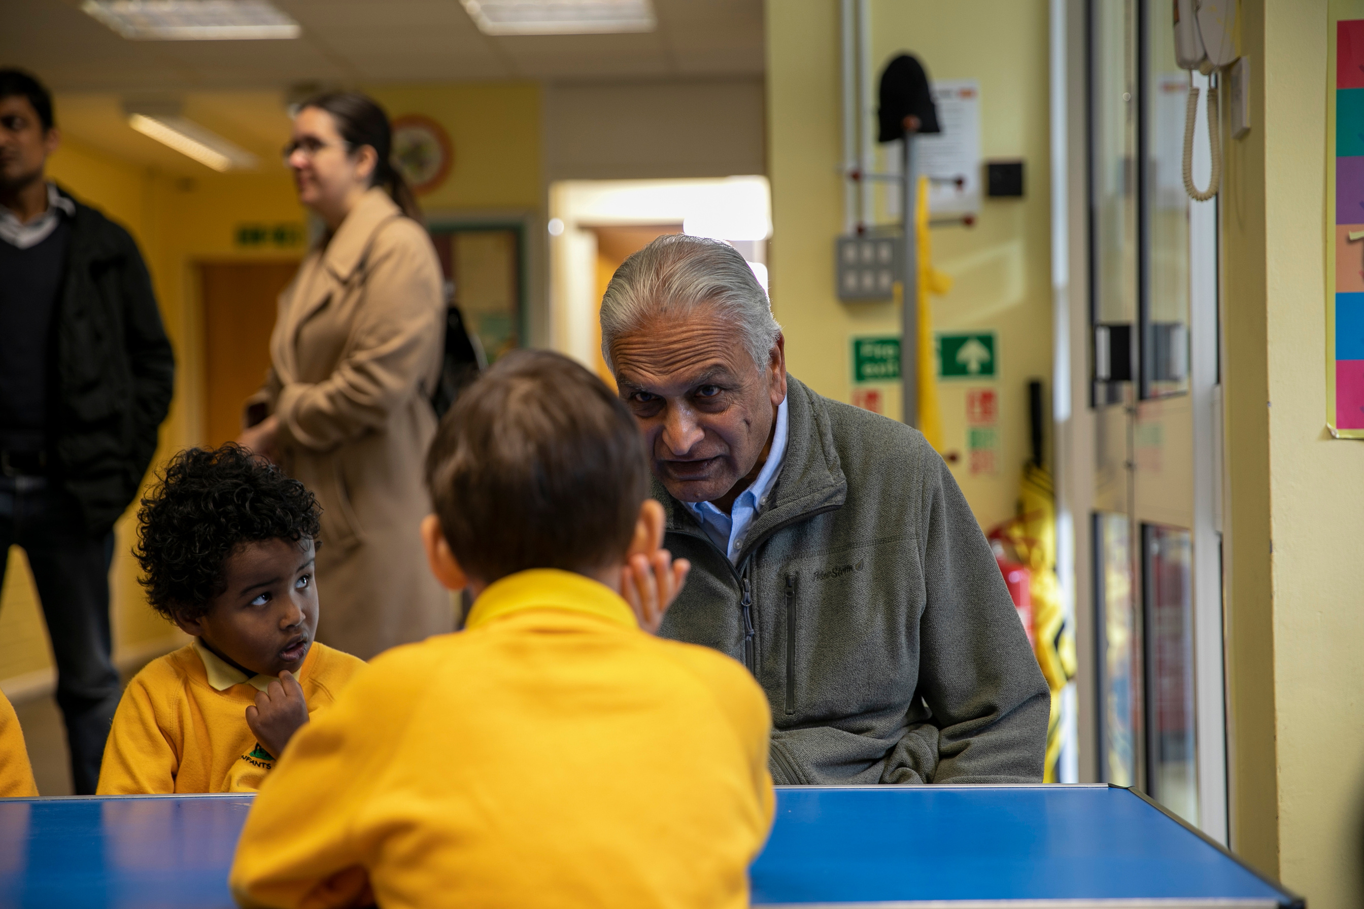
WHO ARE DVS FOUNDATION?
DVS Foundation was established in 2012 by
Rami and Dhiru V. Shah to formalise their family’s philanthropic efforts. Through a combination of strategic grant-making and the delivery of our own in-house programmes, we aim to drive meaningful change.

Slide 4
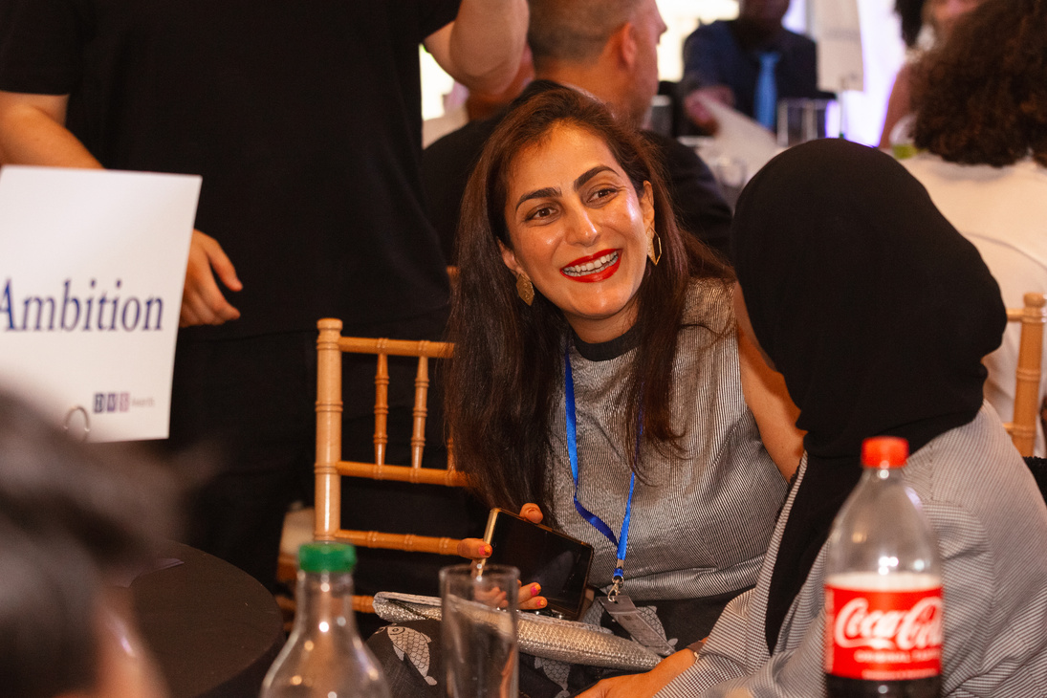
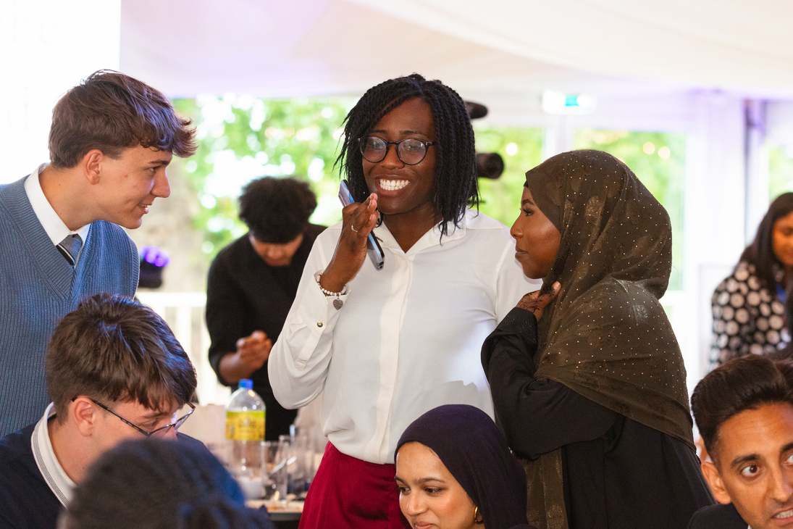
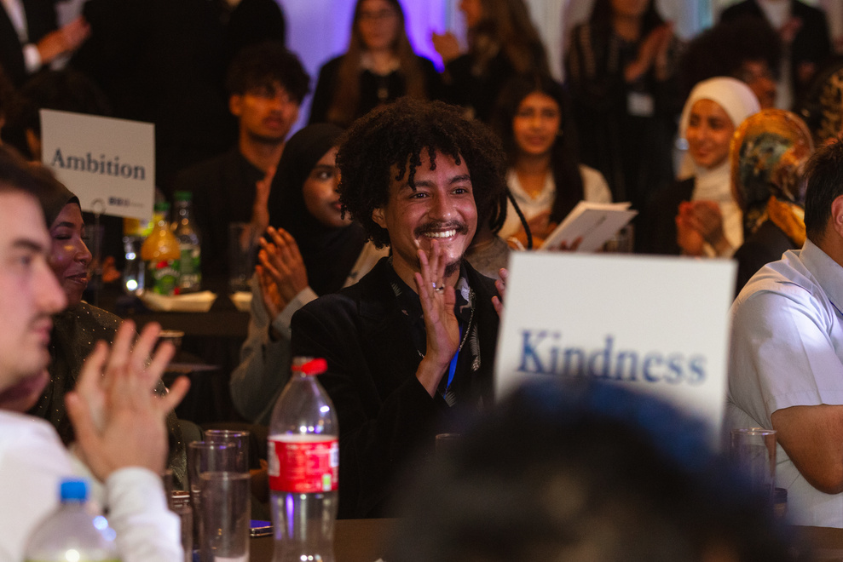

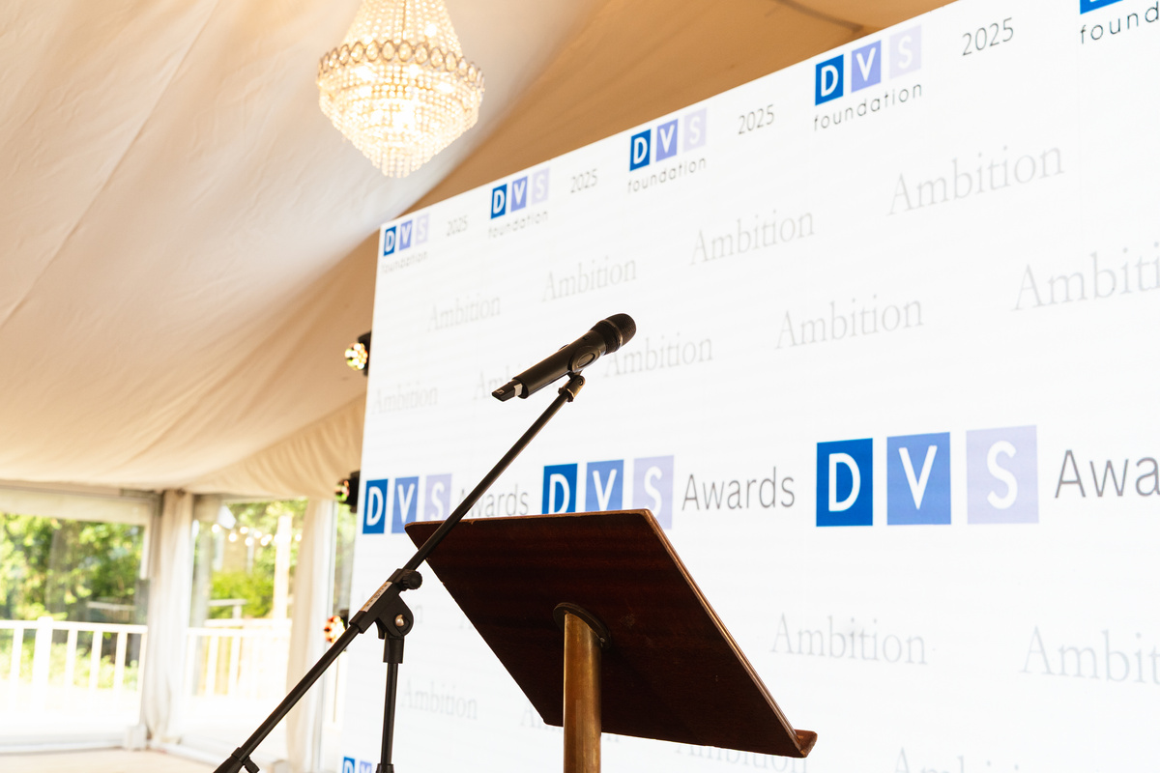
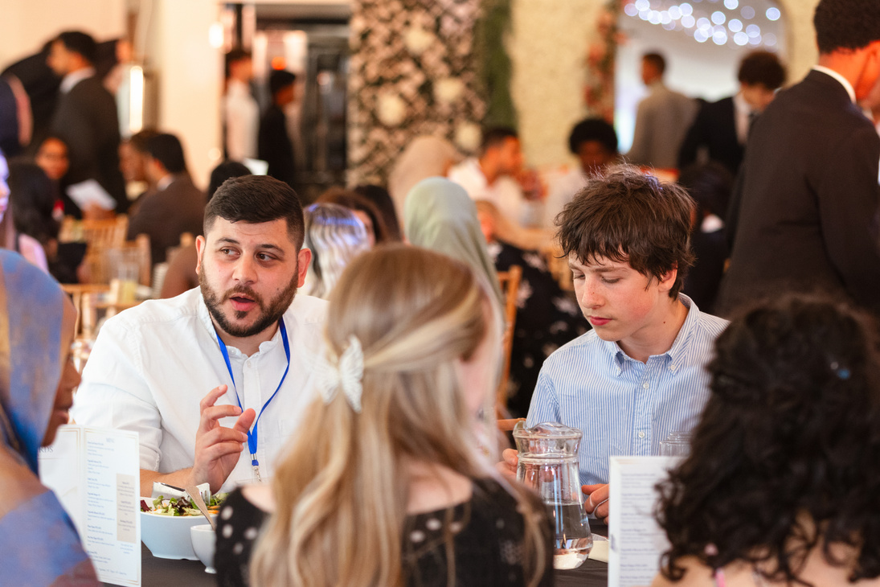
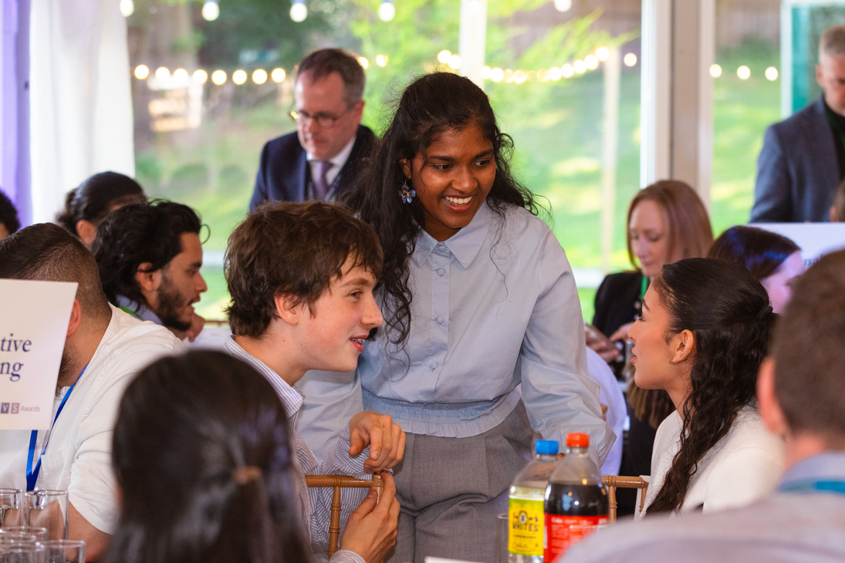


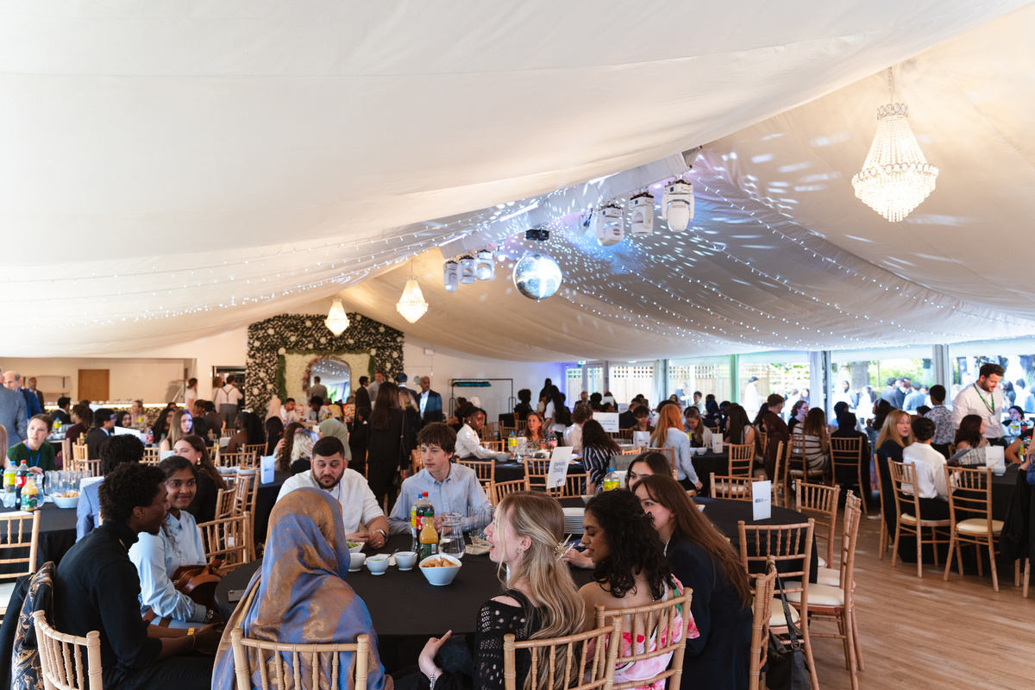
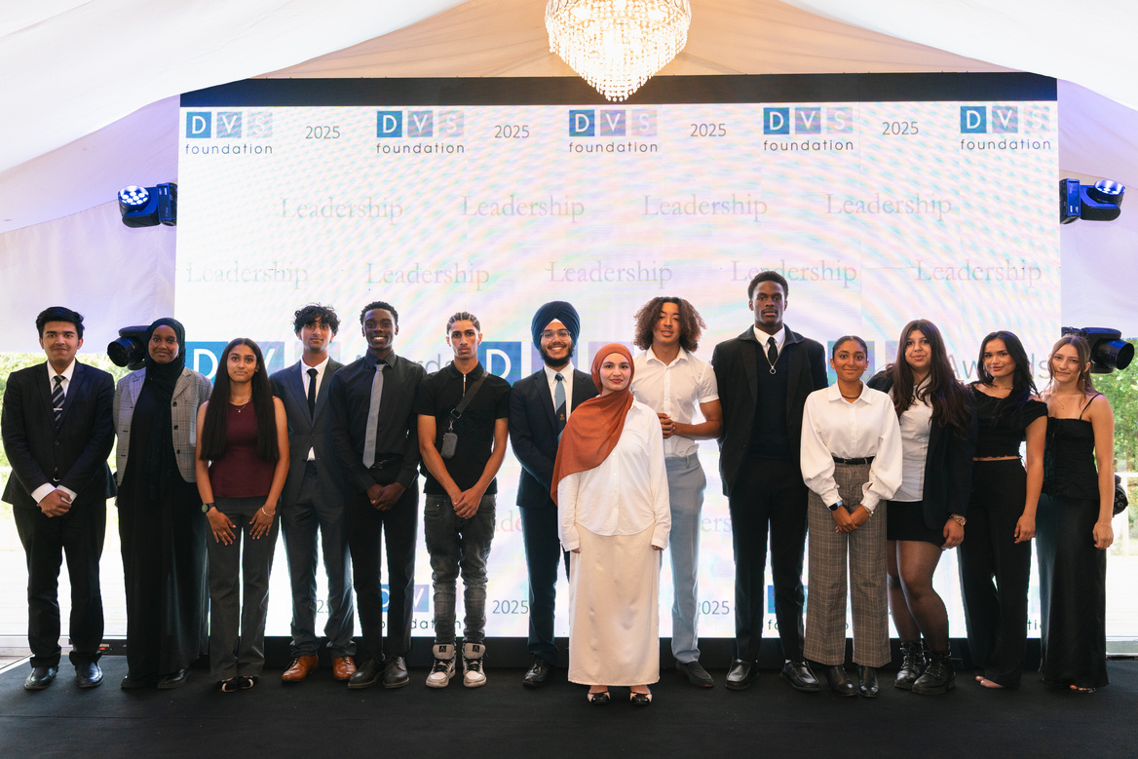
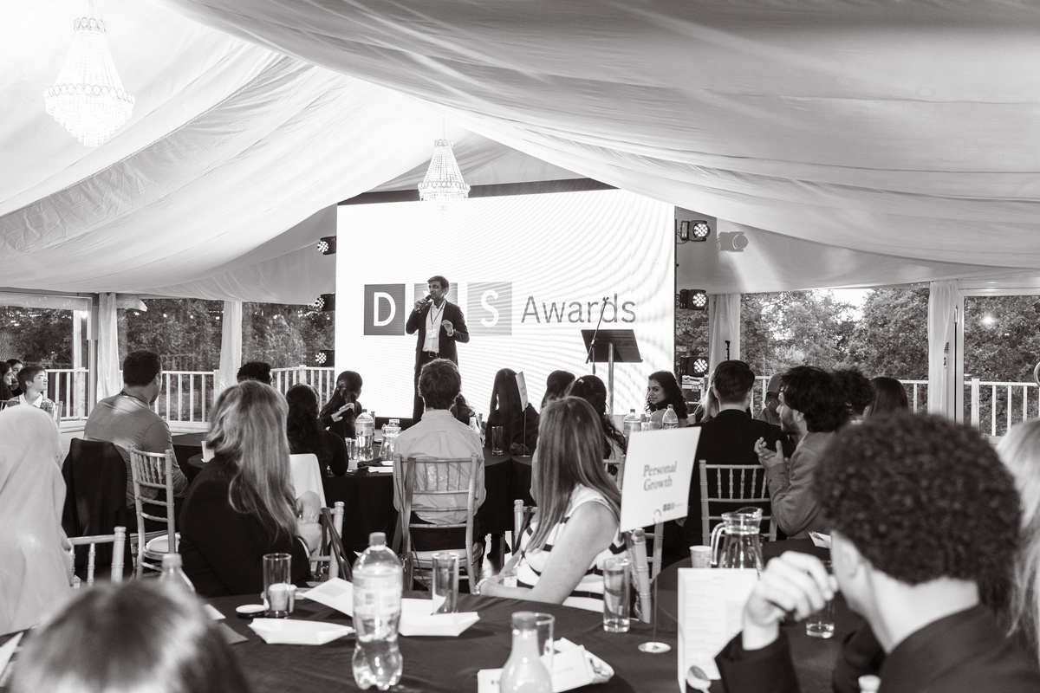
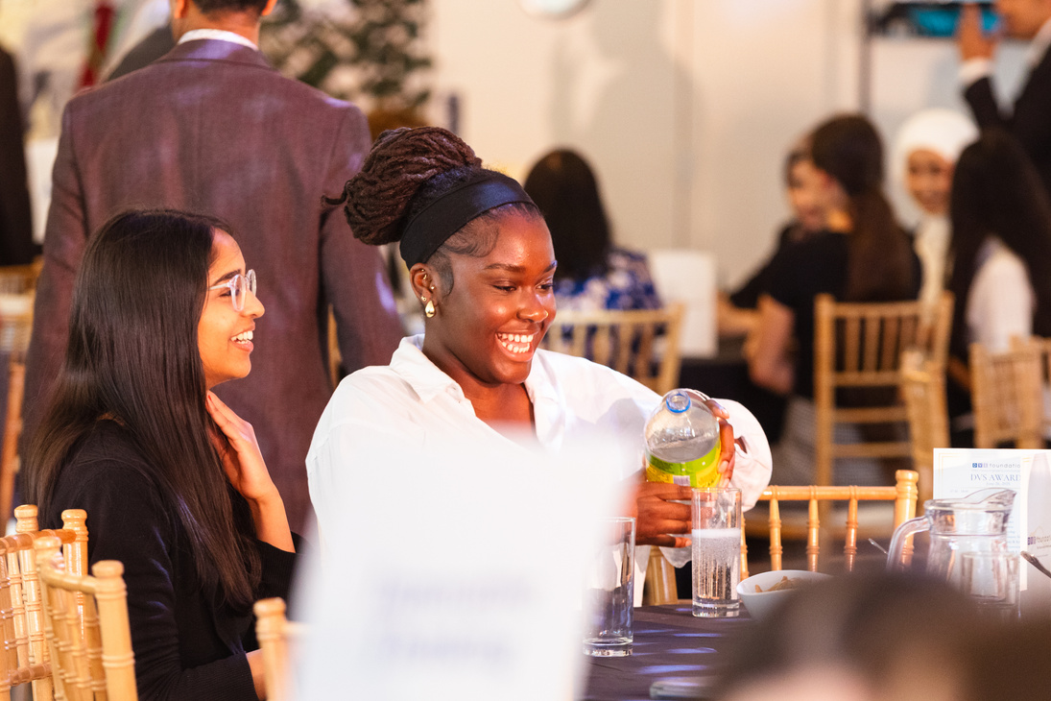
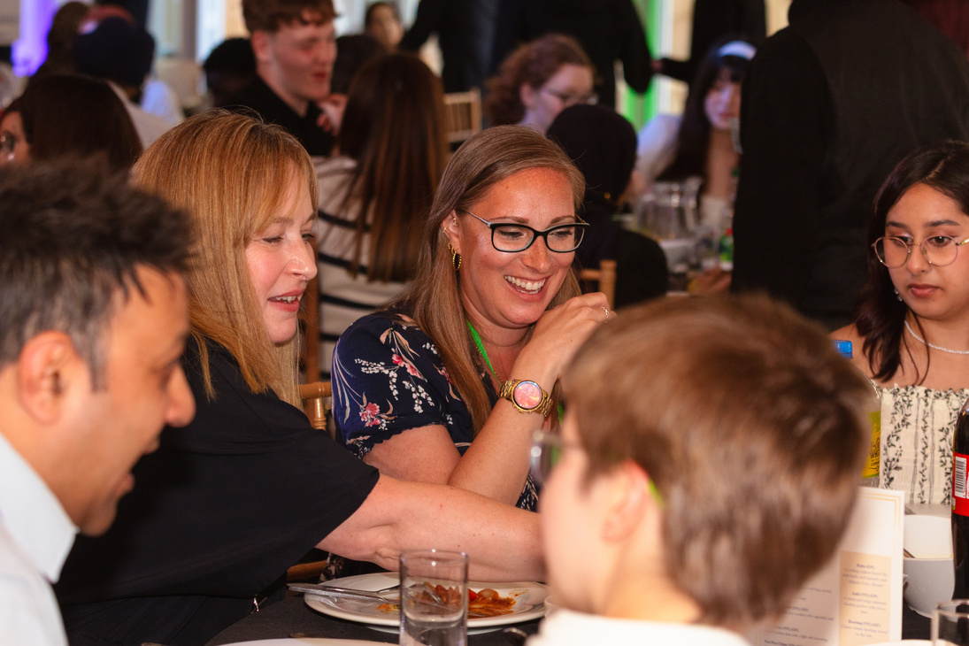

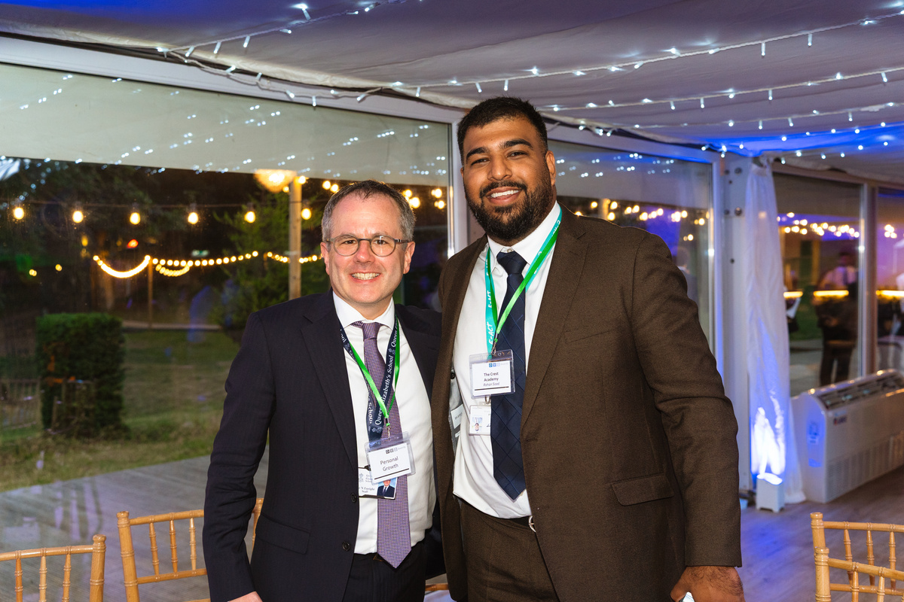
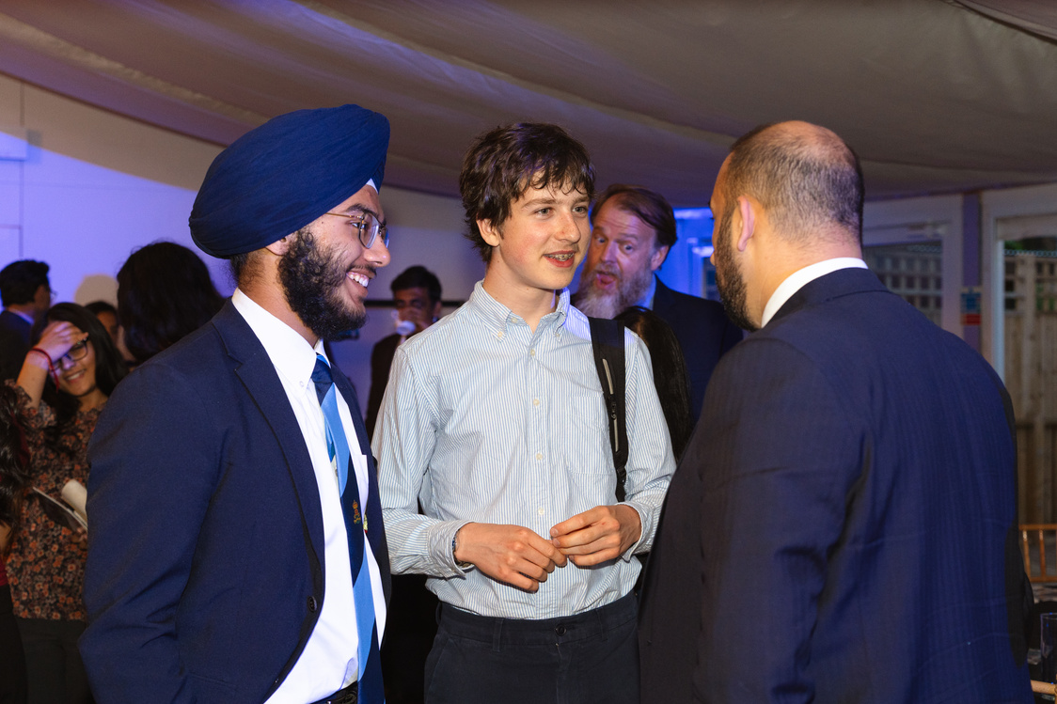
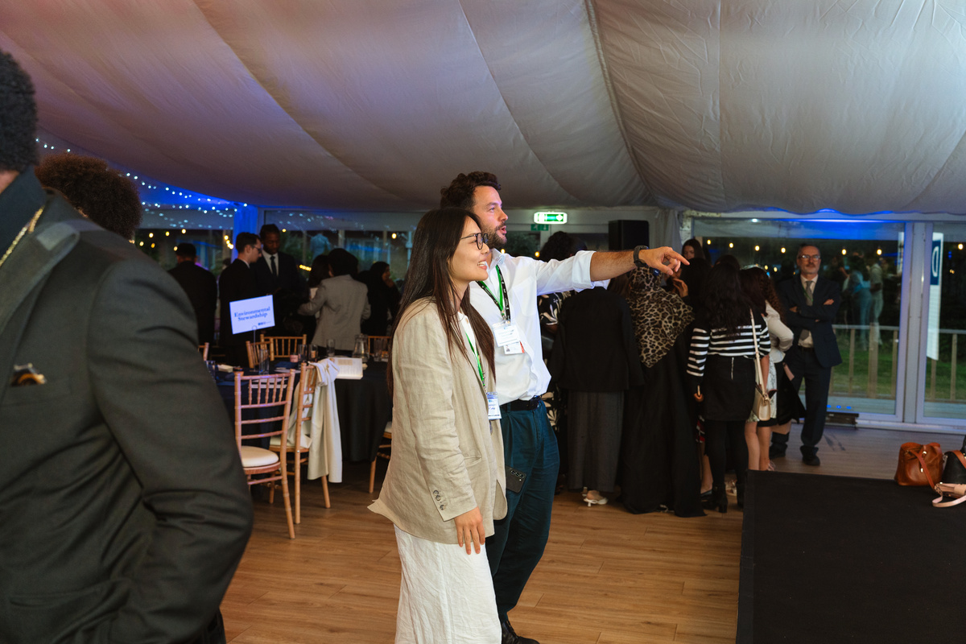
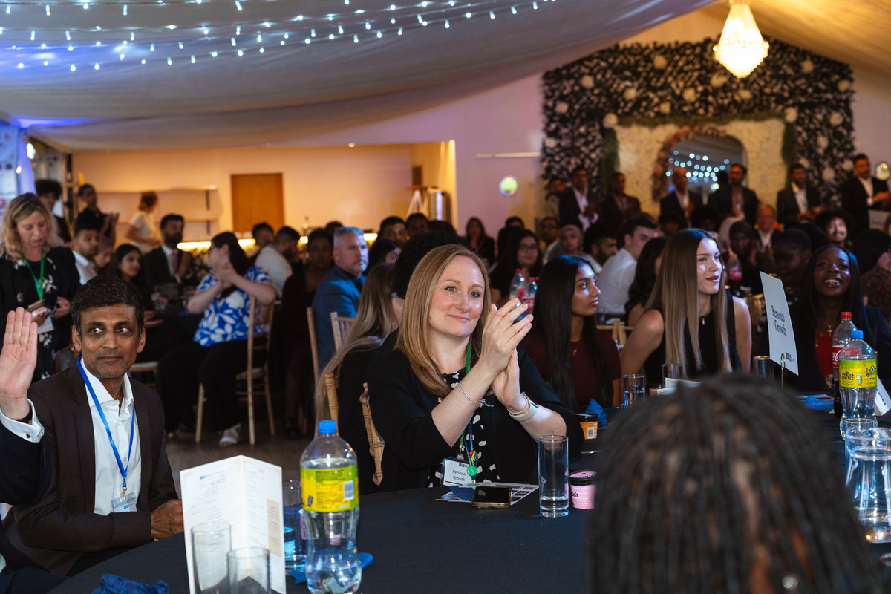
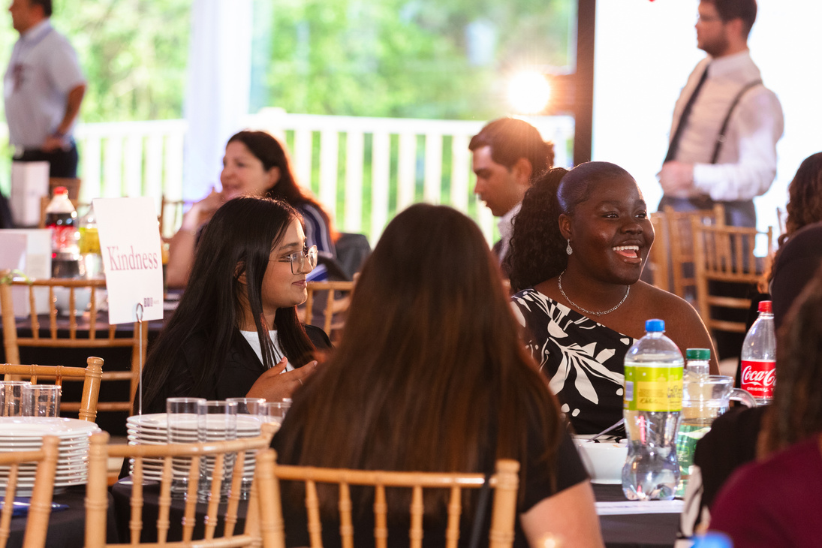
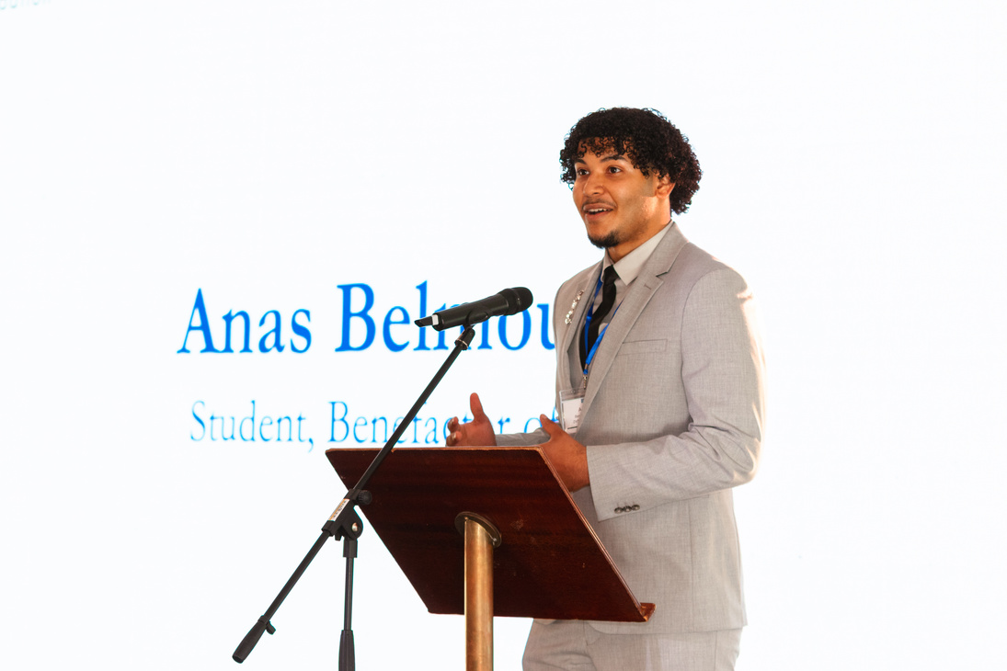
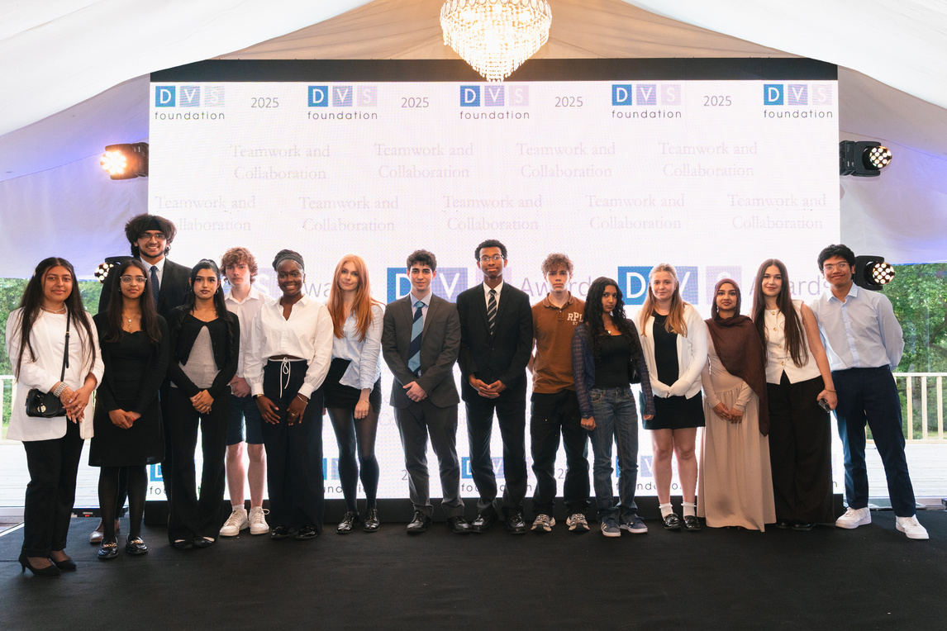
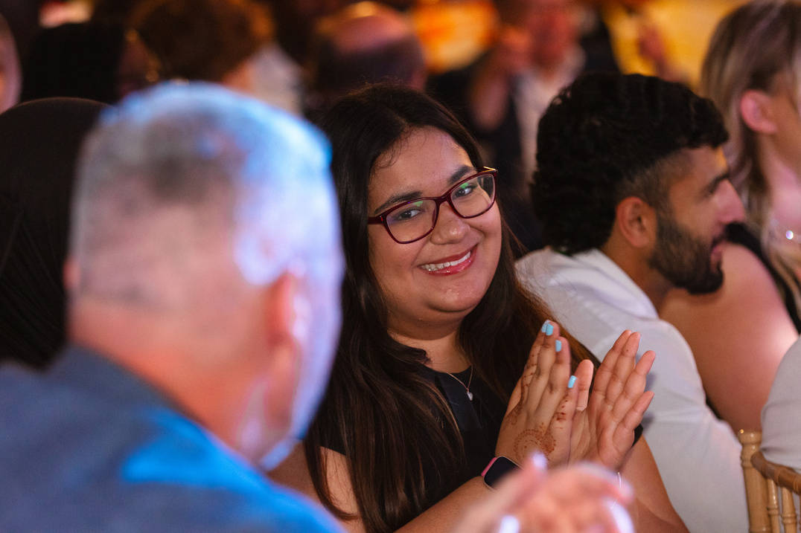
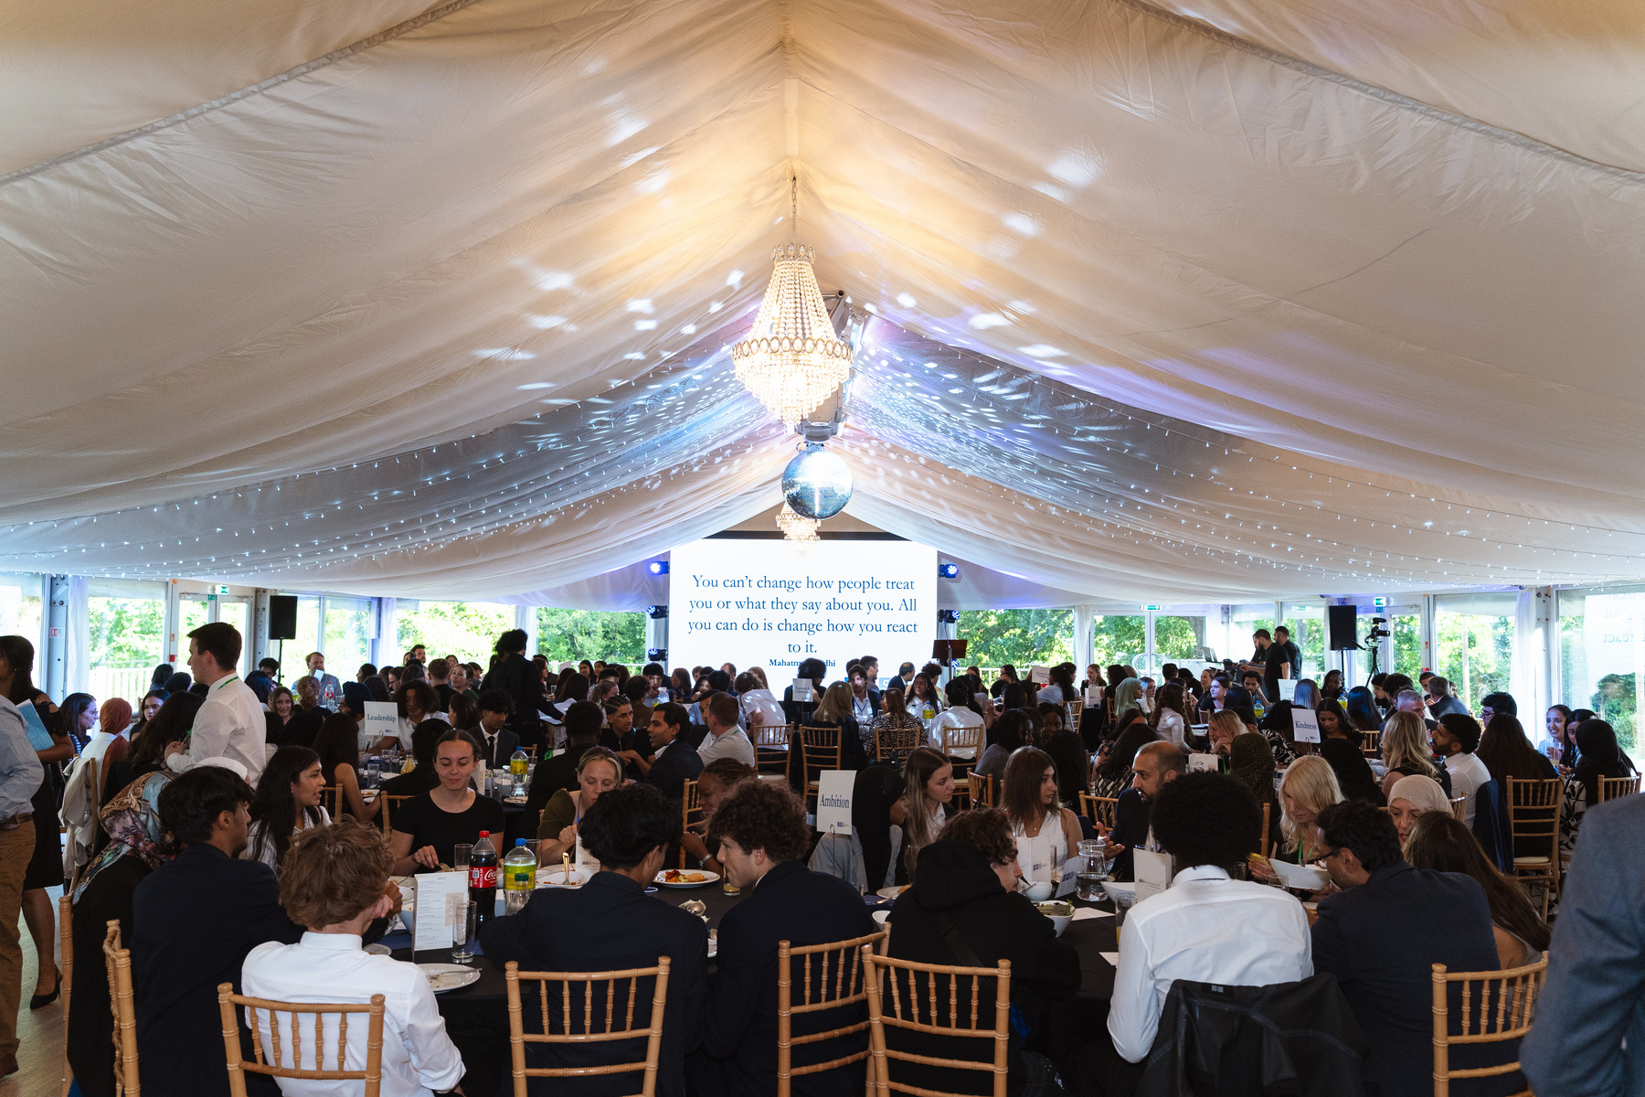
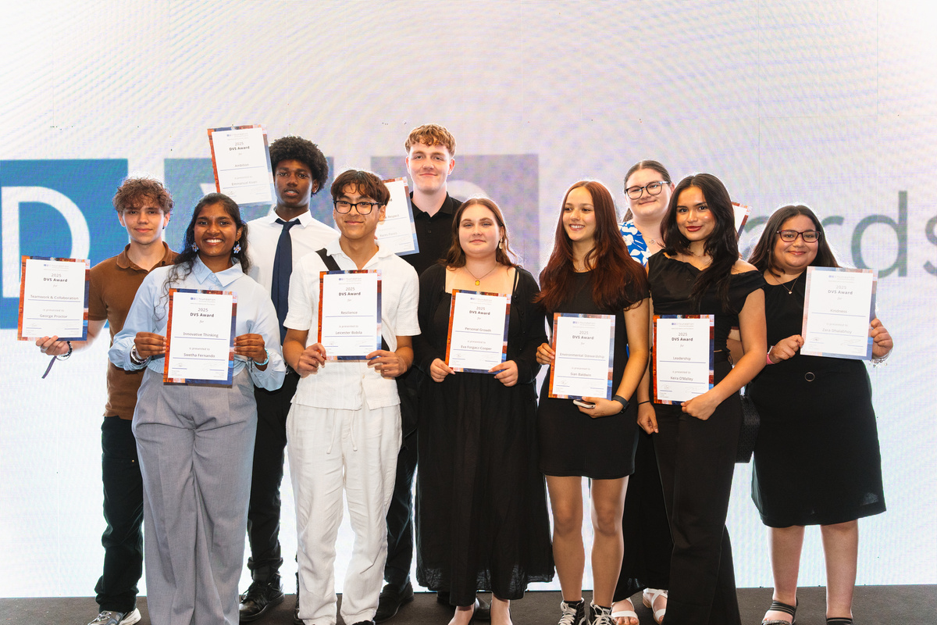
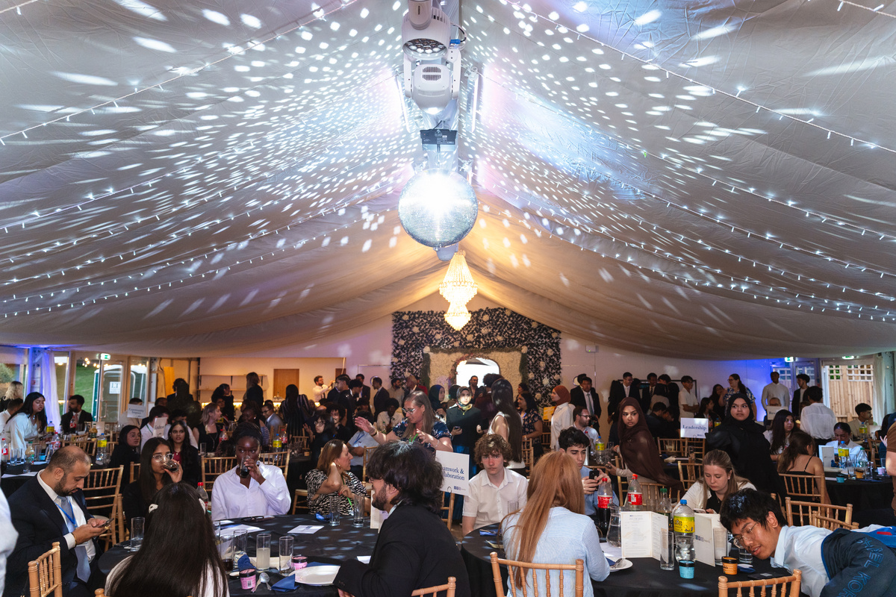

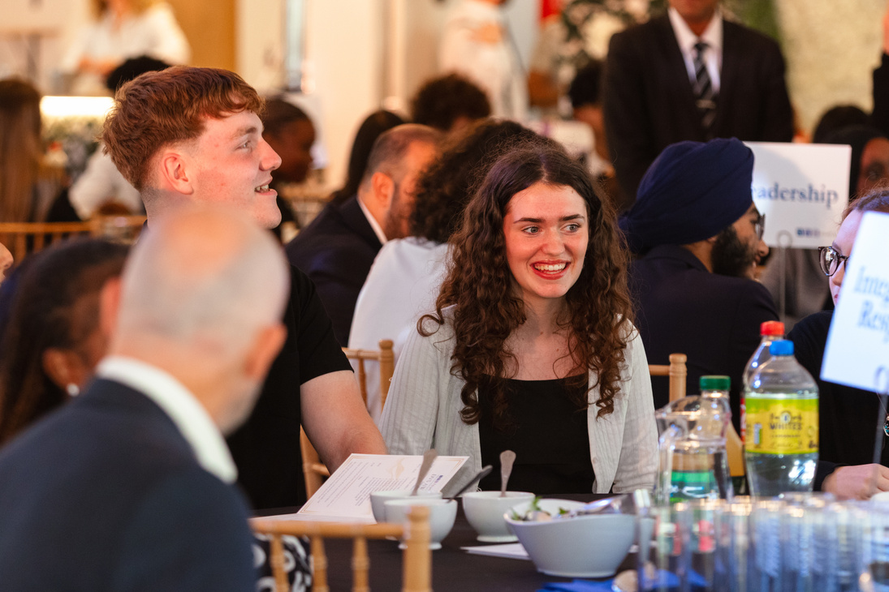
DVS AWARDS

Slide 5
DVS AWARDS
DVS Awards celebrate Year 12 students who embody the values represented in our award categories. The Awards aim to recognise students making significant contribution to their schools and communities.

Slide 6
AWARD CATEGORIES
Kindness
Resilience
Ambition
Leadership
Community Impact
Integrity & Respect
Environmental Stewardship
Teamwork & Collaboration
Innovative Thinking
Personal Growth

Slide 7
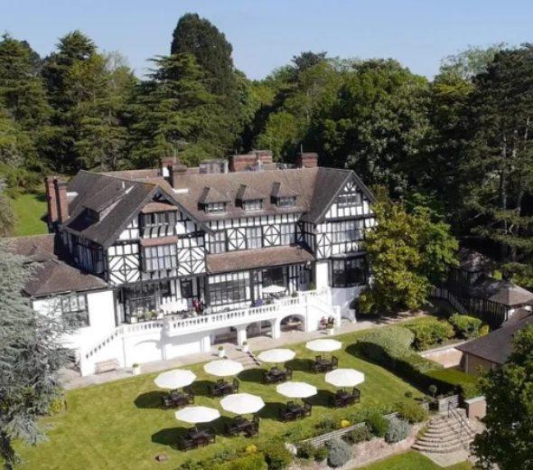
WHAT DO
WINNERS RECEIVE?
Certificate of Achievement
£100 gift voucher
An invitation to the DVS Awards Ceremony
at The Manor Hotel Elstree
Opportunity to network with corporate professionals

Slide 8

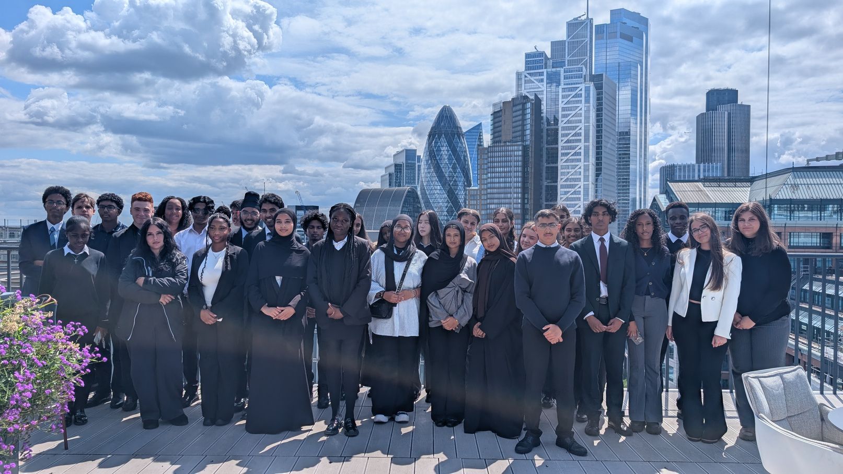
CAREER DISCOVERY
Our Career Discovery Days offer Year 12 students a comprehensive introduction to various industries through a range of activities designed to enhance their understanding of the world of work. Students visit the offices of our corporate partners, gaining first-hand insights into different fields and having the opportunity to speak with professionals about their roles and career journeys.

Slide 9

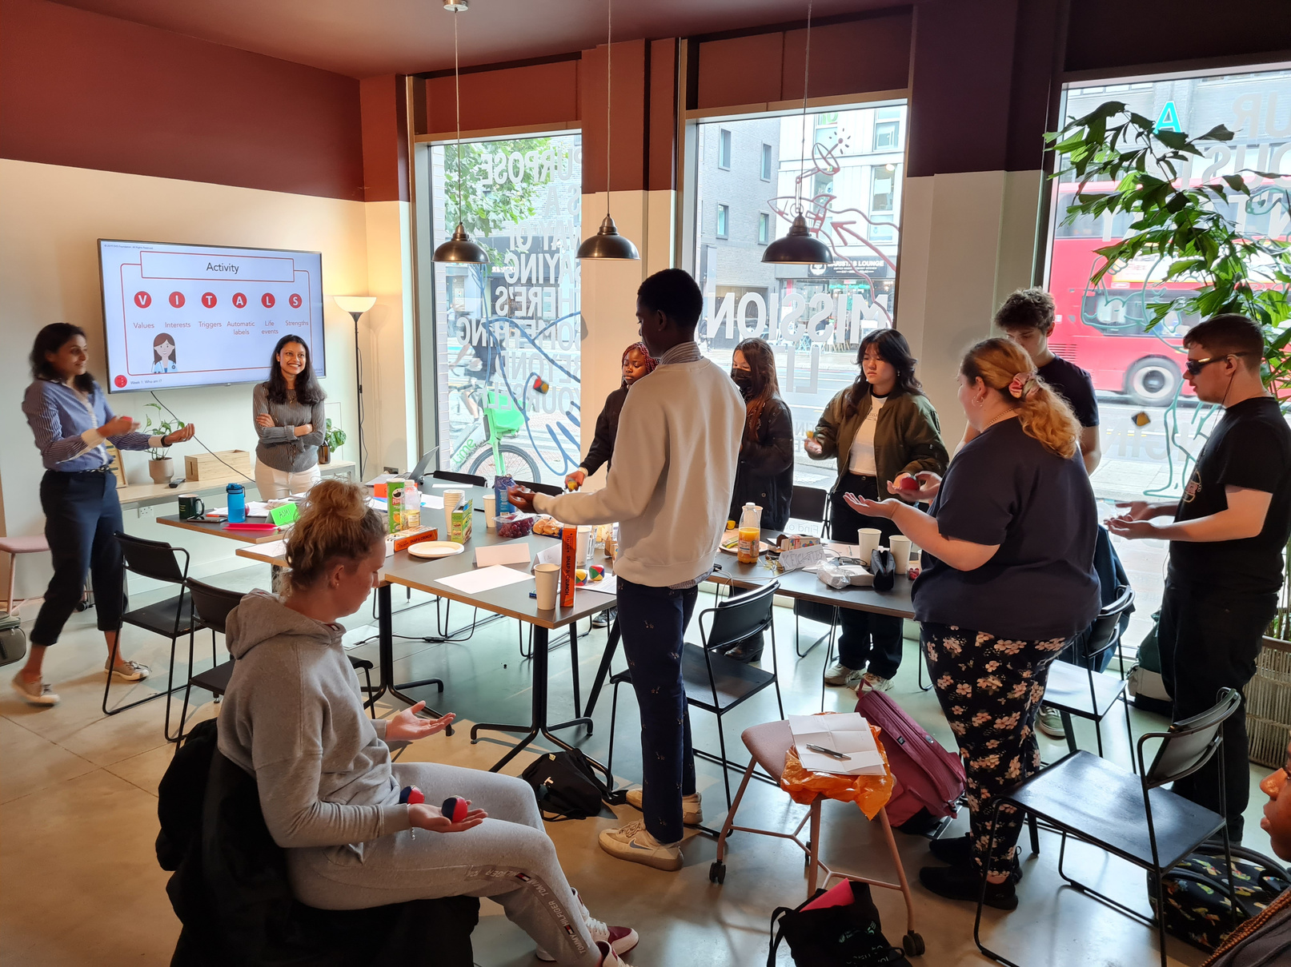
WHYOHYOU
Working with a leading educational consultant, we have intensely developed and designed the five-week WhyOhYou programme which is focussed on personal development for youth aged 15-18 years old. This programme empowers young people to explore self-development, set meaningful goals and learn practical strategies to achieve them.

