Slide 1
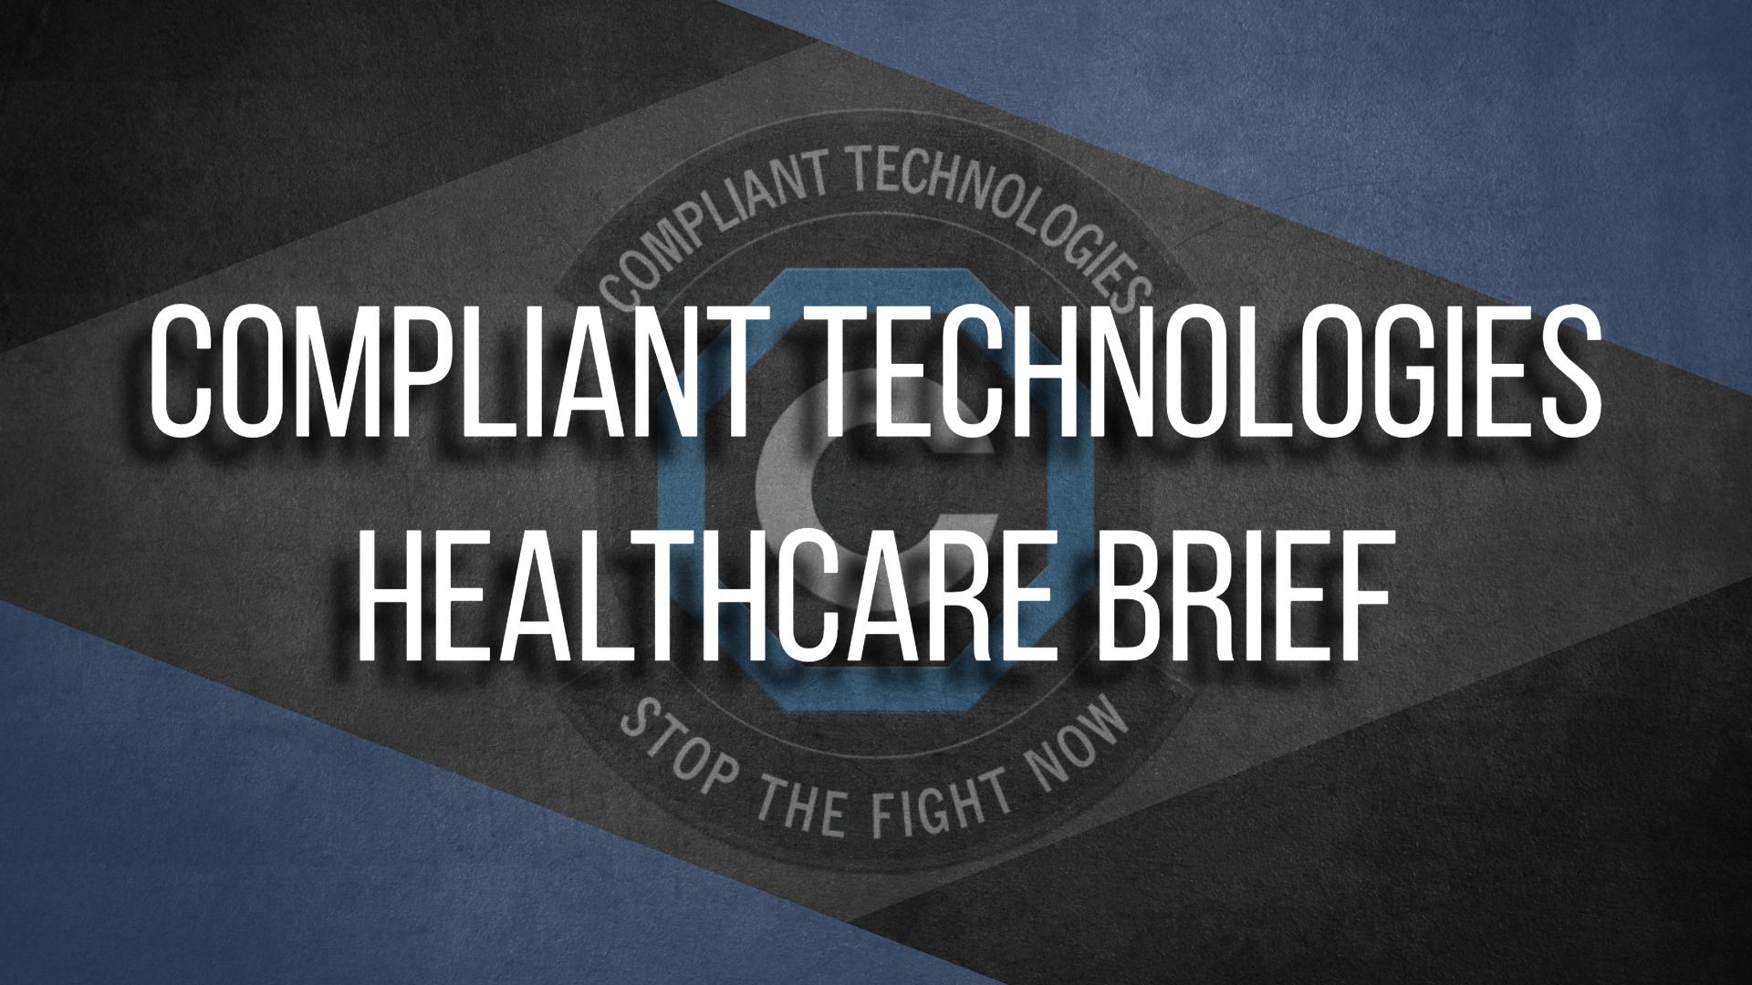

Slide 2
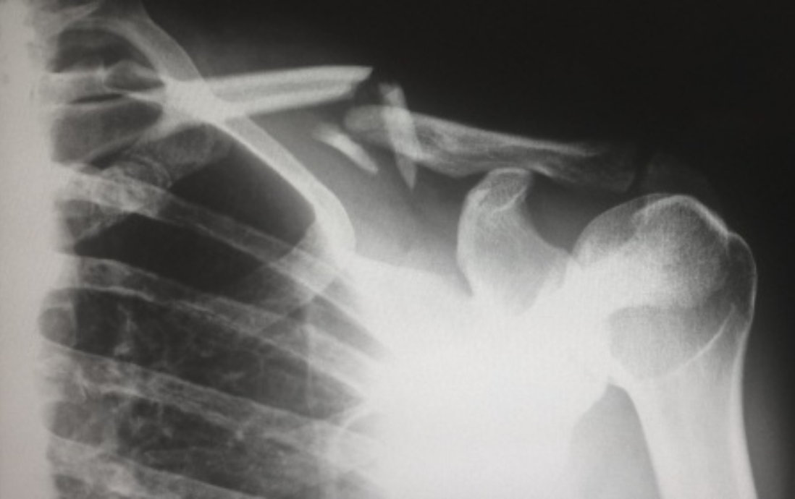
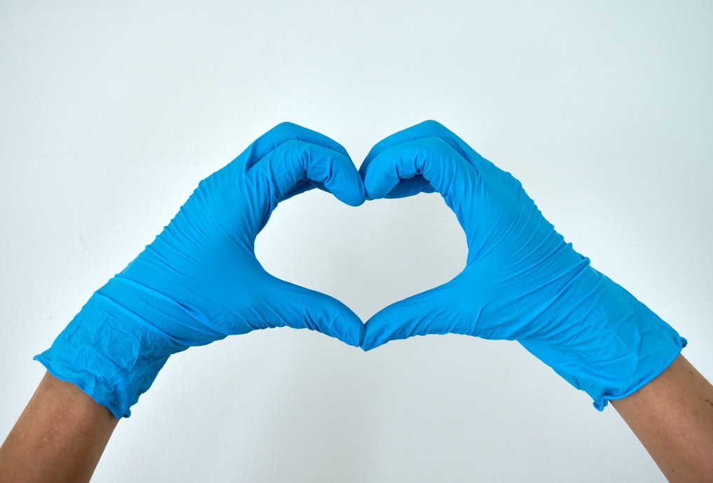
YOU NEVER KNOW WHEN…
BECAUSE ANYTHING CAN HAPPEN AT ANYTIME!
WE WANT TO HELP YOU
DO NO HARM

Slide 3
INTRODUCTION
Thank you for your service. We are honored to be here and if you see fit, we will be honored to partner with you in your mission.
We're not here to compete with or bad mouth any other products in use today.
For the first time in Healthcare history, we have a technology that can be used early in an incident that allows officers to have a low optic, humane, safe, and yet effective de-escalation option. This technology allows officers to free up their hands, transition to and retain their tools while also helping to mitigate tool confusion and lower chances of injury.
For our time together, we encourage you to have an open mind and think outside of the conventional box that we know today.

Slide 4
BOTTOM LINE UP FRONT
Violence against Healthcare employees is greater than other professions and on the rise.
Healthcare workers are more likely to encounter aggression:
  75% of nearly 25,000 workplace assaults occur annually in Healthcare settings.
  30% of nurses and 26% of emergency department physicians have reported incidents of violence.
Employees in the field consider these incidents to be a “part of the job”.
This is unacceptable in our eyes!
We Believe in the Win-Win!
Why can't we have safer hospitals, and also...
Protect our staff, our image, and our budgets?
STOP VIOLENCE AND DO NO HARM

Slide 5
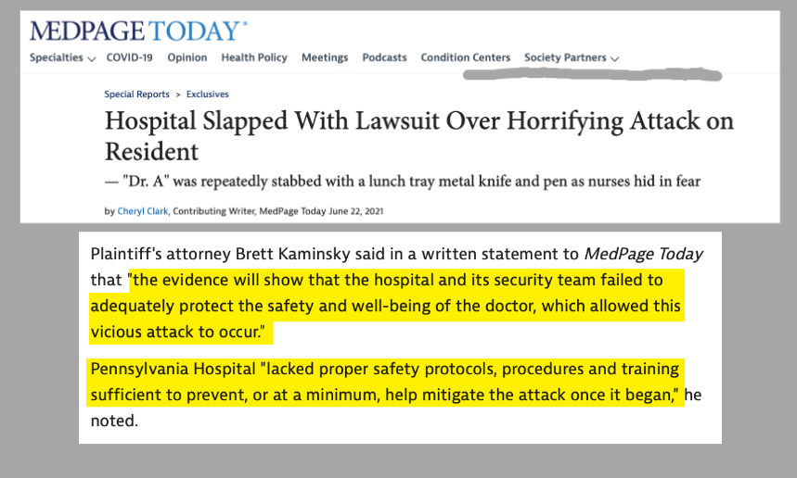
COMPLIANT TECHNOLOGIES, LLC

Slide 6
WHAT IF WE CAN HELP YOU…
Prepare? -$1,500 or 6.8 billion (Minnesota)
Reduce injury rates by 40-50%? However, agencies have reported a 76-90% reduction
Reduce medical expense, workers’ compensation, and litigation by 40-50%?
By providing tools that pay for themselves?
By providing tools that are easy to use and maintain?
By providing additional advanced training?
STOP THE FIGHT NOW AND… DO NO HARM!

Slide 7
ONE OF OUR GOALS IS…
MEASURING COST SAVINGS
STAFF
Reduction in staff injury rates by 40-50%
Reduce your medical expense by 40-50%
Reduce workers’ compensation costs by 40-50%
Less overtime needed
Better overall morale
Increased staff retention
Staff confidence and experience grows
Less need for the costs of hiring NEW staff
PATIENT / SUBJECT
Reduce patient/subject injury rates by 40-50%
Reduce subject-related costs of medical expense by 40-50%
Reduce liability and litigation costs by 40-50%
Less behavioral issues
Less restraining needed
Decrease in facility tension
Better atmosphere
OTHER TOOLS
CS – if not needed is still accessible
Content cost
De-contamination costs, manpower and materials
Quality of life improves with less paperwork and no after affects
CEW’s if not needed are still accessible
Less injury risk to everyone
No cartridge cost or consumable costs

Slide 8
COMPLIANT TECHNOLOGIES, LLC
Kentucky-based, Veteran-owned, Limited Liability Company, started in 2018
Approaching 600 agencies, 43 states, 9 countries
60,000+ real-world uses with no officer or subject injury and no lawsuits to date
U.S. patented and manufacturing
Complete Medical and Product Testing

Slide 9
TEAM MEMBERS
All Compliant Technologies’ team members are current and former public servants
Their duties include Military, Law Enforcement, Corrections, Security and EMS agencies
All Compliant Technologies’ dealers are certified instructors

Slide 10
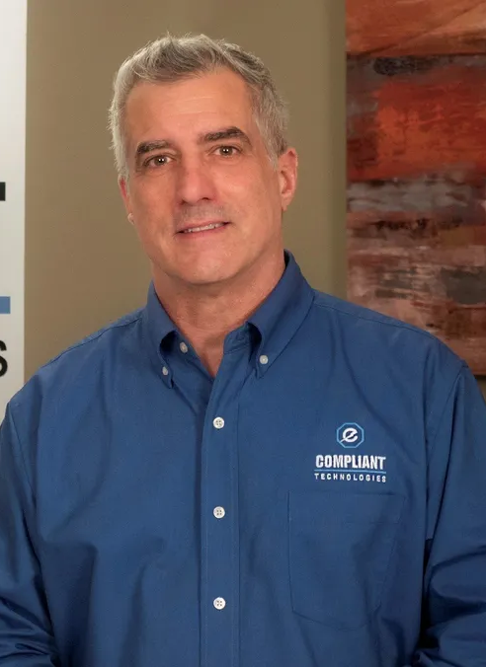
JEFF NIKLAUS
Founder & CEO of Compliant Technologies
Current EMS helicopter pilot Danville, KY, 34+ years flying experience
Retired from U.S. Army in 2006 as CW4, 20 years Active Duty
Liaison to Covered Units with USASOC
Contractor to U.S. State Department, 2006-2007, Poppy Eradication Program Afghanistan
Analyst DynCorp Intl, Falls Church, VA
Degrees in Forestry, Business, Aeronautics
Various entrepreneurial experiences

Slide 11
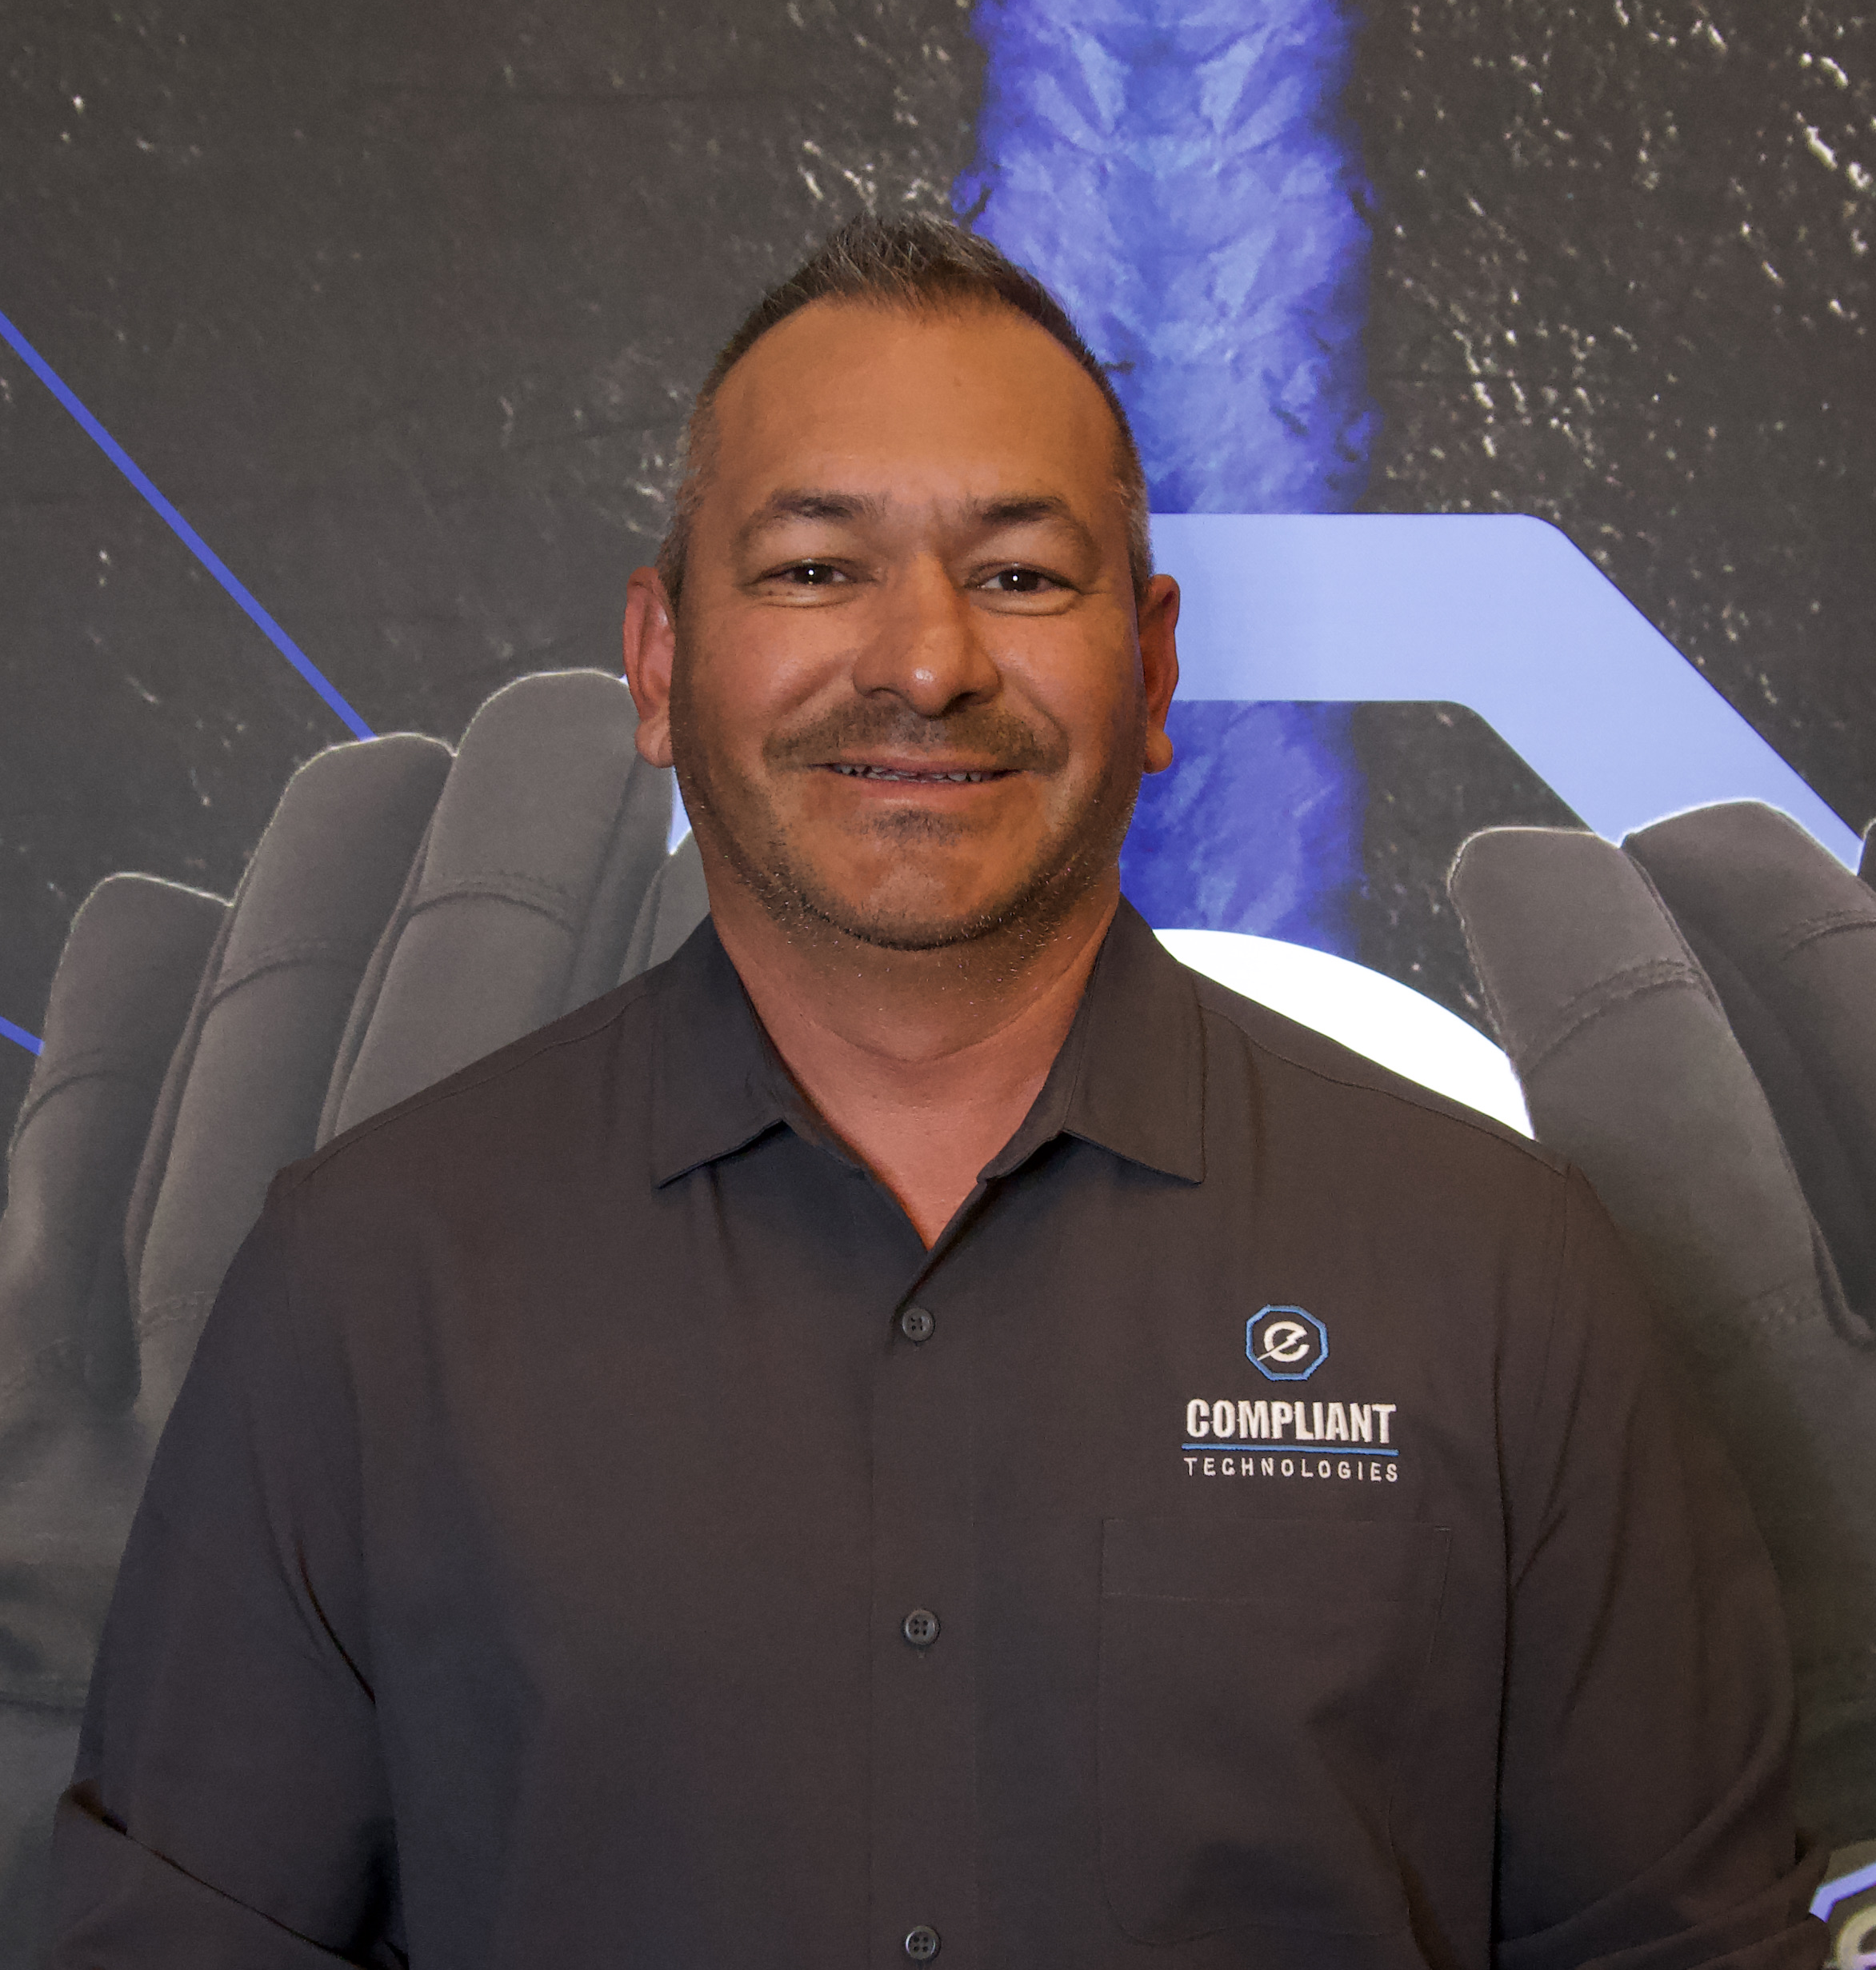
DAN DE LA CRUZ
President & COO of Compliant Technologies
30 years of experience in protection services and training
International Master Instructor for Compliant Technologies Advanced Training

Slide 12
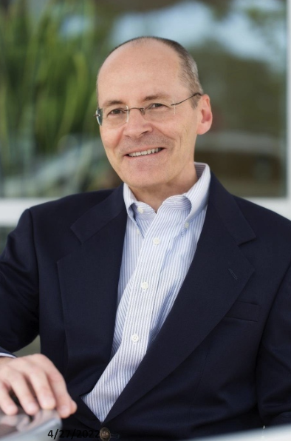
MEDICAL CONSULTANT
Alexei V. Shvilkin, MD
Evaluated Senxunda’s Medical Research on The G.L.O.V.E. technology
Board Certified Cardiologist and Electrophysiologist
American Board of Internal Medicine (Cardiovascular Disease)
American Board of Internal Medicine (Clinical Cardiac Electrophysiology)
Practicing Cardiologist for 35 years

Slide 13
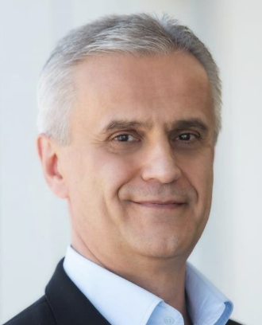
RESEARCH CONSULTANT
Dorin Panescu, PhD
Research for Peer-Rated Article for Compliant Technologies and Senxunda Electronic Technology Co LTD
Chief Technical Officer and Vice President of Research and Development, Axon Therapies, Inc.
Ph.D and M.S. Degrees in Electrical and Computer Engineering
165 issued US patents
Co-authored over 200 technical publications
Fellow of the IEEE
IEEE Chair of the Therapeutic Systems and Technologies Technical Committee
Taser expert and author of many technical papers

Slide 14
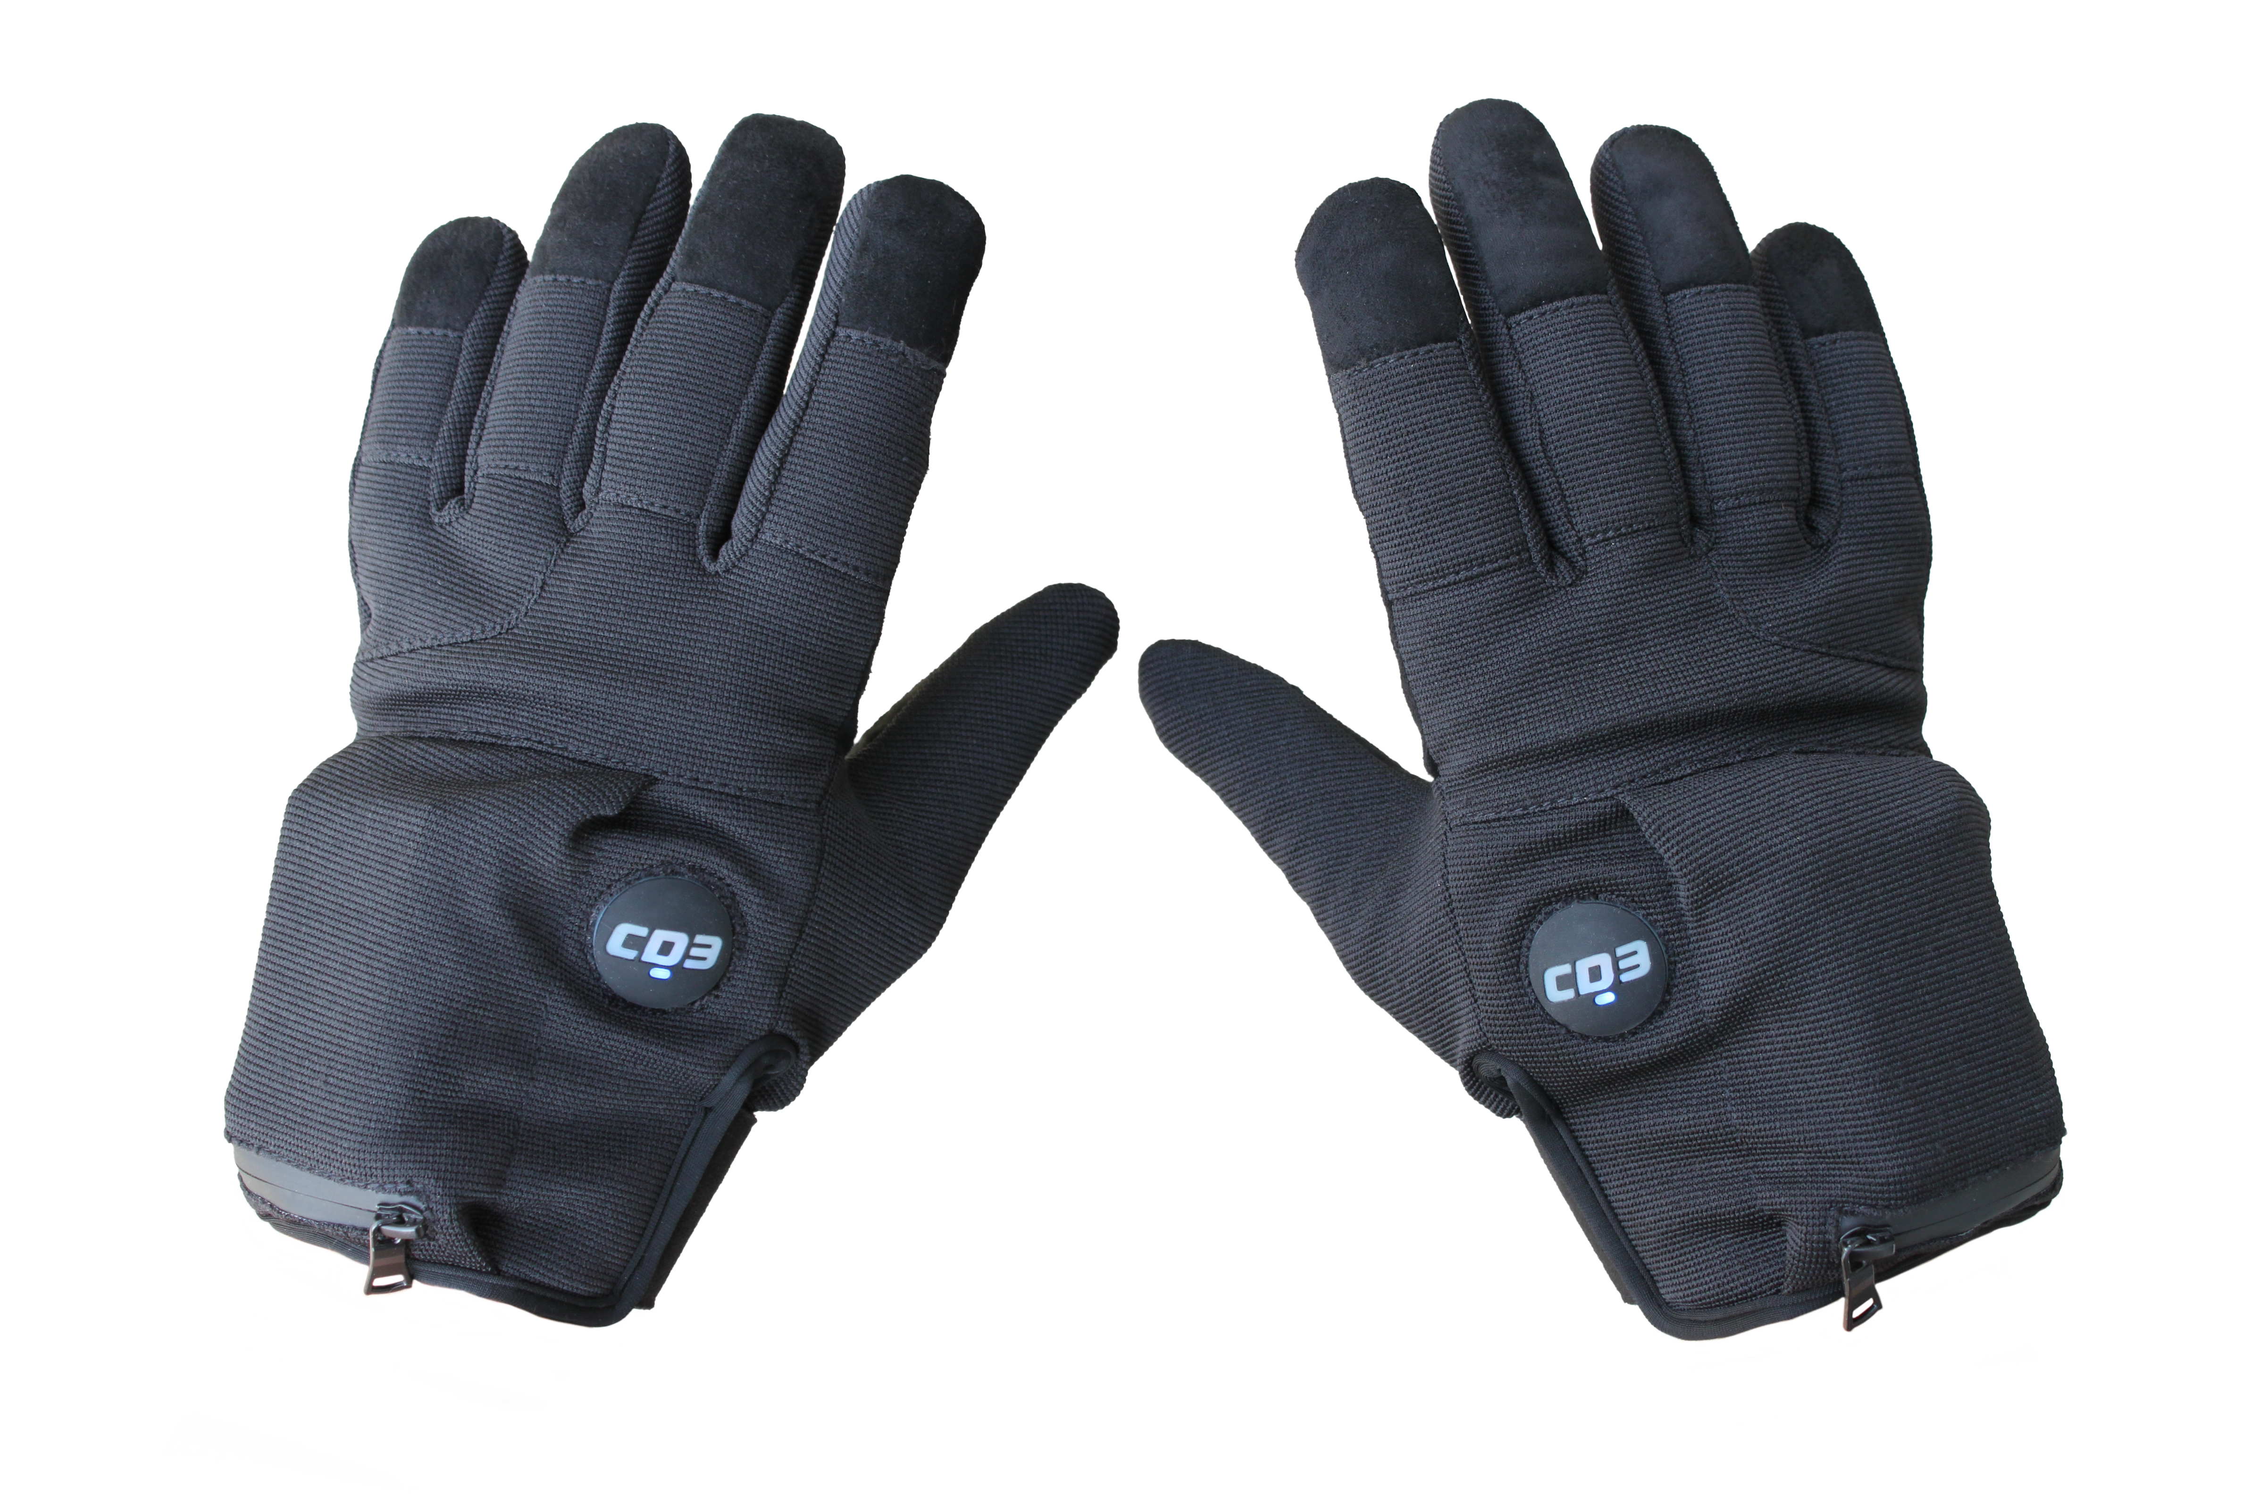
MEET THE GAME CHANGER
The G.L.O.V.E.
CT-G5

Slide 15
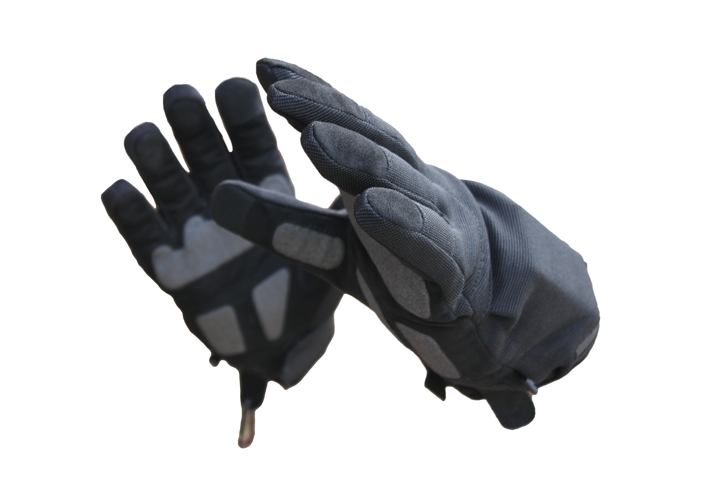
THE G.L.O.V.E.
Generated Low Output Voltage Emitter
A glove that transforms into a low optic, non-lethal CD3 De-escalation tool in 1 second and is a real “Game Changer”
For Operations within the existing Force Continuum, we refer to it as: “The New Protocol in Peacekeeping!”
CT-G5

Slide 16
WHY USE THE G.L.O.V.E.?
The G.L.O.V.E. can give the user a tactical advantage when deployed properly
55-65% of all encounters end up on the ground - Protect your officers! Protect your image!
The G.L.O.V.E.:
  Has very low optics or negative optics
  Can help de-escalate situations before an incident evolves
  Can help the user create space if attacked or finish the encounter – it’s likely having a “built-in back-up”
  Excellent for weapons transition and retention and is not easily taken away
  All but eliminates weapons confusion
  Can help lower injury/liability risk for the user and the subject
  Can help lower medical expenses for the user and the subject
  Is very competitive in price to other main industry tools and weapons
  Has zero operational costs

Slide 17
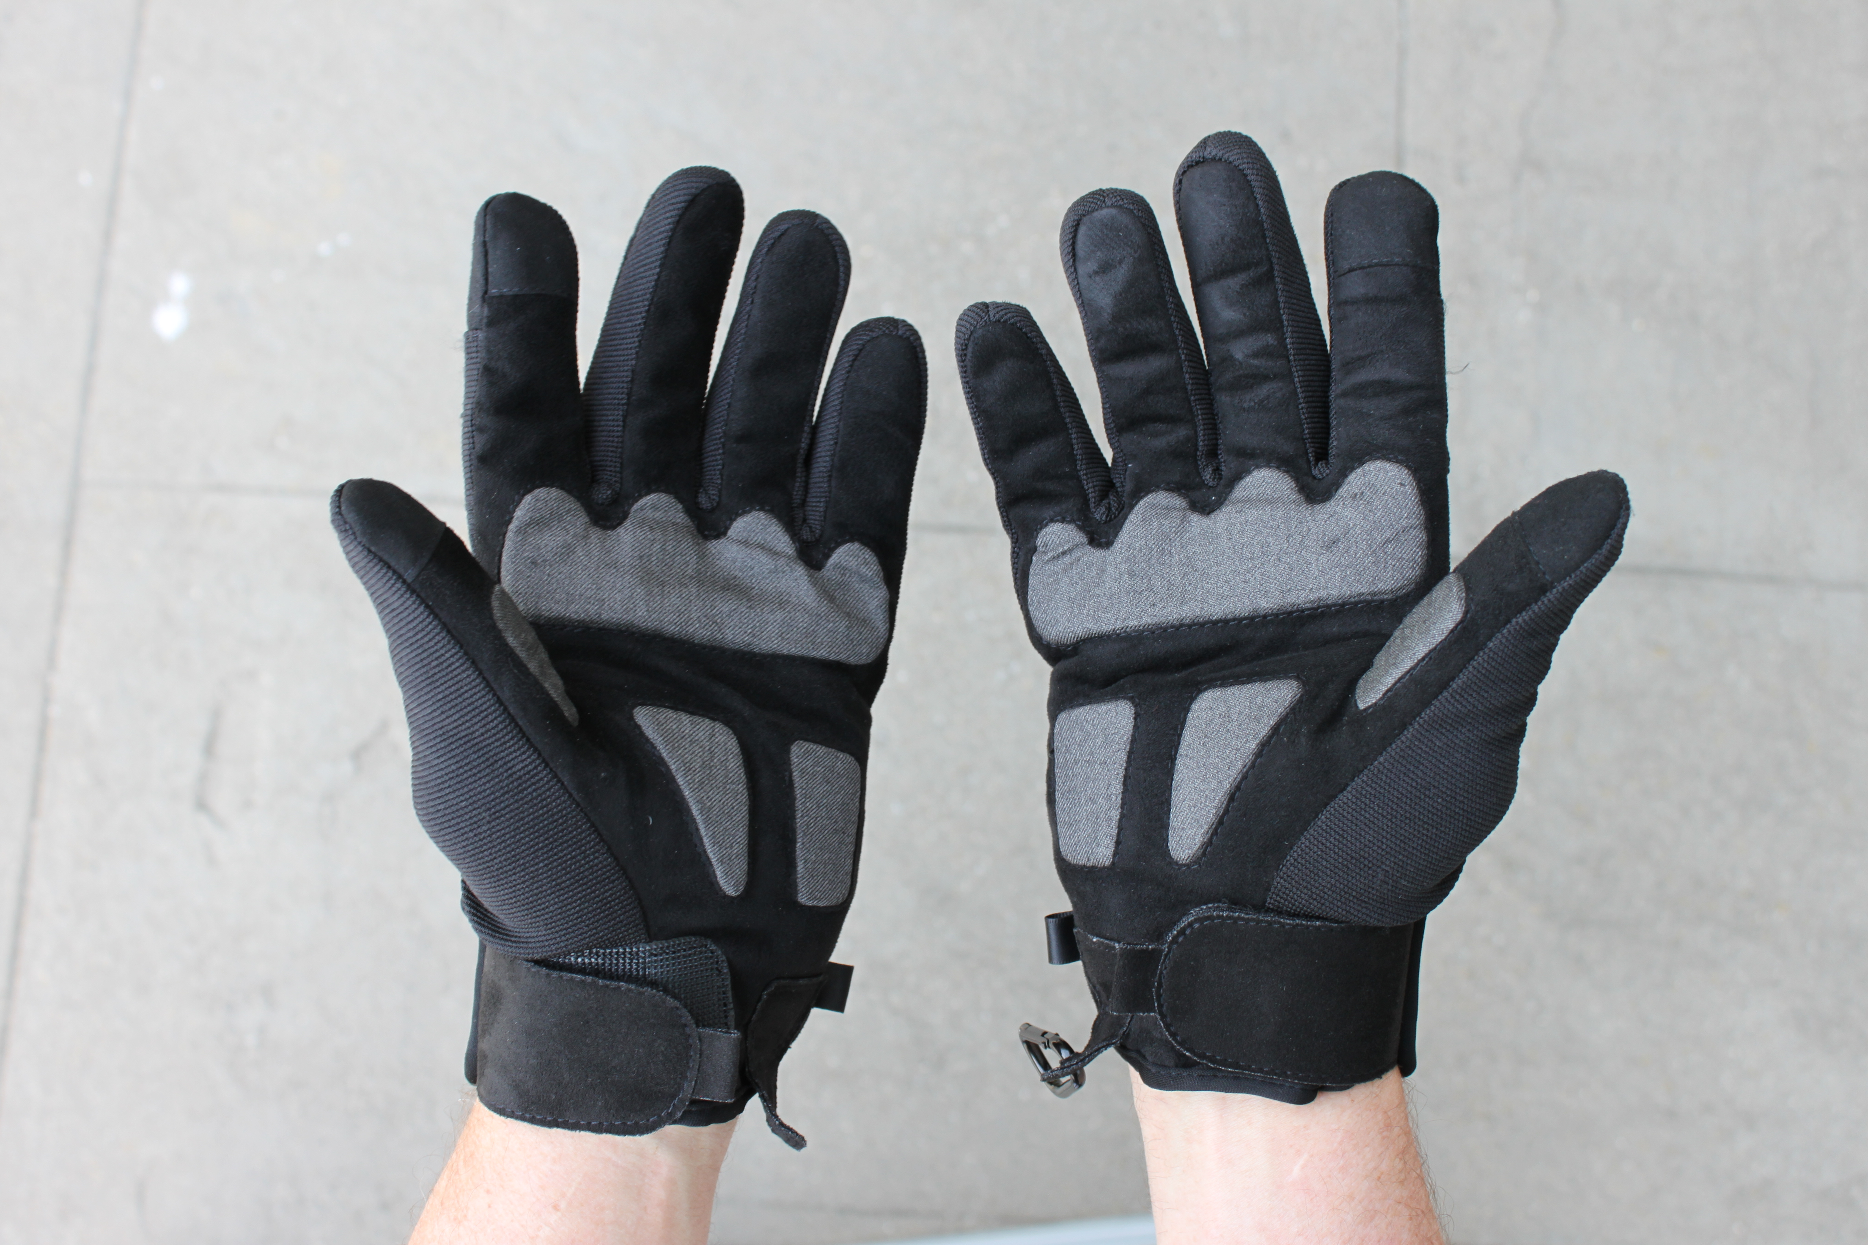
TRAINING
Train the trainer approach
4-8 hour training course depending on size of class
All training materials are accessible on our website
Re-certification is every two years either in-person or online
Compliant Technologies AMI (Agency Master Instructor) is required for healthcare systems
“EVERYONE HAS A PLAN UNTIL THEY GET PUNCHED IN THE FACE” – MIKE TYSON
CT-G5

Slide 18
G.L.O.V.E. SPECIFICATIONS
Sizes: 2XS - 3XL
Weight: 9-23oz. Or 260-650 grams
Activation: 1 second on via switch located on the glove
Duration of use: 90 minutes
Duration of charge: 2 days to months
Battery: 3.7V Lithium-Ion
Charge time: 2 hours
Voltage Range: 324-362V (cannot go above 380V)
Maximum Current: 0.7-1.2A
Pulse duration (µs): 114-116 (.000115 second)
Pulse charge (µC): 72.4-111.7 (.000111 Amp-second)
Pulse repetition rate (pps): 29-30
Duty Cycle (%): 0.348
Operating temperature: 14°F to 122°F (-10°C to 50°C)
Special features: Smart Touch Finger, Stand-by Mode, Event Recording Capability

Slide 19
HOW DO WE FIT IN?
Assists staff in stopping individuals who are being physically aggressive
Helps keep individuals in compliance once under control
Not a replacement for any existing tool in use today
Usable within the entire engagement but is primarily deployed early on within the vicinity of Soft Empty Hand Control Techniques
Activates in 1-second
Compliance from most people within 3-5 seconds
Allows the user to test it before deployment
At the user’s disposal all the way through an event including the ability to transition to higher levels of Force

Slide 20
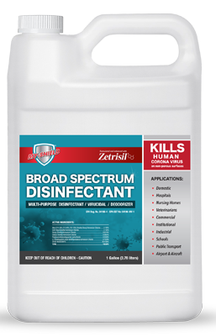
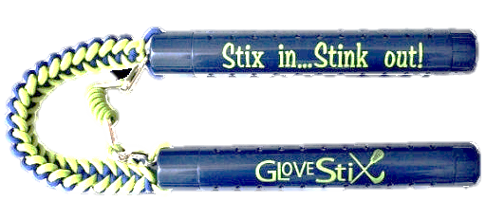
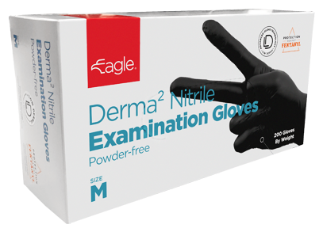
MY-SHIELD®, GLOVE STIX & EAGLE PROTECT
GloveSTIX:
  Dehumidify and Deodorize the G.L.O.V.E. Products from the inside and emits Silver IONs into the fabric prohibiting the growth of Staff, bacteria and molds
  Good for 10 Years
  Moisture absorbers lasts 4-6 months
MY-SHIELD® SURFACE CLEANER & BROAD SPECTRUM DISINFECTANT:
  Cleaning and Disinfecting surfaces and fabrics, i.e., your office areas and CD3 products
  Kills all Viruses and Bacteria for up to 28 Days
  Kills 94% of MRSA
  Neutralizes Fentanyl and other drugs and narcotics
  There are many My-Shield® products – all are patented, made in the USA, EPA certified, FDA approved and food safe!
EAGLE PROTECT:
  Lightweight and Durable 3mil or 6mil Nitril Gloves
  FENTANYL resistant for up to 240 minutes (ASTM D6978 Rated)

Slide 21
WARRANTY AND CUSTOMER SERVICE
Compliant Technologies’ products come with a full 1-year warranty
Other warranty options are available:
  Options for additional 2nd and 3rd year warranty packages on any non-subscription purchase
  Subscription package with Warranty for the entirety of the subscription contract
Compliant Technologies can provide “framework” for or samples of Use of Force Policies
Responsive to our customer needs and service after the sale
Compliant Technologies maintains full product liability insurance
You are why we exist, so we don’t sell our products to the public

