Slide 1


different results
different thinking …
Presenting the Pēpi-Pod® Programme to Coordinators in New Zealand
Stephanie Cowan
Director, Change for our Children, 2025

Slide 2
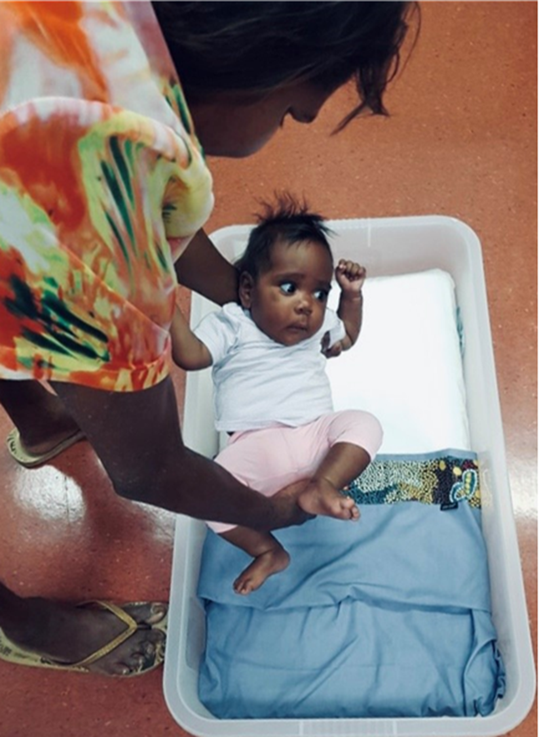
Arms
With permission
Notes:
VISION
ARMS: The arms that lay a baby down to sleep have the greatest power to protect that baby. Our work in prevention is to resource those arms so that every baby wakes from sleep. As we learn together in this workshop, remember those arms.
WELCOME
Warmly welcome participants to the workshop and the program in ways that are culturally and locally preferred.
ACKNOWLEDGE
Policy leadership of the QLD Government, NZ beginnings led by Stephanie Cowan (CCL), Queensland studies led by Jeanine Young, advocacy of QPQC, Indigenous participation to date led by Aboriginal and Torres Strait Islander agencies and communities that have embraced this program and led it to this point.
In particular we acknowledge these key people: Leanne Craigie (Jeanine to add)
And we acknowledge the need for this program and the right to an equal chance at survival from preventable deaths for all babies in our state/country.
SET THE SCENE
Clarify expectations, time management as a mark of respect for the program and people, the program purpose as two-pronged: 1) about protecting infant breathing and not about SUDI; 2) about strengthening communities for fair and lasting change.

Slide 3

Actor-centred approach
Actor: Policy lead
Action: Align
Tool: Policy
Outcome: Equitable access to safe sleep
Main Influence: Coordinator
Policy lead
Coordinator
Distributor
Carer
Baby
Actor: Carer
Action: 1. Protect 2. Share knowledge
Tool: 1. Pēpi-Pod bed 2. Airway simulator (tube) discussion aid Outcome: 1. Consistent use of Pēpi-Pod 2. Spread of safe sleep practice
Main Influence: Baby, community
Actor: Coordinator
Action: Link
Tool: Systems
Outcome: Accountable implementation
Main Influence: Distributor
Actor: Pēpi-Pod® Distributor
Action: Guide
Tool: Words
Outcome: Carers understand risk and act to protect
Main Influence: Carer network
Actor: Baby
Action: Breathe
Tool: Airway
Outcome Waking from sleep
Main Influence: Everyone
© Change for our Children (NZ) 2025 – a Pēpi-Pod® Program Resource: ‘Wheel of Influence’ concept map

Slide 4


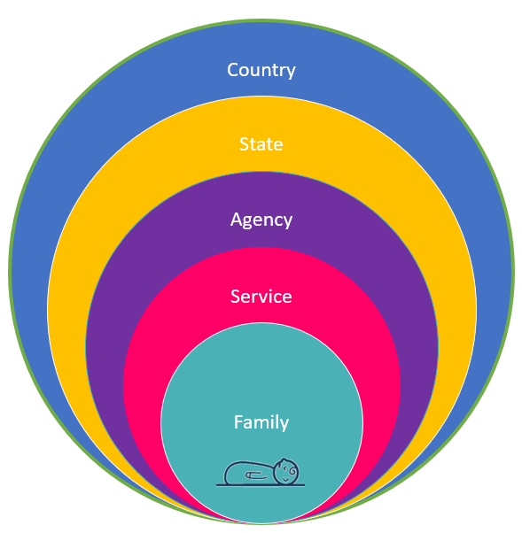
Wheel of influence
Family A
Family F
Family B
Distribution
Hub
Family E
Family C
Family D

Slide 5
Actor: Distributor
Actor (you)
performs a success
action
using a success
tool
to achieve an observable outcome
that influences others
Actor: Pēpi-Pod® Distributor
Action: Guide
Tool: Words
Outcome: Carers understand risk and act to protect
Main Influence: Carer network
© Change for our Children (NZ) 2025 – a Pēpi-Pod® Program Resource: ‘Wheel of Influence’ concept map

Slide 6

Approach to change
1
Diffusion of innovations
  Align with evidence
  Build networks of influence
  Design for value to intended group
Appreciative Inquiry
  Encourage personal storytelling about what’s working well, what feels good
  Listen for personal strengths and values, and build action on these
different thinking – different results
ID 271975805 © Andres Jacobi
Rogers, E. M. (2003). Diffusion of innovations. New York: Free Press.
Cooperrider, D. L., & Whitney, D. (2005). Appreciative inquiry: A positive revolution in change. Berrett-Koehler Publishers.

Slide 7
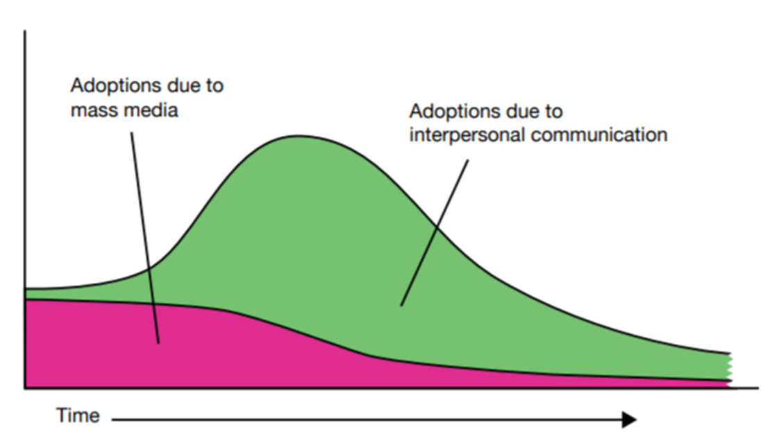
Importance of peer conversations
1
How change spreads
Campaigns increase awareness
Peer conversations increase uptake
Rogers, E. M. (2003). Diffusion of innovations. New York: Free Press.

Slide 8
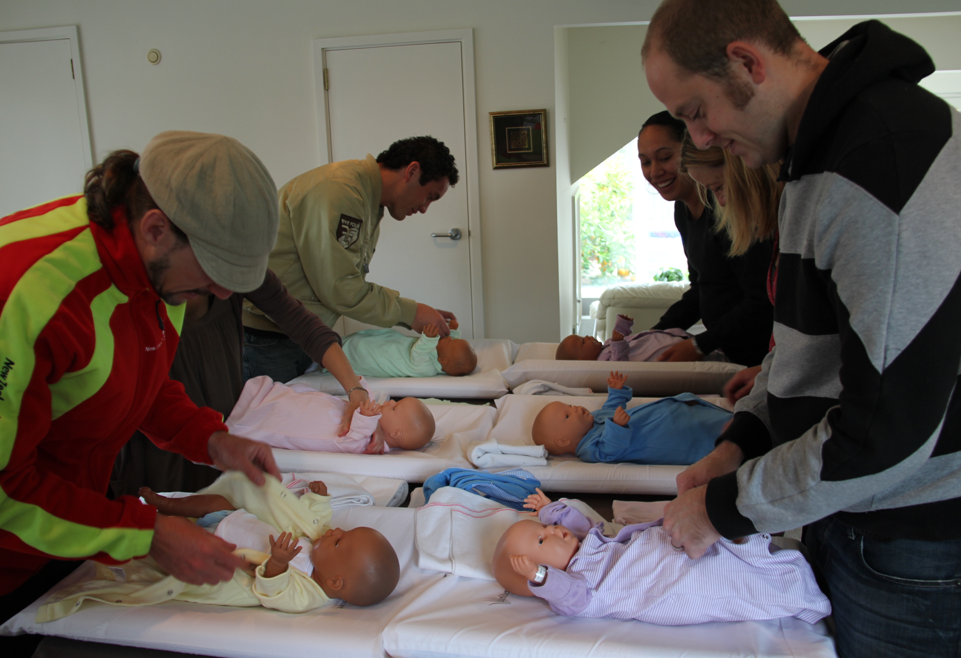
Approach to engagement
1
Believe in parent power
Resource parent influence
  with knowledge
  with opportunity
  with peer communicator role
Invite to use that influence
  Core principle: ‘share your knowledge – protect more babies’
With permission
Harness the power of parents to influence change
Rogers, E. M. (2003). Diffusion of innovations. New York: Free Press.

Slide 9
The risk we cannot see or change
1
Begin with listening for strengths
“What’s going well?”
Introduce invisible vulnerability
Explain the quiet wake-up response
Explain the need for ‘extra’ protection
Describe
  protective actions
  where the Pēpi-Pod comes in
Invite family to lead plan
”What feels most important to you?”
Guide families to understand an invisible breathing vulnerability
and feel confident using protective sleep practices – especially during bedsharing – in a way that is respectful, non blaming, family
With permission

Slide 10
Approach to language
1
Choose enabling topics
Use enabling language
  Ask questions in the direction of strengths e.g. ‘Are you smokefree?’
Practice enabling listening
  Listen for enabling beliefs, feelings and values behind spoken words
Lead conversations in enabling directions
death
problem
recipient
minimise harm
list messages
telling
informing
risk
breath
solution
participant
maximise safety
gist principles
trusting
enabling
protection
Cooperrider, D. L., & Whitney, D. (2005). Appreciative inquiry: A positive revolution in change. Berrett-Koehler Publishers.

Slide 11
Approach to learning
Do
Feel
Believe
Know
1
Four domains
  Cognitive – what I know
  Emotional – what I feel
  Spiritual – what I believe
  Physical – what I do
Pay attention to
  Feelings
  Beliefs

Slide 12
Approach to messaging
1
“Health campaigns, including most safe infant sleep efforts, often share specific risk factors and detailed steps for avoiding risk. This is called verbatim [list] format.
…
Compared to verbatim, gist-based reasoning is associated with improved judgment and decision making, and increased adoption of behaviors recommended to reduce health risks.”
List format
  Precise details
  Easy to forget – easy to overwhelm
  Focus is on being comprehensive
  Supports calculated risk-taking
Gist format
  General meaning
  Easy to understand and remember
  Focus is on what’s most important
  Supports protective action
Middlemiss, Wendy, et al. "Crafting effective messages to enhance safe infant sleep." Journal of the American Association of Nurse Practitioners (2020).

Slide 13
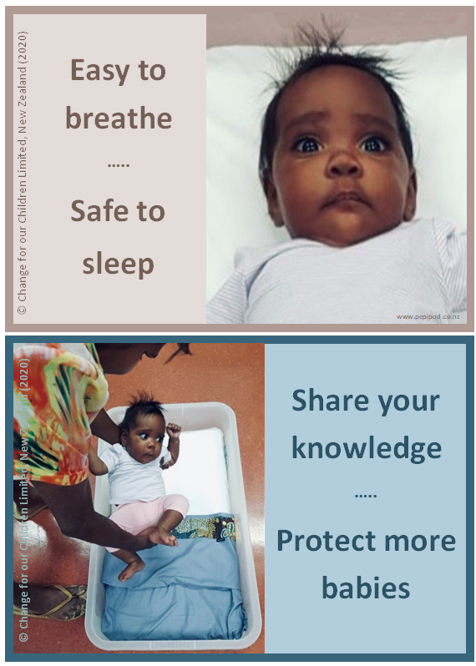
1
The gist
of the
Pēpi-Pod® approach
Blalock SJ, Reyna VF. Using fuzzy-trace theory to understand and improve health judgments, decisions, and behaviors: A literature review. Health Psychol. 2016;35(8):781-792. doi:10.1037/hea0000384

Slide 14
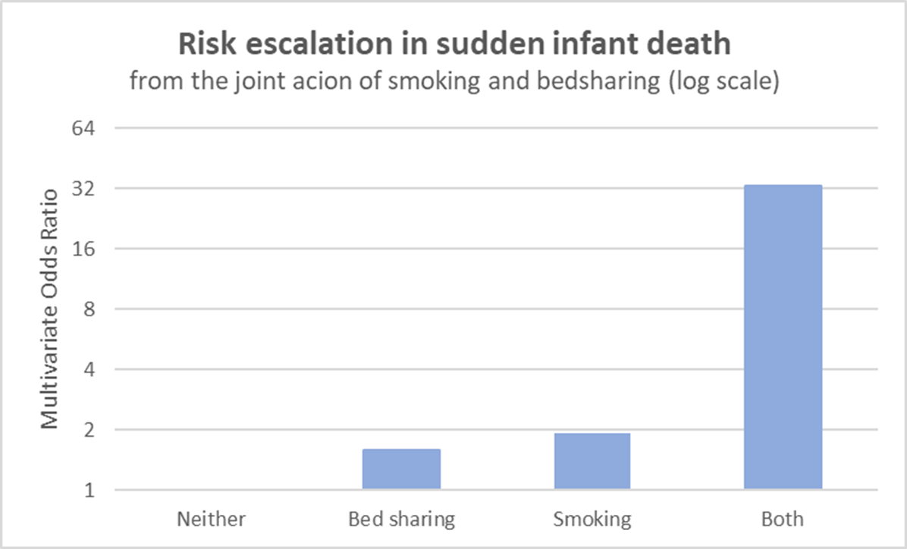
Evidence for escalation of SUDI risk
2
The prevention work of the Pēpi-Pod® bed is to break the joint action effect of ‘maternal smoking in pregnancy’ and ‘bed sharing’.
Ref: Mitchell et al. NZMJ 2 June 2017, Vol 130 No 1456

Slide 15
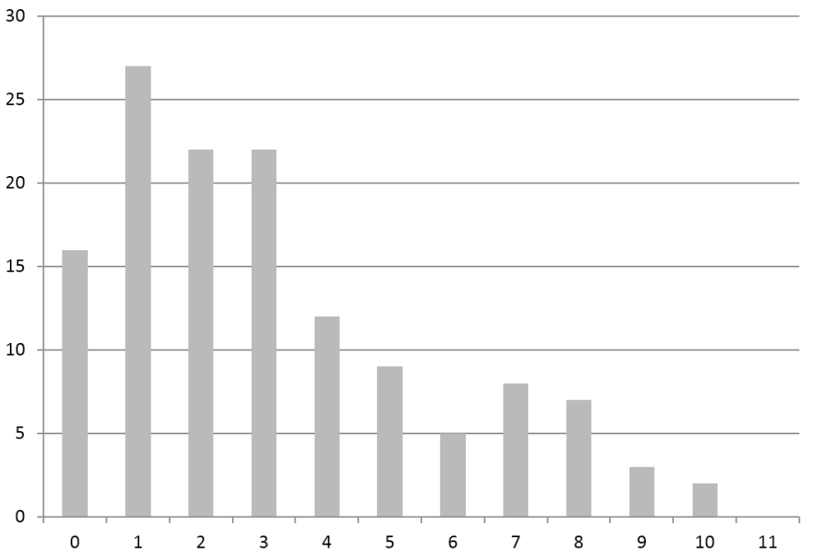
Evidence for early intervention
2
Number of SUDI deaths
SUDI rates are concentrated in younger babies.
Pēpi-Pod® protection is needed from the very first sleep and for 4 completed months.
Infant age in completed months (from 7 days old)
Ref: Mitchell et al. NZMJ 2 June 2017, Vol 130 No 1456

Slide 16
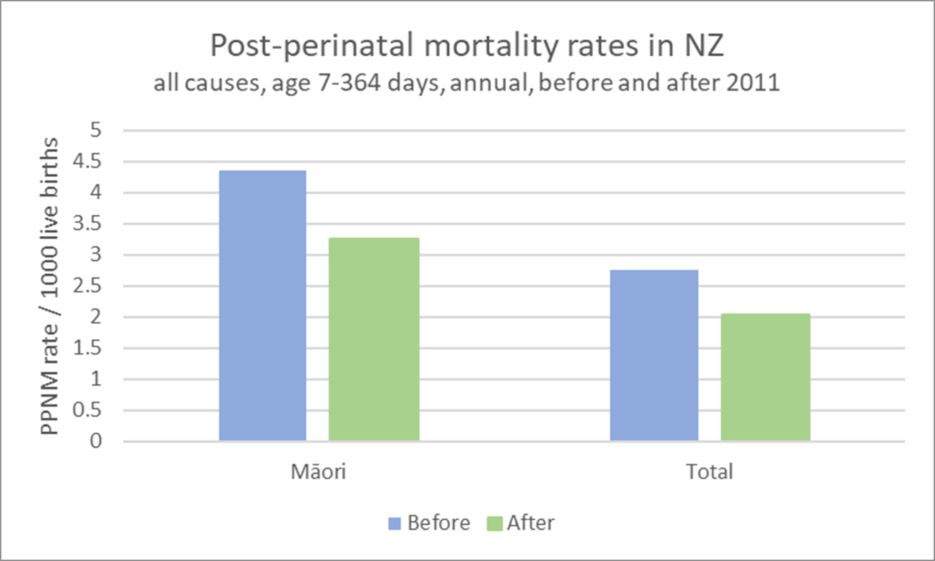
Evidence of impact in New Zealand
2
Change is possible.

Slide 17
Triple risk model
2
stage
setting
baby
Vulnerability lies hidden until three conditions align:
  a critical developmental stage for homeostatic control
  a vulnerable infant
  an external stressor(s)
Filiano JJ, Kinney HC. A perspective on neuropathologic findings in victims of the sudden infant death syndrome: the triple-risk model. Biol Neonate. 1994;65(3-4):194-7. doi: 10.1159/000244052. PMID: 8038282.

Slide 18
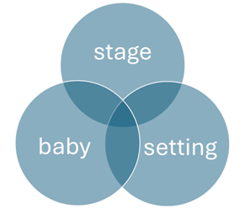
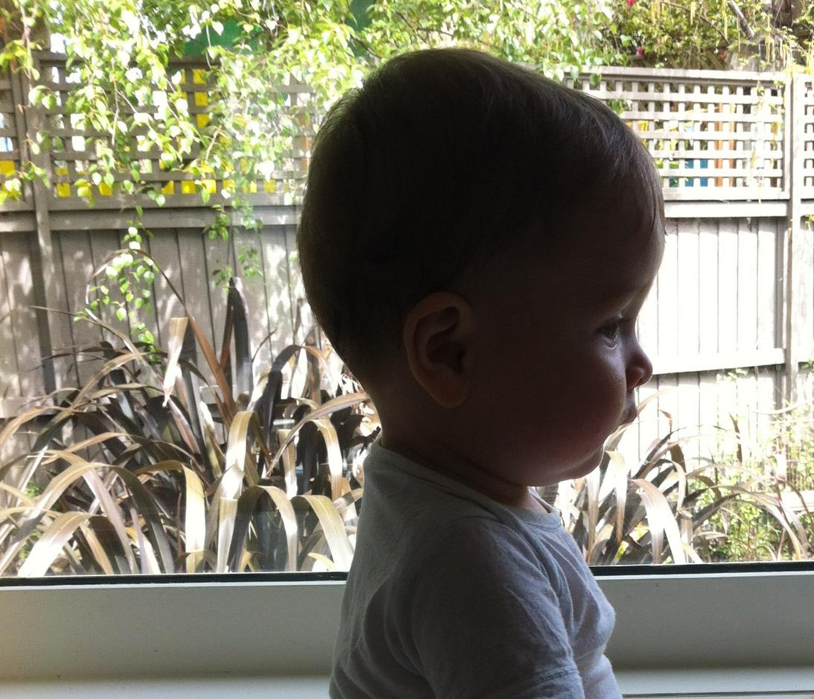
Critical Stage
2
First 6 months
  a time of rapid brain and systems development
  back sleeping essential
Second 6 months
  a time of increasing mobility
  checks to remove potential sleep hazards essential
Young babies have:
large heads
bulge behind
loose jaws
short necks
big tongues
and
only breathe through their noses
NATURE’S PILLOW

Slide 19
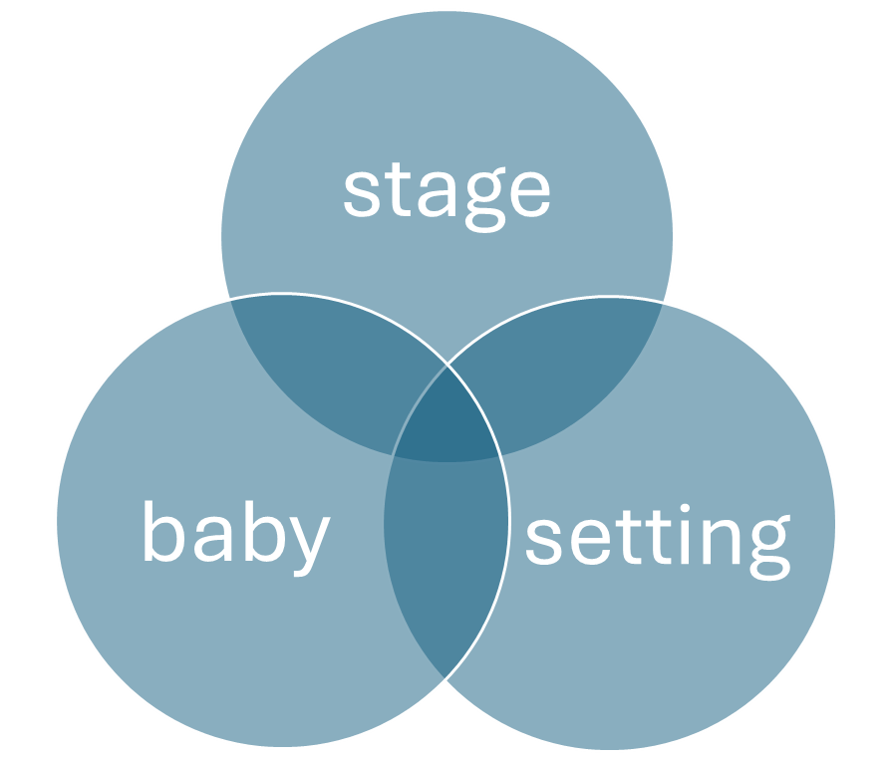
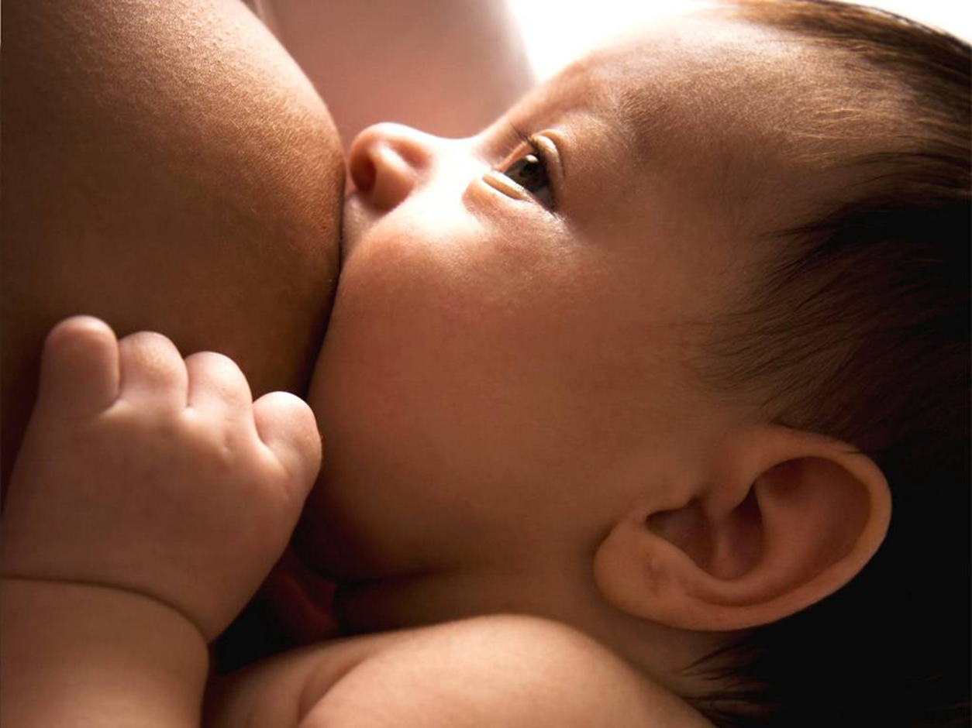
Vulnerable baby
2
Arousal is protective
  it alerts a baby to the need to wake or breathe
  acts like a system ‘reset’.
Exposure to smoking in pregnancy
  reduces baby’s oxygen supply
  changes the developing brain
  weakens arousal
Strong babies are
Breastfed
Smokefree
Immunised
Handled gently
With permission

Slide 20
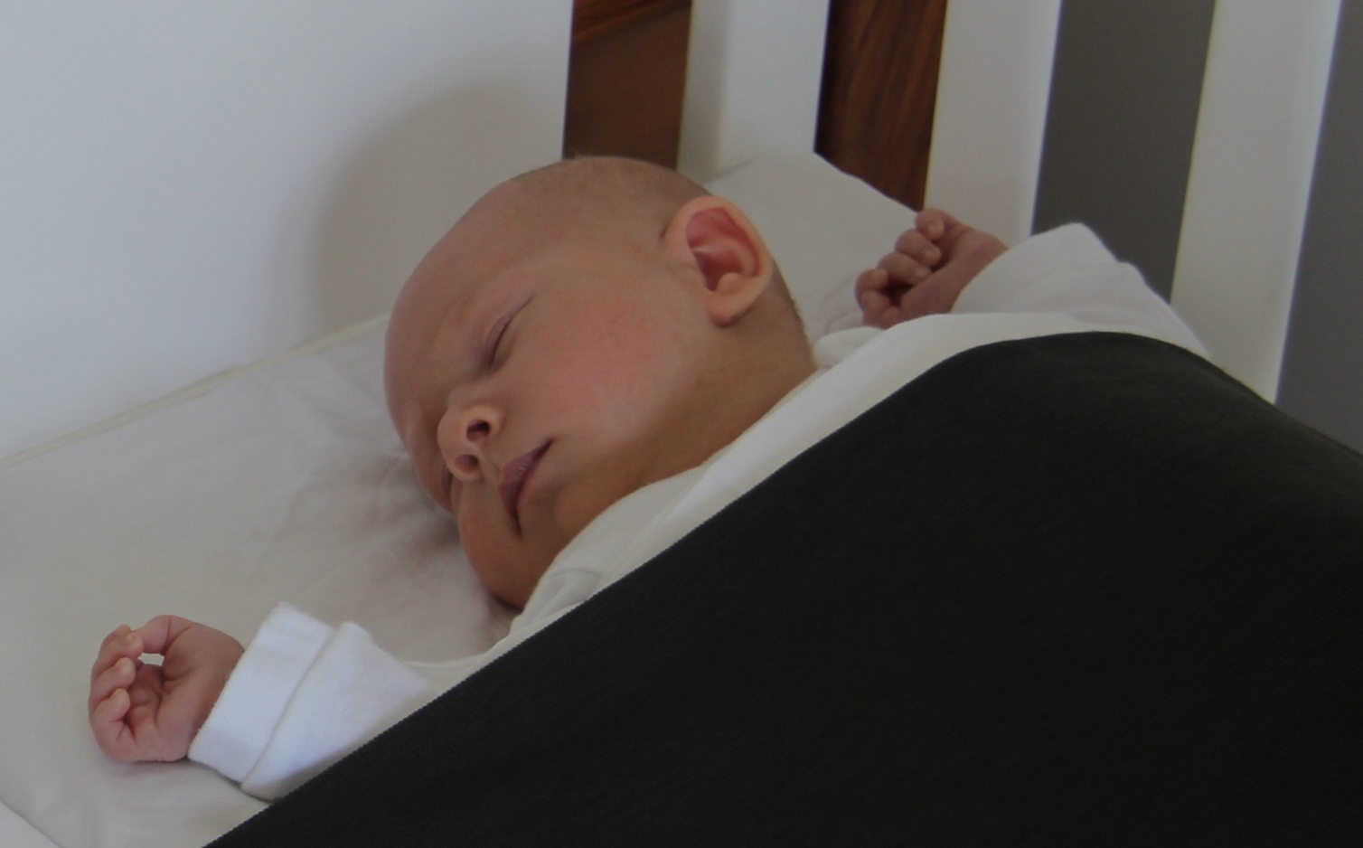
Hazardous setting
2
Hazards in sleep settings can be
  Positions
  People
  Bedding
  Bed surfaces
  Products
  Placement
  Beliefs
easy to breathe – safe to sleep
On the back
Airways clear
In own space
Carer near
Queensland Clinical Guidelines. Safer infant sleeping. Guideline No. MN22.71- V1-R27. Queensland Health. 2022. Available from: http://www.health.qld.gov.au/qcg

Slide 21
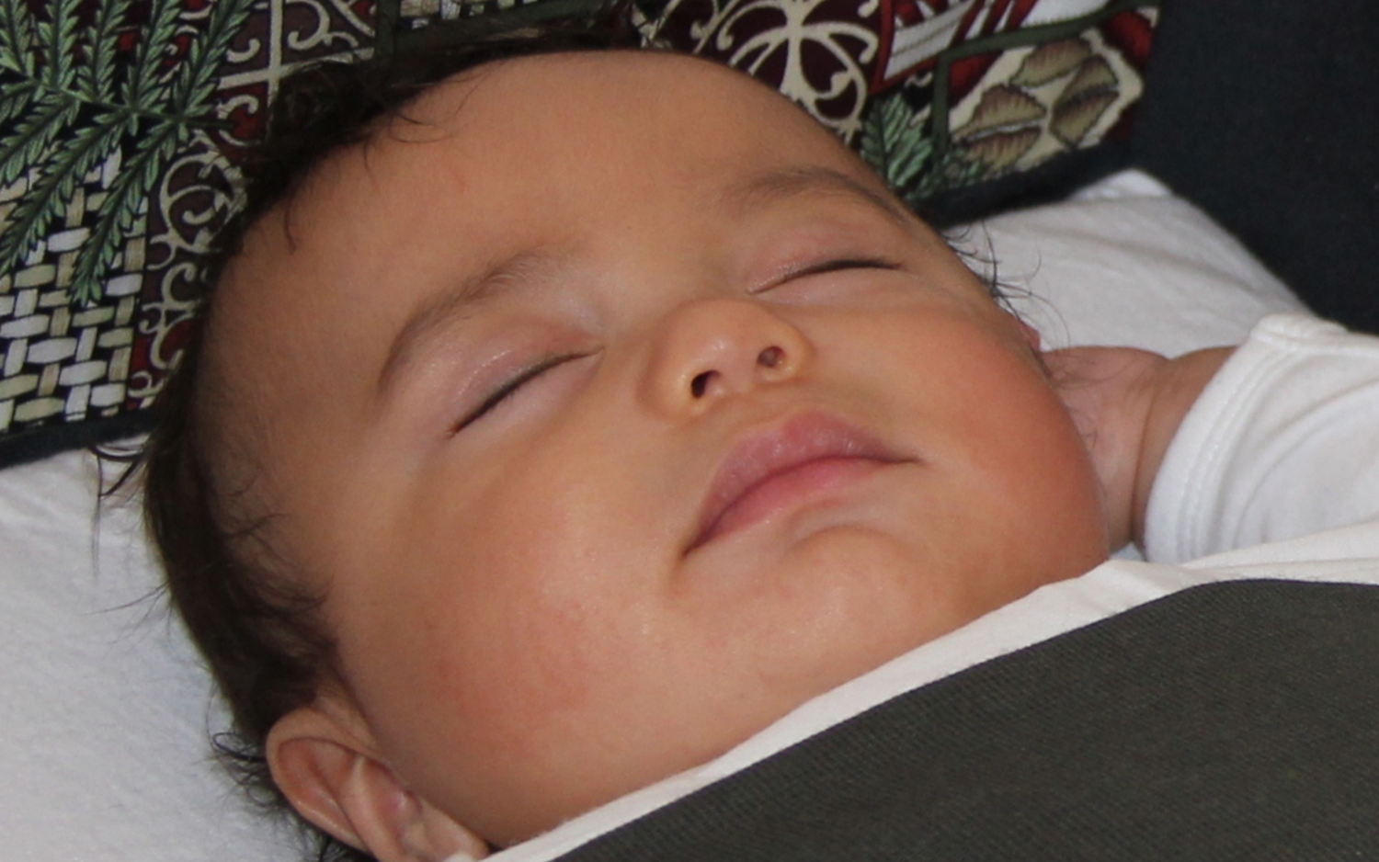
Airway protection
2
Sleeping babies need to breathe

Slide 22
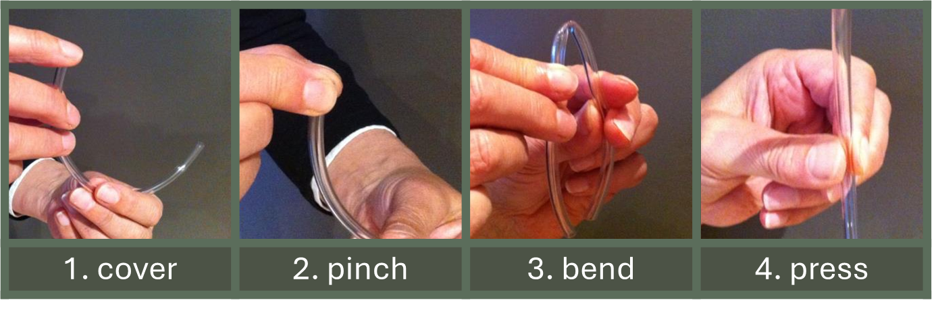
Four ways babies can suffocate
2
A covered face e.g. from soft or loose covers, pillows or pets
A pinched nose e.g. when wedged into gaps
A chin-chest position of the neck e.g. from slumping when propped
Pressure on, or against, the chest e.g. when rolled on by another person

Slide 23

Safety briefing
3
Key conversations
  Breathing
  Airways
  Pēpi-Pod sleep space
  Safe use
  Sharing knowledge
  Protection as a package
  Older babies
  Safe hands

Slide 24
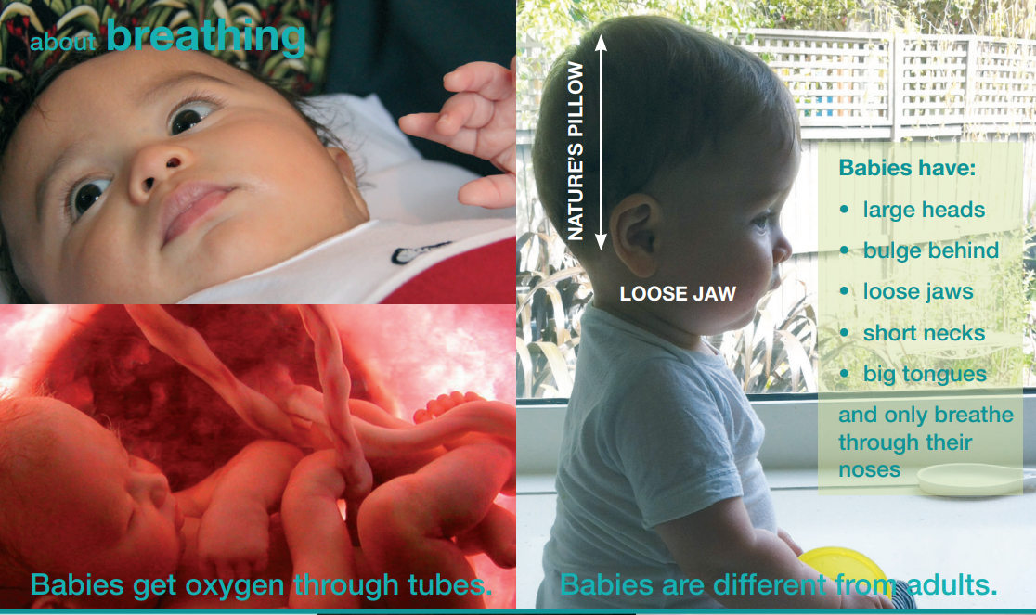
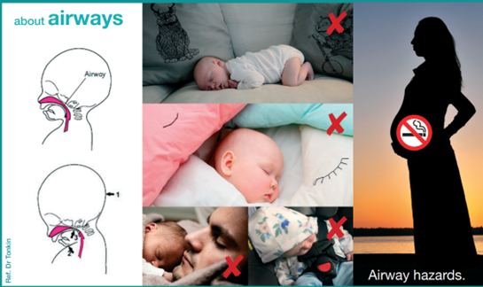
2
Key topics
Breathing
How do babies get their oxygen?
What is the ‘wake-up’ response?
Which babies are more vulnerable?
How are babies different from adults?
Airways
What makes it easy to breathe?
Where is the airway - front or behind?
How can an airway block?
What might be airway hazards?
Notes:
the airway is in front and carries air to your lungs, while the esophagus is behind it and carries food to your stomach.

Slide 25
2
Key topics
Breathing
How do babies get their oxygen?
What is the ‘wake-up’ response?
Which babies are more vulnerable?
How are babies different from adults?
Airways
What makes it easy to breathe?
Where is the airway - front or behind?
How can an airway block?
What might be airway hazards?
Notes:
the airway is in front and carries air to your lungs, while the esophagus is behind it and carries food to your stomach.

Slide 26
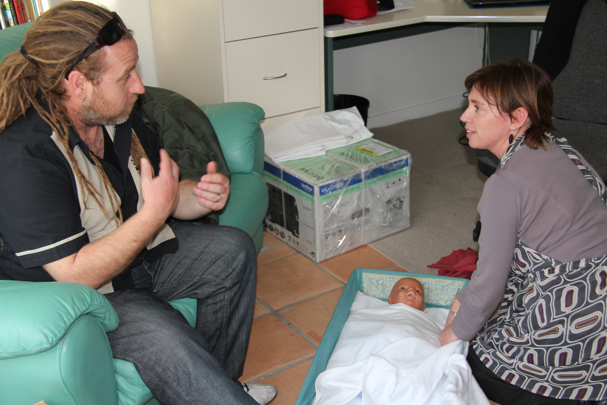
ABC of the PPP
3
The three parts of a distribution session are:
A
Assemble components
Brief the family
Complete data forms
B
C
Briefing an earthquake dad in 2011

Slide 27
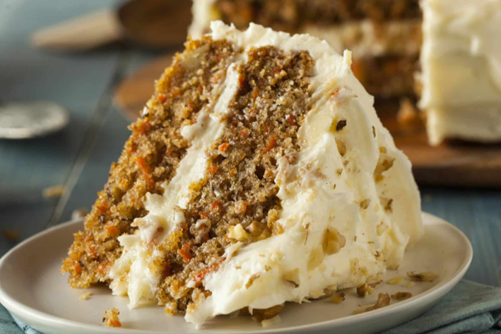
Accountability
3
Recipe analogy
Preserve core ingredients and methods.
Make needed variations to personalise (fit realities)
Monitor impact
Kemp L. Adaptation and Fidelity: a Recipe Analogy for Achieving Both in Population Scale Implementation. Prev Sci. 2016 May;17(4):429-38. doi: 10.1007/s11121-016-0642-7. PMID: 26969173.

Slide 28
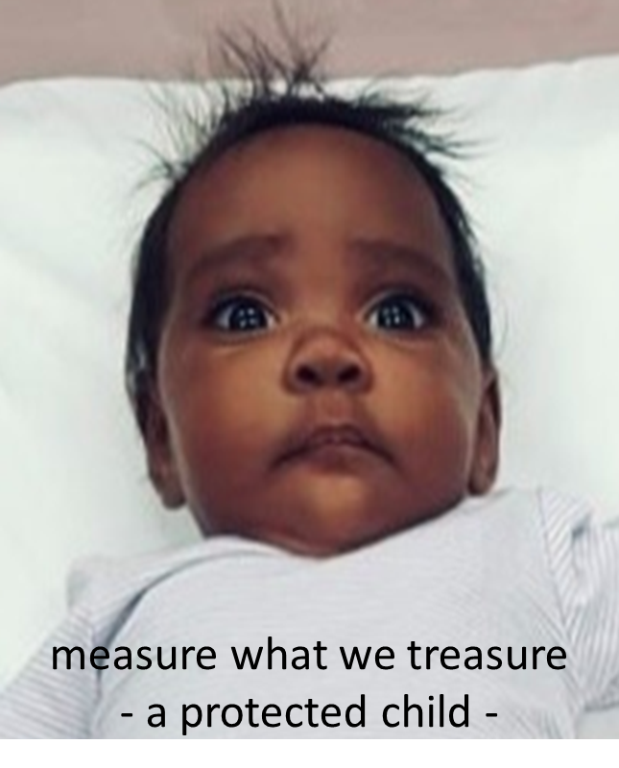
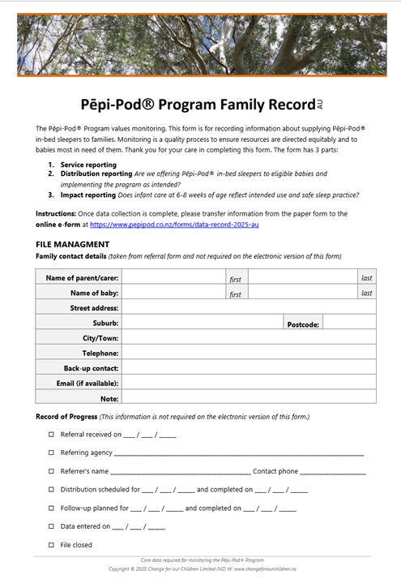
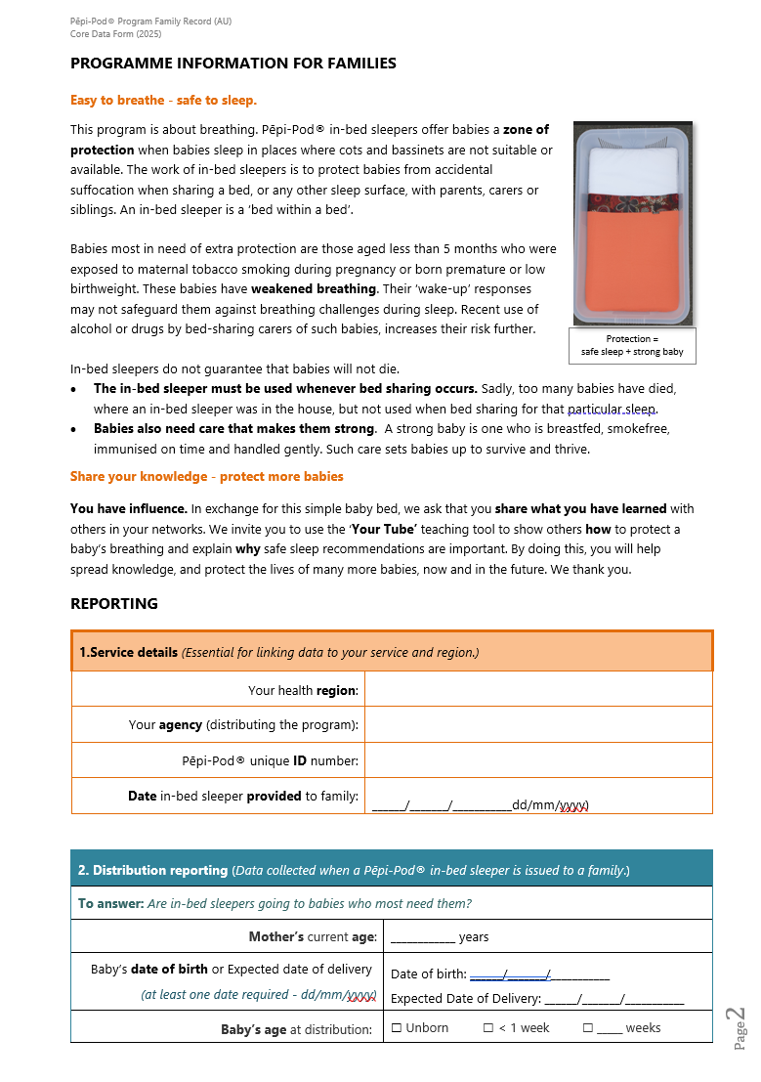
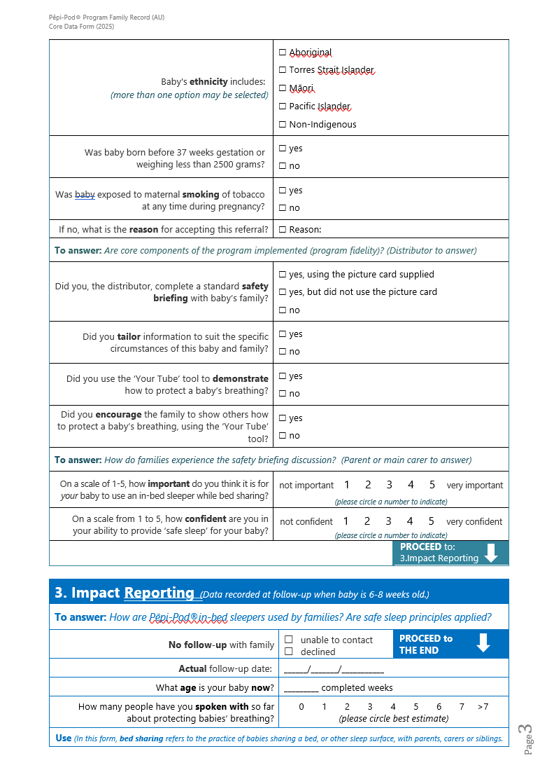
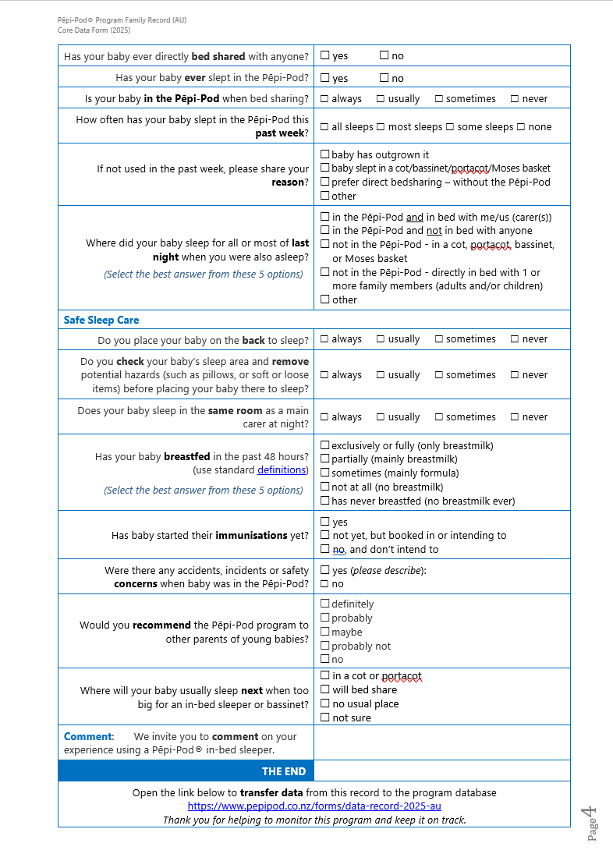
Data Forms
3
Pēpi-Pod Program Family Record – paper version
Electronic record
  Data to be transferred to the link below unless a local website is specified
pepipod.co.nz/forms/data-record-2025-au

Slide 29
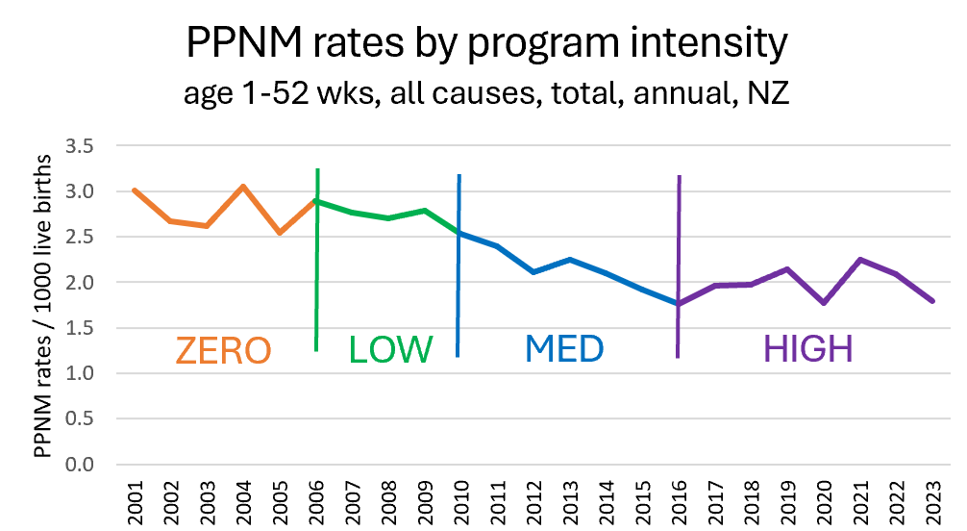
Change is fragile
3
Statistics NZ (2024)
Notes:
Med intensity high fidelity
High intensity – low fidelity

Slide 30
Closing - summary of the Pēpi-Pod® Program
3
what it is and what it is not
program
offered
exchange
accountable process
part of the solution
about breathing
changes opportunities
not a product
not imposed
not free, not a gift or incentive
not free rein
not all of it
not bedsharing
not people

Slide 31
Remember those arms.
Thank you
3
With permission

