Slide 1


Pre-meeting preparation
Notes:
Pre-meeting preparation:
Feel free to break this PowerPoint into multiple sessions.
Feel free to customize this PowerPoint to best fit the needs of your area.
Determine the best tool for recording notes for each discussion and activity. If you are meeting in person, prepare a flipchart and markers. If you are meeting virtually, prepare your preferred note-taking tool and share your screen so all participants can follow along. Remember to distribute a copy of the notes with participants after the meeting.
Consider the Working Together exercise on slide 16. If your working group knows each other well and/or has worked together successfully on other initiatives, it may not be needed. For those who would like to build additional working group cohesion (at the district or club level), it can be one of many possible working group activities.
Some slides in this presentation include two script versions:
Script for GAT Area Leader to prepare district leaders to lead a Build a Team workshop
Script for district leaders when leading a Build a Team workshop
IMPORTANT NOTE ABOUT LLC COURSES: Never copy the link to a course from the browser. This leads to the wrong login page. Unfortunately, we cannot link directly to LLC courses. On slide 19 sample instructions are provided for accessing courses by searching by title in the LLC Content Library.

Slide 2

Global Membership Approach
Build a Team
1
Notes:
Presenter notes:
Begin the session by introducing yourself and welcoming participants to this seminar on the Global Membership Approach.
______________________________________________________________
Welcome to this seminar on the Global Membership Approach.

Slide 3
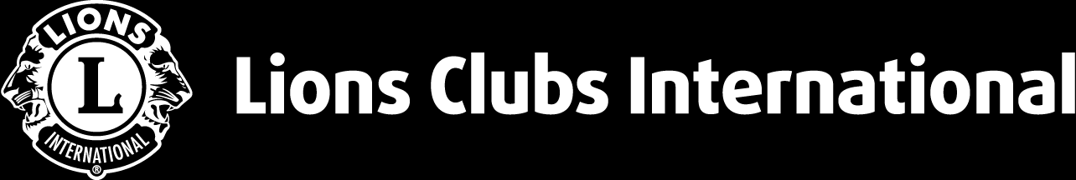
Global Membership Approach Overview
Working Group Organization
Working Group Roles
Next Steps
Agenda
2
Notes:
Presenter notes:
Set the stage for the importance of why are we embarking on this Global Membership Approach. Share your answer and explain why it is relevant to your area.
________________________________________________________________
There are 4 parts to today’s meeting:
An overview of the Global Membership Approach program
How we can organize our working group and the importance of building a team
The roles needed for our area to be successful
And the next steps in this process
We need everyone to contribute their thoughts, so we can build the strongest working group possible. Are you ready?

Slide 4
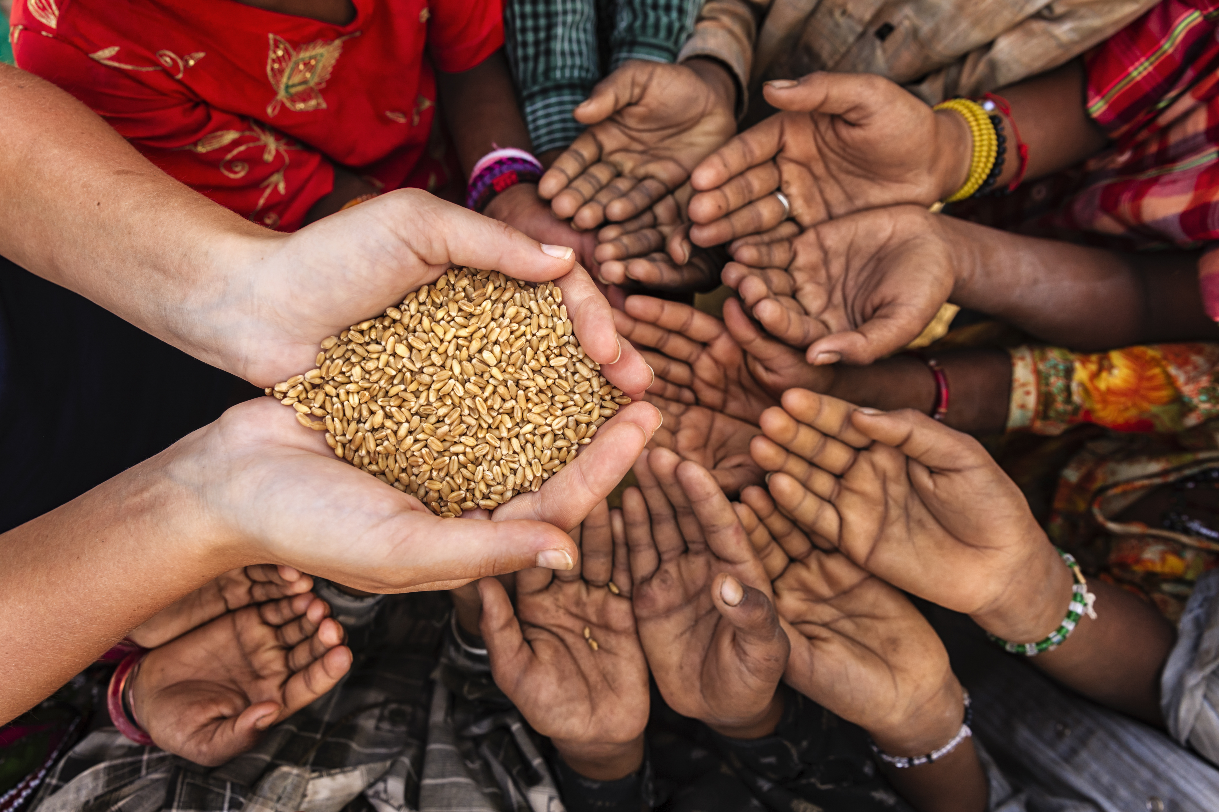
aa
Why are we Lions?
Vision
To be the global leader in community and humanitarian service.
Mission
To empower volunteers to serve their communities, meet humanitarian needs, encourage peace and promote international understanding through Lions clubs.
3
Notes:
Presenter notes:
Prepare your own answer and share it with participants. Allow other participants to answer as well. You can choose to have each participant answer or only call on a few to ensure that participants remain engaged.
________________________________________________________________
Let’s start with a fundamental question: Why are we Lions?
Here are our vision and mission statements.
What are the key words in those statements and what do they mean to you?
Optional question to consider:
How are your clubs fulfilling the vision and mission of our organization?

Slide 5
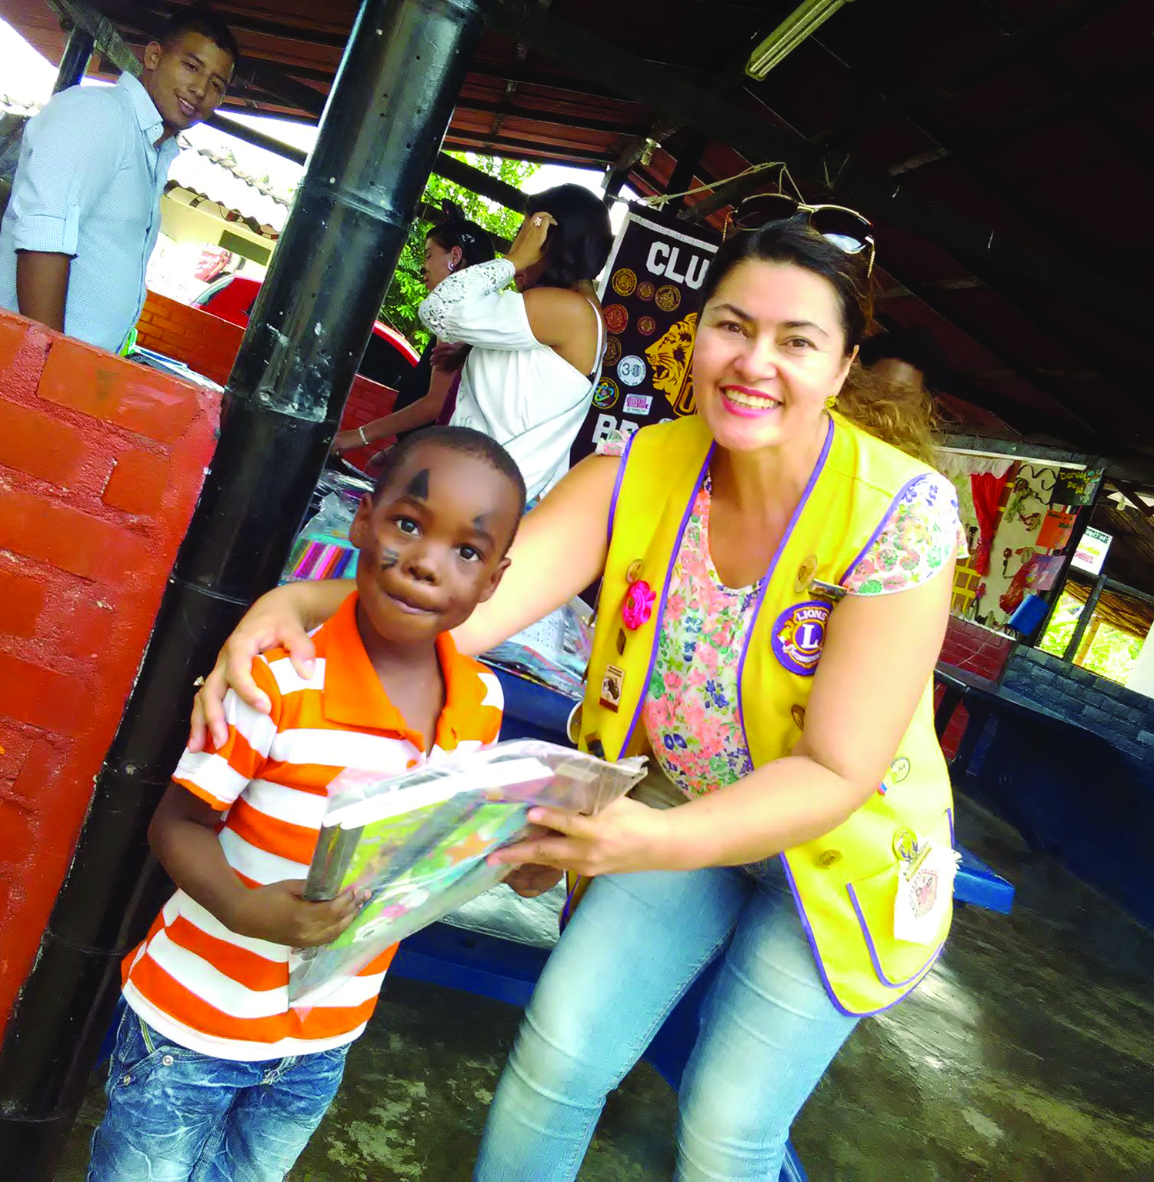

m
How has being a Lion changed your life?
4
Notes:
Presenter notes:
If you feel as if your group needs to get to know each other better, leave this slide in, or modify the slide to tell your own personal story. Remember to regionalize this slide to help facilitate a conversation to promote team building.
Refer to slide 0, Pre-meeting preparation notes.
________________________________________________________________
Being a Lion also affects us, as individuals.
How has being a Lion changed your life?
How do we feel about our current membership situation? Is it urgent that we reverse the membership trend we are experiencing in _______?

Slide 6
Understanding the need for the
Global Membership Approach
-819
-5,592
-7,557
-11,726
32,944
2,126
3,123
-90
Gain/Loss Membership Totals by CA for 2020-2021 FY
5
Notes:
_______________________________________________________________
By reviewing the membership numbers worldwide for the 2020-2021 FY (July 1, 2020 to June 30, 2021) we hope to gain a better understanding of why there is a need for the Global Membership Approach.
In our Constitutional Area/Regional Area specially, we lost/gained ______ members. Combined with our other Constitution Areas worldwide these totals equal to 9,463 dropped members for the year.
We understand that COVID-19 had a great impact on these numbers, so to get a better understanding of where we stand in terms of the membership decline, let’s review our 3-year trends.

Slide 7
Reviewing 3-year trends
-837
-9,315
-5,314
-11,073
-87
587
-3,00921
-496
Average gain/loss membership totals by CA for 2018-19, 2019-20, 2020-21 FYs
6
Notes:
________________________________________________________________
Although our 3-year trends worldwide are substantially better than our totals from 2020-2021 FY, it is important to show the consistent membership decline that our organization has been facing over the last 3 years.
By uniting together under the Global Membership Approach, we hope to provide our clubs with support they need in order to retain our vision of being the global leader in community and humanitarian service. By increasing the number of helping hands our communities have, the greater the impact we can make.

Slide 8
Previous Results
2021-2022 membership growth for pilot districts did show improvement in membership and new clubs.
 | Pre-pilot 2020-21 | 2021-22 | Change
New clubs | 715 | 721 | +6
Net members | 1,914 | 4,263 | +2,349
7
Notes:
Presenter notes:
________________________________________________________________
For the 2021-22 FY, the primary goal for the pilot districts who participated in the process was to achieve a positive membership growth.
Although we still had membership loss overall, we gained 2349 members and 6 clubs over last FY
As a result of the pilot, participating districts ended the year with positive results.

Slide 9
Rejuvenate
districts with
new clubs
Global Membership Approach Objectives
1
Revitalize clubs with new members
Grow membership across all CAs
2
Re-motivate
members with
fellowship and
exciting service
3
8
Notes:
Presenter notes:
________________________________________________________________
Here you’ll see that our objectives are:
To rejuvenate districts with new clubs
Revitalize clubs with new members
Re-motivate our existing members with new fellowships and exciting service.
These three objectives drive us to our goal of increasing the number of Lions worldwide in order to fulfill our mission of serving the needs of our communities.

Slide 10
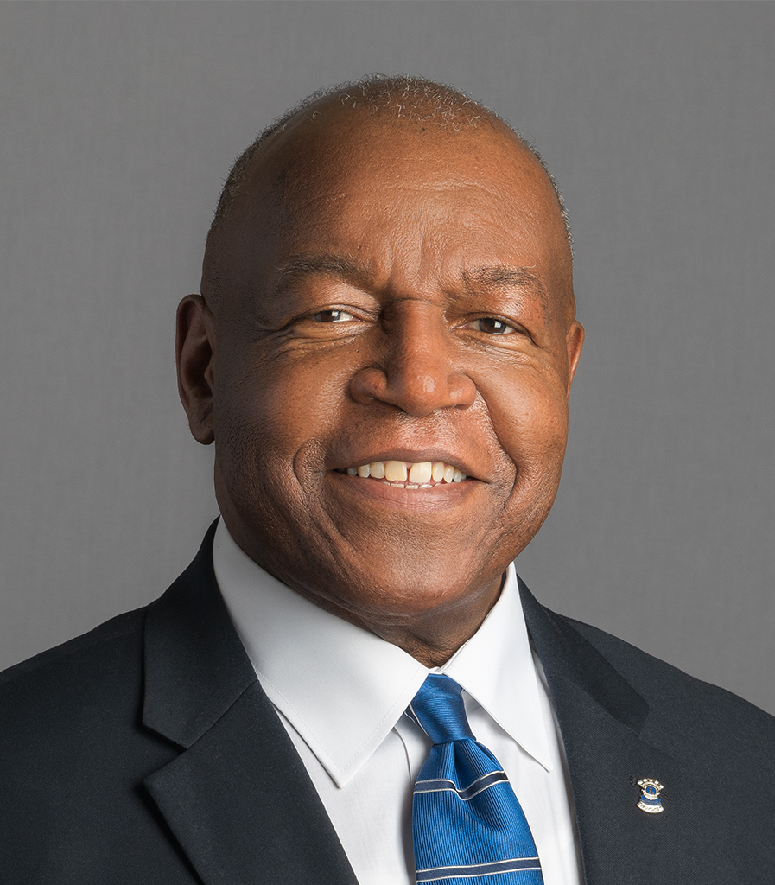
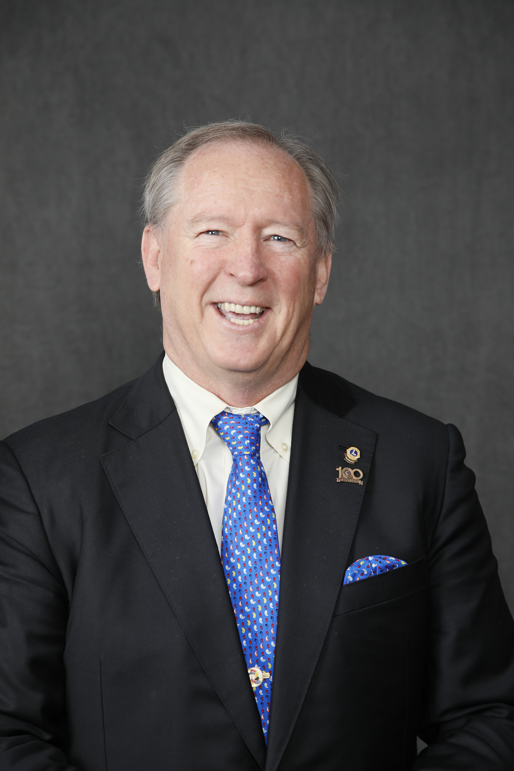
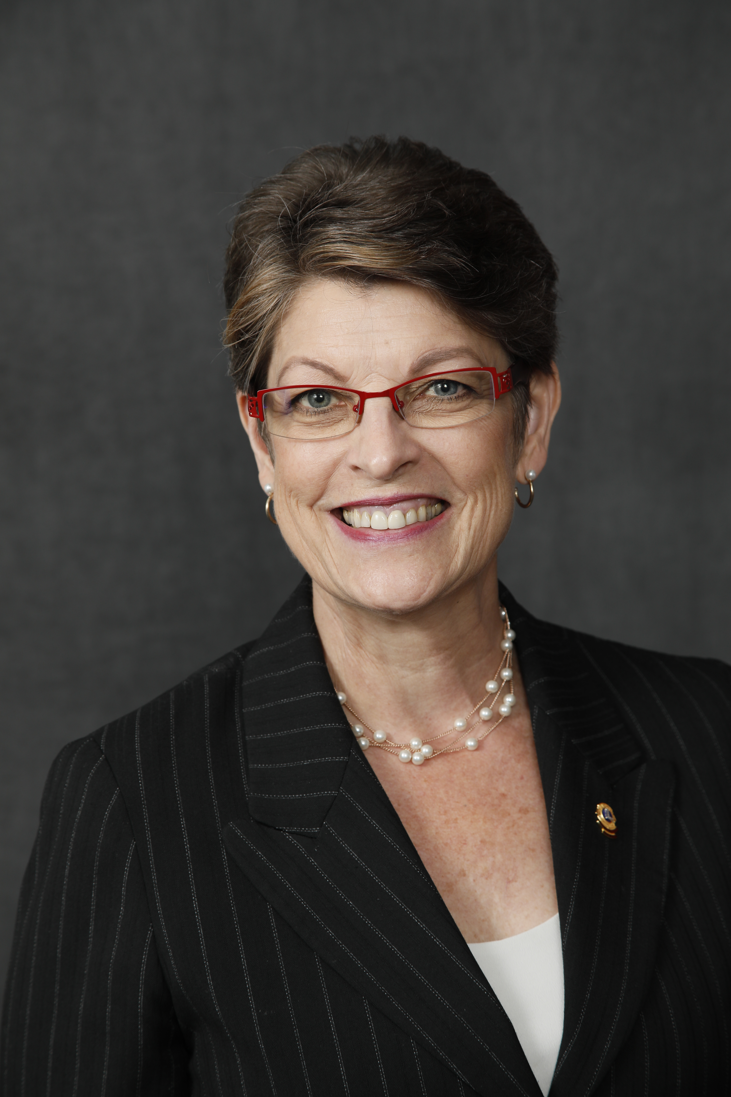
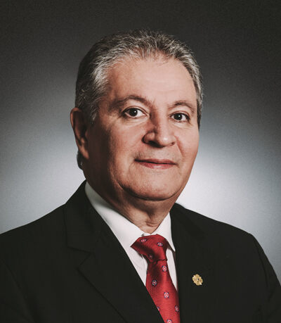
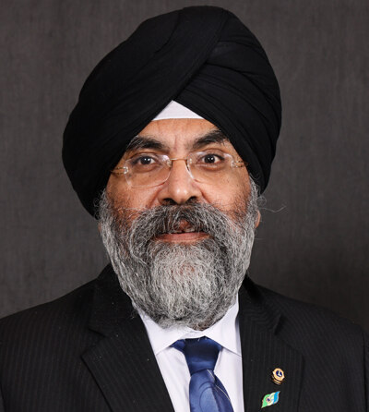
Global Membership Approach Leadership
  IPIP Doug Alexander
  IP Brian Sheehan
  VP Dr. Patti Hill
  VP Fabricio Oliveria
  VP A.P. Singh
PIP Kajit Habanananda
PID Jerome Thompson
PID Allan Hunt
PID Jaime Garcia Cepeda
PID Elisabeth Haderer
IPID Guo-Jun Zhang
PID Magnet Lin
PCC Katsuki Shirosaka
PID Doo-Hoo Ahn
PID Dr. Datuk Nagaratnam (Naga)
PID Sunil Kumar
PID Tony Benbow
PID Manoj Shah
Notes:
Presenter notes:
________________________________________________________________
Our time to act is now. Global Membership Approach has the full support of the International President, International Vice Presidents, plus these additional Global Action Team Lion leaders. It’s important to remember, these leaders are here to support our club's success.
All of these Lions have proven skills in club and membership growth and here to support any Global Membership Approach district or multiple district.

Slide 11
aa
Global Membership Approach Timeline
All CAs conducted their own pilot programs through 2021-22.
GAT drives the process and provide support and accountability in each CA.
The best ideas were integrated into our worldwide process in 2022-23.
2018-19
2019-20
2020-21
2021-22
2022-23
  North American Membership Initiative startup
  Nine CA 1&2 pilot districts
  CAs 1&2 districts that opted-in;
  CAs 3-8 begin training
  All districts in CAs 1&2 and CAs 3-8 pilot districts
  All districts worldwide
10
Notes:
Presenter notes:
Describe the Global Membership Approach timeline shown on the slide.
________________________________________________________________
For the 2020-21 FY, the Executive Officers asked GAT leadership across all constitutional areas to conduct their own pilot programs to learn more about how to regionally adapt the process to best fit the needs of their communities. For CAs 1&2, every district had the opportunity to opt-in to the process, while CAs 3-8 began their journey by choosing districts to participate. Worldwide, GAT leadership drives the process, provides support and ensures accountability is maintained in each CA.
Lessons learned from all pilot districts during the 2021-22 FY, helped develop the regional adaptations to the process in preparation for global expansion in the 2022-23 FY.

Slide 12
Global Membership Approach process
Build a
Team
Build a
Vision
Build a
Plan
Build
Success
11
Notes:
Presenter notes:
Reinforce the idea that participants may shape the process to best fit the needs of their area and remind them that they have the power to build their district team their way.
________________________________________________________________
Global Membership Approach follows a 4-step process: build a team, build a vision, build a plan and build success.
Script for GAT Area Leader to prepare district leaders to lead a Build a Team workshop:
When you return to your district, you will complete the first step of the process: Build a Team. As a part of the Build a Team step, you will have the opportunity to get to know one another and understand our roles in this process and the importance of communication and trust.
From the club level to higher-level GAT leadership, you should choose members of your working group that will be dedicated to helping your district thrive in the year to come and will provide each other with ongoing support throughout the process.
Script for district leaders when leading a Build a Team workshop:
Today, we will be beginning with the first step of the process: Build a Team. As a part of this step, we will have the opportunity to get to know one another and understand our roles in this process and the importance of communication and trust.
From the club level to higher-level GAT leadership, you should choose members of your working group that will be dedicated to helping your district thrive in the year to come and will provide each other with ongoing support throughout the process.

Slide 13
Global Membership Approach Areas of Focus
1
2
3
4
Rejuvenate districts with new clubs
Revitalize clubs with new members
Re-motivate members with new fellowships and exciting service
Provide training and support for our Lion leaders
New
clubs
New
members
Member satisfaction
Leader
support
Notes:
Presenter notes:
Remember to regionalize how these four areas are approached; if there is a stronger focus on leadership in your area, tie everything back to the training and the development of members. If there is a stronger focus on service, remind the group that increased member satisfaction ensures more Lions participate in service activities.
________________________________________________________________
Before we dive into working group organization, you may remember that the Global Membership Approach has three objectives: rejuvenate districts with new clubs, revitalize clubs with new members and re-motivate members with new fellowships and exciting service.
Each of those is a Global Membership Approach Area of Focus, along with, (click) providing training and support for our Lion Leaders. Without that, none of the other objectives are possible.
You’ll see the four Areas of Focus summarized as New Clubs, New Members, Member Satisfaction and Leader Support.

Slide 14





Sample Working Group Organization
Focus Area 1:
New Clubs
Focus Area 2:
New Members
Global Membership Approach Support Lead
05
05
05
Focus Area 4:
Leader Support
Focus Area 3:
Member Satisfaction
: Working Group Lead
: Working Group Members
Notes:
Presenter notes:
Remember to regionalize how working group members are chosen. Some areas may choose to have the district governor or district cabinet choose the team, while others might develop a team specifically dedicated to the cause and call out special individuals to be a part of the team. Other considerations include sending an open invitation to all members of the district/MD to see who is interested in being a member of the team or including young lions to provide a fresh perspective.
Refer to slide 0 , Pre-meeting preparation notes.
________________________________________________________________
To implement our ideas, we’ll need a working group.
Script for GAT Area Leader to prepare district leaders to lead a Build a Team workshop:
This chart is just a sample of how you can organize around the four areas of focus in your district. You can organize the working groups however you’d like with as many people as you need- this includes comprising your working group with Lions of various titles, even those at the club level. Remember: your district, your way.
When thinking about your working group, some things to consider is to choose members who are interested in advancement, want to shape the membership experience, are accountable and are willing to communicate. In the end, choose members who are dedicated and the best fit for the role.
The District GMT Coordinator has been named as the point person for leading the initiative in the district. However, a Past District Governor or another respected leader can be identified as the dedicated Global Membership Approach Support Lead if this works better for your area.
There are also Working Group Leads on the sample chart. Again, you can organize however you like, but in the sample, there is a working group lead for each of the four Global Membership Approach Areas of Focus: New Clubs, New Members, Member Satisfaction and Leader Support. Consider having:
The District Global Extension Team (GET) or the Specialty Club coordinator as the working group lead for focus area 1
The District GST as the working group lead for focus area 3
And the District GLT as the working group lead for focus area 4
Script for district leaders when leading a Build a Team workshop:
We can organize our working groups however we’d like with as many people as we need, this includes comprising our working groups with Lions of various titles, even those at the club level. Remember: our district, our way.
When thinking about our working groups, let’s choose members who are interested in advancement, want to shape the membership experience, are accountable and are willing to communicate. In the end, we choose those who are dedicated and the best fit for the role.
The District GMT Coordinator has been named as the point person for leading the initiative in the district.
Explain any regional differences here, for example: However, Past District Governor XX will be the dedicated Global Membership Approach Support.
There are also Working Group Leads on the sample chart. Again, we can organize however we like, but in the sample, there is a team lead for each of the four Global Membership Approach Areas of Focus: New Clubs, New Members, Member Satisfaction and Leader Support. Consider having:
The District Global Extension Team (GET) or the Specialty Club coordinator as the working group lead for focus area 1
The District GST as the working group lead for focus area 3
And the District GLT as the working group lead for focus area 4

Slide 15
aa
Who can be on the working group?
Member
Membership/ Extension chair
Club leadership
GAT
Zone/region chairperson
Other members
Specialty Club Coordinators
Lions who make an impact
14
Notes:
Presenter notes:
________________________________________________________________
Script for GAT Area Leader to prepare district leaders to lead a Build a Team workshop:
Remember to choose a diverse working group that can impact membership at every level, as we need everyone to participate in order to be successful.
How do you think Lions at these different levels can contribute?
What about us? Can we make a commitment to lead our district to success with the Global Membership Approach?
Script for district leaders when leading a Build a Team workshop:
We chose a diverse working group that can impact membership at every level, as we need everyone to participate in order to be successful.
How do you think Lions at these different levels can contribute?
What about us? Can we make a commitment to lead our district to success with the Global Membership Approach?

Slide 16
Setting Clear Expectations
Define what is expected of each working group member when building the team.
Accountability
Flexibility
Communication
Dedication
Respect
Notes:
Presenter notes:
Feel free to change the expectations listed on the slide to best fit the needs of your area. In addition, there are several questions listed below; use your best judgement when choosing when to open the floor for discussion or get input from the audience.
Highlighted text can be changed depending on who the district appoints as the Global Membership Approach Support Lead.
________________________________________________________________
Script for GAT Area Leader to prepare district leaders to lead a Build a Team workshop:
As we think through defining our roles, a Global Membership Approach best practice is to be clear what we expect from our working group members. This slide lists a few examples of some expectations, but can you think of more? What would you ask of your working group
For example, we could expect the District GMT Coordinator to communicate the various components of the process and be its lead supporter; maintain the plan the working group creates; keep track of goals vs. actuals and be the go-to person when problems arise.
What should we expect from working group leaders? Working group members? The district governor? District GLT, GET, GMT and GST coordinators? Zone and Region Chairpersons? Club leaders? MD Council and MD GAT? Club members?
Everyone plays a role in the process and makes up one working group, which makes us all responsible for actions that will take place over the course of the next year.
When you gather your working group team for the Build a Team workshop, be sure to ask all participants:
Who would like to volunteer their name for a spot on the working group?
Which roles remain to be filled?
Are there any other leaders we should invite to join us?
Who will invite each one?
Script for district leaders when leading a Build a Team workshop:
As we think through defining our roles, a Global Membership Approach best practice is to be clear what we expect from our working group members. This slide lists a few examples of some expectations, but can you think of more? What would you ask of your working group?
For example, we could expect the District GMT Coordinator to communicate the various components of the process and be its lead supporter; maintain the plan the team creates; keep track of goals vs. actuals and be the go-to person when problems arise.
What should we expect from working group leads? Working group members? The district governor? District GLT, GMT, GET and GST coordinators? Zone and Region Chairpersons? Club leaders? MD Council and MD GAT? Club members?
Everyone plays a role in the process and makes up one working group, which makes us all responsible for actions that will take place over the course of the next year.
Who would like to volunteer their name for a spot on the working group?
Which roles remain to be filled? Are there any other leaders we should invite to join us? Who will invite each one?

Slide 17
Working Together
Passion
Purpose
Notes:
Presenter notes:
Refer to slide 0, Pre-meeting preparation notes. For this activity, capture participant input on a flipchart or virtual note-taking tool.
________________________________________________________________
Script for GAT Area Leader to prepare district leaders to lead a Build a Team workshop:
This activity helps members of a new working group to understand each other’s passions and motivations in order to match those to some aspect of the group’s work. When we are passionate about doing something, we are more committed and often more suited to doing it. I will model how to lead the activity for you now. You will lead this same activity once you gather your district working group for the Build a Team workshop.
Begin Activity Let’s talk about how we can turn our passions into purpose to make the Global Membership Approach successful?
What aspects of Lions Clubs are you most passionate about? Some Lions are driven by service, others appreciate the friendships they make, still others are inspired by training or mentoring tomorrow’s leaders. What interests you the most?
How do those interests correspond to the purpose of the Global Membership Approach? How can we leverage our members passions to make an impact in the coming year?
Script for district leaders when leading a Build a Team workshop:
Let’s talk about how we can turn our passions into purpose to make the Global Membership Approach successful?
What aspects of Lions Clubs are you most passionate about? Some Lions are driven by service, others appreciate the friendships they make, still others are inspired by training or mentoring tomorrow’s leaders. What interests you the most?
How do those interests correspond to the purpose of the Global Membership Approach? How can we leverage our members passions to make an impact in the coming year? Let’s take some time to work through this activity to begin selecting members of our working group and which role would be best suited to their passions.

Slide 18

“
Alone we can do so little;
together we can do so much.
”
- Helen Keller
17
Notes:
Presenter notes:
{Allow participants to read for themselves}
________________________________________________________________

Slide 19

Next steps: Prepare for Build a Vision session
m
Select a meeting date and time
Identify the facilitator
Send invitations for virtual meeting
18
Notes:
Presenter notes:
________________________________________________________________
Our next step is to hold a Build a Vision session, where we will analyze our district’s strengths, weaknesses, opportunities and threats, and set goals for the year.
What are your thoughts about when we can meet?
Who would be the best person to facilitate the meeting?
Who should be invited and who will set up the virtual meeting?
Is there anything else we should do to prepare?

Slide 20
Recommended Pre-Work for Build a Vision
Lion Learning Center Courses
Effective Teams
Effective Listening
Introduction to SWOT Analysis
Goal Setting
Search for the courses by name in the Lions Learning Center (LLC) Content Library. Access the LCC through your Lion Account, click Learn, then click Lions Learning Center.
Supplemental Learning
District Strategic Plan Workbook
  Service Activities
  Membership Development
Notes:
Presenter notes:
It is recommended that the facilitator completes all of the LLC courses listed above. In addition, the district governor and the district GMT Coordinator (or chosen Global Membership Approach Support Lead) should take the following courses:
Delegation
Decision Making (not yet available in all languages)
Conflict Resolution
Once you have completed these courses, please regionalize the slide’s recommendations listed above based on the needs of your area.
The District Strategic Plan Workbook provides direction for district leadership on how to look at service and membership trends for their area. It offers links to various reports and resources available.
________________________________________________________________
Before we end our session today, here are a few courses that will help you lead your working group and promote effective listening. In preparation for our next session, reviewing the Introduction to SWOT analysis and Goal Setting will help lead our conversation and gain a better understanding of what a SWOT analysis is and why it is useful in developing a vision, goal and action plan.
In order to get a better understanding the needs and membership trends of your area, complete the Membership Development portion of the District Strategic Plan Workbook. Supplemental resources to help you and your working group build your vision will also be referenced here.

Slide 21
Questions?
© 2020 Lions Clubs International
Updated 8/2022 EN
20
Notes:
Presenter notes:
________________________________________________________________
Are there any questions about what we’ve covered today or what’s next?
{click} We will inspire Lions across our district with new clubs, new members, new fellowship and exciting service.
{click} Thank you for choosing to join the Global Membership Approach.

