Slide 1

Hospital Safety Guide
April 2025
ASSSTe
Notes:
When we go to the hospital sometimes things just don’t go the way we planned, Right?? You don't get the meal you ordered…you weren’t allowed to wear your fuzzy slippers you love to wear at home….
we are talking about something more critical than those disappointments.
Tonight- I hope to prepare you to have a successful outcome in the hospital and return home as soon as possible without complications or unnecessary days spent in the hospital caused by not getting your Parkinson’s needs met.

Slide 2

The Hospital Safety Guide
Aligned with the Hospital Care Standards
Free Resource for the Parkinson’s Community
Use to prepare before you need it
Bring to the hospital as a tool during a medical emergency
Bring to the hospital as a tool during a planned medical procedure
Notes:
We have 15 slides , a short version introducing you to the critical components of the guide, how to use them to advocate for yourself, and be prepared to have a successful outcome in the hospital. Spoiler Alert-There will be some Homework for you to complete sooner rather than later.

Slide 3
What is in the Hospital Safety Guide?
New and updated information to help support a safe hospital stay
Each of the five Parkinson’s Care Needs has its own section in the guide that includes:
Why is this Important
Challenges
Real Time Steps
Tear out resources
Learn more about the Guide by watching our most recent PD Health @ Home here: https://www.youtube.com/watch?v=QVWQS59acbw
Notes:
So- What’s in the HSG?? We are going to focus on the 5 Parkinson's Care Needs if you find yourself in the hospital. As determined by the Parkinson’s foundations work with stakeholders, and research. Some of you have been in the hospital and many of you have ideas about what the 5 Care needs are????What do you think?? Any ideas of what they may be????
Wait for answers…Let’s See…..
The guide has a section devoted to each need and Action Steps called Real time steps for you to follow to ge your needs met.

Slide 4

My Five Parkinson’s Care Needs
I need my hospital chart to include my exact medications and reflect my at-home schedule.
I need to take my Parkinson’s medications within 15 minutes of my usual schedule.
I need to avoid medications that make my PD worse.
I need to move my body as safely and regularly as possible, ideally three times a day.
I need to be screened for swallowing changes.
Notes:
For people with Parkinson’s this is a no brainier- we know this…..but not everybody is a Parkinson’s expert. You cannot assume this….even in the hospital.
.

Slide 5

Imagine 12 people with Parkinson’s
4 of them will be hospitalized this year.
Of those 4, 3 won’t get the right medicine on time
Of those 3, 2 will have complications as a result
2 of every 12 people with Parkinson’s (or 1 in every 6) will have avoidable complications because the hospital doesn’t understand their needs.
MJ Aminoff, et al. Parkinsonism and Rel. Disord. 2011. 17:139-145. KN Magdalinou, et al. Parkinsonism and Rel. Disord. 2007 Dec;13(8):539-40. OHH Gerlach, et al. BMC Neurol. 2012.
Notes:
You may be wondering…..What are the chances I may or someone I know may be hospitalized this year?? Some of you may have been hospitalized- and usually not for a Parkinson’s related event. Meaning- a hip or knee operation, or a fall. So Why are these avoidable complications happening?
READ SLIDE

Slide 6
Medication Changes
Missed:
Omitted:
Delayed:
Substituted:
Medications are missed entirely by error, often because PD is not mentioned or listed in the electronic medical record (EMR) if the presenting issue is not explicitly and directly related to PD.
Medication is withheld intentionally when a clinician incorrectly assumes that
NPO indicates that PD medications should also be omitted
Severe difficulty swallowing (dysphagia) justifies the omission of medication.
Medications are not distributed precisely at the home schedule, but rather follow the standard one-hour window and/or were set to the hospital standard distribution schedule.
Distribution of medication other than the exact medication taken by the patient because it is not available on formulary. Improper substitutions include exchanging:
Immediate release and continuous
Generic and name brand.
Notes:
MODS- Acronym Missed –Omitted- Delayed –Substituted
You are in the hospital for an unrelated PD concern- hip, knee, etc not recorded in your chart ( PD ID bracelet) 2. Omitted- NPO-Nothing by mouth when preparing for surgery (food) or
swallowing issues (have plan with your neurologist in guide) Delayed- nurses have window of 2- hours ( 1 hour before or after) substituted ( formulary does not have your exact meds) ( bribg
your GO BAG with meds I original bottles.

Slide 7
Medications
Anti-Parkinson medications are as necessary to a Parkinson’s patient as insulin is to a diabetic.
“Often, PD medication schedules are changed in the hospital...This change may result in greater risk for disability and consequently an increased risk of accidents and other complications. The acute discontinuation of PD medications...can be life-threatening.”
MJ Aminoff*, et al., Management of the hospitalized patient with Parkinson’s disease: Current state of the field and need for guidelines. Parkinsonism and Related Disorders. 2011

Slide 8
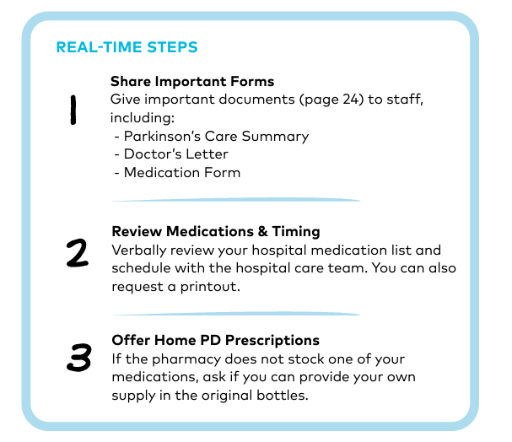
Need 1: I need my hospital chart to include my exact medications and match my at-home schedule.
Notes:
First Example of Action Step= called Real Time Step
We understand the importance of medications On Time Every Time…the challenge is educating your care team .The slide is your real time steps for self advocacy,
Have your Go Bag Prepared a containing 2-days supply of your meds in original bottles, a copy of your medication form including dosing times and notes, and a copy of the Doctor’s letter in your guide signed by your neurologist prioritizing your needs while hospitalized. ALL in your Go BAG.

Slide 9
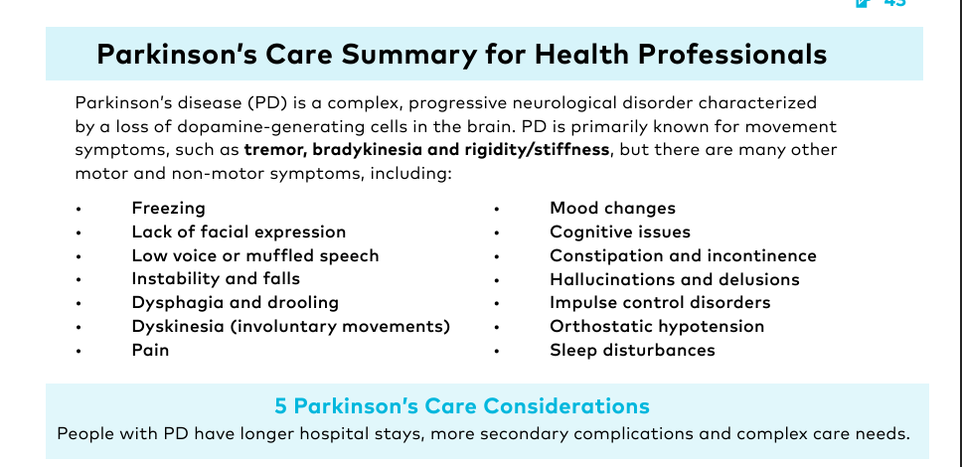
Notes:
Example of the PD Care summary referred to
There are 10 tear out Parkinson’s Care Summary sheets in your guide. Use these as “ cheat sheets” to educate your care team. Everybody cannot be an expert in Parkinson’s .Tear these out and hand them out to your care team. Important: Ask a nurse or your advocate to tape one of these on the white message board located in all hospital rooms. That is the 1st place your care team looks for communication when coming to your room. And write above it in large letters” ASK PATIENT “ Can you think of any other ways you may be able to use this tool to advocate for yourself.

Slide 10
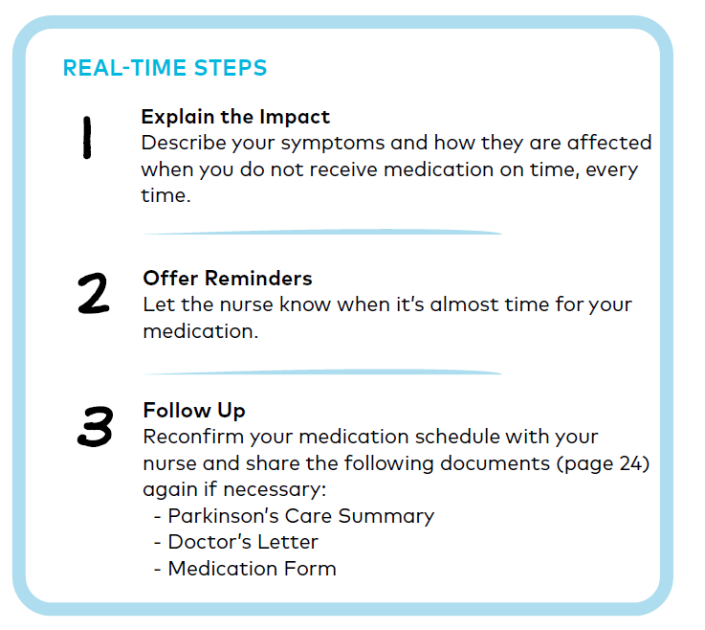
Need 2: I need to take my medications within 15 minutes of my usual schedule.
Notes:
The challenge here is that most hospitals have their own schedule for medication dosing-allow nurses a window of one hour before or after to give meds. Again- Use your guide to explain how critical your dosing is and refer to your Parkinson’s Care summary , doctors' letter and medication form. Having a copy of these on your white board is a good ides. A copy of the Medication form with dosing times and notes is in the guide. Complete this and make copies. You could even write in what complications occur for you personally if you do not get meds on time every time.

Slide 11
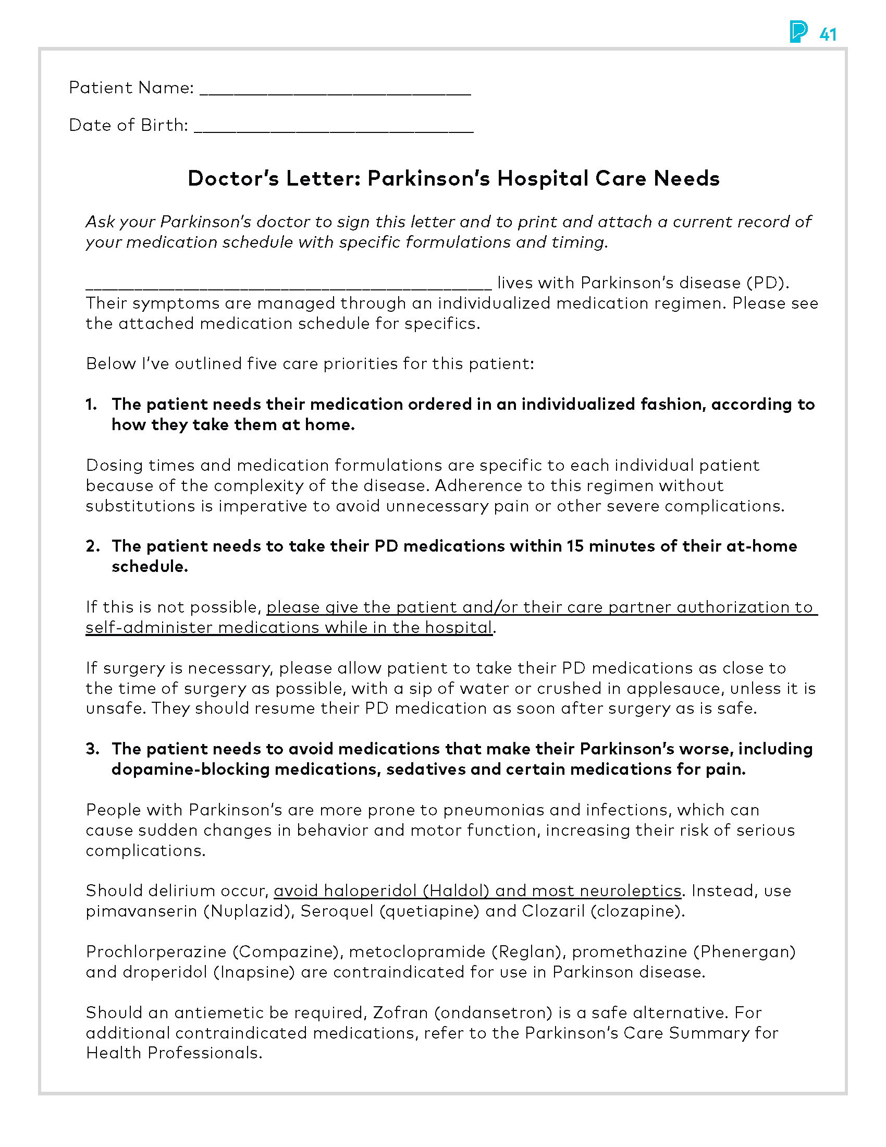
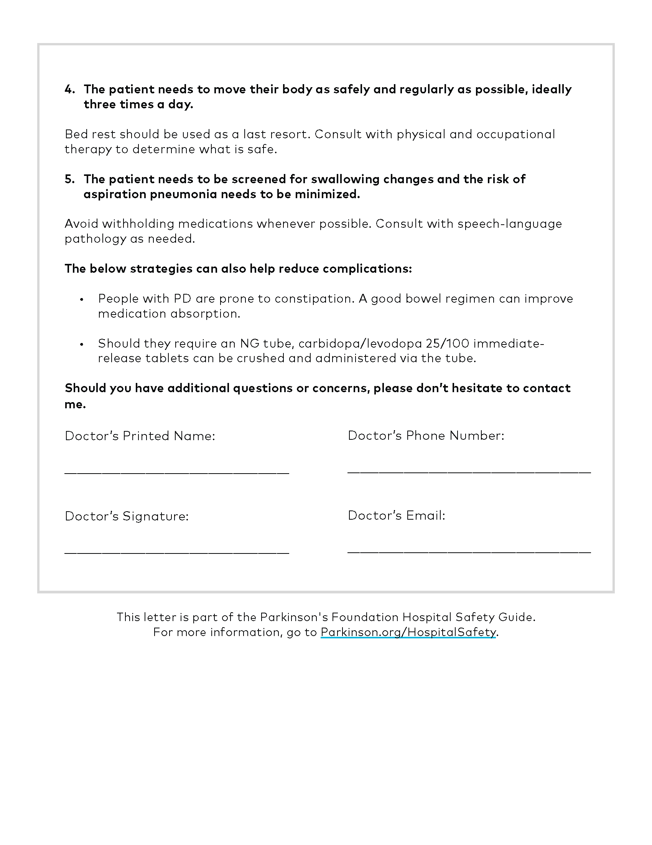

Notes:
Notes:
The doctor’s letter is included in the guide and can also be downloaded at Parkinson.org/Hospital Safety. You can reach out to your Parkinson’s doctor by email or through an online patient portal or you can bring a physical copy for them to sign. Once it has been signed, keep this letter and copies within the guide, your go kit and post a copy on the message board in your hospital room if possible.so that you know exactly where to find it. The letter states clearly the 5- needs we are discussing here and your doctor’s direction for the hospital to meet these needs.

Slide 12
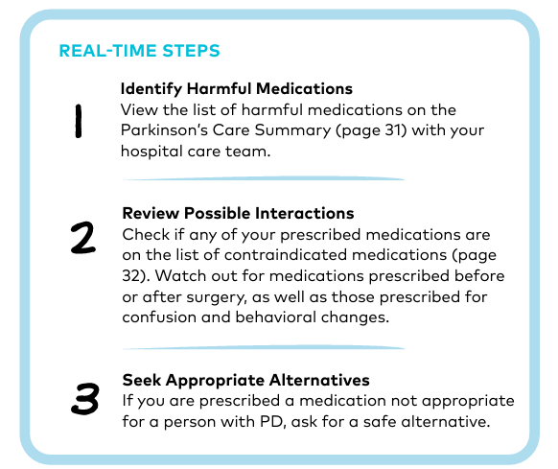
Need 3: I need to avoid medications that make my Parkinson’s worse. These medications include those that block dopamine, sedatives and certain pain medications.
Notes:
Most of us probably know there are meds we need to avoid. Don’t count on your care team being the expert on your Parkinson’s needs. On the BACK of the Parkinson’s Care Summary tear out sheets is a list of medications you should avoid and safe medications that can be used safely for nausea, pain, and antipsychotics. Be careful and ask questions about the meds you are receiving.
Remember, staff may be unfamiliar with safe PD alternatives. Some of you may have had negative experience with contradicted meds. My sister had an episode with a motion sickness med . And a medication for nausea given to her after DBS- at MSU- a center of Excellence. I believe.

Slide 13
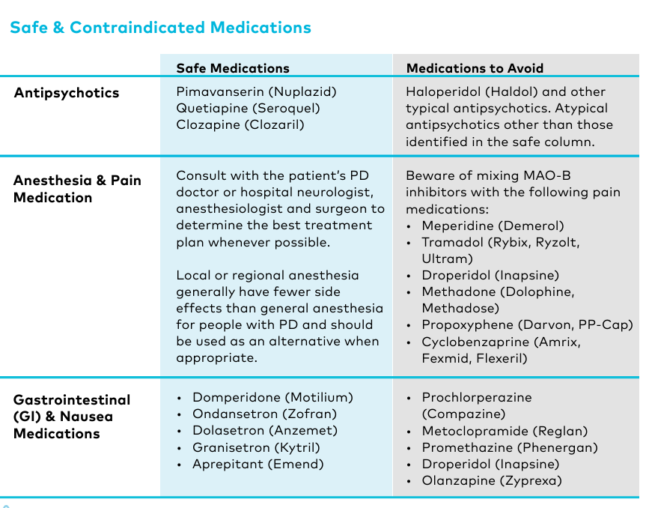
Notes:
Here is part of the back of the Parkinson's Care summary. My sister had an incident while she was in the hospital at MSU for DBS. This can happen even in Centers of Excellence .

Slide 14
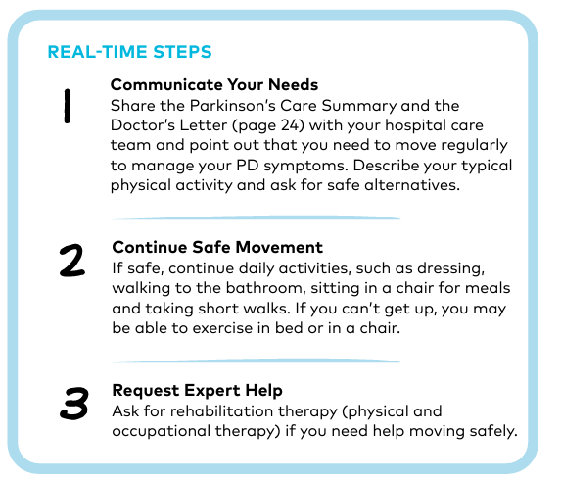
Need 4: I need to move my body as safely and regularly as possible, ideally three times a day.
Notes:
It may be challenging to get occupational or pt as soon as you like.be prepared with alternatives, like tracing the alphabet with your arms, or ankles, and other types of stretching you can do safely from your bed.

Slide 15
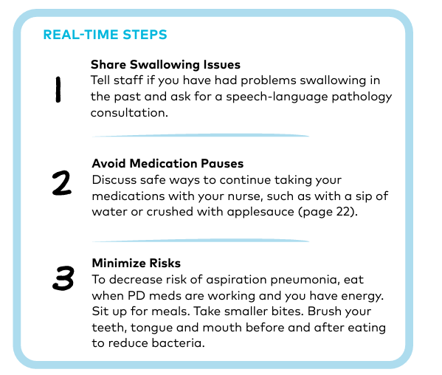
Need 5: I need to be screened for swallowing changes to safely maintain my medication routine and minimize my risk of aspiration pneumonia and weight loss.
Notes:
Inform your care team you have issues with swallowing and educate them on what is safe for you. Using a straw to take meds, sit up, brush teeth before and after meals , eating slowly, and having meals times when your meds are working. Request speech pathology evaluation.

Slide 16
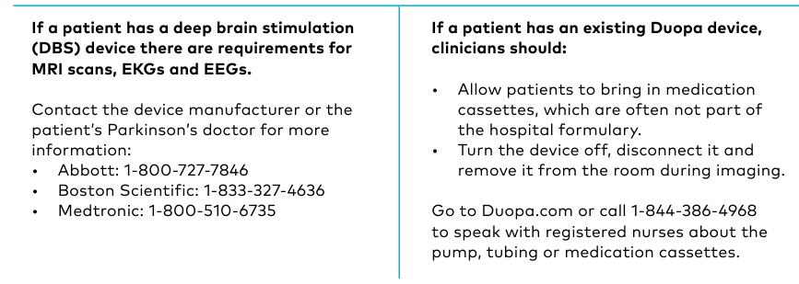
Special Considerations
Notes:
And if you have DBS or a Duopa device – there is more education and preparation necessary.
This is true of DBS recipients with dentist visits as well. Cheek with you Neurologist and the DBS rep. during certain procedures the DBS must be turned off and before certain procedures.

Slide 17
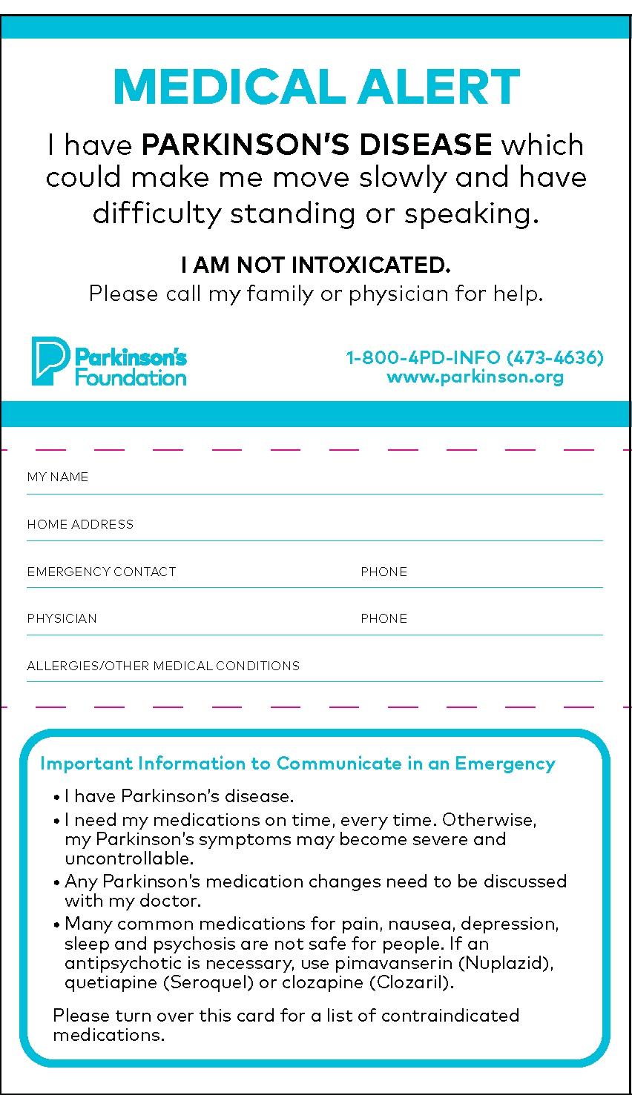
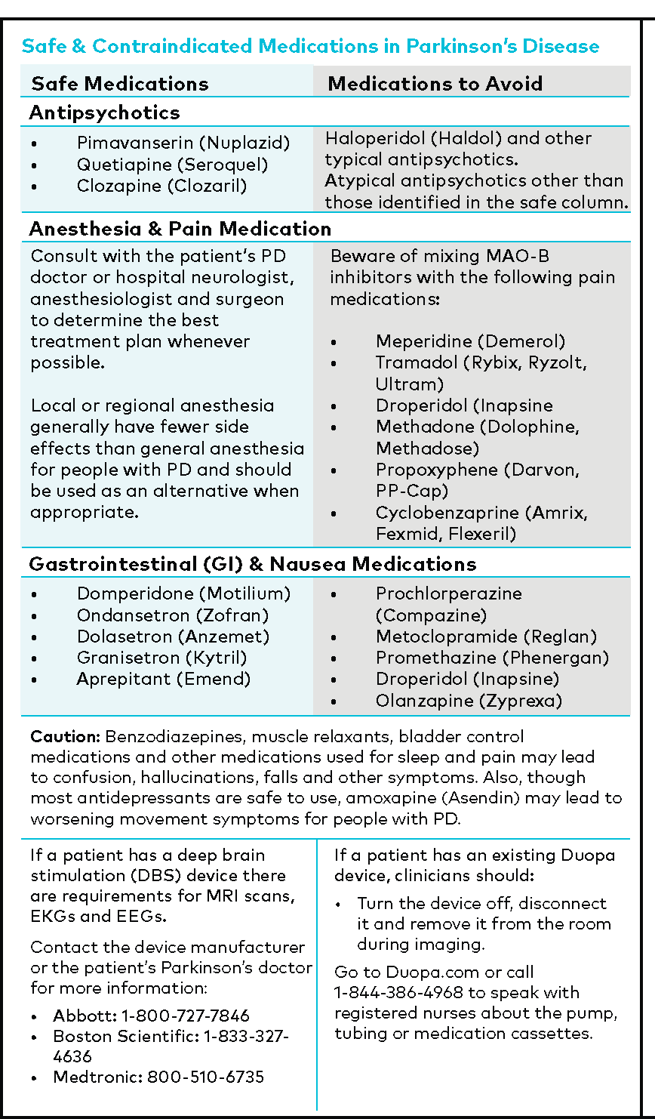
Notes:
Notes:
At the very back of the Hospital Safety Guide, you’ll find two copies of the Medical Alert Card. We recommend tearing out one of these and keeping it in your wallet, the second copy can stay in the guide or can be given to a friend or care advocate .

Slide 18
Homework
1. Prepare a Go Bag . 2-days meds in original bottles ,copies of all forms. Medication Form, signed Doctor’s Letter, Medical Alert Card.
QUESTIONS
Where will you keep your Go Bag?
What else can go into the go bag?
How best can you advocate for yourself?

Slide 19

ANY QUESTIONS?
A

