Slide 1

Legacy
Life insurance + Roth conversions
The Retirement
Stack
Growth Engine
Investment portfolio + growth annuity
Guaranteed Income Floor
Lifetime income annuities
Income by design. A repeatable, roles-based framework for building retirement plans layer by layer.
Foundation
Social Security + pensions
Sean Jantz | Jantz Wealth Solutions | Author, The Straight-Talk Retirement Guide
For financial professional use only. Not for use with the public.
Notes:
Welcome. Today I want to hand you the exact framework I use with every client at Jantz Wealth Solutions. It is called the Retirement Stack, and it is the core of the myRetirement Design system. By the end you will be able to draw it on a whiteboard in 60 seconds and use it in your very next appointment.

Slide 2



THE PROBLEM
Will The Money Last?
Most people arrive at retirement with accounts, not income. They have a pile of money and one terrifying question: will it last? Three things make that question hard.
The paycheck stops
Sequence risk hits early
Products without a job
After 40 years of income arriving on schedule, clients must now write their own paycheck from savings.
A bad market in the first five years of withdrawals can permanently damage a plan, even if averages recover.
Clients own a drawer full of vehicles nobody ever assigned a purpose. Overlap, gaps, and confusion follow.
Notes:
Set up the pain. Your clients do not have an investment problem, they have an income problem. The industry answers with either a withdrawal rate or a product pitch. Neither is a plan. This is the gap the Stack fills.

Slide 3
THE ROLES-BASED METHOD
"Every dollar should have a role.
Every vehicle should have a job."
1
Define the job
2
Size the job
3
Pick the vehicle
What must this money do? Income, growth, protection, or transfer.
How much is needed, starting when, and for how long?
Only then choose the product built to do that job best.
Notes:
This is the philosophy behind everything. We never start with a product. We start with the job description, size it, then hire the vehicle. That single sequence change is what turns a product conversation into a planning conversation, and it is why compliance, clients, and referral partners all respond to it.

Slide 4
THE FRAMEWORK
The Retirement Stack
Legacy
Life insurance + Roth conversions
Built from the bottom up
1. Foundation
The guaranteed lifetime income a client already has: Social Security and pensions.
Growth Engine
Investment portfolio + growth annuity
2. Guaranteed Income Floor
If essentials exceed the Foundation, an income annuity closes the gap for life.
Guaranteed Income Floor
Lifetime income annuities
3. Growth Engine
Everything above the floor is built for long-term growth: a diversified portfolio paired with a growth annuity.
Foundation
Social Security + pensions
4. Legacy
Assets positioned for efficient transfer through life insurance and Roth conversions.
Notes:
Here is the whole system on one slide. Four layers, always built in the same order, bottom up. Security first, growth second, legacy last. The order is the discipline: no growth conversation until the floor is set, no legacy conversation until the engine is running.

Slide 5

STEP 1
Find the Essentials Number
Before any product, any allocation, any illustration: what does it cost this household to keep the lights on and the life running? Separate every expense into two buckets.
Essentials
Discretionary
Housing, utilities, insurance
Groceries and transportation
Healthcare premiums and taxes
Travel and hobbies
Dining out, gifts, upgrades
The "fun" the portfolio funds
The Essentials Number
$6,000/mo
The paycheck retirement must replace, every month, for life. (Sample household)
Notes:
Everything starts with one number. Not risk tolerance, not assets under management. What are the essentials? I use a simple worksheet with clients and we land on a monthly figure. That number drives the entire rest of the design, so do not rush it.

Slide 6
STEP 2 · LAYER 1
The Foundation Number
The Foundation is the guaranteed lifetime income a client already owns: Social Security and any pensions. It arrives every month, for life, no market required. Compare it to the Essentials Number and one of two things is true: the essentials are covered, or there is an income gap.
Essentials Number
Foundation Number
Income Gap
$6,000/mo
−
$4,200/mo
=
$1,800/mo
Timing matters: run the math at the month essentials begin, using the claiming strategy you actually recommend.
Notes:
Layer one costs the client nothing. It is inventory, not a purchase. Add up Social Security at the recommended claiming age plus any pension. Subtract from essentials. In this sample case: 6,000 in essentials, 4,200 of Foundation income, so an 1,800 per month gap. That gap is the entire reason layer two exists.

Slide 7

STEP 3 · LAYER 2
Build the Guaranteed Income Floor
If there is a gap, we close it with contractual lifetime income: an income annuity sized to the gap, nothing more. Only lifetime income vehicles qualify for this layer.
Sized to the gap: in our sample, $1,800/mo of joint lifetime income. The client buys a paycheck, not a product.
Lifetime income only. Bond and CD ladders can fund a period, but only mortality credits can guarantee a lifetime.
Transfers longevity risk and market risk on essential spending to the insurance carrier.
Gives clients psychological permission to spend, and lets the rest of the money take real long-term risk.
Essentials covered.
For life.
Foundation + Floor = every essential dollar arrives on schedule regardless of markets.
Annuity guarantees are backed by the financial strength and claims-paying ability of the issuing insurance company.
Notes:
Notice the discipline here in both directions. If there is no gap, there is no income annuity, and clients respect that enormously. If there is a gap, we buy exactly the paycheck that closes it. And we are strict: this layer is lifetime income annuities only. A bond ladder can bridge a decade, but it cannot pool mortality, so it cannot guarantee a lifetime.

Slide 8
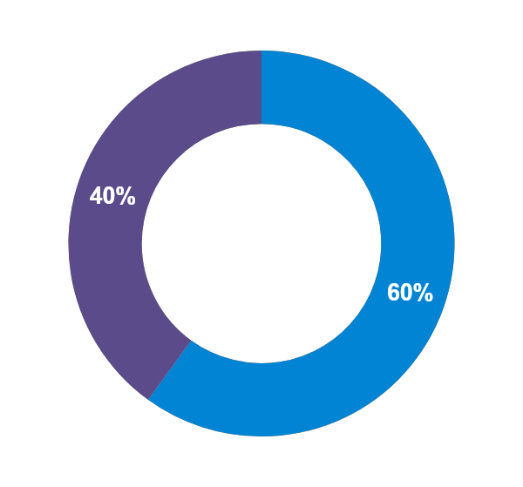
STEP 4 · LAYER 3
The Growth Engine
With essentials guaranteed, everything above the floor is free to pursue long-term growth. The Growth Engine pairs two components with two different jobs.
60% · Investment Portfolio
A diversified, professionally managed allocation such as a Global Core portfolio. Job: long-term growth, liquidity, and rising income for the discretionary life.
40% · Growth Annuity
A growth-focused annuity (such as a fixed indexed annuity) with a 0% floor in down years and index-linked crediting in up years. Job: stabilize the engine.
Typical split. Actual allocation is set by the Investment Strategy Assessment and the client’s Design Profile.
Notes:
Layer three is where most of the money lives. The typical split is 60 percent diversified investment portfolio, 40 percent growth annuity. The portfolio does what markets do best. The annuity sleeve does what insurance does best. The next slide is why that pairing matters so much.

Slide 9

STEP 4 · LAYER 3
Why the 40% Growth Annuity Sleeve
Sequence protection
Volatility buffer
The bond alternative
In down markets, withdrawals come from the annuity sleeve instead of selling depressed equities. The portfolio gets time to recover, which defuses the early-retirement sequence-of-returns problem.
A 0% crediting floor means the sleeve does not participate in market losses. That dampens the volatility of the whole Growth Engine and keeps clients invested through rough years.
The sleeve occupies the role bonds traditionally played, with no duration risk when rates rise, tax deferral, and index-linked upside potential in exchange for caps and limited liquidity.
Fixed indexed annuities are insurance contracts, not securities, and do not directly participate in the market. Caps, participation rates, spreads, and surrender charges apply and limit growth potential. Guarantees are backed by the claims-paying ability of the issuer. Comparisons to bonds are conceptual; performance outcomes vary by product and period.
Notes:
This is the slide that converts skeptics. The 40 percent sleeve is not there to beat the S&P. It has three jobs: absorb withdrawals in down years so we never sell equities at a loss, cut the volatility of the whole engine with its zero floor, and fill the traditional bond role. Frame it as the job description, present the tradeoffs honestly, caps and surrender schedules included, and let compliance-approved illustrations carry the numbers.

Slide 10


STEP 5 · LAYER 4
The Legacy Layer
With income secured and growth engineered, the top of the Stack positions assets to transfer on purpose, not by accident. Two tools do the heavy lifting.
Life insurance
Roth conversions
Delivers an income-tax-free death benefit to heirs
Converts unneeded RMD dollars into leveraged legacy
Riders can add living benefits such as chronic illness protection
Fill low-bracket "gap years" between retirement and RMDs
Move growth from forever-taxed to never-taxed accounts
Blunt the SECURE Act 10-year rule for non-spouse heirs
Notes:
The Legacy layer answers the question clients rarely ask out loud: what happens to what is left? Life insurance turns taxable dollars into tax-free dollars for heirs. Roth conversions during low-bracket years do the same thing for account balances, especially now that most non-spouse beneficiaries must empty inherited IRAs within ten years. Coordinate this layer with the client’s tax professional.

Slide 11
CARRIER SPOTLIGHT
North American: Strength and Stability
A+
A.M. Best
(Superior)
A+
S&P Global
(Strong)
A+
Fitch Ratings
(Stable)
OUR PREFERRED GROWTH ANNUITY
VersaChoice 10
10.1% S&P 500 annual cap
140+ years
$46.9B
For premium of $75,000+ · 0% floor in down years
In business since 1886
Total assets (12/31/2025)
98%
708,000+
OUR PREFERRED INCOME ANNUITY
Investment-grade bond portfolio
Life and annuity policies in force
Income Pay Pro
Guaranteed lifetime income, the product funding the Income Floor in our case study.
Privately held member of Sammons Financial Group, insulated from the short-term earnings pressure public carriers face.
Data as of 12/31/2025 per statutory annual statements. A.M. Best A+ (Superior): 2nd highest of 15; S&P A+ (Strong), affirmed 5/15/2025: 5th of 22; Fitch A+ (Stable), 6/17/2025: 5th of 19. Ratings reflect claims-paying ability, not product performance, and are subject to change. Cap is current as of July 2026 for the S&P 500 annual point-to-point option at the stated premium band; subject to change at renewal.
Notes:
Before we run the case, a word on the carrier both moves rely on. North American has been in business since 1886, holds A plus ratings from all three major agencies, carries about 47 billion in assets against a 98 percent investment-grade bond portfolio, and is privately held under Sammons Financial Group, so it is not managed for the next earnings call. In my practice our preferred growth annuity is VersaChoice 10, currently crediting up to a 10.1 percent S&P 500 annual cap for premium over 75,000, and our preferred income annuity is Income Pay Pro, which is exactly the pairing you are about to see in the case study.

Slide 12
THE STACK IN ACTION
Meet the Sample Household
The plan, in three moves
Sample household
Married couple, both age 65
Retiring at 67, two years from now
$1,000,000 in total savings
Essentials Number: $6,000/mo
Social Security at 67: $4,200/mo combined
Income gap: $1,800/mo
1
Fund the Income Floor
$250,000 buys the $1,800/mo gap as guaranteed lifetime income, starting the month they retire.
2
Build the Growth Engine
The remaining $750,000 is split 60/40: diversified portfolio plus an indexed annuity buffer.
3
Position the Legacy
The two-year runway is an asset. It gives every move below time to work before the first paycheck is needed.
Roth conversions in the low-bracket years plus a survivor life insurance review.
Hypothetical example for financial professional education only. Not a recommendation.
Notes:
Now we run the whole system on one household. Both spouses are 65 and working two more years, which matters: it gives the income annuity a deferral period and gives us two low-earning-year candidates for Roth work later. Same math as before: 6,000 essentials, 4,200 of Social Security, an 1,800 gap. Three moves close it.

Slide 13
THE STACK IN ACTION · MOVE 1
Fund the Income Floor
$250,000
Total savings
North American Income Pay Pro
$1,000,000
Defers for two years while they finish working
At 67, turns on $1,800/mo of guaranteed joint lifetime income
The gap is closed the same month the paychecks stop
Ready to be given jobs
Remaining to allocate: $750,000
Essentials: covered for life from day one of retirement
Hypothetical illustration. Income figures depend on current rider terms, payout rates, ages, and deferral period, and are subject to change. Rider charges may apply. Guarantees are backed by the claims-paying ability of the issuing insurance company.
Notes:
Move one, and it always comes first. 250,000 goes into North American Income Pay Pro today. The two-year deferral works in our favor, and at 67 it turns on 1,800 a month of joint lifetime income, timed to the exact month essentials begin. Show the current illustration here so the room sees real numbers from the rate sheet.

Slide 14
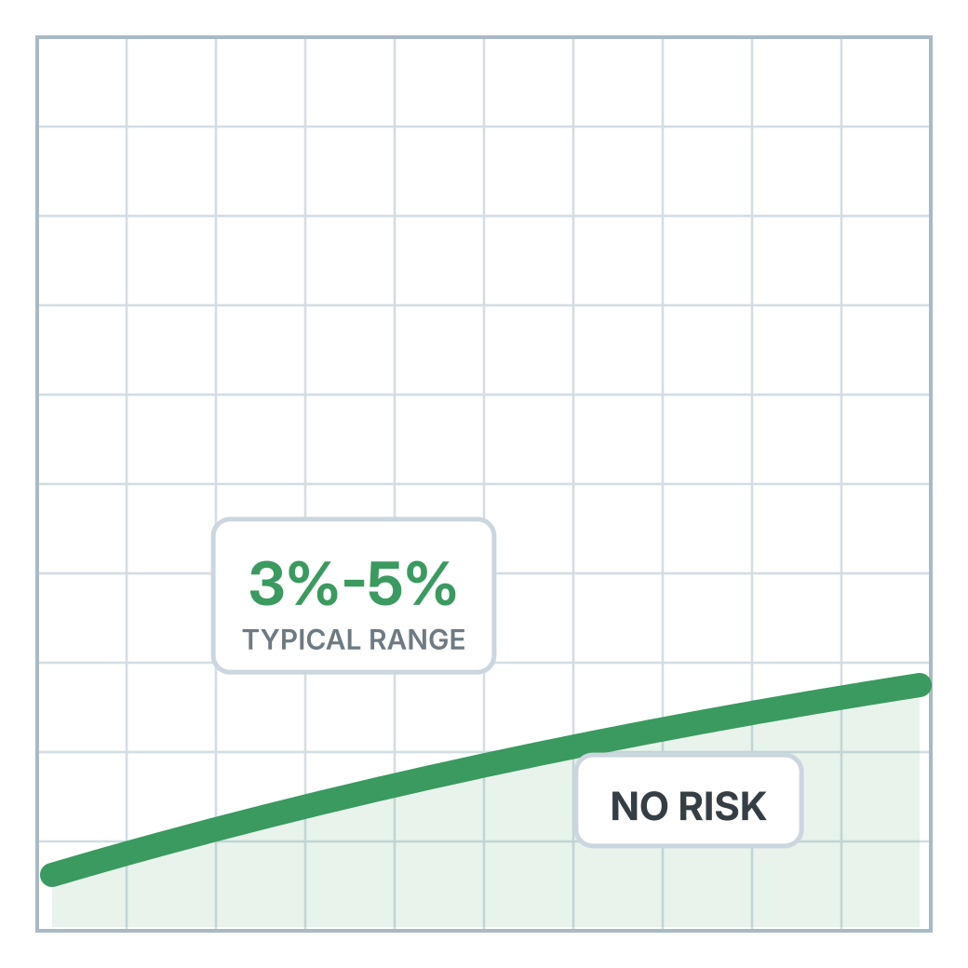
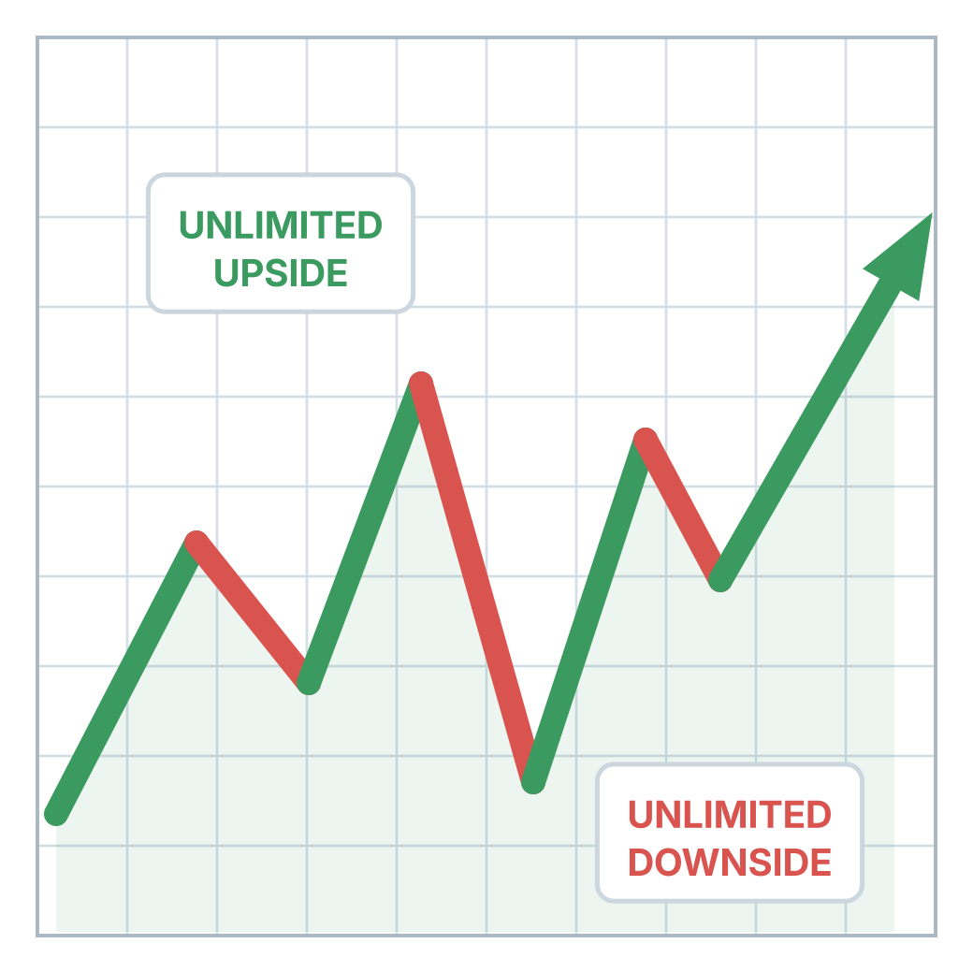
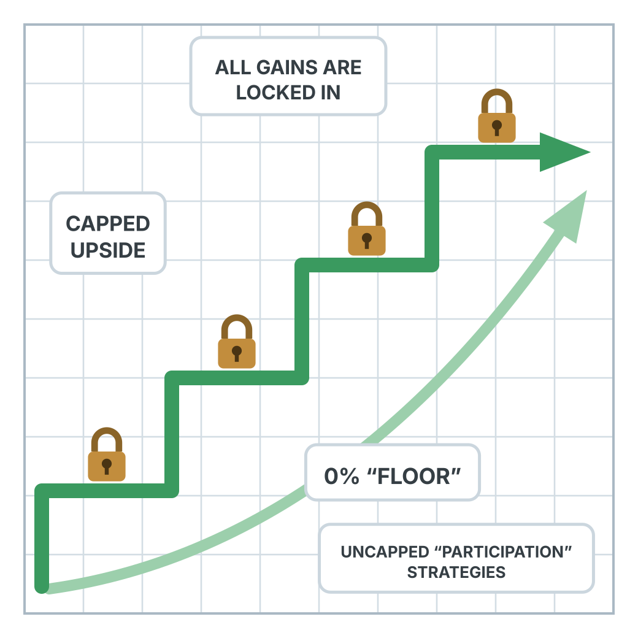

STEP 4 · LAYER 3
Asset Location
Diversify between different risk/reward strategies. There are three ways money can grow.
1
FIXED
2
VARIABLE
3
INDEXED
Low guaranteed growth
Full stock market exposure
Stock market linked growth, with built-in downside protection
Different strategies. Different levels of risk. One goal: Protect and grow your wealth.
Conceptual illustration, not actual performance. Indexed annuity credits are subject to caps, participation rates, and spreads; the 0% floor does not reflect any rider charges or surrender schedules.
Notes:
This is the whiteboard version of the Growth Engine. Three ways money can grow: fixed, low guaranteed growth with essentially no risk; variable, full market exposure with unlimited upside and unlimited downside; and indexed, market-linked growth where gains lock in, upside is capped, and the floor is zero. Most retirees get sold one answer: put the whole portfolio in bucket two as a mix of stocks and bonds, and call it diversified. That is asset allocation. Asset location asks a better question: which bucket should each job live in? We keep the variable bucket, that is where the equity engine belongs. But we take the long-term bonds out of it and relocate that money to bucket three, the indexed growth annuity. Same defensive job the bonds had, now with a 0 percent floor instead of duration risk. That is the 60/40 you are about to see.

Slide 15
THE STACK IN ACTION · MOVE 2
Build the Growth Engine
60% · $450,000
Global Core Portfolio
Remaining savings
Diversified, professionally managed growth. Funds the discretionary life and long-term inflation fight.
$750,000
Split 60/40 by job
40% · $300,000
North American VersaChoice Indexed Annuity
10.1% annual cap, 0% floor. The volatility buffer: withdrawals come from here in down years so the portfolio is never sold at a loss.
Every dollar now has a role. Unallocated: $0.
Hypothetical illustration. Cap and floor reflect current product terms and are subject to change at renewal. Fixed indexed annuities are insurance contracts, not securities; surrender charges and crediting limitations apply. Advisory services and portfolio management are separate from insurance products.
Notes:
Move two: the remaining 750,000 becomes the Growth Engine. 450,000, or 60 percent, goes to a Global Core portfolio for diversified market growth. 300,000, or 40 percent, goes to North American VersaChoice with a 10.1 percent cap and a 0 percent floor. In down years, income and withdrawals come from the VersaChoice side, so the Global Core portfolio gets time to recover. That is the sequence-of-returns defense, purchased in advance.

Slide 16
THE STACK IN ACTION · THE RESULT
The Completed Stack
Legacy
Roth conversions in gap years + survivor life insurance review
At age 67, day one of retirement
$6,000/mo of essentials fully guaranteed for two lifetimes
$750,000 Growth Engine with a built-in volatility buffer
Two gap years already earmarked for Roth conversions
One picture the couple can explain to their kids
Growth Engine
$750,000: $450,000 Global Core + $300,000 VersaChoice (60/40)
Guaranteed Income Floor
$250,000 Income Pay Pro paying $1,800/mo joint life from 67
Foundation
Social Security: $4,200/mo combined, beginning at 67
Hypothetical example for financial professional education only. Payout rates, caps, allocations, and products vary by client, carrier, age, and state. Not a recommendation.
Notes:
And here is the finished design on one page. Foundation: 4,200 of Social Security at 67. Floor: Income Pay Pro turning on 1,800 the same month. Engine: 750,000 split 60/40 between Global Core and VersaChoice. Legacy: Roth conversions in the two gap years plus a survivor life review. Every dollar has a role, every vehicle has a job, and the couple can retell the whole plan without you in the room.

Slide 17


WHY IT WORKS
Better for Clients. Better for Your Practice.
For the client
For your practice
One picture they can actually understand and retell
Permission to spend: essentials never depend on markets
Sequence risk engineered out of the fragile early years
A legacy that transfers by design, not by default
A repeatable process you can run in every appointment
Annuities positioned by job description, not product pitch
Natural fit for hybrid practices: advisory + insurance each do their job
A planning story referral partners and compliance can get behind
Notes:
Two audiences, one framework. Clients get clarity and confidence. You get a process that scales, differentiates you from both the pure product shop and the pure AUM shop, and makes every annuity conversation a planning conversation. In my practice roughly 70 percent of clients hold an annuity, and the Stack is why those placements feel like planning rather than selling.

Slide 18
RECAP
The Five Steps, Every Time
1
2
3
4
5
Essentials
→
Foundation
→
Income Floor
→
Growth Engine
→
Legacy
Find the monthly Essentials Number.
Total Social Security + pension income.
Close any gap with lifetime income.
Split the rest ~60/40, portfolio + growth annuity.
Life insurance + Roth conversions.
Same order, every client. The design changes; the discipline does not.
Notes:
If you remember nothing else, remember the order. Essentials, Foundation, Floor, Engine, Legacy. Run those five steps in sequence and you will never again wonder whether a product belongs in a plan. The plan tells you.

Slide 19
Every dollar has a role.
Every vehicle has a job.
Questions?
Sean Jantz · Jantz Wealth Solutions · jantzwealth.com
The Straight-Talk Retirement Guide, available on Amazon
For financial professional use only. Not for use with the public. Hypothetical examples are for educational purposes and are not recommendations. Investment advisory services offered through Brookstone Wealth Advisors, LLC (BWA), a registered investment advisor. BWA and Brookstone Capital Management, LLC are affiliated companies. BWA and Jantz Wealth Solutions are independent of each other. Insurance products and services are not offered through BWA but are offered and sold through individually licensed and appointed agents. Annuity and life insurance guarantees are backed by the financial strength and claims-paying ability of the issuing insurance company. Roth conversion decisions should be coordinated with a qualified tax professional.
Notes:
Close with the tagline and open for questions. Point advisors to the book for the full framework and offer the one-page Stack worksheet as a follow-up.

