Slide 1


Wisdom for Life’s Journey
Sexual Purity

Slide 2
Wisdom for Life’s Journey
Sexual Purity

Slide 3
Proverbs 5:1-4
My son, pay attention to my wisdom,
turn your ear to my words of insight,
2 that you may maintain discretion
and your lips may preserve knowledge.

Slide 4
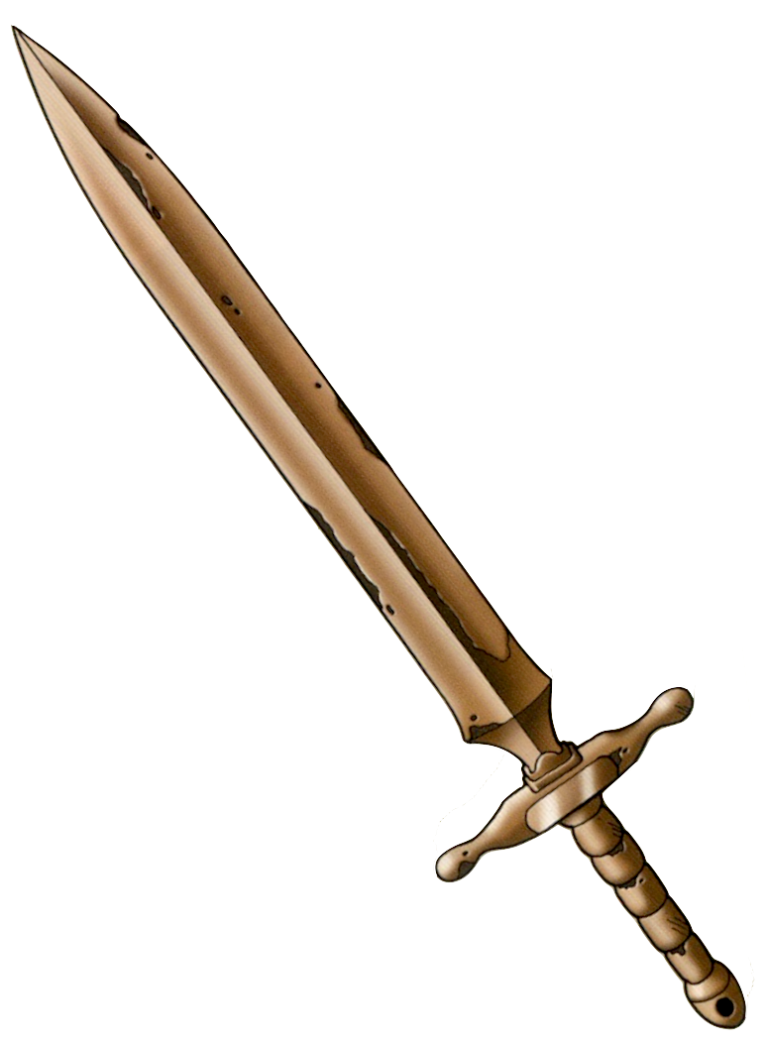
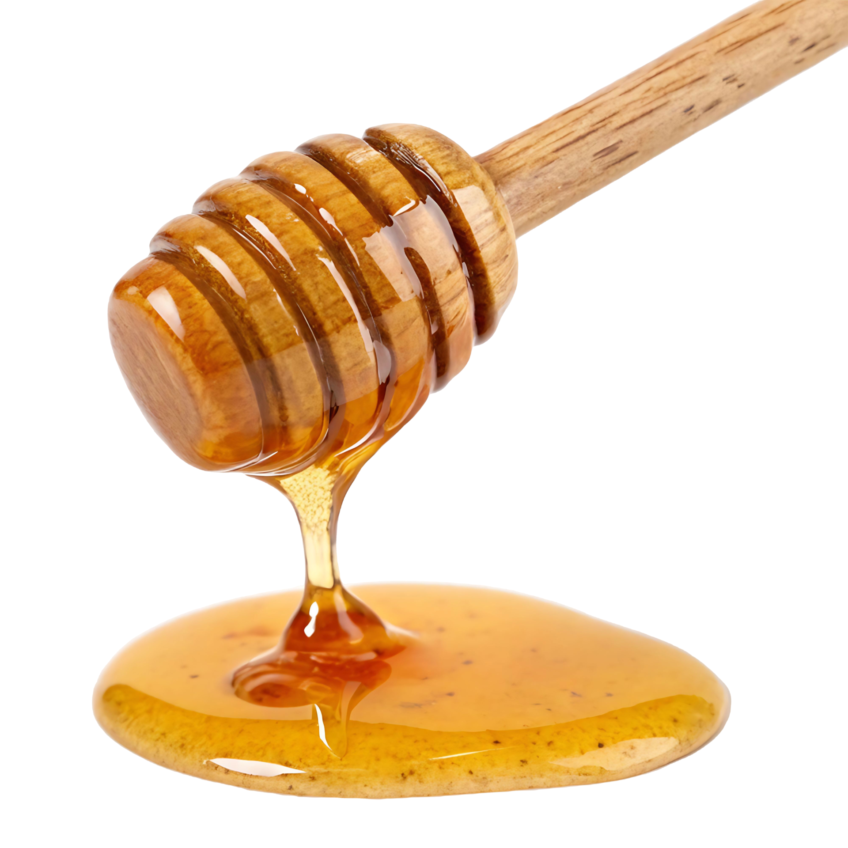
Proverbs 5:1-4
3 For the lips of the adulterous woman drip honey,
and her speech is smoother than oil;
4 but in the end she is bitter as gall,
sharp as a double-edged sword.

Slide 5

Prov. 20:17
Food gained by fraud tastes sweet,
but one ends up with a mouth full of gravel.
“No one will ever know”

Slide 6
1 Timothy 5:24-25
24 The sins of some are obvious, reaching the place of judgment ahead of them; the sins of others trail behind them. 25 In the same way, good deeds are obvious, and even those that are not obvious cannot remain hidden forever.

Slide 7

Ephesians 5:11
11 Have nothing to do with the fruitless deeds of darkness, but rather expose them.

Slide 8


Slide 9
Psalm 103
1 Praise the Lord, my soul;
all my inmost being, praise his holy name.
2 Praise the Lord, my soul,
and forget not all his benefits—
3 who forgives all your sins
and heals all your diseases,

Slide 10
Psalm 103
4 who redeems your life from the pit
and crowns you with love and compassion,
5 who satisfies your desires with good things
so that your youth is renewed like the eagle’s.

Slide 11

Likes = Acceptance

Slide 12
1 Samuel 18:1-4
After David had finished talking with Saul, Jonathan became one in spirit with David, and he loved him as himself. 2 From that day Saul kept David with him and did not let him return home to his family. 3 And Jonathan made a covenant with David because he loved him as himself.

Slide 13

1 Samuel 18:1-4
4 Jonathan took off the robe he was wearing and gave it to David, along with his tunic, and even his sword, his bow and his belt.

Slide 14


Slide 15
2 Samuel 2:25-26
²⁵ “How the mighty have fallen in battle!
Jonathan lies slain on your heights.
²⁶ I grieve for you, Jonathan my brother;
you were very dear to me.
Your love for me was wonderful,
more wonderful than that of women.

Slide 16


Slide 17

Proverbs 5:5-10
5 Her feet go down to death;
her steps lead straight to the grave.
6 She gives no thought to the way of life;
her paths wander aimlessly, but she does not know it.
7 Now then, my sons, listen to me;
do not turn aside from what I say.

Slide 18
Proverbs 5:5-10
8 Keep to a path far from her,
do not go near the door of her house,
9 lest you lose your honor to others
and your dignity to one who is cruel,
10 lest strangers feast on your wealth
and your toil enrich the house of another.

Slide 19
Proverbs 5:11-14
11 At the end of your life you will groan,
when your flesh and body are spent.
12 You will say, “How I hated discipline!
How my heart spurned correction!
13 I would not obey my teachers
or turn my ear to my instructors.
14 And I was soon in serious trouble
in the assembly of God’s people.”

Slide 20
Proverbs 5:15-20
15 Drink water from your own cistern,
running water from your own well.
16 Should your springs overflow in the streets,
your streams of water in the public squares?
17 Let them be yours alone,
never to be shared with strangers.

Slide 21
Proverbs 5:15-20
18 May your fountain be blessed,
and may you rejoice in the wife of your youth.
19 A loving doe, a graceful deer—
may her breasts satisfy you always,
may you ever be intoxicated with her love.

Slide 22
Proverbs 5:15-20
20 Why, my son, be intoxicated with another man’s wife?
Why embrace the bosom of a wayward woman?

Slide 23
1 Corinthians 7:5
⁵ Do not deprive each other except perhaps by mutual consent and for a time, so that you may devote yourselves to prayer. Then come together again so that Satan will not tempt you because of your lack of self-control.

Slide 24
Proverbs 5:21-23
²¹ For your ways are in full view of the Lord,
and he examines all your paths.
²² The evil deeds of the wicked ensnare them;
the cords of their sins hold them fast.
²³ For lack of discipline they will die,
led astray by their own great folly.

Slide 25
Conclusion
Anticipate the appeal of Temptation
Replace Temptation with “Good Things”
Recognize the Danger Zone
Make yourself Accountable
Fill up on the “Good Things”

