Slide 1



Indiana Medicaid pharmacy provider enrollment training
March 2026

Slide 2
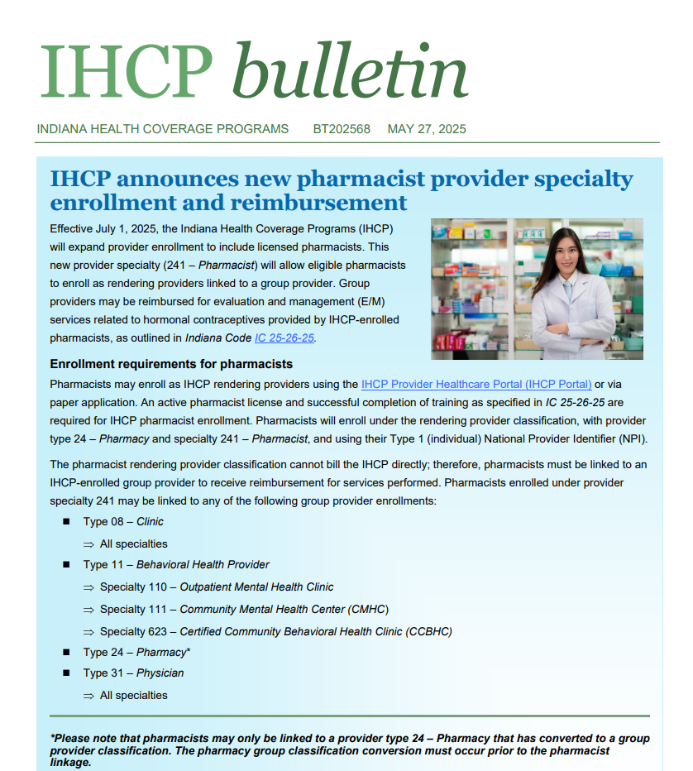
Before Enrolling as a pharmacist…
To bill for pharmacist-provided services related to IC-25-26-25, pharmacies must first convert from a billing to group provider classification. This conversion allows pharmacists as rendering providers to link to the pharmacies they practice at.
IHCP bulletin. Available at: https://www.in.gov/medicaid/providers/files/bulletins/BT202568.pdf
Notes:
As you may know, pharmacists in Indiana are able to bill Medicaid for hormonal contraceptive prescribing services. However, before pharmacists can enroll as providers to bill for this services as outlined in IC_25-26-25…

Slide 3

Step 1: Login to your pharmACY account in the IHCP Portal
Access IHCP Portal: https://portal.indianamedicaid.com/hcp/provider/Home/tabid/135/Default.aspx
Notes:
Step 1: Login to your pharmACY account in the IHCP Portal. After you login, select “Provider Maintenance” under the “Provider” heading.
https://portal.indianamedicaid.com/hcp/provider/Home/tabid/135/Default.aspx

Slide 4

Step 2: After you login, select “Provider Maintenance” under the “Provider” heading.

Slide 5
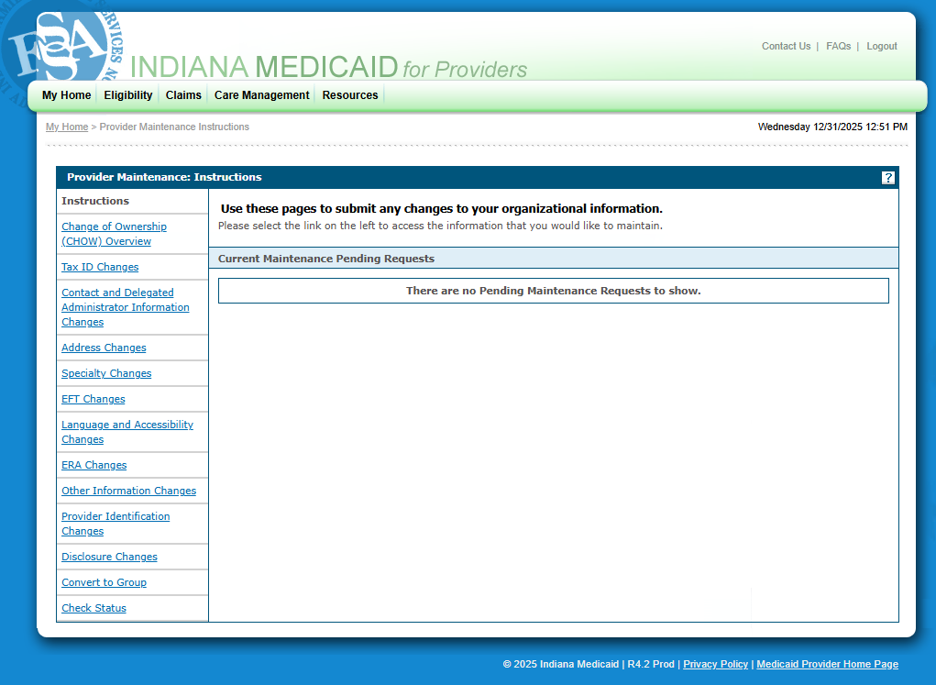
Step 3: In the menu on the left-hand tool bar, select “Convert to Group”
Notes:
Step 2: In the menu on the left-hand tool bar, select “Convert to Group”

Slide 6
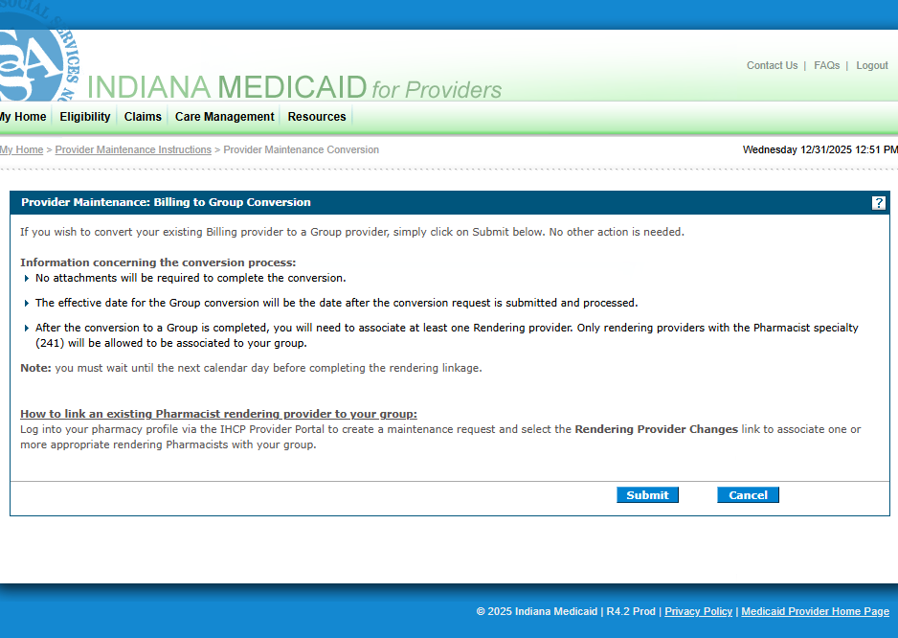
Step 4: Review the prompts and click submit. You will receive an Application Tracking Number (ATN). This ATN can be used by the pharmacist to enroll as a rendering provider at the pharmacy.

Slide 7
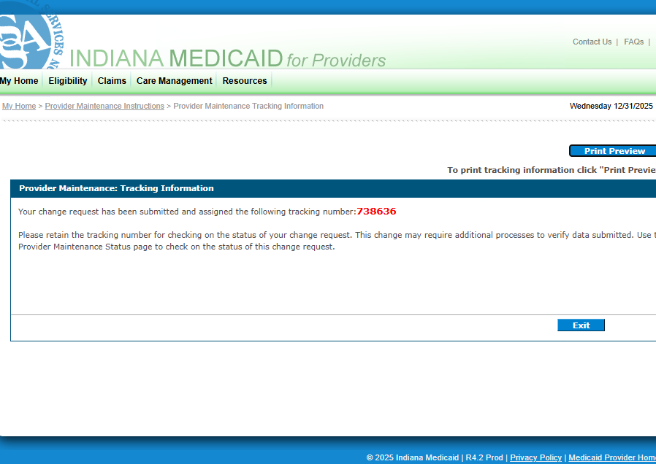
You will receive a tracking number (ATN). Save this for your records.

Slide 8
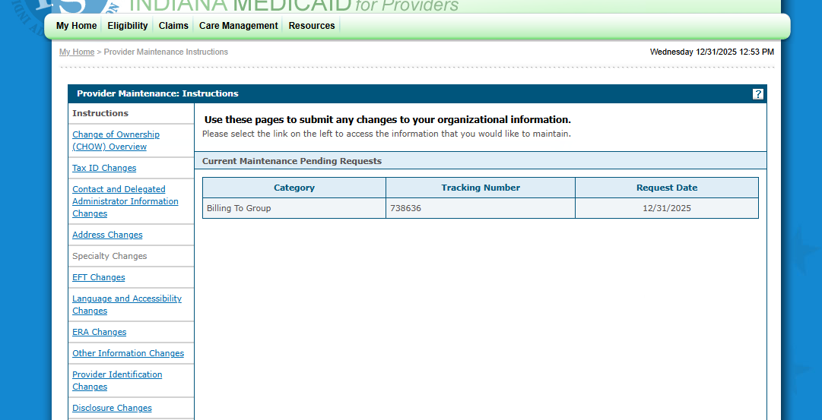
In the provider maintenance section, you can check on your pending requests at any time. You will also receive a letter in the mail to the pharmacy with updates regarding change status.
Notes:
Provider Enrollment URL: https://portal.indianamedicaid.com/hcp/provider/Home/ProviderEnrollment/tabid/477/Default.aspx

Slide 9
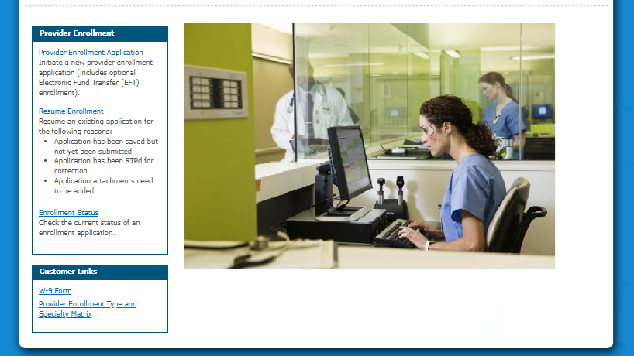
Enrolling as a Pharmacist provider
Individual Pharmacist enrollment as a rendering provider at the pharmacy

Slide 10
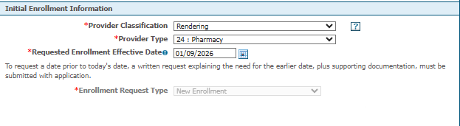
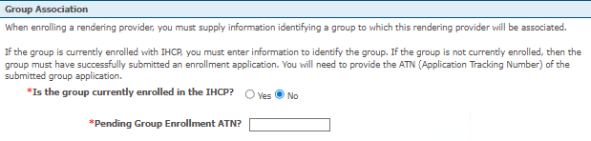
Step 1: Complete Initial Enrollment with the following classifications
**Note the requested enrollment effective date needs to be completed at least a day after ATN
Step 2: Complete Group Association with Pending ATN
Notes:
Initial Enrollment Information

Slide 11
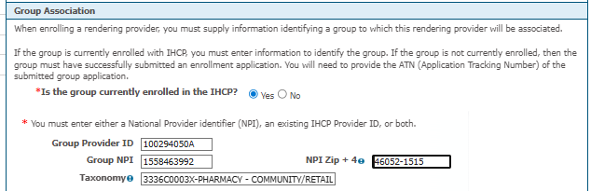
Step 2: OR Complete Group Association with provider ID from letter received in the mail
Notes:
Complete provider information using your own details.
Contact (can be you or delegate)

Slide 12
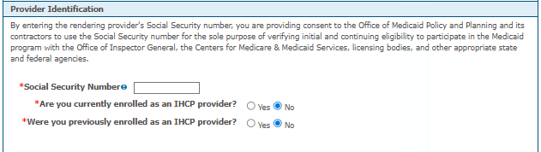
Step 3: Complete provider information using your own information as the rendering provider
Notes:
Complete provider information using your own details.

Slide 13
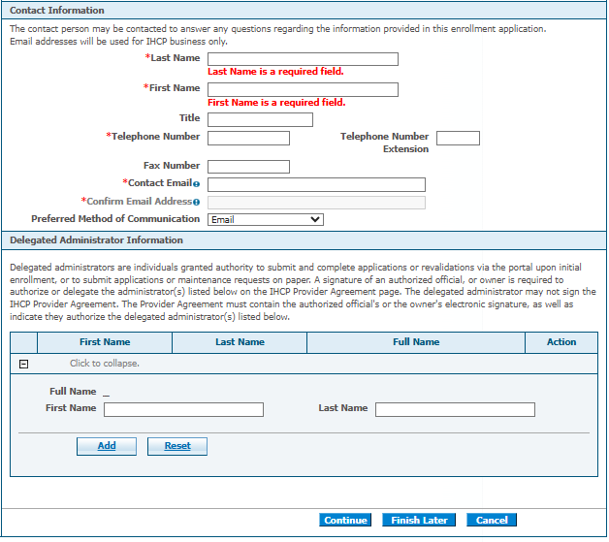
Step 4: Complete Contact Information- this can be yourself or a delegate
Notes:
Contact (can be you or delegate)

Slide 14
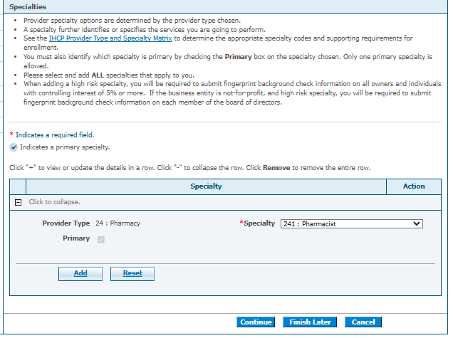
Step 5: Complete Specialty Designation- Pharmacist
Notes:
List options from bulletin. Please note that pharmacists may only be linked to a provider type 24 – Pharmacy that has converted to a group provider classification. The pharmacy group classification conversion must occur prior to the pharmacist linkage
Only option under pharmacy is pharmacist

Slide 15
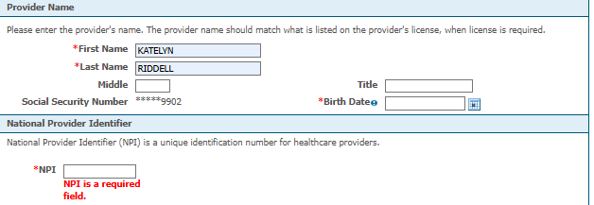
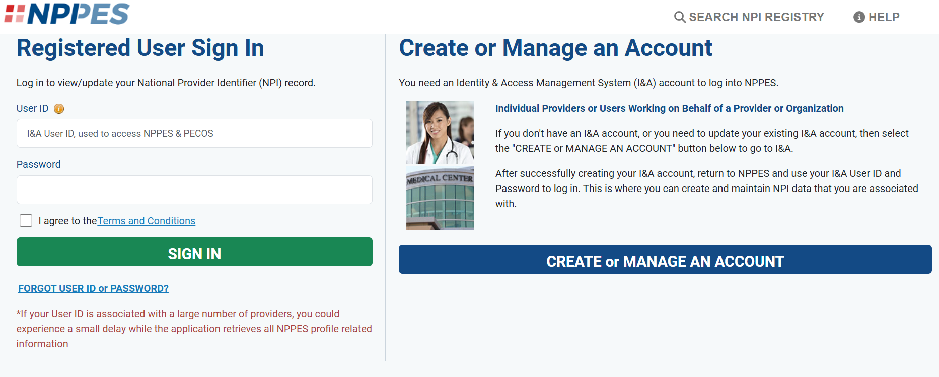
Step 6: Fill in Provider Details
If you do not have an individual NPI, you will need to obtain one through NPPES

Slide 16
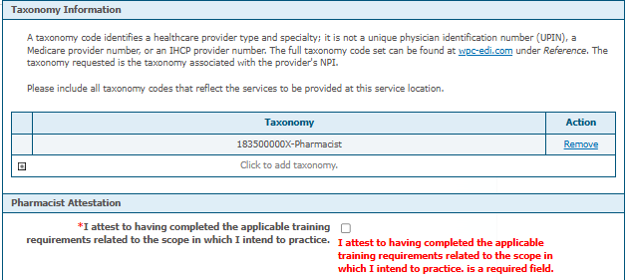
Step 7: Taxonomy Code and Attestation
Taxonomy and Training Requirement Attestation, attestation such as:
License in good standing
Completion of CE per Indiana requirements
Birth Control training requirements
Notes:
Taxonomy and Training Requirement Attestation
Think BC training requirements, continued CE, license in good standing

Slide 17
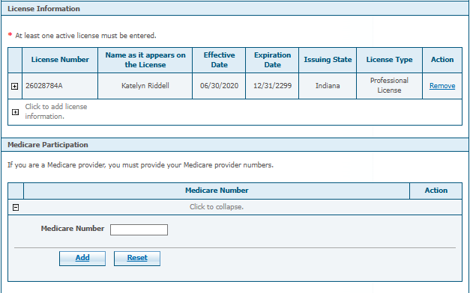

Step 8: License Information
Notes:
Taxonomy and Training Requirement Attestation
Think BC training requirements, continued CE, license in good standing

Slide 18
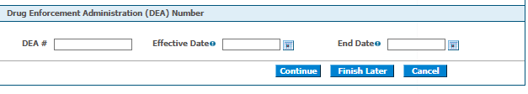
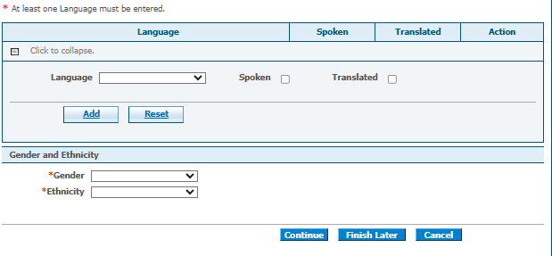
Step 9: Other Information
Not Applicable to Indiana Pharmacists
Notes:
Gender and Ethnicity questions do have “Prefer not to answer” options

Slide 19
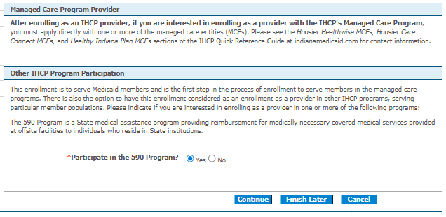
Step 9: Other Information Continued
Notes:
Needs links to MCE enrollment processes and materials

Slide 20
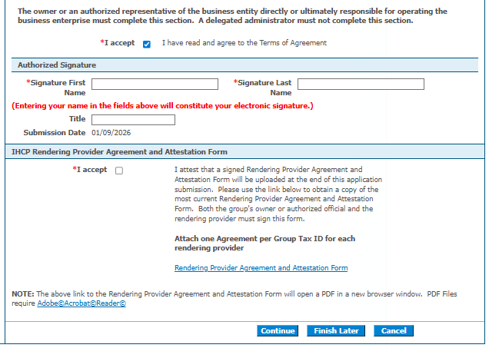
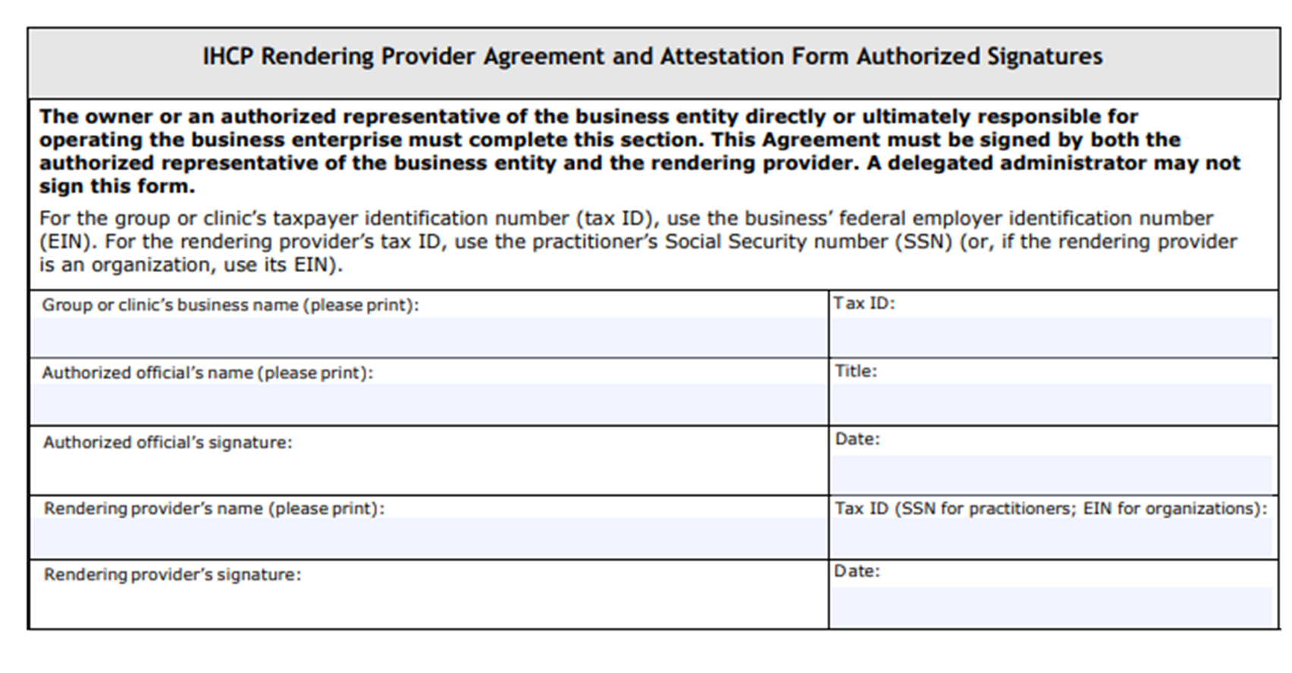
Step 10: Upload Rendering Provider Agreement and Attestation Form

Slide 21
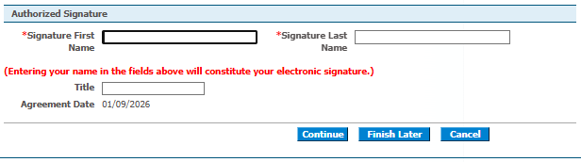
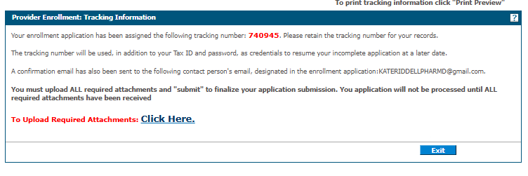
Once the form is uploaded, or if you choose “Finish Later” you will be assigned a tracking number to reference/update your application.

Slide 22
IHCP Application is Submitted- now what?
*Applications are currently taking 7-8 weeks to process
*If you have questions, or receive an email stating your application needs revisions/has been rejected, contact the Provider Enrollment Customer Assistance directly at 1-800-457-4584
*This process must be done FIRST before enrolling with Managed Care Entities (MCEs)
*Stay Tuned for updates on enrolling with MCEs and documentation and billing processes

